Slide 1
Local Maximum node :
Constraint type: equality
Constraint parameters:
Position
Height (scalar)
Saddel node:
Constraint type: equality
Constraint parameters:
Saddle position
Contour line positions
Height (scalar)
Observation:
The parent node of the local maximum node or Saddel Point must be either a saddle node or a root node.
Each contour line has one and only one embracing child node

Slide 2
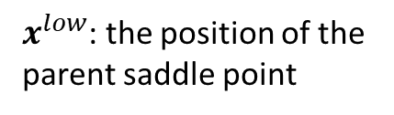




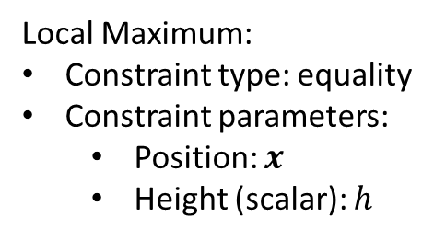





Local Maximum:
Constraint type: equality
Constraint parameters:
Position: $x$
Height (scalar): $h$
$x^{low}$: the position of the parent saddle point
$p$: the persistence of lower edge
$h_{low}$: the height of lower node
Preserving
Vanishing
Emerging
(has corespondence)
(exits in initial state,
does not exist in final state)
(does not exit in initial state,
exists in final state)
$$x={(1−t)x}_{0}+{tx}_{1}$$
$$x=(1−t)(x_{0}−x_{0}^{low})+x_{t}^{low}$$
$$x=t\left(x_{1}−x_{1}^{low}\right)+x_{t}^{low}$$
$$p={\left(1−t\right)p}_{0}+{tp}_{1}$$
$$p={\left(1−t\right)p}_{0}$$
$$p={\left(t\right)p}_{0}$$
$$h=p+h_{low}$$
$h=p+h_{low}$
$h=p+h_{low}$
Shrink to the saddle
Grow out from the saddle

Slide 3



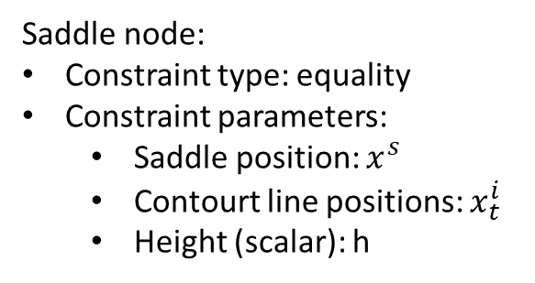
Saddle node: preserving
$x^{low}$: the position of the parent saddle point
Saddle node:
Constraint type: equality
Constraint parameters:
Saddle position: $x^{s}$
Contourt line positions: $x_{t}^{i}$
Height (scalar): h
$p$: the persistence of lower edge
$h_{low}$: the height of lower node
Both Contour line is Preserving
(both has corespondence)
$$x_{t}^{i}=(1−t)x_{0}^{i}+tx_{1}^{i}$$
$$p={\left(1−t\right)p}_{0}+{tp}_{1}$$
$$h=p+h_{low}$$

Slide 4
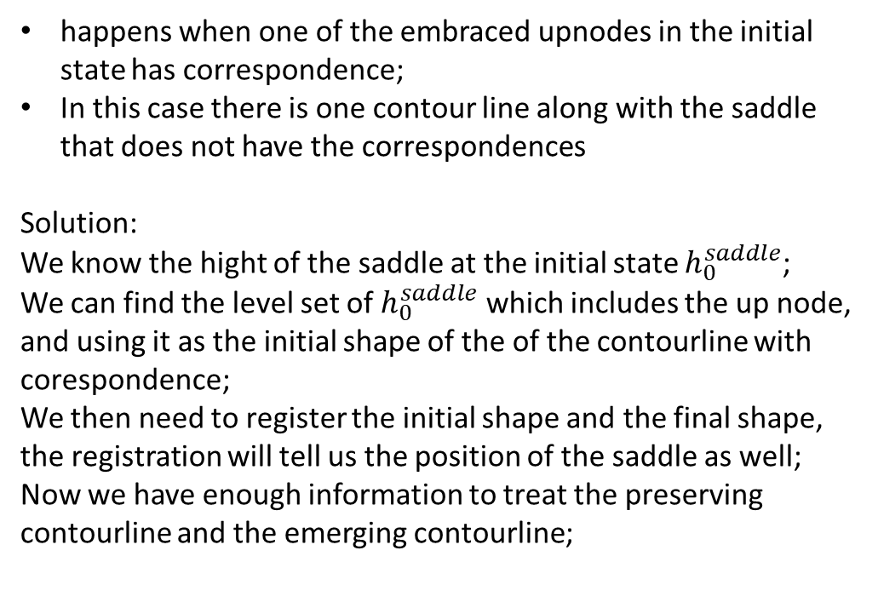

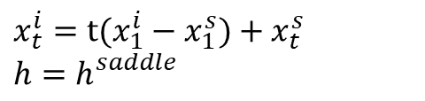
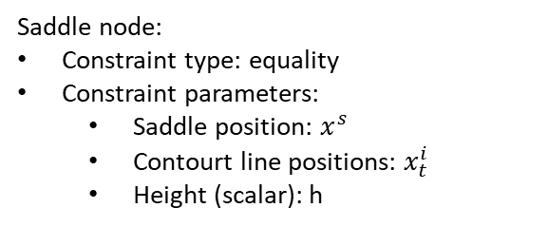
Saddle node:
Constraint type: equality
Constraint parameters:
Saddle position: $x^{s}$
Contourt line positions: $x_{t}^{i}$
Height (scalar): h
Saddle node: emerging
$x^{low}$: the position of the parent saddle point
$p$: the persistence of lower edge
$h_{low}$: the height of lower node
Both Contour lines are emerging:
One Contour line is emerging:
(happens when both of the embraced upnodes in the final state have no correspondences;
grows out from an extreme node)
happens when one of the embraced upnodes in the initial state has correspondence;
In this case there is one contour line along with the saddle that does not have the correspondences
Solution: We know the hight of the saddle at the initial state $h_{0}^{saddle}$;
We can find the level set of $h_{0}^{saddle}$ which includes the up node, and using it as the initial shape of the of the contourline with corespondence;
We then need to register the initial shape and the final shape, the registration will tell us the position of the saddle as well;
Now we have enough information to treat the preserving contourline and the emerging contourline;
$$x_{t}^{i}=t(x_{1}^{i}−x_{1}^{s})+x_{t}^{s}$$
$h=h_{}^{saddle}$
Grow out from the saddle

Slide 5
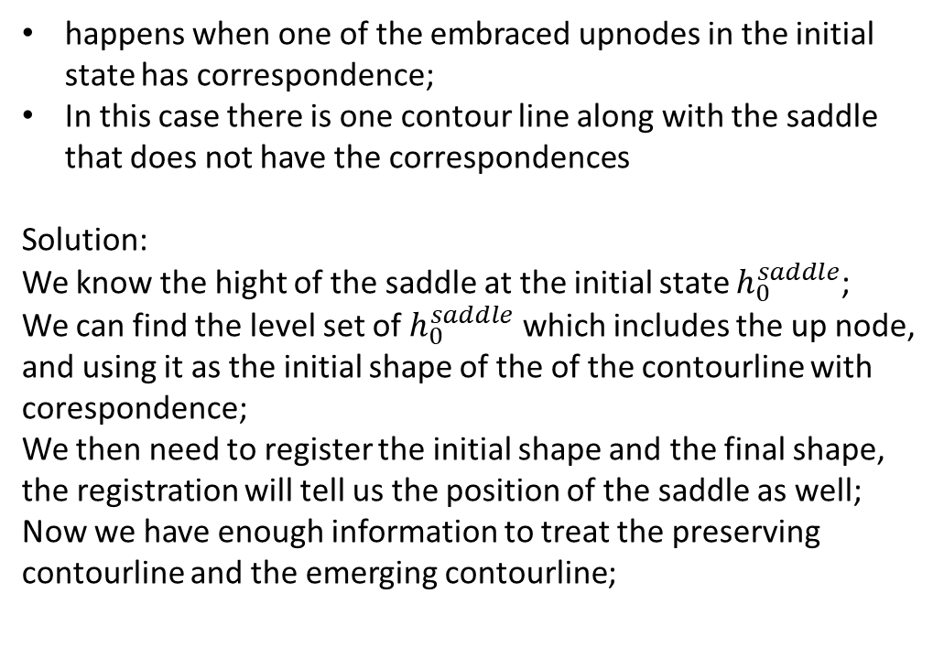
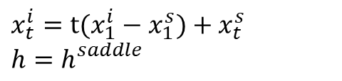
Saddle node:
Constraint type: equality
Constraint parameters:
Saddle position: $x^{s}$
Contourt line positions: $x_{t}^{i}$
Height (scalar): h
Saddle node: vanishing
$x^{low}$: the position of the parent saddle point
$p$: the persistence of lower edge
$h_{low}$: the height of lower node
Both Contour lines are emerging:
One Contour line is emerging:
(happens when both of the embraced upnodes in the initial state have no correspondences)
happens when one of the embraced upnodes in the initial state has correspondence;
In this case there is one contour line along with the saddle that does not have the correspondences
Solution: We know the hight of the saddle at the initial state $h_{0}^{saddle}$;
We can find the level set of $h_{0}^{saddle}$ which includes the up node, and using it as the initial shape of the of the contourline with corespondence;
We then need to register the initial shape and the final shape, the registration will tell us the position of the saddle as well;
Now we have enough information to treat the preserving contourline and the emerging contourline;
$$x_{t}^{i}=t(x_{1}^{i}−x_{1}^{s})+x_{t}^{s}$$
$h=h_{}^{saddle}$
Grow out from the saddle

Slide 6
Needed data:
Correspondence between tree1 and tree2, vanishing node and emerging node have no correspondence
The persistence of each edge during time

Slide 7









$x^{low}$: the position of the parent saddle point
Saddel node:
Constraint type: equality
Constraint parameters:
Saddle position
Contourt line positions
Height (scalar)
$p$: the persistence of lower edge
$h_{low}$: the height of lower node
Node interpolation scheme: (same as the interpolation of extreme node)
Preserving
Vanishing
Emerging
(has corespondence)
(exits in initial state,
does not exist in final state)
(does not exit in initial state,
exists in final state)
$$x={(1−t)x}_{0}+{tx}_{1}$$
$$x=(1−t)(x_{0}−x_{0}^{low})+x_{t}^{low}$$
$$x=t\left(x_{1}−x_{1}^{low}\right)+x_{t}^{low}$$
$$p={\left(1−t\right)p}_{0}+{tp}_{1}$$
$$p={\left(1−t\right)p}_{0}$$
$$p={\left(t\right)p}_{0}$$
$$h=p+h_{low}$$
$h=p+h_{low}$
$h=p+h_{low}$

Slide 8



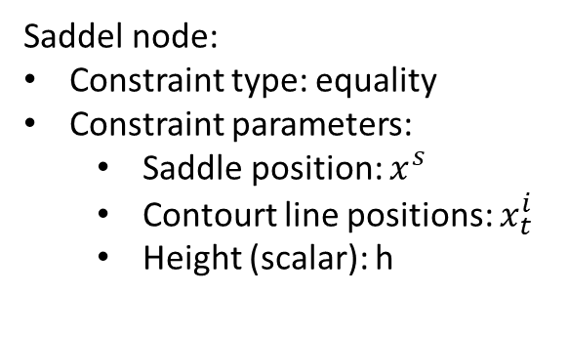




$x^{low}$: the position of the parent saddle point
Saddel node:
Constraint type: equality
Constraint parameters:
Saddle position: $x^{s}$
Contourt line positions: $x_{t}^{i}$
Height (scalar): h
$p$: the persistence of lower edge
$h_{low}$: the height of lower node
Contour interpolation scheme:
Vanishing
Preserving
Emerging
(saddle vanishes : both contour,
or embracing child node vanishes)
(has corespondence)
(saddle emerges,
or child node emerges: one contour)
$$x_{t}^{i}=(1−t)x_{0}^{i}+tx_{1}^{i}$$
$$x_{t}^{i}=(1−t)(x_{0}^{i}−x_{0}^{s})+x_{t}^{s}$$
$$x_{t}^{i}=t(x_{1}^{i}−x_{1}^{s})+x_{t}^{s}$$
$$p={\left(1−t\right)p}_{0}+{tp}_{1}$$
$h=h_{}^{saddle}$
$h=h_{}^{saddle}$
$$h=p+h_{low}$$
Shrink to the saddle
Grow out from the saddle

