Slide 1
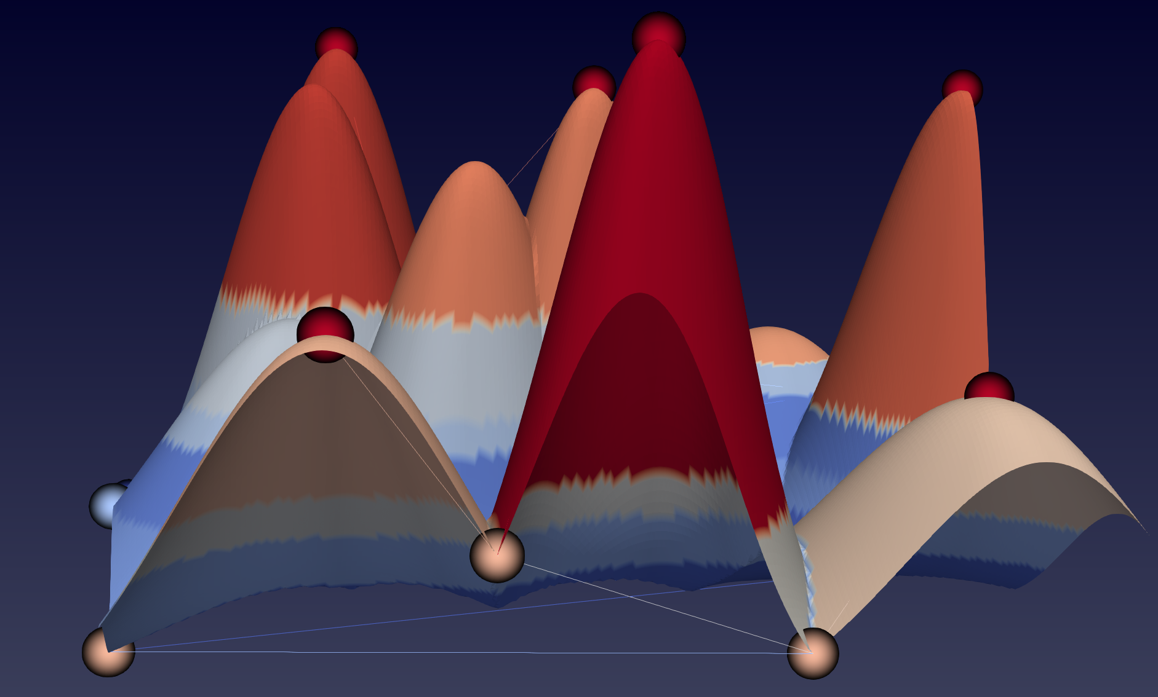
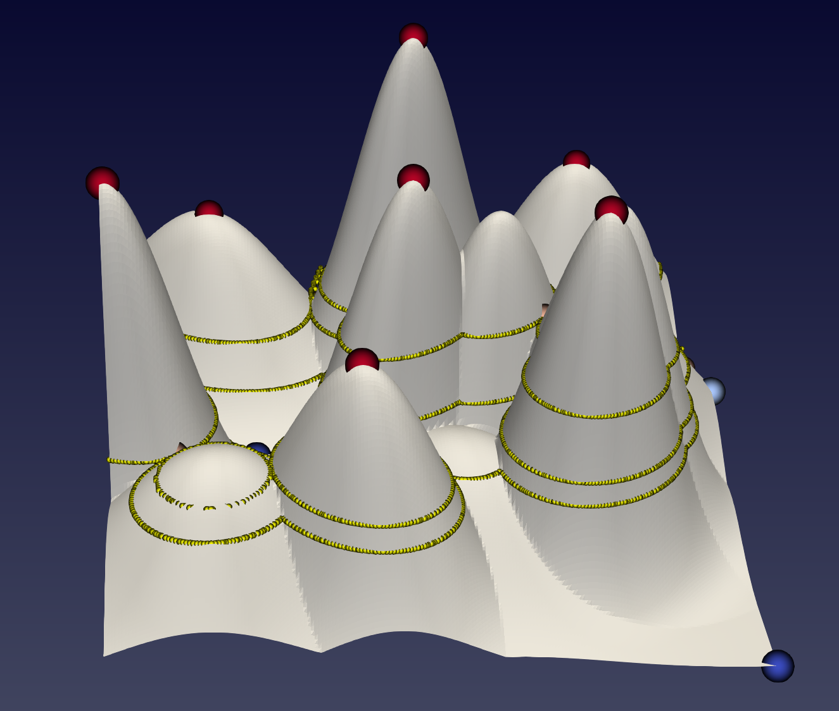
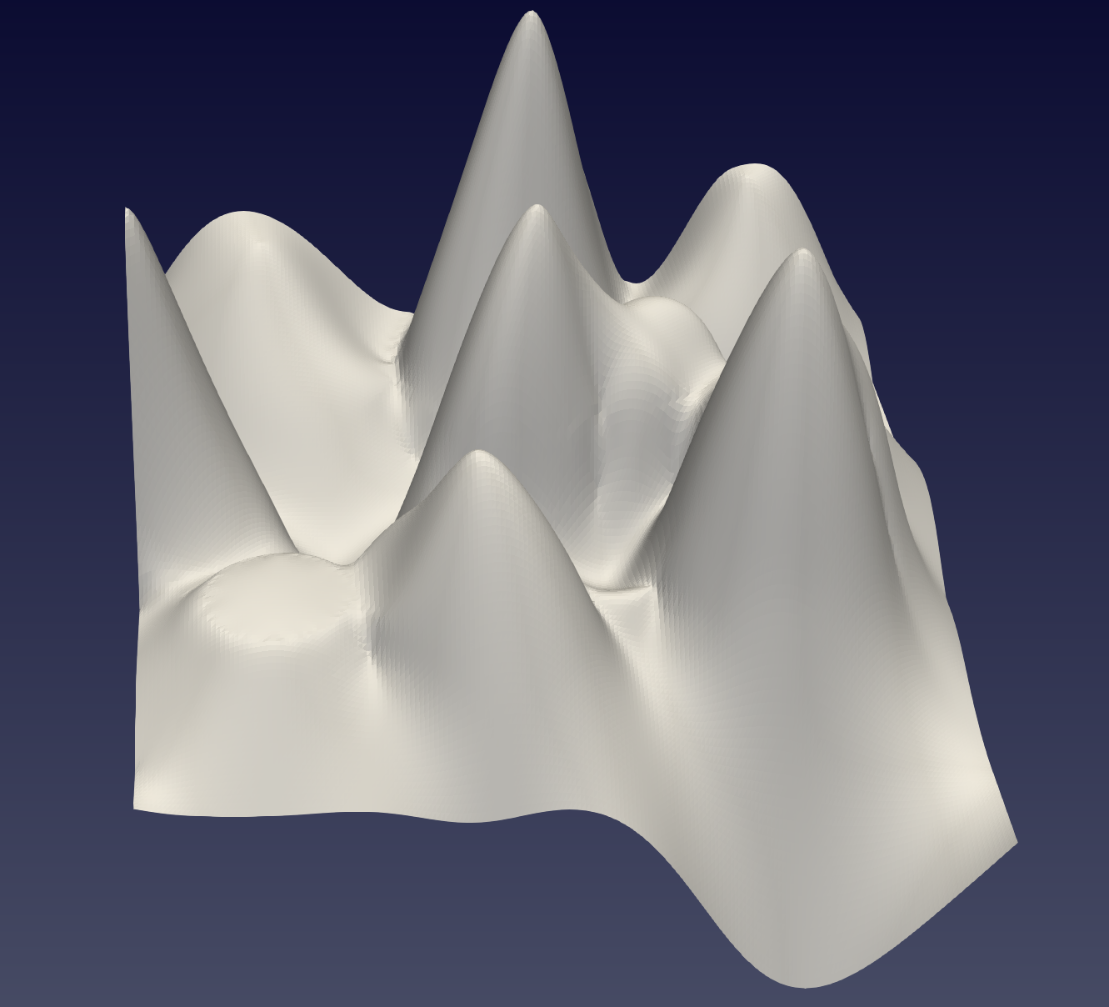
Scalar field to merge tree;
Nodes corresponds to critical points
Edge corresponds to segments
Convert merge tree to constraints:
Critical points
Contour lines
Contour lines to parametric curve
Iterpoloate the merge tree & contour line:
Tree topological interpolation using geodesic in the tree(matrix) space
Contour line interpolation in Euclidean space
(Done/Kind of)
(Done)
(Done)
(Done)
(Done)
Reconstruct the scalar field
Converted deformed tree & countours constraints
(Done)
(Done)

Slide 2
Merge Tree parser:
Node:
Id
Critical Point type
Position
Scalar value
adjacent edge(up/down)
Edge:
Id
Segment Id
up/down nodes
Scalar value
adjacent edge(up/down)
saddle
Scalar Field:
Critical point
Contour line
Segment

Slide 3


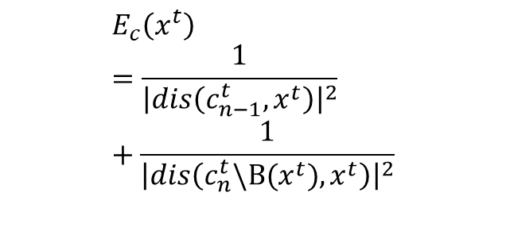

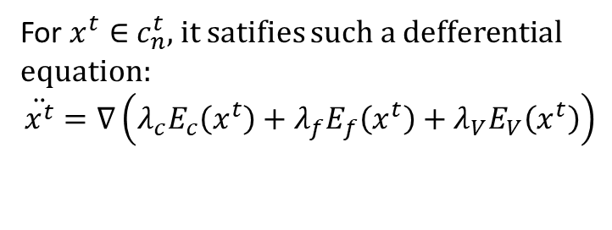





$$c_{n}^{0}$$
$$c_{n}^{t}$$
$$c_{n}^{∞}$$
$$c_{n−1}^{0}$$
$$c_{n−1}^{t}$$
$$c_{n−1}^{1}$$
Initial
Intermediate
Final
Fitting energy:
For $x^{t}∈$ $c_{n}^{t}$, it satifies such a defferential equation:
$$\ddot{x^{t}}=∇\left({λ_{c}E}_{c}\left(x^{t}\right)+{λ_{f}E}_{f}\left(x^{t}\right)+λ_{V}E_{V}\left(x^{t}\right)\right)$$
Fitting Energy:
$$E_{f}\left(x^{t}\right)={\left|x^{t}−x^{∞}\right|}^{2}$$
Collision energy:
$$E_{c}\left(x^{t}\right)=\frac{1}{{\left|dis\left(c_{n−1}^{t},x^{t}\right)\right|}^{2}}+\frac{1}{{\left|dis\left(c_{n}^{t}\backslash B(x^{t}),x^{t}\right)\right|}^{2}}$$
Volume preserving Energy:
inter-contour-line collision energy
$$E_{V}\left(x^{t}\right)$$
self collision energy

Slide 4
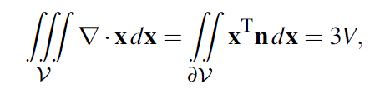
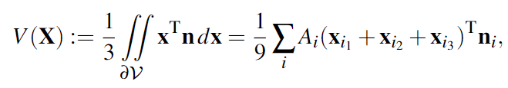


Computation Volume preserving Energy:
Divergence theorem:
Compute volume from surface:
where$A_{i}$ is the area and $i_{1}$, $i_{2}$ and $i_{3}$ are the vertex indices of the $i$-th triangle.
$$E_{V}\left(x^{t}\right)=V^{t}−V_{target}$$

