Slide 1
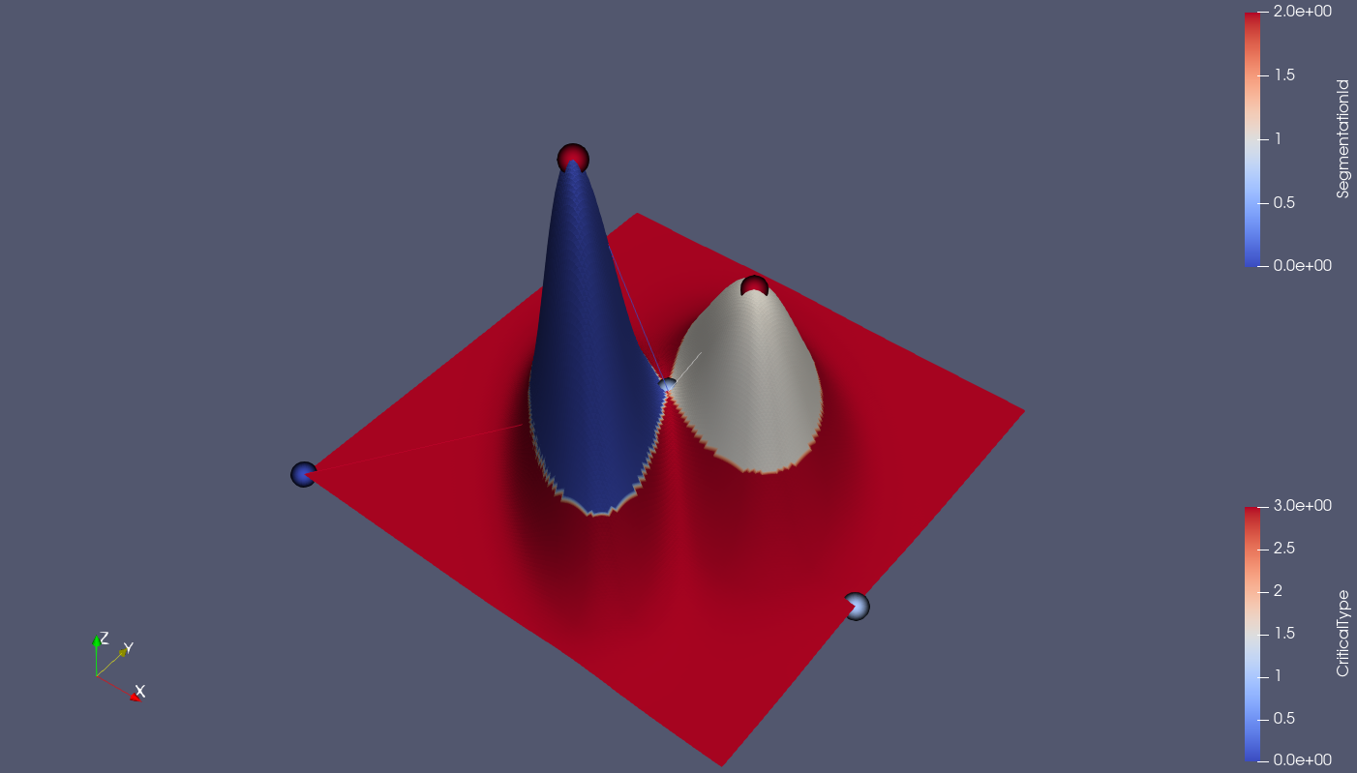
In a scalar field, the local extremity always corresponds
to the leaf nodes in merge tree, however the saddle points
does not always corresponds to branching nodes

Slide 2
After topological simplification, there should be only a few
local extremities left, which all corresponds to leaf nodes

Slide 3
We can reconstruct a scalar field, by controlling the position and number of local extremities, and select where they join
each other by adding saddle points.

Slide 4
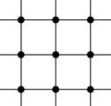
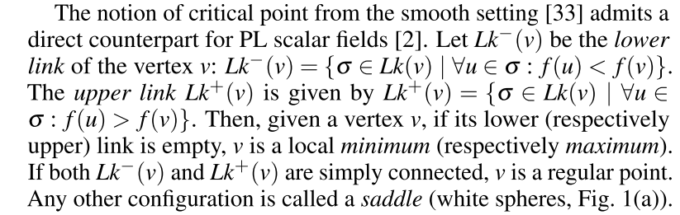
Discrete definition of critical points
[Charles et al. 2017] [T. F. Banchoff. et al. 1970]
Local maximum
Local minimum
Saddle point:
Inclining directions are separated
by declining directions
Regular point:
Inclining directions and declining directions are simply connected
Points with higher value
Points with lower value

Slide 5
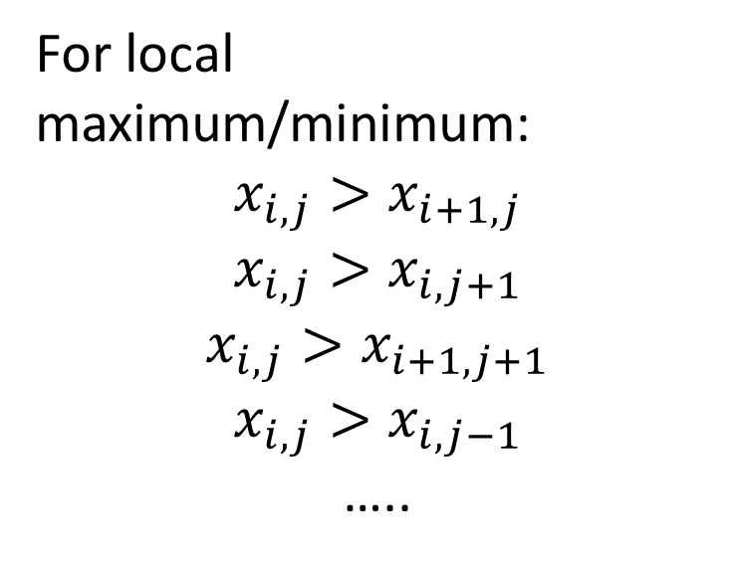
Conver definition of critical points to linear constraints
For local maximum/minimum:
$$x_{i,j}>x_{i+1,j}$$
$$x_{i,j}>x_{i,j+1}$$
$$x_{i,j}>x_{i+1,j+1}$$
$$x_{i,j}>x_{i,j−1}$$
…..
Local maximum
Local minimum

Slide 6
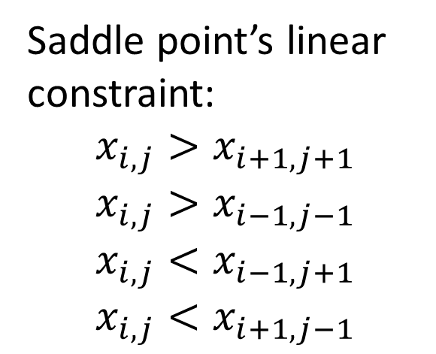
Conver definition of critical points to linear constraints
Local minimum 1 (leaf 1)
Saddle point’s linear constraint:
$$x_{i,j}>x_{i+1,j+1}$$
$$x_{i,j}>x_{i−1,j−1}$$
$$x_{i,j}<x_{i−1,j+1}$$
$$x_{i,j}<x_{i+1,j−1}$$
Saddle point where they join
Local minimum 2 (leaf 2)

Slide 7
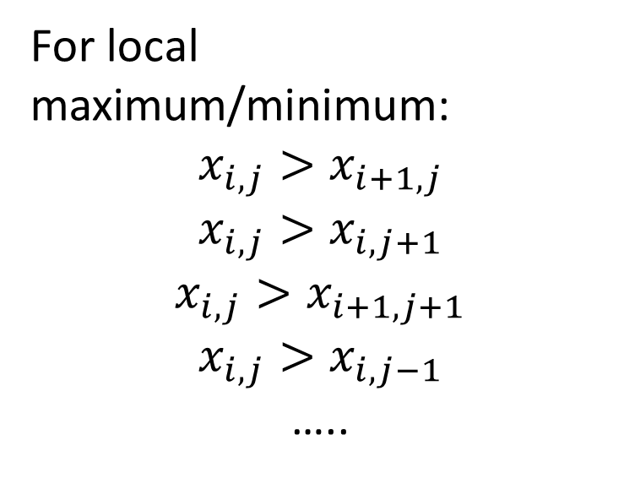
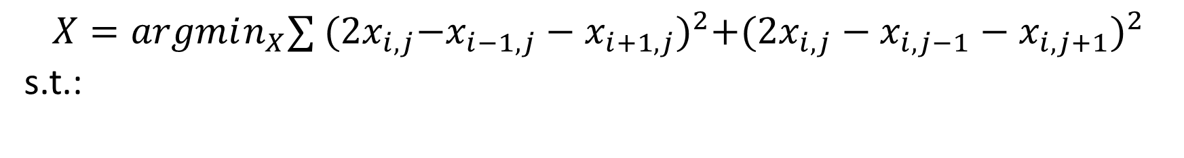
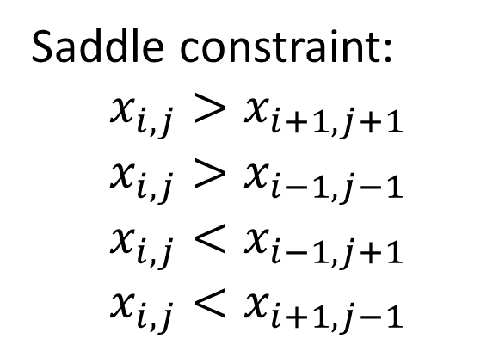
Convex quadratic programming with linear constraint!
$$X=argmin_{X}∑{{ (2x}_{i,j}−x_{i−1,j}−x_{i+1,j})}^{2}{{+(2x}_{i,j}−x_{i,j−1}−x_{i,j+1})}^{2}$$
s.t.:
For local maximum/minimum:
$$x_{i,j}>x_{i+1,j}$$
$$x_{i,j}>x_{i,j+1}$$
$$x_{i,j}>x_{i+1,j+1}$$
$$x_{i,j}>x_{i,j−1}$$
…..
Saddle constraint:
$$x_{i,j}>x_{i+1,j+1}$$
$$x_{i,j}>x_{i−1,j−1}$$
$$x_{i,j}<x_{i−1,j+1}$$
$$x_{i,j}<x_{i+1,j−1}$$

Slide 8
Convex quadratic programming with linear constraint!
Can be directly solved using a linear system!
$$X=argmin_{X}∑{{ (2x}_{i,j}−x_{i−1,j}−x_{i+1,j})}^{2}{{+(2x}_{i,j}−x_{i,j−1}−x_{i,j+1})}^{2}$$
s.t.:
For local maximum/minimum:
$$x_{i,j}>x_{i+1,j}$$
$$x_{i,j}>x_{i,j+1}$$
$$x_{i,j}>x_{i+1,j+1}$$
$$x_{i,j}>x_{i,j−1}$$
…..
Saddle constraint:
$$x_{i,j}>x_{i+1,j+1}$$
$$x_{i,j}>x_{i−1,j−1}$$
$$x_{i,j}<x_{i−1,j+1}$$
$$x_{i,j}<x_{i+1,j−1}$$

Slide 9
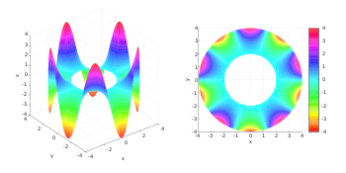
A good aspect about Laplacian equation: It won’t create local minimum/maximum!

