Slide 1
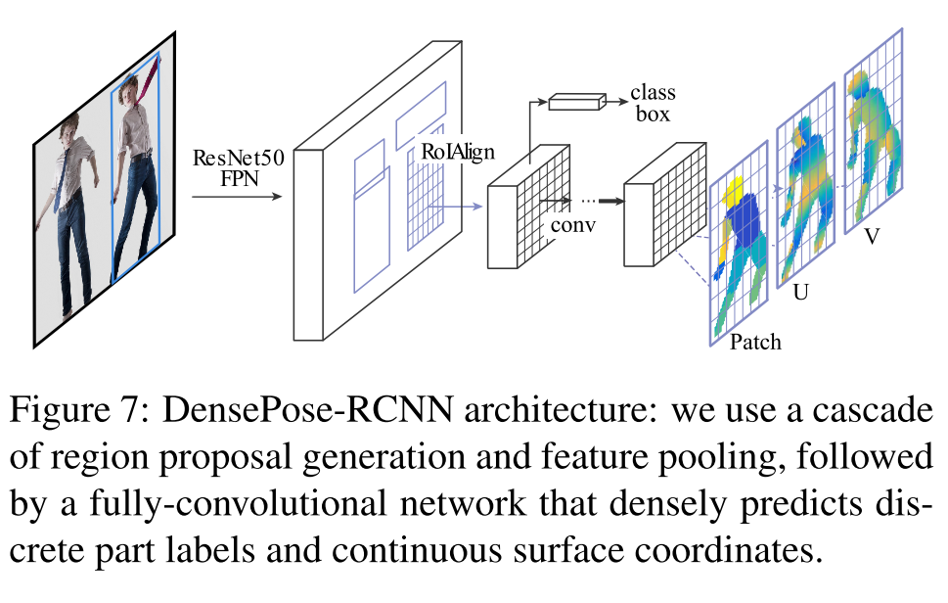
Dense Pose

Slide 2
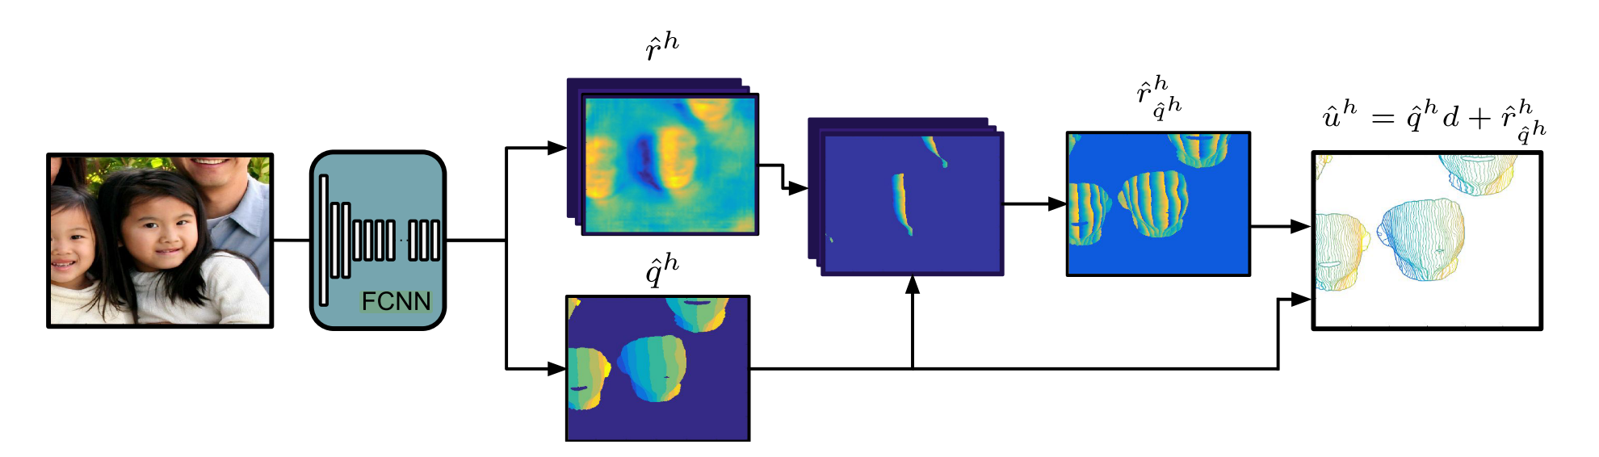
DenseReg

Slide 3
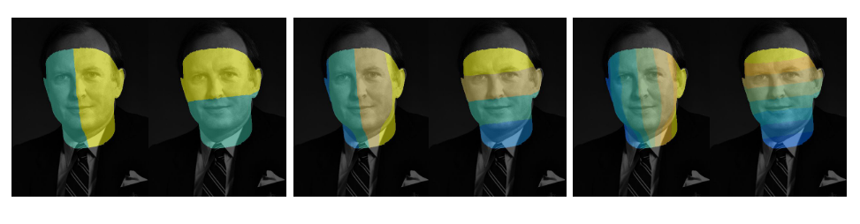
DenseReg [Rıza Alp G¨uler 2017]: 1st step: divide template to
multiple bins, use a dedicated network to predict those bins

Slide 4
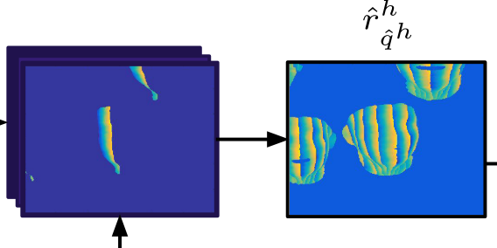
DenseReg: 2nd step: 2 dedicated regressors for each bin to predict u and v separately

Slide 5
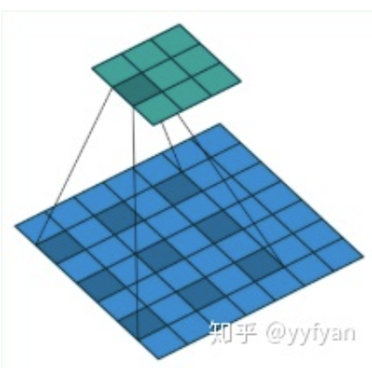
The network that predicts U V are using the structure of DenseLab
DenseLab:
Pretrained head + atrous convolution
Enlarge the field of view of filter without shrinking the image

Slide 6
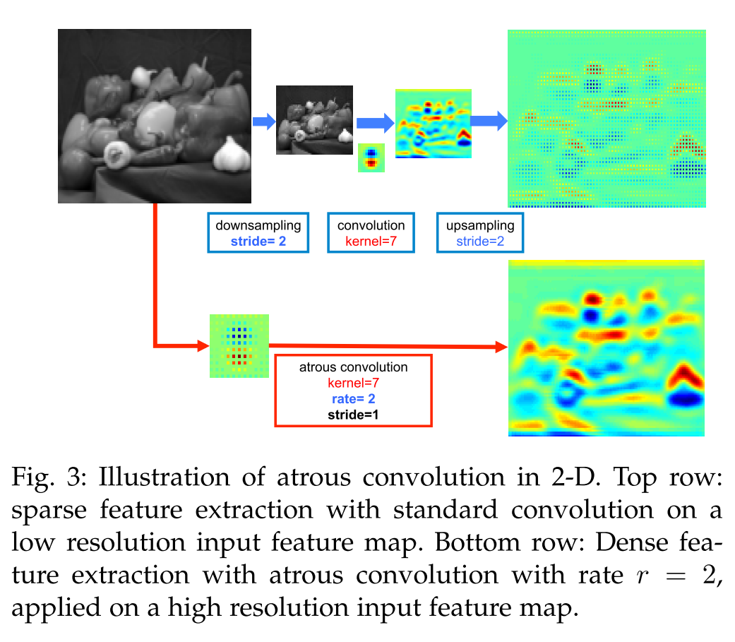
The network that predicts U V are using the structure of DenseLab
DenseLab:
Pretrained head + atrous convolution
Enlarge the field of view of filter without shrinking the image

