Slide 1
Data Mining:
Concepts and Techniques
— Chapter 2 —
Jiawei Han, Micheline Kamber, and Jian Pei
University of Illinois at Urbana-Champaign
Simon Fraser University
©2013 Han, Kamber, and Pei. All rights reserved.

Slide 2
Chapter 2: Getting to Know Your Data
Data Objects and Attribute Types
Basic Statistical Descriptions of Data
Data Visualization
Measuring Data Similarity and Dissimilarity
Summary

Slide 3
Chapter 2: Getting to Know Your Data
Data Objects and Attribute Types
Basic Statistical Descriptions of Data
Data Visualization
Measuring Data Similarity and Dissimilarity
Summary

Slide 4


Types of Data Sets
Record
  Relational records
  Data matrix, e.g., numerical matrix, crosstabs
  Document data: text documents: term-frequency vector
  Transaction data
Graph and network
  World Wide Web
  Social or information networks
  Molecular Structures
Ordered
  Video data: sequence of images
  Temporal data: time-series
  Sequential Data: transaction sequences
  Genetic sequence data
Spatial, image and multimedia:
  Spatial data: maps
  Image data:
  Video data:
Notes:
May we categorize data along the following dimensions?
- structured, semi-structured, and unstructured
- numeric and categorical
- static and dynamic (temporal?)
- by application

Slide 5
Important Characteristics of Structured Data
Dimensionality
  Curse of dimensionality
Sparsity
  Only presence counts
Resolution
  Patterns depend on the scale
Distribution
  Centrality and dispersion

Slide 6
Data Objects
Data sets are made up of data objects.
A data object represents an entity.
Examples:
  sales database: customers, store items, sales
  medical database: patients, treatments
  university database: students, professors, courses
Also called samples , examples, instances, data points, objects, tuples.
Data objects are described by attributes.
Database rows -> data objects; columns ->attributes.

Slide 7
Attributes
Attribute (or dimensions, features, variables): a data field, representing a characteristic or feature of a data object.
  E.g., customer _ID, name, address
Types:
  Nominal
  Binary
  Numeric: quantitative
    Interval-scaled
    Ratio-scaled

Slide 8
Attribute Types
Nominal: categories, states, or “names of things”
  Hair_color = {auburn, black, blond, brown, grey, red, white}
  marital status, occupation, ID numbers, zip codes
Binary
  Nominal attribute with only 2 states (0 and 1)
  Symmetric binary: both outcomes equally important
    e.g., pass/fail in an examination
  Asymmetric binary: outcomes not equally important.
    e.g., medical test (positive vs. negative)
    Convention: assign 1 to most important outcome (e.g., HIV positive)
Ordinal
  Values have a meaningful order (ranking) but magnitude between successive values is not known.
  Size = {small, medium, large}, grades, army rankings

Slide 9
Numeric Attribute Types
Quantitative (integer or real-valued)
Interval Scaled
    Measured on a scale of equal-sized units
    Values have order
      E.g., temperature in C˚or F˚, calendar dates
    No true zero-point
Ratio Scaled
    Inherent zero-point
    We can speak of values as being an order of magnitude larger than the unit of measurement (10 K˚ is twice as high as 5 K˚).
      e.g., temperature in Kelvin, length, counts, monetary quantities

Slide 10
Discrete vs. Continuous Attributes
Discrete Attribute
  Has only a finite or countably infinite set of values
    E.g., zip codes, profession, or the set of words in a collection of documents
  Sometimes, represented as integer variables
  Note: Binary attributes are a special case of discrete attributes
Continuous Attribute
  Has real numbers as attribute values
    E.g., temperature, height, or weight
  Practically, real values can only be measured and represented using a finite number of digits
  Continuous attributes are typically represented as floating-point variables
Main Menu

Slide 11
Chapter 2: Getting to Know Your Data
Data Objects and Attribute Types
Basic Statistical Descriptions of Data
Data Visualization
Measuring Data Similarity and Dissimilarity
Summary

Slide 12
Basic Statistical Descriptions of Data
Motivation
  To better understand the data:
    central tendency,
    Variation, and
    spread
Data dispersion characteristics
  median,
  max,
  min,
  quantiles,
  outliers,
  variance, etc.
Notes:
Note to self (MK): last part of slide does not clearly match slides that follow
Introduction slides:
In the current version, we only talk about numeric data. Can we add some materials about non-numeric data.
- text statistics, TF/IDF
- visualization of text statistics such as word cloud
- distribution of Internet (IN, SCC, OUT, …)
- visualization of social relationship (e.g., http://renlifang.msra.cn/)

Slide 13
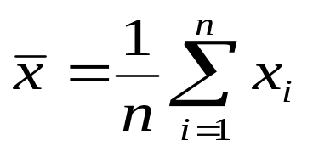


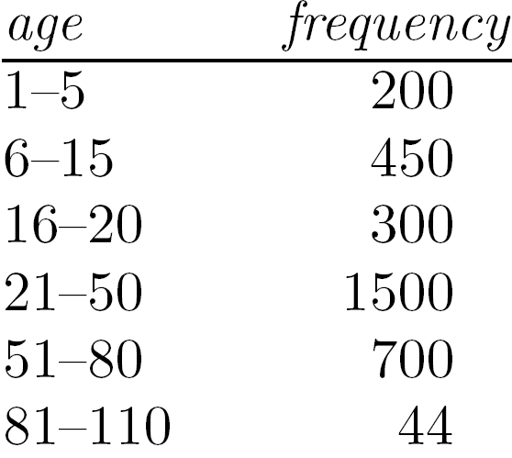
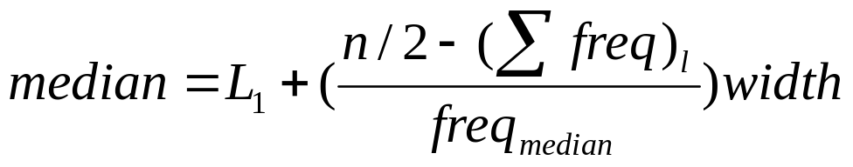
Measuring the Central Tendency
Mean (algebraic measure) (sample vs. population):
  Note: n is sample size and N is population size.
  Weighted arithmetic mean:
  Trimmed mean: chopping extreme values
Median:
  Middle value if odd number of values, or average of the middle two values otherwise
  Estimated by interpolation (for grouped data):
Mode
  Value that occurs most frequently in the data
  Unimodal, bimodal, trimodal
  Empirical formula:
Median interval
L1=21; n=3194; sum of freq < Median; width= 50-20= 30;

Slide 14



Symmetric vs. Skewed Data
Median, mean and mode of symmetric, positively and negatively skewed data
symmetric
positively skewed
negatively skewed
Data Mining: Concepts and Techniques

Slide 15


Measuring the Dispersion of Data
Quartiles, outliers and boxplots
  Quartiles: Q₁ (25th percentile), Q₃ (75th percentile)
  Inter-quartile range: IQR = Q₃ – Q₁
  Five number summary: min, Q₁, median, Q₃, max
  Boxplot: ends of the box are the quartiles; median is marked; add whiskers, and plot outliers individually
  Outlier: usually, a value higher/lower than 1.5 x IQR
Variance and standard deviation (sample size: n, population size: N)
  Variance: (algebraic, scalable computation)
  Standard deviation s (or σ) is the square root of variance s² ⁽or σ²⁾

Slide 16
Boxplot and Inter-Quartile Range (IQR)
Boxplot, or Whisker’s plot as it is known colloquially, is a pictorial method that uses quartiles and median to define an upper and lower limit beyond which any data point will be considered as outliers.
Generally, it is the median value that is considered as the middle-most value instead of the mean in the context of a dataset having outliers or extreme values.
Variability is often summarized by a statistic called the interquartile range (IQR), which is the difference between the first and third quartile values in a dataset arranged sequentially.
Boxplot is a standardized way of displaying the distribution of data based on a five number summary -“Minimum”, first quartile (Q1), Median (Q2), third quartile (Q3), and “Maximum”.

Slide 17
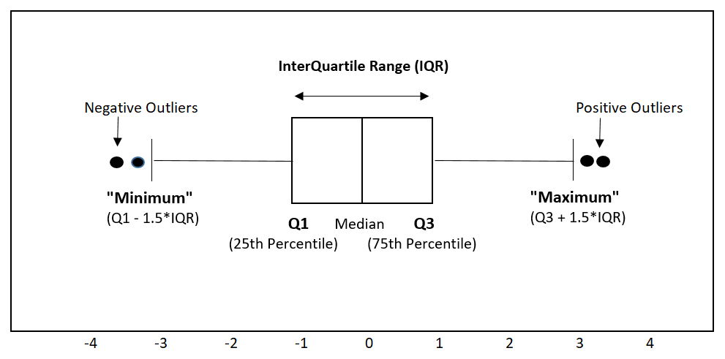
Outliers through Boxplot and IQR Technique

Slide 18
Main Menu
Significance of Boxplot Items
Quartile 2/Median/Q2/50th Percentile marks the middle-most value.
Quartile 1/Q1/25th Percentile marks the middle value between the smallest and median data item (25% of the data items lie below Q1).
Quartile 3/Q3/75th Percentile marks the middle value between the median and the highest valued item in the dataset (25% lie above Q3).
The Inter Quartile Range or IQR is set to : Q3 – Q1
Maximum boundary to the dataset is set to : Q3 + 1.5*IQR (or less)
Minimum boundary to the dataset is set to: Q1 -1.5*IQR (or more)
Positive Outliers are observations, which occur beyond Maximum.
Negative Outliers are observations, which fall below Minimum.

Slide 19
Chapter 2: Getting to Know Your Data
Data Objects and Attribute Types
Basic Statistical Descriptions of Data
Data Visualization
Measuring Data Similarity and Dissimilarity
Summary

Slide 20
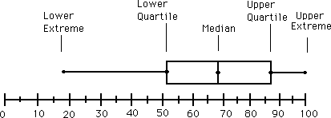
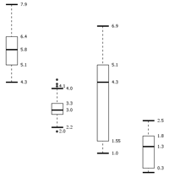
Boxplot Analysis
Five-number summary of a distribution
  Minimum, Q1, Median, Q3, Maximum
Boxplot
  Data is represented with a box
  The ends of the box are at the first and third quartiles, i.e., the height of the box is IQR
  The median is marked by a line within the box
  Whiskers: two lines outside the box extended to Minimum and Maximum
  Outliers: points beyond a specified outlier threshold, plotted individually
Notes:
Redraw the boxplot! Yes, we need a more real boxplot graph!

Slide 21

Visualization of Data Dispersion: 3-D Boxplots
Data Mining: Concepts and Techniques

Slide 22
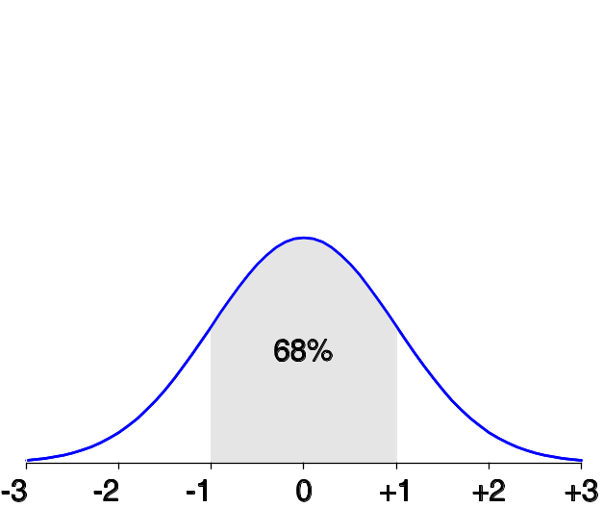
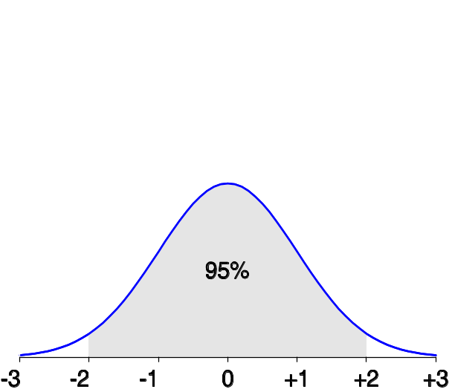
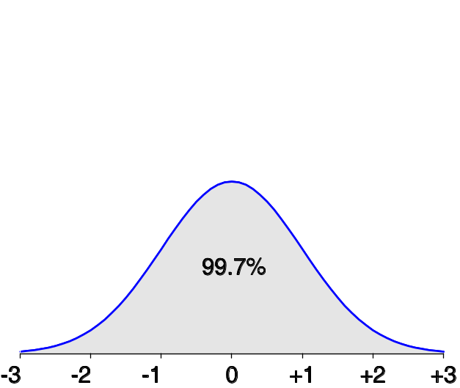
Properties of Normal Distribution Curve
The normal (distribution) curve
  From μ–σ to μ+σ: contains about 68% of the measurements (μ: mean, σ: standard deviation)
  From μ–2σ to μ+2σ: contains about 95% of it
  From μ–3σ to μ+3σ: contains about 99.7% of it

Slide 23
Graphic Displays of Basic Statistical Descriptions
Boxplot: graphic display of five-number summary
Histogram: x-axis are values, y-axis repres. frequencies
Quantile plot: each value x_{i} is paired with f_{i} indicating that approximately 100 f_{i} % of data are ≤ x_{i}
Quantile-quantile (q-q) plot: graphs the quantiles of one univariant distribution against the corresponding quantiles of another
Scatter plot: each pair of values is a pair of coordinates and plotted as points in the plane
Notes:
JH: Maybe we can remove Loess curve

Slide 24
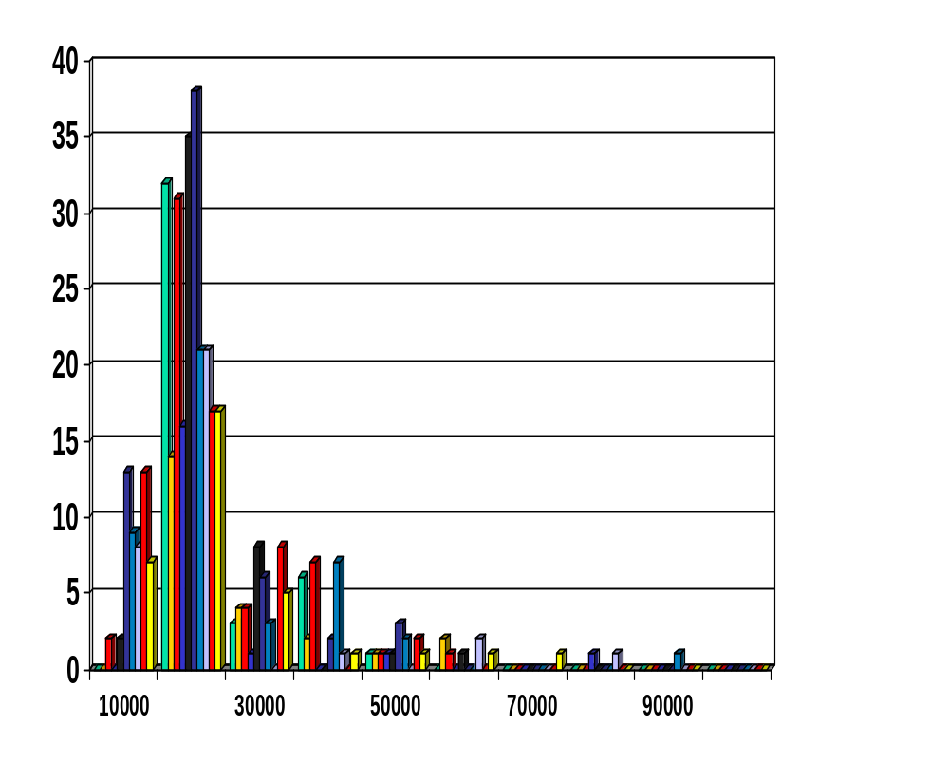
Histogram Analysis
Histogram: Graph display of tabulated frequencies, shown as bars
It shows what proportion of cases fall into each of several categories
Differs from a bar chart in that it is the area of the bar that denotes the value, not the height as in bar charts, a crucial distinction when the categories are not of uniform width
The categories are usually specified as non-overlapping intervals of some variable. The categories (bars) must be adjacent
Notes:
JH: A better and BASIC histogram figure --- because this one overlaps with a later one!

Slide 25
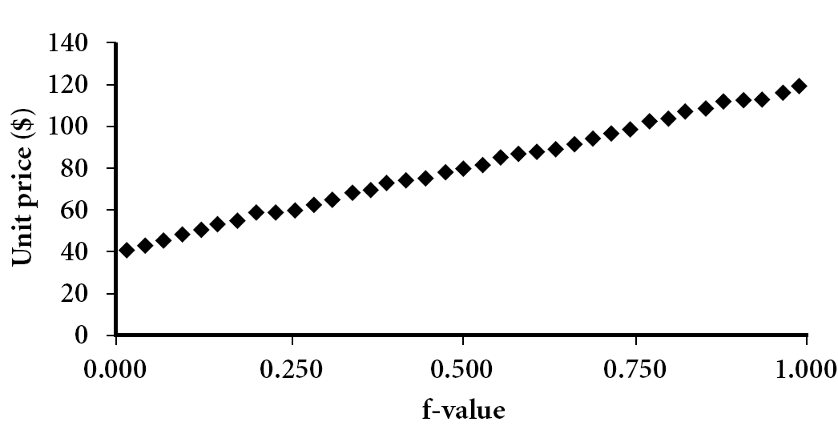
Quantile Plot
Displays all of the data (allowing the user to assess both the overall behavior and unusual occurrences)
Plots quantile information
  For a data x_{i} data sorted in increasing order, f_{i} indicates that approximately 100 f_{i}% of the data are below or equal to the value x_{i}
Data Mining: Concepts and Techniques

Slide 26
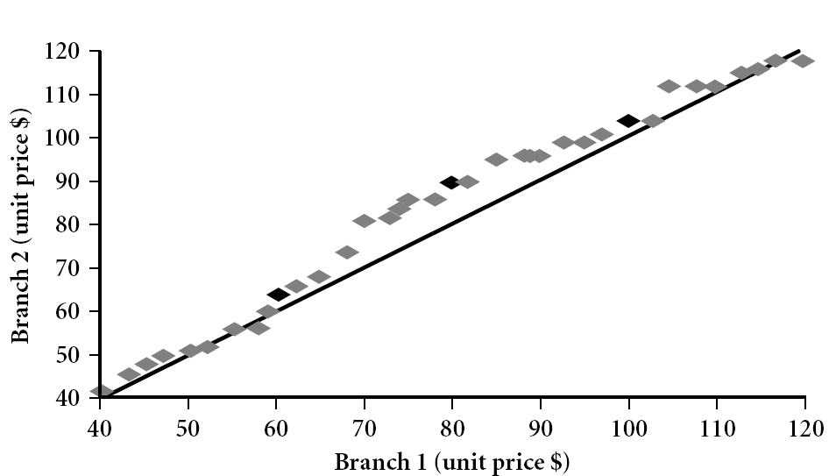
Quantile-Quantile (Q-Q) Plot
Graphs the quantiles of one univariate distribution against the corresponding quantiles of another
View: Is there a shift in going from one distribution to another?
Example shows unit price of items sold at Branch 1 vs. Branch 2 for each quantile. Unit prices of items sold at Branch 1 tend to be lower than those at Branch 2.
Notes:
Note: We need to label the dark plotted points as Q1, Median, Q3 – that would help in understanding this graph.
Tell audience: There is a shift in distribution of branch 1 WRT branch 2 in that the unit prices of items sold at branch 1 tend to be lower than those at branch 2.

Slide 27
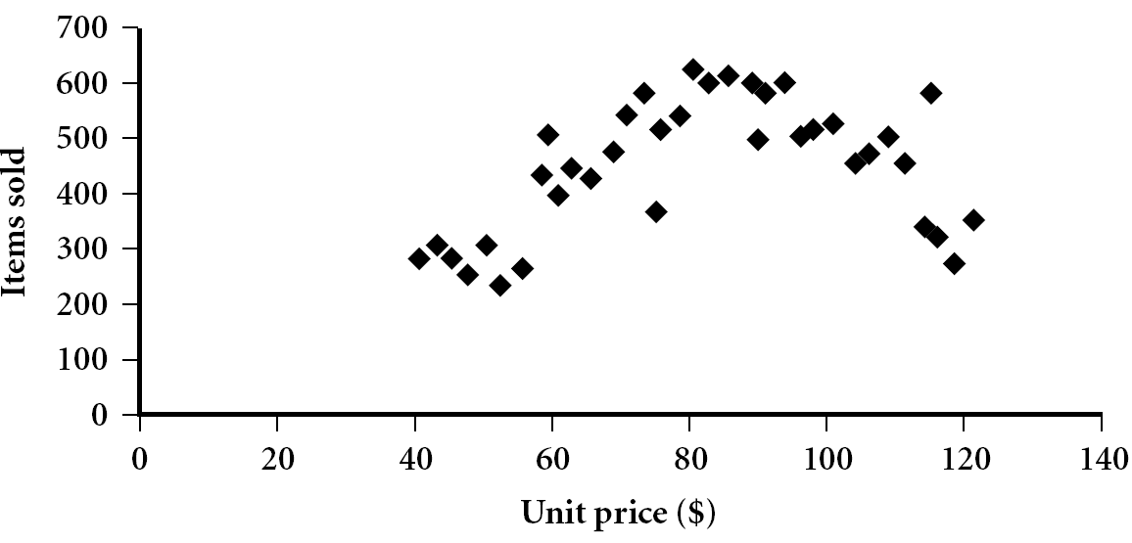
Scatter plot
Provides a first look at bivariate data to see clusters of points, outliers, etc
Each pair of values is treated as a pair of coordinates and plotted as points in the plane
Notes:
Need a better and more MEANINGFUL scatter plot! -JH

Slide 28


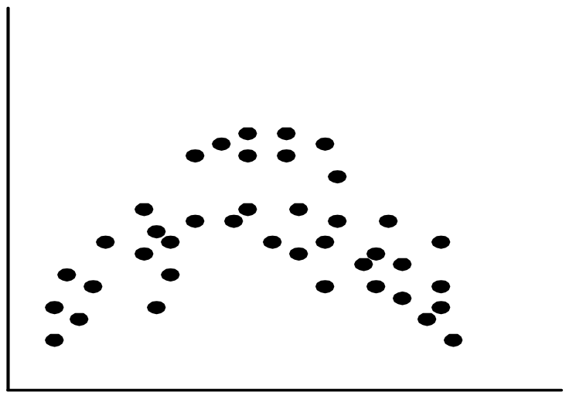
Positively and Negatively Correlated Data
The left half fragment is positively correlated
The right half is negative correlated

Slide 29


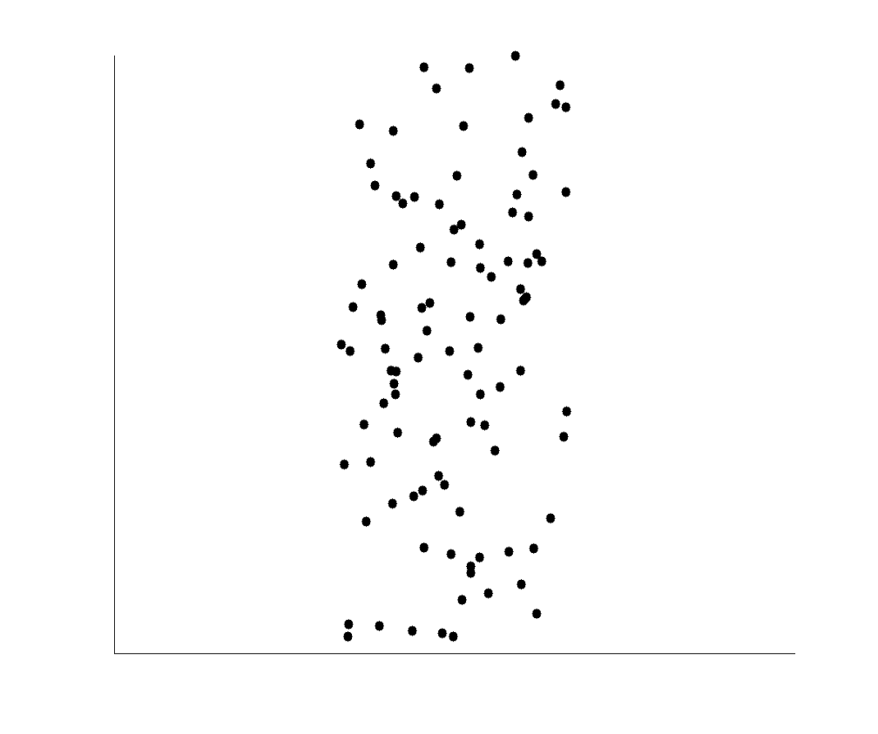
Uncorrelated Data
Main Menu

Slide 30
Chapter 2: Getting to Know Your Data
Data Objects and Attribute Types
Basic Statistical Descriptions of Data
Data Visualization
Measuring Data Similarity and Dissimilarity
Summary

Slide 31
Similarity and Dissimilarity
Similarity
  Numerical measure of how alike two data objects are
  Value is higher when objects are more alike
  Often falls in the range [0,1]
Dissimilarity (e.g., distance)
  Numerical measure of how different two data objects are
  Lower when objects are more alike
  Minimum dissimilarity is often 0
  Upper limit varies
Proximity refers to a similarity or dissimilarity
Notes:
Keep here because keeping it in clustering chapter seems far away. 08.11.02

Slide 32
Sub Menu for Measures
Nominal Attributes
Binary Attributes
Ordinal Data Types
Numeric Data Types
Vector Data Types
Mixed Data Type
Various Distance Measures
Data & Dissimilarity Matrix
Main Menu

Slide 33

Proximity Measure for Nominal Attributes
Can take 2 or more states, e.g., red, yellow, blue, green (generalization of a binary attribute)
Method 1: Simple matching
  m: # of matches, p: total # of variables
Method 2: Use a large number of binary attributes
  creating a new binary attribute for each of the M nominal states
Measures Sub-Menu

Slide 34
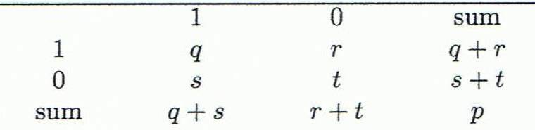
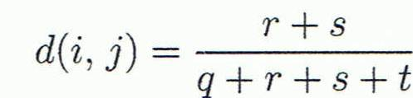
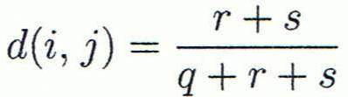

Proximity Measure for Binary Attributes
Object j
A contingency table for binary data
Distance measure for symmetric binary variables:
Distance measure for asymmetric binary variables:
Jaccard coefficient (similarity measure for asymmetric binary variables):
Object i
Note: Jaccard coefficient is the same as “coherence”:
Notes:
MK: I tried to change equations so as to match notation in book, but each time I try to install the equation editor, it fails! Agh!

Slide 35


Dissimilarity between Binary Variables
Example
  Gender is a symmetric attribute
  The remaining attributes are asymmetric binary
  Let the values Y and P be 1, and the value N 0
Measures Sub-Menu

Slide 36


Ordinal Variables
An ordinal variable can be discrete or continuous
Order is important, e.g., rank
Can be treated like interval-scaled
  replace x_{if} by their rank
  map the range of each variable onto [0, 1] by replacing i-th object in the f-th variable by
  compute the dissimilarity using methods for interval-scaled variables
Measures Sub-Menu

Slide 37
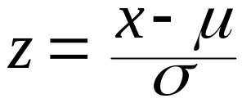
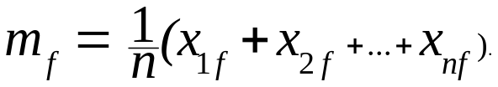
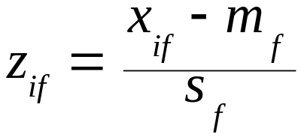
Standardizing Numeric Data
Z-score:
  X: raw score to be standardized, μ: mean of the population, σ: standard deviation
  the distance between the raw score and the population mean in units of the standard deviation
  negative when the raw score is below the mean, “+” when above
An alternative way: Calculate the mean absolute deviation
  where
  standardized measure (z-score):
Using mean absolute deviation is more robust than using standard deviation
Measures Sub-Menu
Notes:
MK: For lecture, this may be OK here, but I think discussion of standardization/normalization is better kept all together in Chapter 3

Slide 38
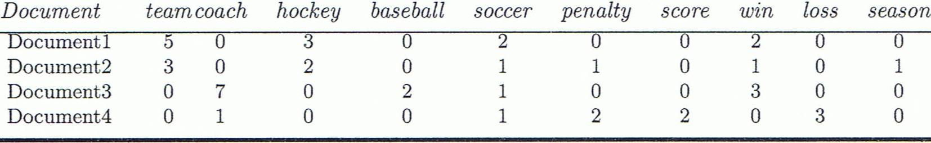
Cosine Similarity (Vector Data)
A document can be represented by thousands of attributes, each recording the frequency of a particular word (such as keywords) or phrase in the document.
Other vector objects: gene features in micro-arrays, …
Applications: information retrieval, biologic taxonomy, gene feature mapping, ...
Cosine measure: If d₁ and d₂ are two vectors (e.g., term-frequency vectors), then
cos(d₁, d₂) = (d₁ • d₂) /||d₁|| ||d₂|| ,
  where • indicates vector dot product, ||d||: the length of vector d
Measures Sub-Menu

Slide 39
Example: Cosine Similarity
cos(d₁, d₂) = (d₁ • d₂) /||d₁|| ||d₂|| ,
  where • indicates vector dot product, ||d|: the length of vector d
Ex: Find the similarity between documents 1 and 2.
  d₁ = (5, 0, 3, 0, 2, 0, 0, 2, 0, 0)
  d₂ = (3, 0, 2, 0, 1, 1, 0, 1, 0, 1)
  d₁•d₂ = 5*3+0*0+3*2+0*0+2*1+0*1+0*1+2*1+0*0+0*1 = 25
  ||d₁||= (5*5+0*0+3*3+0*0+2*2+0*0+0*0+2*2+0*0+0*0)^{0.5}=(42)^{0.5} = 6.481
  ||d₂||= (3*3+0*0+2*2+0*0+1*1+1*1+0*0+1*1+0*0+1*1)^{0.5}=(17)^{0.5} = 4.12
  cos(d₁, d₂ ) = 0.94
Measures Sub-Menu

Slide 40

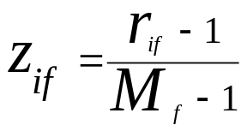
Attributes of Mixed Type
A database may contain all attribute types
  Nominal, symmetric binary, asymmetric binary, numeric, ordinal
One may use a weighted formula to combine their effects
  f is binary or nominal:
    d_{ij}^{(f)} = 0 if x_{if} = x_{jf} , or d_{ij}^{(f)} = 1 otherwise
  f is numeric: use the normalized distance
  f is ordinal
    Compute ranks r_{if} and
    Treat z_{if} as interval-scaled
Measures Sub-Menu

Slide 41
Distance on Numeric Data: Minkowski Distance
Minkowski distance: A popular distance measure
  where i = (x_{i1}, x_{i2}, …, x_{ip}) and j = (x_{j1}, x_{j2}, …, x_{jp}) are two p-dimensional data objects, and h is the order (the distance so defined is also called L-h norm)
Properties
  d(i, j) > 0 if i ≠ j, and d(i, i) = 0 (Positive definiteness)
  d(i, j) = d(j, i) (Symmetry)
  d(i, j) ≤ d(i, k) + d(k, j) (Triangle Inequality)
A distance that satisfies these properties is a metric
Measures Sub-Menu

Slide 42


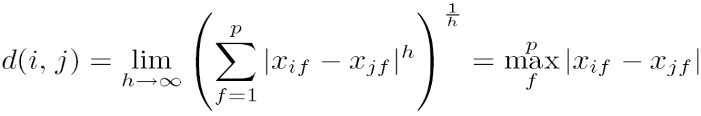
Special Cases of Minkowski Distance
h = 1: Manhattan (city block, L₁ norm) distance
  E.g., the Hamming distance: the number of bits that are different between two binary vectors
h = 2: (L₂ norm) Euclidean distance
h → ∞. “supremum” (L_{max} norm, L∞ norm) distance.
  This is the maximum difference between any component (attribute) of the vectors
Measures Sub-Menu

Slide 43
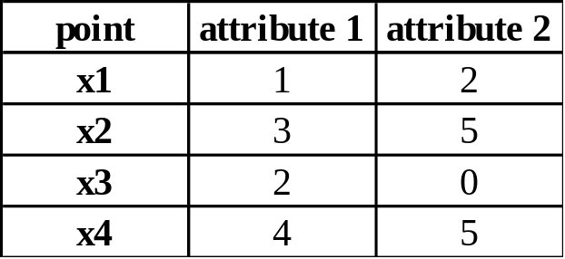
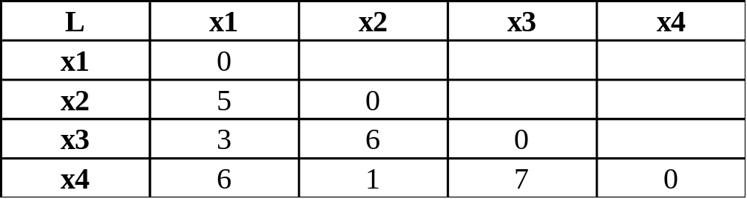
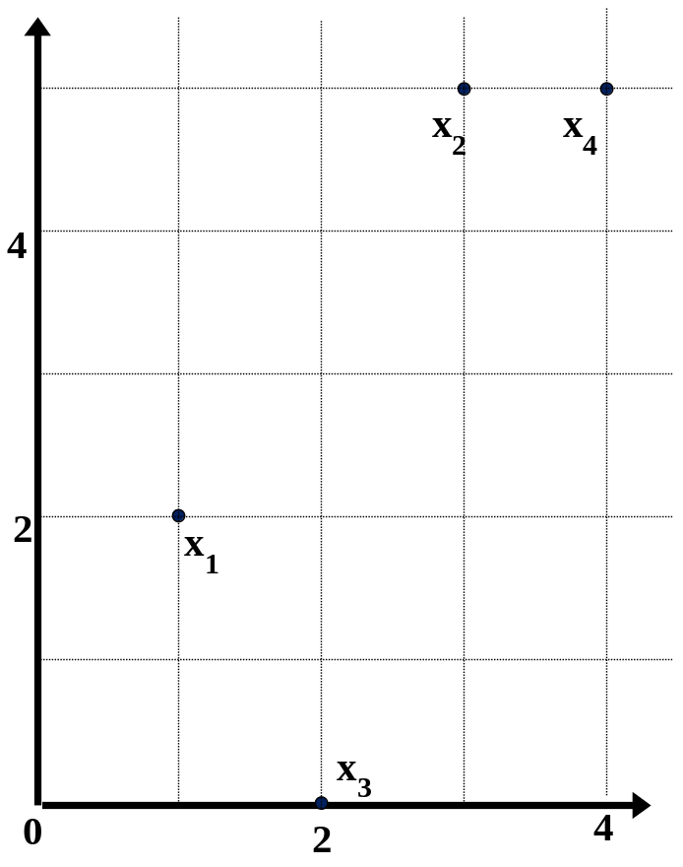
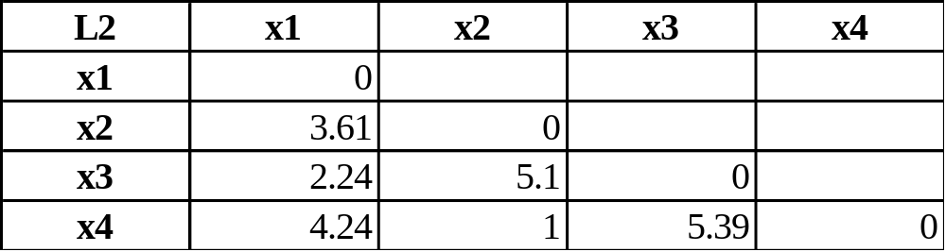
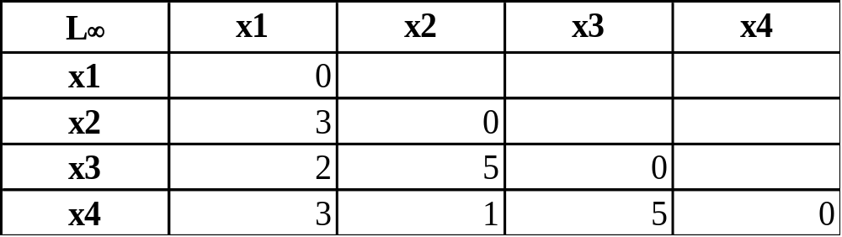
Example: Minkowski Distance
Dissimilarity Matrices
Manhattan (L₁)
Euclidean (L₂)
Supremum

Slide 44
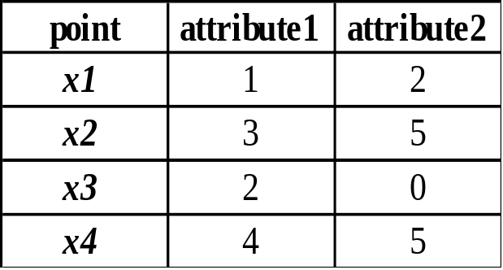
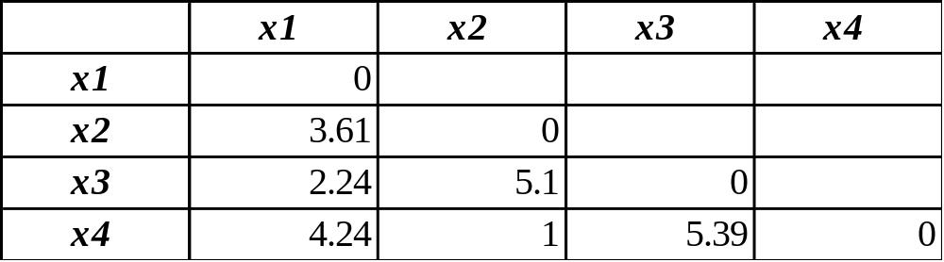
Example:
Data Matrix and Dissimilarity Matrix
Data Matrix
Dissimilarity Matrix
(with Euclidean Distance)
Measures Sub-Menu
Main Menu

Slide 45
Chapter 2: Getting to Know Your Data
Data Objects and Attribute Types
Basic Statistical Descriptions of Data
Data Visualization
Measuring Data Similarity and Dissimilarity
Summary

Slide 46
Summary
Data attribute types: nominal, binary, ordinal, interval-scaled, ratio-scaled
Many types of data sets, e.g., numerical, text, graph, Web, image.
Gain insight into the data by:
  Basic statistical data description: central tendency, dispersion, graphical displays
  Data visualization: map data onto graphical primitives
  Measure data similarity
Above steps are the beginning of data preprocessing
Many methods have been developed but still an active area of research
Main Menu
Notes:
08/10/23: This slide was out of date. Draft of new version above.
Cut out the following:
Data description, data exploration, and measure data similarity set the basis for quality data preprocessing
A lot of methods have been developed but data preprocessing still an active area of research

Slide 47
References
W. Cleveland, Visualizing Data, Hobart Press, 1993
T. Dasu and T. Johnson. Exploratory Data Mining and Data Cleaning. John Wiley, 2003
U. Fayyad, G. Grinstein, and A. Wierse. Information Visualization in Data Mining and Knowledge Discovery, Morgan Kaufmann, 2001
L. Kaufman and P. J. Rousseeuw. Finding Groups in Data: an Introduction to Cluster Analysis. John Wiley & Sons, 1990.
H. V. Jagadish et al., Special Issue on Data Reduction Techniques. Bulletin of the Tech. Committee on Data Eng., 20(4), Dec. 1997
D. A. Keim. Information visualization and visual data mining, IEEE trans. on Visualization and Computer Graphics, 8(1), 2002
D. Pyle. Data Preparation for Data Mining. Morgan Kaufmann, 1999
S. Santini and R. Jain,” Similarity measures”, IEEE Trans. on Pattern Analysis and Machine Intelligence, 21(9), 1999
E. R. Tufte. The Visual Display of Quantitative Information, 2nd ed., Graphics Press, 2001
C. Yu et al., Visual data mining of multimedia data for social and behavioral studies, Information Visualization, 8(1), 2009
Notes:
MK 08.11.02: This needs to be updated to reflect changes.

Slide 48
Confusion Matrix [ Binary Classifier ]
_{ACTUAL CLASS}
_{PREDICTED CLASS}
_{ROW TOTAL}
_{POSITIVE}
_{NEGATIVE}
_{POSITIVE}
_{Tp : True positive Positive}
_{Fn : False Negative}
_{p : Total Actual Positive}
_{NEGATIVE}
_{Fp : False Positive}
_{Tn : True Negative}
_{n : Total Actual negative}
_{COLUMN TOTAL}
p’ : Total Predicted Positive
n’ : Total Predicted Negative
_{N : Total Sample Size}
Back

Slide 49
Finding Accuracy & Error :Confusion Matrix
A C x C matrix, where C = Total Class Count +1
Show Actual Class/Row, Predicted Class /Column
Last row or column = count of total per class label
Other rows or columns keep confusion counts
Element [i,i] = Class_i_No-confusion_Count
For i ≠ j, Element [i,j] = Element [j,i] indicates count of off-diagonal element i confused as j
Element [C,C] = N, where N= Total Sample Count
Back

Slide 50
Measuring Classifier Performance
Typical Measures [for Total Dataset Size N] :-
Error = (Fp+Fn) / N
Accuracy = (Tp + Tn) / N = 1 – Error
Precision = Tp / (Tp + Fp) = Tp / p′
Recall = Tp / (Tp + Fn) = Tp / p
Tp_rate = Tp/p (hit rate)
Fp-rate = Fp / n (false-alarm rate)
Sensitivity = Recall = Tp-rate
Specificity = Tn / n = 1 – Fp-rate
Class Confusion Matrix
}
Information Retrieval
}
Receiver Operating Characteristic (ROC) curve
}
Sensitivity vs. Specificity
Back

Slide 51
Information Retrieval : Precision & Recall
Consider a database of records
System (a binary classifier) generates query
Tp = Relevant records retrieved
Fn = Relevant records not retrieved (confusion)
Fp = Irrelevant records retrieved (again confusion)
Precision = Tp / (Tp + Fp) = Tp / p′ [p′ - column total] = number of relevant records out of total retrieved records
Recall = Tp / (Tp + Fn) = Tp / p [p - row total] = number of relevant records retrieved out of total relevant records
Back

Slide 52
Another Perspective : Sensitivity & Specificity
One class important : class imbalance problem
Sensitivity = Recall = Tp-rate = Tp / (Tp + Fn) = Tp / p how well do we detect the positives
Specificity = 1 - Fp-rate = Tn / (Tn + Fp) = Tn / n how well do we detect the negatives
Typical example : Disease detection, Fraud activity
Main class : Disease Present, Fraud Occurrence
So, overall accuracy may not be important
Sensitivity (sometimes Specificity) more important
Back

Slide 53
Receiver Operating Characteristics Curve
Pairs of (Tp-rate, Fp-rate) plotted in a Tp-rate vs. Fp-rate graph, and a curve approximating points
Tp-rate
: (Tp-rate, Fp-rate) points
(1,1)
AUC : Area Under the Curve
Top Left Corner Point
For an ideal Classifier : Tp-rate = 1, Fp-rate = 0
(0,0)
Fp-rate
But, on the diagonal : Tp-rate = Fp-rate i.e worst case
ROC curve indicates better performance :
For larger values of AUC
If the curve is nearer to the top left corner point
The more it is above the diagonal line
Back

