Slide 1
Suggested Reference Book
Data Mining : Concepts & Techniques (3rd Ed.) by
Han, Kamber,
& Pei

Slide 2
INDEX
INTRODUCTION : TO DATA MINING
ESSENTIAL STEPS IN THE PROCESS
EXAMPLE SYSTEM ON COVID ECONOMY
DATA SOURCE TYPES
MORE ON DATA
DATA MINING TECHNIQUES
EXIT

Slide 3
Introduction : Some points to ponder
The term Data Mining is a Misnomer – why ?
We live in the Information Age – only partially correct!
INDEX

Slide 4
Introduction : Some points to ponder
The term Data Mining is a Misnomer – why ?
We live in the Information Age – only partially correct!
What exactly are we collecting all the time ?
INDEX

Slide 5
Introduction : Some points to ponder
The term Data Mining is a Misnomer – why ?
We live in the Information Age – only partially correct!
What are we collecting all the time : ~ Raw Data
INDEX

Slide 6
Introduction : Some points to ponder
The term Data Mining is a Misnomer – why ?
We live in the Information Age – only partially correct!
What are we collecting all the time : ~ Raw Data
  How much of it ?
INDEX

Slide 7
Introduction : Some points to ponder
The term Data Mining is a Misnomer – why ?
We live in the Information Age – only partially correct!
What are we collecting all the time : ~ Raw Data
  How much of it : petabytes (2⁵⁰ bytes) daily!!!
INDEX

Slide 8
Introduction : Some points to ponder
The term Data Mining is a Misnomer – why ?
We live in the Information Age – only partially correct!
What are we collecting all the time : ~ Raw Data
  How much of it : petabytes (2⁵⁰ bytes) daily!!!
  Where are we storing it ?
INDEX

Slide 9
Introduction : Some points to ponder
The term Data Mining is a Misnomer – why ?
We live in the Information Age – only partially correct!
What are we collecting all the time : ~ Raw Data
  How much of it : petabytes (2⁵⁰ bytes) daily!!!
  Where are we storing it : not in godowns !!!
INDEX

Slide 10
Introduction : Some points to ponder
The term Data Mining is a Misnomer – why ?
We live in the Information Age – only partially correct!
What are we collecting all the time : ~ Raw Data
  How much of it : petabytes (2⁵⁰ bytes) daily!!!
  Where are we storing it : not in godowns !!!
  Is it worth storing ?
INDEX

Slide 11
Introduction : Some points to ponder
The term Data Mining is a Misnomer – why ?
We live in the Information Age – only partially correct!
What are we collecting all the time : ~ Raw Data
  How much of it : petabytes (2⁵⁰ bytes) daily!!!
  Where are we storing it : not in godowns !!!
  Is it worth storing : No, not in that amount
INDEX

Slide 12
Introduction : Some points to ponder
The term Data Mining is a Misnomer – why ?
We live in the Information Age – only partially correct!
What are we collecting all the time : ~ Raw Data
  How much of it : petabytes (2⁵⁰ bytes) daily!!!
  Where are we storing it : not in godowns !!!
  Is it worth storing : Not in that amount (again why ?)
INDEX

Slide 13
Introduction : Some points to ponder
The term Data Mining is a Misnomer – why ?
We live in the Information Age – only partially correct!
What are we collecting all the time : ~ Raw Data
  How much of it : petabytes (2⁵⁰ bytes) daily!!!
  Where are we storing it : not in godowns !!!
  Is it worth storing : Not in that amount
  Because this stupendous amount of data volume is a result of computerization and is usually stored in media, which in spite of getting cheaper day by day, needs expensive churning processes
  So again the question: What are we churning out?

Slide 14
Introduction : Some points to ponder
The term Data Mining is a Misnomer – why ?
We live in the Information Age – only partially correct!
What are we collecting all the time : ~ Raw Data!
And what exactly are we after?
INDEX

Slide 15
Introduction : Some points to ponder
The term Data Mining is a Misnomer – why ?
We live in the Information Age – only partially correct!
What are we collecting all the time : ~ Raw Data!
And what exactly are we after? ~ Information
INDEX

Slide 16
Introduction : Some points to ponder
The term Data Mining is a Misnomer – why ?
We live in the Information Age – only partially correct!
What are we collecting all the time : ~ Raw Data!
And what exactly are we after? ~ Rather, Knowledge!
INDEX

Slide 17
Introduction : Some points to ponder
The term Data Mining is a Misnomer – why ?
We live in the Information Age – only partially correct!
What are we collecting all the time : ~ Raw Data!
And what exactly are we after? ~ Knowledge, and so Another name is coined for the subject :
INDEX

Slide 18
Introduction : Some points to ponder
The term Data Mining is a Misnomer – why ?
We live in the Information Age – only partially correct!
What are we collecting all the time : ~ Raw Data!
And what exactly are we after? ~ Knowledge, and so another name is coined for the subject : KDD or
Knowledge Discovery from Data
INDEX

Slide 19
KDD : Essential Steps
Data Cleaning – raw data contains noise and inconsistencies
Data Integration – data may be from multiple sources
Data Selection – retain only data relevant to the task in hand
Data Transformation – some elements may need to be summarized or aggregated
Data Mining – techniques to extract patterns from data
Pattern Evaluation – assessment of interesting patterns
Knowledge Presentation – convey mined knowledge in a meaningful manner to the end-user
INDEX

Slide 20
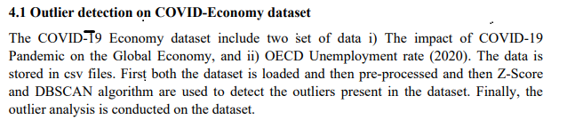
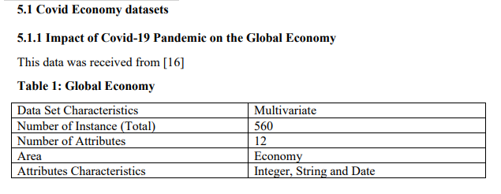
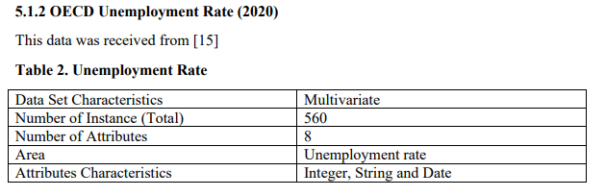
EXAMPLE-APPLICATION
-
0
1

Slide 21
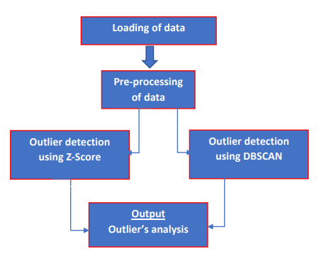
ARCHITECTURE-
OF-SYSTEM
How the System works :-

Slide 22
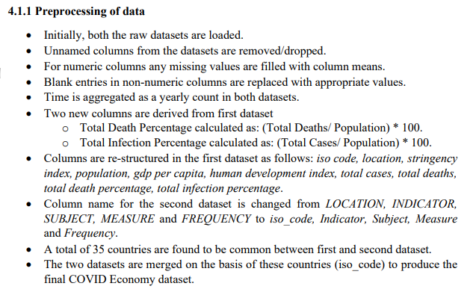
PREPROCESSING _
OF_
DATA
Cleaning, integrating, selecting, transforming data

Slide 23
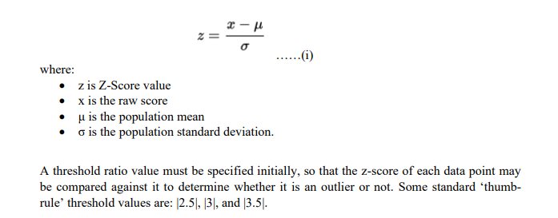
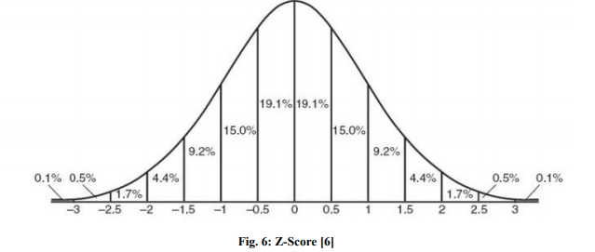
EXPERIMENTAL_TECHNIQUE1
Z-Score : Data Mining Technique 1

Slide 24
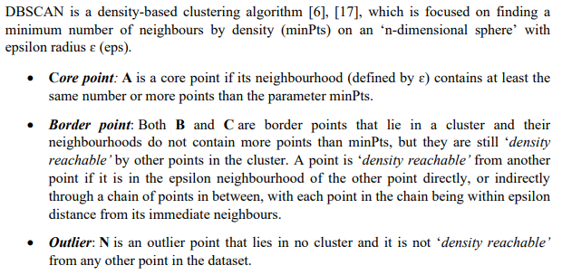
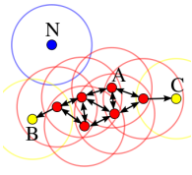
EXPERIMENTAL_TECHNIQUE2
Clustering Algorithm : Data Mining Technique 2
DBSCAN (Density Based Spatial Clustering of Applications with Noise)
All points within the cluster are mutually ‘density-connected’. Two points are said to be ‘density-connected’ if they are ‘density-reachable’ from a common third point within the dataset.
If a point is ‘density-reachable’ from any point of the cluster, it is part of the cluster as well.

Slide 25
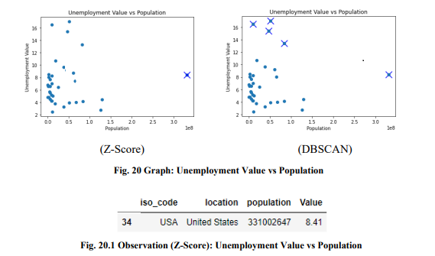
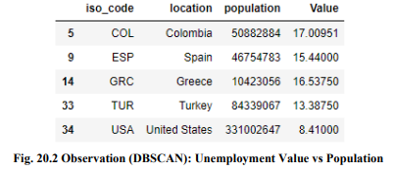
EXPERIMENTAL-
R
E
SULTS
Pattern –Evaluation
-
presentation
INDEX

Slide 26
DATA SOURCE TYPES
DBMS Data – e.g. Relational databases containing tables.
WAREHOUSE Data – consists of Data cubes with OLAP.
TRANSACTION – databases: e.g. customer purchase data.
OTHER KINDS of Data – WEB & many others such as :
Time-related data – time-series, stock-exchange etc.
Text data – containing keyboard and special components
Image data – such as bit-maps and other scanned images
Signal data – audio, video and other recorded signals
Data Stream – continuous video surveillance, sensor data etc

Slide 27
BACK to INDEX
Thanks

