Slide 1
Eager Learner : Decision Tree Induction
History
Example 1
Definitions
Example 2
Algorithm
Attribute Selection Measures
  Information Gain Calculation
1

Slide 2
History
Late1970s – Early1980s: Iterative Dichotomiser ID3
ID3 developed by J.Ross Quinlan (ML Researcher)
Based on Concept learning system framework forwarded by E.B.Hunt, J.Marin, and P.T.Stone.
C4.5 - Successor to ID3 – by Quinlan(benchmark)
1984:Book Classification And Regression Trees (CART) by L.Breiman, J.Freidman, R.Olshen, and C.Stone (all statisticians) – approach similar to ID3
Dichotomy – a division or contrast between two different things
J. Han, M. Kamber, “Data Mining Concepts and Techniques”, 2nd Ed
Chapter 6 – Section 6.3.1

Slide 3
Example 1
Suppose two friends are playing a Guessing Game with “Twenty Questions” : Player 1 has in mind some object that Player 2 tries to guess by asking no more than 20 questions (with Yes/No answers).The Play stops either by reaching the correct answer – i.e. a leaf node - at a depth less than 20; or, by failing to reach a leaf node within 20 branches. The structure is like a Binary Tree.

Slide 4
Decision Tree (DT) Example 1 contd..
Alive ?
No Yes
Ever Alive ? Person ?
No Yes No Yes
… … Mammal ? Friend ?
No Yes No Yes
… … Family-Member ? …
No Yes
… Mom ?
No Yes
…
TRUE

Slide 5
Definitions : DT & It’s Model
A decision tree (DT) is a tree where the root and each internal node is labeled with a question. The arcs emanating from each node represent each possible answer to the associated question. Each leaf node represents a prediction of a solution to the problem under consideration.
A DT Model is a computational one consisting of :
A DT as defined above.
An algorithm to create the tree.
An algorithm that applies the tree to data and solves the problem under consideration.

Slide 6
Example 2 : Training Tuple Set
ID
AGE
INCOME
STUDENT
CREDIT-RATING
Class : BUYS COMPUTER
01
youth
high
no
fair
No
02
youth
high
no
excellent
No
03
senior
low
yes
excellent
No
04
youth
medium
no
fair
No
05
senior
medium
no
excellent
No
Example same as the one used for Naïve Bayes Model

Slide 7
Training Tuples contd..
ID
AGE
INCOME
STUDENT
CREDIT-RATING
Class : BUYS COMPUTER
06
midage
high
no
fair
Yes
07
senior
medium
no
fair
Yes
08
senior
low
yes
fair
Yes
09
midage
low
yes
excellent
Yes
10
youth
low
yes
fair
Yes
11
senior
medium
yes
fair
Yes
12
youth
medium
yes
excellent
Yes
13
midage
medium
no
excellent
Yes
14
midage
High
yes
fair
Yes
Example same as the one used for Naïve Bayes Model

Slide 8
Decision Tree for BUYS COMPUTER
AGE?
youth middle-aged senior
STUDENT ? Yes CREDIT-RATING ?
yes no fair excellent
Yes No Yes No
How Obtained ?
Menu

Slide 9
ID3, C4.5 and CART
All adopt :
- a Greedy algorithm
- With a Non-backtracking approach
- Where Decision-trees are constructed
- In a top-down,
recursive,
divide-and-conquer manner.
The training set is recursively partitioned into smaller subsets as the tree is built.
J. Han, M. Kamber, “Data Mining Concepts and Techniques”, 2nd Ed
Chapter 6 – Section 6.3.1 – Figure 6.3

Slide 10
Algorithm: Generate_decision_tree.
Generate a decision tree from training tuples.
Input:
Data Partition, D – set of training tuples with associated class labels;
attribute_list - the set of candidate attributes;
Attribute_selection_method – procedure to determine splitting criterion – i.e. splitting_attribute and split point / splitting subset ;
Output: A decision tree
// Method follows in Next Slide
// Attribute_selection_method : a heuristic procedure utilizing Information Gain to select the best attribute to split the data tuples into individual classes.
J. Han, M. Kamber, “Data Mining Concepts and Techniques”, 2nd Ed
Chapter 6 – Section 6.3.1 – Figure 6.3

Slide 11
Algorithm: Generate_decision_tree.
Method:
Create a node N.
if tuples in D are all of the same class C, then
return N as a leaf node labeled with the class C;
if attribute_list is empty then
return N as a leaf node labeled with the majority class in D; // majority voting
Apply Attribute_selection_method(D, attribute_list); // finding “best” splitting_criterion
Label node N with splitting_criterion;
if splitting_attribute is discrete-valued and multiway splits allowed then // any tree (binary or..)
attribute_list ← attribute_list – splitting_attribute; // remove splitting_attribute
for each outcome j of splitting_criterion // partition tuples & grow subtrees for each partition
Let Dj be the set of data tuples in D satisfying outcome j ; // a partition
if Dj is empty then
attach a leaf labeled with majority class in D to node N;
else attach the node returned by Generate_decision_tree(Dj, attribute_list) to node N;
endfor
return N;
J. Han, M. Kamber, “Data Mining Concepts and Techniques”, 2nd Ed
Chapter 6 – Section 6.3.1 - Figure 6.3

Slide 12
Algorithmic Complexity & other nuances
Computational Complexity = O(n x |D| x log( |D| )),
Where n : number of attributes
D : training set
|D| : number of training tuples in D
Incremental versions : to incorporate new training data
Attribute Selection Measures (discussed next)
Tree Pruning, Scalability issues, & Rule Extraction
J. Han, M. Kamber, “Data Mining Concepts and Techniques”, 2nd Ed
Chapter 6 – Section 6.3.1 – Pgs. 292-296

Slide 13
Attribute Selection Measures
Information Gain (& others: Gain Ratio, Gini Index etc.)
Used by ID3
Based on information theory (Claude Shannon’s work)
Measure : change in Entropy of the data set
Entropy : “Information Content”
Hence, Information Gain associated with choosing a line of action that leads to a simpler DT (shorter route to leaf)
Splitting Attribute : One with highest Information Gain
This attribute minimizes the information needed to classify the tuples in the resulting partitions and reflects the least randomness or “impurity” in these partitions
J. Han, M. Kamber, “Data Mining Concepts and Techniques”, 2nd Ed
Chapter 6 – Section 6.3.2

Slide 14
Information Gain Calculations
Let Info(D) : expected information needed to classify tuples in D
and let p_{i} : probability that a tuple in D belongs to class C_{i} (i : 1 to m)
A : splitting attribute with n distinct values {a₁, a₂, … a_{n}}
D_{j} : subsets of D for corresponding splits {D₁, D₂, … D_{n}}
Info_{A}(D) : extra information needed to partition D based on A
Then,
p_{i} = |C_{i,D}| / |D|
Info(D) = - Σ p_{i} log₂(p_{i}), for i = 1 to all no. of classes (say, m)
Info_{A}(D) = Σ (|Dj|/|D|) x Info(Dj), for j = 1 to n
Gain(A) = Info(D) – Info_{A}(D)
A log function to the base 2 is used as the information is encoded in bits.
J. Han, M. Kamber, “Data Mining Concepts and Techniques”, 2nd Ed
Chapter 6 – Section 6.3.2

Slide 15
Information Gain Calculations(Example 2)
Info(D) = - (5/14) log₂(5/14) - (9/14) log₂(9/14) = 0.940 bits
Info_{Age}(D) = (5/14) x (- (2/5) log₂(2/5) - (3/5) log₂(3/5))
+ (4/14) x (- (4/4) log₂(4/4) - (0/4) log₂(0/4))
+ (5/14) x (- (3/5) log₂(3/5) - (2/5) log₂(2/5))
= 0.694 bits
Gain(Age) = Info(D) – Info_{Age}(D) = 0.940 – 0.694 = 0.246 bits
Similarly calculating :- Gain(Income) = 0.029 bits
Gain(Student) = 0.151 bits, Gain(Credit_rating) = 0.048 bits
Age being the attribute with highest information gain, Node N is labeled with Age
J. Han, M. Kamber, “Data Mining Concepts and Techniques”, 2nd Ed
Chapter 6 – Section 6.3.2

Slide 16
Rule Extraction from a Decision Tree
Extracting IF-THEN rules from DTs
R1 : IF Age = youth AND Student = no THEN Buys_computer = no
R2 : IF Age = youth AND Student = yes THEN Buys_computer = yes
R3 : IF Age = middle_aged THEN Buys_computer = yes
R4 : IF Age = senior AND Credit_rating = excellent THEN Buys_computer = no
R5 : IF Age = senior AND Credit_rating = fair THEN Buys_computer =yes
Why are rules necessary for Machines?
How to extract rules from Decision Trees?
Menu

Slide 17
Regression (Numeric Prediction): Example
Consider a system to predict price of a used car
Inputs (attributes ) X : make, year, engine capacity, mileage
Output (predicted value) Y : Price of the car (a numeric value)
Training set Data : Past transactions < X, Y >
Plotting a curve to fit Training set Data : Y vs. X
Optimal function fitting the training set data curve : Y(X)
Additional points may be sampled near the optimum of the curve to improve
Current Regression Model by
- adding these points to the existing data, and
- fitting a new and better model
Ethem Alpaydin, “Introduction to Machine Learning”, 3rd Ed
Chapter 1 – Section 1.2.3

Slide 18
Relevant Resources
Dedicated Journals : For latest Researches
  Machine Learning
  Journal of Machine Learning Researches
  Pattern Analysis and Machine Intelligence (IEEE Transactions)
  Data Mining and Knowledge Discovery
  IEEE Transactions on Knowledge and Data Engineering
Datasets for Testing : UCI Repository
- http://archive.ics.uci.edu/ml
Free Software Toolbox and Package
- http://www.cs.waikato.ac.nz/ml/weka/
Ethem Alpaydin, “Introduction to Machine Learning”, 3rd Ed
Chapter 1 – Section 1.4

Slide 19
Tasks
Develop Your Own Software :
  For Naïve Bayes Classifier
  For Decision Tree Induction
Test Softwares :
  Using Available Training Dataset (Example 2)
  Using suitable Datasets From UCI Repository
  Provide comparative studies based on Performance

Slide 20

Brief Review of Entropy
Entropy H(X) associated with a random variable X having a possible outcome (An Example : measure of surprise involved in the process of a biased coin landing on its head or tail)
The average level of “information” inherent in the process is measured in terms of the probabilities (p and 1 - p ) associated with the two events occurring, and is expressed as the number of bits required to represent the outcome
Uncertainty maximum for p = ½. (the two events have equal probability : Entropy = 1 bit)
There is least cause of surprise at p = 0 or p=1. (outcome pre-fixed : Entropy = 0 bit)
All other values of p generates entropy values between 0 and 1 bit.
Plotting H(X) against probabilities of X , we get the Entropy Curve.
Shannon entropy (in Information Theory)
Concept first introduced by Claude Shannon in 1984.
The basic idea of information theory is that the "informational value" of a communicated message depends on the degree to which the content of the message is surprising. If an event is very probable, it is no surprise at all (and hence generally uninteresting). Transmission of such a message carries very little new information. However, if an event is
unlikely to occur, it is much more informative to learn that it happened
or will happen.

Slide 21
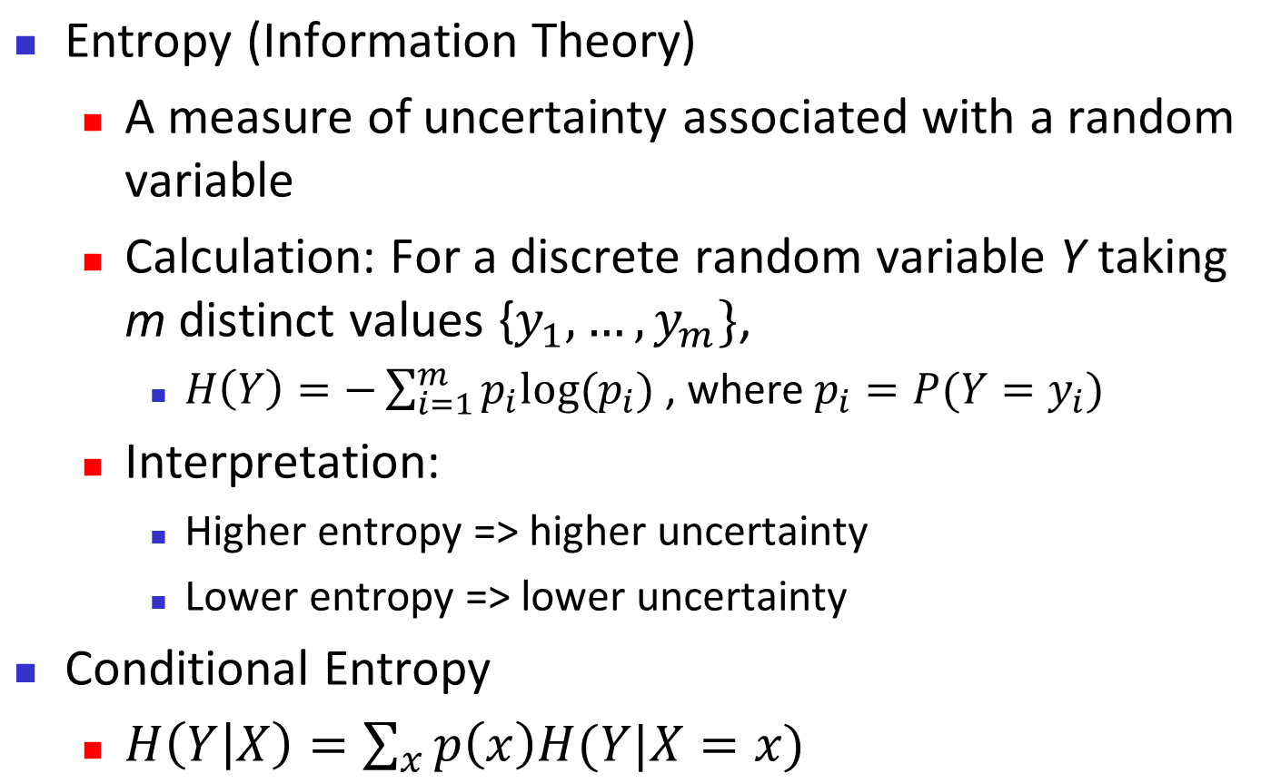
Brief Review of Entropy
Entropy Curve for m=2
Back

