Slide 1






Optimizing Thermal Fluids: The Role of Machine Learning in Predicting Nanofluid Heat Capacity
Authors: Aritra Saha, Ankan Basu, Sumanta Banerjee
Conference: INCOM 2024, Jadavpur University, Kolkata, India, 5-6 January 2024
Paper ID – INCOM 741
INCOM 741

Slide 2
Table of contents
What are Nanofluids?
Uses of Nanofluids
Coolant Fluids
Why SHC?
Nanofluids as Coolants
Objectives
Methodology
Results and Analysis
Conclusion
References
INCOM 741

Slide 3
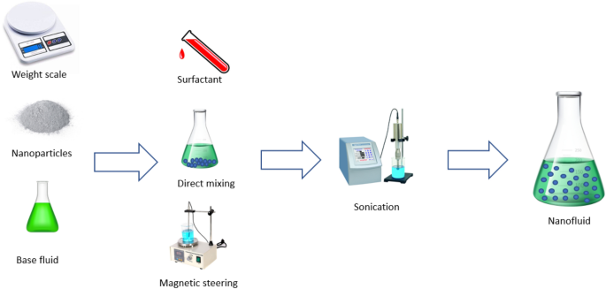
What are Nanofluids
Suspension of Nanoparticles in Base Fluid
Preparation of Nanofluids [1]
INCOM 741

Slide 4
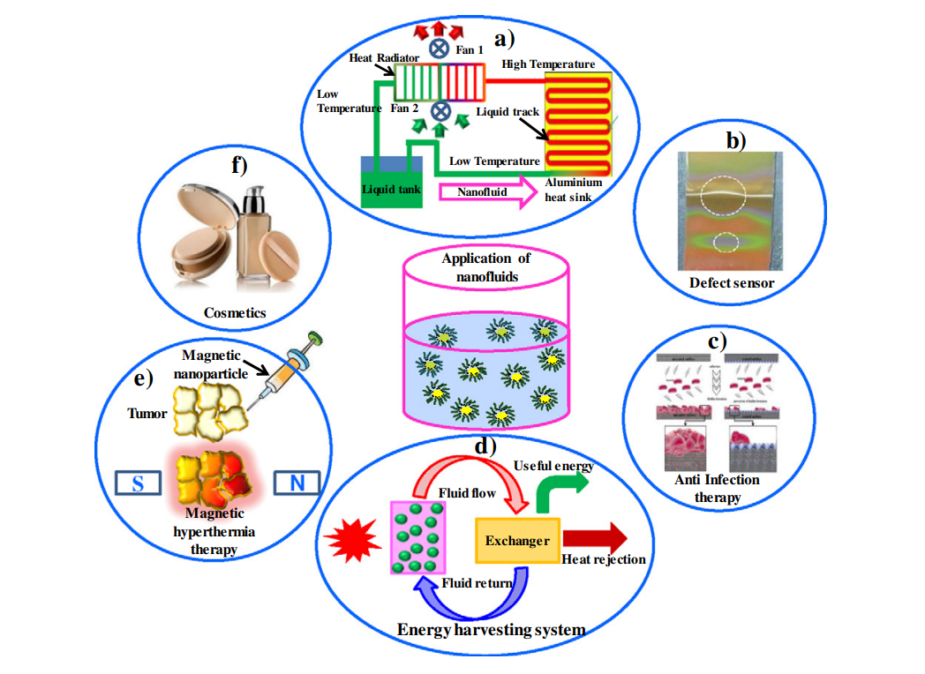
Use of Nanofluids
Various Applications of Nanofluids [2]
INCOM 741

Slide 5
Coolant Fluids
Absorb heat
Protect machineries
Increase efficiency
Should have high SHC
INCOM 741

Slide 6
Why Specific Heat Capacity?
High SHC leads to a more efficient coolant
Lack of sufficient work on the subject [3,4]
Receives less attention compared to TC and Viscosity [5-7]

Slide 7
Nanofluids as Coolants
Traditional fluids have low thermal conductivity.
Addition of nanofluid
increases thermal conductivity
increases SHC and alters other thermophysical properties [8]
Promising as efficient coolants.
INCOM 741

Slide 8
Objectives
Aim - to predict SHC of Copper Oxide/Ethylene Glycol nanofluids using Machine Learning techniques
Comparing Machine Learning models with traditional theoretical models
INCOM 741

Slide 9
Dataset
Experimental data obtained from the work of Barbes et. al. [9] containing 84 data points
Input Variables - Temperature, Nanoparticle SHC and Volume Fraction
Output Variables – Nanofluid SHC
INCOM 741

Slide 10
Methodology
Data preprocessing
Using different models to predict the SHC of CuO/EG nanofluids
ML models fine-tuned using Bayesian Hyperparameter Optimization
Results compared with theoretical models
INCOM 741

Slide 11



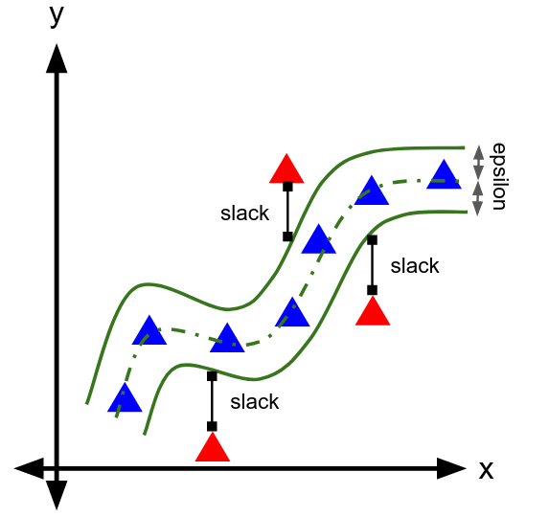
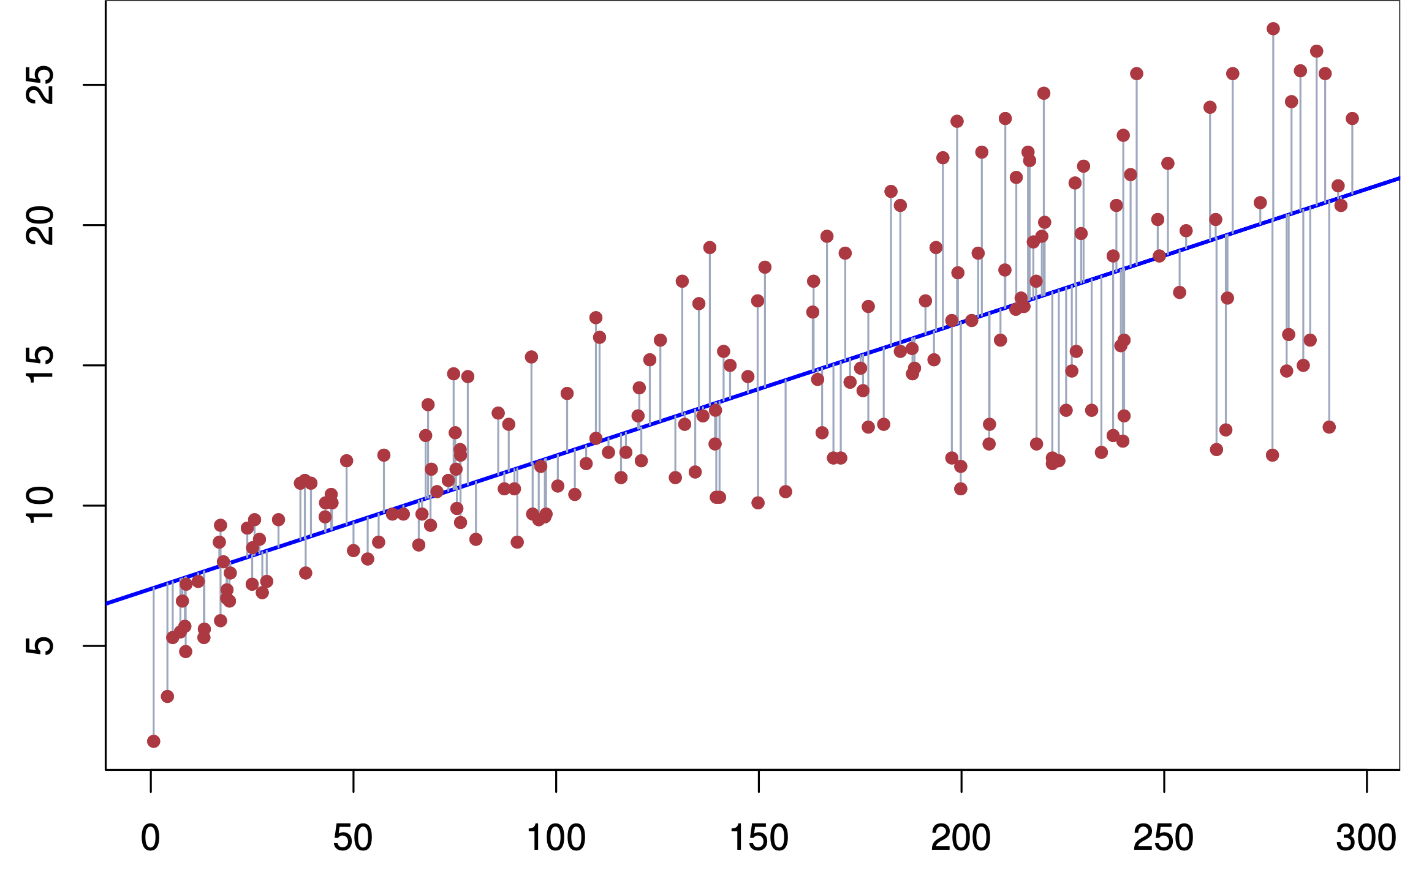

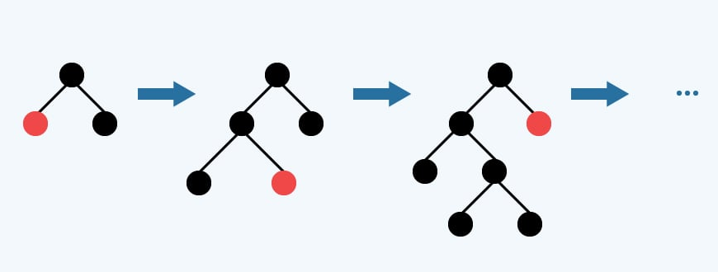


ML Models Used
Support Vector Regression (SVR)
Linear Regression (LR)
Artificial Neural Network (ANN)
Gradient Boosting Machine (GBM)
INCOM 741

Slide 12
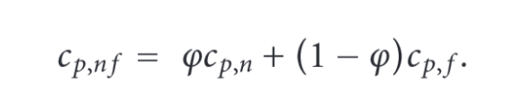
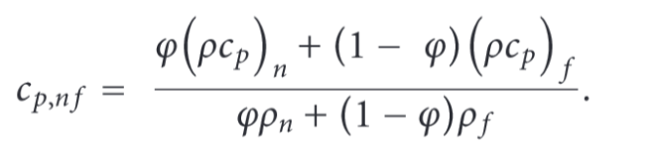
Theoretical Models
MODEL 1
MODEL 2
INCOM 741

Slide 13
Results
INCOM 741

Slide 14
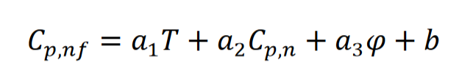
Analysis
All ML models perform better than theoretical models
LR best performing among them
Coefficients of the fitted LR model:
𝑎1 = 0.0056, 𝑎2 = −0.2298, 𝑎3 = −0.0908 and 𝑏 = 0.8657
INCOM 741

Slide 15
Conclusion
ML models are capable of learning to predict the SHC of CuO/EG nanofluids
Can be generalized using data from different types of nanofluids
Can provide fast and accurate calculation of SHC
INCOM 741

Slide 16
References
Ali, A.R.I., Salam, B. A review on nanofluid: preparation, stability, thermophysical properties, heat transfer characteristics and application. SN Appl. Sci. 2, 1636 (2020). https://doi.org/10.1007/s42452-020-03427-1
S.A. Angayarkanni, John Philip, Review on thermal properties of nanofluids: Recent developments, Advances in Colloid and Interface Science, Volume 225, 2015, Pages 146-176, ISSN 0001-8686, https://doi.org/10.1016/j.cis.2015.08.014.
A. Rajabpour, F. Akizi, M. Heyhat and K. Gordiz, Molecular dynamics simulation of the specific heat capacity of water-cu nanofluids, International Nano Letters 3 (2013) p. 58.
R. Vajjha and D. Das, Specific heat measurement of three nanofluids and development of new correlations, Journal of Heat Transfer 131(071601) (2009) 1–7.
I. Alade, T. Oyehan, A. Bagudu, I. Popoola and S. Olatunji, Modeling thermal conductivity enhancement of metal and metallic oxide nanofluids using support vector regression, Advanced Powder Technology 29 (2017) 157–167.
M. Ariana, B. Vaferi and G. Karimi, Prediction of thermal conductivity of aluminawater-based nanofluids by artificial neural networks, Powder Technology 278 (2015) 1–10.
M. Hemmat Esfe, M. Ahangar, D. Toghraie, M. Hajmohammad, H. Rostamian and H. Tourang, Designing artificial neural network on thermal conductivity of al2o3–water–eg (60–40 %) nanofluid using experimental data, Journal of Thermal Analysis and Calorimetry (2016) 1–7.
H. Pandey and N. K. Gupta, A descriptive review of the thermal transport mechanisms in mono and hybrid nanofluid-filled heat pipes and current developments, Thermal Science and Engineering Progress (2022) p. 101281.
B. Barb´es, R. P´aramo, E. Blanco and C. Casanova, Thermal conductivity and specific heat capacity measurements of cuo nanofluids, Journal of Thermal Analysis and Calorimetry 115 (2014) 1883–1891.
INCOM 741

Slide 17
Thank you
INCOM 741

