Slide 1
Predicting HEAT TRANSFER COEFFICIENT Using Bidirectional Long Short-Term Memory
Ankan Basu, Aritra Saha, Sumanta Banerjee
CONFERENCE: INCOM 2024
PAPER ID: INCOM 740

Slide 2
CONTENTS
INTRODUCTION
METHODOLOGY
RESULTS AND DISCUSSION
CONCLUSION AND FUTURE SCOPE
REFERENCES

Slide 3
INTRODUCTION

Slide 4
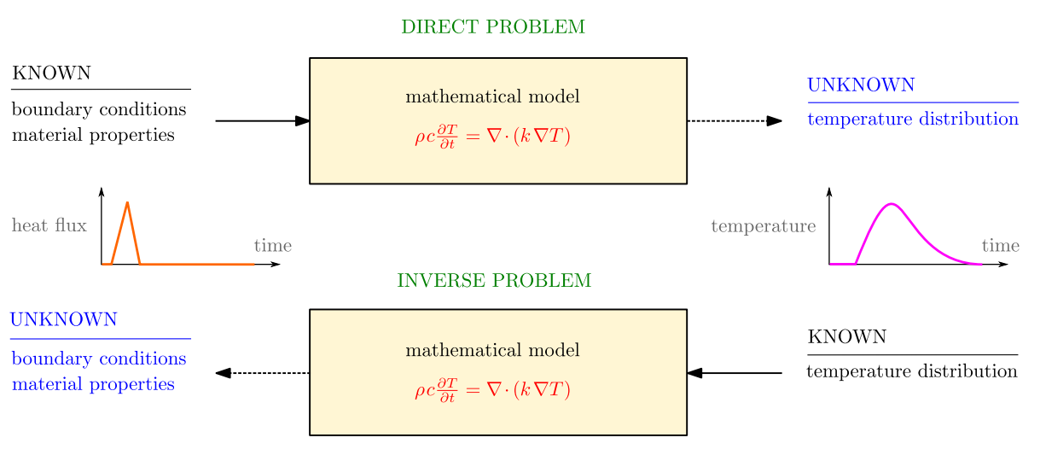
The Heat Transfer Problem
FIG. The Direct and Inverse Heat Transfer Problem (IHTP) [1]

Slide 5
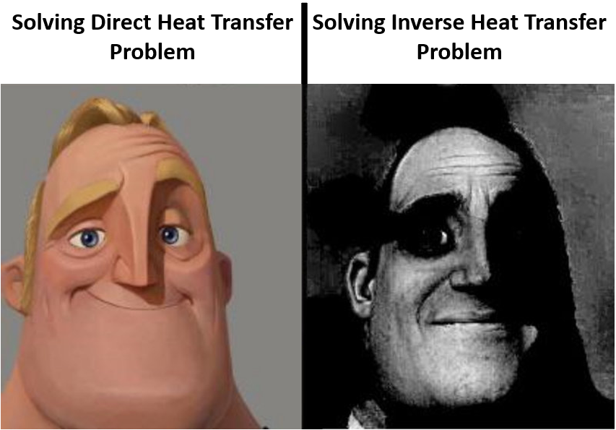

Slide 6
Why is it difficult to solve ihtp?
Non-uniqueness of the solution
Ill-posed
Complex nature of physical systems
Nonlinearities
Limited observations, etc.

Slide 7
What is HTC?
Heat Transfer Coefficient is the proportionality constant between the heat flux and temperature difference
Used in calculating the heat transfer, typically by convection or phase transition between a fluid and a solid
Prediction of HTC from Temperature data -> IHTP

Slide 8
WHY is Knowledge of htc important?
Controlling cooling rates to achieve desired microstructural properties [2, 3]
Improving energy efficiency
Optimization of thermal performance

Slide 9
Different Methods applied to solve IHTP
Iterative and gradient-based
Meta-Heuristic (e.g. PSO, genetic algorithm) [4 - 9]
Machine Learning [10 - 12]

Slide 10
METHODOLOGY

Slide 11
Methodology
AIM
To see the ability of Neural networks to solve the IHTP (prediction of Heat Transfer Coefficient)
Models
Different Neural networks (FFNN, RNN, LSTM, BiLSTM) compared
Data set
Obtained from Szénási and Felde [12]

Slide 12
Dataset OVERVIEW
DATA
Dataset composed of information of quenching process (from 850 °C to room temperature) of a cylindrical Inconel 600 bar.
TRAINING
Training set of 1 million datapoints
VALIDATION
Validation set of 100,000 datapoints
TESTING
Testing set of 100,000 datapoints

Slide 13
Dataset OVERVIEW
INPUT
Temperature recorded for 1 min at interval of 0.5s
t₁ | t₂ | t₃ | t₄ | t₅ | t₆ | t₇ | t₈ | … | t₁₂₀
OUTPUT
HTC at each temperature data point
h₁ | h₂ | h₃ | h₄ | h₅ | h₆ | h₇ | h₈ | … | h₁₂₀

Slide 14

MODELS USED
Output
Output
Output Layer
Output Layer
…
Hidden Layer
$$≡$$
Hidden Layer
…
Input Layer
Input Layer
Input
Input
THE FEED FORWARD NEURAL NETWORK (FFNN)

Slide 15
MODELS USED
FFNN
RNN
THE RECURRENT NEURAL NETWORK (RNN)

Slide 16

MODELS USED
RNN
$$≡$$
RNN
RNN
RNN
RNN
…
RNN unrolled through time

Slide 17
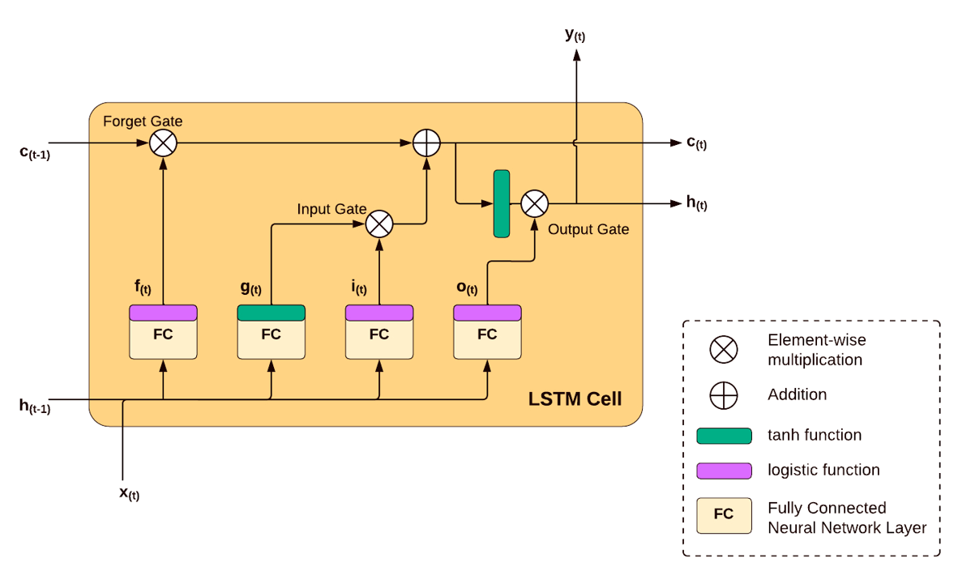
MODELS USED
THE LONG SHORT TERM MEMORY (LSTM)

Slide 18
MODELS USED
LSTM Backward
LSTM Backward
LSTM Backward
LSTM Backward
…
LSTM
Forward
LSTM
Forward
LSTM
Forward
LSTM
Forward
…
THE BIDERCTIONAL LONG SHORT TERM MEMORY (BiLSTM)

Slide 19
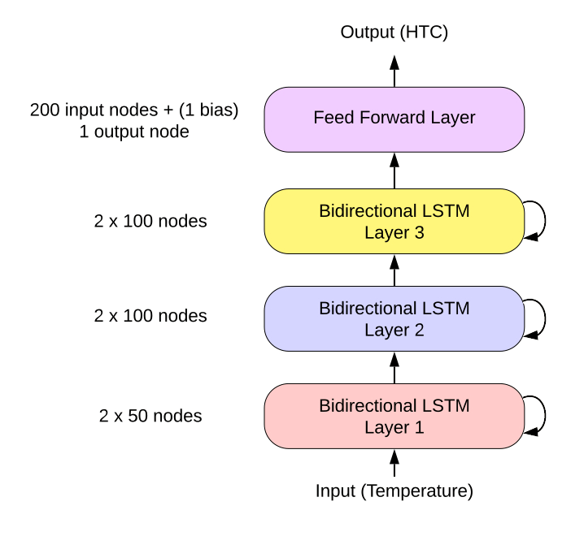
MODELS USED
THE BiLSTM BASED MODEL WITH BEST PERFORMANCE

Slide 20
RESULTS AND DISCUSSION

Slide 21
RESULTS
TABLE: Mean Absolute Percentage Errors for the Different Models
Model | Training | Validation | Testing
FFNN | 8.3559 | 8.3646 | 8.3485
RNN | 5.8751 | 5.8810 | 5.8768
LSTM | 2.2860 | 2.2847 | 2.2860
BiLSTM | 1.2529 | 1.2572 | 1.2548

Slide 23
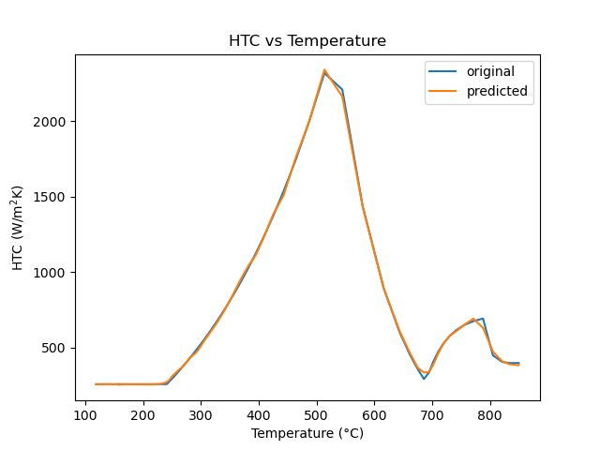
FIG.: HTC vs Temp Plot from BiLSTM model

Slide 24
CONCLUSION AND FUTURE SCOPE

Slide 25
CONCLUSIONS
BiLSTM outperformed other models.
Due to capability to capture temporal relationships.
Ability to derive context from both past and future.
BiLSTM can solve IHTP with sufficient accuracy

Slide 26
FUTURE SCOPE
Can be generalised using data from different materials
Other Neural Network architectures can be explored
Investigating more complex Heat Transfer scenarios

Slide 27
REFERENCES
Martin Zálešák, Lubomír Klimeš, Pavel Charvát, Matouš Cabalka, Jakub Kůdela, Tomáš Mauder, Solution approaches to inverse heat transfer problems with and without phase changes: A state-of-the-art review, Energy, Volume 278, Part B, 2023, 127974, ISSN 03605442, https://doi.org/10.1016/j.energy.2023.127974.
Bamberger, M., & Prinz, B. (1986). Determination of heat transfer coefficients during water cooling of metals. Materials Science and Technology, 2(4), 410-415.
Ramírez-López, A., Aguilar-López, R., Palomar-Pardavé, M., Romero-Romo, M. A., & Muñoz Negrón, D. (2010). Simulation of heat transfer in steel billets during continuous casting. International Journal of Minerals, Metallurgy, and Materials, 17, 403-416.
Colaco, Marcelo & Orlande, Helcio & Dulikravich, George. (2006). Inverse and Optimisation Problems in Heat Transfer. Journal of the Brazilian Society of Mechanical Sciences and Engineering. XXVIII. 10.1590/S1678-58782006000100001.
M. N. Özisik and H. R. B. Orlande, Inverse Heat Transfer: Fundamentals and Applications. Taylor and Francis, 2000
Raudenský, M., Woodbury, K. A., Kral, J., & Brezina, T. (1995). Genetic algorithm in solution of inverse heat conduction problems. Numerical Heat Transfer, Part B Fundamentals, 28(3), 293-306.
S. Vakili and M. S. Gadala, “Effectiveness and Efficiency of Particle Swarm Optimization Technique in Inverse Heat Conduction Analysis,” NUMERICAL HEAT TRANSFER PART B-FUNDAMENTALS, vol. 56, no. 2, pp. 119-141, 2009
S.C. Sun, H. Qi, Y. T. Ren, X. Y. Yu, and L. M. Ruan, “Improved social spider optimization algorithms for solving inverse radiation and coupled radiation-conduction heat transfer problems,” International Communications in Heat and Mass Transfer, vol. 87, pp. 132-146, 2017
Coello Coello, C., Van Veldhuizen, D. A., & Lamont, G. B. (2013). Evolutionary Algorithms for Solving Multi-Objective Problems.
Sreekanth, S., Ramaswamy, H. S., Sablani, S. S., & Prasher, S. O. (1999). A neural network approach for evaluation of surface heat transfer coefficient. Journal of food processing and preservation, 23(4), 329-348.
Soeiro, F. J. C. P., Soares, P. O., Campos Velho, H. F., & Silva Neto, A. J. (2004). Using neural networks to obtain initial estimates for the solution of inverse heat transfer problems. In Inverse Problems, Design an Optimization Symposium (pp. 358-363).
Szénási, Sándor, and Imre Felde. 2019. "Database for Research Projects to Solve the Inverse Heat Conduction Problem" Data 4, no. 3: 90. https://doi.org/10.3390/data4030090

Slide 28
THANK YOU

