Slide 1
BOSTON HOUSE PRICE PREDICTION

Slide 2
AUTHOR
ANKAN BASU
an.basu.kan@gmail.com
8697797274
DETAILS
Student : BTech 1st year
Computer Science and Engineering
Heritage Institute of Technology
Kolkata

Slide 3
CONTENT
Introduction
Python
Libraries
Integrated Development Environments
Algorithm
Source
Overview of Program
Code(with output)
Source
Conclusion

Slide 4
INTRODUCTION
Machine Learning is a field of study that gives computers the ability to learn from given data and predict future outcomes based on that data without being explicitly programmed.
It is a subset of Artificial Intelligence (AI).
In this project Machine Learning has been to predict the price of houses in Boston based on a given data.

Slide 5
PYTHON
Python is a high level, general purpose, interpreted programming language.
It was created by Guido van Rossum.
It is dynamically typed.
It is open sourced.
Python supports several programming paradigms such as Object Oriented, Procedural and Functional Programming.

Slide 6
contd.
Python is used in several domains such as :
Data Analysis.
Machine Learning.
Data Visualization.
Web Development.
GUI Development.
Image Processing.
Internet of Things (IoT)
Game Development

Slide 7
LIBRARIES USED
Numpy
Numpy is used to deal with multidimensional arrays. It supports several mathemetical functions on these arrays.
Pandas
It is used for data manipulation and data analysis.
Scikit-Learn
It is a machine learning library for python. It contains classification, regression and clustering algorithms including support vector machines, random forests, gradient boosting, k-means and DBSCAN. It is designed to interoperate with the Python numerical and scientific libraries NumPy and SciPy.
Matplotlib
It is used for plotting data.

Slide 8
INTEGRATED DEVELOPMENT ENVIRONMENT
An integrated development environment (IDE) is a software application that provides comprehensive facilities to computer programmers for software development. An IDE normally consists of at least a source code editor, build automation tools and a debugger.
Examples of IDEs:
Pycharm (for Python)
Net Beans

Slide 9
ALOGRITHM
Here, the Linear Regression algorithm is used.
Linear regression is a linear approach to modeling the relationship between a scalar response (or dependent variable) and one or more explanatory variables (or independent variables). The case of one explanatory variable is called simple linear regression.
We take the equation as
y' = b + w1x1
where y' is the predicted label(output)
b is the y-intercept(known as bias)
w1 is weight(slope)
x1 is the input

Slide 10
SOURCE
This dataset, used here, contains information collected by the U.S Census Service concerning housing in the area of Boston Mass. It was obtained from the StatLib archive (http://lib.stat.cmu.edu/datasets/boston), and has been used extensively throughout the literature to benchmark algorithms.

Slide 11
OVERVIEW OF THE PROGRAM
The datasheet shows the dependence of price of houses in Boston on various paramenters
CRIM: per capita crime rate by town
ZN: Proportion of residential land zoned for lots over 25,000 sq. ft
INDUS: Proportion of non-retail business acres per town
CHAS: Charles River dummy variable (= 1 if tract bounds river; 0 otherwise)
NOX: Nitric oxide concentration (parts per 10 million)
RM: Average number of rooms per dwelling
AGE: Proportion of owner-occupied units built prior to 1940
DIS: Weighted distances to five Boston employment centers
RAD: Index of accessibility to radial highways
TAX: Full-value property tax rate per $10,000
PTRATIO: Pupil-teacher ratio by town
B: 1000(Bk — 0.63)², where Bk is the proportion of [people of African American descent] by town
LSTAT: Percentage of lower status of the population

Slide 12
contd.
80% of the data is used as training set and 20% as test set.
After training the machine with the training test, it was fed with data from the test set allowed to predict the result(price).
A linear Regression model is used to predict the outcomes of the test set.

Slide 13
CODE
The code has been written in .ipynb format. In the following slides screenshots of the code along with outputs have been provided.
The code can be found at
https://github.com/Ankan-Basu/boston_mlproject/blob/master/Boston_Housing.ipynb

Slide 14
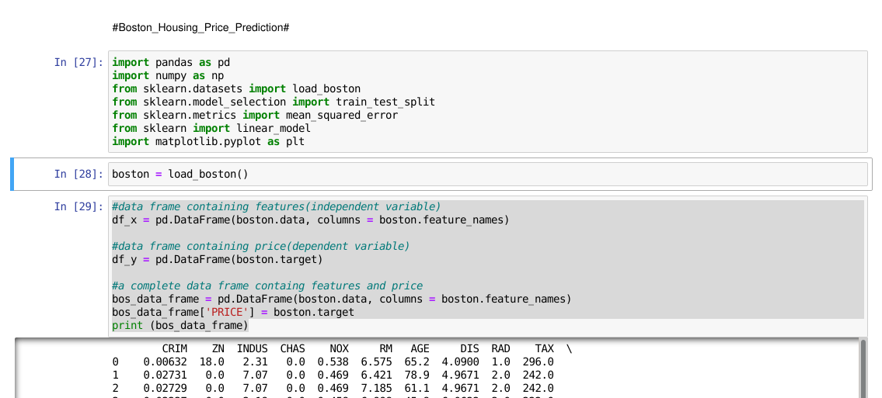

Slide 15
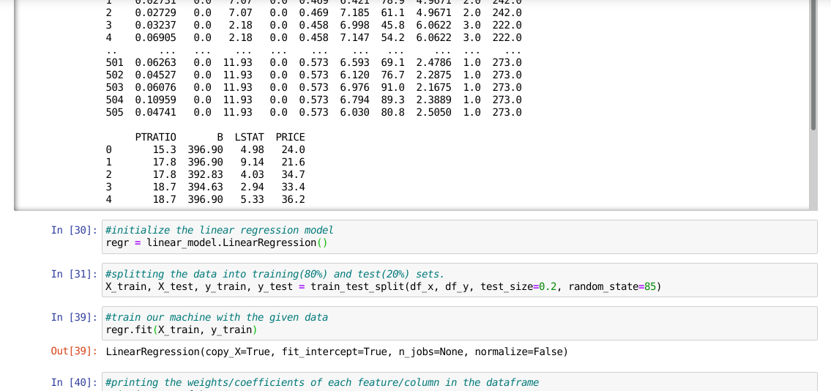

Slide 16
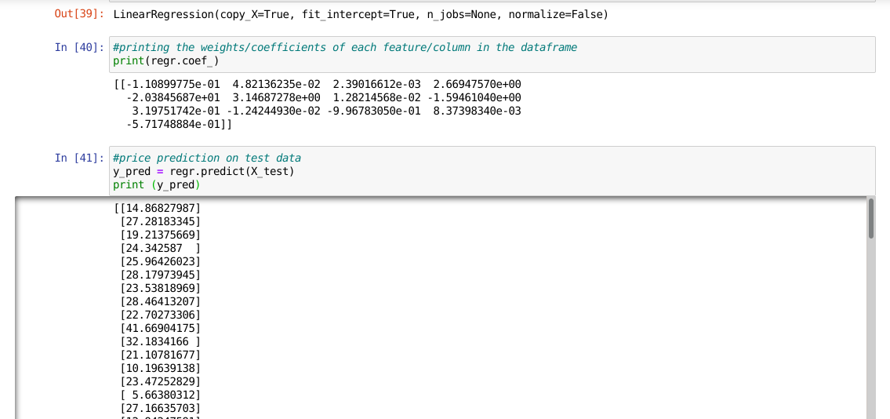

Slide 17
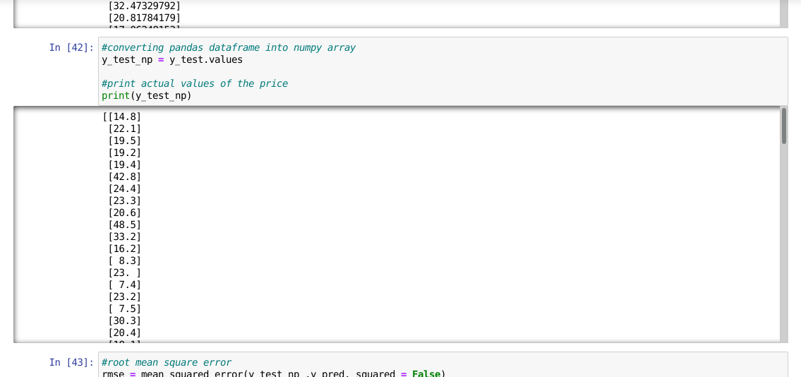

Slide 18
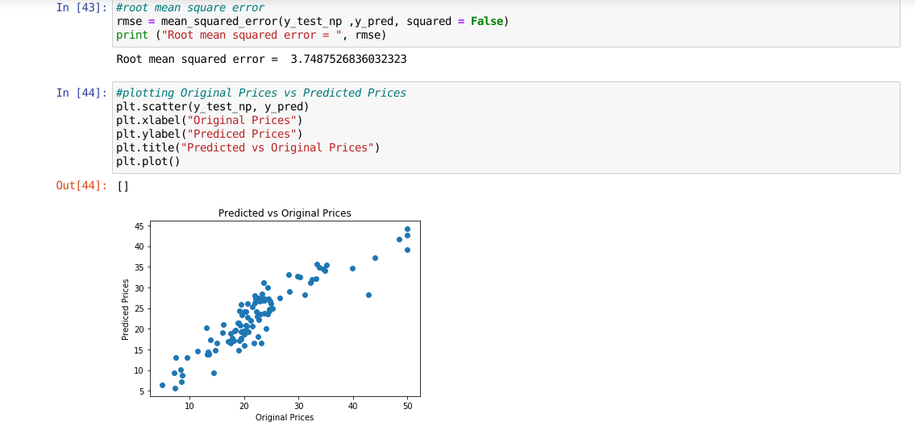

Slide 19
CONCLUSION
The program was written(in python) to implement Linear Regression algorithm in the classic Boston House Price Prediction Problem.
20% of the data was used for testing. The predicted results were compared with the original ones(in the test set).
It showed a root mean square error of 3.749 (approx).

Slide 20
THANK YOU

