Slide 1

Achievement's for Month-Year
Your Info

Slide 2
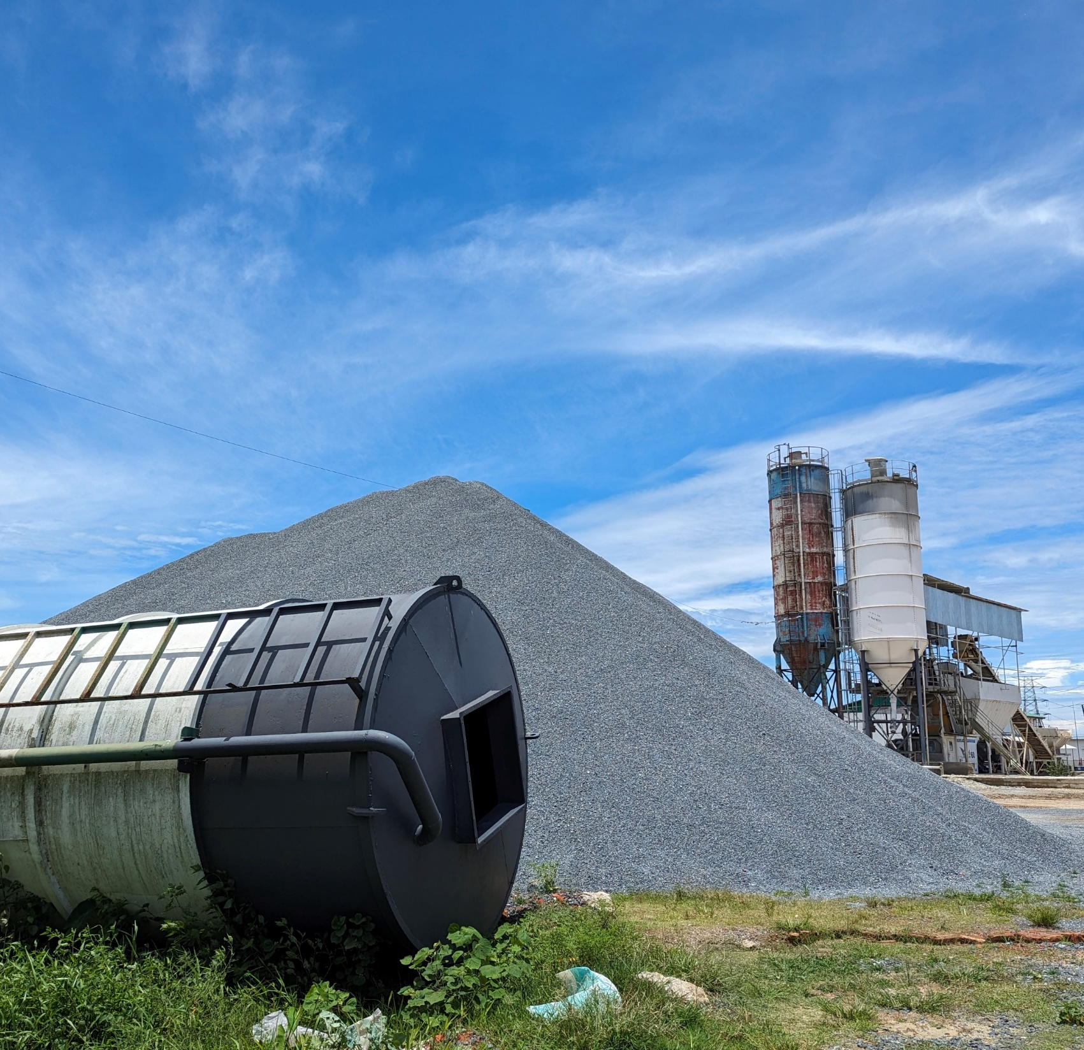
IT Infrastructure & Operation JTML-DIPL

Slide 3
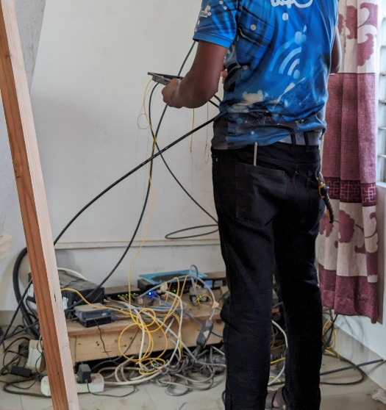
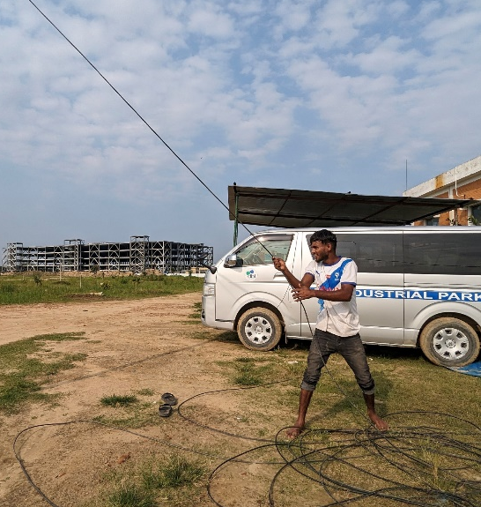
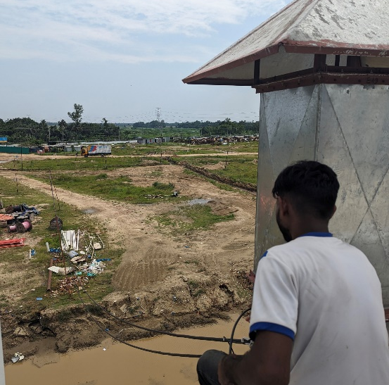
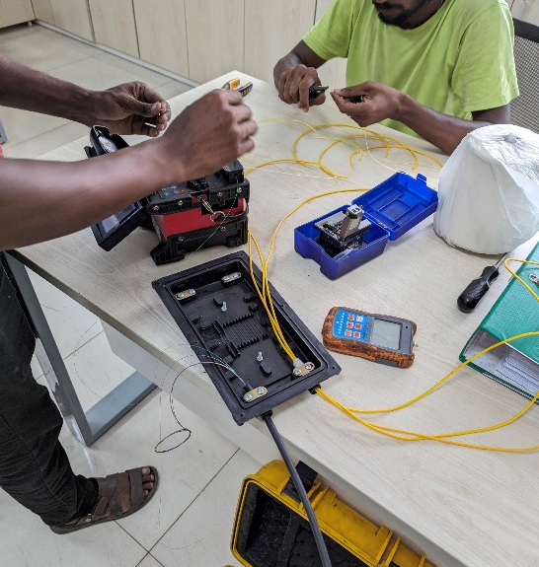
Network Migration
We migrated our both network from our old office to our new office.
JTML running smoothly on Amra and Access-Tel simultaneously.
We also pulled a 12 Core Fiber in a new path for backup purpose.

Slide 4
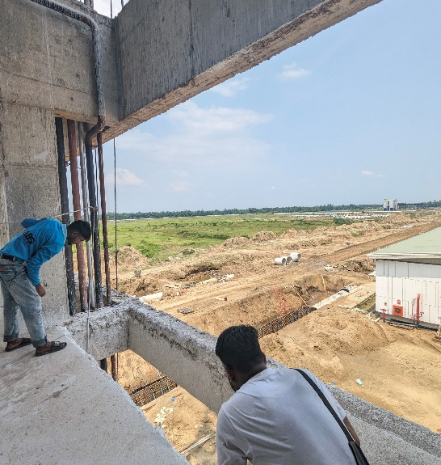
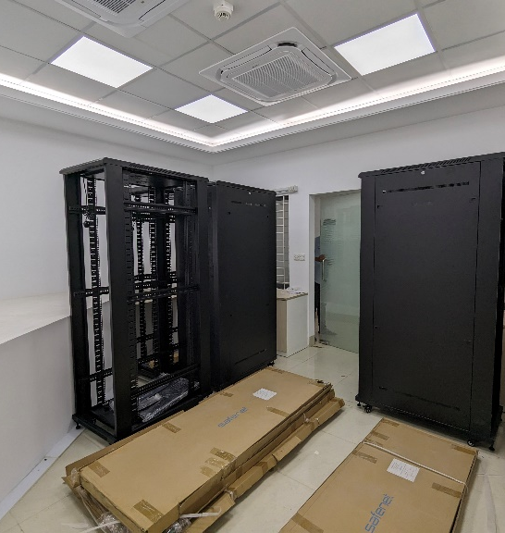
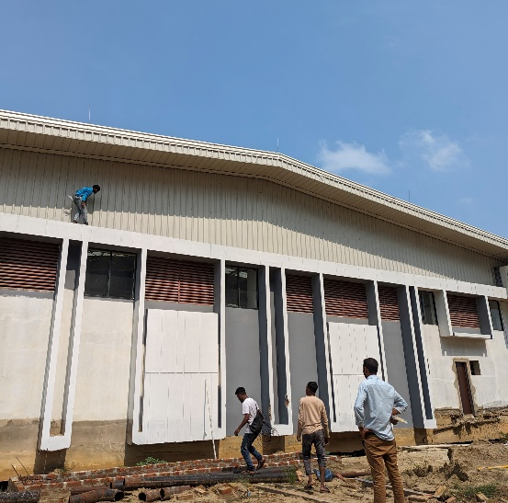
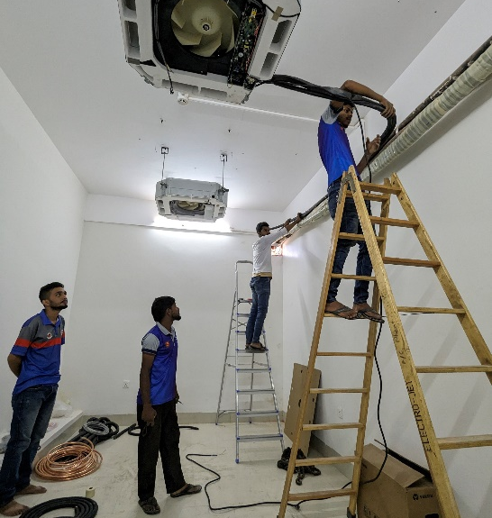
Network Extension
We Extended the coverage of our Wi-Fi network as needed.
Extended our network to Utility Building for their Machinery use purpose.
We Monitored CCTV Server Room Setup Activities.

Slide 5
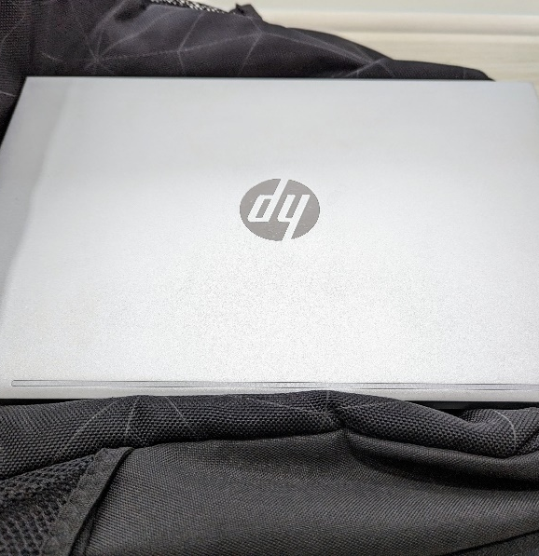
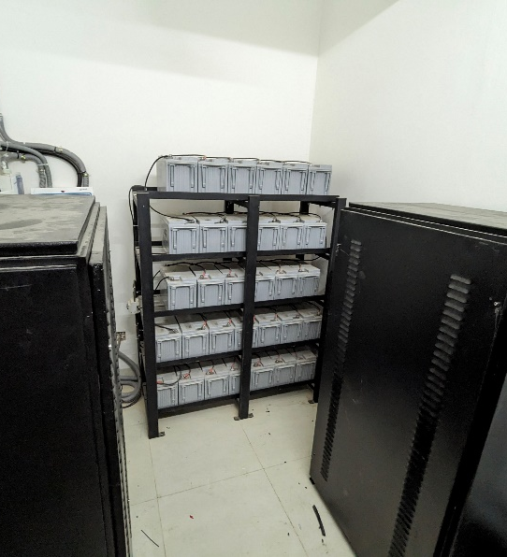
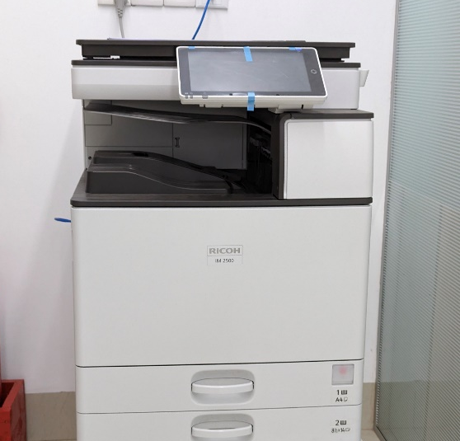
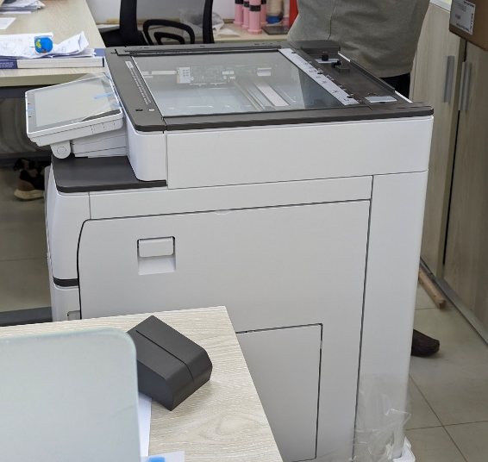
New Setup, Distribute & Maintenance
Allocated the necessary PC to the appropriate individual.
Distributed and Replaced other IT accessories like new Multifunctional Printer to required Department and Office.
Monitored activities during CCTV UPS installation.

Slide 6
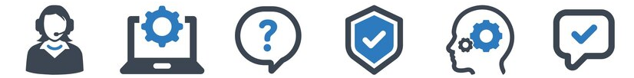
IT Related Support
Provided User end Support by Online or Offline.
Diagnosing and fixing computer and network problems.
Offering technical support for IT-related issues to others.
Installing OS and configuring software and Drivers.
Activating and Installing various software like Windows OS, AutoCAD , MS Office Suite etc.

Slide 7
Thank You

