Slide 1
7th International Conference on Computing, Communication, Control and Automation (ICCUBEA-2023)
Pimpri Chinchwad Education Trust’s
Pimpri Chinchwad College of Engineering, Pune
Presentation By:
Paper ID: 1027
Harnessing Transformers for Detecting Adverse Drug Reaction and Customized Causality Explanation using Generative AI
Ankan Bera¹, Rik Das², Sayantani Ghosh³, Raktim Chakraborty⁴, Indranil Mitra⁵, Prasun Nandy⁶
PricewaterhouseCoopers India Pvt. Ltd.

Slide 2
Outline
Introduction
Problem Statement
Objectives
Literature Review
Methodology
Results
Conclusion
References (Selected)

Slide 3
Introduction
Pharmacovigilance (PV) as defined by the World Health Organization (WHO) is the science and activities relating to the detection, assessment, understanding, and prevention of Adverse Drug Reaction (ADR) or any other drug-related problem.
PV is critical for the pharmaceutical and health-care industries for drug approval, continuance, and to promote safe use of their products. It helps the medical practitioners to enhance and communicate their knowledge in the betterment of therapeutic practices. For patients and the general public, it is the source of all drug safety information and education.
Primary stakeholders responsible for maintaining Pharmacovigilance processes consists of Pharmaceutical Companies, Regulatory Authorities, Research Organizations, Insurance Providers, Healthcare Providers

Slide 4
Problem Statement
Current Process:
Manual process.
Limited manpower.
Exponential increase in case reporting due to rise in internet usage and social media.
Amplifies the possibility of overlooking serious cases leading to reduced patient safety.
Case Receipt
ADR detection
Coding of Drug and Adverse events
Quality Check
Causality Assessment
Data Entry

Slide 5
Objective
Case Receipt
ADR detection
Coding of Drug and Adverse events
Quality Check
Causality Assessment
Data Entry
Objective of this research is to automate the above highlighted process by harnessing the capability of transformer based models and generative AI.
Research Scope

Slide 6
Literature Review
Deep learning techniques have emerged as promising tools for ADR identification due to their ability to learn complex patterns from large-scale data.
Wang et al. [1] proposed a deep neural network model for detecting potential ADRs. They utilized electronic health records (EHRs) and presented efficacy of their model in identifying ADRs with high accuracy and precision.
Ensemble deep learning methods were employed by Christopoulou et al. [2] for ADR and medication relation extraction from EHRs.
Alimova and Tutubalina [3] developed an automated system for ADR detection from social media posts using machine learning techniques.
A research gap identified in these studies is the limited use of transformer-based models in ADR classification. In addition, there is a research gap in identifying causality for ADRs.
No literature is identified showcasing the use of generative AI for customized explanation of causality.

Slide 7
Methodology
1. Data Collection: | Dataset in Use: ADE-Corpus-V2 Dataset: Adverse Drug Reaction Data [4] This is a dataset for Classification if a sentence is ADE-related (True) or not (False) Train set: 17.5k records, Test set: 6k records Train set been divided in 7:3 ratio to create validation set for training.
2. Model Selection: | For ADR classification, Three different transformer models have been chosen for comparison. DistilBERT: smaller and efficient version of BERT model. Xlm-RoBERTa: larger and more powerful BERT model. GPT-NEO-125M: GPT Based Transformer Model. For Named Entity Recognition of Drugs and Adverse effects, Sci-BERT : version of BERT model pre-trained on a large corpus of scientific data. We have used a fine-tuned version of the model (scibert_scivocab_uncased-finetuned-ner) [5] trained specifically for extracting Drugs and Adverse Effects information from natural language texts. For Causality Explanation, GPT-3.5 API “text-davinci-003” model.

Slide 8
Methodology (Contd.)
3. Evaluation of Pre-trained Model for ADR classification: | The three chosen transformer models have been evaluated on the same test set for comparison of their pre-trained capability with regards to ADR classification. The results were recorded for analysis.
4. Fine-Tuning Pre-trained Models and Evaluation for ADR classification: | All the three models then have been fine-tuned with our training and validation dataset. The trained models have been used for evaluation of ADR classification performance using the same test dataset as mentioned before. The results were recorded for analysis.
5. Named Entity Recognition and Causality Explanation using Gen AI | scibert_scivocab_uncased-finetuned-ner, version of the Sci-BERT model fine-tuned with Ade_corpus_v2_drug_ade_relation dataset to extract drugs and adverse effects from our natural language inputs. The outputs of the Classification and NER then used in a pre-defined prompt template for generating Causality Explanation using Gen AI.

Slide 9
Results
ADR Classification Performance:
Pre-Trained
Fine-Tuned

Slide 10
Results
Analysing Model Performance w.r.t Training Loss:
xlm-RoBERTa and DistilBERT shows consistent training loss reduction across all epochs. GPT-NEO-125M also exhibits a steady decrease in training loss in each epoch.
But GPT-NEO-125M achieves 0 training loss after the 7th epoch. This indicates potential overfitting of the model.
The abovementioned overfitting might be a contributing factor to its relatively poorer performance on the test data.

Slide 11
Results
Analysing Model Performance w.r.t Validation Loss:
For GPT-NEO-125M, validation loss steadily increases throughout each epoch.
For DistilBERT and xlm-RoBERTa, validation loss decreases during some of the epochs.
This indicates that the BERT models are successfully learning from the training data during each epoch as opposed to memorizing the training data pattern and leading to overfitting, as can be seen for GPT-NEO-125M, leading to poorer performance.

Slide 12
Results
Both the training and validation loss suggest overfitting of the GPT-NEO-125M model, leading to poorer performance metrics compared to DistilBERT and xlm-RoBERTa.
DistilBERT and xlm-RoBERTa exhibited similar Accuracy and Precision for ADR classification.
DistilBERT outperformed xlm-RoBERTa slightly in terms of Recall and F1 score.
Based on the above observations:
The fine-tuned DistilBERT model is selected for the final solution development.
DistilBERT's smaller size and higher efficiency makes it a more practical choice compared to xlm-RoBERTa.

Slide 13
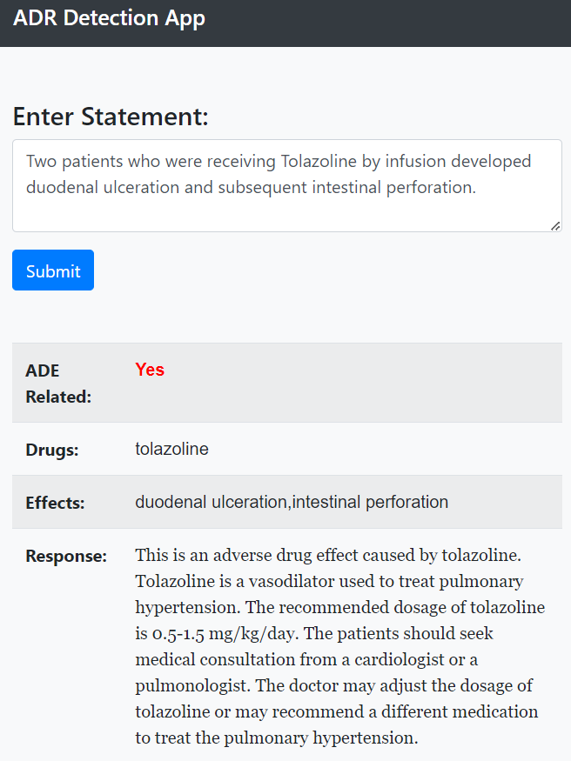
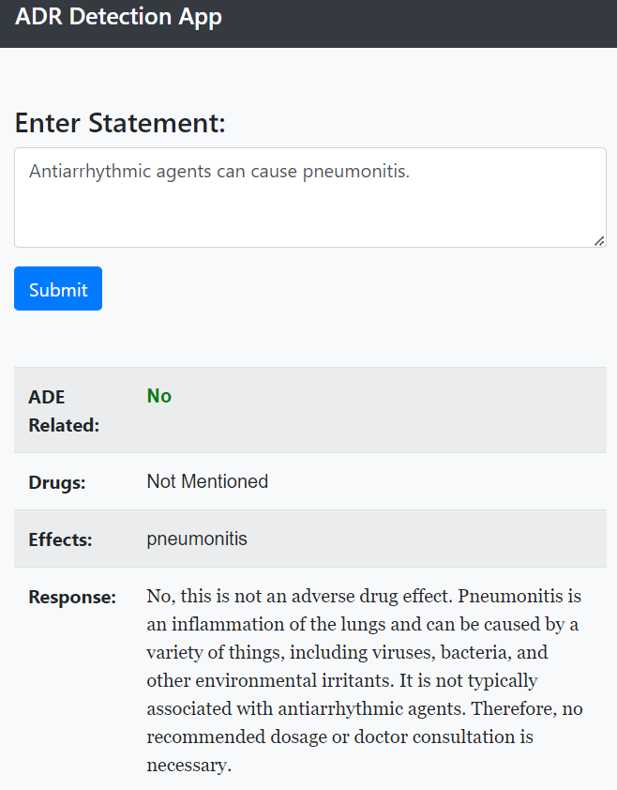
Results

Slide 14
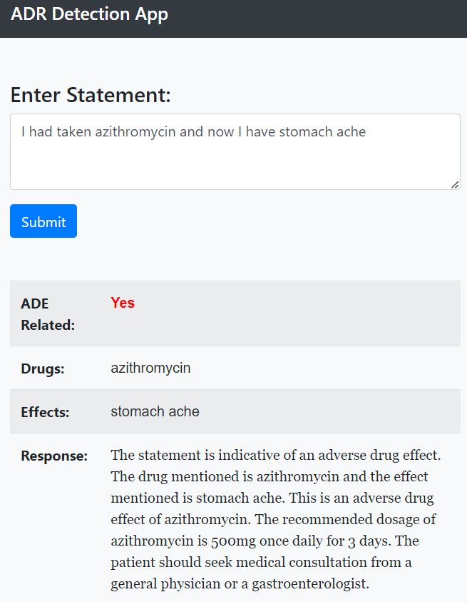
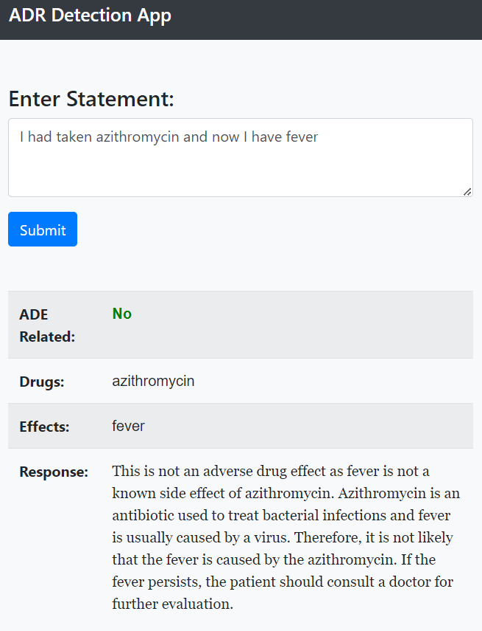
Results

Slide 15
Conclusion
This study showcases the viability of employing transformer-based models for classifying Adverse Drug Reactions (ADRs) from unstructured natural language text.
This research underscores a method capable of substantially automating the pharmacovigilance process.
Causality explanations using generative AI in pharmacovigilance streamlines the process, offering personalized, standardized, and comprehensive insights while reducing human effort and improving decision-making.
As the volume of unstructured data from social media and online forums continue to grow, there is a need for continuous development of automation to process the same.

Slide 16
References
[1] C.-S. Wang, P.-J. Lin, C.-L. Cheng, S.-H. Tai, Y.-H. Kao Yang, and J.-H. Chiang, “Detecting Potential Adverse Drug Reactions Using a Deep Neural Network Model,” J. Med. Internet Res., vol. 21, no. 2, p. e11016, Feb. 2019, doi: 10.2196/11016.
[2] F. Christopoulou, T. T. Tran, S. K. Sahu, M. Miwa, and S. Ananiadou, “Adverse drug events and medication relation extraction in electronic health records with ensemble deep learning methods,” J. Am. Med. Informatics Assoc., vol. 27, no. 1, pp. 39–46, Jan. 2020, doi: 10.1093/jamia/ocz101.
[3] I. Alimova and E. Tutubalina, “Automated Detection of Adverse Drug Reactions from Social Media Posts with Machine Learning,” 2018, pp. 3–15. doi: 10.1007/978-3-319-73013-4_1.
[4] “ade_corpus_v2 Datasets at Hugging Face.” https://huggingface.co/datasets/ade_corpus_v2/viewer/Ade_corpus_v2_classification/train (accessed May 25, 2023).
[5] “scibert_scivocab_uncased-finetuned-ner model at Hugging Face.”
https://huggingface.co/jsylee/scibert_scivocab_uncased-finetuned-ner (accessed May 25, 2023).

Slide 17
THANK YOU
Any Questions?

