Slide 1

Team Name: Radiant Ranger
Team Member: Ankan Bera
Problem Statement: Police Performance and Resource Management

Slide 2

Title
Harnessing AI and Social Media for Early Crime Detection and Efficient Personnel Management.
Problem Statement | Solution Brief
Law enforcement agencies need to gather information effectively to respond to incidents and allocate their resources. However, the existing methods of information gathering have several drawbacks. They depend on direct reports from people who witness or hears about the events, or from police personnel who communicate through internal channels. These methods are slow and inefficient, as they do not cover all the possible sources of information and analyzed manually. As a result, law enforcement agencies face challenges in planning their actions effectively. | To solve this problem, we propose to utilize social media as a source of information for law enforcement. Social media platforms generate a lot of data that can be relevant for detecting and responding to incidents, such as posts, comments, images, videos, hashtags, locations, etc. However, these data being unstructured, makes it hard to analyze and use. Therefore, we will apply AI enrichment techniques to automatically process and transform the unstructured data into structured and meaningful data points. These data points will help us create KPIs and Metrics along with an alert system that will enable law enforcement agencies with efficient resource planning and management.

Slide 3
Solution Overview
Collect posts and comments from various social media platforms regarding relevant events, through their respective web APIs
Analyze sentiments of the collected data as Positive, Negative and Neutral.
Classify the data as related to any particular relevant topic, like Crime, Accidents, Riots, etc.
Extract the named entities mentioned in the data to collect information about Location, Person, Time, etc.
Classify the severity level of the mentioned events as Low, Medium or High
Store the collected unstructured data in a data lake and transformed structured data in a centralized sql database
Develop KPIs and Metrics to be displayed in a real time dashboard which is updated continuously.
Set up rules to monitor the incoming data points and trigger alerts to concerned officials immediately.
Use the dashboard to see the real time incidents and corelate with the personnel data, to plan and deploy resources in the affected area.
Use the historical data points in the database to train custom models of your own for predictive analytics.

Slide 4
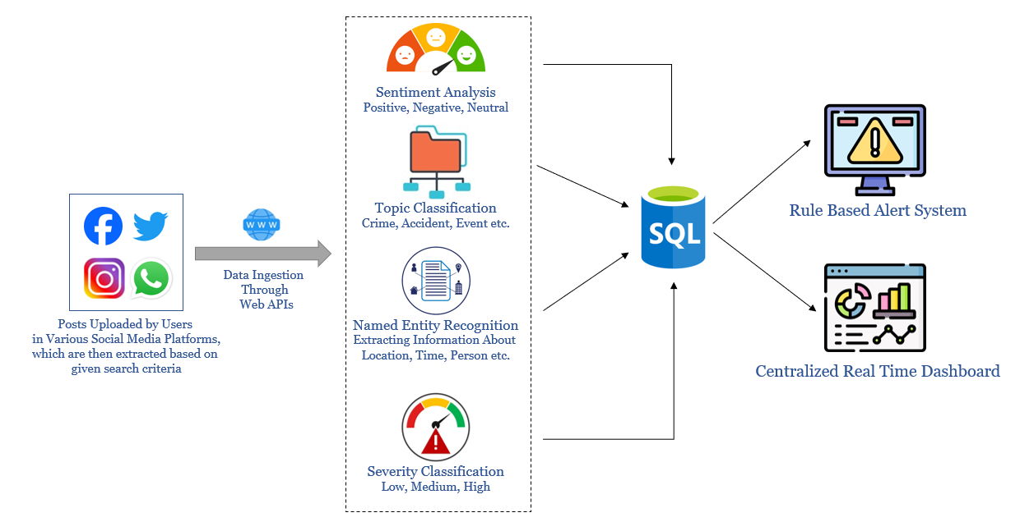
Logical Architecture
Assumption:
Police Personnel Details and Deployment
Information is already recorded in a
separate database
Ingestion
Enrichment
Storage
Visualization

Slide 5
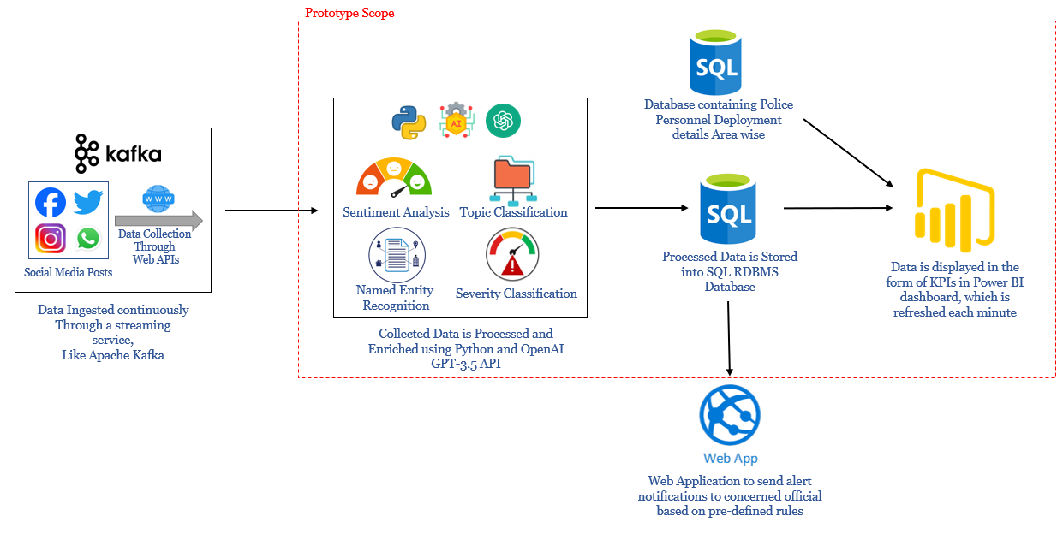
Solution Architecture

Slide 6
Prototype Details and Tech Stack

Slide 7

Benchmarking (If Any)

Slide 8
Snapshots of Final Product

Slide 9
GitHub Repository URL & Description

Slide 10
Demo Video URL
(Video should not be more than 2 Minutes)

Slide 11
Additional Details

Slide 12
Summary

Slide 13


