Slide 1
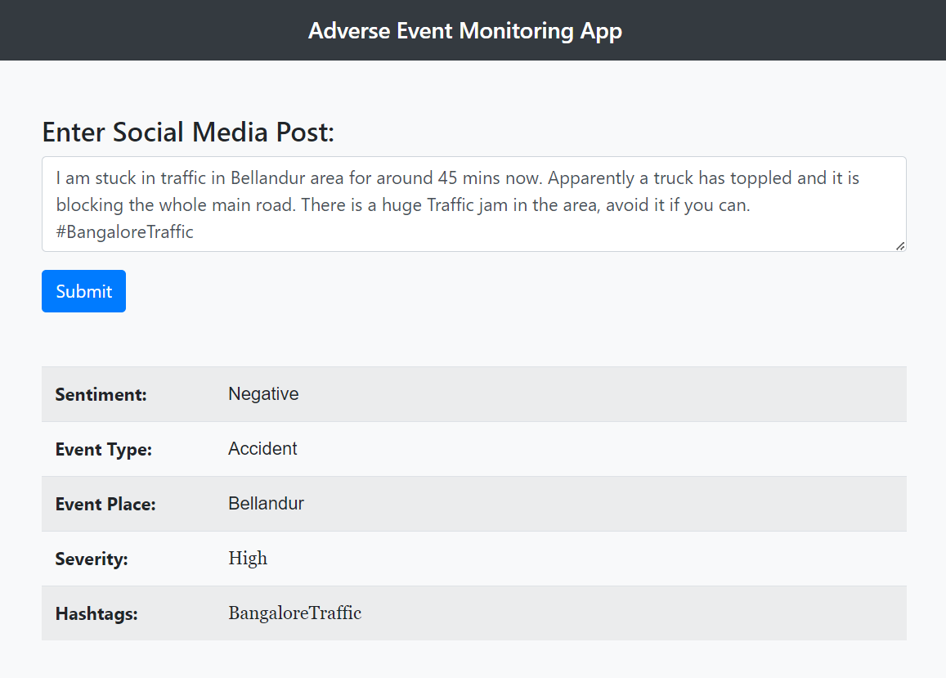
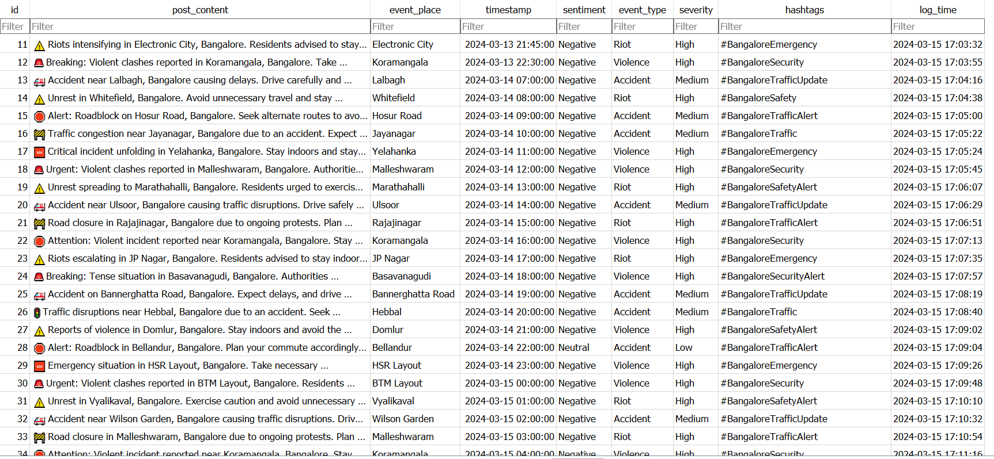
Data Collected From Each Social Media Post
From a social media posts, we are extracting the Sentiment, Event Type (Accident, Riot, Violence), Event Place, Severity Level information with our AI based application. (on left)
These data is then stored in to a database table (on right) for analysis and visualization purposes. It will be updated periodically with few minutes interval.

Slide 2
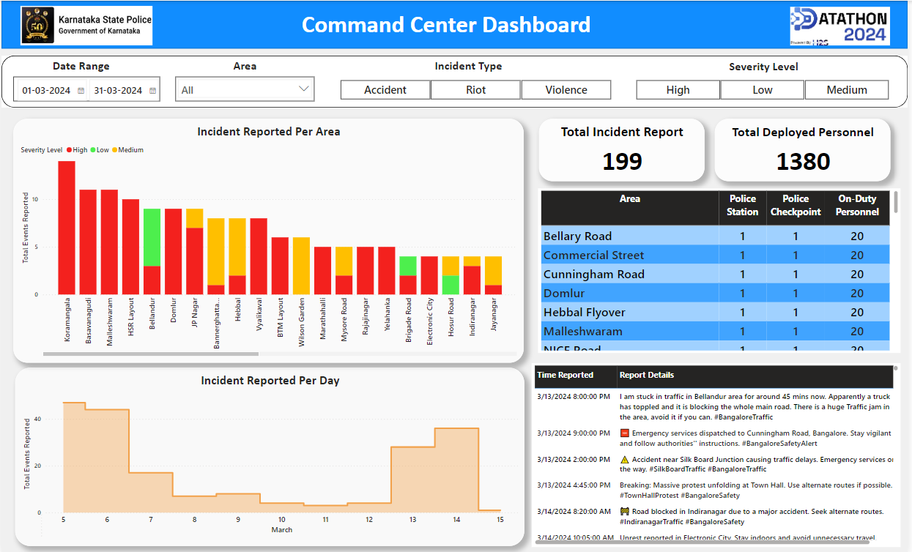
Power BI Dashboard for Data Visualization and Monitoring
This Bar Chart shows area-wise how many incident reports we have collected from social media.
The more people will get affected by an incident, the more reports of that incidence will be posted in social media.
Those areas will automatically come to the top of our Bar Chart, pulling our attention towards that area.
The number of police personnel deployed in an Area, in terms of total police stations, police checkpoints, and total personnel on duty at a time.
The actual social media posts which have been collected and processed is displayed here for reference.

Slide 3
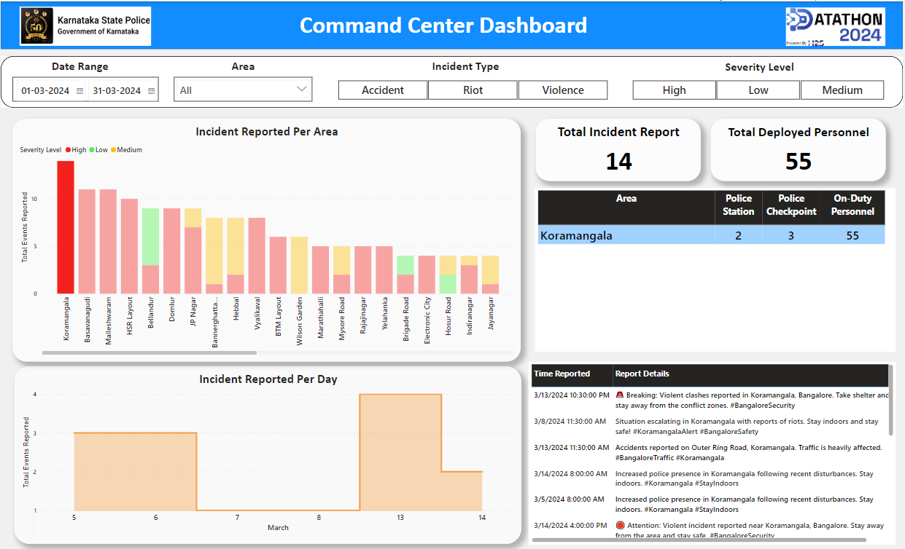
Monitor Critical Incidents and Resource Available
When you click on an area name in the Bar chart, it shows you how many reports we have come across about various incidences in that area.
You can also see how many police personnel are deployed in that area.
Based on this information, authorities can plan for proper resource deployment in the concerned area.

Slide 4
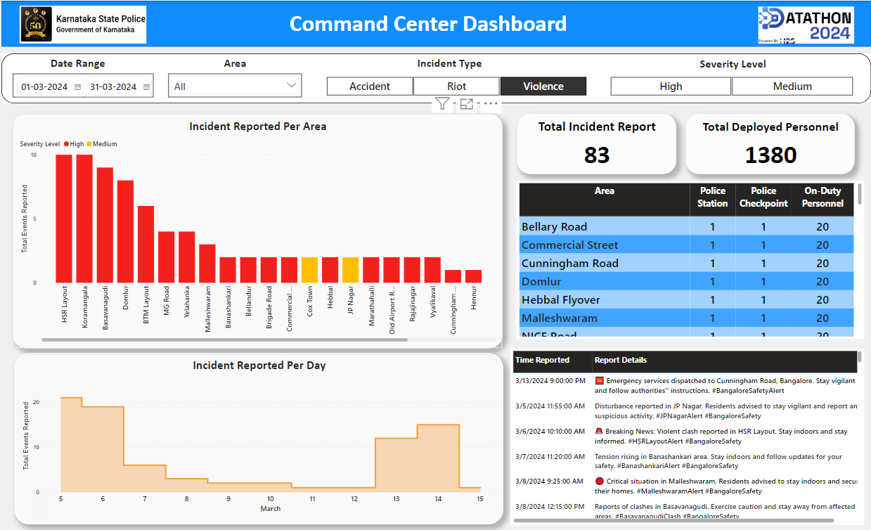
You can apply the filters as per your requirements to set your visualization, in order to monitor specific kinds of incidence reports.

