Slide 1
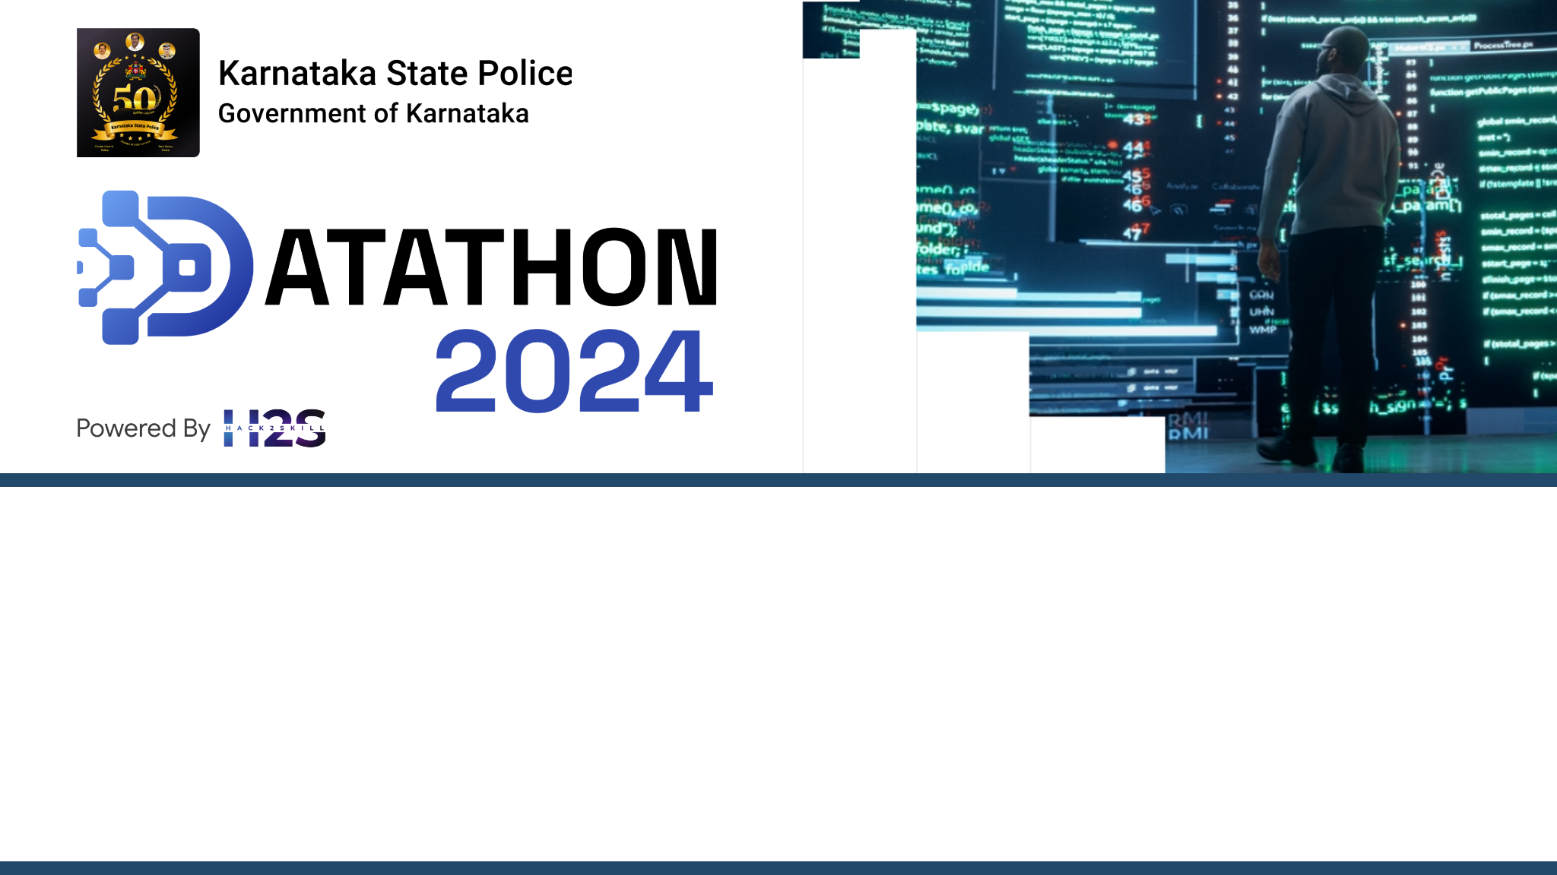
Team Name: Radiant Ranger
Team Member: Ankan Bera
Problem Statement: Police Performance and Resource Management

Slide 2

Title
Harnessing AI and Social Media for Early Crime Detection and Efficient Personnel Management.
Problem Statement | Solution Brief
Law enforcement agencies need to gather information effectively to respond to incidents and allocate their resources. However, the existing methods of information gathering have several drawbacks. They depend on direct reports from people who witness or hears about the events, or from police personnel who communicate through internal channels. These methods are slow and inefficient, as they do not cover all the possible sources of information and analyzed manually. As a result, law enforcement agencies face challenges in planning their actions effectively. | To solve this problem, we propose to utilize social media as a source of information for law enforcement. Social media platforms generate a lot of data that can be relevant for detecting and responding to incidents, such as posts, comments, images, videos, hashtags, locations, etc. However, these data being unstructured, makes it hard to analyze and use. Therefore, we will apply AI enrichment techniques to automatically process and transform the unstructured data into structured and meaningful data points. These data points will help us create KPIs and Metrics along with an alert system that will enable law enforcement agencies with efficient resource planning and management.

Slide 3
Solution Overview
Collect posts and comments from various social media platforms regarding relevant events, through their respective web APIs
Analyze sentiments of the collected data as Positive, Negative and Neutral.
Classify the data as related to any particular relevant topic, like Crime, Accidents, Riots, etc.
Extract the named entities mentioned in the data to collect information about Location, Person, Time, etc.
Classify the severity level of the mentioned events as Low, Medium or High
Store the collected unstructured data in a data lake and transformed structured data in a centralized sql database
Develop KPIs and Metrics to be displayed in a real time dashboard which is updated continuously.
Set up rules to monitor the incoming data points and trigger alerts to concerned officials immediately.
Use the dashboard to see the real time incidents and corelate with the personnel data, to plan and deploy resources in the affected area.
Use the historical data points in the database to train custom models of your own for predictive analytics.

Slide 4
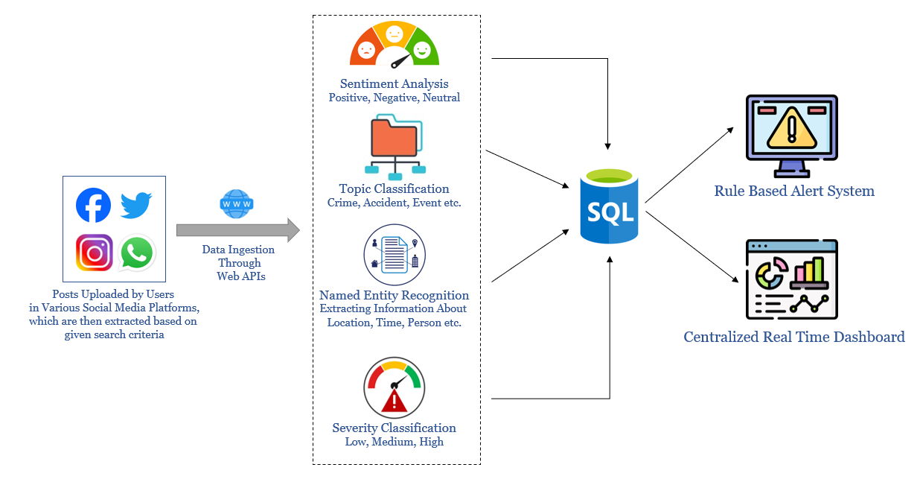
Logical Architecture
Assumption:
Police Personnel Details and Deployment
Information is already recorded in a
separate database
Ingestion
Enrichment
Storage
Visualization

Slide 5
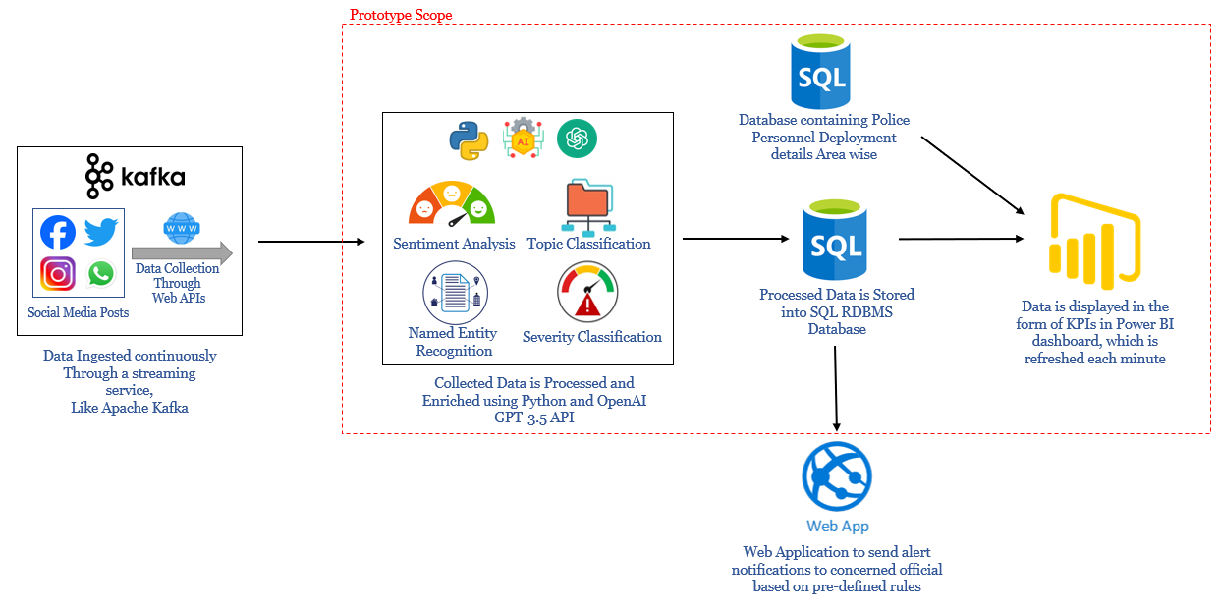
Solution Architecture

Slide 6
Prototype Details and Tech Stack
To implement the Prototype, Sample source data have been generated by AI, which mimics any real life social media post.
The source data is then processed with OpenAI GPT-3.5 API to extract relevant information from them and stored in a local database.
That data is being displayed in a Power BI dashboard in the form of useful and relevant KPIs.
Additional data regarding Police personnel details have also been generated by AI to display in the dashboard.
The whole data processing steps are automated using python programming and the corresponding codes are shared in the GitHub repository.
While the prototype have been developed using OpenAI API services, it can be easily replaced by any open source language model, provided the relevant data sets are available for training the models.
As the social media APIs are a paid service and no no-cost options are available, the data ingestion process though Kafka streaming couldn’t be implemented in the prototype phase, but it will be a crucial part of the final product implementation.

Slide 7


Future Scope/Scale Up Plan
Serverless Deployment
Deploy the Application in a Cloud Platform to Handle Increasing Volume of Data Seamlessly Without Infra Management
Enhanced Analytics Dashboard
Add/Modify Additional KPIs to enhance the Analysis Capability of the Dashboard
Enhanced Data Extraction Rules
Identify and Extract Additional Information from the SM Posts to Enable Improved Analysis
Additional Language Support
Including Support for Regional Languages to Analyze Larger number of Posts

Slide 8
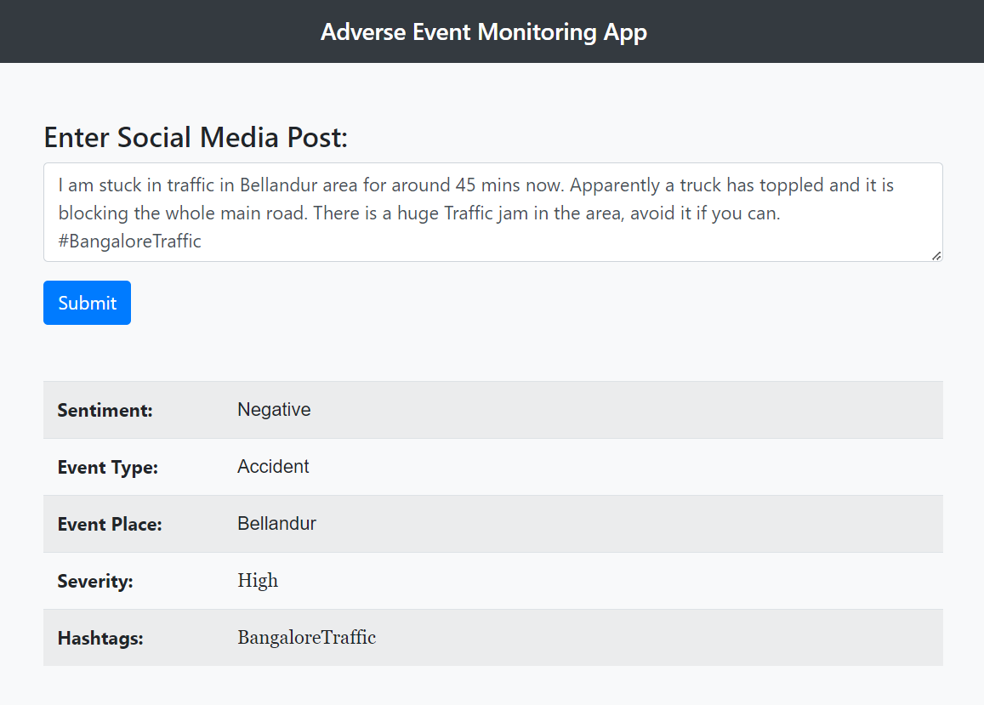
Snapshots of Final Product
This app demonstrates what kind of information are being extracted from each social media posts using AI

Slide 9
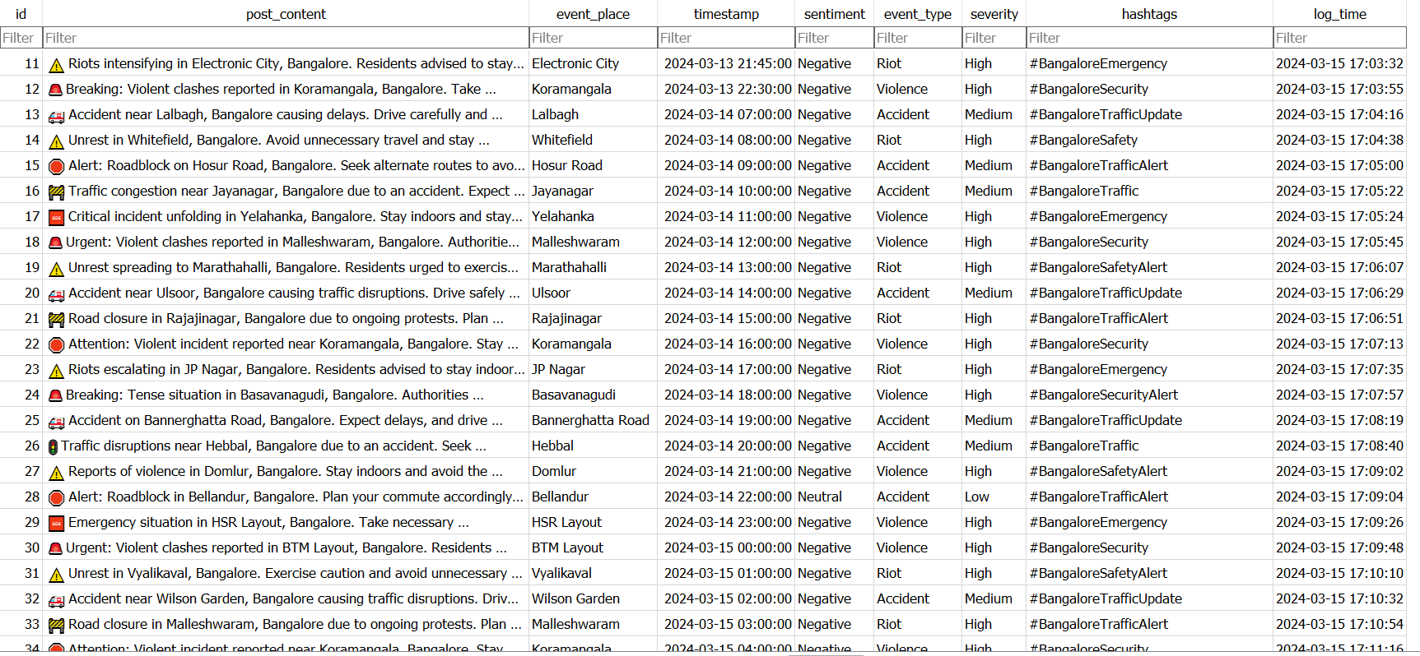
Snapshots of Final Product
This is the database where all the processed data is being stored for analysis. It contains the actual text of the SM post, it’s time and other
Information

Slide 10
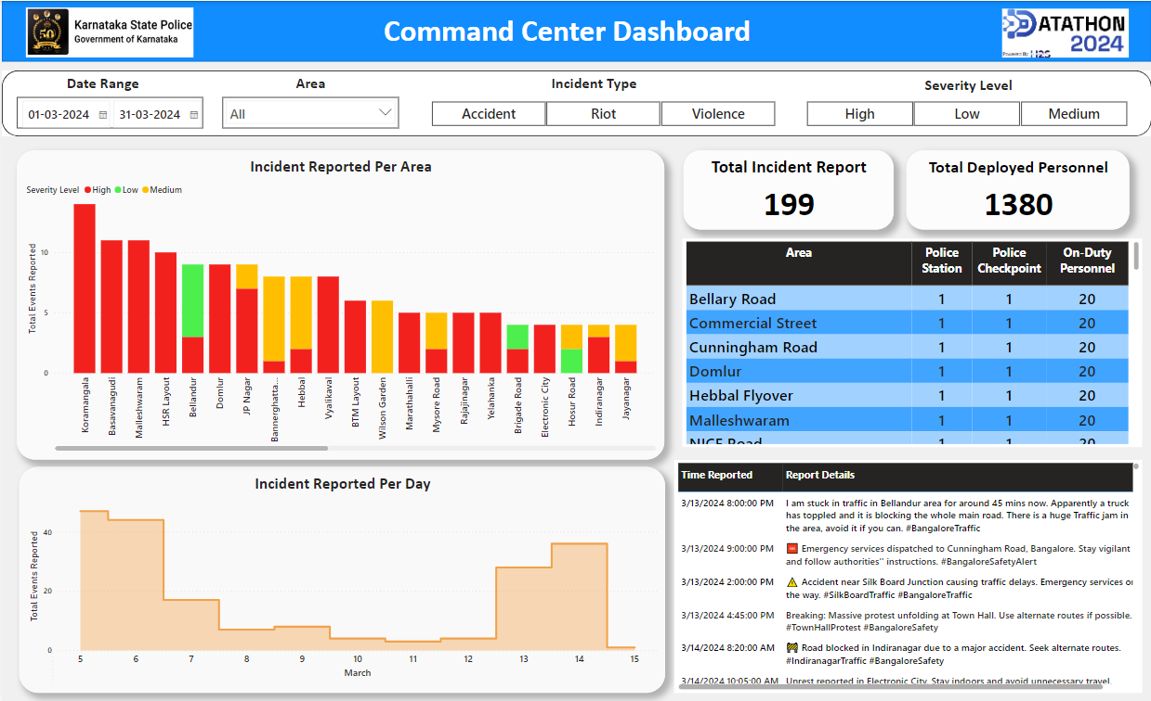
Snapshots of Final Product
Power BI dashboard to display the
Processed data in form of KPIs for easy analysis

Slide 11
GitHub Repository URL & Description
https://github.com/Ankan54/ksp-hackathon-radiant-ranger
Demo Video URL
(Video should not be more than 2 Minutes)
https://drive.google.com/file/d/1TRsYCmJyxMHgJmRTN_94RPCixIQtjIiX/view?usp=drive_link

Slide 12
Value Proposition
The solution enables law enforcement agencies to gather and analyze large amounts of data automatically.
The solution uses machine learning and real time data analysis to identify the locations, types, and severity of disturbances. It also correlates this data with the data of deployed and available personnel. This helps law enforcement agencies plan how to deploy their personnel effectively and control the situation as soon as possible.
This solution also helps law enforcement agencies control and mitigate fake news on social media by automatically identifying the trending topics.
Moreover, the data collected by the system will enable the agencies to train their own custom models for predictive analytics purposes.
By using this solution, law enforcement agencies can act proactively even before complaints reach them, and thus build trust with the public.

Slide 13




Our Edge / Uniqueness
Relevant information are gathered through crowdsourcing, and automated processes extract meaningful insights from unstructured source data
The solution is designed using open-source technology, which means it can be easily developed and modified as per future requirements, and can be deployed both in cloud or on-prem server as well.
The solution architecture is modular and service-oriented, each module can be modified and upgraded without disturbing the rest of the processes.
This solution grants users full control and ownership of their data, enabling its use for both diagnostic and predictive analytics in the future.

Slide 14


