Slide 1
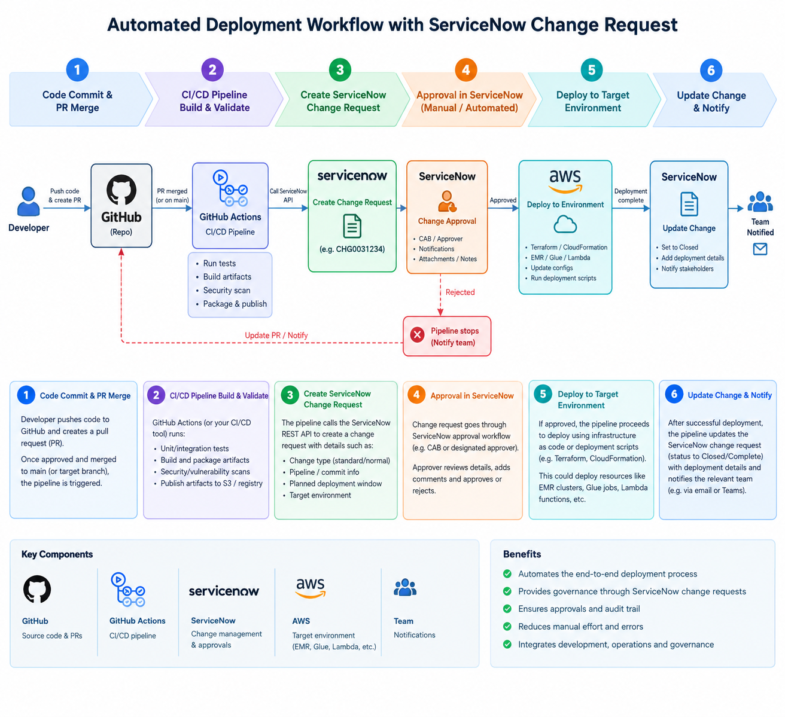
Automated deployment with ServiceNow change control
01
A governed path from code change to production — with an auditable approval gate.
1 / 3

Slide 2
How the workflow works
02
The pipeline orchestrates the release; ServiceNow remains the system of record for change governance.
01
02
03
04
Commit & validate
Create change (CHG)
Approval gate
Deploy & reconcile
• PR merged to an approved branch
• GitHub Actions calls ServiceNow REST API
• Wait for an approved status / approval event
• Assume a scoped AWS deployment role
• Run unit/integration tests, lint and security scans
• Attach release, commit SHA, target, window and risk
• Verify CHG is approved and within its window
• Apply Terraform or release application assets
• Build immutable, versioned artifacts
• Include implementation, test and backout plans
• Rejected, expired or unavailable → fail closed
• Write outcome/evidence back; close or escalate
If approved
Deployment proceeds only for the approved scope and window.
If rejected / deployment fails
Stop or fail the pipeline, notify owners, preserve evidence and follow rollback/incident policy.
Control principle: approval is enforced by the pipeline, not inferred from a notification or a manually updated ticket.
2 / 3

Slide 3
How we build it — and where Devin fits
03
Build a reusable, policy-controlled workflow once; let teams supply configuration rather than reinventing the integration.
BUILD PLAN
1. Define the contract
Agree CHG fields, approval states, standard vs normal change rules, deployment window and failure handling.
2. Implement reusable GitHub workflow
Create a centrally maintained reusable workflow/action: validate → create CHG → wait/check approval → deploy → update CHG.
3. Integrate securely
Use approved secrets/OIDC patterns, least-privilege ServiceNow integration identity and scoped AWS roles. Never put credentials in repo code.
4. Pilot and operationalise
Test approved/rejected/timeout/API failure/deploy failure paths in non-prod; publish runbook, audit evidence and support ownership.
WHERE DEVIN / AI HELPS
Generate the first draft
Scaffold reusable YAML workflows, ServiceNow API client code, Terraform validation and test fixtures from an approved skill/spec.
Review and improve
Analyse logs, identify failed edge cases, propose fixes and generate unit/integration tests and documentation.
Maintain the workflow
Help update templates when API fields, policy rules or AWS deployment modules change; prepare PRs for human review.
GUARDRAILS — AI DOES NOT APPROVE OR DEPLOY BY ITSELF
• No production credentials or direct approval authority for Devin
• Generated changes go through PR review, tests and policy checks
• ServiceNow remains the approval record; deterministic workflow enforces the gate
Suggested MVP: one non-production repo + one deployment type + one CHG template + explicit approval polling + full success/failure audit trail.
3 / 3

