Slide 1
Apache Iceberg: Schema Evolution & Versioning
Modern Data Lakehouse Table Format

Slide 2
Introduction
What is Apache Iceberg?
Key Features:
• ACID transactions
• Hidden partitioning
• Schema & evolution support
• Time travel

Slide 3
Schema Evolution in Iceberg
Schema changes supported:
• Add / Drop / Rename columns without rewrite
• Backward / Forward compatibility
• Example: Add column 'risk_score'
• Example: Rename 'dob' → 'date_of_birth'

Slide 4
Versioning & Snapshots
Each write creates a new snapshot:
• Snapshots = table state at a point in time
• Queries can reference current or past versions

Slide 5
Time Travel Queries
Query historical versions:
Example:
SELECT * FROM loans VERSION AS OF '2024-08-01';
• Enables auditing & rollback
• Compare old vs new data

Slide 6
Metadata Structure
Iceberg metadata includes:
• Manifest files
• Snapshot log
• Metadata.json

Slide 7
Comparison with Athena Parquet Table
Parquet + Glue Catalog:
• Limited schema evolution
• Requires schema sync manually
Apache Iceberg:
• Robust schema + versioning
• Supports rename, delete, time travel

Slide 8
Best Practices
Recommendations:
• Keep snapshot retention policy (e.g. last 90 days)
• Use tags/refs for important versions
• Automate schema changes with governance

Slide 9
Conclusion
Apache Iceberg provides:
• Simplified schema evolution
• Reliable versioning with snapshots
• Foundation for a true Data Lakehouse

Slide 10
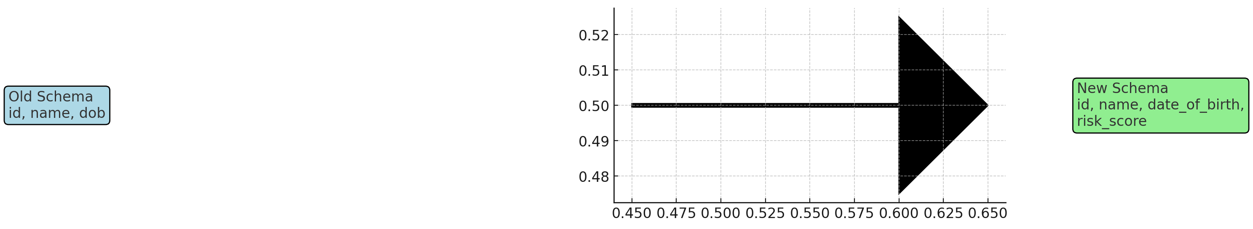
Schema Evolution in Iceberg (Diagram)

Slide 11
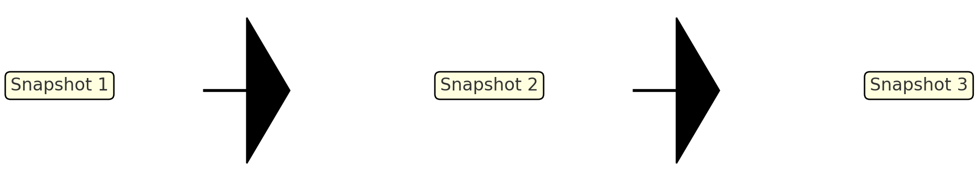
Versioning & Snapshots (Diagram)

Slide 12
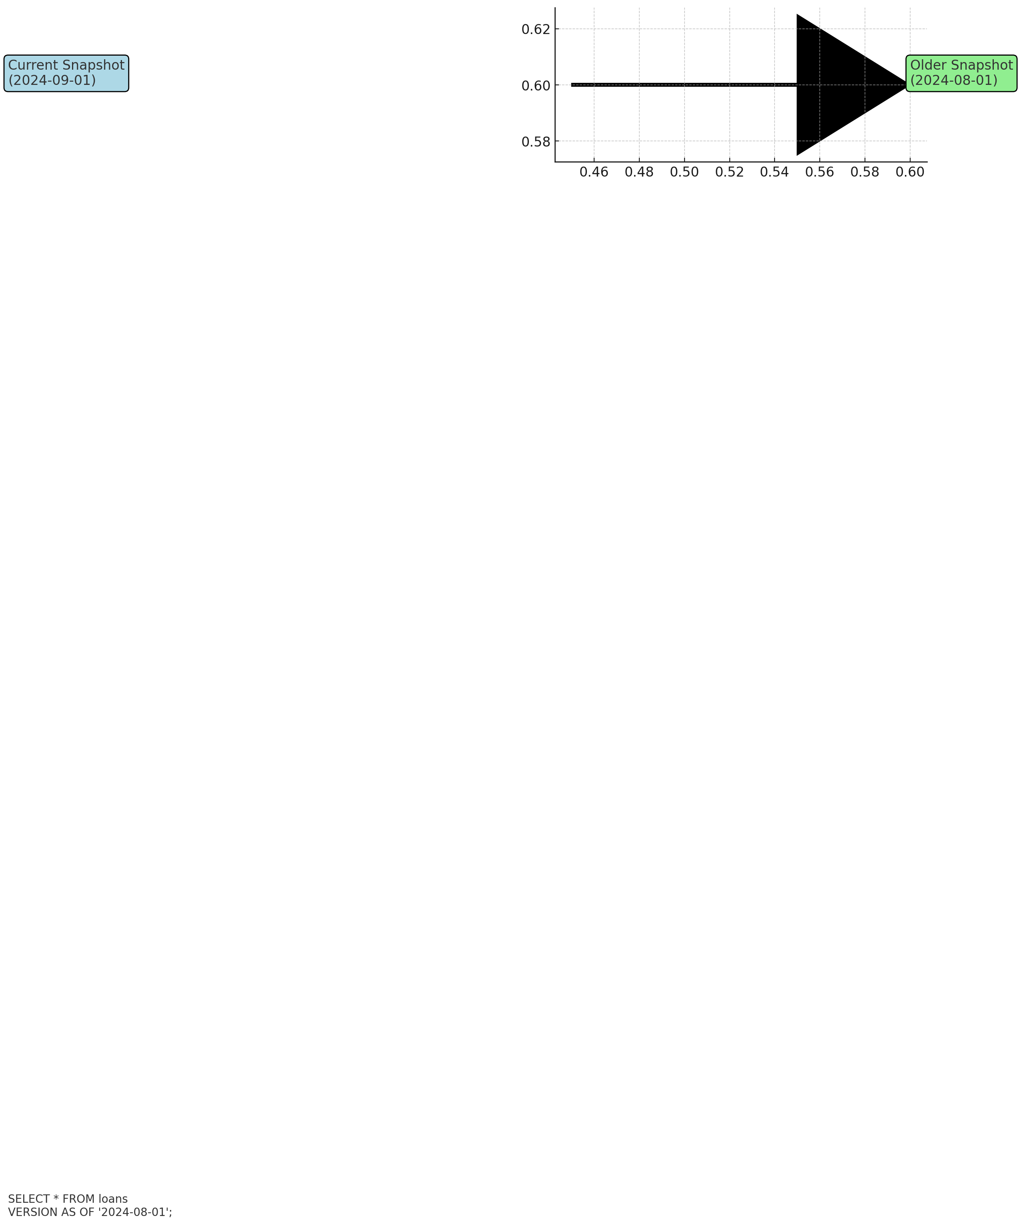
Time Travel Queries (Diagram)

Slide 13
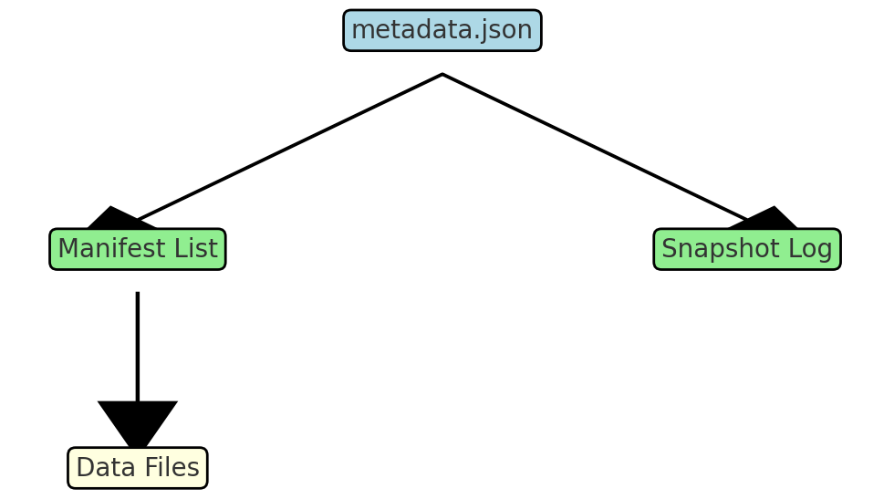
Metadata Structure (Diagram)

Slide 14
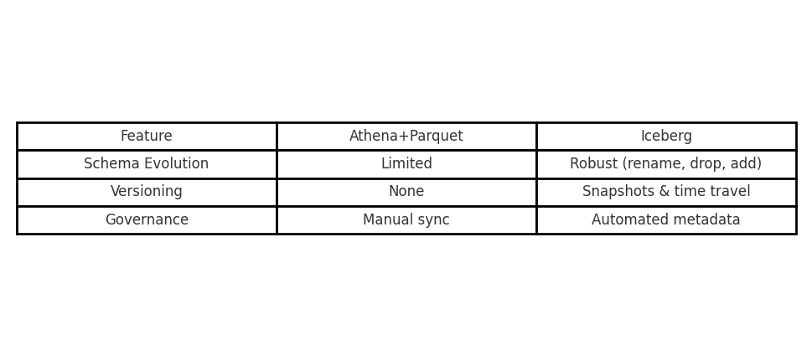
Comparison with Athena Parquet Table (Diagram)

Slide 15
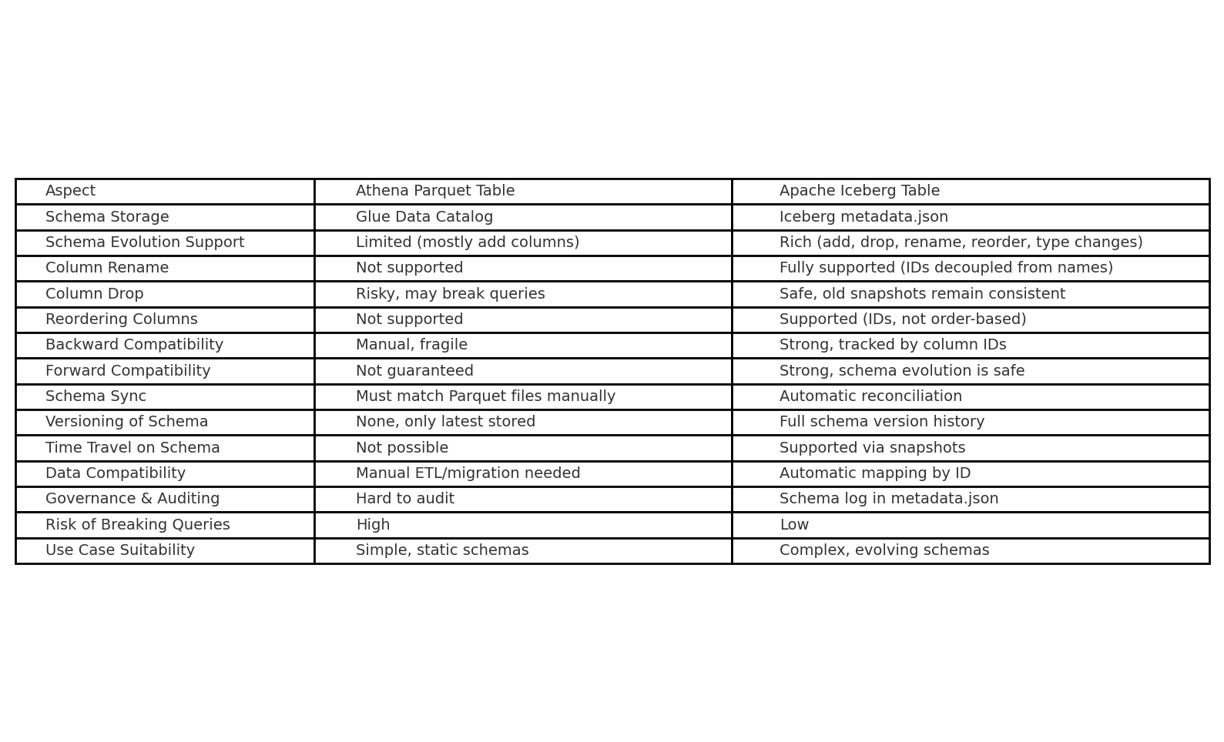
Detailed Comparison: Athena Parquet vs Iceberg (Schema Versioning)

