Slide 1
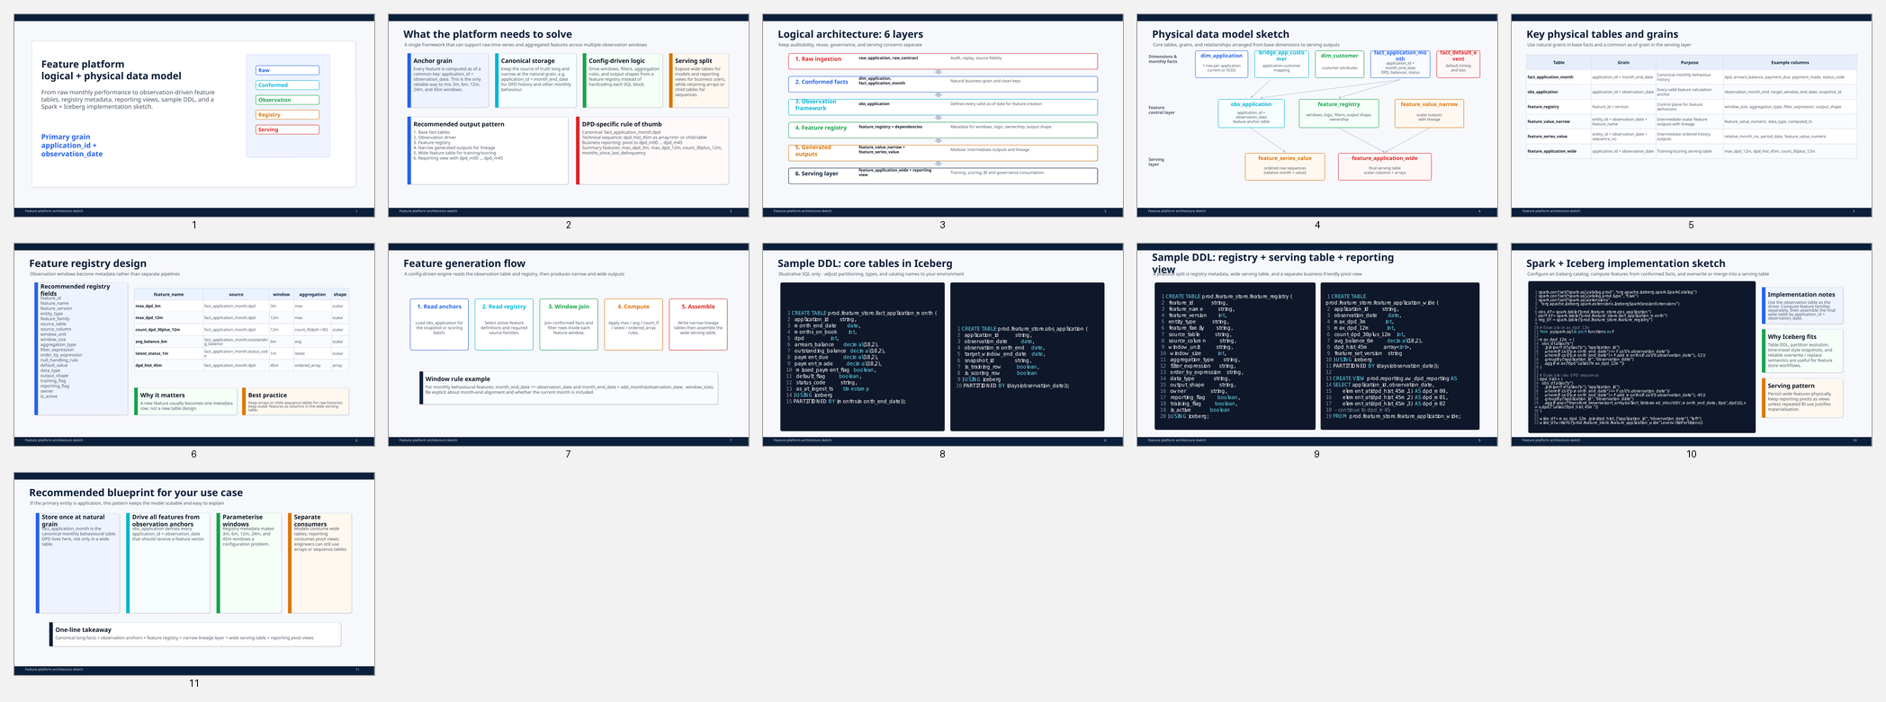
Feature Platform
Logical Model, Physical Model, DDL and Spark Iceberg Sketch
Covers the path from raw ingestion to conformed monthly facts, observation anchors, feature registry, generated feature values, wide serving tables, reporting views, and implementation patterns for Spark + Iceberg.
Recommended serving pattern
Canonical storage: long monthly fact tables
Computation driver: application_id + observation_date
Control plane: feature registry with window and aggregation metadata
Serving: wide feature table plus optional reporting pivots
1

Slide 2
Logical architecture from raw to serving
Each layer has a single responsibility and a clear grain.
1. Raw ingestion
Source-aligned landing tables. Preserve source payload, batch IDs, replayability and audit history.
↓
2. Standardised base facts
Conformed application, contract and monthly performance facts with typed columns and business keys.
↓
3. Observation framework
One row per application and observation date. Drives all lookback logic.
↓
4. Feature registry
Metadata defining source, window, aggregation, ordering, output type and owner.
↓
5. Feature computation
Generated narrow values and optional sequence outputs used to assemble final serving tables.
↓
6. Serving and reporting
Wide application feature table, arrays for sequences, and business-friendly reporting views.
2

Slide 3
Sample logical data model diagram
Primary entity shown at application grain with customer and contract support.
dim_application
bridge_application_customer
feature_registry
One current or SCD2 row per application.
Maps joint applications to one or many customers.
Feature metadata: source, window, filter, aggregation, output shape and owner.
feature_application_wide
Model-serving table keyed by application_id + observation_date.
dim_customer
fact_application_month
Current or historised customer attributes.
feature_value_narrow
application_id + month_end_date
DPD, balances, arrears, payments, status.
entity_id + observation_date + feature_name
Auditable generated values.
fact_contract_month
vw_feature_application_reporting
Contract monthly balances and delinquency.
Wide reporting view with dpd_m00...dpd_m45 and summary metrics.
obs_application
application_id + observation_date
Driver of feature calculation.
Feature engine joins observation rows to base facts, filters by lookback window, applies registry rules, and assembles wide serving outputs.
3

Slide 4
Physical data model by layer
Suggested core tables and their grains.
Raw and conformed base tables
Observation and control plane
Generated and serving outputs
raw_application
raw_contract
raw_monthly_performance
dim_application
bridge_application_customer
dim_customer
fact_application_month
fact_contract_month
fact_default_event
obs_application
• application_id + observation_date
feature_registry
feature_registry_dependency
feature_registry_tag
feature_value_narrow
feature_series_value
feature_application_wide
vw_feature_application_reporting
Recommended key grains
Recommended DPD representations
fact_application_month: application_id + month_end_date
obs_application: application_id + observation_date
feature_value_narrow: entity_id + observation_date + feature_name
feature_series_value: entity_id + observation_date + feature_name + sequence_no
feature_application_wide: application_id + observation_date
Canonical: fact_application_month.dpd
Technical serving: feature_application_wide.dpd_hist_45m as array<int>
Business reporting: vw_feature_application_reporting.dpd_m00 to dpd_m45
Summary metrics: max_dpd_3m, max_dpd_12m, count_dpd_30plus_12m, months_since_last_delinquency
4

Slide 5
Feature registry design
Control feature generation using metadata rather than hand-coded tables.
Core registry fields
Example registry entries
feature_id
feature_name
feature_version
entity_type
feature_family
source_table
source_column
window_unit
window_size
aggregation_type
filter_expression
order_by_expression
null_handling_rule
default_value
data_type
output_shape
serving_layer_flag
reporting_flag
owner
valid_from_date
is_active
max_dpd_3m → source fact_application_month.dpd, window 3, aggregation max, output scalar
count_dpd_30plus_12m → source fact_application_month.dpd, window 12, aggregation count_if, filter dpd >= 30
dpd_hist_45m → source fact_application_month.dpd, window 45, aggregation array, order month_end_date desc, output array
avg_balance_6m → source fact_application_month.outstanding_balance, window 6, aggregation avg
How the engine uses it
1. Read obs_application
2. Read active feature definitions
3. Join entity facts to each observation row
4. Apply the feature window, for example month_end_date <= observation_date and month_end_date > add_months(observation_date, -window_size)
5. Aggregate or collect ordered sequences
6. Write narrow values, then assemble wide serving outputs
5

Slide 6
Sample DDL sketch
Illustrative Iceberg tables for observation anchors, monthly facts and serving tables.
CREATE TABLE risk.fact_application_month (
application_id string,
month_end_date date,
months_on_book int,
dpd int,
arrears_balance decimal(18,2),
outstanding_balance decimal(18,2),
payment_due decimal(18,2),
payment_made decimal(18,2),
missed_payment_flag boolean,
default_flag boolean,
status_code string
) USING iceberg
PARTITIONED BY (months(month_end_date));
CREATE TABLE risk.obs_application (
application_id string,
observation_date date,
model_segment string,
is_training_row boolean,
snapshot_id string
) USING iceberg
PARTITIONED BY (months(observation_date));
CREATE TABLE risk.feature_application_wide (
application_id string,
observation_date date,
max_dpd_3m int,
max_dpd_12m int,
count_dpd_30plus_12m int,
dpd_hist_45m array<int>,
feature_set_version string
) USING iceberg
PARTITIONED BY (months(observation_date));
6

Slide 7
Spark + Iceberg implementation sketch
Observation-driven generation for aggregate and sequence features.
from pyspark.sql import functions as F
obs = spark.table('risk.obs_application')
perf = spark.table('risk.fact_application_month')
base = (obs.alias('o')
.join(perf.alias('p'), 'application_id')
.where(F.col('p.month_end_date') <= F.col('o.observation_date')))
# 12 month aggregate example
dpd_12m = (base
.where(F.col('p.month_end_date') > F.add_months(F.col('o.observation_date'), -12))
.groupBy('application_id', 'observation_date')
.agg(
F.max('dpd').alias('max_dpd_12m'),
F.sum(F.when(F.col('dpd') >= 30, 1).otherwise(0)).alias('count_dpd_30plus_12m')
))
# 45 month ordered sequence example
dpd_45m = (base
.where(F.col('p.month_end_date') > F.add_months(F.col('o.observation_date'), -45))
.groupBy('application_id', 'observation_date')
.agg(F.expr("transform(array_sort(collect_list(named_struct('m', month_end_date, 'v', dpd))), x -> x.v)").alias('dpd_hist_45m')))
final_df = (dpd_12m.join(dpd_45m, ['application_id','observation_date'], 'left')
.withColumn('feature_set_version', F.lit('v1')))
(final_df.writeTo('risk.feature_application_wide')
.overwritePartitions())
7

Slide 8
Reporting view and delivery options
Use different shapes for different consumers.
Recommended serving outputs
Reporting view shape
Why this split works
1. feature_application_wide for training and scoring
2. feature_series_value if consumers prefer row-based sequences
3. vw_feature_application_reporting for business review and dashboards
4. Narrow auditable values for lineage and debugging
application_id
observation_date
dpd_m00 ... dpd_m45
max_dpd_3m
max_dpd_12m
count_dpd_30plus_12m
months_since_last_delinquency
Long base facts stay scalable.
Registry keeps logic consistent.
Wide serving tables are model-friendly.
Reporting views remain simple for analysts and BI tools.
Implementation summary
Store canonical monthly performance in fact tables.
Drive every feature off application_id plus observation_date.
Parameterise windows and aggregations in the registry.
Generate narrow values first, then assemble wide outputs.
Expose arrays for technical sequences and pivots for reporting.
Best default for DPD
Canonical: long
Technical: array<int>
Reporting: dpd_m00 to dpd_m45
8

