Slide 1
Athena: Parquet vs Iceberg
Schema Upgrades • Statistics • Evolution • Time Travel

Slide 2
Schema Upgrades in Athena Tables
- Add column: supported (old files return NULL)
- Rename / Drop / Type change: limited; often need new table/ETL
- Partition management is manual
- Iceberg provides richer schema evolution

Slide 3
Schema vs Parquet Field Names
- Case-insensitive, but names preserved
- Extra Athena cols → NULL; Extra Parquet cols → ignored
- Nested fields need exact match
- Types must be compatible

Slide 4
Parquet vs Iceberg – Pros & Cons
Parquet:
- Simple, cheap, append-only
- Limited schema changes
- No ACID, no time travel
Iceberg:
- Full schema evolution
- ACID & concurrent writes
- Snapshots & time travel
- Smarter pruning

Slide 5
Parquet Statistics in Athena
- Uses Parquet footer stats (min/max, nulls)
- Row group pruning works for num/string/timestamp
- Efficiency depends on row group size
- Iceberg adds file-level metadata pruning

Slide 6
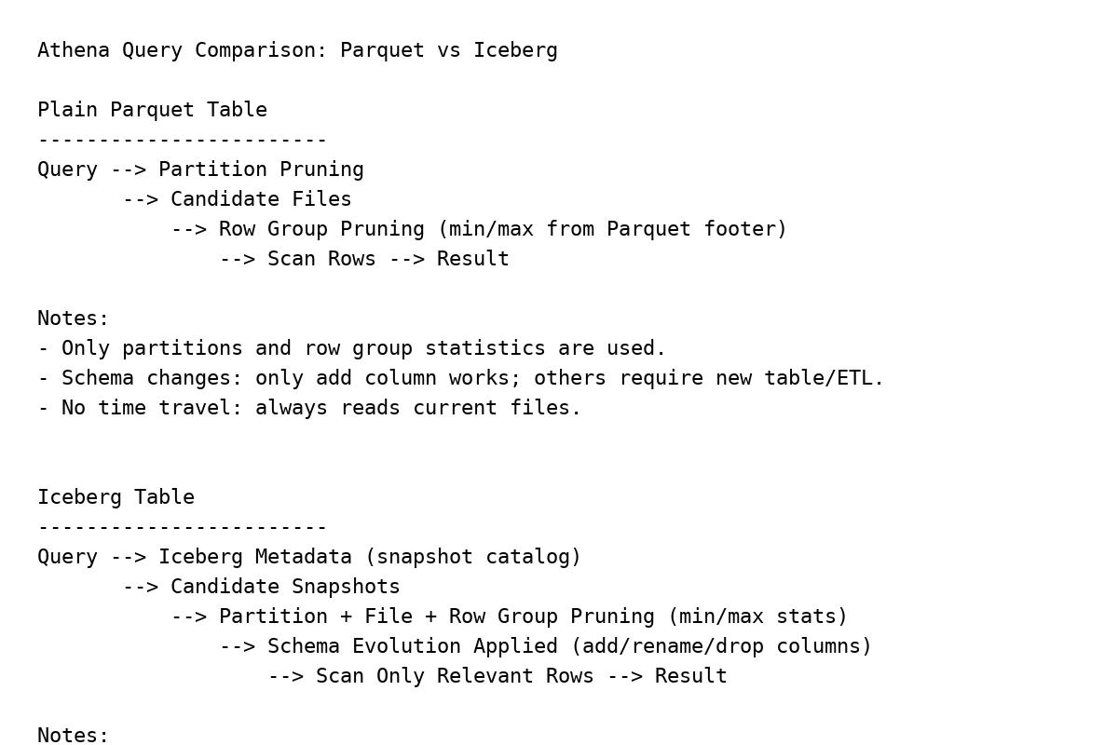
Query Flow: Parquet vs Iceberg

Slide 7
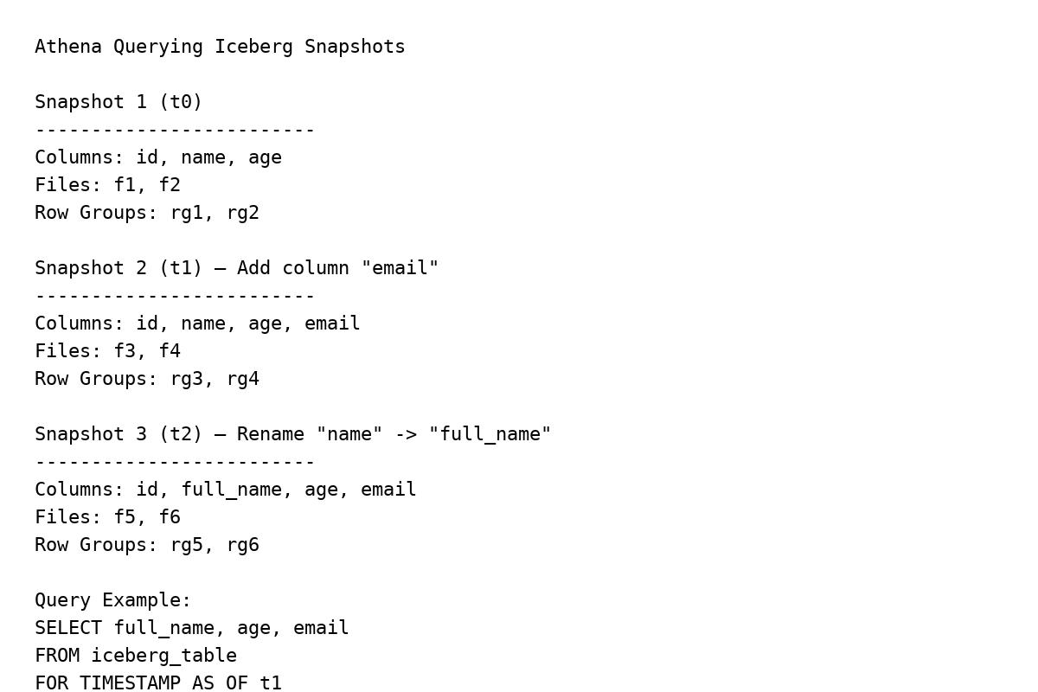
Iceberg Snapshots & Schema Evolution

Slide 8
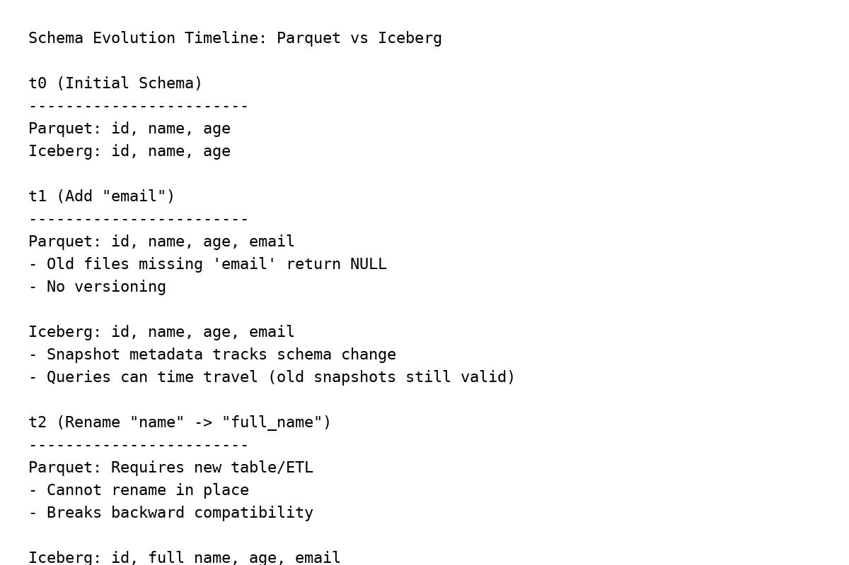
Schema Evolution Timeline: Parquet vs Iceberg

Slide 9
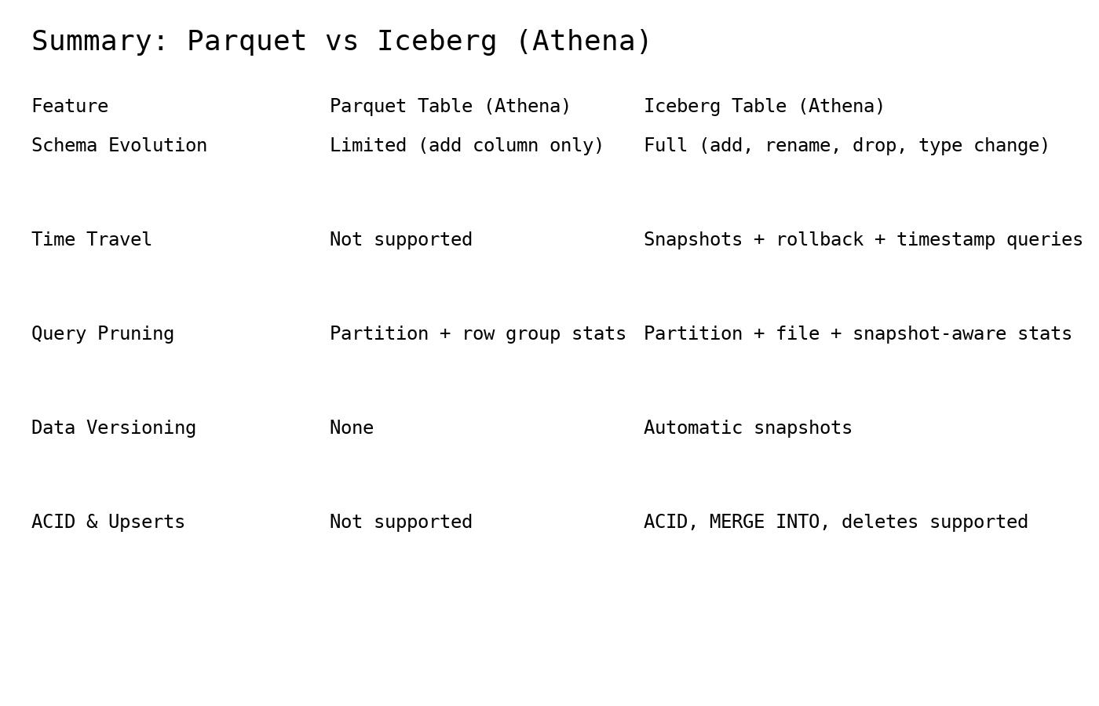
Summary Comparison

