Slide 1


ElectroMart
Modern E-Commerce Web Application
Built with React.js · Redux Toolkit · Vite · Razorpay
LIVE DEMO AVAILABLE
OPEN SOURCE ON GITHUB
Developer: Ankani Balaji · Role: Frontend Developer (React)
Speaker Notes: ElectroMart is a production-grade e-commerce web application I built to demonstrate modern frontend engineering skills. It features a complete user shopping experience — product browsing, cart management, wishlist, checkout, and Razorpay payment integration — all backed by a Redux-powered state architecture. The live demo is deployed on Vercel, and the full source code is available on GitHub. I'll walk you through the architecture, key features, and technical decisions in this presentation.
Notes:
1

Slide 2

Project Overview
The Problem
Many e-commerce platforms suffer from slow performance, poor state management, and fragmented user experiences — especially on mobile devices.
The Solution
ElectroMart delivers a fast, responsive, and intuitive shopping experience with a clean architecture built for scalability and maintainability.
Core Objectives
Seamless product discovery and filtering
Robust cart and wishlist management
Secure authentication and payment flow
Production-ready, scalable codebase
Speaker Notes: I built ElectroMart to solve real pain points I observed in existing e-commerce platforms — slow load times, inconsistent state management, and poor mobile experiences. The project demonstrates my ability to architect a complete shopping flow with proper state management using Redux Toolkit, RESTful API integration via Axios, and a responsive UI. Every feature — from product search to payment — was designed with scalability and user experience in mind.
Notes:
2

Slide 3






Key Features
A complete shopping experience — from discovery to checkout.
User Module
Smart Cart
Registration, login, protected routes, and personalized dashboards.
Persistent cart with quantity controls and real-time total calculation.
Wishlist
Razorpay Payment
Save favorite products with instant Redux-synced toggling.
Test-mode payment gateway with success callbacks and order confirmation.
Search & Filter
Admin Dashboard
Real-time product search with category filtering and sorting.
Product, order, and user management with a dedicated admin interface.
Speaker Notes: ElectroMart covers the full e-commerce feature set. The user module handles authentication with protected routes. The cart persists across sessions and syncs with Redux for real-time updates. Wishlist lets users save products with instant feedback. Razorpay integration handles the full payment lifecycle. Search and filter enable product discovery, and the admin dashboard provides backend-style management for products, orders, and users — all within a responsive UI that works across devices.
Notes:
3

Slide 4
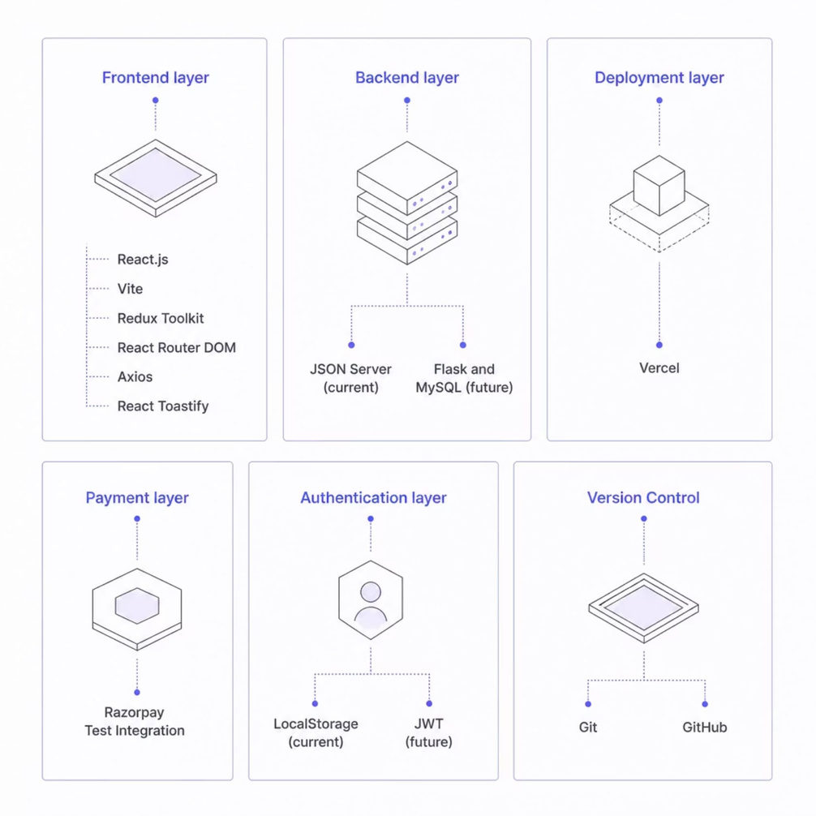
Technology Stack
Why These Choices?
React + Vite: Fast HMR, modern build tooling, and component-driven architecture
Redux Toolkit: Predictable global state with minimal boilerplate
Axios: Clean REST API communication with interceptors
Razorpay: Industry-standard payment gateway for India
Vercel: Zero-config deployment with edge networking
Future backend: Flask REST API + MySQL + JWT authentication for a fully production-grade stack.
Speaker Notes: React and Vite provide a fast development experience with hot module replacement. Redux Toolkit simplifies global state management — I chose it over Context API because the app has multiple interconnected features (cart, wishlist, auth, products) that benefit from a centralized store. Axios handles API calls with clean syntax. Razorpay is the leading payment gateway in India. Vercel offers zero-config deployment. The future backend will replace JSON Server with Flask, MySQL, and JWT for a fully production-ready system.
Notes:
4

Slide 5
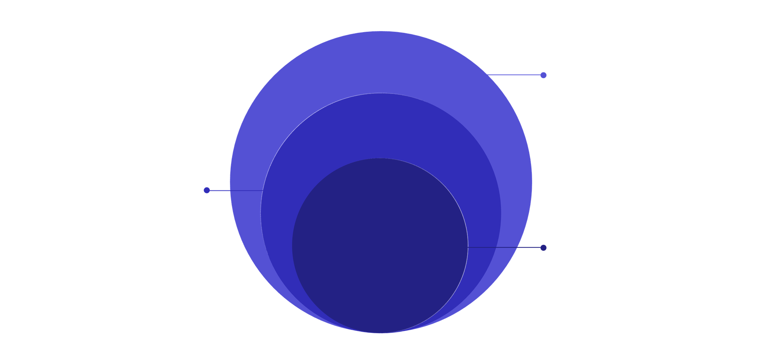

Application Architecture
Redux Store
Global state and dispatched actions
React Components
Pages and presentational components
User Interface
Browser-based user interactions
A clean separation of concerns ensures maintainability. The UI layer communicates exclusively through Redux, which dispatches actions via Axios to the REST API — keeping components pure and predictable.
Speaker Notes: This architecture follows a strict unidirectional data flow. Users interact with React components, which dispatch actions to the Redux store. Redux triggers async thunks that call Axios to fetch data from the JSON Server REST API. The response flows back through Redux, updating the store, which re-renders the relevant components. This separation keeps components pure — they only read from the store and dispatch actions — making the app predictable and easy to debug.
Notes:
5

Slide 6

Folder Structure & Component Architecture
Project Structure
Component Hierarchy
Layouts: Navbar, Footer, AdminLayout
Pages: Home, Products, Cart, Checkout, Orders
Shared: ProductCard, Loader, Toast
Features: CartItem, WishlistBtn, OrderSummary
src/
├── components/ # Reusable UI
├── pages/ # Route views
├── redux/ # Store, slices
├── services/ # Axios API calls
├── assets/ # Images, fonts
├── layouts/ # Page wrappers
├── routes/ # Route config
└── admin/ # Admin module
Components are atomic and reusable — each handles a single responsibility, enabling rapid iteration and consistent UI.
Speaker Notes: The folder structure follows a feature-based organization. Components are split into reusable UI elements (ProductCard, Loader) and feature-specific pieces (CartItem, OrderSummary). Pages map directly to routes. Redux logic is isolated in its own folder with store, slices, and reducers. Services contain all Axios API calls, keeping HTTP logic out of components. The admin folder houses the entire admin module separately. This structure makes the codebase easy to navigate and scale.
Notes:
6

Slide 7
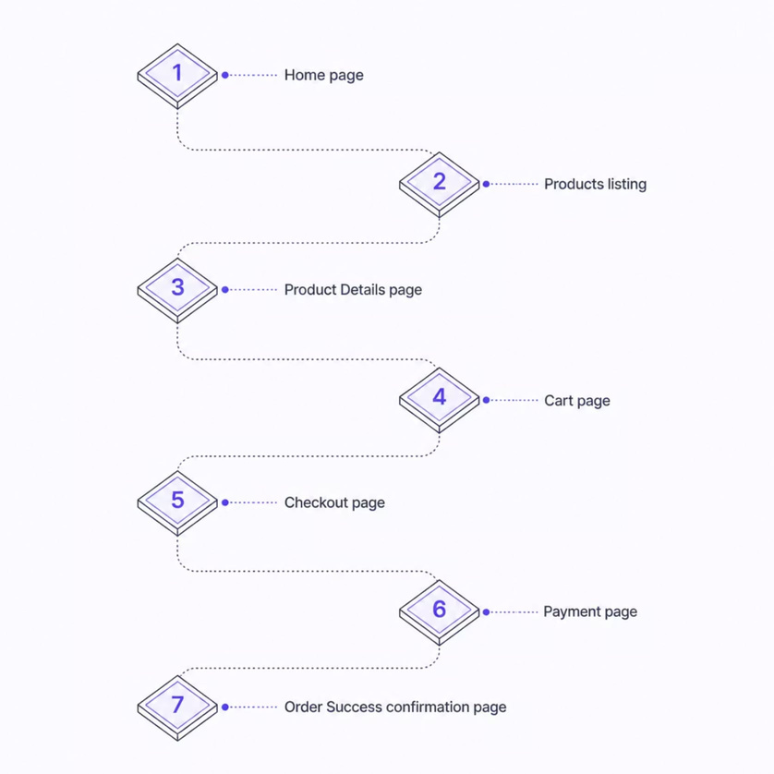
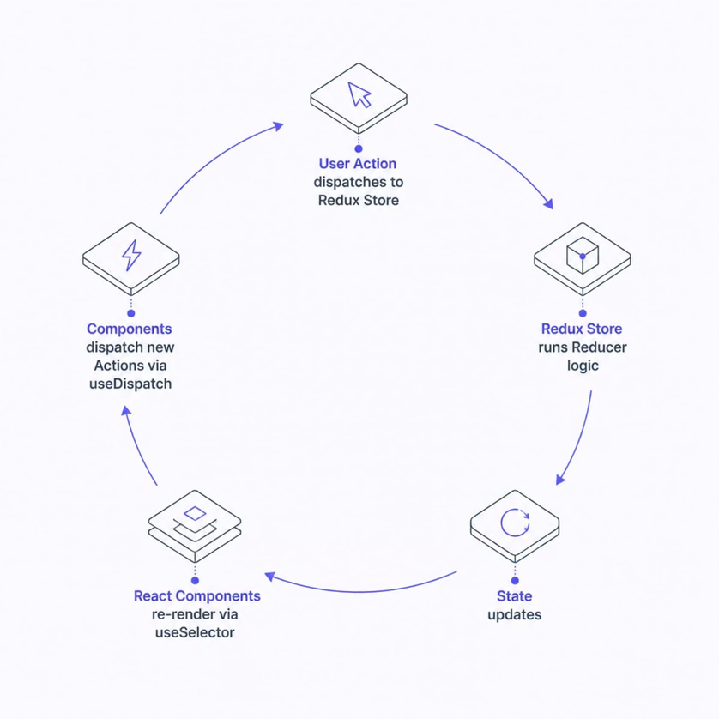
Routing & Redux State Management
React Router Flow
Redux Toolkit Flow
Protected routes guard checkout and admin pages. Redux eliminates prop-drilling — any component accesses global state via useSelector and triggers changes via useDispatch.
Speaker Notes: React Router DOM manages all navigation with protected routes — unauthenticated users are redirected to login when accessing checkout or admin pages. For Redux, I created separate slices for products, cart, wishlist, and auth. Each slice has its own reducer and async thunks. Components subscribe to state with useSelector and dispatch actions with useDispatch. This eliminates prop-drilling entirely and makes state changes traceable through Redux DevTools.
Notes:
7

Slide 8
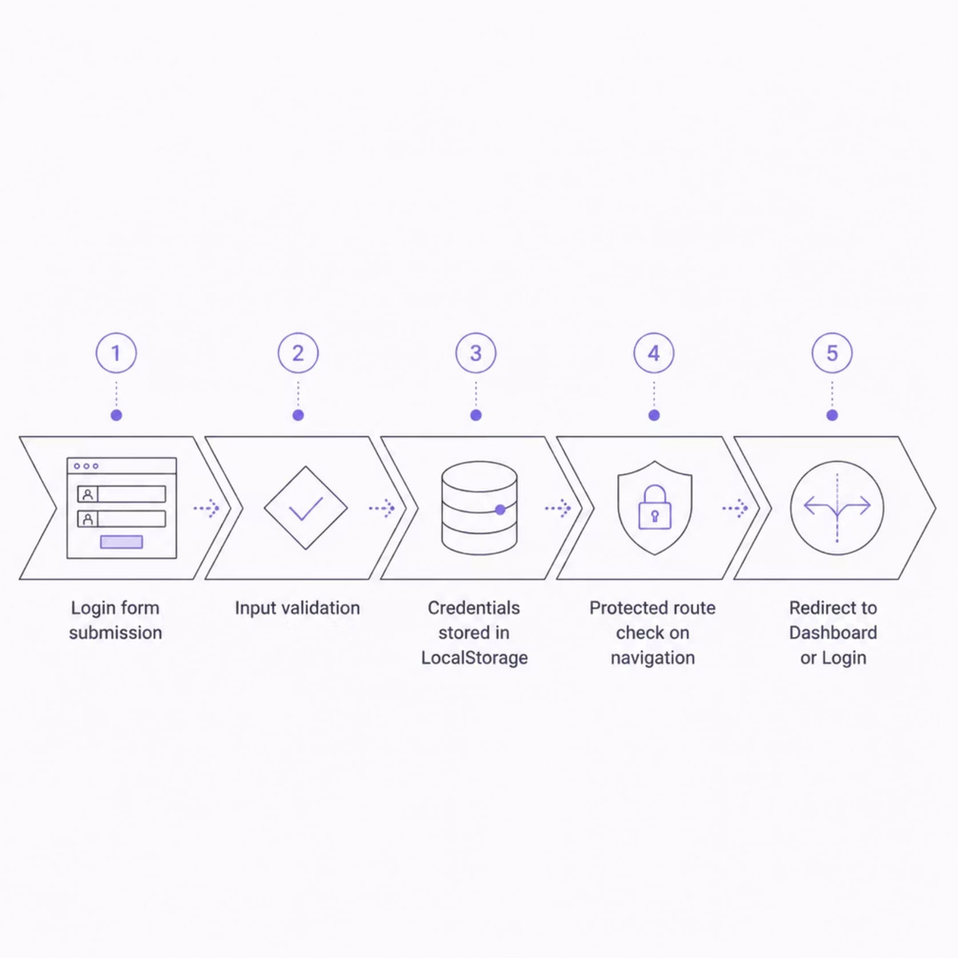
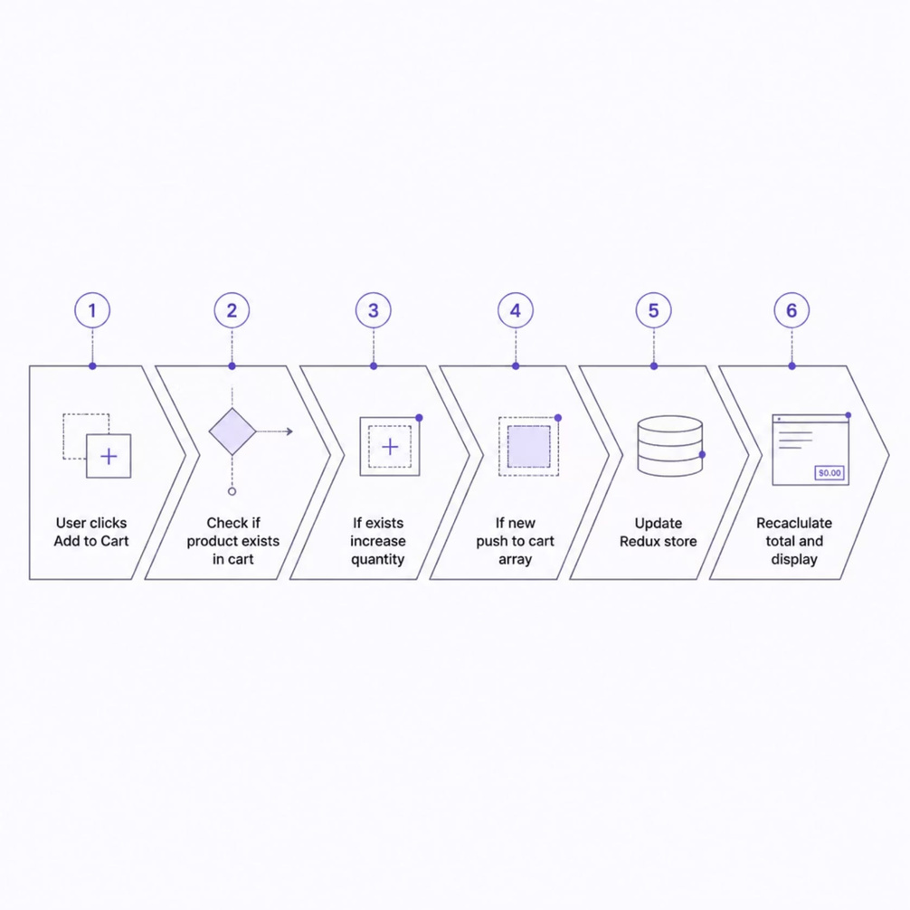
Core Logic Flows
Authentication Flow
Cart & API Integration
Cart items persist in LocalStorage and sync with Redux on load. Axios handles all REST calls — GET for products, POST for orders, PUT for updates, and DELETE for removals.
Speaker Notes: For authentication, on login the credentials are validated, then a user object is stored in LocalStorage. A protected route component checks this token on every navigation — if absent, the user is redirected to login. For the cart, when a user adds a product, I first check if it already exists. If yes, I increment the quantity; if not, I push a new item. Redux updates immediately, and the total recalculates. All API calls use Axios with consistent error handling and loading states.
Notes:
8

Slide 9


Challenges, Optimizations & Security
Challenges Faced
Performance Optimizations
Security Approach
Managing complex global state across cart, wishlist, and auth
Implementing Razorpay test-mode callbacks correctly
Preventing unnecessary re-renders with memoization
Current: LocalStorage auth with route guards
Future: JWT tokens, bcrypt hashing, HTTPS, role-based access
Redux Toolkit's normalized state for efficient updates
Component-level React.memo to prevent re-renders
Lazy loading routes with React.lazy and Suspense
Speaker Notes: The biggest challenge was managing global state — cart, wishlist, auth, and products all interact, so Redux Toolkit was essential for predictable updates. Razorpay's test mode required careful handling of success and failure callbacks. For performance, I used React.memo on frequently re-rendering components like ProductCard, and lazy-loaded route components to reduce initial bundle size. Security is currently handled via LocalStorage with protected routes; the future backend will add JWT, bcrypt, HTTPS, and role-based access control for production-grade security.
Notes:
9

Slide 10

Future Scope, Learnings & Conclusion
🔭 Future Scope
📚 Lessons Learned
✅ Why It Matters
Flask REST API + MySQL + JWT backend
Docker, Redis caching, cloud storage
Reviews, coupons, notifications, order tracking
Redux Toolkit simplifies complex state
Clean architecture accelerates debugging
REST APIs + payments in production contexts
Demonstrates React, Redux, routing, and payments
Responsive, deployed, and open-source
Ready for backend integration at scale
Thank you for your time. I'm happy to walk through the live demo or dive into any technical detail.
🔗 Live Demo · 📂 GitHub Repository
Speaker Notes: The future roadmap includes replacing JSON Server with a Flask REST API and MySQL database, adding JWT authentication, Docker containerization, and Redis caching. I also plan to add user reviews, discount coupons, email notifications, and real-time order tracking. This project demonstrates proficiency in React, Redux Toolkit, routing, REST APIs, payment integration, responsive UI design, and deployment — all skills directly relevant to a frontend engineering role. I'm happy to open the live demo or walk through the codebase on GitHub.
Notes:
10

Slide 11

Thank You

