Slide 1
Major Project — Custom Vulnerable Web Lab & Automated Exploit Testing Suite
Student Name: Ankan Sarkar
Role: Ethical Hacking & Cybersecurity Intern
Organization: VaultofCodes
Selected Option: Option 11 — Custom Vulnerable Lab (Advanced Option)

Slide 2
Problem Statement & Project Goals:
The Problem: Insecure coding practices lead to persistent web application vulnerabilities such as broken access control, XSS, and weak authentication in production systems.
Project Objective: Build a complete, functional lab environment (app.py) featuring multiple controlled vulnerabilities alongside an automated exploit test suite (exploit_test.py).
Value Delivered: Demonstrates end-to-end vulnerability execution, payload verification, and defensive remediation strategies.

Slide 3
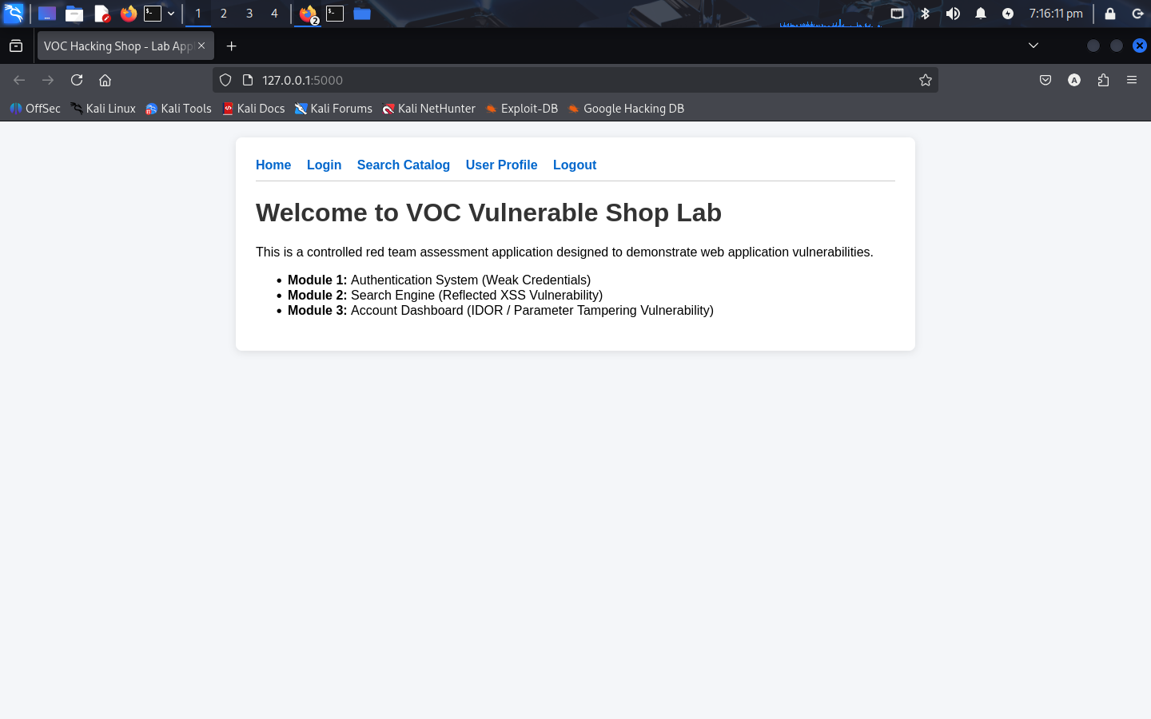
Lab Architecture & Vulnerability Modules:
Module 1 — Weak Authentication: Uses predictable default credentials (admin / admin123) without rate limiting.
Module 2 — Reflected XSS (/search?q=): Echoes dynamic URL parameters directly into rendered HTML without output encoding.
Module 3 — IDOR / Parameter Tampering (/profile?user_id=): Evaluates account access based on client-controlled URL parameters rather than server-side session tokens.

Slide 4
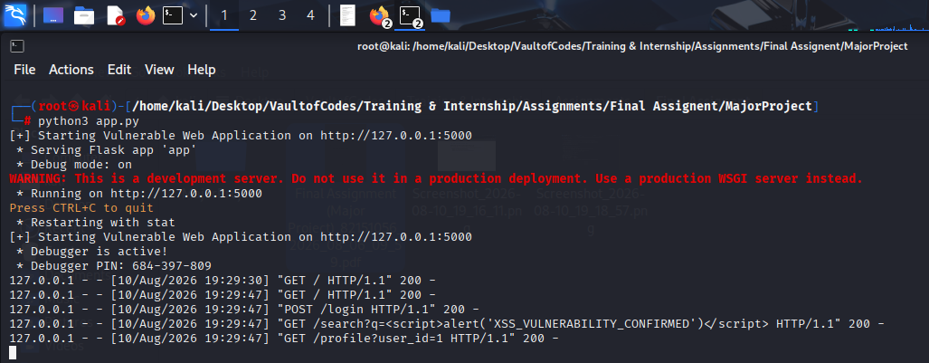
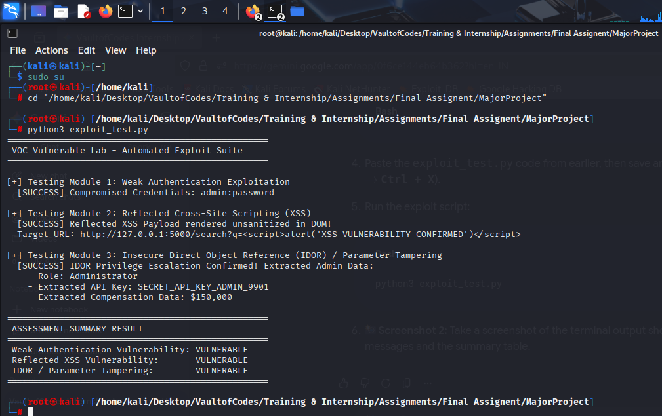
Exploit Demonstration & Key Findings:
Automated Proof-of-Concept: Executed exploit_test.py against active target server http://127.0.0.1:5000 .
Reflected XSS Verified: Payload <script>alert(...) rendered in DOM.
Privilege Escalation Verified: Tampered ?user_id=3 to ?user_id=1 to extract private Administrator API key (SECRET_API_KEY_ADMIN_9901).
Exploit Result: 100% automated verification across all three attack vectors.

Slide 5
Remediation & Secure Coding Recommendations:
Enforce Context-Aware Output Encoding: Apply htmlspecialchars() or jinja auto-escaping to eliminate Reflected XSS.
Server-Side Session Validation: Verify user permissions against secure server sessions ($_SESSION['user_id']) to block IDOR attacks.
Credential Hardening: Implement multi-factor authentication (MFA) and account lockouts after failed login attempts.

