Slide 1


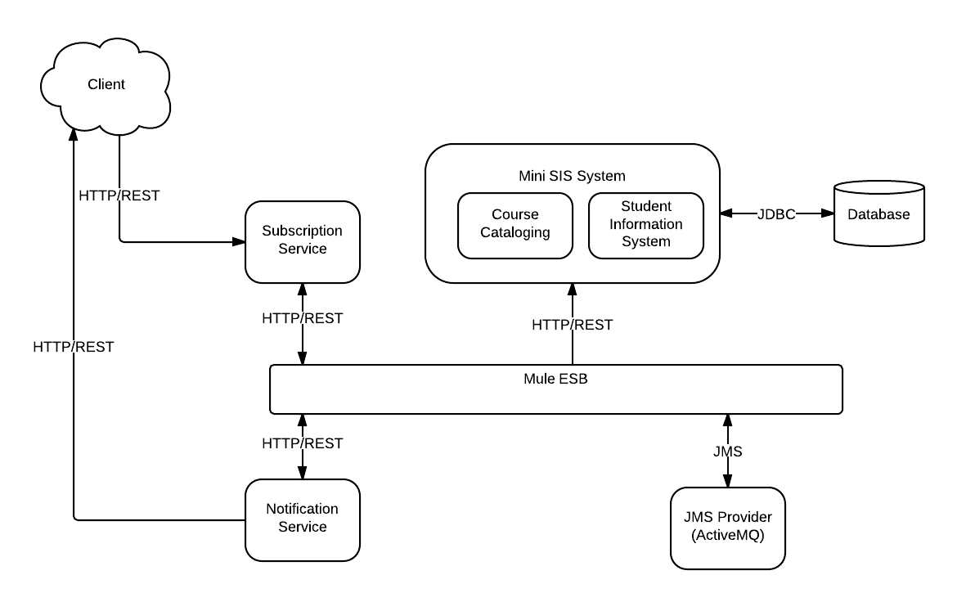
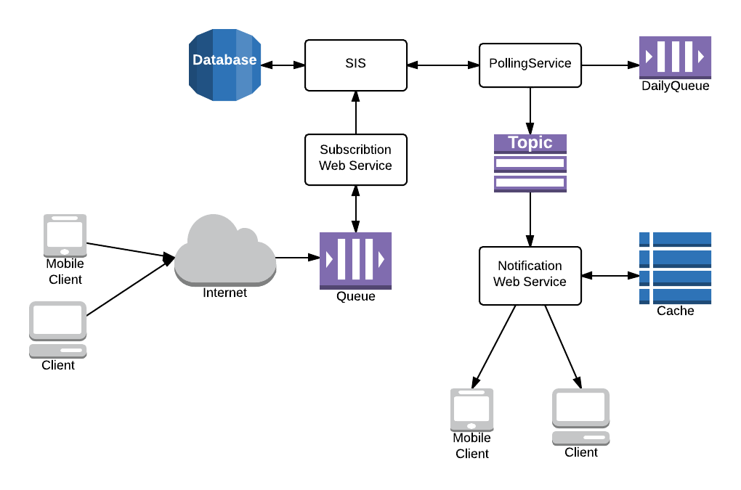



Distributed Notification System
TEAM AAG
Ayemi Musa, Ankan Mookherjee, Greg Wright
PROJECT GOALS
ARCHITECTURE AND DESIGN IMPLEMENTATION
CURRENT STATUS
To develop a notification system for a student information system.
To allow users to select classes and receive reminders 15 minutes prior to start time.
Cloud-to-cloud integration.
End-to-end subscription and notification cycle implemented.
Reliable communication using message queue.
Fault handling using retries and dead letter queue.
Service-Oriented Architecture pattern.
MOTIVATION FOR WORK
SIS is unable to synchronize with calendar applications.
Students/Faculty must manually enter class information into calendar applications.
FUTURE WORK
More functionality (unsubscribe).
Implementation efficient caching strategy.
Real-time modification of daily schedule.
Better system clock handling.
SMS notification.
CURRENTLY EXISTING WORK
Figure 1. High-Level Architecture
Currently there exist many calendaring systems.
Microsoft Outlook
Google Calendar
Due for IOS
None of these systems integrate with student class schedule in SIS.
REFERENCES
[1] A. Inc. Amazon elastic compute cloud (amazon ec2).http://aws.amazon.com/ec2/.
[2] G. Inc. Google apps for business.
http://www.google.com/intx/en/enterprise/
apps/business/products.html#calendar.
[3] MuleSoft. Mulesoft cloudhub.
http://www.mulesoft.com/cloudhub/ipaas-cloud-based-integration-demand.
[4] Phocus. Jot down a task and set up a reminder really, really fast? http://www.dueapp.com/.
LESSONS LEARNED
Subscription and polling are handled outside of pubsub middleware
JMS implements a non-polling protocol.
Replication causes temporary inconsistency.
Figure 2. Runtime View
Notes:
Photos should be at least 300dpi, but not more than 5-12 mgs each. Your page is set to be enlarged 200% so do not change the page size to fit another poster size. Please call me and I will help you with a new page size if desired. Lisa 792-4724
Please note this is only a template for you to start with. You can change the font size, colors, column widths and the number of columns

