Slide 1
Investigating the Temperature, Density, Emission Measure Using EBTEL++
WEEK 1 Progress
Ankan Bose
Gujarat University
Dr. Laura A. Hayes
Assistant Professor
Dublin Institute For Advance Sciences, Dublin

Slide 2
Task Done
Read the project scope and Klimchuk et al.’s introduction and conclusions.
Create a dedicated Python environment with EBTEL++ and plotting tools.
Run an unchanged single-event example (Heating only the electrons with one triangular event).
.Tried changing durations to 0.5, 1 and 3 times the baseline duration in the input parameters, Noted and plotted the temperature, density, emission measure plots. Found peak temperature, peak density, peak emission measure and Excess energy.

Slide 3
Plots

Slide 4
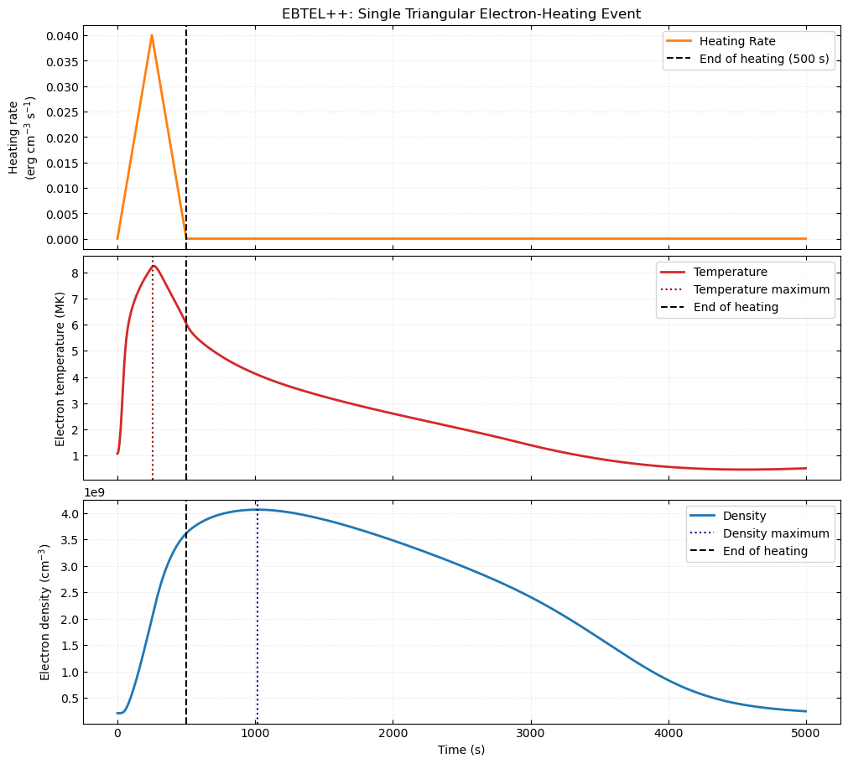
Example : (Unchanged) Heating only the
Electrons with one Triangular Event
Loop Half Length: 40Mm
Pulse shape: Triangular
Background Heating: 3.50e-05 cm^-3 s^-1
Pulse duration: 500s
Peak Heating Rate: 0.04 erg cm^-3 s^-1
Model Output:
Temp. Maxima: 8.240Mk
Temp. Maxima time: 258.3s
Density Maxima: 4.066e+9 cm^-3
Density Maxima Time: 1750s
End of Heating: 500s

Slide 5
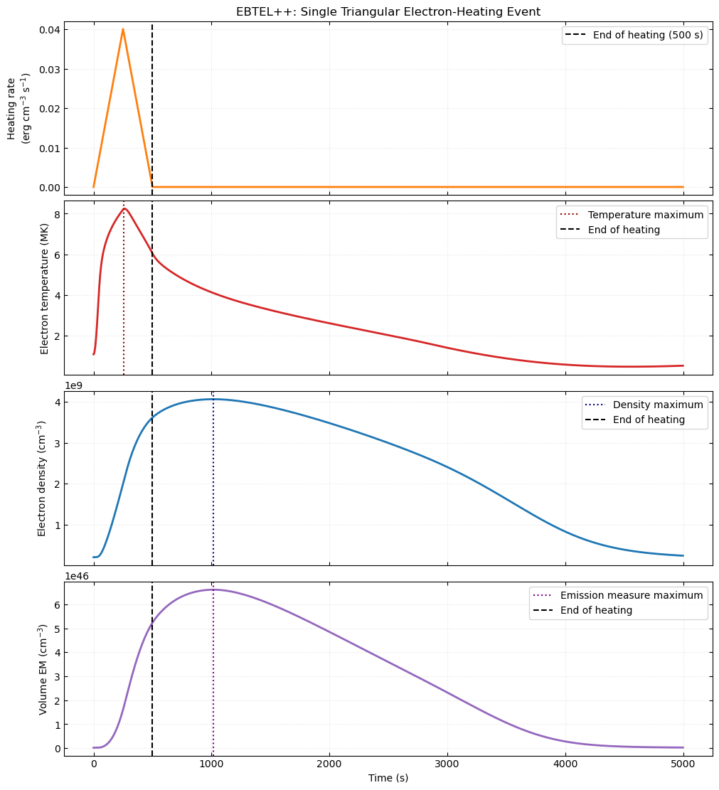
Experiment 1: Baseline (500s) duration
Loop Half Length: 40Mm
Pulse shape: Triangular
Background Heating: 3.50e-05 cm^-3 s^-1
Pulse duration: 500s
Peak Heating Rate: 0.04 erg cm^-3 s^-1
Heating Partition: 1.00
Model Output:
Temp. Maxima: 8.240Mk
Temp. Maxima time: 258.3s
Density Maxima: 4.066e+9 cm^-3
Density Maxima Time: 1750s
End of Heating: 500s
Emission Measure
Assumed Width : 10Mm
Cross sectional Area: 1e+18 cm^2
Half loop volume : 4.00e+27 cm^3
Maxima Volume EM: 5.940e+46 cm^-3
Time of Maxima EM: 1750s
Integrated Excess Heating: 9.9975 erg cm^-3

Slide 6
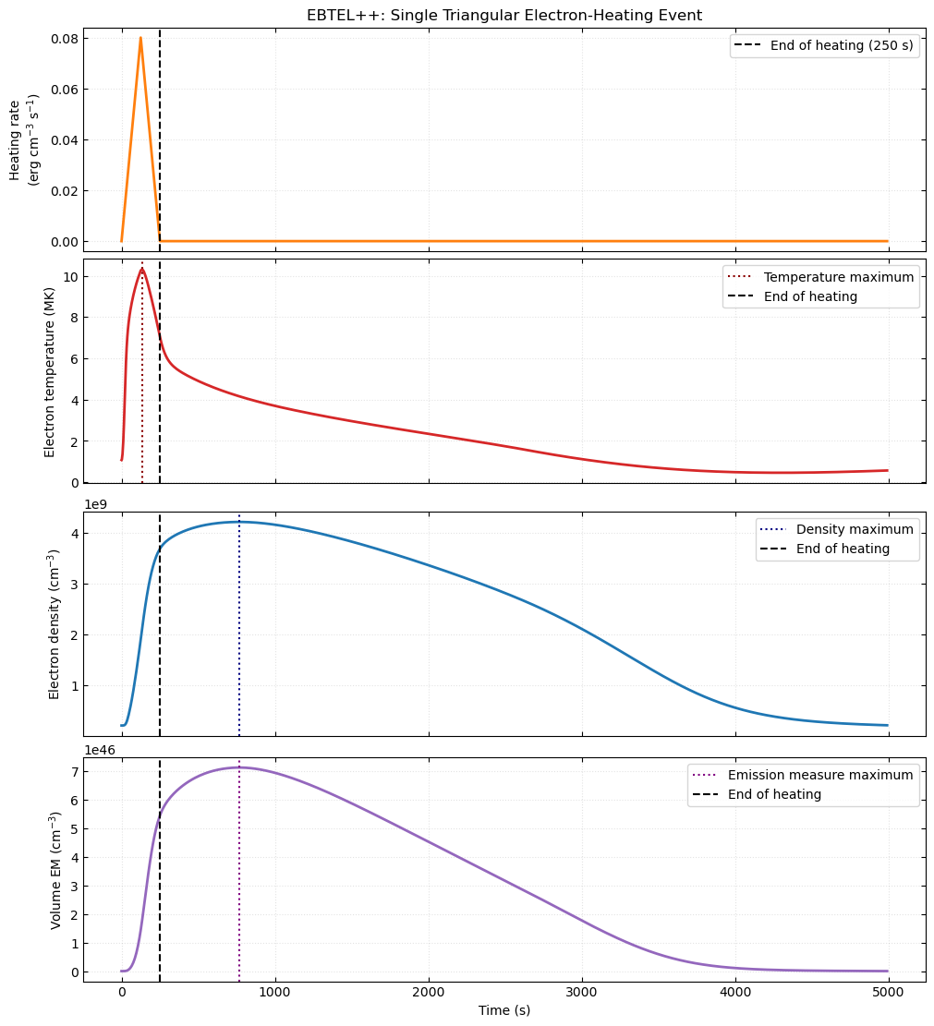
Experiment 2: Baseline (250s) duration
Loop Half Length: 40Mm
Pulse shape: Triangular
Background Heating: 3.50e-05 cm^-3 s^-1
Pulse duration: 250s
Peak Heating Rate: 0.08 erg cm^-3 s^-1
Heating Partition: 1.00
Model Output:
Temp. Maxima: 10.314Mk
Temp. Maxima time: 135.0s
Density Maxima: 4.216e+9 cm^-3
Density Maxima Time: 770s
End of Heating: 250s
Emission Measure
Assumed Width : 10Mm
Cross sectional Area: 1e+18 cm^2
Half loop volume : 4.00e+27 cm^3
Maxima Volume EM: 7.110e+46 cm^-3
Time of Maxima EM: 770s
Integrated Excess Heating: 9.999 erg cm^-3

Slide 7
Experiment 1: Baseline (1500s) duration
Loop Half Length: 40Mm
Pulse shape: Triangular
Background Heating: 3.50e-05 cm^-3 s^-1
Pulse duration: 1500s
Peak Heating Rate: 0.0133 erg cm^-3 s^-1
Heating Partition: 1.00
Model Output:
Temp. Maxima: 6.088Mk
Temp. Maxima time: 800.0s
Density Maxima: 3.853e+9 cm^-3
Density Maxima Time: 1750s
End of Heating: 1500s
Emission Measure
Assumed Width : 10Mm
Cross sectional Area: 1e+18 cm^2
Half loop volume : 4.00e+27 cm^3
Maxima Volume EM: 5.940e+46 cm^-3
Time of Maxima EM:1750s
Integrated Excess Heating: 9.9975 erg cm^-3

Slide 8
Heating Input Parameters of 250s, 500s, 1500s
Parameter | 250s | 500s | 1500s
Loop Half Length (Mm) | 40 | 40 | 40
Pulse Shape | Triangular | Triangular | Triangular
Background Heating (erg cm^-3 s-1 | 3.50e-05 cm^-3 s^-1 | 3.50e-05 cm^-3 s^-1 | 3.50e-05 cm^-3 s^-1
Pulse Durations (s) | 250 | 500 | 1500
Peak Heating rate (erg cm^-3 s^-1) | 0.08 | 0.04 | 0.0133
Heating Partition | 1 | 1 | 1
End of Heating | 250 | 500 | 1500
Assumed Strand Width (Mm) | 10 | 10 | 10
Half Loop Volume (cm^3) | 4.00e+27 cm^3 | 4.00e+27 cm^3 | 4.00e+27 cm^3
Integrated Excess energy (erg cm^-3 s^-1) | 9.999 | 9.755 | 9.755

Slide 9
EBTEL Output Parameters of 250s, 500s, 1500s
Parameter | 500s | 250s | 1500s
Peak electron temperature (MK) | 8.240Mk | 10.314Mk | 6.088Mk
Time of Peak Temperature(s) | 258.3s | 135.0s | 800
Peak Density (cm^-3) | 4.066e+9 cm^-3 | 4.216e+9 cm^-3 | 3.853e+9 cm^-3
Time of Peak Density (s) | 1750s | 770 | 1750
Peak EM (cm^-3) | 5.940e+46 cm^-3 | 7.110e+46 cm^-3 | 5.940e+46 cm^-3
Time of Peak EM (s) | 1750 | 770 | 1750

