Slide 1
Web Technologies
Ram Software Engineering Labs Pvt Ltd

Slide 2
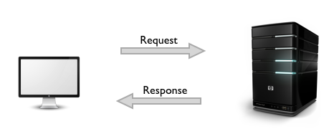
HTTP Request
and
Response

Slide 3

HTTP Request and Response
HTTP (Hypertext Transfer Protocol)
generic, stateless protocol
governs the transfer of files across a network

Slide 4


HTTP Request and Response
HTTP (Hypertext Transfer Protocol)
supports access to SMTP,FTP and other protocols
was designed to support hypertext

Slide 5

HTTP Request and Response
HTTP (Hypertext Transfer Protocol)
Exchanged information can be static or dynamic
Every resource, accessible over the Web has a URL(Uniform resource locator)
HTTP mechanism is based on client/server model typically using TCP/IP sockets

Slide 6
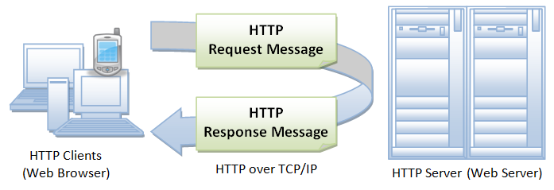
HTTP Request and Response
Figure illustrates request-response client-server protocol

Slide 7
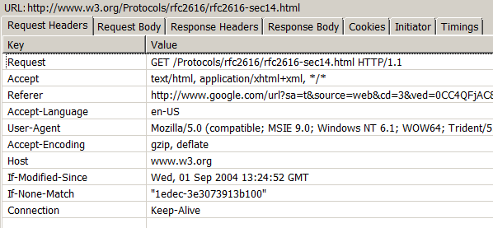
HTTP Request
Request = Request-Line
*(( general-header
| request-header
| entity-header ) CRLF)
CRLF
[ message-body ]
Example :
Source : http://www.w3.org/Protocols/rfc2616/rfc2616-sec5.html#sec5

Slide 8
HTTP Request
Request-Line
begins with a method token,
followed by the Request-URI & protocol version & ending with CRLF
elements are separated by SP characters
No CR or LF is allowed except in the final CRLF sequence
Request-Line = Method SP Request-URI SP HTTP-Version CRLF

Slide 9
Request-Line Method
Method = "OPTIONS"
| "GET"
| "HEAD"
| "POST"
| "PUT"
| "DELETE"
| "TRACE"
| "CONNECT"
| extension-method
extension-method = token

Slide 10
Request-Line Request-URI
Request-URI = "*" | absoluteURI | abs_path | authority
Notes:
The four options for Request-URI are dependent on the nature of the request. The asterisk "*" means that the request does not apply to a particular resource, but to the server itself, and is only allowed when the method used does not necessarily apply to a resource.

Slide 11
HTTP Request General header
general-header = Cache-Control
| Connection
| Date
| Pragma
| Trailer
| Transfer-Encoding
| Upgrade
| Via
| Warning

Slide 12
HTTP Request Request header
request-header = Accept
| Accept-Charset
| Accept-Encoding
| Accept-Language
| Authorization
| Expect
| From
| Host
| If-Match
| If-Modified-Since
| If-None-Match
| If-Range
| If-Unmodified-Since
| Max-Forwards
| Proxy-Authorization
| Range
| Referer
| TE
| User-Agent

Slide 13
HTTP Request Entity header
entity-header = Allow
| Content-Encoding
| Content-Language
| Content-Length
| Content-Location
| Content-MD5
| Content-Range
| Content-Type
| Expires
| Last-Modified
| extension-header
extension-header = message-header

Slide 14
HTTP Request Message body
message-body = entity-body
| <entity-body encoded as per Transfer-Encoding>

Slide 15
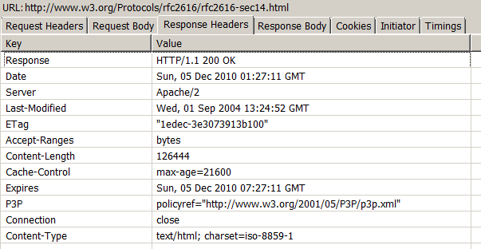
HTTP Response
Response = Status-Line
*(( general-header
| response-header
| entity-header ) CRLF)
CRLF
[ message-body ]
Example :
Source : http://www.w3.org/Protocols/rfc2616/rfc2616-sec5.html#sec5

Slide 16
HTTP Response
Status Line
Status-Line = HTTP-Version SP Status-Code SP Reason-Phrase CRLF
Status Code and Reason Phrase
1xx: Informational - Request received, continuing process –
2xx: Success - The action was successfully received, understood, and accepted
3xx: Redirection - Further action must be taken in order to complete the request
4xx: Client Error - The request contains bad syntax or cannot be fulfilled
5xx: Server Error - The server failed to fulfill an apparently valid request
For a detailed list of status codes refer : http://www.w3.org/Protocols/rfc2616/rfc2616-sec6.html#sec6
Source : http://www.w3.org/Protocols/rfc2616/rfc2616-sec6.html#sec6

Slide 17
HTTP Response
Response Header
response-header = Accept-Ranges
| Age
| ETag
| Location
| Proxy-Authenticate
| Retry-After
| Server
| Vary
| WWW-Authenticate
Status Code and Reason Phrase
Source : http://www.w3.org/Protocols/rfc2616/rfc2616-sec6.html#sec6

Slide 18
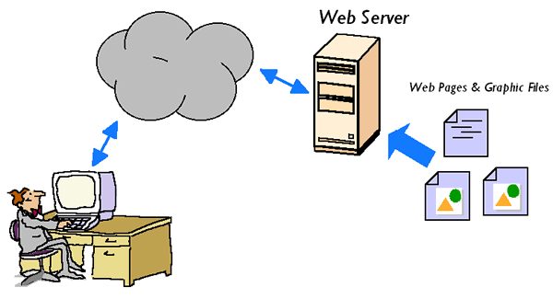
Web Server
a piece of software that enables a website to be viewed using HTTP
Server(computer) that serves Web pages
Has an IP address & domain name

Slide 19
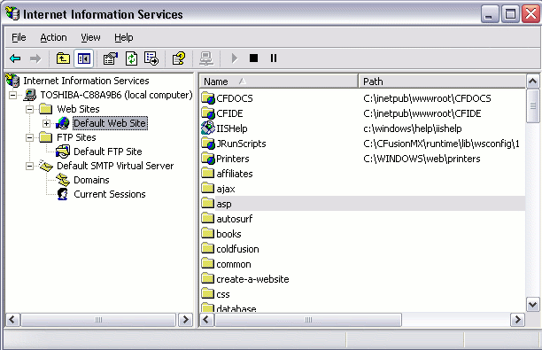
Web Server
Example Web server – IIS 5.1 (Microsoft Internet Information Services)
left pane represents the various websites, FTP sites, and SMTP virtual servers
Screenshot has 1 Website,1 FTP site and one SMTP virtual server

Slide 20

Web Server
Some common features
Create one or more websites
Configure log file settings
Configure website/directory security
Create an FTP site

Slide 21
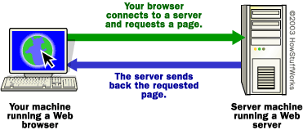
Web Server
Some common features
Create virtual directories, and map them to physical directories
Configure/nominate custom error pages
Specify default documents

Slide 22
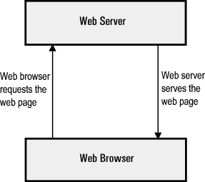
Web Server – How it works
Step 1 : Web browser gets IP address of website from cache or requests it from DNS server
Step 2 : Web browser requests full URL from the Web server

Slide 23
Web Server – How it works
Step 3 : Web server sends back requested page. Error page is sent if requested page is not found
Step 4 : Browser receives page and renders it

Slide 24
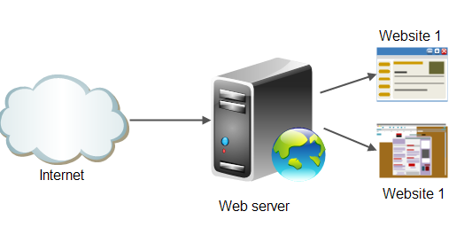
Web Server
Multiple Websites
One web server could be configured to host multiple sites with unique IP address

Slide 25
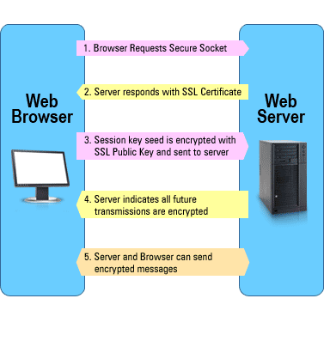
Web Server
SSL (Secure Socket Layer) Certificates
SSL can be applied to the website using a web server
Navigation to the website thus becomes secure
Uses https:// instead of http://

Slide 26
Web server Examples
Apache HTTP Server - http://httpd.apache.org
Microsoft Internet Information Services (IIS) -
http://www.microsoft.com/iis
Sun Java System Web Server - http://www.sun.com/software/products/web_srvr/home_web_srvr.xml

