Slide 1
Web Technologies
Ram Software Engineering Labs Pvt Ltd

Slide 2
Overview
Simple Web Pages
HTTP
HTML
Web Application Architectures
Dynamic Web Pages
Scripting
CGI
Server Extensions (APIs)
Java: Servlets, JSP, JDBC
Microsoft: ASP, ADO, ODBC

Slide 3
History of the Internet
Developed in 60s and 70s by US Department of Defense
called ARPANET (Advanced Research Projects Agency NETwork)
project to build a network that could withstand physical attacks
1982: TCP/IP adopted as ARPANET standard protocol
1986: project shifted from military to government/universities by grant money from National Science Foundation
renamed NSFNET (National Science Foundation NETwork)
1995: NSFNET ceased control of network backbone; network becomes known as Internet.

Slide 4
Intranet vs. Extranet
Intranet : a web site or group of sites belonging to an organization, accessible only by the members of the organization (behind firewall)
Extranet : an intranet that is partially accessible to authorized outsiders

Slide 5
HTTP (HyperText Transfer Protocol)
The protocol used to transfer Web pages through the Internet.
Version history:
HTTP/0.9: early development of the web
HTTP/1.0: released in 1995
HTTP/1.1: current version

Slide 6
HTTP (continued)
Based on a “request-response” paradigm:
connection – the client establishes a connection with the web server
request – the client sends a request message to the web server
response – the web server sends a response to the client
close – the connection is closed by the web server
NOTE: HTTP is inherently a “stateless” protocol;

Slide 7
MIME types
Multipurpose Internet Mail Extensions
used by HTTP header to determine how to handle multiple media types
Example:
text/html (html document; *.html)
application/java (java class file; *.class)

Slide 8
HTTP Request
HTTP header indicating:
type of request
GET: gets the requested resource
POST: transfer posted data to the specified resource
HEAD: similar to get but returns the HTTP header ONLY
PUT (HTTP/1.1): uploads the resource to the server
DELETE (HTTP/1.1): deletes the resource from the server
OPTIONS (HTTP/1.1):request’s the server’s configuration options
name of a resource
HTTP version
body (*optional)

Slide 9
HTTP Response
HTTP header indicating:
HTTP version
status of the response
information to control the response behavior
body (*optional)

Slide 10
Static vs. Dynamic Web Pages
static: content stored in an html page
content does not update unless the file is updated
dynamic: content is generated “on the fly”
content is gathered and delivered based on the user’s request; usually content here is stored in a database

Slide 11
two-tier client-server architecture Web-DBMS Architecture
Client (tier 1) : primarily responsible for presentation of data to the user
user interface actions
main business application logic
Server (tier 2) : primarily responsible for supplying data services to the client
limited business application logic (i.e. verification not able to be processed by the client)
access to the requested data

Slide 12
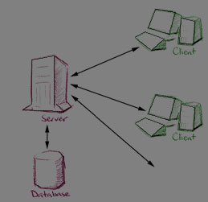
two-tier architecture (continued) Web-DBMS Architecture
tier 2
Server-side validation
Database access
tier 1
User interface
Main business and data processing logic

Slide 13
three-tier architecture Web-DBMS Architecture
Client (tier 1) : primarily responsible for presentation of data to the user
Application Server (tier 2) : primarily responsible for supplying data processing and business logic
Database Server (tier 3) : responsible for data validation and database access

Slide 14
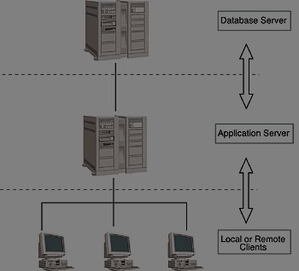
three-tier architecture (continued) Web-DBMS Architecture
Tier 3
data validation
database access
Tier 2
business logic
data processing logic
Tier 1
user interface

Slide 15
two-tier vs. three-tier Web-DBMS Architecture
2 tier
A ‘fat’ client, requiring considerable resources on the client’s computer to run effectively. This includes RAM, disk space, and CPU power.
A significant client-side administration overhead.
3 tier
Less expensive because client is ‘thin’
Maintenance is centralized
Centralized business logic makes deployment easier
Added modularity allows modifications to any tier without affecting others
Load balancing is easier with separation of servers

Slide 16
n-tier architecture Web-DBMS Architecture
Done by extending 3-tier’s middle tier into any # of tiers
Is more modular, therefore changes can be more independent
Load balancing is better because of distribution of work

Slide 17
Web-DBMS Advantages
Simplicity (minor)
Platform Independence
GUI
Standardization (minor)
Cross-Platform Support (minor)
Transparent Network Access
Scalable Deployment
Innovation

Slide 18
Integrating Web and DBMSs
Scripting languages – JavaScript, VBScript, Perl
CGI
HTTP Cookies
Web Server Extensions (APIs) – NetscapeAPI, Microsoft’s IIS API
Java and JDBC, SQLJ, Servlets, JSP
ASP and ActiveX Data Objects (ADO)

Slide 19
Scripting Languages
Scripts are embedded in HTML
Some can generate HTML ‘on-the-fly’
Interpreted, NOT compiled
Examples:
JavaScript, VBScript, Perl & PHP

Slide 20
JavaScript
Object-based scripting language
Relatively simple
Data Types: numeric, String, and boolean values
Syntax similar to Java
No API functions that interact with the filesystem
JavaScript IS NOT Java

Slide 21
JavaScript vs. Java
JavaScript
Code sent to client; Interpreted by client (browser)
Object-based. Built in, extensible objects, but no class inheritance
Code embedded in HTML
Loose typing (variable data types not declared)
Dynamic binding. Object references checked at runtime.
Cannot automatically write to hard disk
Java
Compiled on server before execution on client
Object-oriented. Object classes with inheritance.
Code distinct from HTML
Strong Typing (variable data types must be declared)
Static binding. Object references must exist at compile time
Cannot automatically write to hard disk

Slide 22
VBScript
Virtually identical to JavaScript
Syntax similar to Visual Basic instead of Java
No API functions that interact with the file system
Client side scripts – Mac, *nix, Netscape do not handle VBScript (Internet Explorer alone)
Server side – mostly used with ASP

Slide 23
Perl & PHP
Perl combines features of C and Unix utilities
The most widely used languages for server-side programming
Founded on Unix, but now cross-platform
PHP is HTML embedded Perl scripting language
Very popular – Apache HTTP Server, PHP, and mySQL or PostgreSQL (very simple and quick)

Slide 24
Common Gateway Interface (CGI)
CGI : A specification for transferring information between a Web server and a CGI program
Program accepts information from STDIN and outputs to STDOUT (web server)
Output must also first send MIME header
Since it is a specification, any language can be used; Perl, however, is by far the most common
Using a CGI script is transparent to the user (web browser)

Slide 25
CGI (continued)
Steps in CGI script execution:
1: user initiates the CGI script
2. browser contacts server asking for permission to use script
3. server checks user permission and that script exists
4. server prepares ENV variables and launches script
5. script executes and reads ENV and STDIN
6. script sends MIME header and contents to STDOUT
7. server sends data in STDOUT to browser and closes connection
8. browser displays information

Slide 26
CGI (continued)
Passing information to a CGI script:
Command line : HTML provides ISINDEX tag (must be placed inside <HEAD>)
Environment variables : QUERY_STRING contains name > values from URL
http://localhost/test.pl?var1=val1&var2=val2 … QUERY_STRING now contains var1=val1&var2=val2
ENV is the most popular and easiest; data must be parsed to get relevant information

Slide 27
Advantages of CGI
de facto standard for interfacing web servers with external programs
Simplicity
Language independence (minor)
Web server independence (minor)
Wide acceptance

Slide 28
Disadvantages of CGI
Communication between client and DB server must always go through Web Server; this creates a bottleneck
Lack of efficiency and transaction support (inherited statelessness from HTTP)
Validating user input
Form filling
Server must create new process for each CGI script
Large overhead
Concurrency issues
Security
If script forks a shell, passed parameters can cause serious damage
Because GET is used, sometimes hackers can hack the script

Slide 29
Cookies
Cookies store information on the client by the server
Application programmers can store information and retrieve it if needed
Clients can disable use of cookies
Used heavily in all methods of web development (sessions, customization, login information, browsing patterns)
Think of it as a persistent ENV table associated with each server
Mostly insecure, and should be used with care

Slide 30
Extending Web Server with APIs
Also called non-CGI gateways
Can be better than CGI (if API is good), but is much more complicated
Must use proprietary software
Netscape’s LiveWire Pro
Microsoft’s IIS
A better alternative is JSP/Servlets or ASP/ADO
Examples:
NetscapeAPI (NSAPI)
Microsoft Internet Information Server API (ISAPI)

Slide 31
J2EE, Servlets, JSP Java
Allows for development of Web Applications using tested design patterns (MVC)
Separates Presentation from Model/Controller
Allows for multiple views (HTML, Swing, GTK+, etc) to be applied to single application
Platform independent
Relies on Bean and Enterprise Java Beans (EJB)

Slide 32
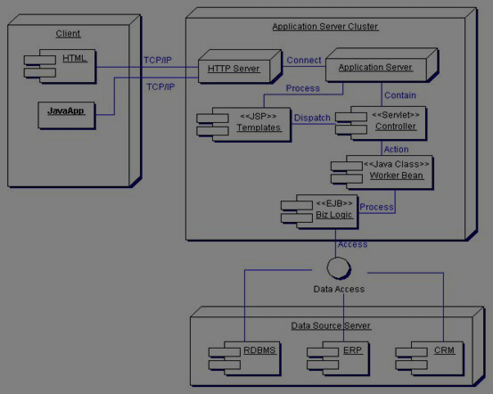
J2EE Architecture Java
Presentation Tier
Business Tier
Data Tier

Slide 33
Enterprise Java Beans Java
Server-side component architecture for the business tier, encapsulating business and data logic
EJB Session Beans: components implementing business logic, business rules, and workflow
Lives for the lifetime of the session; can be used by only 1 client at a time
Performs order entry, banking transactions, DB operations, etc.
EJB Entity Beans: components encapsulating some data contained by the Enterprise
Persistent: may live longer than the session; may be shared by multiple clients
Bean-Managed Persistence (BMP) Entity Beans: component developer writes code to make bean persistent, using JDBC, or Java serialization
Container-Managed Persistence (CMP) Entity Beans: persistence is provided automatically by the container

Slide 34
JDBC Java
Most prominent and mature approach for accessing R-DBMS
Modeled after ODBC
Embedded SQL for Java – JDBC requires SQL statements be passed as strings to Java methods
Direct mapping of R-DBMS tables to Java classes – each row of the table becomes an instance of that class, and each column value corresponds to an attribute of that instance

Slide 35
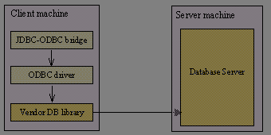
JDBC-ODBC Bridge Java
Provides JDBC access using
ODBC drivers
Performance overhead associated with translation between JDBC and ODBC
User is limited by the functionality of underlying ODBC driver
ODBC drivers are VERY common (more common than JDBC drivers)
Can use existing components (ODBC) instead of writing new drivers (native JDBC drivers)

Slide 36
Partial JDBC driver Java
Converts JDBC calls to calls on the client API for the DBMS (skips ODBC, and directly uses vendor driver)
Better performance than JDBC-ODBC bridge
Requires DB client software to be installed on each client

Slide 37
Java JDBC driver for DB Middleware Java
Translates JDBC calls into middleware vendor’s protocol, which is translated to DBMS protocol
In general, most flexible JDBC alternative
Middleware provides connectivity to many different DBs

Slide 38
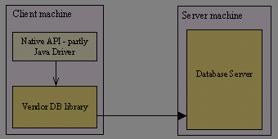
Native Java JDBC Java
Converts JDBC calls into network
protocol used directly by DBMS
Allows direct call from client to
DBMS server
Drivers can be downloaded
dynamically
Drivers are completely implemented in Java; therefore completely platform-independent
Limits deployment issues (since completely native Java)
Requires a different driver for each DBMS
Drivers come from DB vendors; most have implemented these

Slide 39
Advantage: pure JDBC Java
If a pure JDBC driver exists from the Database Vendor, it should be used instead of JDBC-ODBC bridge
Better integration
Little overhead

Slide 40
Java Servlets Java
Similar to CGI, with many added benefits (especially with increased number of users):
Improved performance
Compiled code instead of interpreted code
Handled by thread of JVM instead of new process
Remains in memory, instead of being loaded for each request
Extensibility
Employs fully object-oriented language
Larger set of APIs to work from (JDBC, email, directory servers, etc)
Simpler session management
Whereas CGI uses cookies, Servlets maintain persistence until the web server shuts down
Session management is handled through the web server instead of by the developer
Improved security
Java’s implementing security model
Improved reliability
Java’s inherent type checking/safety

Slide 41
Java Servlets (continued) Java
Mainly Java code with embedded HTML: HelloWorldServlet.java
import javax.servlet.*;
import javax.servlet.http.*;
public class HelloWorldServlet
extends HttpServlet
{
public void service(HttpServletRequest req,
HttpServletResponse resp)
{
out.println("<HTML>");
out.println("<HEAD>");
out.println("<TITLE>HelloWorld Servlet</TITLE>");
out.println("</HEAD>");
out.println("<BODY>");
out.println("hello world!");
out.println("</BODY>");
out.println("</HTML>");
}
}

Slide 42
JavaServer Pages (JSP) Java
Whereas Servlets are mainly Java code with embedded HTML, JSP are mainly HTML with embedded Java
Allows for separation of presentation from development (different teams with different skill sets)
Scriptlets
<% … %>
Directives
<%@ … %>
Actions
<jsp:useBean …> … </jsp:useBean>
JSP engine compiles JSP into a Servlet upon first request
After which the JSP behaves exactly as a Servlet

Slide 43
JSP (continued) Java
Mainly HTML with embedded Java: HelloWorld.jsp
<HTML>
<HEAD>
<TITLE>HelloWorld JSP</TITLE>
</HEAD>
<BODY>
<%= "Hello World!" %>
</BODY>
</HTML>

Slide 44
Microsoft Web Solution Platform Microsoft
Object Linking and Embedding (OLE)
Object-oriented technology enabling development of reusable software components
Component Object Model (COM)
OLE extension that allow services to be OLEs
Object-based model consisting of both a specification defining interface between objects and system, and a concrete implementation
Packaged as a Dynamic Link Library (DLL)
Distributed COM (CDOM)
Allows COM architecture across the Enterprise
Replaces inter-process communication (IPC) between component and client with appropriate network protocol
Web Solution Platform (COM+)
Provides more application infrastructure, allowing developers to focus on core application logic
ASP and ADO are core components of this architecture

Slide 45
Active Server Pages (ASP) Microsoft
Analogous to JSP, but developed by MS
Initially only supported by IIS, but now Apache supported
Supports ActiveX scripting and ActiveX components (which are readily available)
Not compiled upon first use (ASP engine must process every time *.asp is requested)
Runs in thread forked by the Web Server instead of in separate process

Slide 46
ActiveX Data Objects (ADO) Microsoft
ASP extension supported by IIS for database connectivity
combines RDS & ADO
Key Features:
Independently created objects
Support for stored procedures
Different cursor types, including potential for support of different back-end specific cursors
Batch updating
Support for limits on numbers of returned rows and other query goals
Support for multiple record sets returned from procedures or batch statements
Benefits:
Ease of use
High speed
Low memory overhead
Small disk footprint

Slide 47
Remote Data Services (RDS) Microsoft
Technology for client-side database manipulation (primarily across the Internet)
Mechanism to directly interact with the database at the client level
Implemented as a client-side ActiveX control, included with Internet Explorer
Example:
<OBJECT CLASSID="clsid:BD96C556-65A3-11D0-983A-00C04FC29E33" ID="ADC">
<PARAM NAME="SQL" VALUE="SELECT * FROM employees">
<PARAM NAME="Connect" VALUE="DSN=EmployeeDB;">
<PARAM NAME="Server" VALUE="localhost">
</OBJECT
<TABLE DATASRC="#ADC">
<TR><TD><Span DATAFLD="empID"></SPAN></TD></TR>
</TABLE>

Slide 48
Microsoft Access Microsoft
Export wizards for automatically generating HTML based on data
Static pages
Export data to *.html
Pages can become out of date quickly
Can use templates to customize pages
Dynamic pages, using ASP
Export data to *.asp
Data will be generated dynamically
Dynamic pages, using DAP (data access pages)
Used like access forms
Written in Dynamic HTML (DHTML)
Requires > Internet Explorer 5.0

Slide 49
Future of ASP and ADO (.NET style) Microsoft
ASP.NET (more like current JSP and Java Servlets)
Language-neutral common runtime framework
Web forms
Web services
Rich controls (server-side complicated HTML generation controls; i.e. Calendars)
Server controls
ADO.NET
Connected Layer (similar to ADO)
Uses XML to exchange data
Disconnected Layer (similar to RDS)
Maintains relationship information in memory

Slide 50
JSP vs. ASP
JSP
Platform-independent
Easier portability
Extensible tags (custom tag libraries)
EJBs, JavaBeans, and custom tags reusable across platforms
Potentially more reliable
ASP
Primarily Microsoft platform
Easier Interoperability
Non-extensible tags
ActiveX Controls not reusable (windows platform only)

