Slide 1
AJAX
Ram Software Engineering Labs Pvt Ltd

Slide 2

Contents
What’s Ajax?
Classic Model Vs. Ajax Model
Defining Ajax
XHTML, DOM, XML, XMLHttpRequest, JavaScript
Advantages & Disadvantages
Ajax Alternatives
XUL, XAML, Applets, Flash, SVG
Enhanced Ajax
DWR, Xajax, Ajax.Net
Examples + Demo

Slide 3

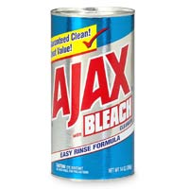
What’s Ajax
Ajax may sound familiar…
Washing Machine powder
Dutch soccer team
Notes:
Stat with: Who doesn’t own a cellphone? Say that it is different than anything we knew until today.

Slide 4
What’s Ajax
Ajax is the buzzword of the moment among web developers
It Stands for Asynchronous JavaScript And XML
Jesse James Garrett invented this bad acronym in Feb 2005 to describe its use by Google.
Most of the Ajax world is focused on the client side, and "ooooh ahhhh" effects ☺
Lets see some of these effects!
Notes:
Stat with: Who doesn’t own a cellphone? Say that it is different than anything we knew until today.

Slide 5
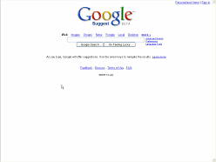
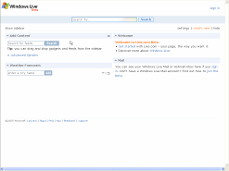
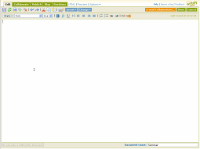
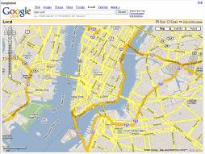
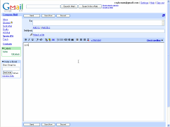
What’s Ajax
Google Suggest
Microsoft Live
Examples
From the Web
Writely
Google Maps
Gmail
Notes:
Stat with: Who doesn’t own a cellphone? Say that it is different than anything we knew until today.

Slide 6
What’s Ajax
Ajax isn’t a technology
Ajax is an approach to Web application development that uses client-side scripting to exchange data with the Web server
Ajax is also more of a pattern -- a way to identify and describe a useful design technique
Ajax is new in the sense that many developers are just beginning to be aware of it, but all of the components that implement an Ajax application have existed for several years
Notes:
Stat with: Who doesn’t own a cellphone? Say that it is different than anything we knew until today.

Slide 7
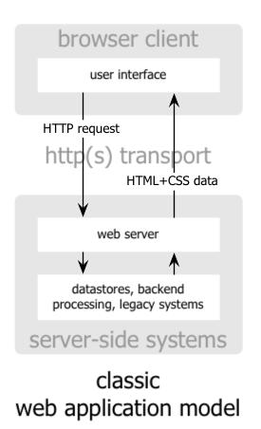
Classic Model
The classic web application model works like this:
Most user actions in the interface trigger an HTTP request back to a web server.
The server does some processing — retrieves data, crunches numbers, talks to various legacy systems
And then returns an HTML page to the client
Notes:
Stat with: Who doesn’t own a cellphone? Say that it is different than anything we knew until today.

Slide 8
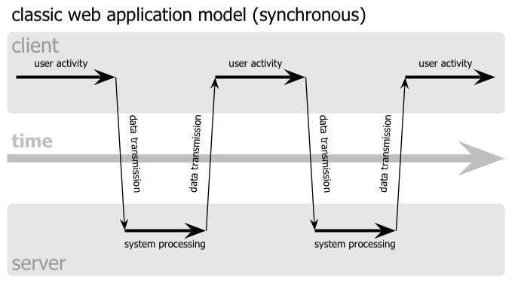
Classic Model
This approach makes a lot of technical sense, but it doesn’t make for a great user experience.
At every step in a task, the user waits.
The user sees the application go to the server
Notes:
Stat with: Who doesn’t own a cellphone? Say that it is different than anything we knew until today.

Slide 9
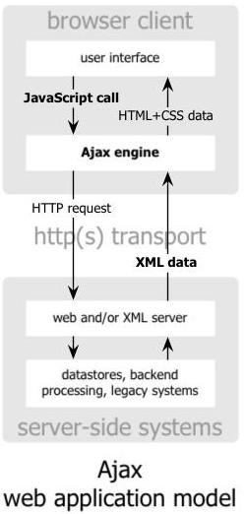
Ajax Model
An Ajax application eliminates the start-stop-start-stop nature of interaction on the Web
It introduces an intermediary, an Ajax engine, between the user and the server.
Instead of loading a webpage, at the start of the session, the browser loads an Ajax engine, written in JavaScript and usually tucked away in a hidden frame.
The Ajax engine allows the user’s interaction with the application to happen asynchronously, independent of communication with the server
Notes:
Stat with: Who doesn’t own a cellphone? Say that it is different than anything we knew until today.

Slide 10
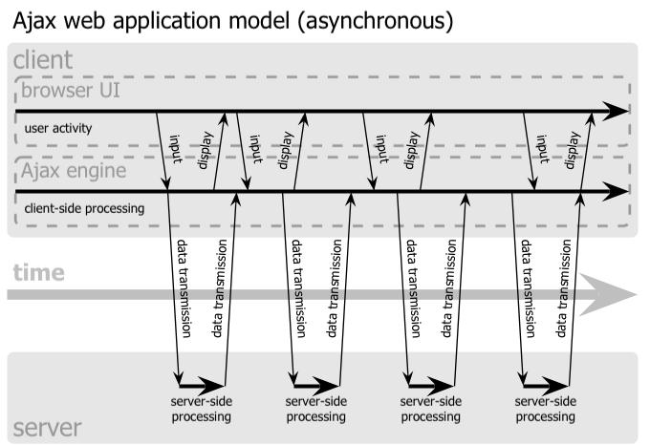
Ajax Model
Every user action that normally would generate an HTTP request takes the form of a JavaScript call to the Ajax engine
Notes:
Stat with: Who doesn’t own a cellphone? Say that it is different than anything we knew until today.

Slide 11
Ajax Model
Any response to a user action that doesn’t require a trip back to the server — such as simple data validation, editing data in memory, and even some navigation — the engine handles on its own.
If the engine needs something from the server in order to respond — if it’s submitting data for processing, loading additional interface code, or retrieving new data — the engine makes those requests asynchronously, usually using XML, without stalling a user’s interaction with the application.
The user is never staring at a blank browser window and an hourglass icon, waiting around for the server to do something.
Notes:
Stat with: Who doesn’t own a cellphone? Say that it is different than anything we knew until today.

Slide 12
Defining Ajax
Ajax incorporates several technologies, each flourishing in its own right, coming together in powerful new ways.
standards-based presentation using XHTML, CSS
dynamic display and interaction using DOM
data interchange and manipulation using XML, XSLT
asynchronous data retrieval using XMLHttpRequest
and JavaScript binding everything together.
Notes:
Stat with: Who doesn’t own a cellphone? Say that it is different than anything we knew until today.

Slide 13
XHTML, CSS
XHTML stands for EXtensible HyperText Markup Language
It consists of all the elements in HTML 4.01 combined with the syntax of XML.
CSS stands for Cascading Style Sheets
It is used to describe the presentation of a document written in HTML or XML.
Notes:
Stat with: Who doesn’t own a cellphone? Say that it is different than anything we knew until today.

Slide 14
DOM
The HTML DOM is the Document Object Model for HTML .
DOM provides a standard set of objects for representing HTML and XML documents, and a standard interface for accessing and manipulating them.
Essentially, it connects web pages to scripts or programming languages.
It defines an HTML document as a collection of objects that have properties and methods and that can respond to events
Notes:
Stat with: Who doesn’t own a cellphone? Say that it is different than anything we knew until today.

Slide 15
XML, XSLT
XML stands for EXtensible Markup Language
XML was designed to describe data and to focus on what data is (unlike HTML which was designed to display data and to focus on how data looks)
It is a general-purpose markup language for creating special-purpose markup languages that carry data.
XSL stands for EXtensible Stylesheet Language
XSLT stands for XSL Transformations
XSLT is used to transform an XML document into another XML document, or another type of document that is recognized by a browser, like HTML and XHTML
Notes:
Stat with: Who doesn’t own a cellphone? Say that it is different than anything we knew until today.

Slide 16
XMLHttpRequest
The kernel of Ajax is the XmlHttpRequest
The XMLHttpRequest object allows client-side JavaScript to make HTTP requests (both GET and POST) to the server without reloading pages in the browser and without blocking the user
This JavaScript object was originally introduced in Internet Explorer 5 by Microsoft (Gasp!, yes they actually invented something), and it is the enabling technology that allows asynchronous requests
Despite its name, you can use the XMLHttpRequest object with more than just XML. You can use it to request or send any kind of data.
Notes:
Stat with: Who doesn’t own a cellphone? Say that it is different than anything we knew until today.

Slide 17
XMLHttpRequest
By performing screen updates on the client, you have a great amount of flexibility when it comes to creating your Web site :
Eliminate page refreshes every time there is user input
Edit data directly in place, without requiring the user to navigate to a new page to edit the data
Increase site performance by reducing the amount of data downloaded from the server
The possibilities are endless!
Notes:
Stat with: Who doesn’t own a cellphone? Say that it is different than anything we knew until today.

Slide 18
JavaScript
JavaScript is one of the world's most popular programming languages
Its popularity is due entirely to its role as the scripting language of the WWW along with VBScript
JavaScript has a syntax similar to Java but:
It is not a real programming language (it is script)
It was developed at Netscape and not Sun.
It was originally called LiveScript, but that name wasn't confusing enough.
Notes:
Stat with: Who doesn’t own a cellphone? Say that it is different than anything we knew until today.

Slide 19
JavaScript
JavaScript binds all the mentioned technologies together to create the Ajax “pattern”.
When a user clicks a button, you can use JavaScript and XHTML to immediately update the UI
Then you spawn an asynchronous request to the server using the XMLHttpRequest object via JavaScript to perform an update or query a database.
When the request returns as XML, you can then use JavaScript, CSS, XSLT and DOM to update your UI accordingly without refreshing the entire page.
Most importantly, users don't even know your code is communicating with the server: the Web site feels like it's instantly responding ("desktop-like" usability)
Notes:
Stat with: Who doesn’t own a cellphone? Say that it is different than anything we knew until today.

Slide 20
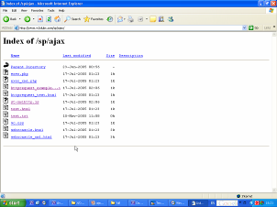
Small Example
In this example we have an HTML page:
In it we have a link
When we press it, it goes to another html page.
Reads its content from the server.
And pops an alert box with the content as a string.
Notes:
Stat with: Who doesn’t own a cellphone? Say that it is different than anything we knew until today.

Slide 21
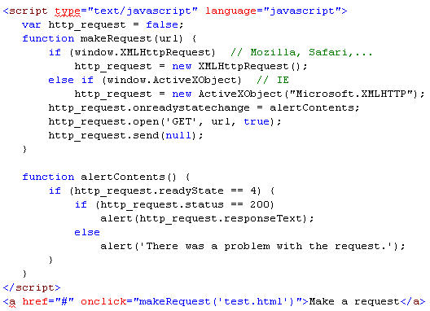
Small Example
if (window.XMLHttpRequest)
http_request = new XMLHttpRequest();
else if (window.ActiveXObject)
http_request = new ActiveXObject(“Microsoft.XMLHTTP”);
http_request.onreadystatechange= alertContents;
http_request.open(‘GET’, url, true);
http_request.send(null);
if (http_request.readyState == 4)
if (http_request.status == 200)
alert(http_request.responseText);
<a href=“#” onclick=“makeRequest(‘test.html’)”> Make a request </a>
Notes:
Stat with: Who doesn’t own a cellphone? Say that it is different than anything we knew until today.

Slide 22
Ajax Advantages
Client Side
Can produce smooth, uninterrupted user workflow.
Saves bandwidth by only transmitting new information
Creates possibility of entirely new types of user interfaces not possible in traditional model.
Developer Side
Provides a Middle-of-the-Road approach between sophisticated web design (Java applets and Flash) to simple web design (HTML).
Doesn't require 3rd party software like Java or Flash
Fits into normal code flow
Most developers already know JavaScript.
Notes:
Stat with: Who doesn’t own a cellphone? Say that it is different than anything we knew until today.

Slide 23
Ajax Disadvantages
Client Side
Poor compatibility with very old or obscure browsers, and many mobile devices.
Limited Capabilities like multimedia, interaction with web-cams and printers, local data storage and real time graphics.
The first-time long wait for Ajax sites.
Problem with back/forward buttons and bookmarks.
Developer Side
Easily Abused by “bad” programmers.
Not everyone have JavaScript enabled.
Too much code makes the browser slow.
Notes:
Stat with: Who doesn’t own a cellphone? Say that it is different than anything we knew until today.

Slide 24
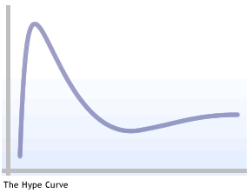
Ajax Alternatives
As a new technology moves through the hype curve, people emerge to raise the inevitable question "Why not something else?“
Now we have AJAX –
an admittedly powerful
approach to web development
is that because it's really
the best option for the job?
Notes:
Stat with: Who doesn’t own a cellphone? Say that it is different than anything we knew until today.

Slide 25
Ajax Alternatives
XUL
Pronounced "zool", XUL is a high performance markup language for creating rich dynamic user interfaces
It’s part of the Mozilla browser and related applications and is available in Mozilla browsers (like Firefox).
XUL is comprised mainly of a set of high-performance widgets that can be combined together
Advantages: high performance, fast, works with JavaScript, based on XML
Disadvantages: Only compatible with Mozilla browsers.
Notes:
Stat with: Who doesn’t own a cellphone? Say that it is different than anything we knew until today.

Slide 26
Ajax Alternatives
XAML
XAML is a high performance markup language for creating rich dynamic user interfaces.
It’s part of Avalon, Microsoft’s next generation UI technology (will be supported in IE 7).
Advantages: high performance, robust, highly configurable.
Disadvantages: Microsoft-only technology and will be available only when Vista is released.
Notes:
Stat with: Who doesn’t own a cellphone? Say that it is different than anything we knew until today.

Slide 27
Ajax Alternatives
Java Applets
An Applet is a program written in JAVA that can be included on a web page.
Advantages: Fast. Supported on most platforms (with the Java plugin).
Disadvantages: Requires the Sun Java plugin and takes a while to load.
Macromedia Flash & Shockwave (or the new FLEX)
These are powerful presentation-layer frameworks.
Advantages: Browser and platform compatibility. Speed and flexibility. Increasingly powerful development tools.
Disadvantages: General distrust from enterprise software developers. Rare skillset required.
Notes:
Stat with: Who doesn’t own a cellphone? Say that it is different than anything we knew until today.

Slide 28
Ajax Alternatives
SVG (Scalable Vector Graphics)
A text based graphics language that describes images with vector shapes, text, and embedded raster graphics.
It has good interoperability with CSS and JavaScript
Advantages: Speed and flexibility.
Disadvantages: Requires proprietary plugins that many firms will not allow users to install. Rare skillset required to do development. This language is still somewhat immature and developing.
Notes:
Stat with: Who doesn’t own a cellphone? Say that it is different than anything we knew until today.

Slide 29
Ajax Alternatives
Ajax | Applets | Flash | SVG | XAML | XUL
 |  |  |  |  |  | Desktop-like UI
 |  |  |  |  |  | Platform Independence
 |  |  |  |  |  | Vendor Independence
 |  |  |  |  |  | Skill Set Transferrance
Notes:
Stat with: Who doesn’t own a cellphone? Say that it is different than anything we knew until today.

Slide 30
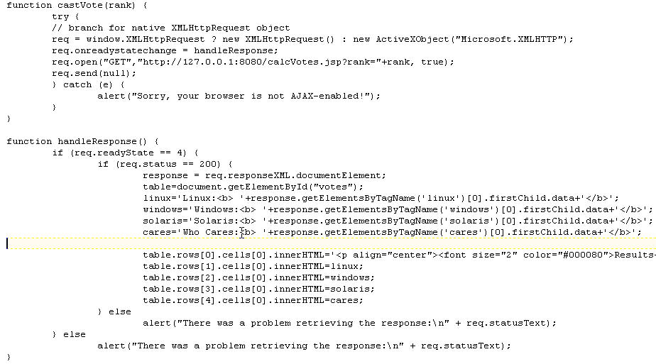
Raw XMLHttpRequest
The JavaScript File (voteRaw.js)
function castVote(rank)
req = window.XMLHttpRequest ?
new XMLHttpRequest() : new ActiveXObject("Microsoft.XMLHTTP");
req.onreadystatechange = handleResponse;
req.open("GET","http://127.0.0.1:8080/calcVotes.jsp?rank="+rank, true);
req.send(null);
if (req.readyState == 4) {
if (req.status == 200) {
response = req.responseXML.documentElement;
table=document.getElementById("votes");
linux='Linux:<b> '+response.getElementsByTagName('linux')[0].firstChild.data
…
…
table.rows[1].cells[0].innerHTML=linux;
table.rows[2].cells[0].innerHTML=windows;
…
function handleResponse()
Notes:
Stat with: Who doesn’t own a cellphone? Say that it is different than anything we knew until today.

Slide 31
Raw XMLHttpRequest
The HTML File – Pretty long boring HTML Stuff…
Only 2 related things:
At the <head> section we put a link to the file we created:
At the Vote form we link the links to the functions in the JavaScript file:
<script type="text/javascript" src="voteRaw.js"></script>
<tr>
<td class="sidemenuitem" width="134" align="center">
<a href="#" onclick="castVote(1); return false;">
Penguin Guy</a></td>
</tr>
Notes:
Stat with: Who doesn’t own a cellphone? Say that it is different than anything we knew until today.

