Slide 1
Hibernate
Ram Software Engineering Labs Pvt Ltd

Slide 2
Agenda
Hibernate framework – An Overview
Hibernate association and collection mapping
Hibernate object lifecycle
Hibernate transaction management
Hibernate querying
Hibernate HQL
Java Persistence API

Slide 3
Session 1: Introduction to Hibernate

Slide 4
Objectives
Refresher in enterprise application architectures
Traditional persistence
Hibernate motivation

Slide 5
Objectives
Refresher in enterprise application architectures
Traditional persistence
Hibernate motivation

Slide 6
N-Tier Architecture
Application is made up of layers or tiers
Each layer encapsulates specific responsibilities
Enables changes in one area with minimal impact to other areas of the application

Slide 7
N-Tier Architecture (Cont)
Common tiers
– Presentation
• ‘View’ in model-view-controller
• Responsible for displaying data only. No business logic
– Service
• Responsible for business logic
– Persistence
• Responsible for storing/retrieving data

Slide 8
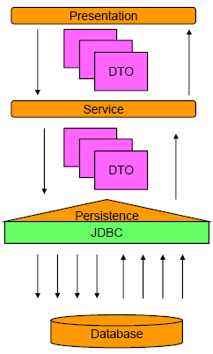
N-Tier Architecture (Cont)

Slide 9
DAO Design Pattern
Data Access Object
– Abstracts CRUD (Create, Retrieve, Update, Delete) operations
Benefits
– Allows different storage implementations to be ‘plugged in’ with minimal impact to the rest of the system
– Decouples persistence layer
– Encourages and supports code reuse

Slide 10
Objectives
Refresher in enterprise application architectures
Traditional persistence
Hibernate motivation

Slide 11
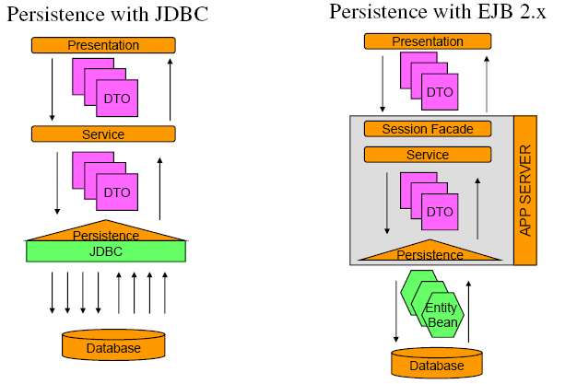
Traditional Persistence

Slide 12
JDBC Overview
JDBC API provides ability to
– Establish connection to a database
– Execute SQL statements
– Create parameterized queries
– Iterate through results
– Manage database transactions

Slide 13
JDBC Overview (Cont)
Basic Steps to JDBC Operations
Load driver or obtain datasource
Establish connection using a JDBC URL
Create statement
Execute statement
Optionally, process results in result set
Close database resources
Optionally, commit/rollback transaction

Slide 14
JDBC Example – Create Account
public Account createAccount(Account account) {
Connection connection = null;
PreparedStatement getAccountIdStatement = null;
PreparedStatement createAccountStatement = null;
ResultSet resultSet = null;
long accountId=0;
// Load driver
try {
Class.forName("oracle.jdbc.driver.OracleDriver");
catch (Exception e) {
throw new RuntimeException(e);
}
try {
//Get connection and set auto commit to false
Connection connection =
DriverManager.getConnection("jdbc:oracle:
thin:lecture1/lecture1@localhost:1521:XE");
connection.setAutoCommit(false);
...

Slide 15
JDBC Example – Create Account(Cont)
...
//Get account id from sequence
getAccountIdStatement = connection
.prepareStatement("SELECT ACCOUNT_ID_SEQ.NEXTVAL
FROM DUAL");
resultSet = getAccountIdStatement.executeQuery();
resultSet.next();
accountId = resultSet.getLong(1);
//Create the account
createAccountStatement = connection
.prepareStatement(AccountDAOConstants.CREATE_ACCOUNT);
createAccountStatement.setLong(1, accountId);
createAccountStatement.setString(2,
account.getAccountType());
createAccountStatement.setDouble(3, account.getBalance());
createAccountStatement.executeUpdate();
//Commit transaction
connection.commit();
}
...

Slide 16
JDBC Example – Create Account(Cont)
...
catch (SQLException e) {
//In case of exception, rollback
try{
connection.rollback();
}catch(SQLException e1){// log error}
throw new RuntimeException(e);
}
finally {
//close database resources
try {
if (resultSet != null)
resultSet.close();
if (getAccountIdStatement!= null)
getAccountIdStatement.close();
if (createAccountStatement!= null)
createAccountStatement.close();
if (connection != null)
connection.close();
} catch (SQLException e) {// log error}
}
}

Slide 17
Objectives
Refresher in enterprise application architectures
Traditional persistence
Hibernate motivation

Slide 18
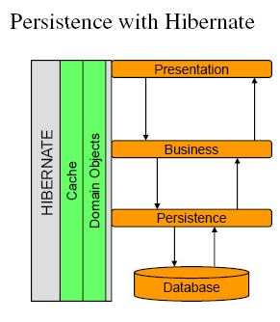
Traditional Persistence vs. Hibernate

Slide 19
Hibernate History
Grass roots development (2001)
– Christian Bauer
– Gavin King
JBoss later hired lead Hibernate developers (2003)
– Brought Hibernate under the Java EE specification
– Later officially adopted as the official EJB3.0 persistence
implementation for the JBoss application server.
EJB 3.0 Expert Group (2004)
– Key member which helped shape EJB3.0 and JPA
NHibernate
– .NET version release in 2005

Slide 20
Why Hibernate?
Impedance mismatch
– Object-oriented vs. relational
Failure of EJB 2.x
– Entity Beans were extremely slow, complex
Reduce application code by 30%
- Less code is better maintainable

Slide 21
Why Hibernate?
Java developers are not database developers
– Reduce the need for developers to know and fully understand database design, SQL, performance tuning
– Increase portability across database vendors
Increase performance by deferring to experts
– Potential decrease in database calls
– More efficient SQL statements
– Hibernate cache usage

Slide 22
Summary
Refresher in application architectures
Traditional Persistent implementation
– JDBC example
Motivation
– Origination and history of Hibernate
– Reasons for Hibernates development
• Impedance mismatch
• Failure of EJB 2.x
• Java developers are not database developers
• Performance benefits

Slide 23
Session 2: Walk-through of a Simple Hibernate Example

Slide 24
Objectives
Creating a simple, but full, end to end Hibernate Application
How to use JUnit in developing Enterprise Application

Slide 25
Objectives
Creating a simple, but full, end to end Hibernate Application
How to use JUnit in developing Enterprise Application

Slide 26
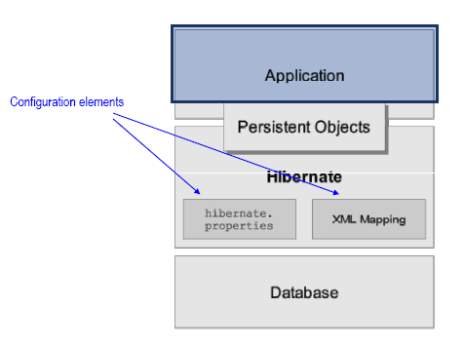
High Level Architecture

Slide 27
Building a Hibernate Application
1. Define the domain model
2. Setup your Hibernate configuration
– hibernate.cfg.xml
3. Create the domain object mapping files
– <domain_object>.hbm.xml
4. Make Hibernate aware of the mapping files
– Update the hibernate.cfg.xml with list of mapping files
5. Implement a HibernateUtil class
– Usually taken from the Hibernate documentation
6. Write your code

Slide 28
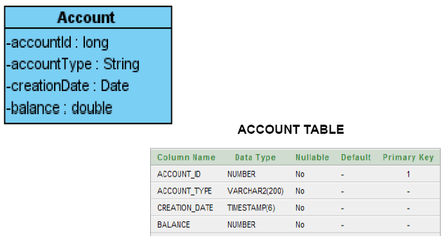
Account Object / Table

Slide 29
hibernate.cfg.xml
<?xml version="1.0" encoding="UTF-8"?>
<!DOCTYPE hibernate-configuration PUBLIC
"-//Hibernate/Hibernate Configuration DTD 3.0//EN"
"http://hibernate.sourceforge.net/hibernate-configuration-3.0.dtd">
<hibernate-configuration>
<session-factory>
. . .
</session-factory>
<hibernate-configuration>
Configure Hibernate here, particularly the session-factory

Slide 30
hibernate.cfg.xml (Cont)
...
<session-factory>
<property name="hibernate.connection.driver_class">
oracle.jdbc.driver.OracleDriver</property>
<property name="hibernate.connection.url">jdbc:oracle:thin:@localhost:1521:XE
</property>
<property name="hibernate.connection.username">lecture2</property>
<property name="hibernate.connection.password">lecture2</property>
...

Slide 31
hibernate.cfg.xml (Cont)
...
<property name="dialect">
org.hibernate.dialect.Oracle10gDialect</property>
<property name="connection.pool_size">1</property>
<property name="current_session_context_class">thread</property>
<property name="show_sql">true</property>
<property name="format_sql">false</property>
</session-factory>
…

Slide 32
Configuring Hibernate
There are multiple ways to configure Hibernate, and an application can leverage multiple methods at once
Hibernate will look for and use configuration properties in the following order
– hibernate.properties (when ‘new Configuration()’ is called)
– hibernate.cfg.xml (when ‘configure()’ is called on Configuration)
– Programatic Configuration Settings

Slide 33
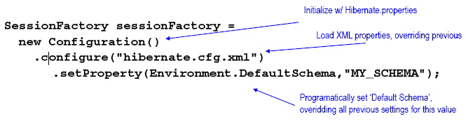
Configuring Hibernate(Cont)

Slide 34
Object Mapping Files
<?xml version="1.0"?>
<!DOCTYPE hibernate-mapping PUBLIC
"-//Hibernate/Hibernate Mapping DTD 3.0//EN"
"http://hibernate.sourceforge.net/hibernate-mapping-3.0.dtd">
<hibernate-mapping>
<class>
. . .
</class>
</hibernate-mapping>
Describe your class attributes here.

Slide 35
Account.hbm.xml Mapping File
...
<class name="courses.hibernate.vo.Account“ table="ACCOUNT">
<id name="accountId" column="ACCOUNT_ID">
<generator class="native"/>
</id>
<property name="creationDate" column="CREATION_DATE“ type="timestamp" update="false"/>
<property name="accountType" column="ACCOUNT_TYPE“ type="string" update="false"/>
<property name="balance" column="BALANCE“ type="double"/>
</class>
...

Slide 36
Hibernate ID Generators
Native:
– Leverages underlying database method for generating ID (sequence, identity, etc…)
Increment:
– Automatically reads max value of identity column and increments by 1
UUID:
– Universally unique identifier combining IP & Date (128-bit)
Many more…

Slide 37
Make Hibernate aware of the mapping files
...
<property name="dialect">org.hibernate.dialect.Oracle10gDialect
</property>
<property name="connection.pool_size">1</property>
<property name="current_session_context_class">thread</property>
<property name="show_sql">true</property>
<property name="format_sql">false</property>
<mapping resource="Account.hbm.xml"/>
</session-factory>
…

Slide 38
HibernateUtil
Convenience class to handle building and obtaining the Hibernate SessionFactory
– Use recommended by the Hibernate org
SessionFactory is thread-safe
– Singleton for the entire application
Used to build Hibernate ‘Sessions’
– Hibernate Sessions are NOT thread safe
– One per thread of execution

Slide 39
HibernateUtil (Cont)
import org.hibernate.SessionFactory;
import org.hibernate.cfg.Configuration;
public class HibernateUtil {
private static final SessionFactory sessionFactory;
// initialize sessionFactory singleton
static {
sessionFactory = new Configuration().
configure().buildSessionFactory();
}
// method used to access singleton
public static SessionFactory getSessionFactory() {
return sessionFactory;
}
}

Slide 40
Session API
How to get Hibernate Session instance
Session session =HibernateUtil.getSessionFactory().getCurrentSession();
Hibernate Session
– session.saveOrUpdate()
– session.get()
– session.delete()
What about just plain save?
– It’s there, but not typically used
– session.save()

Slide 41
Account DAO – saveOrUpdate()
public void saveOrUpdateAccount(Account account) {
Session session =
HibernateUtil.getSessionFactory().getCurrentSession();
session.saveOrUpdate(account);
}
Remember the number of LOC needed to do this with JDBC?

Slide 42
Account DAO – get()
public Account getAccount(long accountId) {
Session session =
HibernateUtil.getSessionFactory().getCurrentSession();
Account account =
(Account)session.get(Account.class,accountId);
return account;
}

Slide 43
Account DAO – delete()
public void deleteAccount(Account account) {
Session session =
HibernateUtil.getSessionFactory().getCurrentSession();
session.delete(account);
}

Slide 44
Service Layer - AccountService
import courses.hibernate.dao.AccountDAO;
import courses.hibernate.vo.Account;
/**
* Service layer for Account
*/
public class AccountService {
AccountDAO accountDAO = new AccountDAO();
...
}
Declare all business methods here

Slide 45
AccountService – business methods
/**
* Create a new account or update an existing one
* @param account
* account to be persisted
*/
public void saveOrUpdateAccount(Account account) {
accountDAO.saveOrUpdateAccount(account);
}

Slide 46
AccountService – business methods
/**
* Retrieve an account
* @param accountId
* identifier of the account to be retrieved
* @return account represented by the identifier provided
*/
public Account getAccount(long accountId) {
return accountDAO.getAccount(accountId);
}

Slide 47
AccountService – business methods
/**
* Delete account
* @param account
* account to be deleted
*/
public void deleteAccount(Account account) {
accountDAO.deleteAccount(account);
}

Slide 48
Testing with JUnit
JUnit is an open source framework to perform testing against units of code.
– A single test class contains several test methods
– Provides helper methods to make ‘assertions’ of expected results
– Common to have multiple test classes for an application

Slide 49
Using JUnit
Download the jar from JUnit.org
Add downloaded jar to project classpath
Create a class to house your test methods, naming it anything you like (typically identifying it as a test class)
Implement test methods, naming them anything you like and marking each with the @Test annotation at the method level
Call the code to be tested passing in known variables and based on expected behavior, use ‘assert’ helper methods provided by Junit to verify correctness
– Assert.assertTrue(account.getAccountId() == 0);

Slide 50
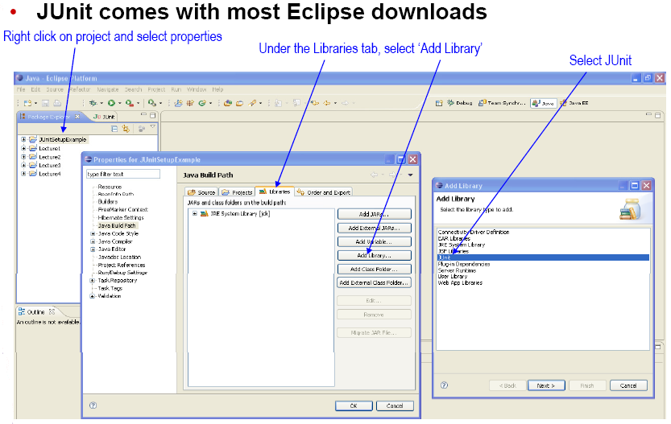
JUnit and Eclipse

Slide 51
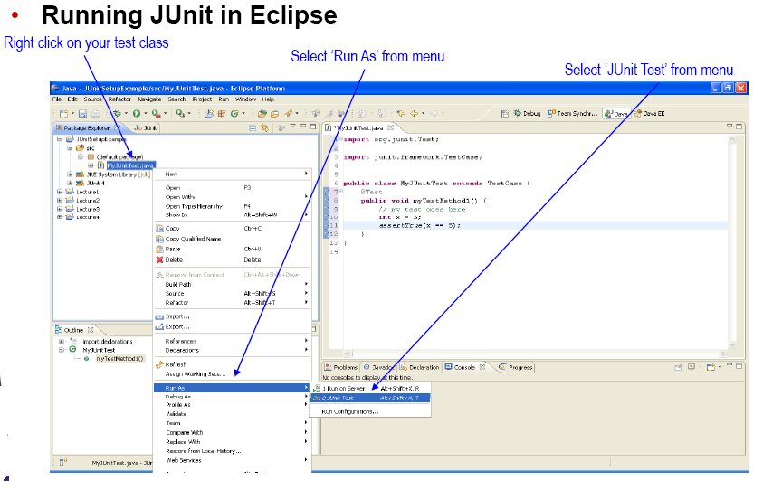
JUnit and Eclipse

Slide 52
Test Create
@Test
public void testCreateAccount() {
Session session = HibernateUtil.getSessionFactory().getCurrentSession();
session.beginTransaction();
Account account = new Account();
// no need to set id, Hibernate will do it for us
account.setAccountType(Account.ACCOUNT_TYPE_SAVINGS);
account.setCreationDate(new Date());
account.setBalance(1000L);
// confirm that there is no accountId set
Assert.assertTrue(account.getAccountId() == 0);
...

Slide 53
Test Create (Cont)
. . .
// save the account
AccountService accountService = new AccountService();
accountService.saveOrUpdateAccount(account);
session.getTransaction().commit();
HibernateUtil.getSessionFactory().close();
System.out.println(account);
// check that ID was set after the hbm session
Assert.assertTrue(account.getAccountId() > 0);
}

Slide 54
Handling Transactions
Why am I starting/ending my transactions in
my test case?
– In order to take advantage of certain Hibernate features, the Hibernate org recommends you close your transactions as late as possible. For test cases, this means in the tests themselves
– Later we’ll discuss suggested ways of handling this within applications

Slide 55
Test Get
@Test
public void testGetAccount() {
Account account = createAccount(); // create account to get
Session session = HibernateUtil.getSessionFactory().getCurrentSession();
session.beginTransaction();
AccountService accountService = new AccountService();
Account anotherCopy = accountService.getAccount(account.getAccountId());
// make sure these are two separate instances
Assert.assertTrue(account != anotherCopy);
session.getTransaction().commit();
HibernateUtil.getSessionFactory().close();
}

Slide 56
Test Update Balance
@Test
public void testUpdateAccountBalance() {
// create account to update
Account account = createAccount();
Session session = HibernateUtil.getSessionFactory().getCurrentSession();
session.beginTransaction();
AccountService accountService = new AccountService();
account.setBalance(2000);
accountService.saveOrUpdateAccount(account);
session.getTransaction().commit();
HibernateUtil.getSessionFactory().close();
...

Slide 57
Test Update Balance (Cont)
. . .
Session session2 = HibernateUtil.getSessionFactory().getCurrentSession();
session2.beginTransaction();
Account anotherCopy = accountService.getAccount(account.getAccountId());
System.out.println(anotherCopy);
// make sure the one we just pulled back from the
// database has the updated balance
Assert.assertTrue(anotherCopy.getBalance() == 2000);
session2.getTransaction().commit();
HibernateUtil.getSessionFactory().close();
}

Slide 58
Test Delete
@Test
public void testDeleteAccount() {
// create an account to delete
Account account = createAccount();
Session session = HibernateUtil.getSessionFactory().getCurrentSession();
session.beginTransaction();
AccountService accountService = new AccountService();
// delete the account
accountService.deleteAccount(account);
session.getTransaction().commit();
HibernateUtil.getSessionFactory().close();
...

Slide 59
Test Delete (Cont)
...
Session session2 = HibernateUtil.getSessionFactory().getCurrentSession();
session2.beginTransaction();
// try to get the account again -- should be null
Account anotherCopy = accountService.getAccount(account.getAccountId());
System.out.println("var anotherCopy = "+ anotherCopy);
Assert.assertNull(anotherCopy);
session2.getTransaction().commit();
HibernateUtil.getSessionFactory().close();
}

Slide 60
Summary
End to end Hibernate Application
- Configuration
hibernate.cfg.xml
<property name="hibernate.connection.url">jdbc:oracle:thin:@localhost:1521:XE
</property>
Object mapping files
Account.hbm.xml
<class name="courses.hibernate.vo.Account“
table="ACCOUNT">
<property name="accountType“ column="ACCOUNT_TYPE“ type="string"
update="false"/>

Slide 61
Summary (Cont)
– HibernateUtil to handle Session
static {
sessionFactory = newConfiguration()
.configure().buildSessionFactory();
}
public static SessionFactory getSessionFactory() {
return sessionFactory;
}
– Writing the implementation
Session session = HibernateUtil.getSessionFactory().getCurrentSession();
session.saveOrUpdate(account);

Slide 62
Q & A

