Slide 1
Java Web services

Slide 2
Overall Presentation Goal
Understand the different ways that SOAP and REST endpoints can be implemented using Java Web Services.

Slide 3
Java WS have improved since J2EE 1.4 and JAX-RPC.
JAXB standard XML Binding
JAX-WS much better than JAX-RPC
JAX-RS REST API being developed for Java EE 6 (JSR-311)

Slide 4
Outline
Web Services Platform Architecture (WSPA)
Basic REST with HttpServlet
WSDL, SOAP, and Java/XML Binding
JAXB and JAX-WS
JAX-RS for REST
The ServiceLayerTM Framework

Slide 5
Web Services are Hard
Java – OO Programming Paradigm
Web Services – Message Exchange Paradigm
…
creates an
….
Impedance Mismatch

Slide 6
Impedance Mismatch

Slide 7
Web Services Platform Architecture (WSPA)
WSPA Identifies Three Components of JWS
Invocation
Proxies Represent Web Services in Java
Interface to Messaging System (HTTP)
QoS (Handlers)
Marshalling (Impedance Matcher)
Java/XML Binding
Deployment
Implement Web Service Endpoints (SOAP, REST) with Java

Slide 8
Invocation

Slide 9
Java Proxies Represent Web Services

Slide 10
Marshalling and Unmarshalling

Slide 11
Deployment
Notes:
Arrows show dependencies. Objects with multiple roles have multiple dependencies. E.g., Java Target is deployed both in the container and as a web service.

Slide 12
REST vs. SOAP
 | REST | SOAP
Message Format | XML / JSON¹ | SOAP
Interface Definition | None² | WSDL
Transport | HTTP | HTTP³, FTP, MIME, JMS, SMTP, etc.
Also uses HTTP headers and query string. XML Schema sometimes provided. And “out of band” documentation. Without WS-Addressing, SOAP relies on the message transport for dispatching (e.g., HTTP context path).

Slide 13
REST vs. SOAP
REST is best when …
Rapid prototyping and quick demos for endusers are important.
Data is not highly structured or well defined by a schema – so you want to experiment and see the data in a browser and write code based on that.
SOAP is best when …
Bullet-proof integration of systems is important.
Well defined application interfaces are needed.
Data conforms to a schema.
QoS (e.g., guaranteed delivery) issues are important.

Slide 14
Code Examples
Implementing REST Services
HttpServlet vs. JAX-WS vs. JAX-RS

Slide 15
Basic REST – HttpURLConnection

Slide 16
Basic REST – Dispatch<Source> (JAX-WS 2.0 )

Slide 17
Basic REST - HttpServlet

Slide 18
Basic REST – Provider<Source>

Slide 19
REST using JAX-RS (Java EE 6 Preview)

Slide 20
The Role of WSDL in Enterprise SOA

Slide 21
Mapping WSDL and XML Schema to Java
WSDL
JAXB
types
Service Endpoint
Implementation (SEI)
portType
JAX-WS
operation
+ method(…)

Slide 22
Approaches to Web Services Development

Slide 23
Code First
Annotate Your Code
Deploy it in a container that supports JAX-WS
The JAX-WS runtime will:
Generate WSDL.
Translate SOAP request to a Java method invocation.
Translate method return into a SOAP response.

Slide 24
SOA Using Java Web Services – Part I
JAX-WS – Client Side Invocation with Proxy

Slide 25
DEMO
Code First With JAX-WS

Slide 26
Contract First
“Compile” the WSDL for the service that you would like to deploy.
wsimport reads the WSDL and generates an interface for each portType
Create a class that implements each interface. The business logic of these classes implements your Web services.
Deploy these Service Endpoint Implementation classes to a JAX-WS container.

Slide 27
SOA Using Java Web Services – Part I
JAX-WS – Server Side Invocation Subsystem

Slide 28
DEMO
Contract First
With JAX-WS

Slide 29
SOA Application Development Challenges
Too Much Mapping Code
JAX-WS/JAXB generated Java and WSDL leads to multiple types for similar things (e.g., PurchaseOrder).
Lots of code (or XSLT) must be created and maintained to map/translate between types.
Production Systems are often difficult or impossible to modify by adding @WebService type annotations.

Slide 30
A JAXB Mapping Problem (Impedance Mismatch)

Slide 31
Solution 1: Custom Mappings (“DIY” Recursion)

Slide 32
Solution 2 – Customization with XmlAdapter

Slide 33
Meet in the Middle
Start with WSDL and XML Schema …
… AND existing Java classes.
Two sides of the same problem:
Invoke the Web services using your existing Java classes as parameters (e.g., PurchaseOrder).
Deploy your existing Java classes to provide Web services that conform to the existing WSDL and XML Schema.
This is the most common scenario faced by enterprises that are implementing SOA using Java Web Services.

Slide 34
Java Programmers Need a Web Services Framework
Servlets/JSPs → Struts
JAX-WS/JAXB → ??? JWS Framework ???
A JWS Framework should provide two capabilities:
Adapter Bindings
Endpoint Mirroring

Slide 35
Mapping Code Problem
Supplier1
Web Service
Supplier2
Web Service
Supplier2
Web Service
PO1
PO2
PO3
Map1
Map2
Map3
PO

Slide 36
Adapter Binding
Implements “Meet in the Middle”
Organizes, manages, maintains the mapping code in a library of reusable type mappings.
Hides the complexity of mapping from business logic programmers.
WSDL
Adapter
Binding
Java
Meet in the
Middle

Slide 37
Endpoint Mirroring
SOAP
Duplicate a production API with a WS publishing system.
Bind the duplicate API to a WS endpoint using JAX-WS or JAX-RS.
No disruption of the production system.
@WebService
Purchasing
Invoker
Production
Purchasing

Slide 38
DEMO
ServiceLayerTM
Java-WS Framework

Slide 39
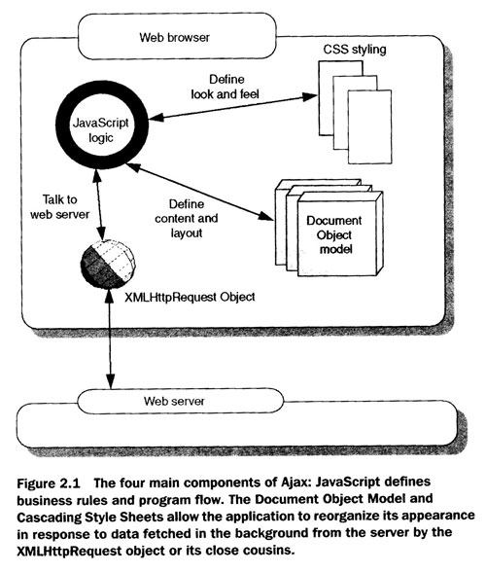
What is AJAX?
Asynchronous JavaScript and XML
An Interaction Model
A Set of Technologies for Rich Client Development
...
A Composite Application Framework for Flexible Business Process Management ???
“Ajax In Action”, Dave Crane et al., Chapter 2 pg 33

Slide 40
SOA Using JWS and Ajax

Slide 41
SOAShopper Architecture

Slide 42
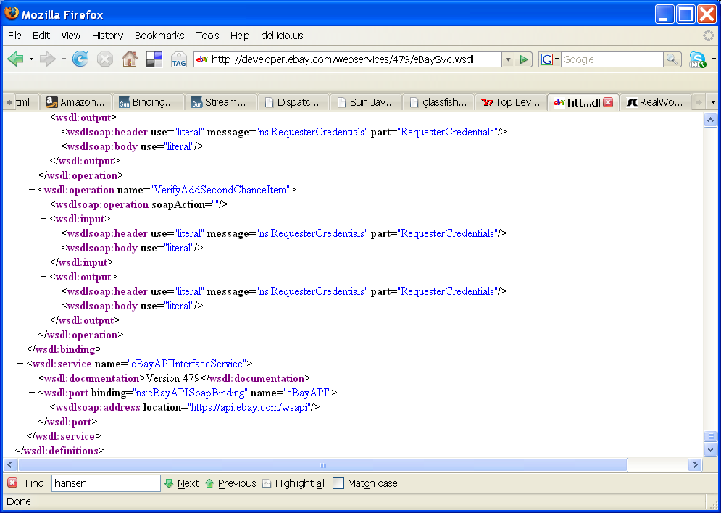
eBay WSDL

Slide 43
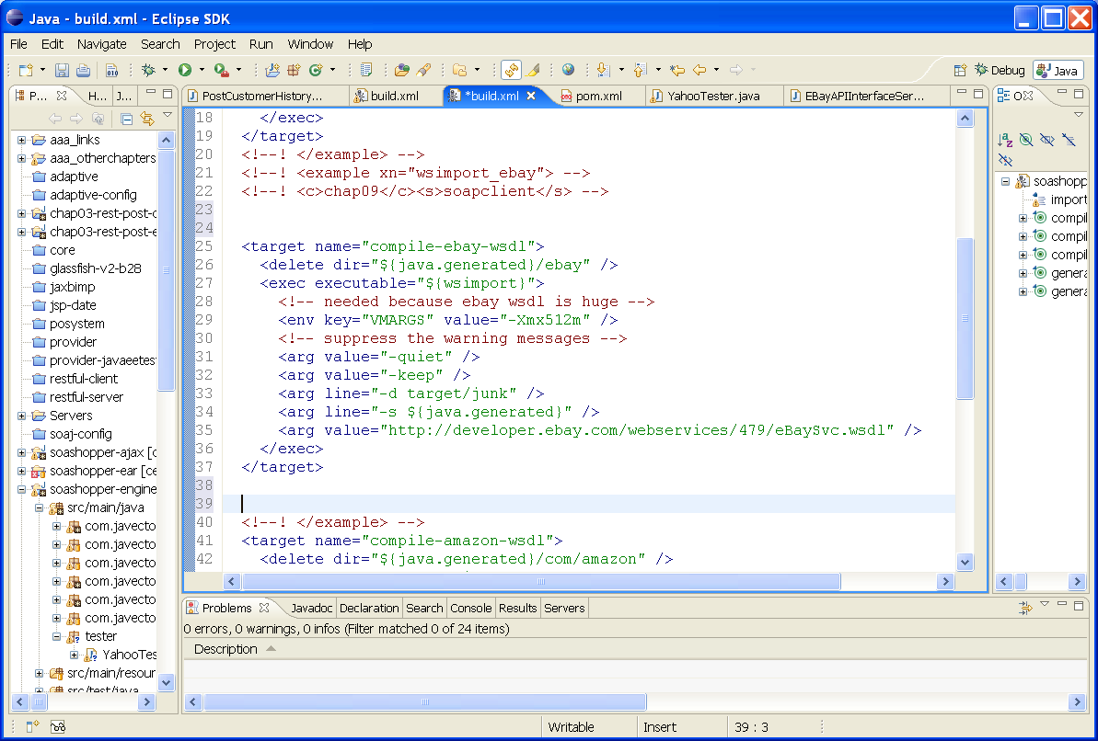
Ant Task to Compile eBay WSDL

Slide 44
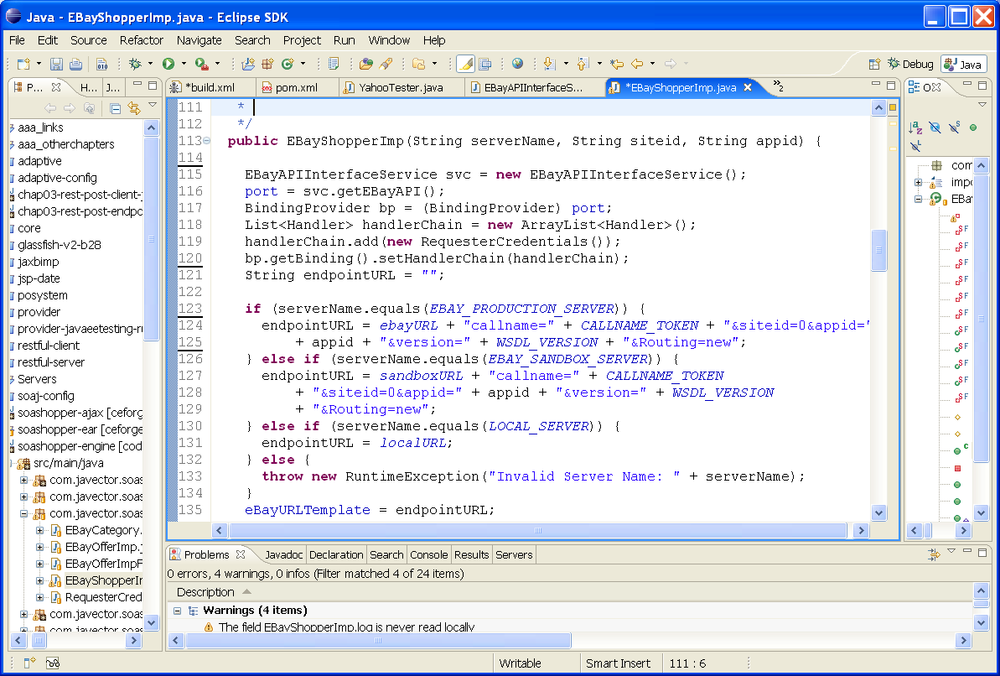

Using the Generated eBay API

Slide 45
A Client Binding Example
public List<Offer> offerSearch(
String keywords, Category category,
Price lowprice, Price highprice) {
ShopperImp binding =
BindingService.getBinding(
ShopperImp.class, EBayAPIInterface.class);
return
binding.offerSearch(keywords,
category, lowprice, highprice);
}

Slide 46
Meet in the Middle – Service Integration Bridge

Slide 47
Meet in the Middle – Object Integration Bridge

Slide 48
Implementing a Binding Service
public abstract class BindingService {
public static <C> C getBinding(
Class<C> client, Class<?> service) {
...
}
}

Slide 49
Demo
SOAShopper – Integrating Yahoo!, Amazon, and eBay

