Slide 1
Java EE Security
Ram Software Engineering Labs Pvt Ltd

Slide 2
Goals
Understand the basic concepts behind Java EE Security
Be able to define an access control policy for our applications
EJB Tier
Web Tier
Be able to define and use an authentication provider

Slide 3
Objectives
Java EE Access Control Points
EJB Access Control
JNDI Login
Web Tier Access Control
Run-As

Slide 4
Java EE Access Control Points

Slide 5
EJB Security

Slide 6
EJB Access Control: Annotations
@PermitAll
public String pingAll() {
return getInfo("pingAll");
}
@RolesAllowed({"user"})
public String pingUser() {
return getInfo("pingUser");
}
@RolesAllowed({"admin"})
public String pingAdmin() {
return getInfo("pingAdmin");
}
@DenyAll
public String pingExcluded() {
return getInfo("pingExcluded");
}

Slide 7
EJB Access Control: ejb-jar.xml
<assembly-descriptor>
<method-permission>
<unchecked/>
<method>
<ejb-name>SecurePingEJB</ejb-name>
<method-name>pingAll</method-name>
</method>
</method-permission>
<method-permission>
<role-name>admin</role-name>
...
<method-name>pingAdmin</method-name>
</method>
</method-permission>
<method-permission>
<excluded/>
...
<method-name>pingExcluded</method-name>
</method>
</method-permission>
</assembly-descriptor>

Slide 8
Programmatic Security
Permits access control down to object level
@PermitAll
public void internalCheck() {
if (ctx.isCallerInRole(“internalRole”)) { ... }
}
ejb-jar.xml – map internal role-name to security-role
<enterprise-beans>
<session>
<ejb-name>SecurePingEJB</ejb-name>
<security-role-ref>
<description>role-name checked within EJB
</description>
<role-name>internalRole</role-name>
<role-link>admin</role-link>
</security-role-ref>
</session>
</enterprise-beans>
<assembly-descriptor>
<security-role>
<role-name>admin</role-name>
</security-role>
</assembly-descriptor>

Slide 9
JBoss Server Setup: standalone.xml
<security-domain name="other" cache-type="default">
<authentication>
<login-module code="Remoting" flag="optional">
<module-option name="password-stacking" value="useFirstPass"/>
</login-module>
<login-module code="RealmUsersRoles" flag="required">
<module-option name="usersProperties"
value="${jboss.server.config.dir}/application-users.properties"/>
<module-option name="rolesProperties"
value="${jboss.server.config.dir}/application-roles.properties"/>
<module-option name="realm" value="ApplicationRealm"/>
<module-option name="password-stacking" value="useFirstPass"/>
</login-module>
</authentication>
</security-domain>

Slide 10
EJB Setup: META-INF/jboss-ejb3.xml
<?xml version="1.0"?>
<jboss:ejb-jar
xmlns:jboss="http://www.jboss.com/xml/ns/javaee"
xmlns:sec="urn:security"
xmlns="http://java.sun.com/xml/ns/javaee"
xmlns:xsi="http://www.w3.org/2001/XMLSchema-instance"
xsi:schemaLocation="http://www.jboss.com/xml/ns/javaee http://www.jboss.org/j2ee/schema/jboss-ejb3-2_0.xsd
http://java.sun.com/xml/ns/javaee http://www.jboss.org/j2ee/schema/jboss-ejb3-spec-2_0.xsd
urn:security urn:security"
version="3.1"
impl-version="2.0">
<assembly-descriptor>
<sec:security>
<ejb-name>*</ejb-name>
<sec:security-domain>other</sec:security-domain>
</sec:security>
</assembly-descriptor>
</jboss:ejb-jar>

Slide 11
JBoss Server Setup: UserRolesLoginModule
> cat standalone/configuration/application-users.properties
known=3745b3f6973383c9c11810c7b200b1f4
user1=2dc3eacfed8cf95a4a31159167b936fc
admin1=2ae76a0e3f0b615a6229c880555273b5
publisher1=339f01ebd721959a38efe71b27cb9e0f
subscriber1=a74cfc25bf9656748f8c739e85c458ed
requestor1=46f7f1aa4b38e1ea1ac9e638453fcf4a
worker1=b7c10ea4277ca245d50b85707728ddf3
> cat standalone/configuration/application-roles.properties
user1=user
admin1=user,admin
publisher1=publisher
subscriber1=subscriber
requestor1=requestor
worker1=worker

Slide 12
Alternate Modules
<application-policy name = "ejavaDomain">
<authentication>
<login-module
code="org.jboss.security.auth.spi.UsersRolesLoginModule"
flag="sufficient"> <!-- first provide a quick back door -->
<module-option name="unauthenticatedIdentity">anonymous
</module-option>
</login-module>
<login-module
code="org.jboss.security.auth.spi.DatabaseServerLoginModule"
flag="required"> <!-- now delegate realistic DB module -->
<module-option name = "unauthenticatedIdentity">anonymous
</module-option>
<module-option name = "dsJndiName">java:/ejavaDS</module-option>
<module-option name = "principalsQuery">
SELECT PASSWD FROM EJAVA_Users WHERE USERID=?</module-option>
<module-option name = "rolesQuery">
SELECT Role, 'Roles' FROM EJAVA_UserRoles WHERE USERID=?
</module-option>
</login-module>
</authentication>
</application-policy>

Slide 13
JBoss Server Setup: DatabaseServerLoginModule
securePing_create.ddl
CREATE TABLE EJAVA_Users(
userId VARCHAR(32) PRIMARY KEY,
passwd VARCHAR(64)
)
CREATE TABLE EJAVA_UserRoles(
userId VARCHAR(32),
Role VARCHAR(32)
)
securePing_populate.ddl
insert into EJAVA_Users values('admin3', 'password')
insert into EJAVA_UserRoles values('admin3', 'admin')
insert into EJAVA_UserRoles values('admin3', 'user')
insert into EJAVA_Users values('user4', 'password')
insert into EJAVA_UserRoles values('user4', 'user')

Slide 14
Client Authentication
JNDI Login

Slide 15
jndi.properties (JBoss Remoting)
$ cat src/test/resources/jndi.properties
java.naming.factory.initial=${jboss.remoting.java.naming.factory.initial}
java.naming.factory.url.pkgs=${jboss.remoting.java.naming.factory.url.pkgs}
java.naming.provider.url=${jboss.remoting.java.naming.provider.url}
#java.naming.security.principal=${jboss.remoting.java.naming.security.principal}
#java.naming.security.credentials=${jboss.remoting.java.naming.security.credentials}
jboss.naming.client.ejb.context=true
$ cat target/test-classes/jndi.properties
java.naming.factory.initial=org.jboss.naming.remote.client.InitialContextFactory
java.naming.factory.url.pkgs=
java.naming.provider.url=remote://127.0.0.1:4447
#java.naming.security.principal=known
#java.naming.security.credentials=password
jboss.naming.client.ejb.context=true

Slide 16
InitialContext
private Context runAs(String username, String password)
throws NamingException {
Properties env = new Properties();
if (username != null) {
env.put(Context.SECURITY_PRINCIPAL, username);
env.put(Context.SECURITY_CREDENTIALS, password);
}
return new InitialContext(env);

Slide 17
Authentication
Context jndi = null;
try {
jndi = runAs(adminUser, adminPassword);
SecurePing ejb=(SecurePing)jndi.lookup(jndiName);
String result=ejb.pingAll();
log.info(result);
}
catch (Exception ex) {
fail("error calling pingAll:" +ex);
}
finally {
if (jndi != null) { jndi.close(); jndi=null; }
}

Slide 18
Client/EJB Test Drive: EJB Code
@RolesAllowed({"admin"})
public String pingAdmin() {
return getInfo("pingAdmin");
}
private String getInfo(String prefix) {
StringBuilder text = new StringBuilder();
text.append("called " + prefix);
try {
text.append(", principal="+ ctx.getCallerPrincipal().getName());
text.append(", isUser=" + ctx.isCallerInRole("user"));
text.append(", isAdmin=" + ctx.isCallerInRole("admin"));
text.append(", isInternalRole=" +
ctx.isCallerInRole("internalRole"));
}
catch (Throwable ex) {
text.append(", error calling Session Context:" + ex);
}
String result = text.toString();
return result;
}

Slide 19
Client/EJB Test Drive: Anonymous Client
try {
jndi=runAs(null, null);
SecurePing ejb=(SecurePing)jndi.lookup(jndiName);
log.info(ejb.pingAdmin());
fail("didn't detect anonymous user");
} catch (NamingException ex) {
log.info("expected exception thrown:" + ex);
} catch (Exception ex) {
fail("unexpected exception type:" + ex);
} finally {
if (jndi != null) { jndi.close(); jndi=null; }
}
-expected exception thrown:javax.naming.NamingException: Failed to create remoting connection [Root exception is java.lang.RuntimeException: javax.security.sasl.SaslException: Authentication failed: all available authentication mechanisms failed]

Slide 20
Client/EJB Test Drive: Known Client
try {
jndi=runAs(knownUser, knownPassword);
SecurePing ejb=(SecurePing)jndi.lookup(jndiName);
log.info(ejb.pingAdmin());
fail("didn't detect known, but non-admin user");
} catch (EJBAccessException ex) {
log.info("expected exception thrown:" + ex);
} catch (Exception ex) {
fail("unexpected exception type:" + ex);
} finally {
if (jndi != null) { jndi.close(); jndi=null; }
}
-expected exception thrown:javax.ejb.EJBAccessException: JBAS014502: Invocation on method: public abstract java.lang.String ejava.examples.secureping.ejb.SecurePing.pingAdmin() of bean: SecurePingEJB is not allowed

Slide 21
Client/EJB Test Drive: User Client
try {
jndi = runAs(userUser, userPassword);
SecurePing ejb=(SecurePing)jndi.lookup(jndiName);
log.info(ejb.pingAdmin());
fail("didn't detect non-admin user");
} catch (EJBAccessException ex) {
log.info("expected exception thrown:" + ex);
} catch (Exception ex) {
fail("unexpected exception type:" + ex);
} finally {
if (jndi != null) { jndi.close(); jndi=null; }
}
-expected exception thrown:javax.ejb.EJBAccessException: JBAS014502: Invocation on method: public abstract java.lang.String ejava.examples.secureping.ejb.SecurePing.pingAdmin() of bean: SecurePingEJB is not allowed

Slide 22
Client/EJB Test Drive: Admin Client
try {
jndi = runAs(adminUser, adminPassword);
SecurePing ejb=(SecurePing)jndi.lookup(jndiName);
log.info(ejb.pingAdmin());
} catch (Exception ex) {
log.info("error calling pingAdmin:" + ex, ex);
fail("error calling pingAdmin:" +ex);
} finally {
if (jndi != null) { jndi.close(); jndi=null; }
}
-called pingAdmin, principal=admin1, isUser=true, isAdmin=true, isInternalRole=true

Slide 23
Web Tier Access Control

Slide 24
Web Tier Access Control
HTTP Basic Authentication
supported by HTTP protocol
based on username/password
browser collects information from client
authenticates user into a realm
not secure; passwords sent simple base64 encoding
target server not authenticated
short-comings overcome by layering over TLS (HTTPS)
HTTPS Client Authentication
based on public key/private key
Form Based Authentication
permits the use of JSP/HTML forms to gather user info

Slide 25
web.xml: admin/* security constraint
<security-constraint>
<web-resource-collection>
<web-resource-name>admin-only</web-resource-name>
<url-pattern>/model/admin/*</url-pattern>
</web-resource-collection>
<auth-constraint>
<role-name>admin</role-name>
</auth-constraint>
<user-data-constraint>
<transport-guarantee>CONFIDENTIAL</transport-guarantee>
</user-data-constraint>
</security-constraint>
<login-config>
<auth-method>FORM</auth-method>
<form-login-config>
<form-login-page>/WEB-INF/content/Login.jsp
</form-login-page>
<form-error-page>/WEB-INF/content/Login.jsp
</form-error-page>
</form-login-config>
</login-config>

Slide 26
web.xml: servlet mapping
<servlet>
<servlet-name>Handler</servlet-name>
<servlet-class>
ejava.examples.secureping.web.SecurePingHandlerServlet
</servlet-class>
</servlet>
<servlet-mapping>
<servlet-name>Handler</servlet-name>
<url-pattern>/model/admin/handler</url-pattern>
</servlet-mapping>
<servlet-mapping>
<servlet-name>Handler</servlet-name>
<url-pattern>/model/user/handler</url-pattern>
</servlet-mapping>
<servlet-mapping>
<servlet-name>Handler</servlet-name>
<url-pattern>/model/handler</url-pattern>
</servlet-mapping>

Slide 27
WEB-INF/jboss-web.xml: security-domain
<?xml version="1.0" encoding="UTF-8"?>
<!DOCTYPE jboss-web PUBLIC "-//JBoss//DTD Web Application 2.4//EN“ "http://www.jboss.org/j2ee/dtd/jboss-web_4_0.dtd">
<jboss-web>
<security-domain>other</security-domain>
</jboss-web>

Slide 28
FORM Login.jsp/html
<html>
<body>
<h1>Login Required</h1>
<form action="j_security_check" method="POST">
User Name:
<input type="text" size="20" name="j_username"><p/>
Password:
<input type="password" size="10" name="j_password"><p/>
<input type="submit" value="Login">
</form>
</body>
<html>

Slide 29
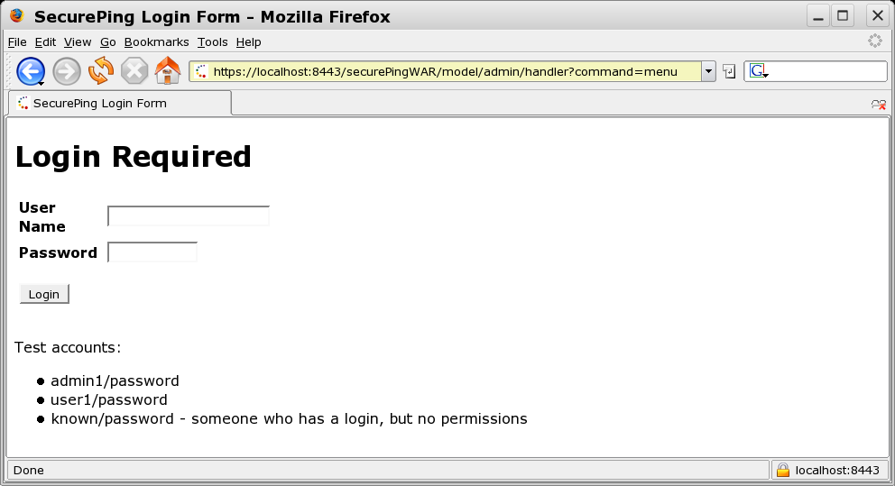
FORM Based Authentication
transport-guarantee=CONFIDENTIAL

Slide 30
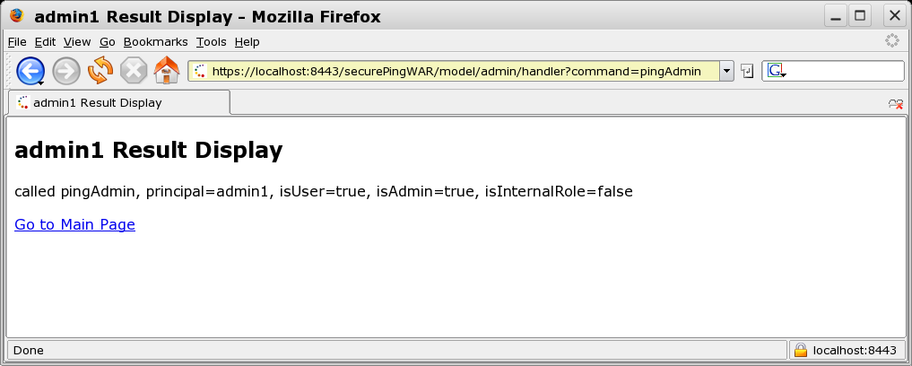
Web Authentication Context Passed to EJB

Slide 31
web.xml: user/* security constraint
<security-constraint>
<web-resource-collection>
<web-resource-name>user-access</web-resource-name>
<url-pattern>/model/user/*</url-pattern>
</web-resource-collection>
<auth-constraint>
<role-name>user</role-name>
</auth-constraint>
<user-data-constraint>
<transport-guarantee>NONE</transport-guarantee>
</user-data-constraint>
</security-constraint>
<login-config>
<auth-method>BASIC</auth-method>
</login-config>

Slide 32
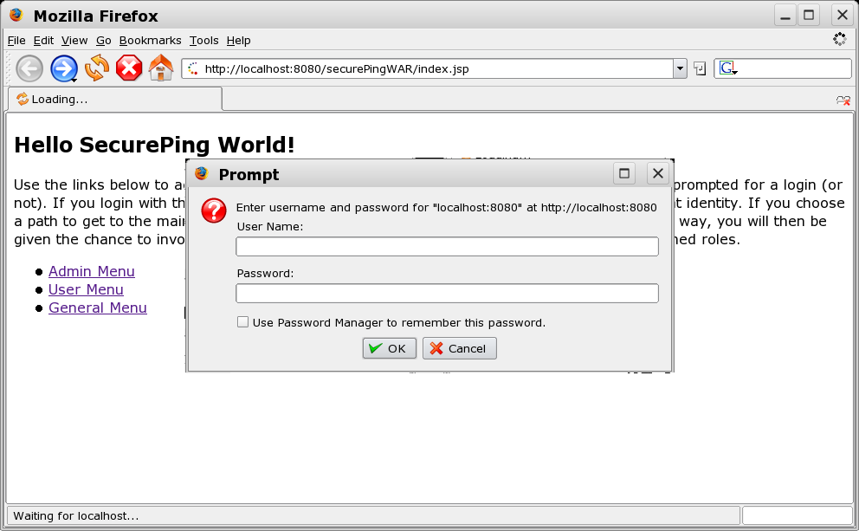
BASIC Authentication

Slide 33
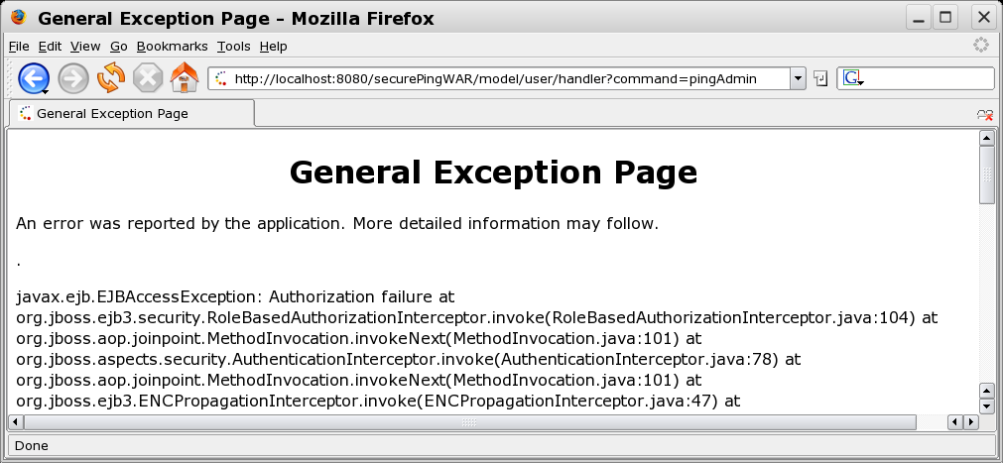
Web Subject not Authorized by EJB Tier

Slide 34
run-as
caller-identity
default
uses caller Principal and roles
role-name
uses a named role
allows methods to be invoked on behalf of a user

Slide 35
run-as:ejb-jar.xml
<session>
<ejb-name>SecurePingClientEJB</ejb-name>
<ejb-ref>
<ejb-ref-name>ejb/SecurePingEJB</ejb-ref-name>
<ejb-ref-type>Session</ejb-ref-type>
<remote>ejava.examples.secureping.ejb.SecurePingEJB</remote>
<injection-target>
<injection-target-class>
ejava.examples.secureping.ejb.SecurePingClientEJB
</injection-target-class>
<injection-target-name>
securePingServer
</injection-target-name>
</injection-target>
</ejb-ref>
<security-identity>
<run-as>
<role-name>admin</role-name>
</run-as>
</security-identity>
</session>

Slide 36
run-as:META-INF/jboss-ejb3.xml
<?xml version="1.0"?>
<jboss:ejb-jar
xmlns:jboss="http://www.jboss.com/xml/ns/javaee"
xmlns:sec="urn:security"
xmlns="http://java.sun.com/xml/ns/javaee"
xmlns:xsi="http://www.w3.org/2001/XMLSchema-instance"
xsi:schemaLocation="http://www.jboss.com/xml/ns/javaee http://www.jboss.org/j2ee/schema/jboss-ejb3-2_0.xsd
http://java.sun.com/xml/ns/javaee http://www.jboss.org/j2ee/schema/jboss-ejb3-spec-2_0.xsd
urn:security urn:security"
version="3.1"
impl-version="2.0">
…
<assembly-descriptor>
<sec:security>
<ejb-name>*</ejb-name>
<sec:security-domain>other</sec:security-domain>
<sec:run-as-principal>admin1</sec:run-as-principal>
</sec:security>
</assembly-descriptor>
</jboss:ejb-jar>

Slide 37
run-as: thread output
run-as is allowing all users call pingAdmin method
real principal name supplied by ctx.getPrincipal() by both EJBs
-*** testPingAdmin ***
-securePingClient called pingAll, principal=known, isUser=false, isAdmin=false, isInternalRole=false:
securePing=called pingAll, principal=admin1, isUser=false, isAdmin=true, isInternalRole=true
-securePingClient called pingAll, principal=user1, isUser=true, isAdmin=false, isInternalRole=false:
securePing=called pingAll, principal=admin1, isUser=false, isAdmin=true, isInternalRole=true
-securePingClient called pingAll, principal=admin1, isUser=true, isAdmin=true, isInternalRole=false:
securePing=called pingAll, principal=admin1, isUser=false, isAdmin=true, isInternalRole=true

Slide 38
Summary
Java EE
requires provider to provider authentication
defines access control specifications for components
Java EE does not
dictate the authentication mechanisms used
dictate the access control mechanisms used
EJB Access Control
class/method level
JNDI Login
JBoss Login Modules
Web Tier Access Control
run-as

Slide 39
References
“Enterprise JavaBeans 3.0, 5th Edition”; Burke & Monsen-Haefel; ISBN 0-596-00978-X; O'Reilly
Sun Developer Network (SDN), JAAS Reference Documentation http://java.sun.com/products/jaas/reference/docs/index.html
Java EE 5 Specification http://jcp.org/aboutJava/communityprocess/final/jsr244/index.html

