Slide 1
Open Authorization 2.0 (OAuth 2.0)
Ram Software Engineering Labs Pvt Ltd

Slide 2
Outline
What is OAuth?
History
Terminology
Why to use OAuth 2.0
Authorization Flows
What about Mobile Apps ?
Tools and Libraries
Demo
Summary

Slide 3
Outline
What is OAuth?
History
Terminology
Why to use OAuth 2.0
Authorization Flows
What about Mobile Apps ?
Tools and Libraries
Demo
Summary

Slide 4
What is OAuth
“OAuth is an open standard for authorization. It allows users to share their private resources stored on one site with another site without having to hand out their credentials, typically supplying username and password tokens instead. Each token grants access to a specific site for specific resources and for a defined duration. This allows a user to grant a third party site access to their information stored with another service provider, without sharing their access permissions or the full extent of their data.”
Source: Wikipedia

Slide 5
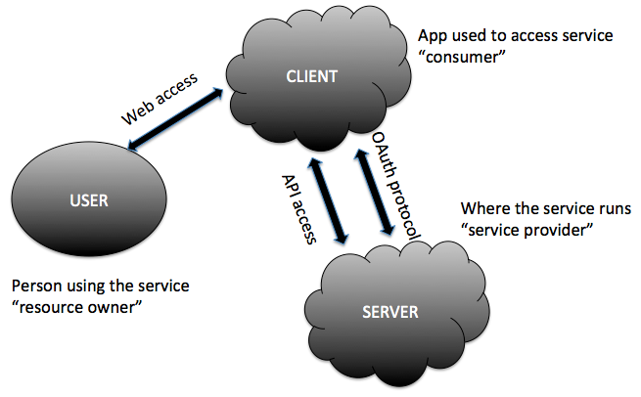
What is OAuth

Slide 6
Outline
What is OAuth?
History
Terminology
Why to use OAuth 2.0
Authorization Flows
What about Mobile Apps ?
Tools and Libraries
Summary

Slide 7
History
HTTP basic authentication
APIs as google calendar API used ClientLogin protocol.
Flicker (acquired by Yahoo!) used Blogger ( acquired by Google).
Specific protocols e.g. Google's AuthSub and Yahoo!'s BBAuth
OAuth Standards
OAuth 1.0
OAuth 1.0a
OAuth 2.0

Slide 8
Outline
What is OAuth?
History
Terminology
Why to use OAuth 2.0
Authorization Flows
What about Mobile Apps ?
Tools and Libraries
Summary

Slide 9
Terminology
Authentication
Federated Authentication
Authorization
Delegated Authorization
Roles
Resource server (API provider)
Resource owner (user of an application)
Client
Authorization server

Slide 10
Terminology
Client Profiles
Server-side web application
Client-side application
Native application
Access Token
Authorization Header
Query parameter

Slide 11
Outline
What is OAuth?
History
Terminology
Why to use OAuth 2.0
Authorization Flows
What about Mobile Apps ?
Tools and Libraries
Summary

Slide 12
Why to use OAuth 2.0
Developer's point of view
Many Functionality:
Getting access to a user’s social graph
Posting to user's Facebook wall or Twitter stream
Store data in users' online filesystem of choice e.g. Google Docs or Dropbox account
Integrating business applications to drive smarter decisions.

Slide 13
Why to use OAuth 2.0
User's point of view
Increase trust
Decreased user sensitivity to phishing
No more expanded access and risk
No limited reliability
Easy service revocation
Passwords isn't required anymore
Easier to implement stronger authentication

Slide 14
Outline
What is OAuth?
History
Terminology
Why to use OAuth 2.0
Authorization Flows
What about Mobile Apps ?
Tools and Libraries
Summary

Slide 15
Authorization Flows
Server-Side Web Application Flow
Client-Side Web Applications Flow
Resource Owner Password Flow
Client Credentials Flow

Slide 16
Authorization Flows
Server-Side Web Application Flow
Client-Side Web Applications Flow
Resource Owner Password Flow
Client Credentials Flow

Slide 17
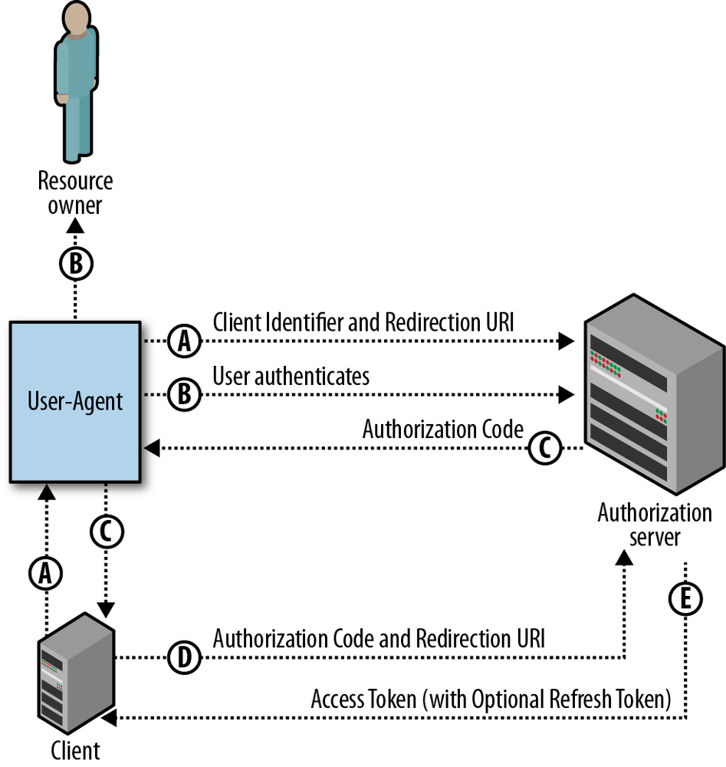
Server-Side Web Application Flow

Slide 18
Server-Side Web Application Flow
When should it be used?
Long-lived access is required.
The OAuth client is a web application server.
Accountability for API calls is very important and the OAuth token shouldn’t be leaked to the browser, where the user may have access to it.
Security Properties

Slide 19
Authorization Flows
Server-Side Web Application Flow
Client-Side Web Applications Flow
Resource Owner Password Flow
Client Credentials Flow

Slide 20
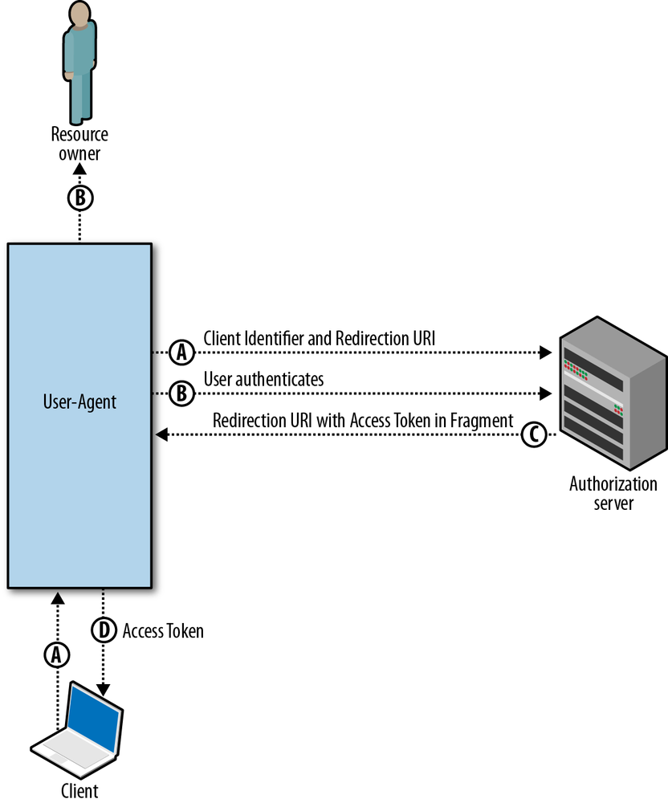
Client-Side Web Applications Flow

Slide 21
Client-Side Web Applications Flow
When should it be used?
Only temporary access to data is required.
The user is regularly logged into the API provider.
The OAuth client is running in the browser (using JavaScript, Flash, etc.).
The browser is strongly trusted and there is limited concern that the access token will leak to untrusted users or applications.
Security Properties

Slide 22
Authorization Flows
Server-Side Web Application Flow
Client-Side Web Applications Flow
Resource Owner Password Flow
Client Credentials Flow

Slide 23
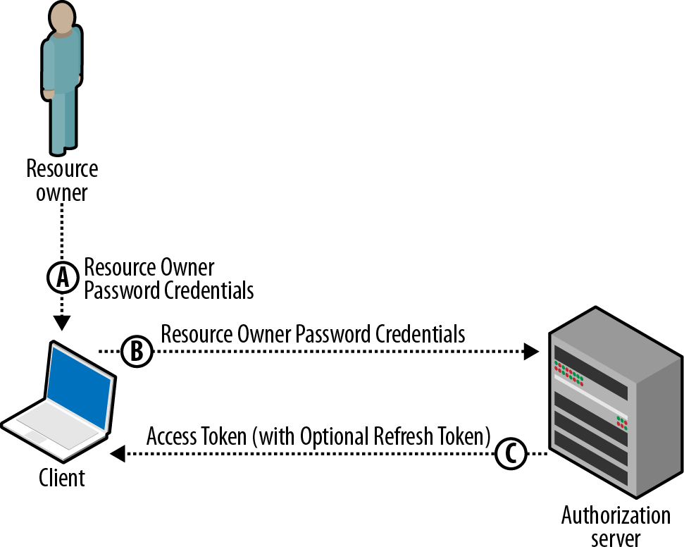
Resource Owner Password Flow

Slide 24
Resource Owner Password Flow
When should it be used?
Recommended only for first-party “official” applications released by the API provider, and not opened up to wider third-party developer communities.
Security Properties
Better than regular HTTP Authentication as the application only needs access to the user’s credentials once.
When password changes, no need to reenter the password for every application that uses it.

Slide 25
Authorization Flows
Server-Side Web Application Flow
Client-Side Web Applications Flow
Resource Owner Password Flow
Client Credentials Flow

Slide 26
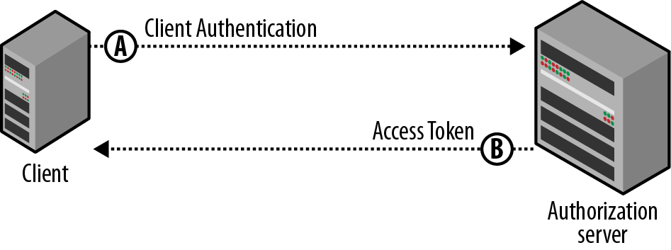
Client Credentials Flow

Slide 27
Client Credentials Flow
When should it be used?
When acting on behalf of the app itself rather than on behalf of any individual user.
Security Properties
A single set of credentials for a client could provide access to a large amount of data.
It is extremely critical that the credentials used to authenticate the client be kept highly confidential.

Slide 28
Outline
What is OAuth?
History
Terminology
Why to use OAuth 2.0
Authorization Flows
What about Mobile Apps ?
Tools and Libraries
Summary

Slide 29
What about Mobile Apps ?
Mobile-optimized web Apps using HTML5
Use traditional OAuth client-side or Web Application flows
Native Mobile Apps
Access to your own APIs
Access to APIs from other providers

Slide 30
What about Mobile Apps ?
Authentication Flows for Native Mobile Apps ?
Have a Mobile Backend Web Server ?
YES:
Client-side flow or Server-side web apps flow
NO:
Client-side flow or Server-side web apps flow with redirect URL is custom URI scheme
Native client flow

Slide 31
What about Mobile Apps ?
Embedded Web View
Advantages
Disadvantages
System Web Browser
Advantages
Disadvantages

Slide 32
Outline
What is OAuth?
History
Terminology
Why to use OAuth 2.0
Authorization Flows
What about Mobile Apps ?
Tools and Libraries
Summary

Slide 33
Tools and Libraries
Tools:
Google’s OAuth 2.0 Playground
Google’s TokenInfo Endpoint
Apigee’s Console
Facebook’s Access Token Tool and Access Token Debugger
Libraries:
Google APIs Client Libraries for Java, Objective-C, PHP, Python, Ruby, JavaScript
Facebook SDKs for JavaScript, Android, iOS, PHP
Foursquare has community-contributed libraries

Slide 34
Outline
What is OAuth?
History
Terminology
Why to use OAuth 2.0
Authorization Flows
What about Mobile Apps ?
Tools and Libraries
Summary

Slide 35
Outline
What is OAuth?
History
Terminology
Why to use OAuth 2.0
Authorization Flows
What about Mobile Apps ?
Tools and Libraries
Summary

Slide 36
Resources
Getting Started with OAuth 2.0
OAuth.Net
OAuth - The Big Picture
OAuth 2.0 draft
OpenID Connect Basic, Standard and Messages
Google APIs Client Libraries
Facebook SDKs
Foursquare's community-contributed libraries
Oauth Overview - http://tutorials.jenkov.com/oauth2/overview.html

