Slide 1

Multi-Focus Image Fusion using Convolutional
Neural Network
Presented by
Ankesh Raj
Prof. Dr. Arup Kumar Pal
Department of Computer Science & Engineering
INDIAN INSTITUTE OF TECHNOLOGY
(INDIAN SCHOOL OF MINES)
DHANBAD – 826004, INDIA

Slide 2
Outlines
Introduction to Image Fusion
Multi Focus Images
CNN
Proposed Works
Experimental Analysis
Future Work
Conclusions
References

Slide 3
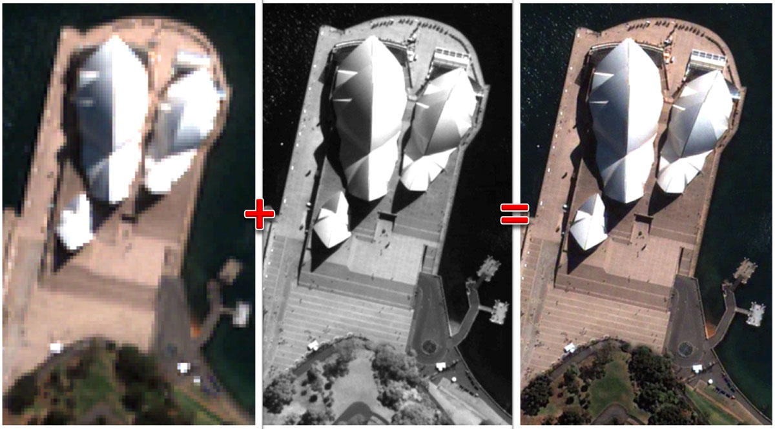
Introduction - “What is Image Fusion”
Integrating the details of different source images to a single image for more clarity in visuals as well as in information.

Slide 4
Why Image Fusion ?
To bring all the details of source images into a single image so that lesser memory and better visual is achieved. Here details mean color texture and information.
Aspects of Image fusion
More informative
Better visuals
Superiority
Lesser space required
More details
Enhanced quality

Slide 5
Application and Types
Photography
Military
Remote sensing
Machine vision
Robotic
Medical imaging
Astronomy
multi-focus image fusion
visible-infrared image fusion
multi-modal medical image fusion
Multi Resolution image fusion
Multi Sensor image fusion

Slide 6
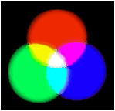
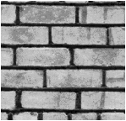
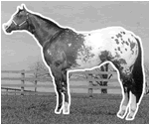
What an Image contains ?
Information of any image refers to the Visual Features present with in that images.
These Visual Features can be distinguish by human eyes and these features are :-
1.Color Information
2.Texturural Information
3.Figure Information

Slide 7
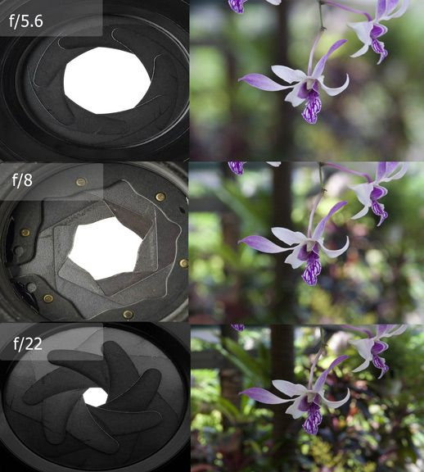
Multi Focus Images
optical devices have limited depth of focus
It is nearly Impossible for normal camera to capture every plane in-focus.
Only some fields can be captured with detail called Depth of field. :-Exposure Triangle

Slide 8
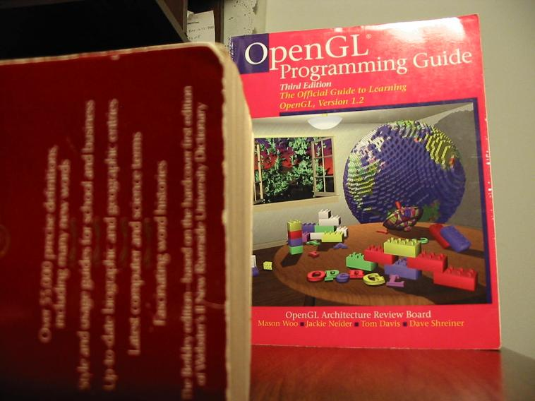
I1

Slide 9
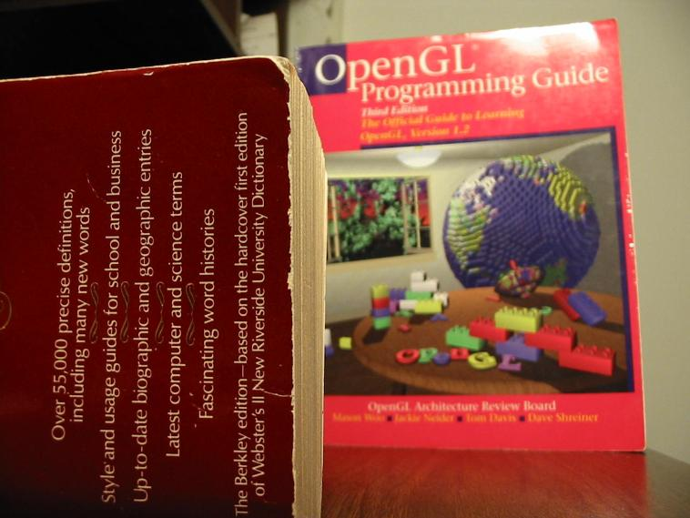
I2

Slide 10
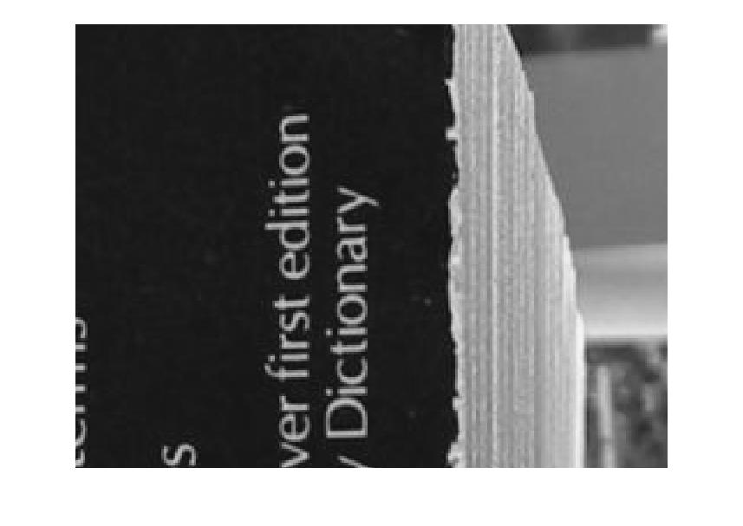
I2

Slide 11
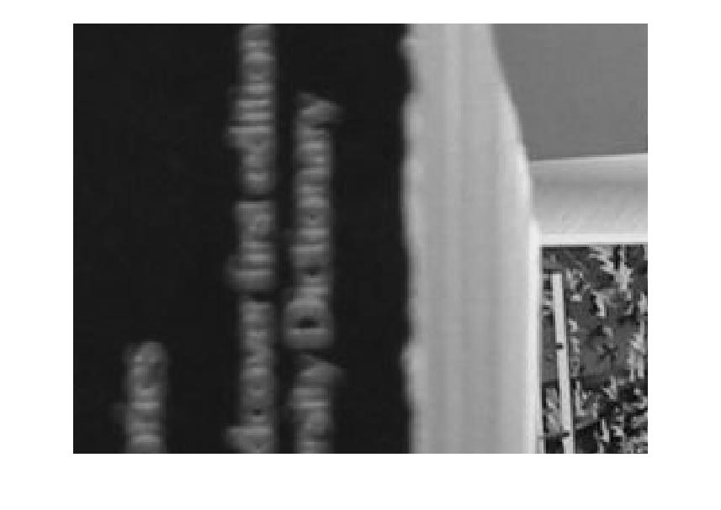
I2

Slide 12
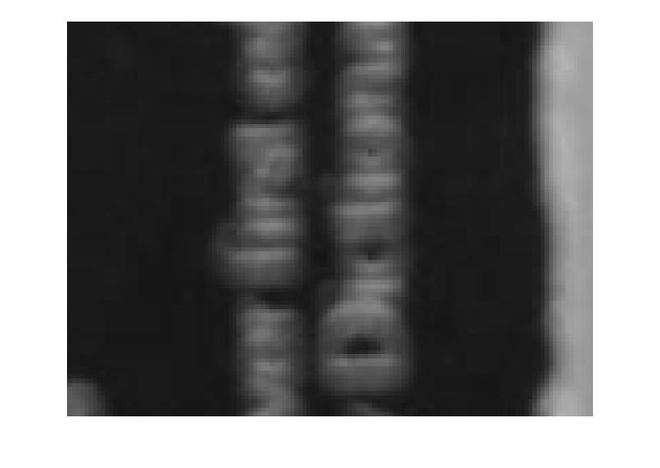
I2

Slide 13
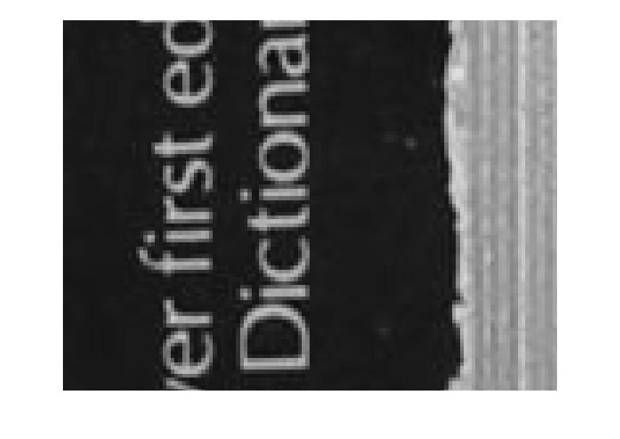
I2

Slide 14
Observation
The Source Images have different depth of field
Due to different camera settings
Focused Plane have more information than unfocused part
The information of any image is understood by the quality of texture
The Solution of this problem is to aggregate all details into one image

Slide 15
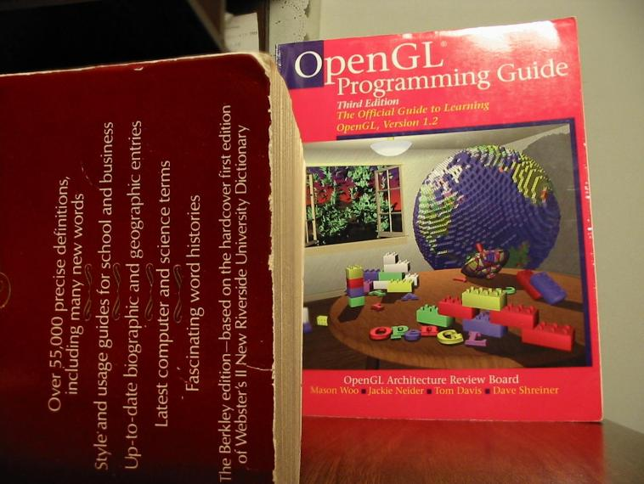
Desired Image

Slide 16
Basic Steps of Image Fusion
Major steps of any typical Image Fusion are as follows:
Preprocessing: The source images may have some defects like noise or may have different frames .Therefore noise reduction and Image registration is required.
Fusion Algorithm: To combine all the Information of source images Appropriate algorithms are applied
Post Processing: Image enhancement and Performance evaluation
Output Image: Final single fused Image

Slide 17
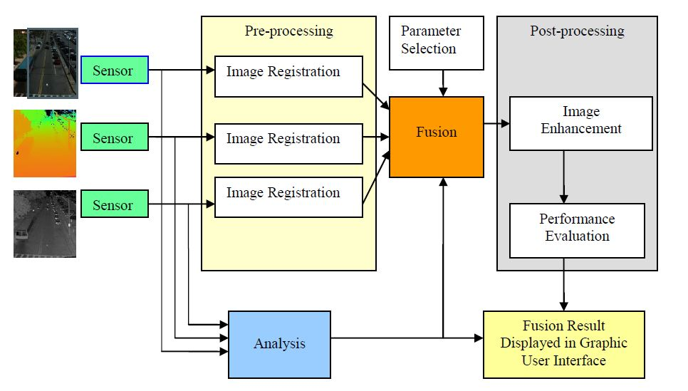
Block Diagram of typical Image Fusion
1.Color Information
2.Texturural Information
3.Figure Information

Slide 18
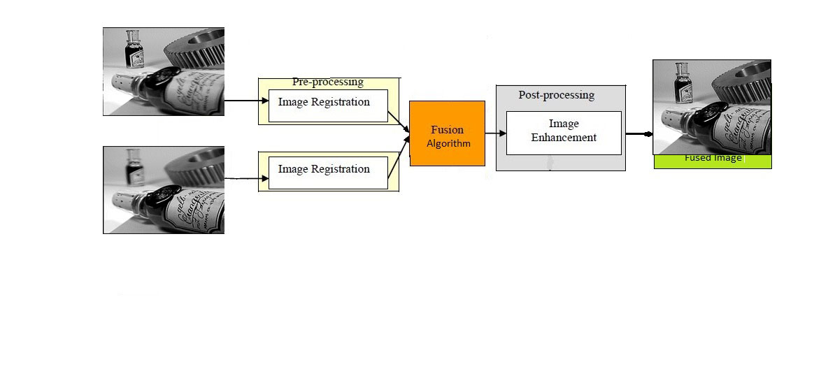
Neural network
Deep learning (DL) has achieved great success in a number of computer vision and image processing problems.
Methods based on DL techniques including CNNs, CSR and tacked auto encoders (SAEs) are introduced.
NN is used for classification problems therefore it can also be used in image fusion issues which can be considered as classification problems.

Slide 19
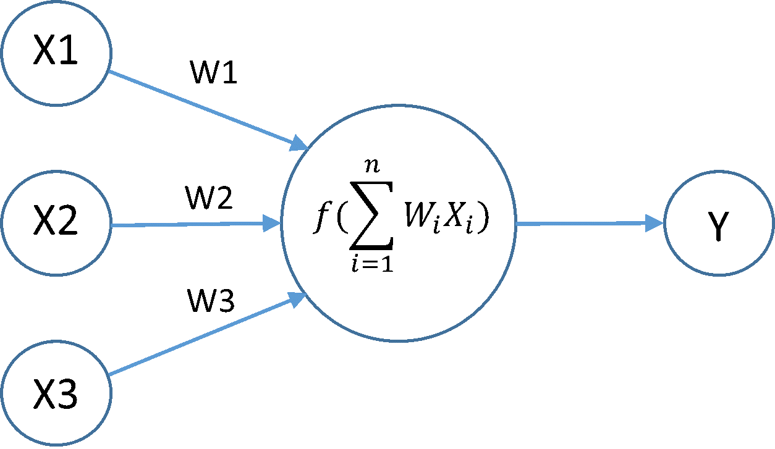
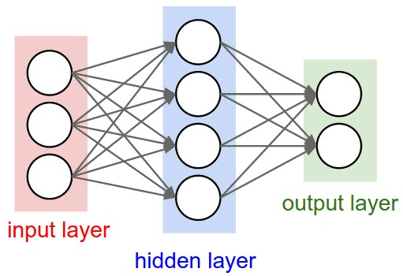
Neuron and Network
A Neural Network is combinations of Neurons — also called perceptrons
Each input node is connected via a weighted link to the output node. The weighted link is used to emulate the strength of synaptic connection between neurons
Weight is the measure of strength up to what extent a neuron can effect the output.
The multiple layer stacked to form a network call NN.
Feeding entire image is not wise as local features and edges are more important than individual pixel

Slide 20
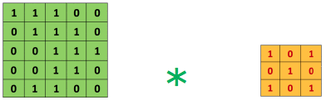
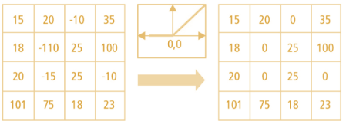
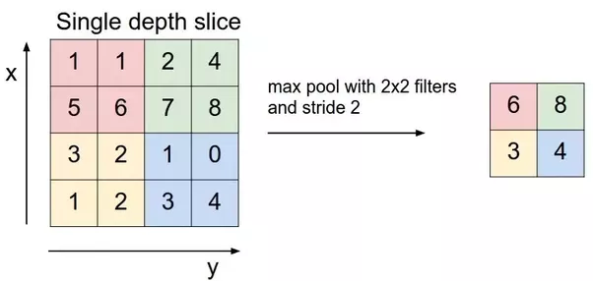
CNN components
Convolution is the first layer to extract features from an input image. It is a mathematical operation that takes two inputs such as image matrix and a filter or kernal
Pooling Layers
Its function is to progressively reduce the spatial size of the representation to reduce the amount of parameters and computation in the network. Pooling layer operates on each feature map independently.
ReLU stands for Rectified Linear Unit for a non-linear operation. The output is ƒ(x) = max(0,x). Why ReLU is important : ReLU’s purpose is to introduce non-linearity in our ConvNet.

Slide 21
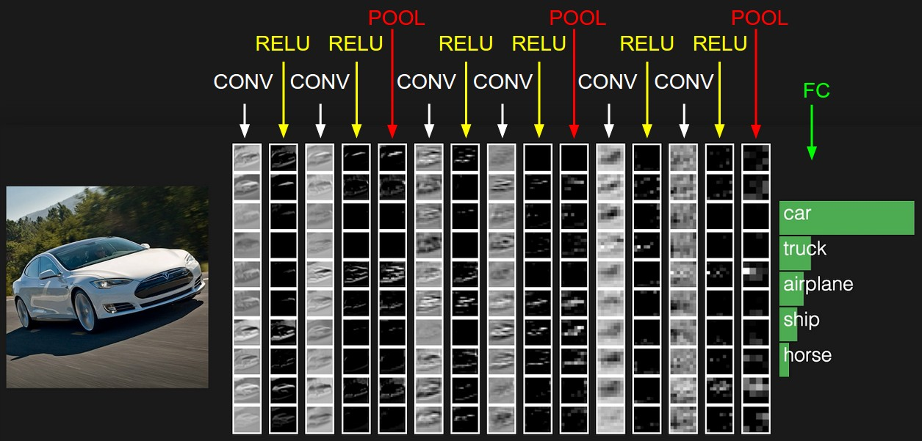

Slide 22
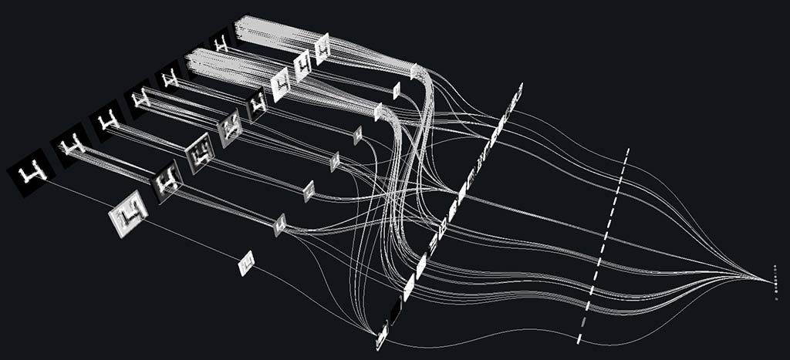
CNN
.
Figure : (a) normal image (b) output image after use of non-linear anisotropic diffusion scheme on normal image.

Slide 23
Evaluation and Back Propagation
Softmax activation function : probability of each class (each digit) given the input image. The output of this dense layer then passes through the Softmax activation function, which maps all the final dense layer outputs to a vector whose elements sum up to one
Calculating the Loss: To measure the accuracy network use of a loss function. A common loss function to use when predicting multiple output classes is the Categorical Cross-Entropy Loss function, defined as follows:
Back propagation: To compute the gradients that will force the network to update its weights and optimize its objective, backpropagate gradients through the convolutional and max pooling layers.

Slide 24
Proposed Image Fusion
Pair of image patches { p A , p B } of the same scene, output value should be close to 1 when p A is focused while p B is defocused, and the value should be close to 0 when p B is defocused while p A is focused.
Input the source images into the network as a whole without dividing them into patches, as was applied in the fully-connected layers should be firstly converted into convolutional layers by reshaping parameters.
Each image (converted into gray scale space at first), five blurred versions with different blurring level are obtained using Gaussian filtering. Gaussian filter with a standard deviation of 2 and cut off to 7 ×7 is adopted here.
The first blurred image is obtained from the original clear image with the Gaussian filter. The second blurred image is obtained from the first blurred image with the filter, and so on.
Choose-max strategy to process , a fixed threshold of 0.5 is applied to segment M is into a binary map T , which is in accord with the classification principle of the learned CNN model. That is, the focus map is segmented by
T (x, y ) = 1 , M(x, y ) > 0 . 5
0 , otherwise .

Slide 25
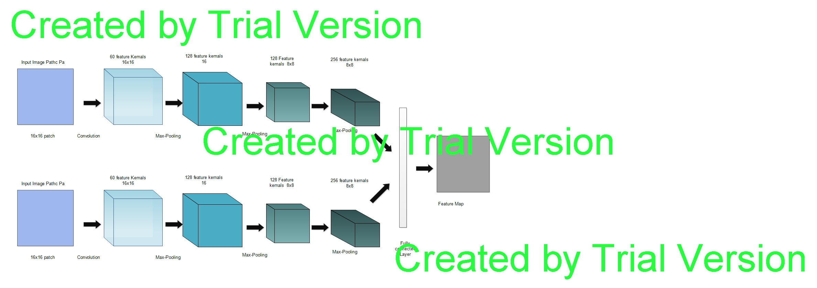
Network Architecture

Slide 26
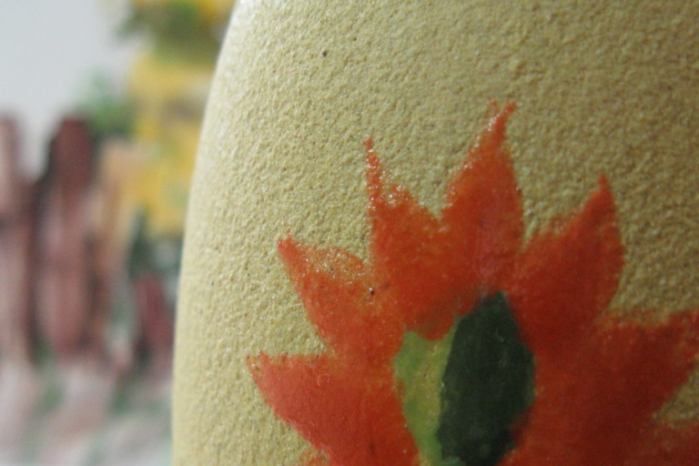
I1

Slide 27

I2

Slide 28
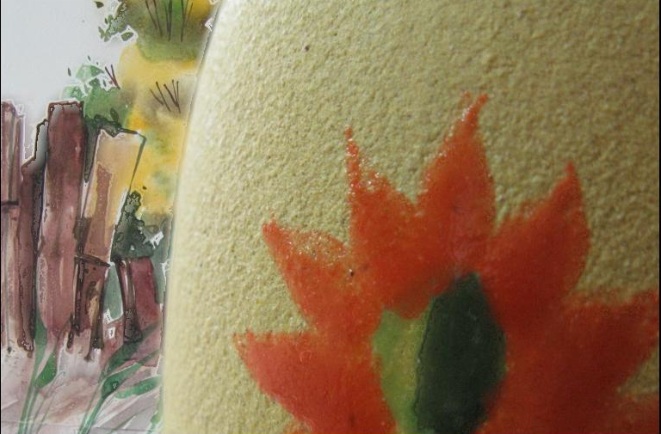
Fused Image

Slide 29
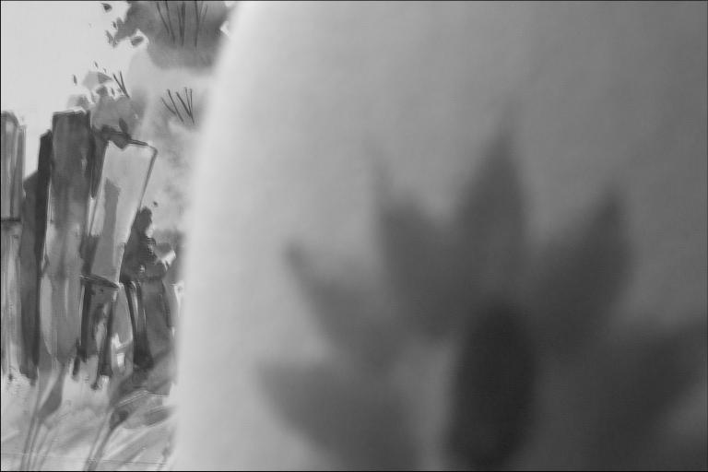
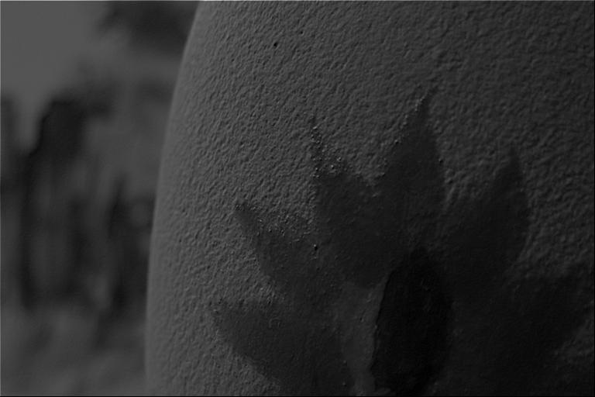
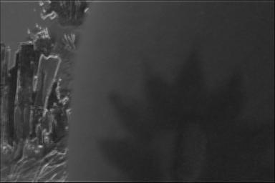
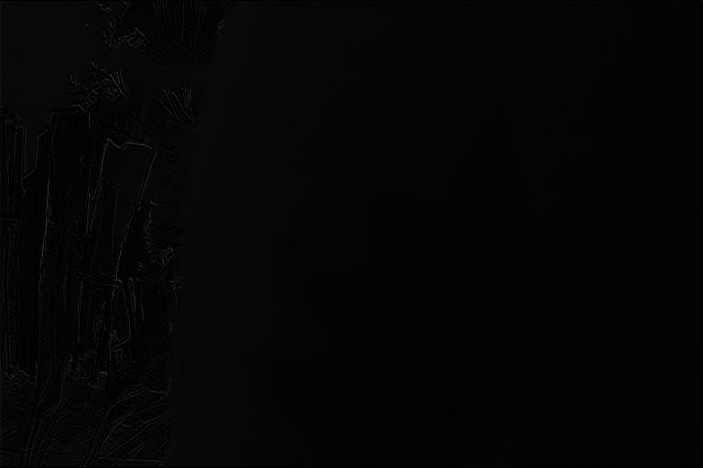
Different Convolution feaure

Slide 30
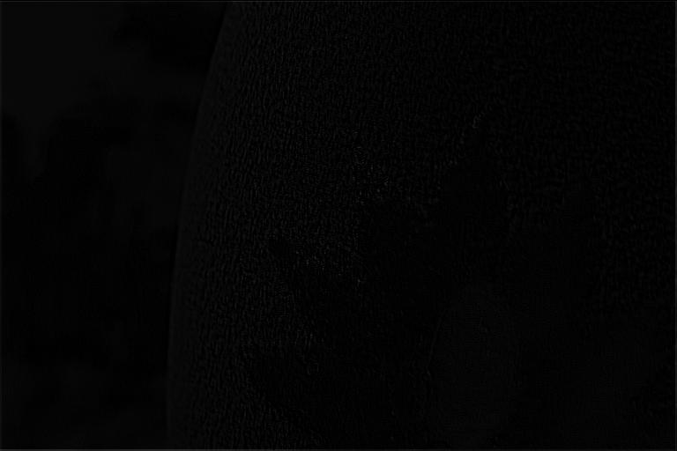

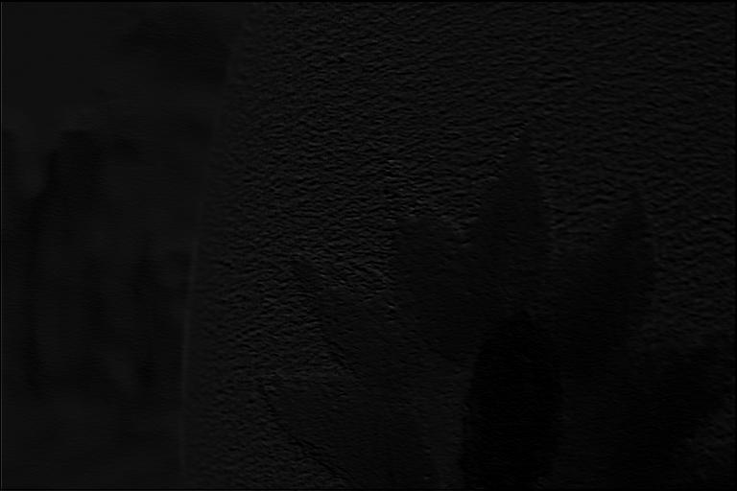
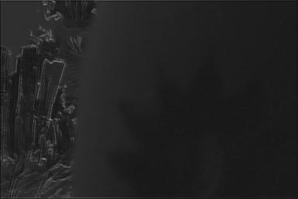
Different Convolution feaure

Slide 31
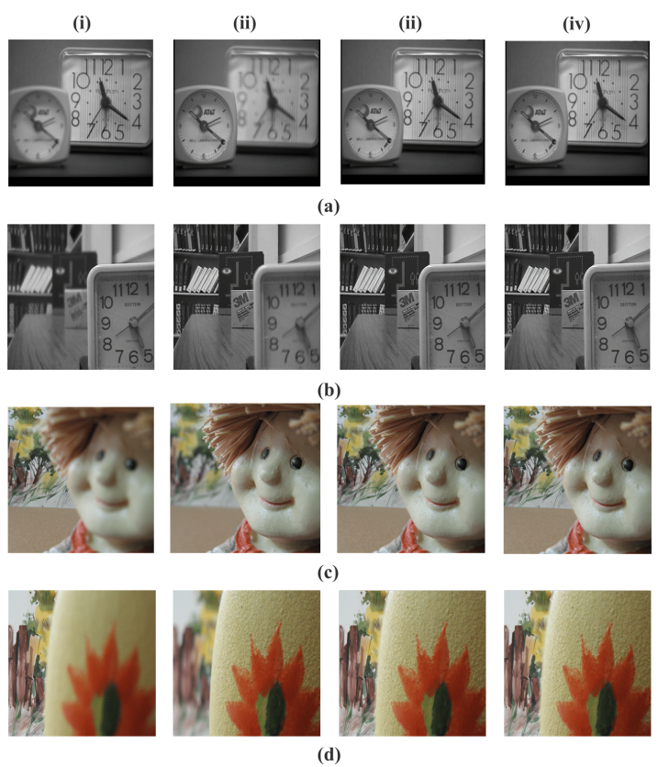
Fusion Results

Slide 32
Proposed Algorithm Advantages
More edges comes out
Minute details
Localized
Selection criteria
Simple and straight forward
Easy to implement
No artifacts
No details lost
No noise created
Lesser space required
Better than many state of the art methods

Slide 33
Conclusions
Introduced a CNN architecture for Multiscale Image fusion
learning a CNN model to achieve a direct mapping between source images and the focus map.
Build a dataset using high quality imaged and Gaussian filter for learning example of the network.
Experimental results demonstrate the proposed method can achieve state-of-the-art results in terms of visual quality and objective assessment.
Development of more complicated fusion schemes.
The fused image is then enhanced (sharpening etc.)

Slide 34
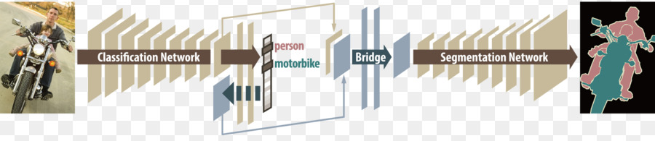
Future Work
There is a vast application of Neural network in computer vision
Deconvolutional Neural Network is used for segmentation of objects, it can also be implemented in image fusion
Fusion of images can be viewed as the segmentation of focused regions from source images.

Slide 35
Reference
A .A . Goshtasby , S. Nikolov , Image fusion: Advances in the state of the art, Inf. Fus. 8 (2) (2007) 114–118 .
H.A. Eltoukhy, S. Kavusi, A computationally efficient algorithm for multi-focus image reconstruction, Proceedings of SPIE Electronic Imaging (June 2003) 332–341.
Z. Zhang , R.S. Blum , A categorization of multiscale-decomposition-based im- age fusion schemes with a performance study for a digital camera applica- tion, Proc. IEEE 87 (8) (1999) 1315–1326.
A.P. James , B.V. Dasarathy , Medical image fusion: A survey of the state of the art, Inf. Fusion 19 (3) (2014) 4–19 .
Wavelets for Image Fusion, Authors, Authors and affiliations, Stavri Nikolov Paul Hill David Bull Nishan, Canagarajah.
Gemma Piella, A general framework for multiresolution image fusion: from pixels to regions, In Information Fusion, Volume 4, Issue 4, 2003, Pages 259-280.
L. Yang, B.L. Guo, W. Ni, Multimodality medical image fusion based on multiscale geometric analysis of contourlet transform, In Neurocomputing, Volume 72, Issues 1–3, 2008, Pages 203-211.
D. Looney and D. P. Mandic, "Multiscale Image Fusion Using Complex Extensions of EMD," in IEEE Transactions on Signal Processing, vol. 57, no. 4, pp. 1626-1630, April 2009. doi: 10.1109/TSP.2008.2011836
A. Ellmauthaler, C. L. Pagliari and E. A. B. da Silva, "Multiscale Image Fusion Using the Undecimated Wavelet Transform With Spectral Factorization and Nonorthogonal Filter Banks," in IEEE Transactions on Image Processing, vol. 22, no. 3, pp. 1005-1017, March 2013. doi: 10.1109/TIP.2012.2226045
L. Zhang and J. Zhang, "A New Saliency-Driven Fusion Method Based on Complex Wavelet Transform for Remote Sensing Images," in IEEE Geoscience and Remote Sensing Letters, vol. PP, no. 99, pp. 1-5. doi:

Slide 36
Reference (Conti…)
10.1109/LGRS.2017.2768070
Joachim Weickert , “Anisotropic Diffusion in Image Processing” University of Copenhagen Copenhagen, Denmark B.G. Teubner Stuttgart 1998.
H.F. Li , Y. Chai , R. Ling , H.P. Yin , Multifocus image fusion scheme using fea- ture contrast of orientation information measure in lifting stationary wavelet domain, J. Inf. Sci. Eng. 29 (2) (2013) 227–247 .
A. Saha , G. Bhatnagar , Q.M.J. Wu , Mutual spectral residual approach for multi- focus image fusion, Digit. Signal Process 23 (4) (2013) 1121–1135 .
Y.A.V. Phamila , R. Amutha , Discrete cosine transform based fusion of multi-fo- cus images for visual sensor networks, Signal Process 95 (2014) 161–170 .
V.N. Gangapure , S. Banerjee , A.S. Chowdhury , Steerable local frequency based multispectral multifocus image fusion, Inf. Fusion 23 (2015) 99–115 .
T. Stathaki , Image Fusion: Algorithms and Applications, first ed., Elsevier, Lon- don, 2008 .
W.W. Kong , Y. Lei , H.X. Zhao , Adaptive fusion method of visible light and in- frared images based on non-subsampled shearlet transform and fast non-neg- ative matrix factorization, Infrared Phys. Techn 67 (2014) 161–172 .
Z. Liu , H.P. Yin , Y. Chai , S.X. Yang , A novel approach for multimodal medical image fusion, Expert Syst. Appl 41 (16) (2014) 7425–7435 .
Z.D. Liu , H.P. Yin , B. Fang , Y. Chai , A novel fusion scheme for visible and infrared images based on compressive sensing, Opt. Commun. 335 (2015) 168–177.
Zhaodong Liu, Yi Chai, Hongpeng Yin, Jiayi Zhou, Zhiqin Zhu, A novel multi-focus image fusion approach based on image decomposition, In Information Fusion, Volume 35, 2017, Pages 102-116.

Slide 37

Suggestion…

Slide 38


