Slide 1
AwaazAlert
1 / 5 · PS2 · Real-time speech emotion analysis for cybercrime investigation
Problem statement and understanding
Operators on the 1930 cybercrime helpline hear fear all day and cannot hear it any more.
WHAT THE OPERATOR NEEDS, IN ORDER
Which line first?
One operator, many lines: a victim mid-"digital arrest", a fraudster being baited, a routine status query — all at once.
PS2 asks for real-time emotional signals to prioritise calls, treated as indicative, never as evidence.
Our reading: emotion alone is weak on Indian call audio — no Hindi SER benchmark exists; real call-centre accuracy is 55–65 %.
What is reliable is the script. Indian scams follow fixed scripts: impersonation → threat → secrecy → payment. So we fuse voice with words.
a score that orders the queue
Why that one?
measured cues, not a black box
Which playbook?
the scam named: digital arrest, KYC block, task scam…
Am I allowed to?
nothing stored, PII hidden, "indicative only" on screen
Team: Ankit Gupta · solo build, 24 h
Notes:
Frame the problem from the operator chair. Emotion is weak on Hindi audio; scripts are strong — that is the thesis.

Slide 2
AwaazAlert
2 / 5 · three independent signals, one explainable score
Technical approach
Call audio
16 kHz mono · mic / telephony / file
Voice · emotion2vec+
fear / sad / anger probabilities (FunASR)
urgency 0–100
0.40 distress
0.20 arousal
0.30 fraud script
0.10 speech rate
Operator
queue by urgency · why it lit up · named script · redacted transcript
Prosody · librosa
pitch σ, energy, voicing — relative to this caller's own baseline
3 s window
+ 9 s rolling context
Words · whisper large-v3-turbo
hi/en pinned, repetition guards → Hinglish fraud-script lexicon → named scam
Call level = max(peak-weighted windows, whole-transcript script scan). A named script floors the call at medium: the pattern is actionable whatever the voice does.
Every line in "why this line lit up" is generated from a measured value — pitch σ 72 Hz, cues: cbi, parcel, arrest — never a template.
FastAPI + WebSocket streaming, React/Vite dashboard. Audio is processed in memory and discarded; transcripts are PII-redacted by default.
Notes:
Walk the diagram left to right. Stress speaker-relative prosody and the whole-call script scan.

Slide 3
AwaazAlert
3 / 5 · measured on the bundled calls · python server/eval.py
Feasibility and viability
sample (synthetic, edge-tts) | urgency | level | named script | latency
Digital arrest — scammer | 64 | high | Digital arrest | 0.76 s
Victim calling after loss | 67 | high | Digital arrest (as described) | 0.57 s
Bank KYC / OTP — scammer | 54 | medium | Remote-access takeover | 0.52 s
Part-time task scam (English) | 50 | medium | Task / investment scam | 0.47 s
Routine status query — control | 16 | low | — | 0.57 s
HONEST LIMITS
Demo calls are synthetic (flat affect): they prove the pipeline and script path, not emotion accuracy. Real-call accuracy is unmeasured.
Stress test, 20 extra synthetic calls: on 5 unseen scams a plain keyword alarm caught 5, our fused score 2 — but it raised fewer false alerts (1/4 vs 2/4). Legit and scam calls share vocabulary.
So AwaazAlert is a ranking aid for a human operator, not a scam detector. Next step: consented, expert-labelled calls.
One speaker per stream; Whisper mishears some Hinglish.
control lowest: PASS · real-time factor 0.16–0.26 on one RTX 4060 laptop GPU
3–4×
< 1 s
0 bytes
scam vs control separation
per 3-second window
of audio written to disk
Notes:
Be upfront: the numbers prove real-time + script separation. Emotion accuracy is unproven on Hindi, and on a held-out stress set a keyword alarm out-recalled the fused score (5/5 vs 2/5) while raising more false alerts. Say so before the judges do; README has the full table.

Slide 4
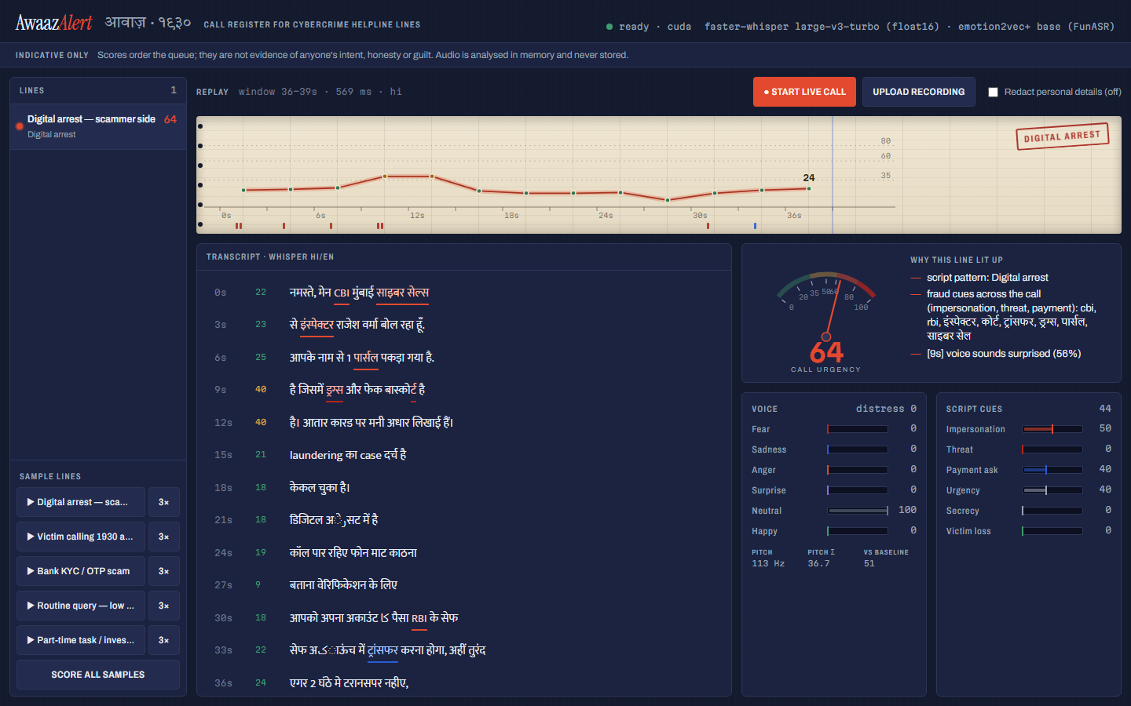
AwaazAlert
4 / 5 · for the operator, the victim, and the cyber cell
Impact and benefit
1
Minutes matter
A victim whose money is still in transit reaches the top of the queue; bank freeze requests go out sooner.
2
A named playbook
Digital arrest → hang up, no transfer, file NCRP. KYC block → call the bank's number, not the caller.
3
Explainable, not oracular
The operator sees which cues fired and how the voice moved against its own baseline — and can disagree.
4
Deployable where the data is
On-prem at a state cyber cell: nothing stored, PII redacted, "indicative only" on every screen.
The register: pen trace of urgency, ink ticks for cues, the scam stamped by name.
Notes:
Impact is time-to-triage and a playbook per scam. Keep the responsible-AI point explicit.

Slide 5
AwaazAlert
5 / 5 · what exists · what a typical SER demo does · what AwaazAlert adds
Comparison with existing platforms — our unique feature
Existing platforms
Typical hackathon SER
AwaazAlert
Uniphore, Cogito, Nemesysco: enterprise call-centre emotion analytics — English, black-box, no fraud-script awareness.
1930 today: Goa Police AI voice assistant does complaint intake only; MHA ordered an AI upgrade (Jun 2026) — no distress or priority layer.
Academic SER: English acted corpora (IEMOCAP, RAVDESS); 70–80 % lab, 55–65 % on real calls.
Upload one clip → one emotion label.
English benchmark voices.
No transcript, no context, no queue.
A sentence about privacy.
Fusion: voice + prosody vs the caller's own baseline + Hinglish fraud-script detection with named patterns.
Live streaming across lines, 3 s windows, priority queue, strip-chart register.
Explanation built only from measured features.
Redaction on by default, nothing stored, "indicative only" baked into the UI.
github.com/Anki1004/awaaz-alert
Notes:
Close on the unique feature: script-aware fusion with explanations, not a better emotion classifier.

