Slide 1
INVESTMENT ASSIGNMENT SUBMISSION
Name: Ankit Agrawal

Slide 2
Business Objectives & Strategic Goals
Business Objectives:
Spark Funds has two minor constraints for investments:
It wants to invest between 5 to 15 million USD per round of investment
It wants to invest only in English-speaking countries because of the ease of communication with the companies it would invest in
The objective is to identify the best sectors, countries, and a suitable investment type for making investments. The overall strategy is to invest where others are investing, implying that the 'best' sectors and countries are the ones 'where most investors are investing’
Goals of data analysis: goals are divided into three sub-goals:
Investment type analysis: Comparing the typical investment amounts in the venture, seed, angel, private equity etc. so that Spark Funds can choose the type that is best suited for their strategy.
Country analysis: Identifying the countries which have been the most heavily invested in the past. These will be Spark Funds’ favourites as well.
Sector analysis: Understanding the distribution of investments across the eight main sectors. (Note that we are interested in the eight 'main sectors' provided in the mapping file. The two files — companies and rounds2 — have numerous sub-sector names; hence, you will need to map each sub-sector to its main sector.)

Slide 3
Data Analysis Methodology
Load Companies & Rounds Data
Download & Load English Speaking Countries data
And UN country code data and merge them
Country Analysis
Merge the two dataset, perform data cleaning and wrangling to form a dataset top9 to find out Top 3 Countries receiving maximum investments in Venture Funding
Find if all the companies in rounds data are present in Companies data or not
Sector Analysis
Data Wrangling, Data Cleaning to analyse data to find out Best sectors to invest for Venture Funding, in startups set up in Senglish Speaking Counries and funding range in 5 -15 mil USD
Merge Companies and Rounds data to create a Master dataframe
Create a copy of Master Frame as df1 for venture funding type
Data Cleaning, Messaging to find out Average funding in Funding Types
Data Visualization
Use master Frame to create visuals to Show CEO which funding type, countries, and sectors could be best for Spark Fund investment

Slide 4
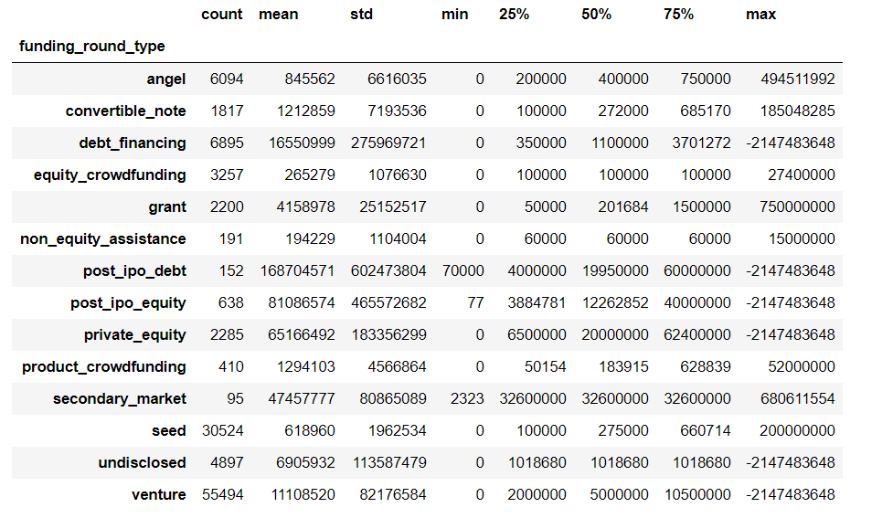
Funding Type Analysis
Clearly , based on the average funding received by startups in various funding types, we can deduce that
Venture type funding falls in the 5 – 15 million USD investment budget profile set by Spark Funds

Slide 5
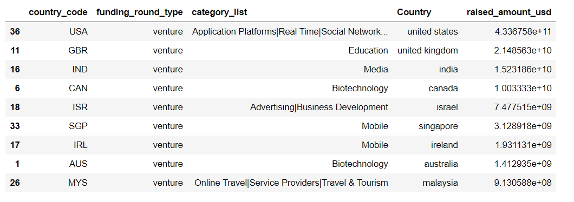
Country Analysis
Above table displays Top 9 English speaking countries that have received maximum investments in
Venture funding round
Clearly United States, United Kingdom, and India are most active countries for startups receiving venture funding

Slide 6
Sector Analysis
D1.groupby('main_sector', as_index=False).agg({'company_permalink':'first','funding_round_permalink':'first',
'funding_round_type':'first','funding_round_code':'first', 'funded_at':'first',
'name':'first','homepage_url':'first', 'category_list':'first', 'status':'first',
'country_code':'first', 'state_code':'first','region':'first', 'city':'first',
'founded_at':'first', 'Country':'first', 'primary_sector':'first',
'raised_amount_usd':['count','sum’]})
D2.groupby('main_sector', as_index=False).agg({'company_permalink':'first','funding_round_permalink':'first',
'funding_round_type':'first','funding_round_code':'first', 'funded_at':'first',
'name':'first','homepage_url':'first', 'category_list':'first', 'status':'first',
'country_code':'first', 'state_code':'first','region':'first', 'city':'first',
'founded_at':'first', 'Country':'first', 'primary_sector':'first',
'raised_amount_usd':['count','sum’]})
D3.groupby('main_sector', as_index=False).agg({'company_permalink':'first','funding_round_permalink':'first',
'funding_round_type':'first','funding_round_code':'first', 'funded_at':'first',
'name':'first','homepage_url':'first', 'category_list':'first', 'status':'first',
'country_code':'first', 'state_code':'first','region':'first', 'city':'first',
'founded_at':'first', 'Country':'first', 'primary_sector':'first',
'raised_amount_usd':['count','sum']})
D1, D2, D3 datasets are used to find out 3 Best Sectors in Top 3 Countries : USD, GBR, and IND for Venture Funding
In 5 -1 5 million USD investments range

Slide 7
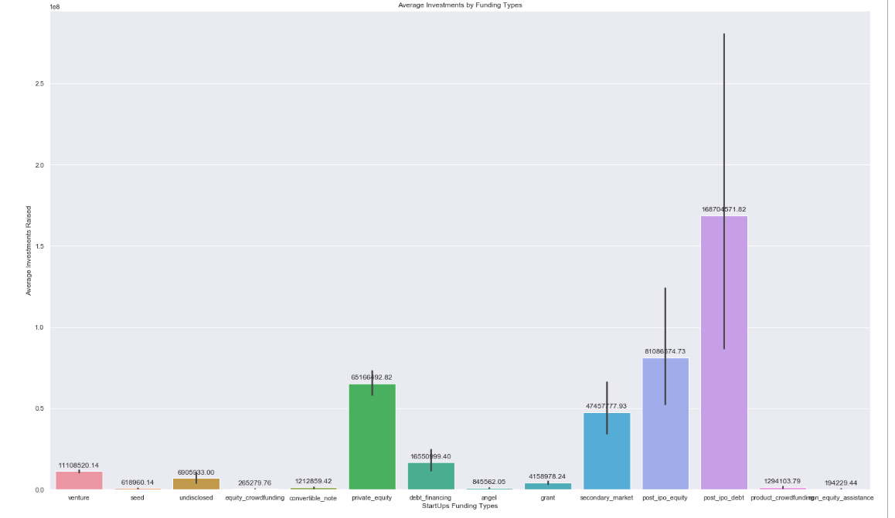
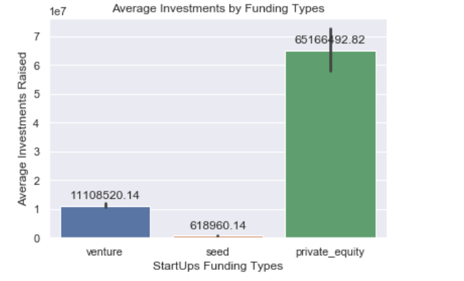
Average Investments by Funding Types

Slide 8
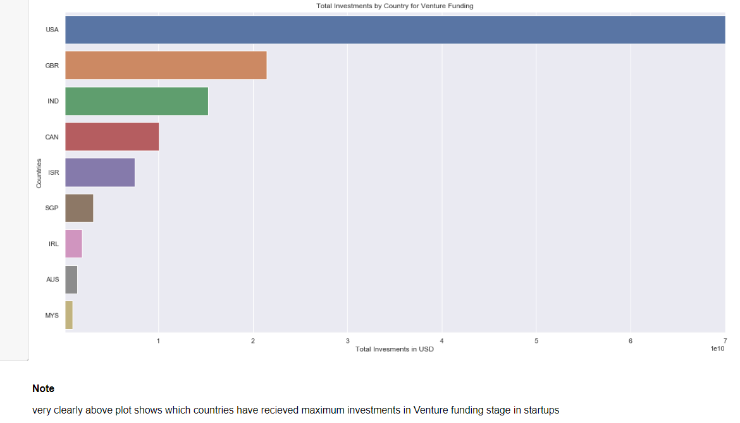
Total Investments by Countries for Funding Type-Venture

Slide 9
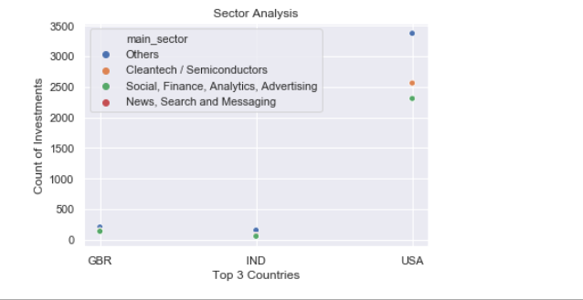
Average Investments by Funding Types

Slide 10
Summary
Since Spark Funds is targeting to enter the startup funding business with a 5 -15 million USD budget per round, looking into the average USD received by startups globally, Spark Fund may target startups targeting “Venture” funding and not necessarily enter into extremely early stage funding like Seed funding seeking startups.
For startups setup in English speaking countries, data clearly shows the Top countries which have most active startups seeking Venture round funding, and as clearly stated in business strategy laid down for investment profile by Spark Funds business team, we strongly suggest Spark Funds to focus on startups in United States, United Kingdom, and India.
Based on data analysis and looking into business constraints set by Spark Funds, we suggest following investment sectors :
Cleantech/Semiconductors
Social, Finance, Analytics, Advertising
News, Search & Messaging
Others

