Slide 1
Search Strategy Builder for Literature Reviews – Part 3
Ankie Fan

Slide 2
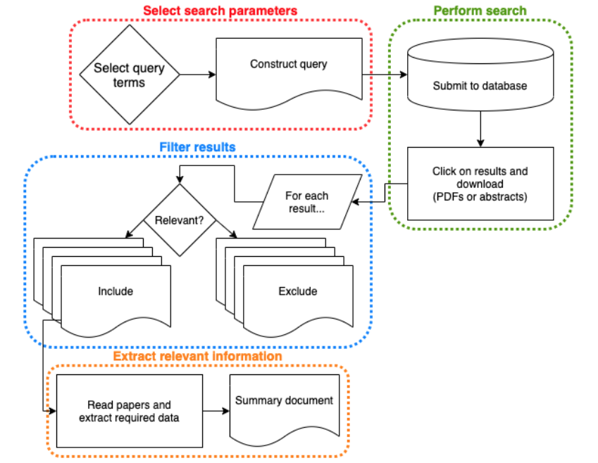
What are we going to do:
Produce user search terms (keywords)
Provide a graphical interface for user to easily construct a search strategy
Figure 3

Slide 3
User Test
First stage: 2 versions (click/drag)
Second stage: 2 groups

Slide 4
First stage feedback:
Uploading file step: add more instruction
Result: drag words between group
Result: add bin(drag to throw the words)
Result: automatically construct (OR in a group, AND/NOT between groups)
Result: choose the database in formulating

Slide 5
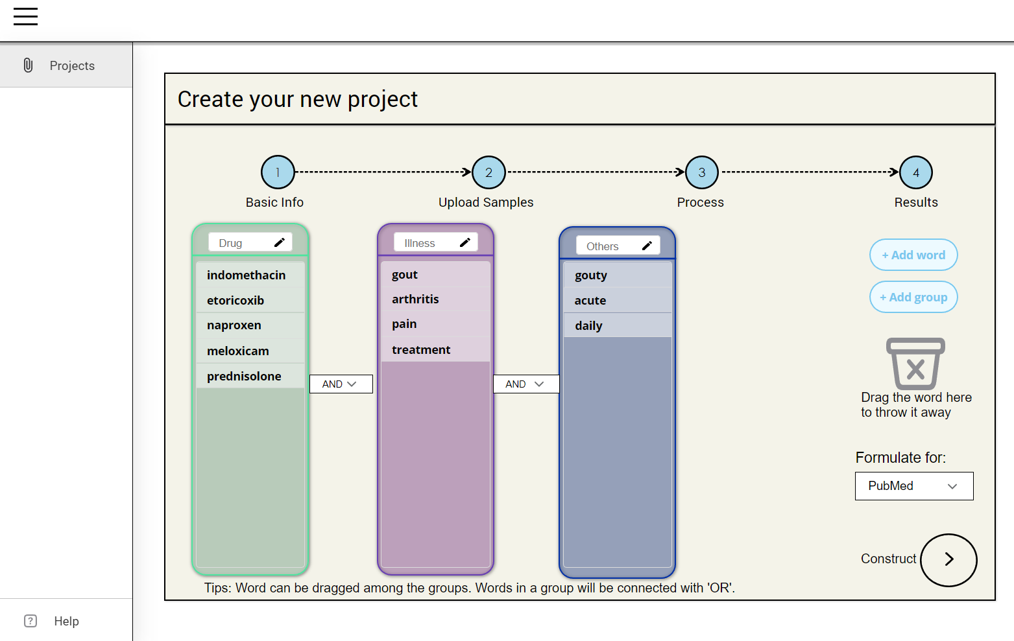
Final prototype

Slide 6
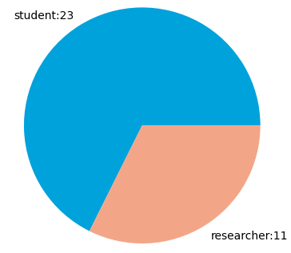
Second stage: 2 groups
34 responses
Bias Elimination: Those who had participated in the first stage test did not participate in this test
Group 1: Students (Undergraduate, graduate students)
Group 2: Researchers (PhD, PostDoc or other researchers)

Slide 7
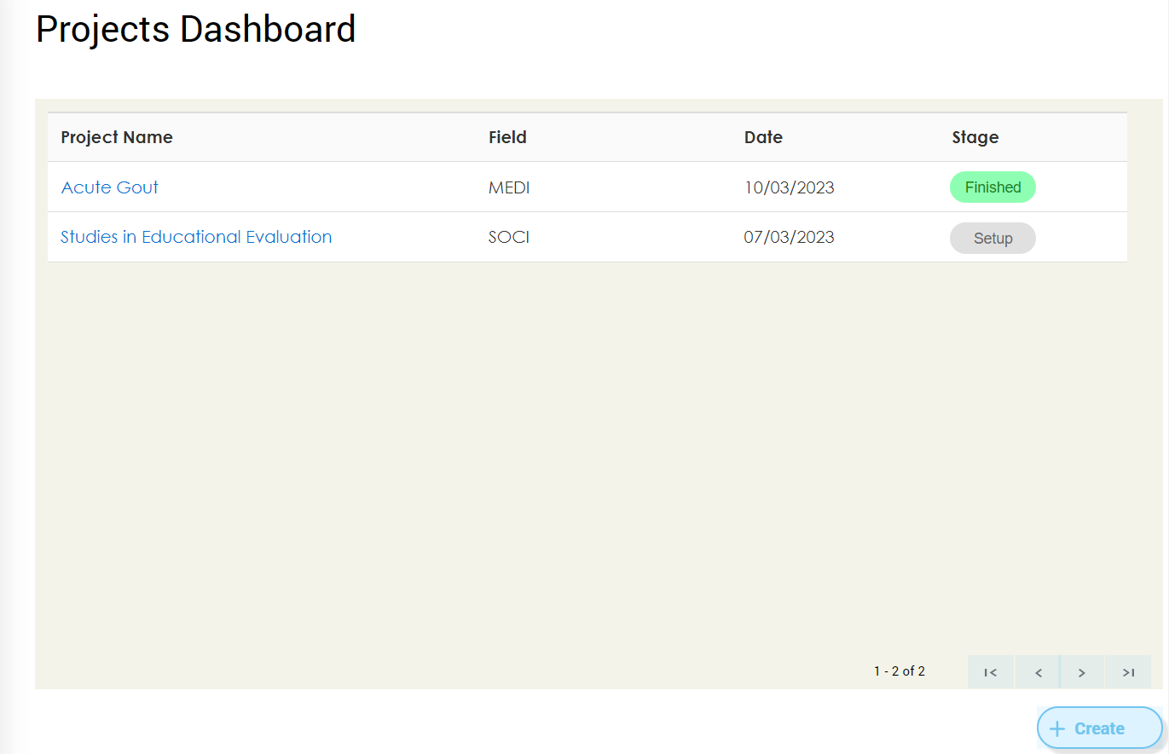
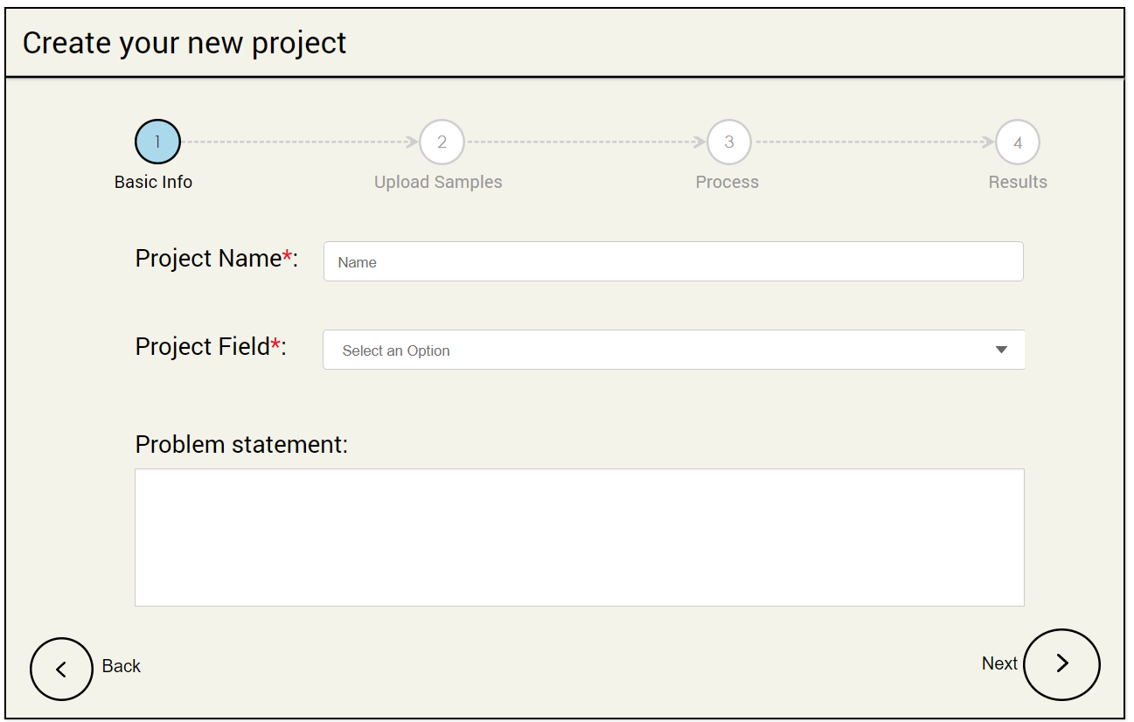
Tasks
1. Starting to create a new project 2. Filling in basic information

Slide 8
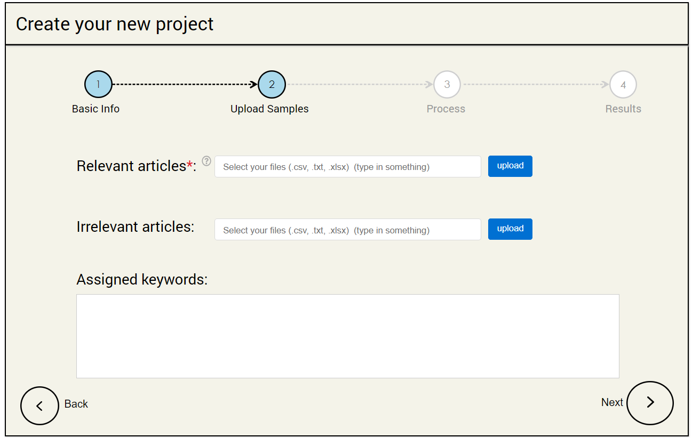
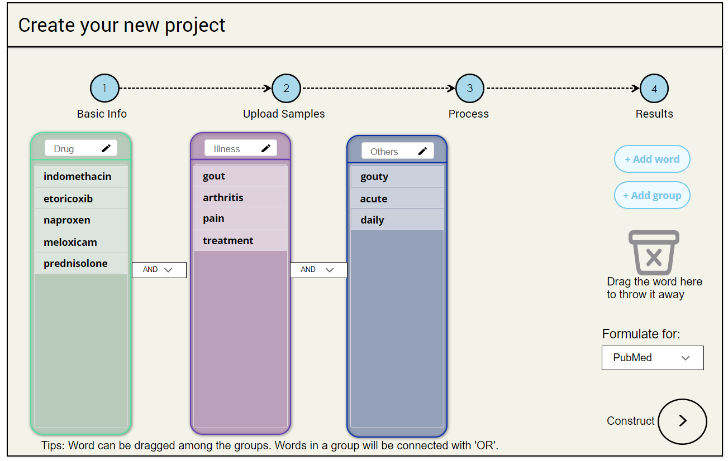
Tasks
3. Uploading samples 4. Constructing the query

Slide 9
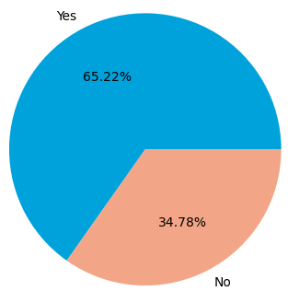
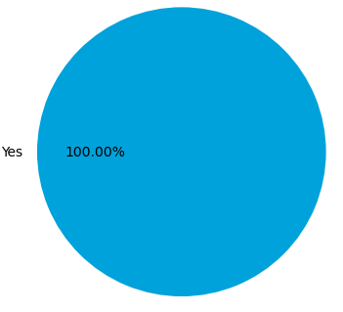
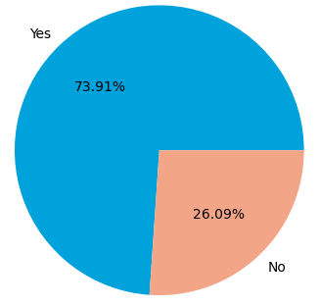
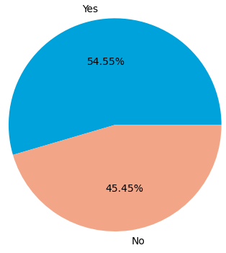
Question: Do you have experience writing a literature review?
Student:
Researcher：
Question: Do you have trouble developing an appropriate search query when starting to write a literature review?
Student:
Researcher：

Slide 10
Assumption of learnability
Although students have a greater need for this application, the researchers' experience with literature reviews gives them a higher level of learnability.

Slide 11
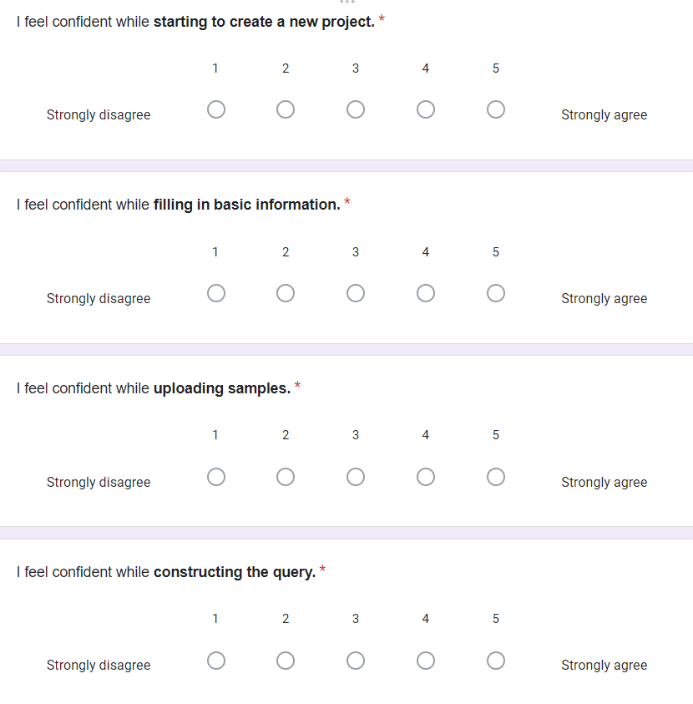
Learnability test part 1:
Test users if they can use this application smoothly in four main steps
Range: [1,5]

Slide 12
Paired t-test: CI = 95%
Null hypothesis: Two groups perform the same in the overall process
Question: I feel confident while… | Average score of student group | Average score of researcher group
Starting to create a new project | 3.5652 | 4.4167
Filling in basic information | 3.6522 | 4.6667
Uploading samples | 3.6087 | 4.25
Constructing the query | 3.3478 | 3.5
t-statistic: -3.2272
p-value: 0.0483 < 0.05
Reject null hypothesis

Slide 13
Two-sample t-test (one-tailed): CI = 95%
Null hypothesis(for each task): Student group has a better use
(the mean of the distribution underlying the student group is greater than the mean of the distribution underlying the research group*)
Question: I feel confident while… | Two sample t-test p-value | Reject null hypothesis?
Starting to create a new project | 0.0109 | Success
Filling in basic information | 0.0005 | Success
Uploading samples | 0.0169 | Success
Constructing the query | 0.3357 | Fail
Researchers has a better use in step 1, 2 and 3
*“Scipy.stats.ttest_ind,” scipy.stats.ttest_ind - SciPy v1.10.1 Manual. [Online]. Available: https://docs.scipy.org/doc/scipy/reference/generated/scipy.stats.ttest_ind.html. [Accessed: 26-Mar-2023].

Slide 14
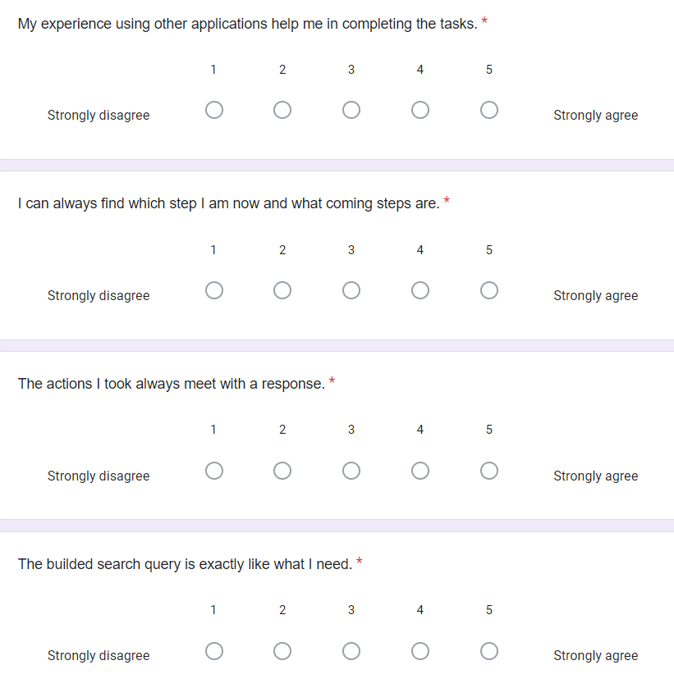
Learnability test part 2:
Ask about the learnability from the from the learnability properties
Range: [1,5]
Familiarity
Predictability
Operation visibility
Consistency

Slide 15
Paired t-test: CI = 95%
Null hypothesis: Two groups have the same level of overall learnability
Learnability properties | Average score of student group | Average score of researcher group
Familiarity | 3.4348 | 4.1667
Predictability | 3.6957 | 4.4167
Operation visibility | 3.6087 | 4.3333
Consistency | 3.4348 | 3.5833
t-statistic: -4.1456
p-value: 0.0254 < 0.05
Reject null hypothesis

Slide 16
Two-sample t-test (one-tailed): CI = 95%
Null hypothesis(for each property): Student group has higher level of learnability
(the mean of the distribution underlying the student group is greater than the mean of the distribution underlying the research group*)
Learnability properties | Two sample t-test p-value | Reject null hypothesis?
Familiarity | 0.0279 | Success
Predictability | 0.0017 | Success
Operation visibility | 0.0071 | Success
Consistency | 0.3235 | Fail
Researchers has higher level of learnability in Predictability and Operation visibility
*“Scipy.stats.ttest_ind,” scipy.stats.ttest_ind - SciPy v1.10.1 Manual. [Online]. Available: https://docs.scipy.org/doc/scipy/reference/generated/scipy.stats.ttest_ind.html. [Accessed: 26-Mar-2023].

Slide 17
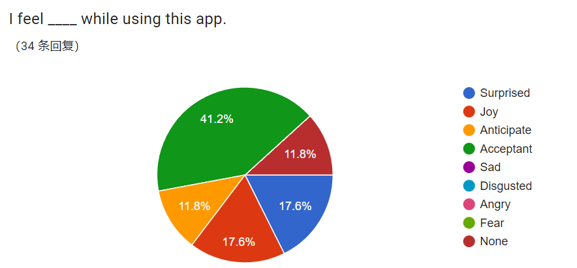
Emotions
Emotions appear in all 34 response are all positive
Sort them by activeness:
Surprised - 5
Joy - 4
Anticipate - 3
Acceptant - 2
None – 0

Slide 18
Two-sample t-test (Welch's t-test)
Student: [3, 0, 3, 4, 2, 2, 4, 2, 5, 4, 3, 0, 2, 2, 4, 0, 4, 5, 2, 2, 3, 2, 2]
Average: 2.6
Researcher: [2, 4, 0, 5, 5, 2, 2, 5, 5, 2, 2]
Average: 3.1 -> more active
Null hypothesis: There is no significant difference in the emotions when using the app between the two groups of users
t-statistic: -0.7918
p-value: 0.4396 > 0.05
Deny null hypothesis
And researcher group has a higher average

Slide 19
Conclusion
Learnability is better in researcher group.
Researcher group is more active in emotion test.

Slide 20
Thank you

