Slide 1
TDR Cable Fault Detection with Physics-Informed Machine Learning
Finding and classifying coaxial-cable faults from one reflectometry trace: classical baseline vs ML / neural networks, from simulation to real data
[Team members] · Guide: [Guide]
[Institution] · [Course] · November 2026
Notes:
Title slide. Replace the bracketed placeholders with the team, guide and institution. The talk goes from zero (what a cable fault and TDR are) to the measured results and what is still pending.

Slide 2
What this presentation covers
1
2
3
4
Introduction and basics
Development journey
System architecture
Hardware
5
6
7
8
Software
Localization (ML/NN)
Detection (ML/NN)
End-to-end working
9
10
11
12
Hardware–software integration
Feature by feature
Testing and validation
Performance analysis
13
14
15
16
Problems and solutions
Achievements and status
Limitations and future
Conclusion + appendix
Notes:
The deck follows the project from the first idea to the current state. Parts 6 and 7 (localization and detection) are the core technical results; part 11 is the testing evidence; part 14 separates what is done from what is pending.

Slide 3
The project in one slide
What
Why
How
Status
Send a voltage step into a cable.
Record the echo with an oscilloscope.
Software answers: is there a fault, which kind, and how far away?
Faults hide inside cables.
Manual reading is slow and subjective.
Weak echoes drown in noise.
Lab instruments add ringing and jitter.
Physics simulator makes labelled traces.
Classical baseline vs 5 ML families × 2 inputs.
Calibration ties simulation to the real setup.
Tested on 16 real measured traces (Zenodo).
Software: complete, 62 tests + self-test.
Best distance model: Extra Trees (features).
Best fault-type model: 1-D CNN (raw).
Own lab measurements: pending.
0.37 m
85 %
0.983
19/19
mean distance error, ET-B, every faulted test trace
of faults the classical baseline locates at all
macro-F1 of CNN-A over 4 fault classes
features pass the end-to-end self-test
Notes:
What: a system that finds where a coaxial cable is faulty and what kind of fault it is, from one oscilloscope trace. Why: manual reading is slow and fails for weak echoes in noise. How: physics simulation trains ML models; a classical method is the reference. Status: software complete and tested; simulation and real-data (Zenodo) results measured; our own lab session pending.

Slide 4
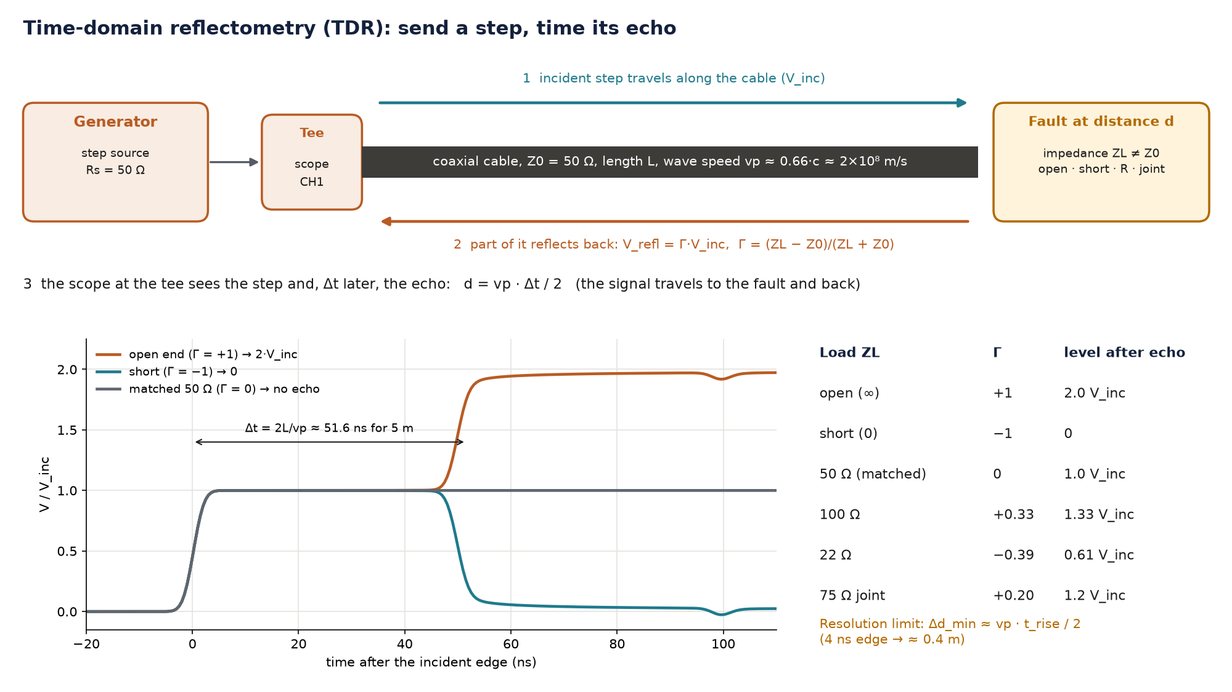
The real-world problem: faults hidden inside cables
Break (open)
conductor cut → very high impedance → echo positive (Γ = +1)
Short
conductors touching → zero impedance → echo negative (Γ = −1)
Damaged insulation / water
partial leakage path → lower impedance → small negative echo
Bad connector / corrosion
series resistance → higher impedance → small positive echo
Wrong-impedance repair
50 Ω joined to 75 Ω → impedance step → Γ = +0.2
One measurement from one end of the cable can reveal all of these faults.
Notes:
Every type of damage changes the cable's local impedance. That is why one technique, reflectometry, can see them all: the echo's sign separates high-impedance faults (breaks) from low-impedance ones (shorts, wet insulation).

Slide 5
Why reading the echo is hard
Noise
Edge speed (resolution)
Small echoes from partial faults sink into noise.
A threshold low enough to see them also fires on noise.
Lab generators rise in 5–15 ns.
Faults closer than vp·t_rise/2 (≈ 0.4–1.5 m) merge with the step.
Cable loss and dispersion
Real instruments
The echo returns smaller and slower than it left.
This biases both timing (distance) and height (fault type).
Ringing, adapter reflections, trigger jitter, 8-bit ADC, drift.
A simple threshold mistakes them for faults.
Notes:
These four effects are exactly what the simulator models and what the experiments vary: SNR (E1), distance range (E2), real instruments (E3/E4), weak faults (E5).

Slide 6
TDR from zero: send a step, time its echo
Notes:
Explain the picture from top to bottom: the step travels at vp (about 20 cm per ns in RG-58); at the fault part of it reflects with coefficient Γ; the scope at the tee sees the step and, Δt later, the echo. Distance d = vp·Δt/2 because the signal goes there and back. The table on the right is the whole physics needed to classify faults.

Slide 7
Key terms used in this presentation
Term | Meaning | Term | Meaning
TDR | time-domain reflectometry: send a step, time its echo | SNR | signal-to-noise ratio, 20·log10(V_inc/σ) in dB
Z0 | characteristic impedance of the cable (50 Ω for RG-58) | Rise time t_r | 10–90 % time of the edge; sets the resolution
Γ (gamma) | reflection coefficient (ZL − Z0)/(ZL + Z0) | ML / NN | machine learning / neural network
V_inc | height of the incident step at the tee | RF / ET | Random Forest / Extra Trees: averages of many decision trees
vp, VF | wave speed in the cable; VF = vp/c ≈ 0.66 | k-NN | k-nearest neighbours: answer of the most similar training traces
Δt | round-trip time of the echo; d = vp·Δt/2 | MLP / CNN | multi-layer perceptron / convolutional neural network
Localization | estimating the distance d to the fault | Method A / B | model input: raw trace (256 samples) / 23 physics features
Detection | deciding fault vs no fault and its class | MAE / F1 | mean absolute error (m) / harmonic mean of precision and recall
Notes:
Every abbreviation used later is defined here once.

Slide 8
Existing methods and their limitations
Method | How it works | Limitation
Manual scope reading | operator measures Δt with cursors | slow, subjective, impossible for small echoes in noise
Threshold / peak detection | first derivative lobe above a noise threshold | misses weak echoes at low SNR; ringing causes false early detections
Commercial TDR instruments | dedicated fast-edge hardware + vendor software | expensive, closed algorithms, not in a student lab
Matched filter (Shin et al. 2005) | correlate with the expected echo shape | needs a known pulse shape; still a threshold at the end
Published ML on TDR (Scarpetta 2021, Slimani 2024/25, Smail 2011) | CNN / k-NN / neural inverse model | each uses its own data; rarely compared with a classical baseline on identical traces
Our angle: five model families × two inputs vs a classical baseline on identical traces, then the same chain on real data.
Notes:
Our classical baseline is the threshold method of row 2, implemented carefully; the matched filter of row 4 is our baseline on the Zenodo pulse data. The gap we address is in the last column of row 5.

Slide 9
Our proposed solution
1 Physics first
2 One processing chain
3 Fair comparison
transmission-line simulator → unlimited labelled traces
simulated and measured traces go through identical code
5 families × 2 inputs vs baseline, chosen on validation only
4 Calibration
5 Real-data test
6 Lab tooling
vp, t0, rise, V_inc measured → simulator re-centred
16 measured traces + 1 M simulated (Zenodo 5720438)
auto-capture, labelled log, live check, beginner hardware guide
Notes:
Six design decisions. The first three are about fair, reproducible ML; the last three connect it to the real world.

Slide 10
Objectives and expected outcome
# | Objective | Implemented in | Status
O1 | Simulate realistic labelled TDR traces | src/sim_tdr.py | Done, physics-checked
O2 | Classical baseline to beat | src/baseline.py | Done
O3 | ML for distance + fault type; raw vs features | features.py, models.py, train.py | Done, 18 models
O4 | Experiments E1–E6 | src/evaluate.py, analysis.py | Done on simulation
O5 | Lab setup, calibration, labelled real data | capture.py, calibrate.py, hardware/ | Software done; lab pending
O6 | Interactive demonstrator | app/dashboard.py | Done
O7 | Validate on real measured traces | src/zenodo.py | Done (16 Zenodo traces)
Notes:
Status column is honest: O5 needs our own lab session. Everything else is implemented and measured.

Slide 11
Development journey
Part 2
How the project went from a brief to a tested system, stage by stage

Slide 12
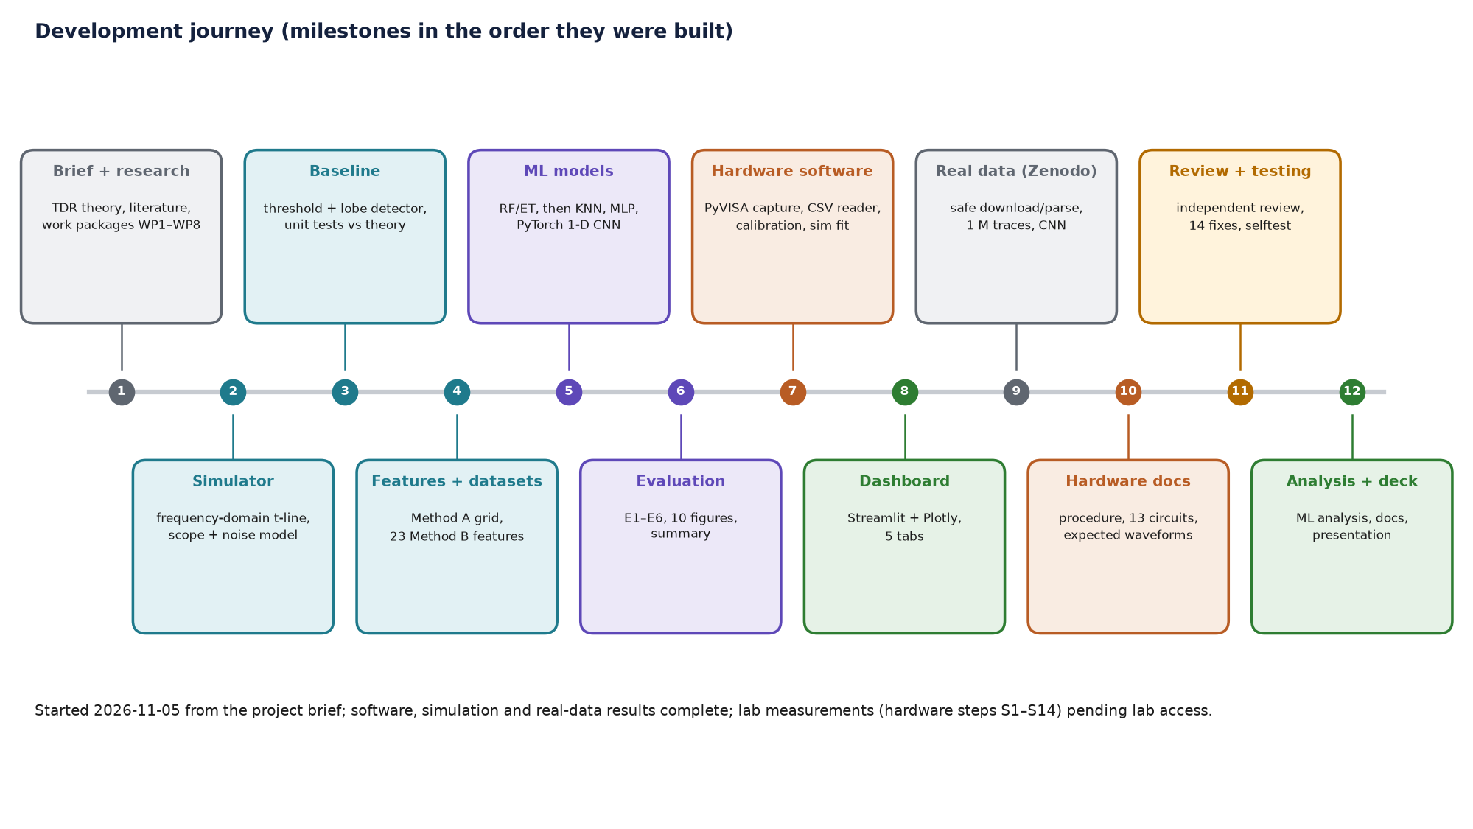
Milestones in the order they were built
Notes:
Each milestone depended on the previous: the baseline needed the simulator to test against theory; the models needed the processing chain; evaluation needed models; the lab software needed the processing chain; the review came last and changed the code before the final runs.

Slide 13
Research and planning: from literature to model choice
Source | What it contributed | What we built
Brief (WP1–WP8) | RF / ET with physics features, E1–E6 | baseline, RF-B, ET-B, experiments
Smail et al. 2011 | train a neural network on physics simulations, invert on real data | simulator + MLP
Slimani et al. 2024/25 | k-NN beat a 1-D CNN for localisation (RG-58 simulations) | k-NN on both inputs
Scarpetta et al. 2021 | 1-D CNN on pulse TDR + public dataset with real traces | 1-D CNN, Zenodo pipeline
Shin et al. 2005 | cross-correlation detection, resolution limited by rise time | matched-filter baseline (Zenodo)
Chang & Park 2019 | time-frequency CNN | noted as future work (P3-7)
Notes:
We read the reading list and mapped each paper to something we build or compare against. The key insight from Slimani: a simple k-NN beat a 1-D CNN at localisation, so classical ML must be in the comparison, not only deep learning.

Slide 14
Requirements we set before coding
Functional
Non-functional
Locate a fault (distance in m) from one trace.
Classify: open / short / matched / partial.
Work with any common lab scope (unknown model).
Calibrate the setup from measurements.
Compare classical vs ML on identical traces.
Show results interactively.
Runs on a student laptop (CPU only).
Reproducible: fixed seeds, stored settings.
Fair: hyper-parameters chosen on validation only.
Safe with downloaded data (no code execution).
Usable without hardware (simulated scope).
Every feature testable automatically.
Notes:
Functional requirements come from the brief; non-functional ones came from the lab situation (unknown scope model, limited lab time, need for a demo).

Slide 15
Technology selection and why
Need | Choice | Why this one
Numerics, signal processing | NumPy, SciPy | FFT-based simulator, filters, least-squares fit
Classical ML | scikit-learn | RF, ET, k-NN, MLP with one fit/predict interface
Neural network (1-D CNN) | PyTorch (CPU) | flexible, runs on a laptop, streams large datasets
Instrument control | PyVISA + pyvisa-py | one API for USB/LAN scopes; driver-free fallback
Dashboard | Streamlit + Plotly | interactive web app from one Python file, zoomable plots
Figures | Matplotlib, schemdraw | report figures; circuit diagrams as code
Data | pandas, joblib | tables, model bundles
Testing | pytest + own self-test | unit tests + end-to-end runs in a sandbox
Notes:
All open-source Python; PyTorch CPU build because no GPU is assumed; Streamlit because a dashboard is one Python file; PyVISA because it talks to every major scope vendor through one API.

Slide 16
Development environment and first run
# 1. Python environment (Windows, Python 3.11+)
python -m venv .venv
.venv\Scripts\pip install -r requirements.txt
.venv\Scripts\pip install torch --index-url https://download.pytorch.org/whl/cpu
# 2. Check packages, VISA backends, calibration, models
.venv\Scripts\python index.py check
# 3. Train and evaluate on simulation (about 1 h on a laptop)
.venv\Scripts\python index.py train
.venv\Scripts\python index.py evaluate
.venv\Scripts\python index.py analyze
# 4. Prove every feature works (temporary folder, no hardware)
.venv\Scripts\python index.py selftest
# 5. Demo
.venv\Scripts\python index.py dashboard
What each step gives
requirements.txt pins numpy, scipy, pandas, matplotlib, scikit-learn, streamlit, plotly, pyvisa, pytest, schemdraw.
check: [ok] per package, VISA backend, calibration and model status.
train: models/tdr_models.joblib (18 models).
evaluate / analyze: report/results + figures.
selftest: report/results/feature_tests.md.
Notes:
Steps a new team member follows. The self-test proves the installation works without any hardware.

Slide 17
Stage by stage: what, why, input, output
Stage | What we did / why | Input → output | Challenge → resolution
Simulator | frequency-domain transmission line, all fault kinds: labelled data at no cost | parameters → (t, v) + labels | tail of incident edge looked like an echo → shared lobe boundary
Baseline | threshold + lobe detector: the reference to beat | trace → Δt, d, Γ, class | noise false alarms → MAD noise, adaptive smoothing
Features / datasets | Method A grid, 23 features; cached sets | traces → X (n×256), F (n×23) | stale caches → config fingerprint in names
Models + training | 5 families, grid search on validation | train/val → bundle | no sample weights in k-NN/MLP → row repetition
Evaluation | E1–E6, 10 figures, then deep analysis | bundle + test sets → tables | unfair comparison → 'fair' subset metric
Lab software | PyVISA capture, universal CSV, calibration, fit | scope → CSV + log → calibration.json | unknown scope → 4 vendor drivers + CSV fallback
Real data | Zenodo 5720438, 4.18 GB, safe parsing | archive → Z1–Z3 results | pickled labels → restricted unpickler
Review + tests | independent review: 14 findings, 12 fixed, 1 documented, 1 not occurring; self-test | code → fixes + evidence | see Part 13
Notes:
Read row by row. The 'next depends on' column explains the order of the timeline.

Slide 18
System architecture
Part 3
Three layers: lab hardware, online software per trace, offline simulation/training/evaluation

Slide 19
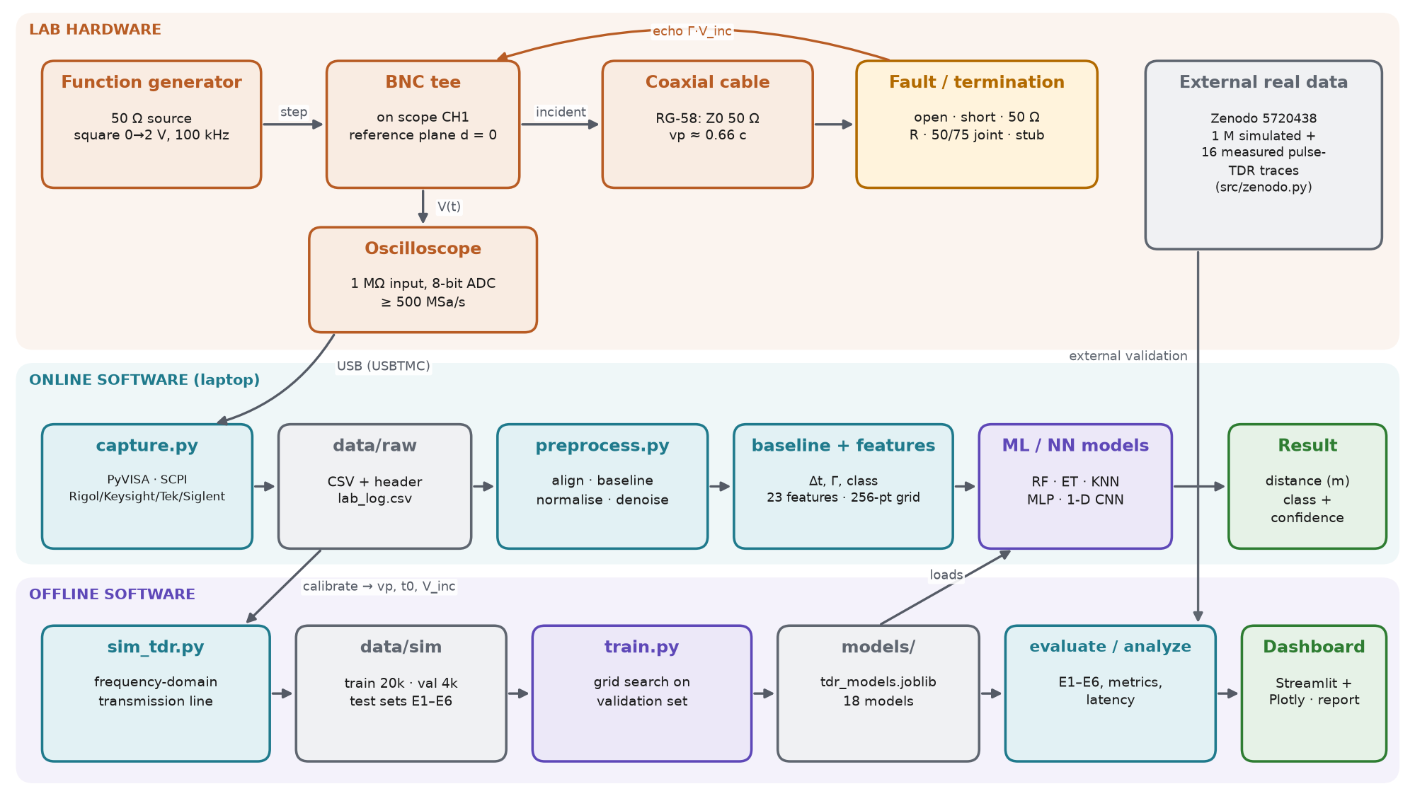
Overall system block diagram
Notes:
Top: the physical signal path. Middle: what happens to each measured trace. Bottom: the offline loop that produces the models. Calibration is the bridge: it is measured on the hardware and re-centres the simulator. The Zenodo box is the external real-data test.

Slide 20
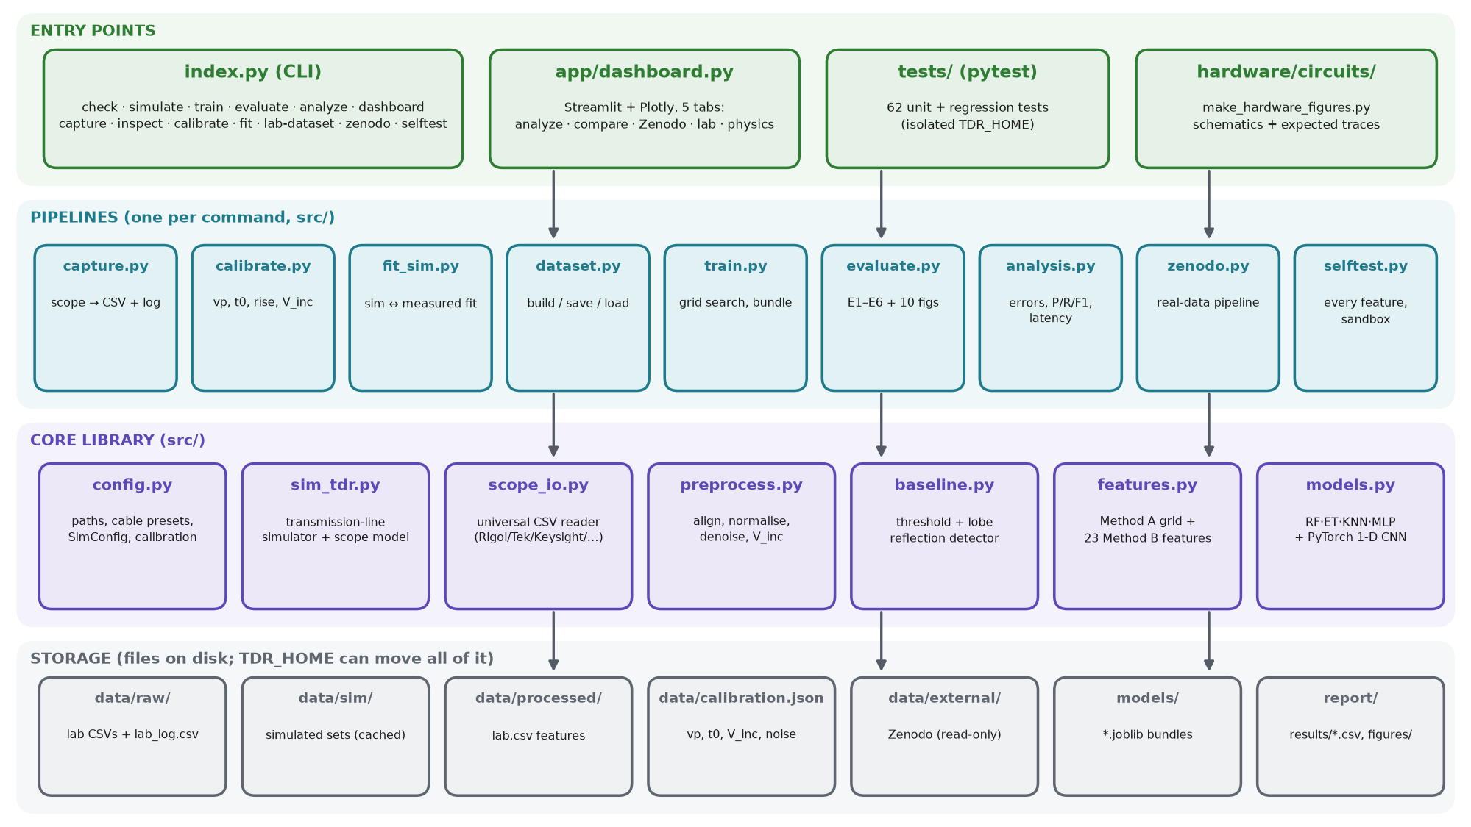
Software architecture: four layers
Notes:
Entry points call pipelines; pipelines use the core library; everything reads and writes plain files. TDR_HOME moves all storage, which is how tests run without touching real results.

Slide 21
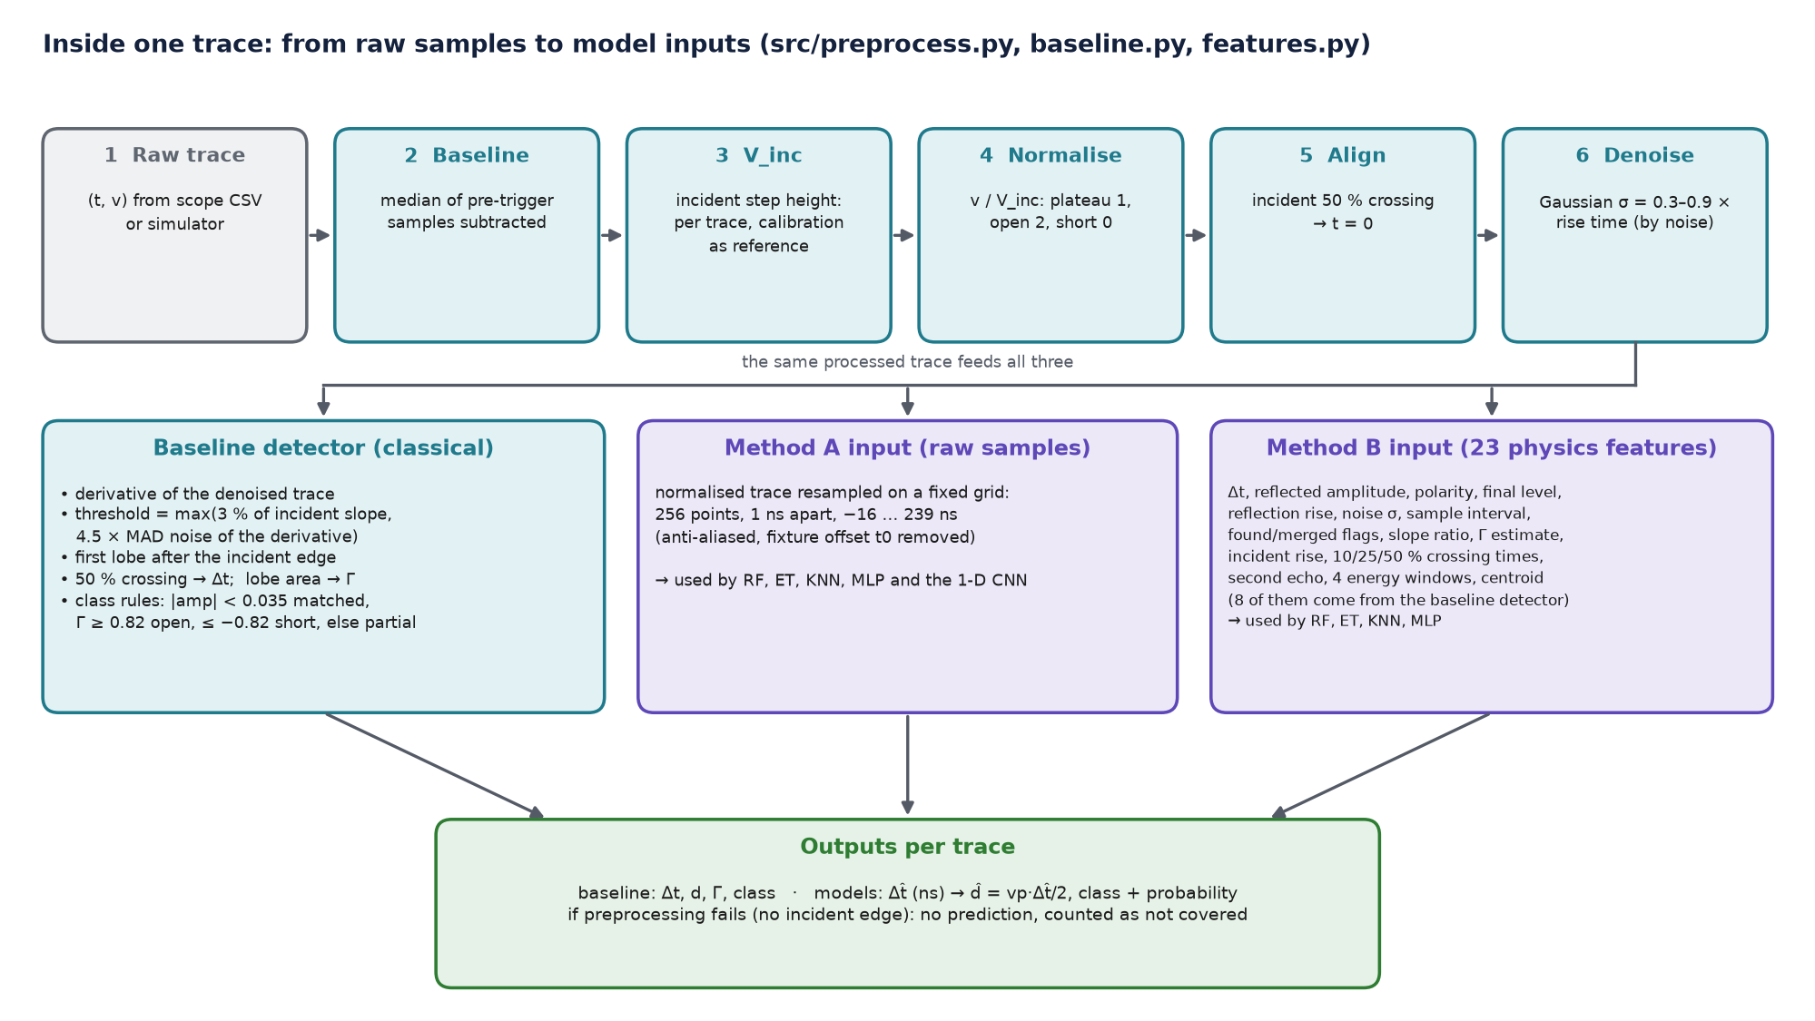
Data flow inside one trace
Notes:
Six preprocessing steps make every trace look the same; then three consumers: the classical detector and the two model inputs. If the incident edge cannot be found the trace gets no prediction rather than a made-up one.

Slide 22
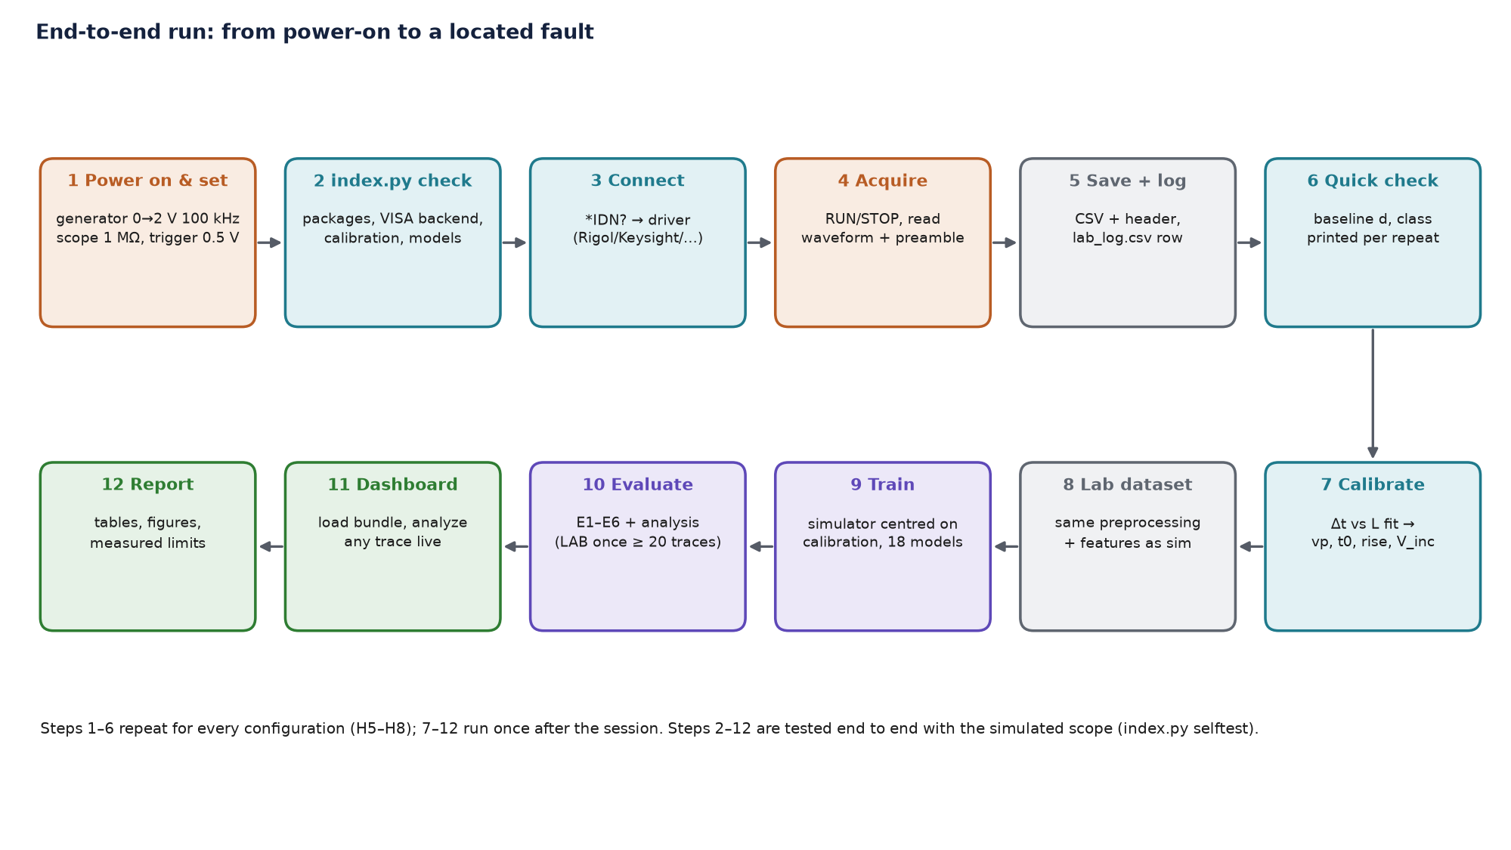
Complete workflow, start to finish
Notes:
Steps 1–6 happen at the bench for every configuration; 7–12 once after the session. All software steps are rehearsed end to end with the simulated scope.

Slide 23
Hardware
Part 4
Standard lab instruments, coaxial cables and a few passive parts. No microcontroller, no firmware. Built in the order of hardware/README.md

Slide 24
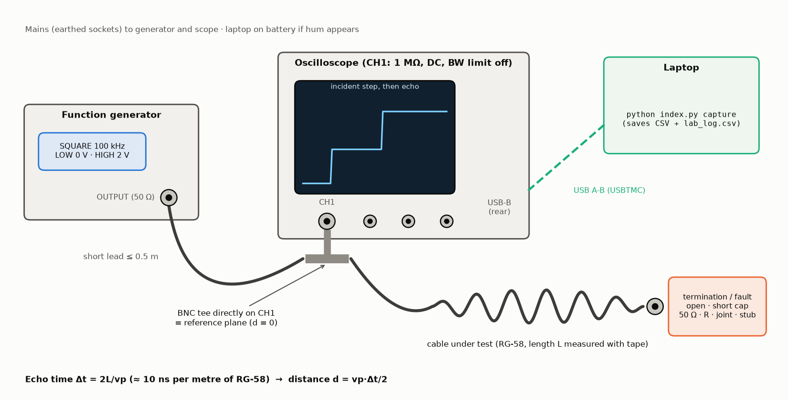
Hardware set-up at a glance
Generator: 50 Ω source, square 0 → 2 V, 100 kHz
Tee on CH1: joins generator, cable and scope
Cable: RG-58, 2 / 5 / 10 m
Load: open, short, 50 Ω or an approved fault
Laptop: USB-TMC to the scope, runs capture
Notes:
The tee directly on the scope input is the reference plane: every distance is measured from there. A short generator lead keeps secondary echoes out of the window.

Slide 25
Component inventory (bill of materials)
Component | Specification | Purpose / why selected
Function generator | 50 Ω out; 0 V/2 V levels; edge ≤ 15 ns (≤ 5 ns better) | makes the incident step; 50 Ω absorbs returning echoes
Digital oscilloscope | ≥ 100 MHz, ≥ 500 MSa/s, 1 MΩ, USBTMC, CSV export | records the step and echo; bandwidth sets rise time
Coaxial cables RG-58 | Z0 50 Ω, VF ≈ 0.66; 2, 5, 10 m (+ 3, 2, 1 m pieces) | lines under test; ≥ 2 lengths needed for calibration
BNC tee ×2, short lead ≤ 0.5 m | 50 Ω, UG-274 style | reference plane at CH1; second tee for shunt/stub
Terminations | 50 Ω end + feed-through, shorting cap, 75 Ω | matched / short / joint loads
Fault parts | 22, 49.9, 100 Ω 1 % 0.25 W; binding-post adapters; series box; RG-59 | partial faults with known Γ
Tools | multimeter, tape (mm), USB stick, camera | check parts, lengths, CSV fallback, setup photo
Optional pulser | 74AC14, 4 × 180 Ω, 5 V | ≈ 2–3 ns edge for better resolution
Notes:
Full list with specifications, quantities and tick boxes in hardware/README.md §3. Specifications are minimums; the column 'why' is the selection reason.

Slide 26
Component deep-dive: generator, oscilloscope, cable
Function generator
Oscilloscope
Coax + tee + loads
Principle: internal source Vs behind Rs = 50 Ω.
Use: square 0→2 V, 100 kHz; high time 5 µs ≫ round trip.
I/O: OUTPUT BNC → short lead → tee.
Power: mains, earthed socket.
Expect: 2.0 V open, 1.0 V into 50 Ω (H3).
Problem: plateau doubled → 'Load = 50 Ω' display setting only.
Principle: samples V(t) with an 8-bit ADC after a trigger.
Use: CH1 1 MΩ, DC, BW limit off, trigger rising 0.5 V Normal.
I/O: CH1 BNC in; USB-B (USBTMC) or LAN out.
Expect: step to 1 V, echo at 2L/vp.
Problem: half-height plateau → input set to 50 Ω.
Principle: wave travels at vp; impedance changes reflect.
RG-58: Z0 50 Ω, VF 0.66, 16 dB/100 m @100 MHz.
Tee: male stem on CH1, two female ports.
Loads: open (Γ +1), short (−1), 50 Ω (0).
Problem: extra echoes → long lead or tee not on CH1.
Notes:
Each component's operating principle in one line, how we use it, what we expect, and the common problem with its fix.

Slide 27
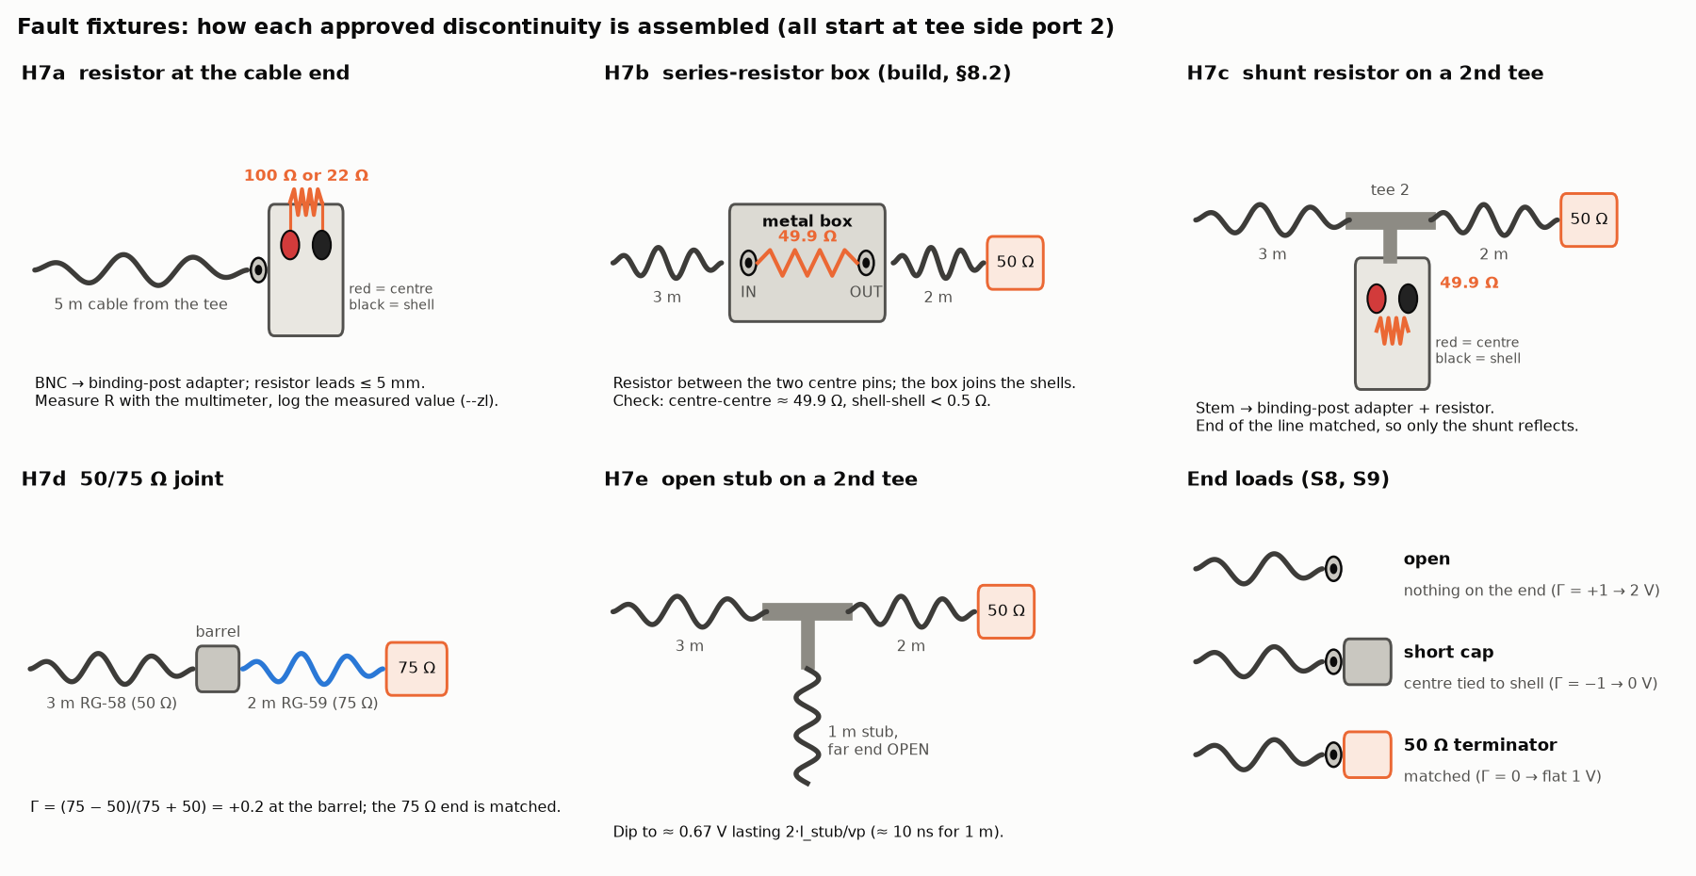
Fault fixtures: how each discontinuity is assembled
Notes:
Only instructor-approved fixtures are built. Measured resistor values go into the log, not nominal ones.

Slide 28
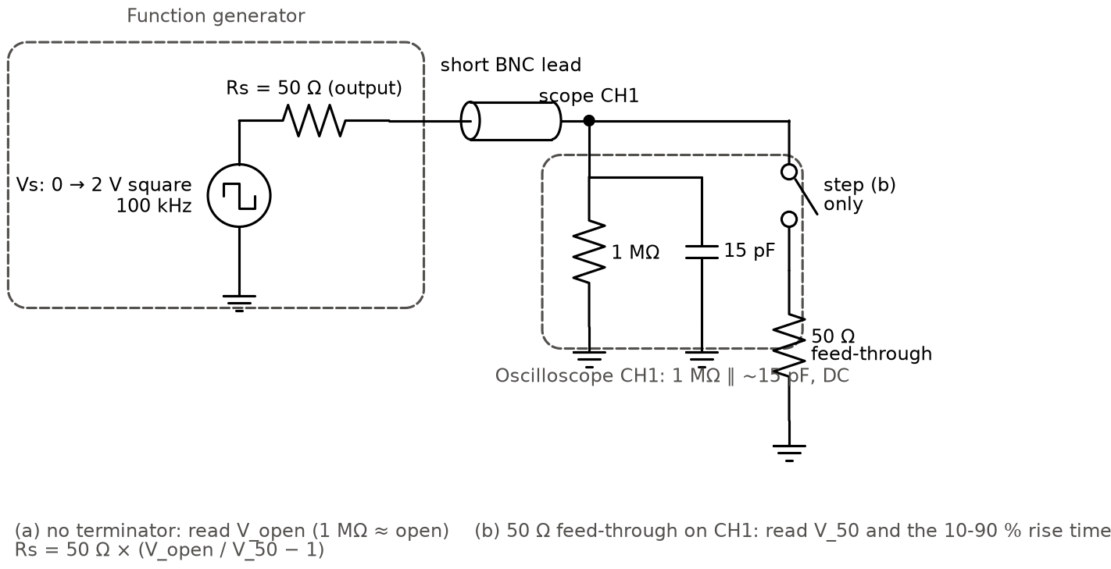
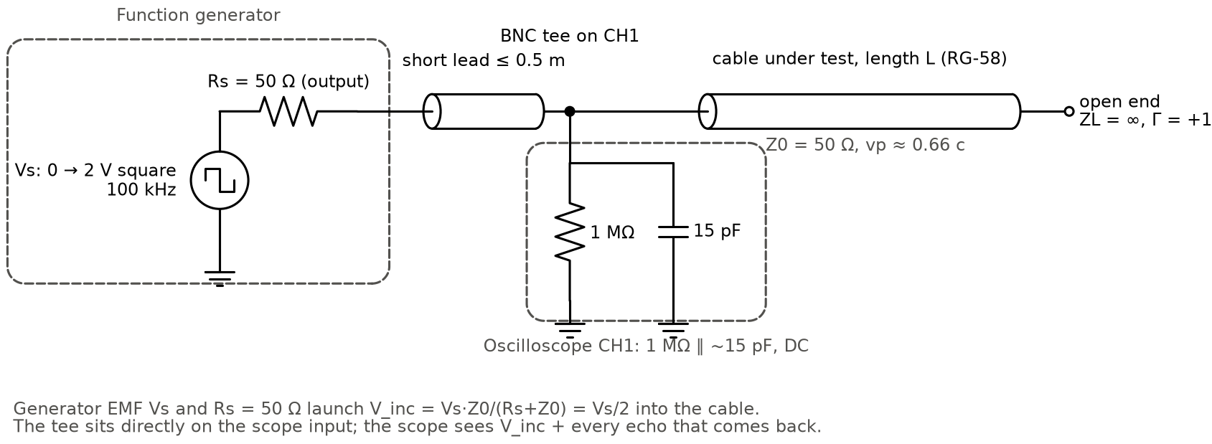
Circuit diagrams: generator check and basic TDR set-up
Notes:
Left: H3 checks the generator's output resistance (V_open/V_50 − 1 times 50 Ω). Right: the measurement circuit used for every trace; the scope input is modelled as 1 MΩ ∥ 15 pF.

Slide 29
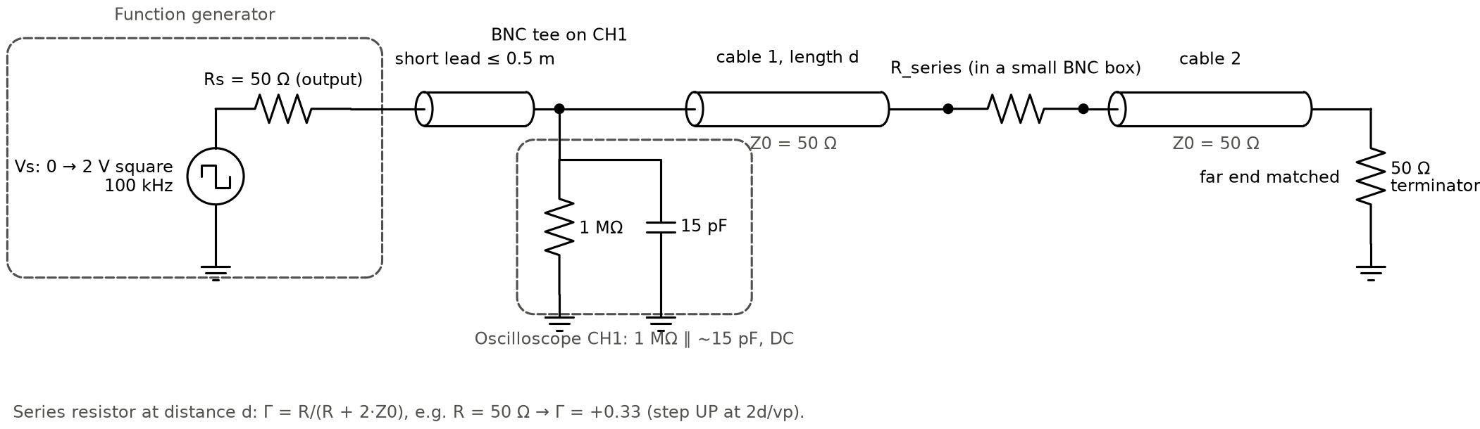
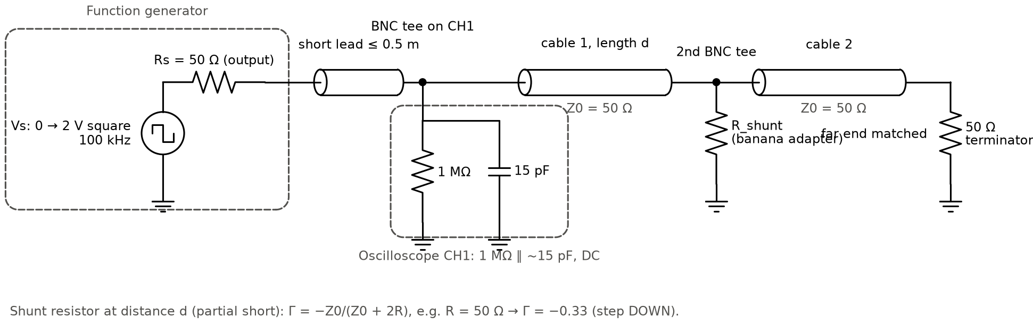
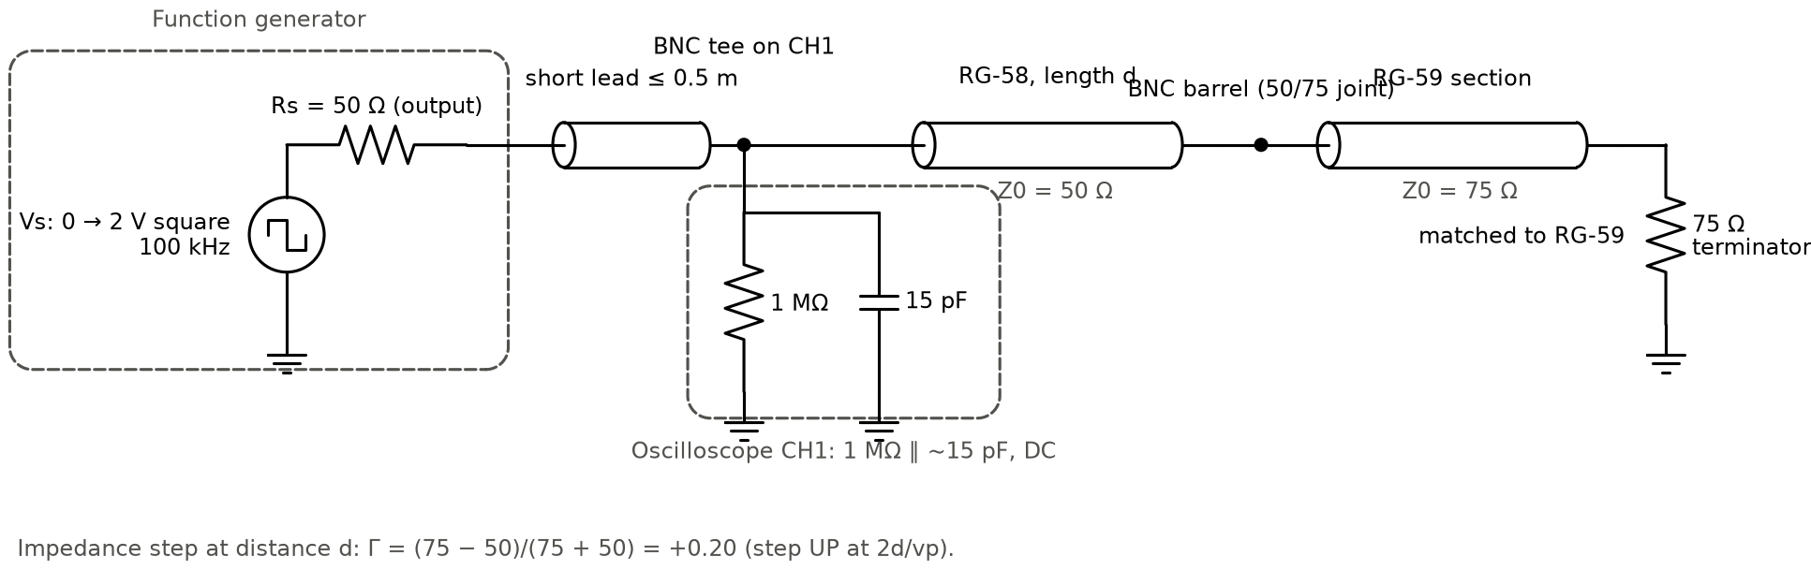
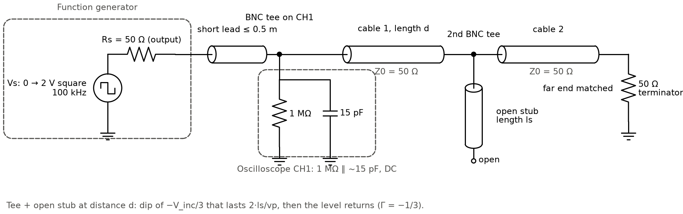
Circuit diagrams of the partial faults
Notes:
Series and shunt resistors at 3 m with a matched far end, the 50/75 Ω joint and the open stub. Expected levels: 1.33 V, 0.67 V, 1.2 V, dip to ≈ 0.67 V.

Slide 30
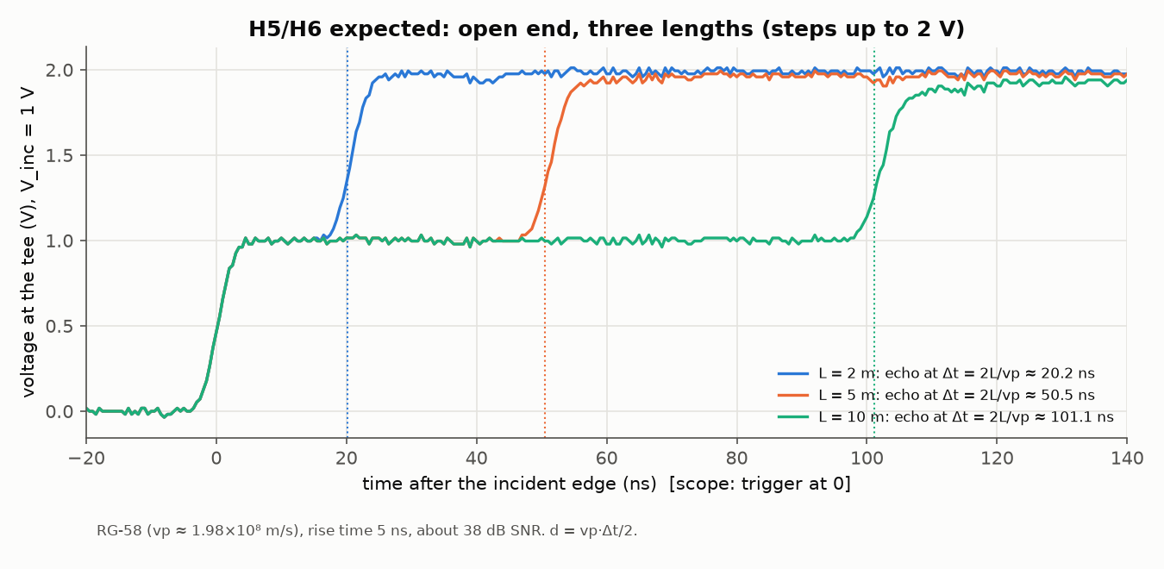
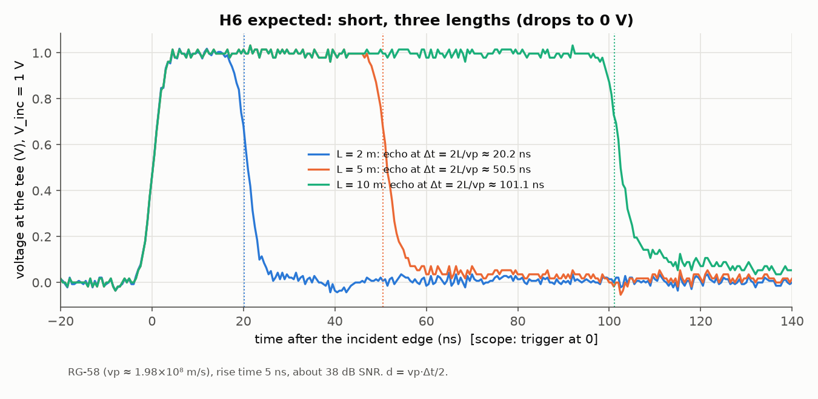
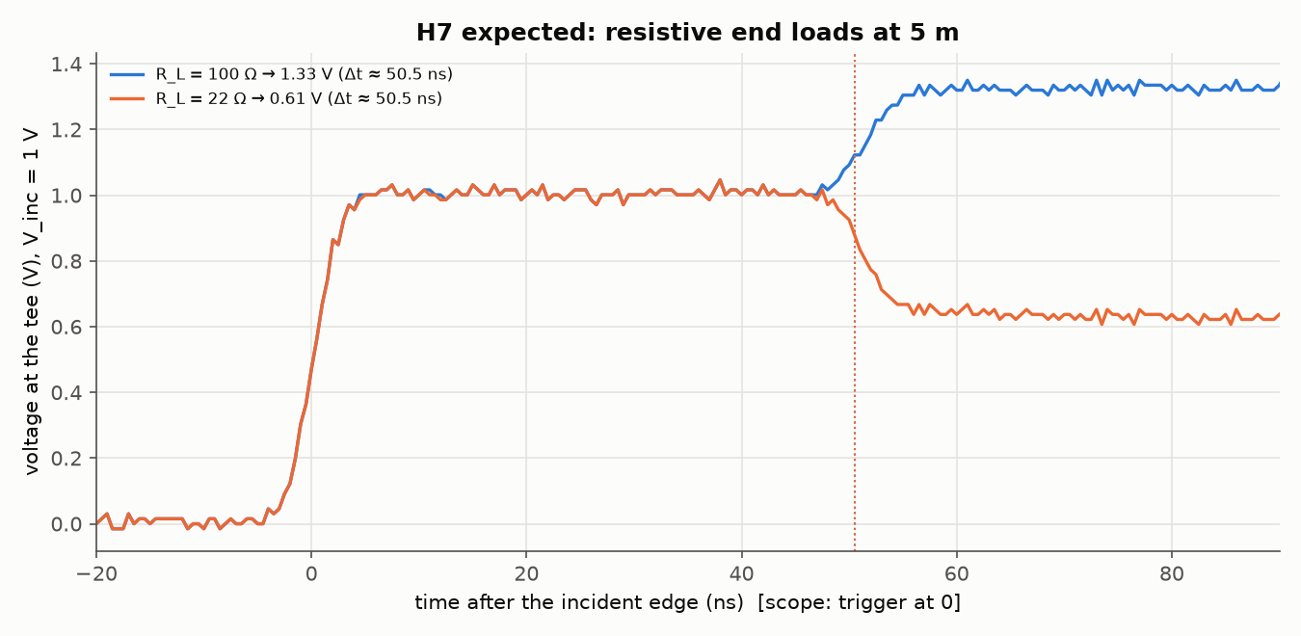
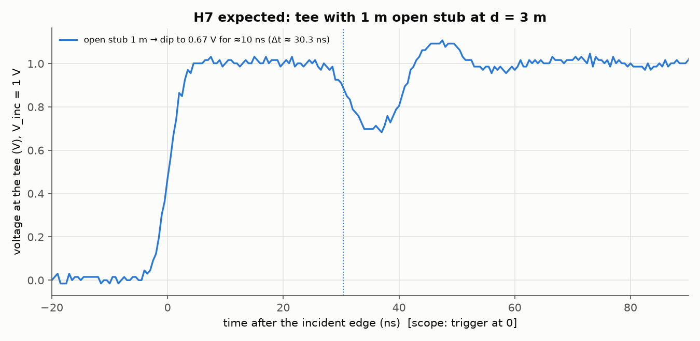
Expected scope pictures (simulated before the lab)
Notes:
Produced by our simulator for RG-58, 5 ns rise, 1 V incident step. At the bench these are the 'is it right?' reference: the levels and the 2L/vp delays must match.

Slide 31
Port-to-port connection table (set-up B)
# | From (port, connector) | Via | To (port, connector)
B1 | Scope CH1 input, BNC female | – | tee male stem, directly on CH1
B2 | Generator OUTPUT, BNC female | short lead ≤ 0.5 m (M–M) | tee side port 1
B3 | Tee side port 2 | – | cable under test, end A
B4 | Cable end B | – | open / shorting cap / 50 Ω terminator / fault
B5 | Laptop USB-A | USB A-B cable | scope rear USB Device (USBTMC)
Ground reference: BNC shells, tied to mains earth through both instruments' earthed sockets.
Notes:
Every connection is a BNC bayonet. Fault set-ups only change what is attached to tee side port 2 (hardware/README.md §5.3).

Slide 32
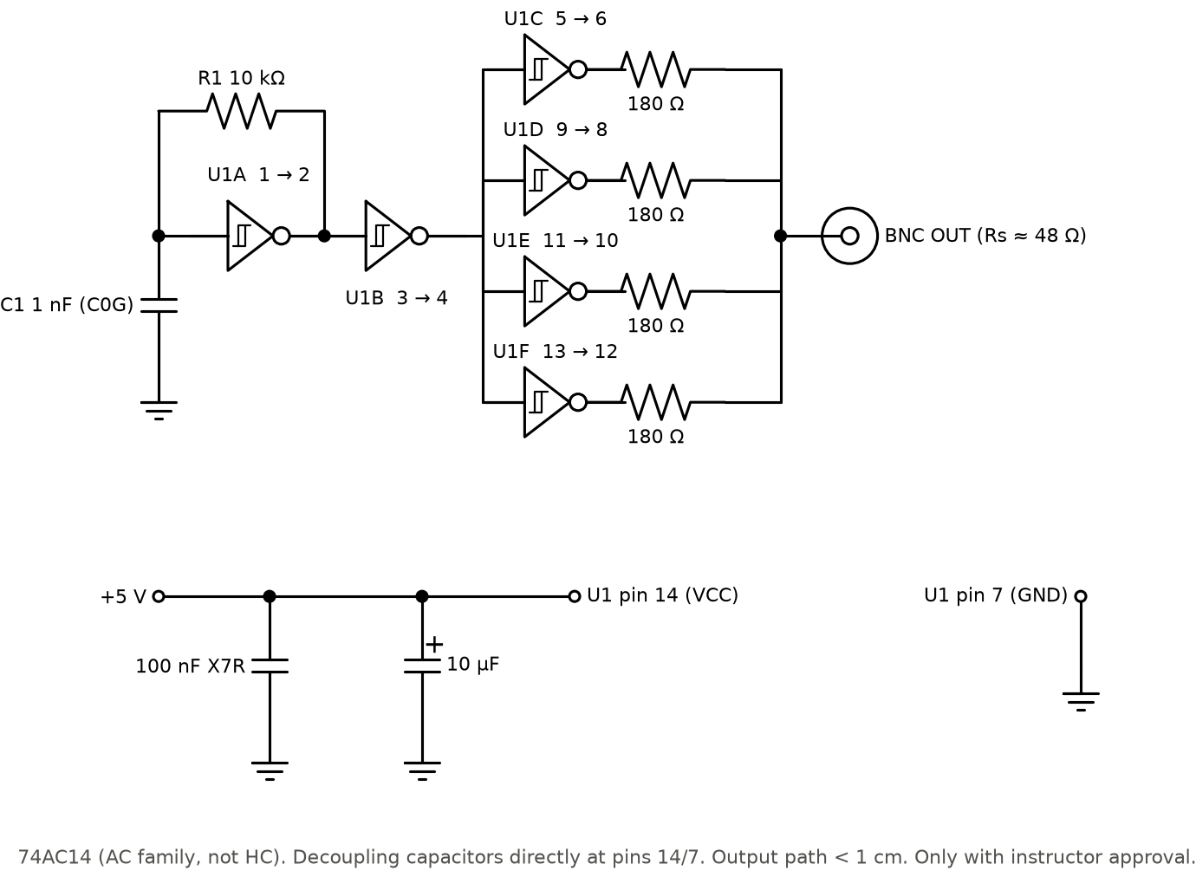
Optional fast-edge pulser: schematic and pinout
Pin | Connects to
1 (1A) | R1 10 kΩ + C1 1 nF
2 (1Y) | R1 (feedback), pin 3
4 (2Y) | pins 5, 9, 11, 13
6, 8, 10, 12 | 180 Ω each → BNC centre
7 GND | ground plane, BNC shell
14 VCC | +5 V, 100 nF + 10 µF
Notes:
74AC14 Schmitt inverters: gate A is an RC oscillator (≈ 100 kHz), gate B buffers, four gates in parallel drive the BNC through 180 Ω each, about 48 Ω source impedance to match the cable. AC family, not HC: HC edges are 6–10 ns.

Slide 33
Power distribution and safety
Equipment | Supply | Draw / note
Generator, scope | mains via earthed sockets | < 100 W each; never defeat the earth pin
Laptop | battery or charger | run on battery if 50/60 Hz hum appears
Cables, loads | none (passive) | max ≈ 17 mW in a 22 Ω load
Pulser (optional) | 5.0 V ± 0.25 V, ≥ 150 mA | ≈ 10 mA idle, ≈ 105 mA peak into a short
Safety rules
Generator ≤ 5 V peak (2 V used); an open end doubles it.
Scope on 1 MΩ; never the 50 Ω input above its rating.
Discharge long cables before connecting.
Generator output OFF while changing loads.
Only instructor-approved modifications.
No high-voltage (avalanche) pulsers.
Notes:
Only the optional pulser needs a DC supply; everything else is mains-powered instruments and passive parts. Safety rules are from the lab procedure and override convenience.

Slide 34
Hardware assembly and test sequence (S1–S15)
Step | Task | Done when | Status
S1–S2 | approvals; collect and multimeter-check parts | every BOM row ticked, parts verified | pending (lab)
S3 | laptop install + rehearsal | check ok, selftest no Fail | ready
S4–S5 | equipment discovery; laptop ↔ scope | *IDN? string printed | pending (lab)
S6–S7 | generator check (Rs 45–55 Ω); basic set-up | flat 1 V plateau, echo where expected | pending (lab)
S8 | calibration: open at ≥ 2 lengths + matched | VF 0.64–0.68, σ(vp)/vp < 1 %, |t0| < 3 ns | pending (lab)
S9–S11 | test matrix, partial faults, low-SNR | ≈ 180 + fault + low-SNR traces logged | pending (lab)
S12–S14 | data check + backup; process; report | E3/E4 marked LAB | software ready
S15 | optional pulser | Rs 45–55 Ω, faster edge | optional
Notes:
The beginner manual gives each step a what / why / you need / how / done-when. The software side of every step is ready; the lab steps need lab access.

Slide 35
Calibration: method and rehearsal result
Measure: 20 open-circuit traces at each of ≥ 2 lengths (2, 5, 10 m), 10 matched traces.
Fit: straight line Δt vs L → slope 2/vp, intercept t0 (tee + trigger delay).
Also: rise time → resolution vp·t_r/2; V_inc and noise at the normal amplitude.
Used by: every later command automatically (calibration.json).
Rehearsal (simulated scope): vp = 1.9616e+08 m/s vs simulated truth 1.9786e+08 (-0.86 %); t_offset 0.23 ns; rise 4.15 ns; resolution 0.41 m; SNR 30.5 dB
Status: method tested; real calibration values pending the lab session.
Notes:
Calibration fits Δt = (2/vp)·L + t0 over open-circuit traces at several lengths. The rehearsal uses the simulated scope, whose true vp is known, so it measures the method's accuracy; the real values come from the lab.

Slide 36
Software
Part 5
Python 3.13 · NumPy/SciPy · scikit-learn · PyTorch · PyVISA · Streamlit/Plotly · pytest

Slide 37
Folder structure
D:\EMT
├─ index.py one CLI for every step
├─ src/
│ ├─ config.py paths, cable presets, SimConfig
│ ├─ sim_tdr.py transmission-line simulator
│ ├─ preprocess.py align · normalise · denoise
│ ├─ baseline.py classical detector
│ ├─ features.py Method A grid, 23 features
│ ├─ dataset.py build / save / load sets
│ ├─ models.py RF·ET·KNN·MLP·1-D CNN
│ ├─ train.py · evaluate.py · analysis.py
│ ├─ scope_io.py · capture.py · calibrate.py · fit_sim.py
│ ├─ zenodo.py external real data
│ └─ selftest.py every feature end to end
├─ app/dashboard.py Streamlit + Plotly
├─ tests/ 62 pytest tests
├─ hardware/ manual, procedure, circuits/
├─ docs/ report/ documentation, results, figures
└─ presentation/ this deck + diagrams
Main execution flow
1 index.py parses the command.
2 Dispatch to src/<module>.main() inside a CLI error handler.
3 config.load_calibration() merges calibration.json with defaults.
4 The module reads its inputs (traces, datasets, bundle).
5 Writes outputs to data/, models/ or report/.
6 Wrong inputs: one-line error, exit code ≠ 0 (TDR_DEBUG=1 for a traceback).
Notes:
Code in src/ and app/; results regenerate into report/; data/ and models/ are produced by commands (and moveable with TDR_HOME).

Slide 38
Modules: purpose, inputs and outputs (1/2)
Module | Purpose | Input → output | Key algorithm
config.py | paths, presets, ranges, calibration | calibration.json → settings | merge with datasheet defaults; cfg fingerprint
sim_tdr.py | make labelled traces | params → (t, v), labels | Γ_in(f) recursion, IFFT, scope model
scope_io.py | read any scope CSV | file → Waveform | dialect detection, unit parsing
preprocess.py | normalise every trace | (t, v) → Processed | MAD noise, V_inc, 50 % alignment, Gaussian
baseline.py | classical detection | Processed → Δt, d, Γ, class | derivative threshold + lobe walk
features.py | model inputs | Processed → grid, 23 features | resampling, crossings, energies
models.py | model zoo | params → estimator | sklearn pipelines, PyTorch CNN
Notes:
Core library. Every module is a plain Python file with functions; no hidden global state except the configuration.

Slide 39
Modules: purpose, inputs and outputs (2/2)
Module | Purpose | Input → output
dataset.py | build/save/load simulated and lab sets | traces + labels → CSV, X.npy, raw.npz
train.py | grid search on validation, bundle | train/val → models/tdr_models.joblib
evaluate.py | E1–E6, ten figures, summary | bundle + test sets → report/results
analysis.py | error stats, P/R/F1, latency, sizes | bundle + test sets → analysis_*.csv, a1–a6
capture.py | scope capture, labelled log, quick check | VISA scope → CSV + lab_log.csv
calibrate.py / fit_sim.py | vp, t0, rise, V_inc; simulator fit | open traces → calibration.json, fig0 / fig5
zenodo.py | external dataset pipeline | 4.18 GB archive → Z1–Z3
selftest.py | run every feature in a sandbox | → feature_tests.md
app/dashboard.py | interactive analysis | bundle + results + traces → web UI
Notes:
Pipelines: one per CLI command.

Slide 40
Inside the simulator (sim_tdr.py)
# per frequency f (simplified from transfer_function)
gamma = alpha(f) + 1j*2*pi*f/vp # cable: loss + delay
G_d = fault_reflection(kind, ZL, R, Z2, stub, f)
G_in = G_d * exp(-2*gamma*d) # back to the input
Z_in = Z0 * (1 + G_in) / (1 - G_in)
Z_tee = Z_in || Z_scope(1 MOhm, C) # scope at the tee
H = Z_tee / (Rs + Z_tee) # divider with generator
H *= gaussian_edge(f, rise)
v = cumsum(irfft(H)) * Vs # step response
v = scope(v, jitter, drift, noise@SNR, 8-bit)
Fault kinds: end load, series R, shunt R, impedance step, open stub.
Loss: α(f) = α_dc + k_s√f + k_d·f from datasheet points.
Randomised: d, Γ, rise 2–10 ns, SNR 10–40 dB, Rs ±8 %, scope C, sampling.
Checked: final level = 1 + Γ within 0.015, delay = 2L/vp (F09).
Notes:
The load seen at the input is computed per frequency, then transformed to time. This is what makes thousands of realistic traces per minute possible, with exact labels.

Slide 41
Inside preprocessing: one normalised trace from any source
def preprocess_measured(t, v, cal, v_inc=None):
est = preprocess(t, v, v_inc=None) # estimate from this trace
ref = cal['v_inc_v'] if calibrated else None
use_ref = (not est.ok # estimate failed
or 0.8 <= est.v_inc/ref <= 1.25 # same amplitude
or est.rise_inc > 1.6*cal['rise_time_s']) # echo merged
return preprocess(t, v, v_inc=ref) if use_ref else est
1 Baseline: median of pre-trigger samples removed.
2 V_inc: plateau after the first big rise.
3 Normalise: plateau = 1, open → 2, short → 0.
4 Align: incident 50 % crossing → t = 0 (removes trigger jitter).
5 Denoise: Gaussian, 0.3–0.9 × rise time depending on noise.
6 Grid: 256 points, 1 ns, −16…239 ns (Method A).
Same code for simulated, Zenodo-style and lab traces: the models never see a different preprocessing.
Notes:
The fix from the code review is visible here: V_inc is estimated per measured trace, so traces taken at a different generator amplitude (the low-SNR set) are normalised correctly.

Slide 42
Inside the classical baseline (baseline.py)
ds = d/dt smooth(trace)
thr = max(0.03*peak_incident_slope, 4.5*MAD(ds))
for lobe in lobes_after_incident(ds, thr):
if abs(lobe.area) >= 0.02: # skip ADC / noise lobes
dt = t50(lobe) - t_offset; amp = lobe.area; break
d = vp*dt/2
gamma = amp*exp(2*alpha(0.1/rise)*d)
cls = matched if |amp|<0.035 else open if gamma>=0.82
else short if gamma<=-0.82 else partial
Output: found?, Δt, d, amplitude, Γ, class, second echo.
Merged mode: same-polarity echo inside the incident edge → Δt from the lobe centroid.
Strength: very accurate when it finds the echo.
Weakness: misses weak echoes at low SNR; ringing → false early lobes.
Notes:
The baseline is deliberately strong: robust noise estimate, a threshold that adapts to both noise and edge size, skipping of tiny ADC lobes, loss-compensated Γ and a merged-edge mode for very close faults.

Slide 43
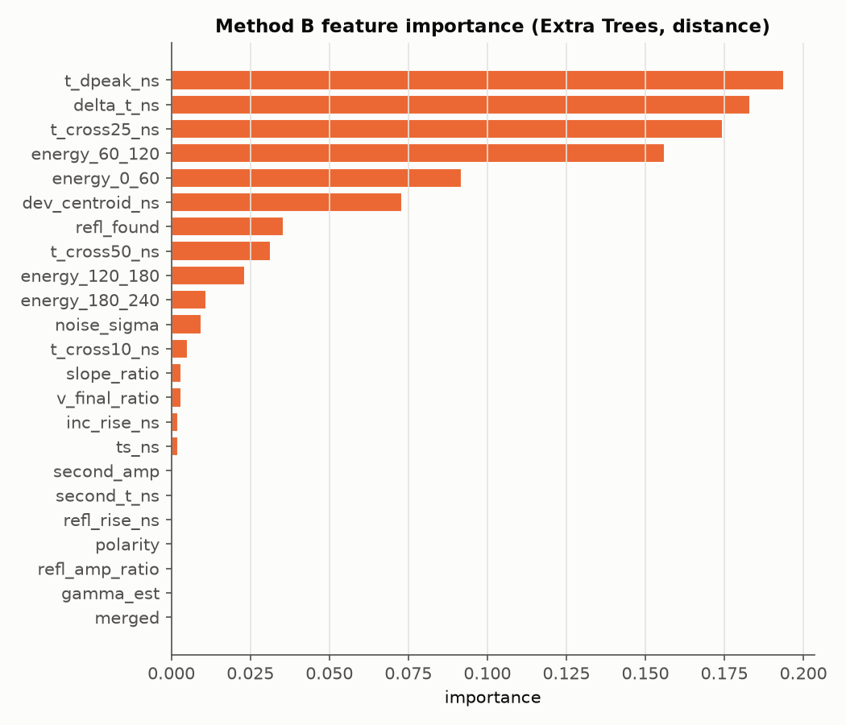
Method B: the 23 physics features
Group | Features
Timing | delta_t_ns, t_dpeak_ns, t_cross10/25/50_ns, second_t_ns, dev_centroid_ns
Amplitude / sign | refl_amp_ratio, polarity, v_final_ratio, gamma_est, second_amp, slope_ratio
Shape | refl_rise_ns, inc_rise_ns, energy_0_60, energy_60_120, energy_120_180, energy_180_240
Quality / flags | noise_sigma, ts_ns, refl_found, merged
Notes:
Features are computed automatically from every trace; the true distance, Γ and attenuation are never inputs. 8 come from the baseline detector.

Slide 44
Instrument control (capture.py)
class Rigol(ScopeDriver):
def read(self, ch):
self.w(f':WAV:SOUR CHAN{ch}')
self.w(':WAV:MODE NORM'); self.w(':WAV:FORM BYTE')
pre = [float(x) for x in self.q(':WAV:PRE?').split(',')]
raw = self.inst.query_binary_values(':WAV:DATA?', datatype='B')
v = (raw - yorig - yref) * yinc # from the preamble
t = (arange(n) - xref) * xinc + xorig
return t, v
Vendor | Command set
Rigol | :WAV:PRE? / :WAV:DATA?
Keysight/Agilent | :WAVeform:PREamble? / DATA?
Tektronix | WFMOutpre? / CURVE?
Siglent (X-E) | C1:WF? DAT2 + TRDL?
unknown | Keysight-style fallback
--simulate | SimScope (no hardware)
Every repeat: acquire → save CSV with all labels → append lab_log.csv → print a live baseline check.
Notes:
One driver class per vendor family behind the same acquire() interface. The preamble converts raw ADC bytes into volts and seconds. SimScope replaces the instrument for rehearsals and tests.

Slide 45
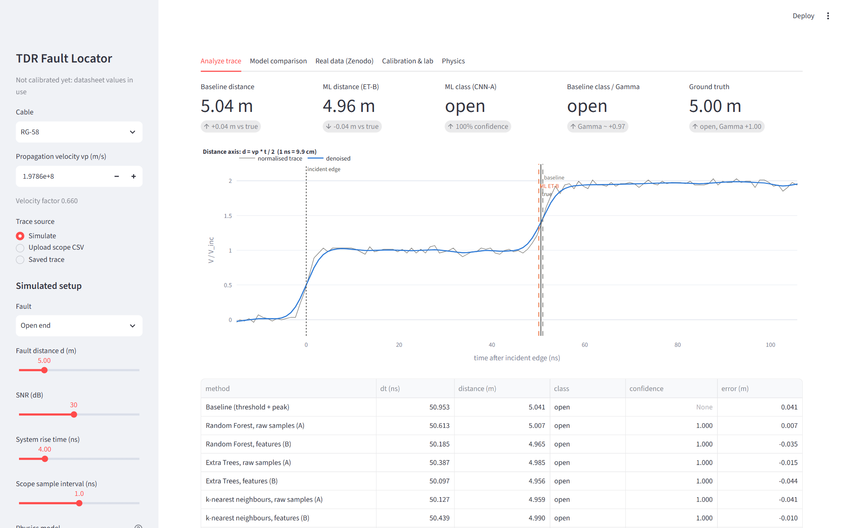
Dashboard: analyze any trace live
Notes:
Sidebar chooses the source (simulate any fault, upload a scope CSV, or a saved lab trace). The cards show baseline and best ML answers against the truth; the plot marks the incident edge, the baseline, the ML estimate and the true position.

Slide 46
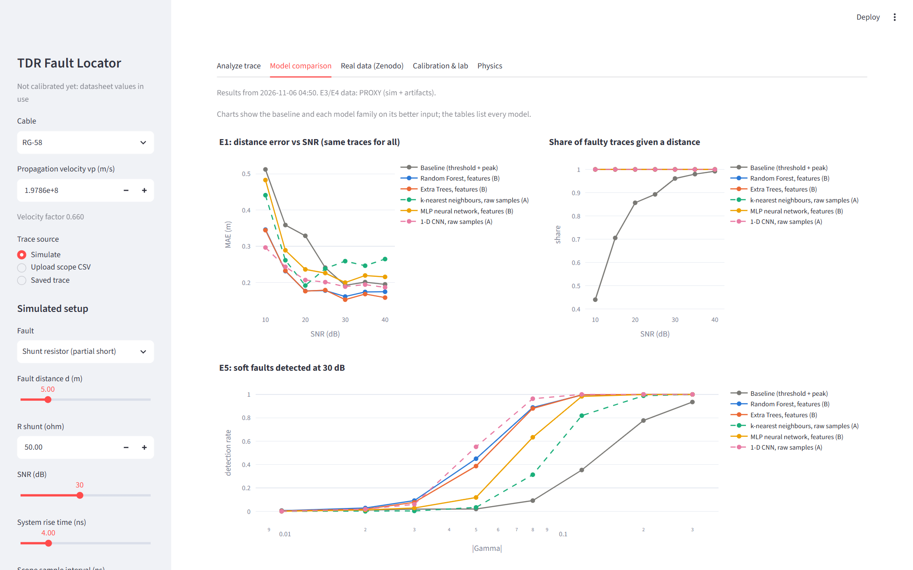
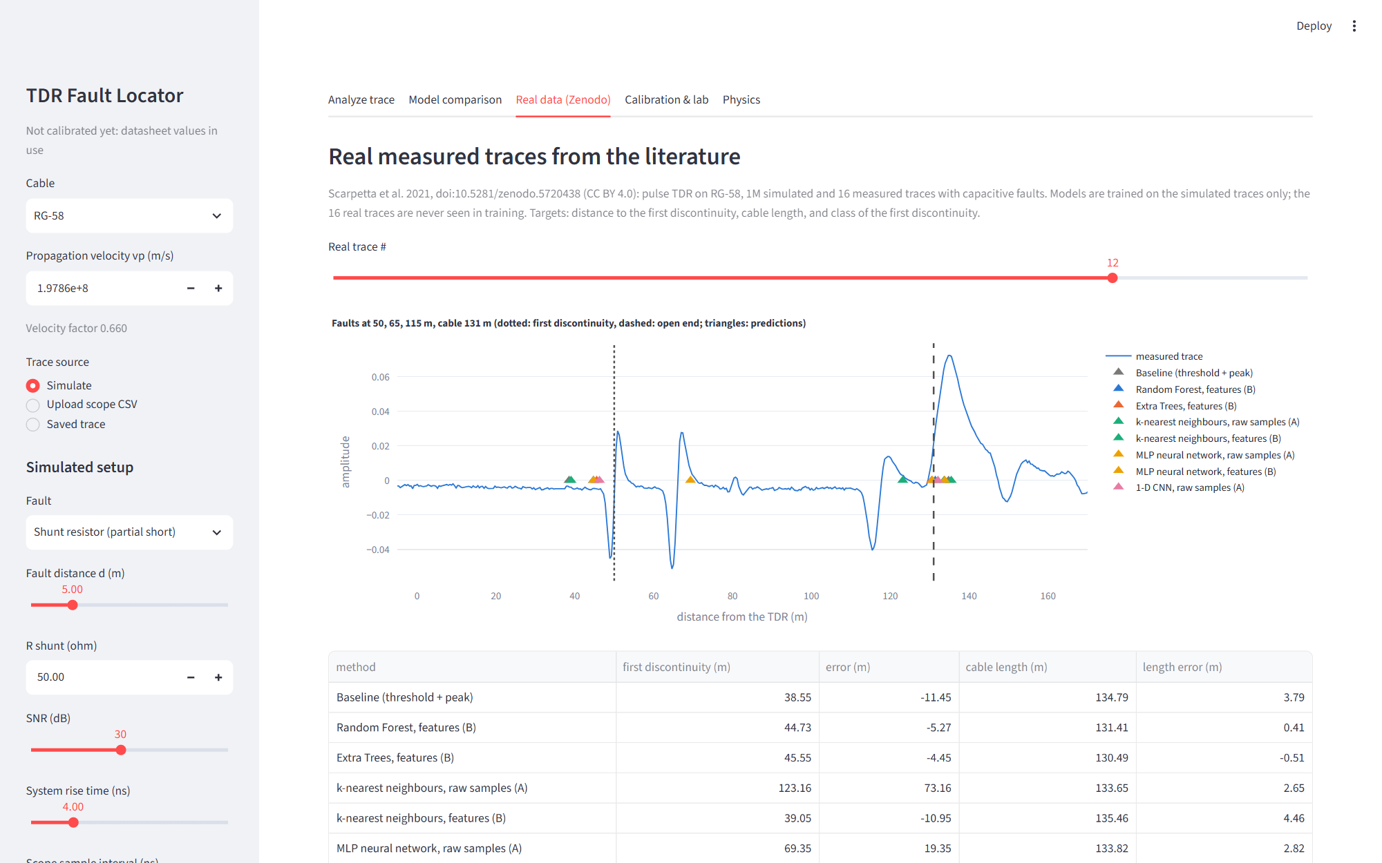
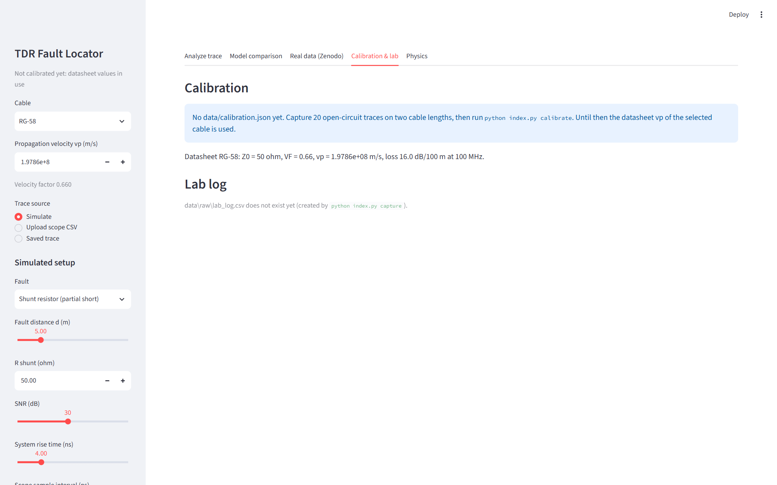
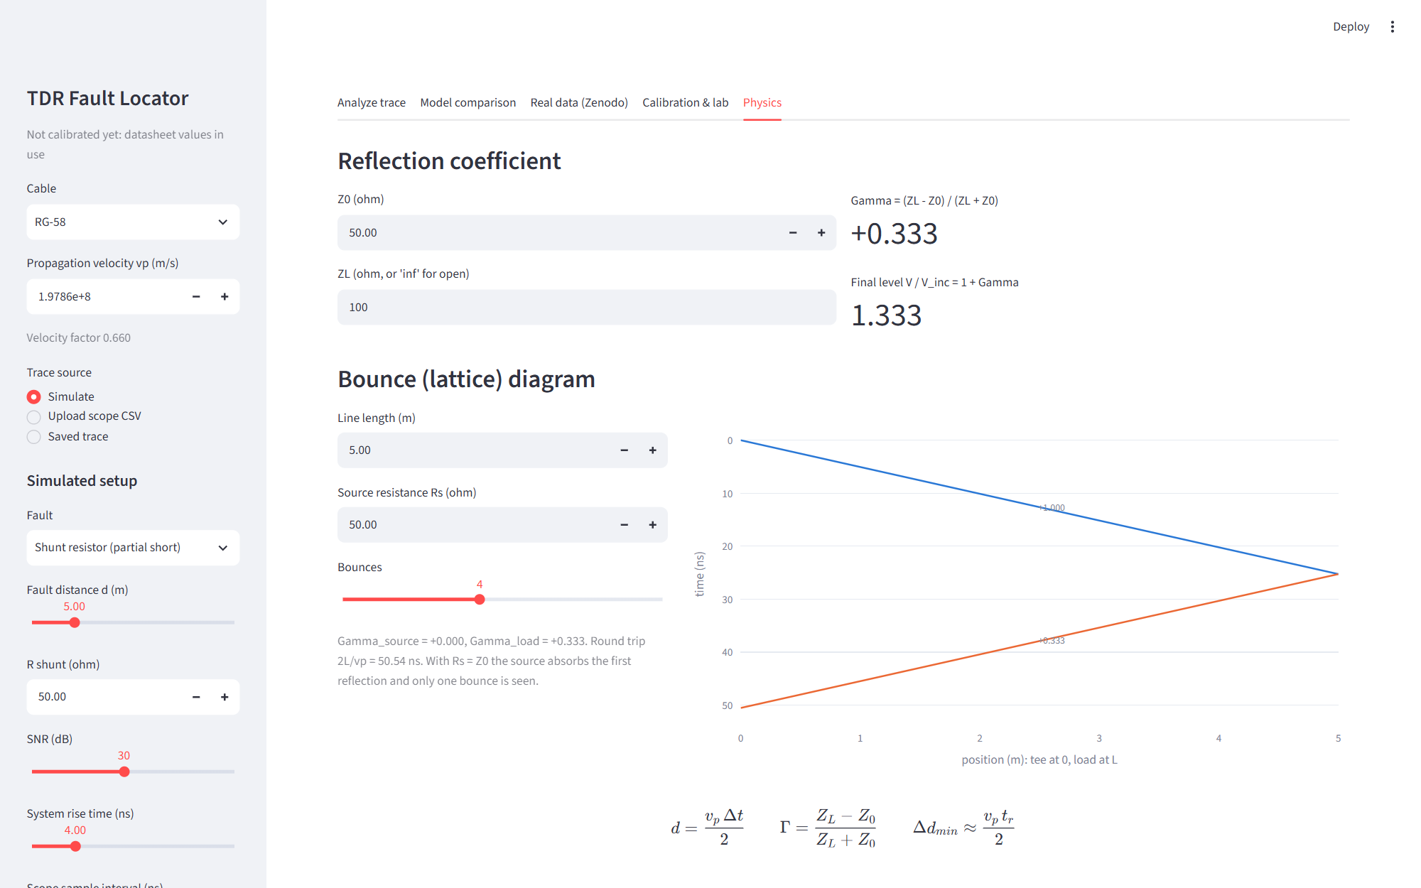
Dashboard: the other four tabs
Notes:
Model comparison (E1–E6 tables and charts), real data (Zenodo results), calibration and lab log, and a physics tab with the Γ calculator and a bounce diagram.

Slide 47
Error handling, isolation and data safety
Error handling
Isolation and reproducibility
Downloaded data safety
CLI-wide handler: missing file, bad CSV, bad value → one-line 'error: …', exit 1.
argparse errors → usage + exit 2.
Dashboard: unreadable file → sidebar message, app keeps running.
Failed preprocessing → no prediction (not a made-up one).
TDR_DEBUG=1 shows tracebacks.
TDR_HOME moves data/, models/, report/.
pytest and selftest run in temporary folders.
Seeds fixed per dataset; config fingerprint in cache names.
Bundle stores selected params, forest size, training-set name, sim config.
Zenodo archive treated as untrusted.
Labels read with a whitelist unpickler (no code runs).
Arrays memory-mapped inside the zip.
Archive's TensorFlow model never loaded.
Python reads it in isolated mode (-I).
Notes:
These are the non-functional requirements made concrete. Each item is tested: the self-test F16 runs seven deliberately wrong commands.

Slide 48
Localization with ML / NN
Part 6
How far away is the fault? Classical timing vs five learned regressors

Slide 49
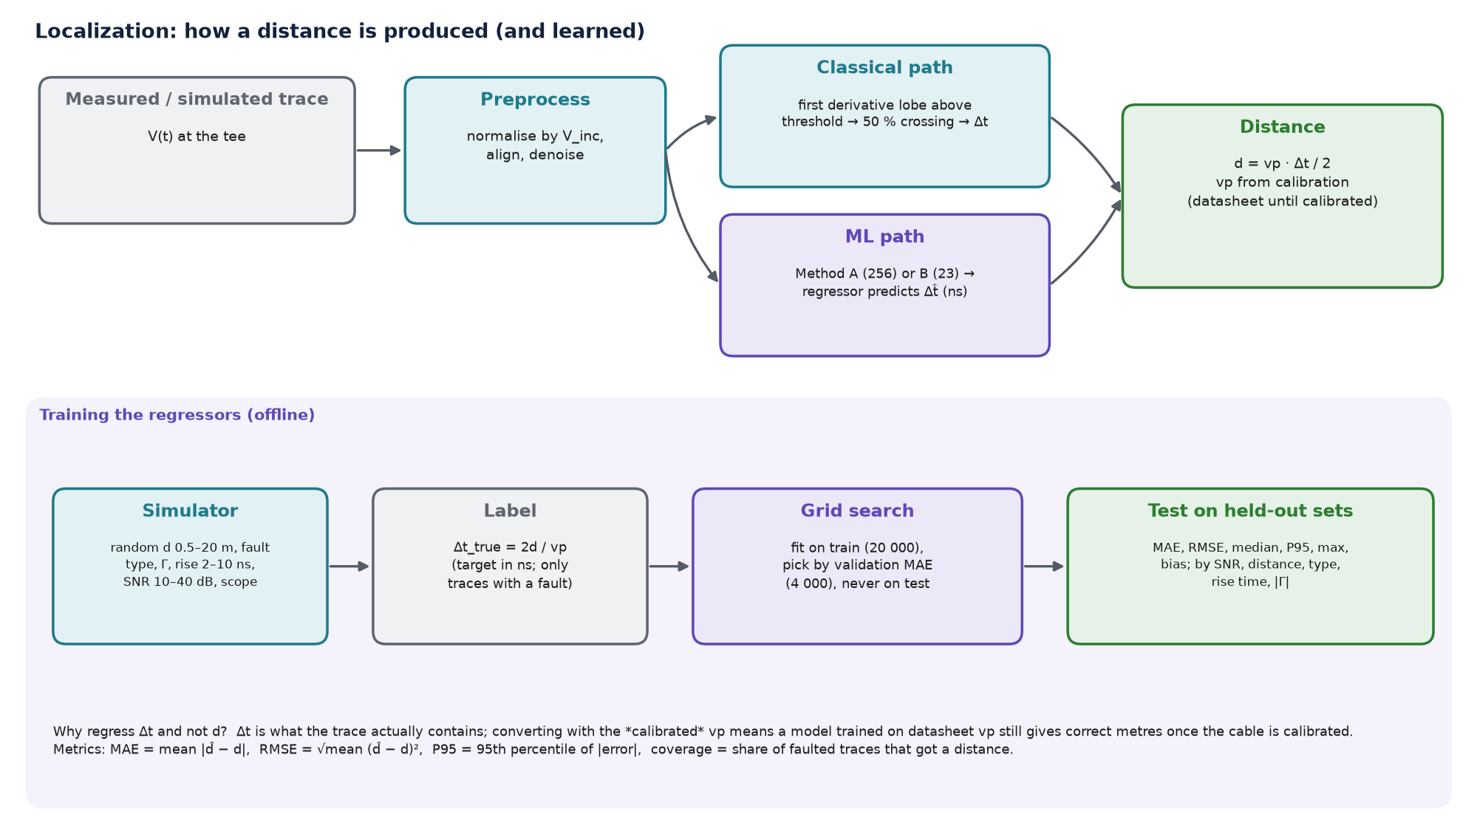
What localization is and how we do it
Notes:
Localization = estimating the distance d to the fault. Both paths end in d = vp·Δt/2 with the calibrated vp. The ML models predict Δt, not d: Δt is what the trace contains, and the calibrated vp converts it.

Slide 50
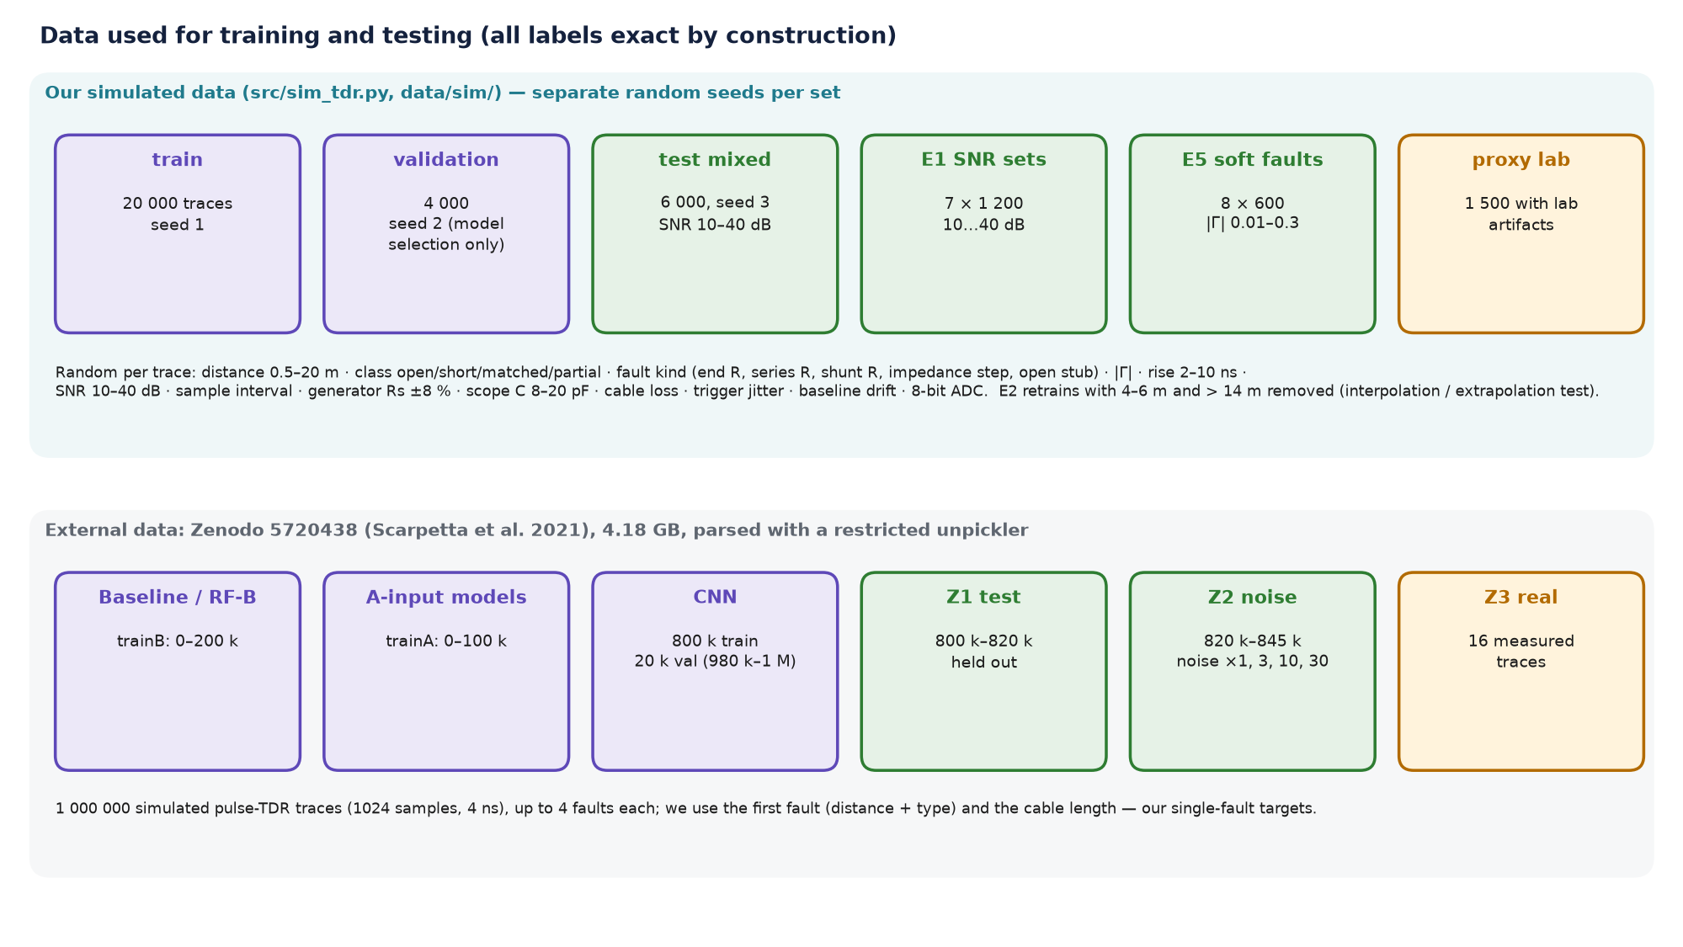
Training data and methodology
Train: 20 000 simulated traces.
Validation: 4 000, only for choosing hyper-parameters.
Test: 6 000 mixed + E1 (7 × 1 200) + E5 (8 × 600).
Target: Δt = 2d/vp (ns), traces with a fault only.
Excluded: traces with no incident edge.
Real-data test: 16 measured traces from Zenodo 5720438 (Part 12).
Notes:
Training and selection never see the test sets. The same seeds reproduce every set.

Slide 51
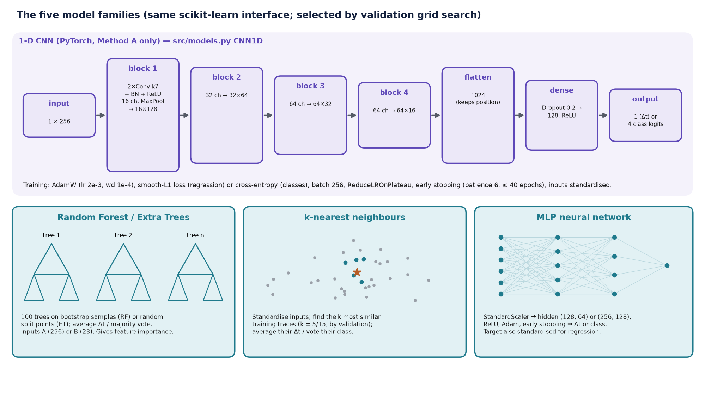
The five model families and their architecture
Notes:
Same interface for all five; the CNN works on the raw 256-sample trace only, because convolutions need a sequence. The flatten layer keeps position information, which is exactly the target.

Slide 52
Selected model configuration (validation grid search)
Model | Task | Selected parameters | Val. score | Size (MB) | Detail
RF-A | distance | {max_features: sqrt, min_samples_leaf: 2} | 4.79 ns | 20.26 | 100 trees, 827,092 nodes
ET-A | distance | {max_features: 0.3, min_samples_leaf: 2} | 4.02 ns | 32.56 | 100 trees, 1,309,182 nodes
KNN-A | distance | {n_neighbors: 5, weights: distance} | 4.13 ns | 14.55 | stores 15,035 training traces, k = 5
MLP-A | distance | {hidden_layer_sizes: (256, 128), alpha: 0.0001} | 3.82 ns | 1.90 | 98,817 weights, layers (256, 128)
CNN-A | distance | {epochs: 40, patience: 6} | 2.64 ns | 0.92 | 245,393 weights (1-D CNN)
RF-B | distance | {max_features: 0.5, min_samples_leaf: 2} | 2.78 ns | 19.64 | 100 trees, 828,246 nodes
ET-B | distance | {max_features: 1.0, min_samples_leaf: 2} | 2.78 ns | 31.55 | 100 trees, 1,303,340 nodes
KNN-B | distance | {n_neighbors: 15, weights: distance} | 7.46 ns | 1.08 | stores 15,035 training traces, k = 15
MLP-B | distance | {hidden_layer_sizes: (128, 64), alpha: 0.0001} | 4.75 ns | 0.23 | 11,393 weights, layers (128, 64)
RF-A | class | {max_features: 0.3, min_samples_leaf: 1} | 0.967 | 1.66 | 100 trees, 71,988 nodes
ET-A | class | {max_features: sqrt, min_samples_leaf: 1} | 0.968 | 4.86 | 100 trees, 257,494 nodes
KNN-A | class | {n_neighbors: 5, weights: distance} | 0.951 | 19.31 | stores 20,000 training traces, k = 5
MLP-A | class | {hidden_layer_sizes: (256, 128), alpha: 0.0001} | 0.974 | 1.12 | 99,204 weights, layers (256, 128)
CNN-A | class | {epochs: 40, patience: 6} | 0.985 | 0.93 | 245,780 weights (1-D CNN)
RF-B | class | {max_features: 0.5, min_samples_leaf: 1} | 0.979 | 1.44 | 100 trees, 67,676 nodes
ET-B | class | {max_features: 0.5, min_samples_leaf: 1} | 0.979 | 3.69 | 100 trees, 205,776 nodes
KNN-B | class | {n_neighbors: 5, weights: distance} | 0.953 | 1.19 | stores 20,000 training traces, k = 5
MLP-B | class | {hidden_layer_sizes: (256, 128), alpha: 0.0001} | 0.971 | 0.45 | 39,556 weights, layers (256, 128)
Notes:
Each row is what the validation set chose. Size is the compressed joblib size; the detail column gives trees and nodes, weights or stored traces.

Slide 53
Localization results on the mixed test set
Method | Coverage | MAE fair (m) | MAE all (m) | Median (m) | P95 (m) | Max (m) | ≤ 0.25 m
Baseline (classical) | 85 % | 0.26 | 0.26 | 0.15 | 0.61 | 15.59 | 69 %
Random Forest (raw) | 100 % | 0.29 | 0.53 | 0.17 | 2.68 | 11.87 | 63 %
Random Forest (features) | 100 % | 0.19 | 0.37 | 0.16 | 1.27 | 17.28 | 67 %
Extra Trees (raw) | 100 % | 0.25 | 0.47 | 0.16 | 2.13 | 12.12 | 66 %
Extra Trees (features) | 100 % | 0.19 | 0.37 | 0.16 | 1.23 | 17.11 | 68 %
k-NN (raw) | 100 % | 0.26 | 0.48 | 0.17 | 2.05 | 15.78 | 64 %
k-NN (features) | 100 % | 0.36 | 0.75 | 0.28 | 3.78 | 13.90 | 46 %
MLP (raw) | 100 % | 0.26 | 0.44 | 0.20 | 1.47 | 12.29 | 58 %
MLP (features) | 100 % | 0.24 | 0.51 | 0.20 | 2.07 | 16.29 | 59 %
1-D CNN (raw) | 100 % | 0.21 | 0.31 | 0.19 | 0.70 | 17.25 | 65 %
Best regressor (fair MAE): Extra Trees (features). The baseline is accurate when it answers but leaves 15 % of faults unlocated.
Notes:
Two views. 'Fair' MAE uses only the faults the baseline located, so every method answers the same traces. 'All' MAE includes the hard traces where the baseline gave no answer but the models still had to. Coverage is the share of faulted traces that got a distance.

Slide 54
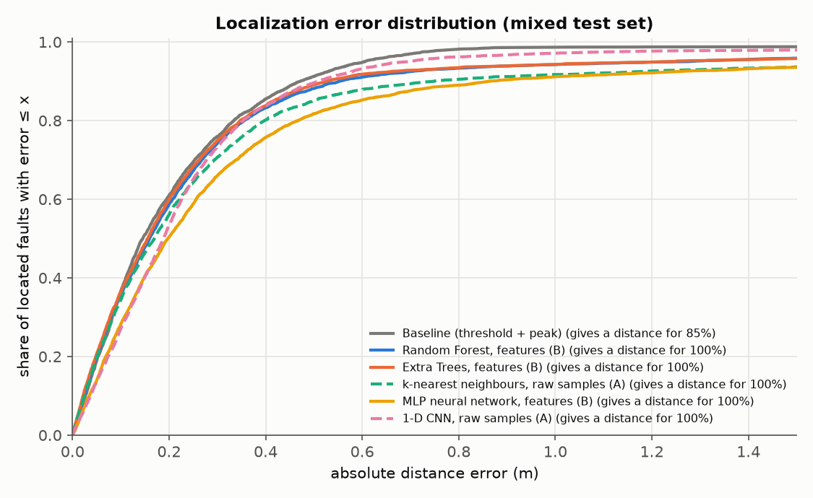
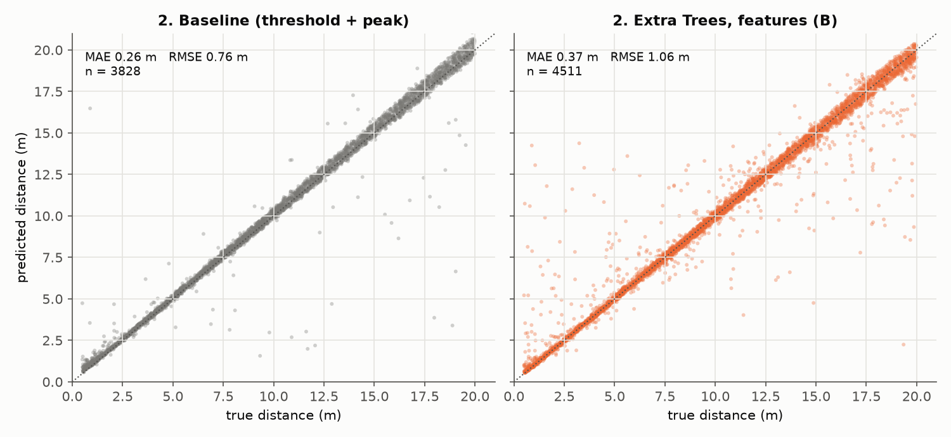
How the localization error is distributed
Notes:
Cumulative distribution: the curve's height at x is the share of located faults with error ≤ x. Steeper and higher is better. The legend gives each method's coverage.

Slide 55
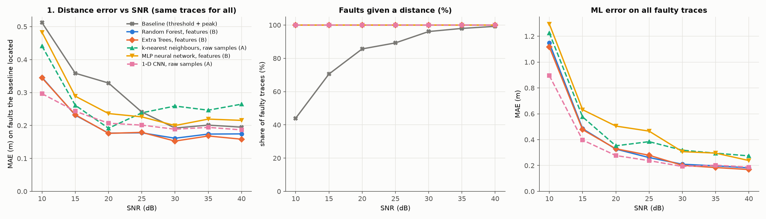
Accuracy vs noise (E1)
SNR (dB) | Baseline | Extra Trees B | CNN-A
10 | 0.51 | 0.34 | 0.30
15 | 0.36 | 0.23 | 0.24
20 | 0.33 | 0.18 | 0.21
25 | 0.24 | 0.18 | 0.20
30 | 0.19 | 0.15 | 0.19
35 | 0.20 | 0.17 | 0.19
40 | 0.19 | 0.16 | 0.19
MAE (m) on faults the baseline located (E1, 1 200 traces per SNR). At 10 dB the baseline locates only 44 % of faults; the models answer all.
Notes:
MAE on the same traces for every method, by SNR. The best ML models (Extra Trees on features, 1-D CNN) stay at or below 0.35 m even at 10 dB, where the baseline rises to 0.51 m and locates only 44 % of faults. Not every model is robust: Random Forest on raw samples is worse than the baseline at 10 dB.

Slide 56
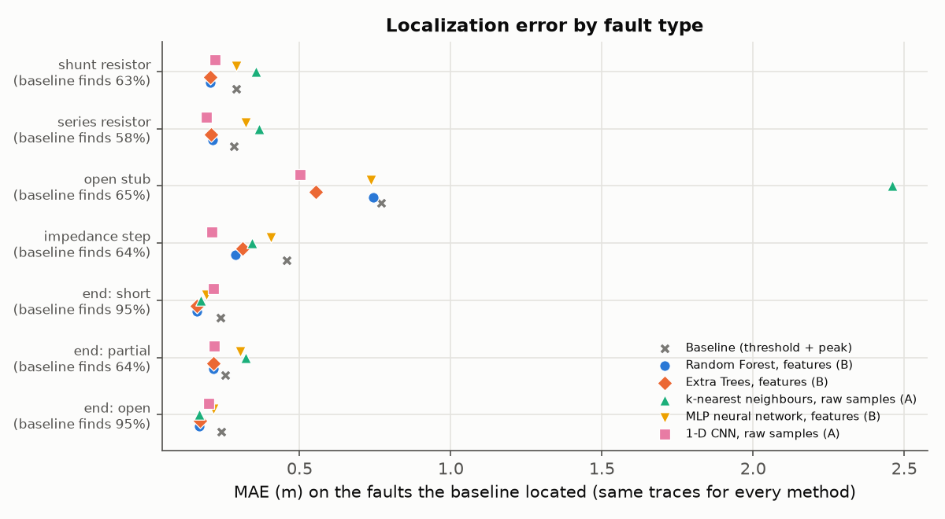
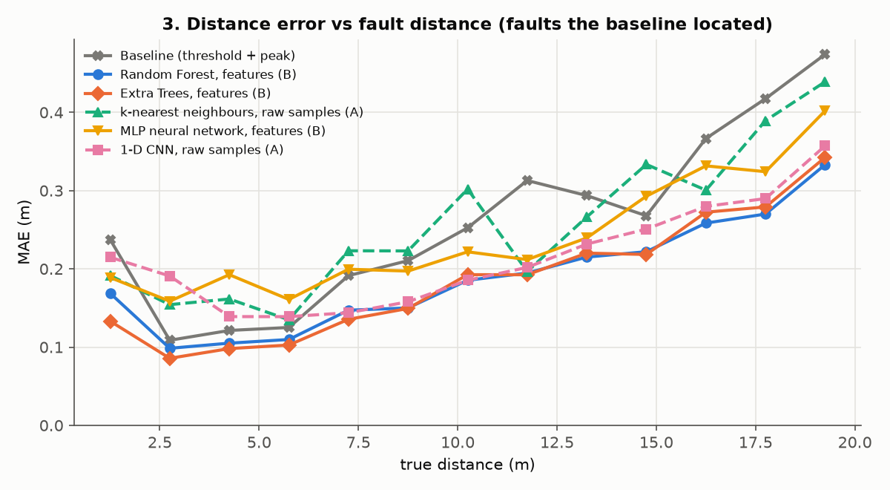
Which conditions make localization harder
Notes:
Same traces for every method (faults the baseline located; its share is under each label). Open stubs are the hardest fault for every method (CNN 0.50 m, Extra Trees 0.55 m, baseline 0.77 m), then impedance steps. The baseline locates only 58-65 % of the partial-type faults but 95 % of opens and shorts. Right: the error grows with distance because loss and dispersion slow the echo.

Slide 57
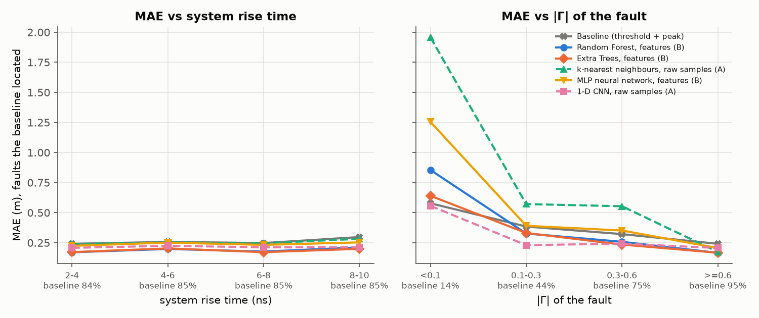
Rise time and fault strength
Notes:
Same traces for every method (faults the baseline located; its share is under each label). Weak faults with |Γ| < 0.1 are hard for every method: the baseline locates only 14 % of them, and errors rise to 0.56-0.86 m (k-NN about 2 m). Between 0.1 and 0.3 the CNN is clearly best (0.23 m vs 0.38 m baseline). Rise time between 2 and 10 ns changes the error little.

Slide 58
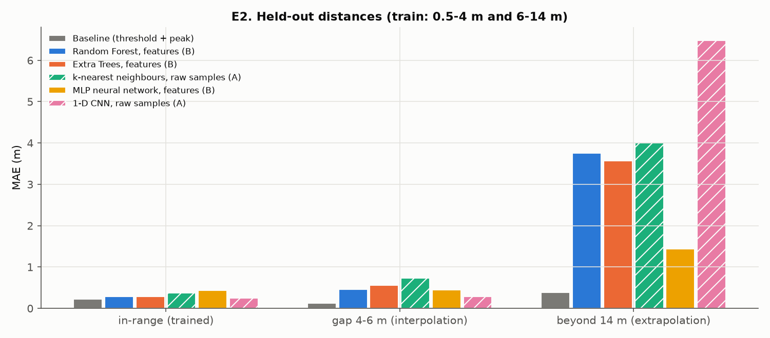
Generalisation to unseen distances (E2)
Band | Baseline | ET-B | CNN-A
in-range (trained) | 0.22 | 0.29 | 0.25
gap 4-6 m (interpolation) | 0.12 | 0.56 | 0.29
beyond 14 m (extrapolation) | 0.38 | 3.57 | 6.48
Consequence: train on the full distance range of the cables you will test (limitation L3).
Notes:
Models were retrained without 4–6 m and without > 14 m. Interpolation inside the gap costs a little accuracy; extrapolation beyond the trained range fails for every learned model. The baseline has no training range.

Slide 59
Worst cases of the best regressor (ET-B)
True d (m) | Predicted (m) | Error (m) | Fault | Γ | SNR (dB) | Rise (ns) | Baseline found?
19.35 | 2.25 | -17.11 | end: partial | 0.38 | 11.58 | 5.48 | no
0.89 | 14.24 | 13.36 | impedance step | 0.25 | 26.98 | 4.34 | yes
1.05 | 13.06 | 12.00 | open stub | -0.33 | 10.08 | 2.19 | no
3.24 | 14.38 | 11.14 | open stub | -0.33 | 16.93 | 8.67 | no
19.69 | 8.55 | -11.14 | end: partial | -0.14 | 29.72 | 4.75 | no
19.42 | 8.73 | -10.68 | end: partial | 0.09 | 15.86 | 3.13 | no
19.87 | 9.33 | -10.54 | open stub | -0.33 | 21.21 | 4.24 | no
0.54 | 10.74 | 10.20 | open stub | -0.33 | 23.58 | 8.76 | no
Notes:
The largest errors, with their conditions. In 14 of these 15 cases the baseline found no echo either: the trace carries almost no usable information (weak partial faults, stubs, low SNR), and the model falls back to a guess in the middle of the trained range (8-14 m). A confidence threshold or the hybrid rule (future work) would flag these.

Slide 60
Detection with ML / NN
Part 7
Is there a fault, and what kind? Rules vs learned classifiers

Slide 61
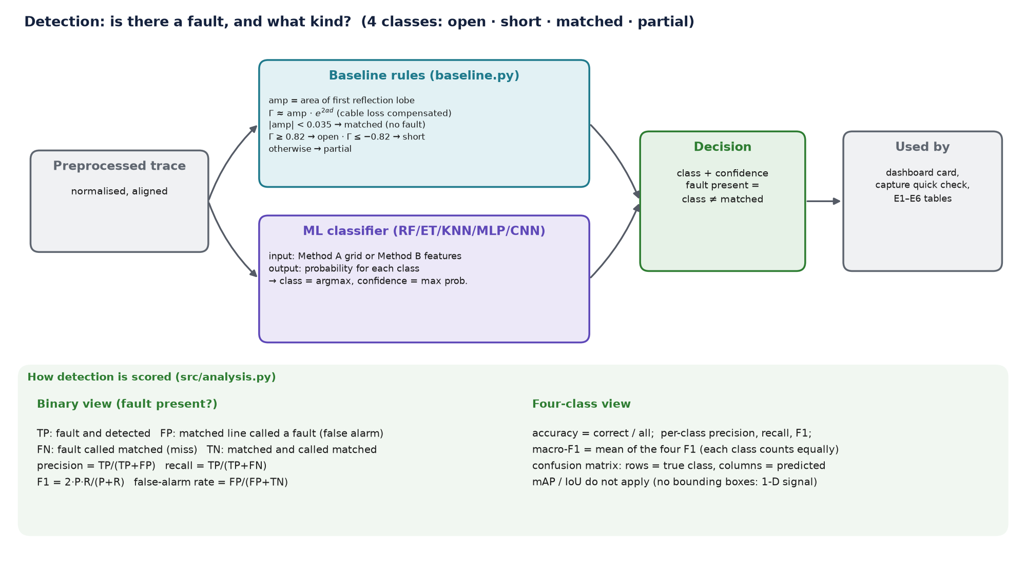
What detection is and how we do it
Notes:
Detection = deciding whether there is a fault and which class. The baseline uses rules on the echo's size and sign; the classifiers learn the decision from data and return a probability per class.

Slide 62
Detection results: binary and four-class
Method | Precision | Recall | F1 (binary) | False alarms | Misses | Accuracy (4-class) | Macro-F1
Baseline (classical) | 0.994 | 0.846 | 0.914 | 1.5 % | 15.4 % | 0.861 | 0.860
Random Forest (raw) | 0.992 | 0.968 | 0.980 | 2.4 % | 3.2 % | 0.968 | 0.968
Random Forest (features) | 0.992 | 0.978 | 0.985 | 2.4 % | 2.2 % | 0.976 | 0.976
Extra Trees (raw) | 0.995 | 0.964 | 0.979 | 1.5 % | 3.6 % | 0.968 | 0.968
Extra Trees (features) | 0.994 | 0.977 | 0.985 | 1.7 % | 2.3 % | 0.978 | 0.978
k-NN (raw) | 0.995 | 0.946 | 0.970 | 1.5 % | 5.4 % | 0.955 | 0.954
k-NN (features) | 0.984 | 0.951 | 0.967 | 4.8 % | 4.9 % | 0.947 | 0.946
MLP (raw) | 0.987 | 0.977 | 0.982 | 3.8 % | 2.3 % | 0.971 | 0.970
MLP (features) | 0.987 | 0.972 | 0.980 | 3.9 % | 2.8 % | 0.968 | 0.968
1-D CNN (raw) | 0.996 | 0.981 | 0.989 | 1.2 % | 1.9 % | 0.983 | 0.983
Best classifier: 1-D CNN (raw) (macro-F1 0.983) vs baseline 0.860.
Notes:
Binary: fault present or not (matched = no fault). Four-class: open / short / matched / partial; macro-F1 averages the four classes equally.

Slide 63
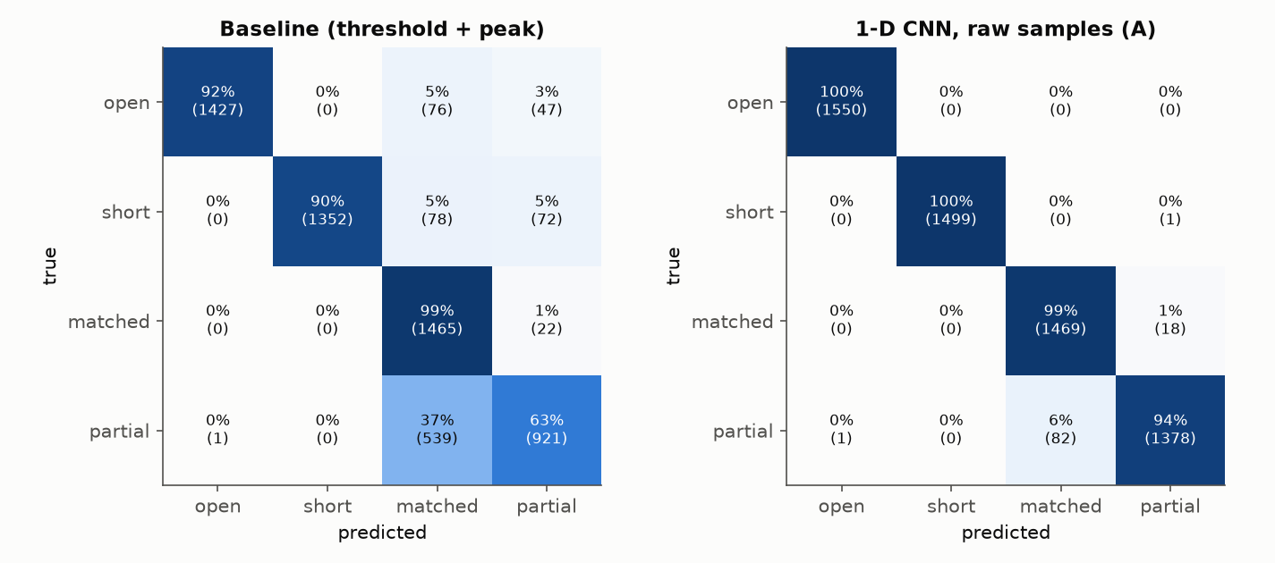
Confusion matrices: baseline vs best classifier
Notes:
Rows are the true class, columns the prediction; the diagonal is correct. The baseline's dominant error: 539 of 1 461 partial faults called matched (echo below its threshold); about 5 % of opens and shorts are called matched or partial. The CNN misses 82 partial faults and raises 18 false alarms.

Slide 64
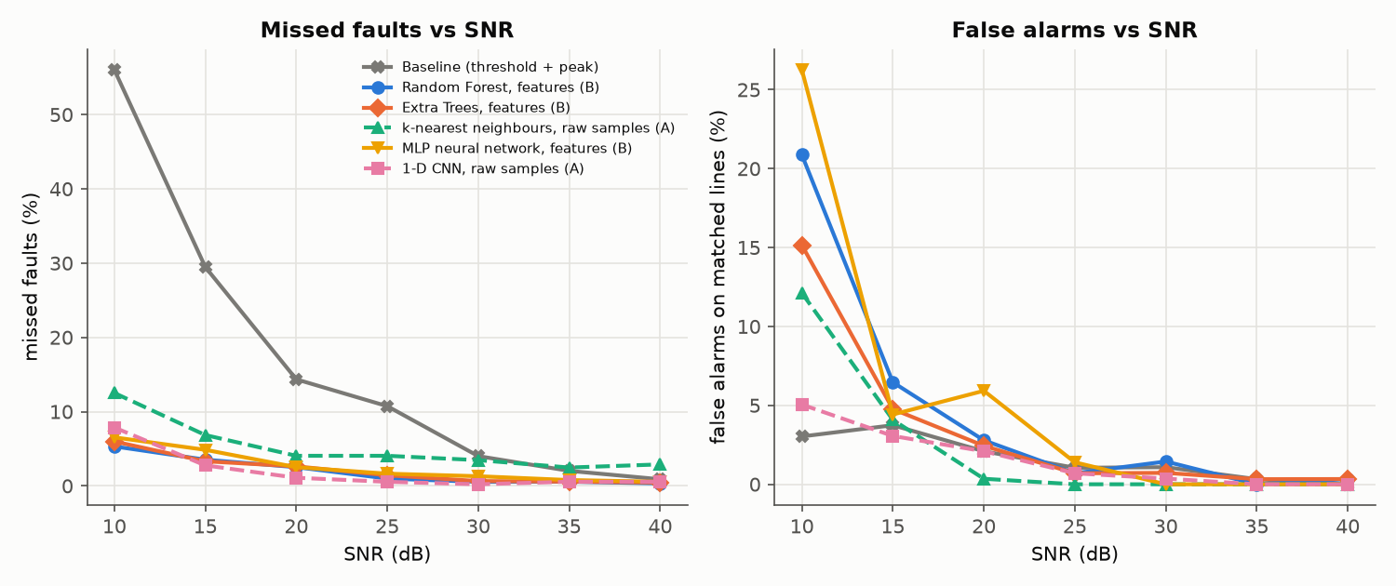
Misses and false alarms
Method | Kind | Condition | n | Rate
Baseline | miss rate | |Gamma| 0.1-0.3 | 426 | 56.1 %
Baseline | miss rate | |Gamma| 0.3-0.6 | 755 | 24.9 %
Baseline | miss rate | |Gamma| <0.1 | 95 | 87.4 %
Baseline | miss rate | |Gamma| >=0.6 | 3237 | 5.7 %
Baseline | miss rate | SNR (dB) 10-15 | 802 | 40.4 %
Baseline | miss rate | SNR (dB) 15-20 | 741 | 22.7 %
Baseline | miss rate | SNR (dB) 20-30 | 1484 | 10.0 %
Baseline | miss rate | SNR (dB) 30-40 | 1486 | 3.5 %
Baseline | false-alarm rate | SNR (dB) 10-15 | 248 | 1.6 %
Baseline | false-alarm rate | SNR (dB) 15-20 | 255 | 0.8 %
Baseline | false-alarm rate | SNR (dB) 20-30 | 507 | 2.6 %
Baseline | false-alarm rate | SNR (dB) 30-40 | 477 | 0.6 %
CNN-A | miss rate | |Gamma| 0.1-0.3 | 426 | 4.2 %
CNN-A | miss rate | |Gamma| 0.3-0.6 | 755 | 4.2 %
Notes:
Misses dominate the baseline's errors: it misses 87 % of faults with |Γ| < 0.1 and 40 % of all faults at 10-15 dB (CNN: 34 % and 5.5 %). False alarms are rare for both; the CNN's 5.2 % at 10-15 dB (baseline 1.6 %) is the price of its higher sensitivity.

Slide 65
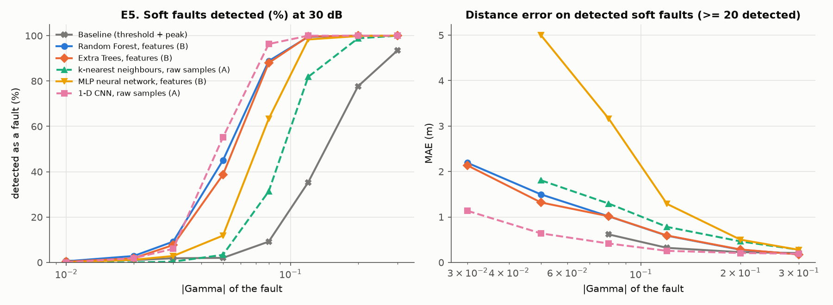
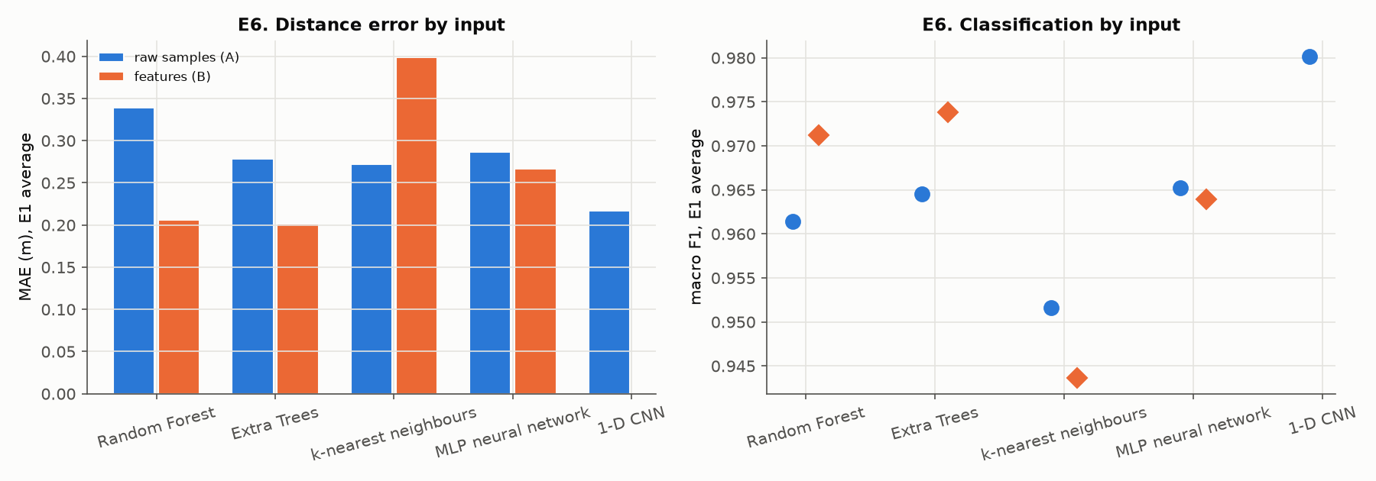
Weak (soft) faults and the input representation
Notes:
E5: partial faults with |Γ| from 0.01 to 0.3 at 30 dB. E6: the same family with raw samples (A, dashed) or physics features (B, solid).

Slide 66
End-to-end working and hardware–software integration
Part 8–9
What happens, step by step, from power-on to a located fault

Slide 67
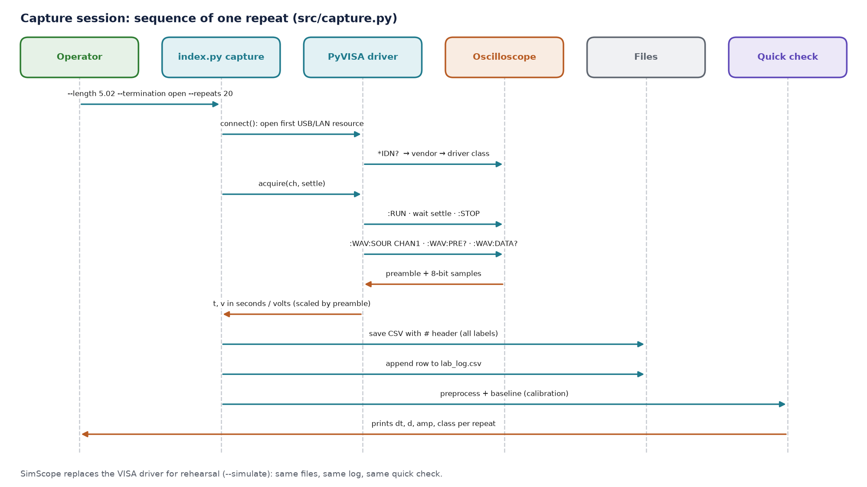
Capture session: what happens in one repeat
Notes:
The operator runs one command per configuration; the software does the rest and prints a check for every repeat, so a mislabelled set-up is caught at the bench.

Slide 68
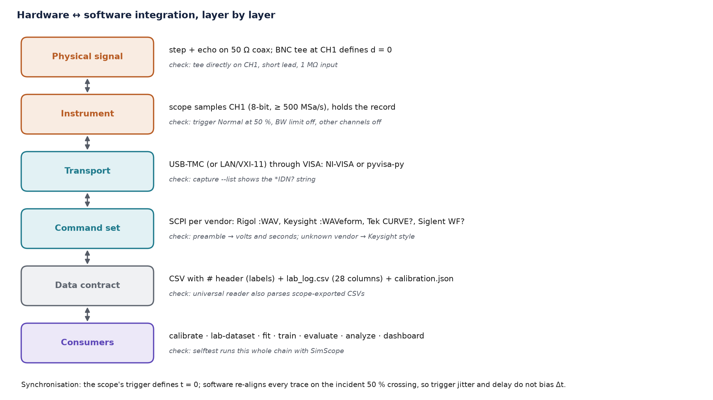
Integration layer by layer
Notes:
Each layer has a check that proves it works. The trigger defines t = 0, and software re-aligns every trace on the incident 50 % crossing, so trigger jitter does not bias Δt.

Slide 69
Real execution example (self-test, simulated scope)
Feature | Actual output
Capture session with logging (capture --simulate) | 28 traces + log rows written; quick-check distances: 2 m open -> 2.04 m; 5 m open -> 5.07 m; 10 m open -> 10.11 m; 5 m short -> 5.06 m; 5 m partial 100 ohm -> 5.07 m; 5 m partial 22 ohm -> 5.05 m
Read any scope CSV (inspect) | exit 0; vendor/format detected; baseline d = 5.065 m (true 5.00); plot saved = True
Velocity calibration (calibrate) | vp = 1.9616e+08 m/s vs simulated truth 1.9786e+08 (-0.86 %); t_offset 0.23 ns; rise 4.15 ns; resolution 0.41 m; SNR 30.5 dB
Simulator-to-measurement fit (fit) | exit 0; RMSE 0.0238 (normalised); fitted vp 1.972e+08 m/s; overlay figure written
Lab dataset builder (lab-dataset) | exit 0; 28 traces processed; Method A matrix (28, 256)
Notes:
Actual console output from index.py selftest: 7 set-ups × 4 repeats captured, logged, checked live; the 5 m trace inspected; calibration solved; simulator fitted.

Slide 70
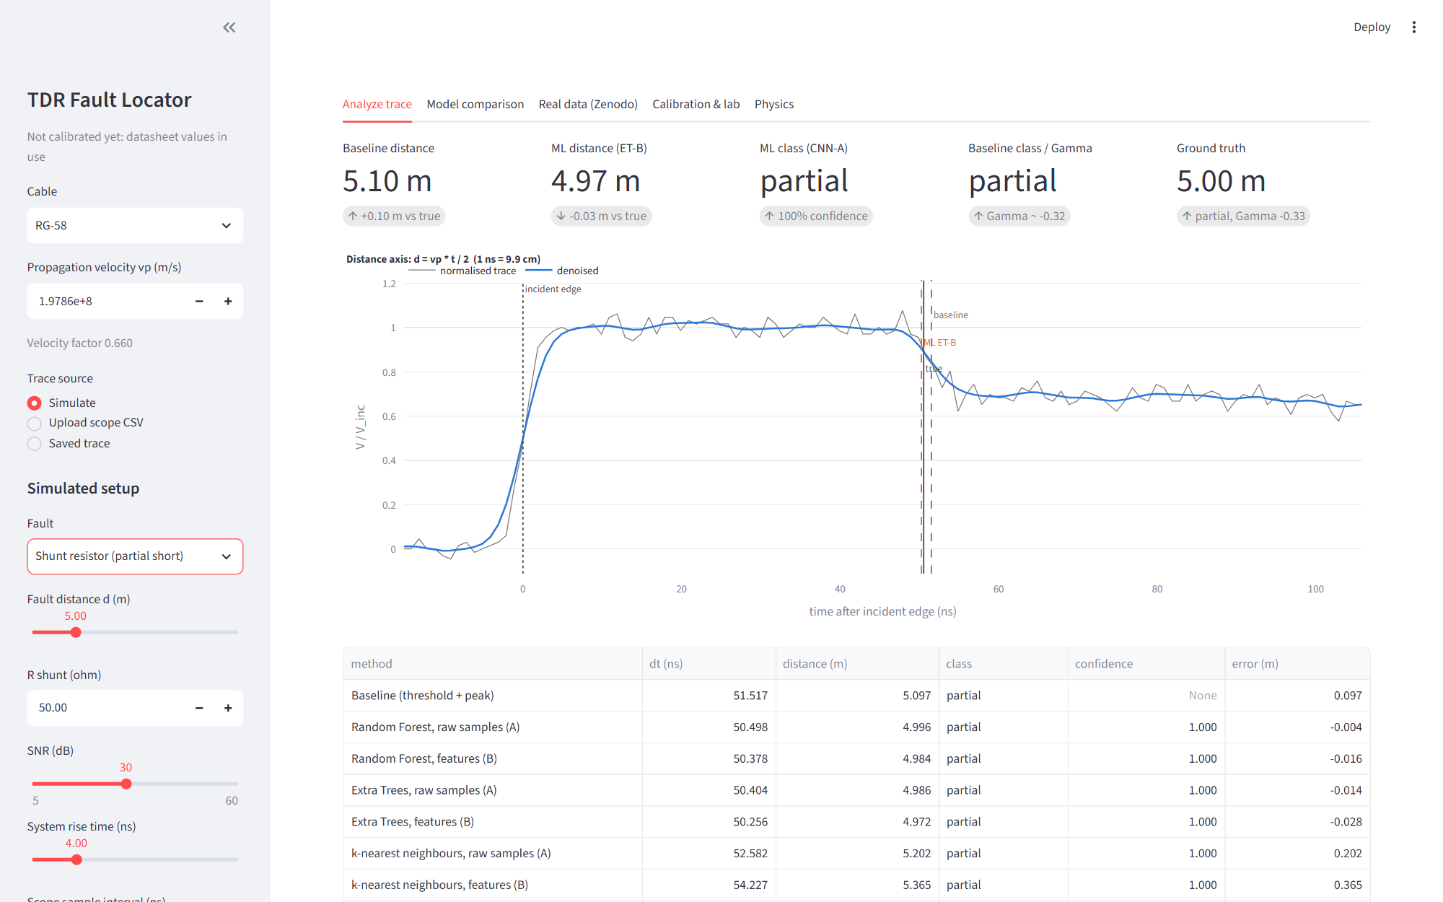
Example: one trace through the dashboard
Notes:
A simulated 50 Ω shunt resistor at 5 m: the baseline and the ML models both find the step down, and the classifiers call it partial. The plot shows where each method puts the echo against the true position.

Slide 71
Features, testing and validation
Part 10–11
Every feature executed for real, with expected vs actual output

Slide 72
Testing strategy
Unit
Integration
System / performance
Robustness / edge cases
62 pytest tests:
physics levels and delays
baseline on clean traces
every scope CSV dialect
every model family
safe unpickler, zip memmap
16 regression tests for review findings
capture → calibrate → fit → lab‑dataset
evaluate with a lab log (E3/E4 = LAB)
dashboard driven through all inputs
full self-test (19 features)
latency per model
Zenodo pipeline on 1 M traces
real-trace test (16)
7 wrong CLI calls
low amplitude traces
2 traces only, zero noise
blank channel cells
relative paths
Notes:
Four levels. The self-test is the system/integration level: it runs the actual CLI commands in a sandbox and compares results with expectations.

Slide 73
Feature test matrix (1/3)
ID | Feature | Expected | Actual | Status
F01 | Instrument discovery (capture --list) | Exit 0 and a clear 'no instrument' message (no hardware attached here) | exit 0; No instruments found (Visa Library at py). Check the USB/LAN cable, that the scope is on, its USB mode (USBTMC) and the VISA driver; see hardware/HARDWARE_GUIDE.md, H2. | Pass
F02 | Capture session with logging (capture --simulate) | 28 CSV files + 28 log rows; live distance within 0.3 m of the cable length | 28 traces + log rows written; quick-check distances: 2 m open -> 2.04 m; 5 m open -> 5.07 m; 10 m open -> 10.11 m; 5 m short -> 5.06 m; 5 m partial 100 ohm -> 5.07 m; 5 m partial 22 ohm -> 5.05 m | Pass
F03 | Read any scope CSV (inspect) | Distance within 0.3 m of 5 m, class open, PNG written | exit 0; vendor/format detected; baseline d = 5.065 m (true 5.00); plot saved = True | Pass
F04 | Velocity calibration (calibrate) | vp within 1.5 % of the simulator's true vp; calibration.json + fig0 written | vp = 1.9616e+08 m/s vs simulated truth 1.9786e+08 (-0.86 %); t_offset 0.23 ns; rise 4.15 ns; resolution 0.41 m; SNR 30.5 dB | Pass
F05 | Simulator-to-measurement fit (fit) | Converges, normalised RMSE < 0.05 | exit 0; RMSE 0.0238 (normalised); fitted vp 1.972e+08 m/s; overlay figure written | Pass
F06 | Lab dataset builder (lab-dataset) | data/processed/lab.csv with 28 rows and a (28, 256) Method A matrix | exit 0; 28 traces processed; Method A matrix (28, 256) | Pass
F07 | Synthetic dataset, transmission-line model (simulate) | 400 rows, X (400, 256), all 4 classes, finite values | exit 0; 400 labelled traces, X (400, 256), classes {'matched': 108, 'open': 100, 'short': 99, 'partial': 93}, raw traces saved | Pass
Notes:
From report/results/feature_tests.csv, written by index.py selftest. Expected is set before the run; actual is copied from the command output.

Slide 74
Feature test matrix (2/3)
ID | Feature | Expected | Actual | Status
F08 | Synthetic dataset, brief's simple model + lab artifacts | 200 rows written, source tagged as artifacts | exit 0; 200 rows, source column = sim_artifacts | Pass
F09 | Physics check of the simulator | Every level within 0.03 of theory (small cable loss allowed) | final level / theory 1+Gamma: open: 1.985/2.000; short: 0.015/0.000; matched gamma=0: 1.000/1.000; partial zl=100: 1.328/1.333; partial zl=22: 0.617/0.611; partial kind=1,r_fault=50: 1.328/1.333; partial kind=2,r_fault=50: 0.672/0 | Pass
F10 | Classical baseline detector | At 40 dB: median distance error < 0.25 m (half the 0.4-0.5 m resolution of a 4-5 ns edge) and class accuracy > 0.9 | SNR 40 dB: median |err| 0.17 m, mean 0.20 m, class acc 0.99, missed 1%; SNR 20 dB: median |err| 0.16 m, mean 0.30 m, class acc 0.81, missed 21% | Pass
F11 | Model training with validation grid search (train) | 18 models in models/tdr_models.joblib and a validation_grid.csv | exit 0; 18 models stored (RF/ET/KNN/MLP x A/B + CNN-A, regression + classification); best val MAE ET-B 3.36 ns; best val macro-F1 ET-B 0.977 | Pass
F12 | Inference latency (all models) | Well under 1 s per trace end to end (interactive use) | front end (preprocess + baseline + 23 features) 0.7 ms/trace; single-trace model call 0.62-22.8 ms (slowest KNN-A reg); batched 0.008-0.24 ms/trace | Pass
F13 | Experiments E1-E6 + figures (evaluate --quick) | Exit 0, fig1..fig10 and summary.md written; E3/E4 run on the logged traces | exit 0; 11 figures, summary.md written; E3/E4 data source captured (lab-format) traces; best regressor ET-B, best classifier ET-B | Pass
F14 | Dashboard: every input path (Streamlit AppTest) | No exception on any run, 5 tabs rendered | exit 0; 9 script runs (8 fault types + saved lab trace), no exceptions; tabs 5 | Pass
Notes:
From report/results/feature_tests.csv, written by index.py selftest. Expected is set before the run; actual is copied from the command output.

Slide 75
Feature test matrix (3/3)
ID | Feature | Expected | Actual | Status
F15 | Dashboard server start-up (index.py dashboard) | Health endpoint answers 'ok' and the page is served | health endpoint 'ok', index page 6467 bytes | Pass
F16 | Error handling of the CLI | Non-zero exit (or a clear 'nothing to do' message) and no traceback | inspect missing file: exit 1, clean message; inspect garbage CSV: exit 1, clean message; capture without length: exit 2, clean message; calibrate without log: exit 2, clean message; fit missing file: exit 1, clean message; lab-dat | Pass
F17 | Hardware circuit + expected-waveform generator | 13 schematics (SVG + PNG) and 11 expected-waveform PNGs | exit 0; 13 circuit SVGs, 26 PNGs (circuits + expected waveforms) | Pass
F18 | Unit test suite (pytest) | All tests pass | 62 passed in 14.03s | Pass
F19 | External real-data pipeline (Zenodo 5720438) | models/zenodo_models.joblib and the Z1/Z2/Z3 tables exist | all result files present; Z1 table has 8 rows (see ML_ANALYSIS.md) | Pass
Notes:
From report/results/feature_tests.csv, written by index.py selftest. Expected is set before the run; actual is copied from the command output.

Slide 76
Independent code review: findings and fixes
# | Finding | Effect before the fix | Fix
1 | one calibration V_inc normalised every lab trace | low-amplitude traces misclassified | V_inc per trace, calibration as reference
2 | relative capture paths unresolvable | lab log silently unusable | paths relative to the log, POSIX
3 | fixture offset t0 removed only from Δt | ~10 cm bias in model inputs | t0 removed from both model inputs
4 | blank channel cell → float channel | lab files skipped | integral floats accepted
5 | test overwrote a real report figure | fake calibration in dashboard | tests run in a temp TDR_HOME
6 | calibrate crashed on 2 traces / zero noise | traceback | guarded fit and SNR
7 | failed trace encoded like a short | confident wrong answers | no prediction, counted as not covered
8 | Zenodo test noise = training noise | biased k-NN result | noise seed per split
9–12 | options ignored, stale caches, Siglent delay, crash paths | inconsistent runs | bundle settings, cache fingerprint, TRDL, handlers
Notes:
A reviewer with no stake in the code read every module and reproduced each finding. Findings 1-12 are fixed (11 pinned by regression tests or re-runs; the Siglent fix needs a Siglent scope to confirm). 13 (Zenodo k-NN size) is documented; 14 (real-trace noise level) was measured and does not occur.

Slide 77
Performance analysis
Part 12
Speed, resources, real data and the objectives check

Slide 78
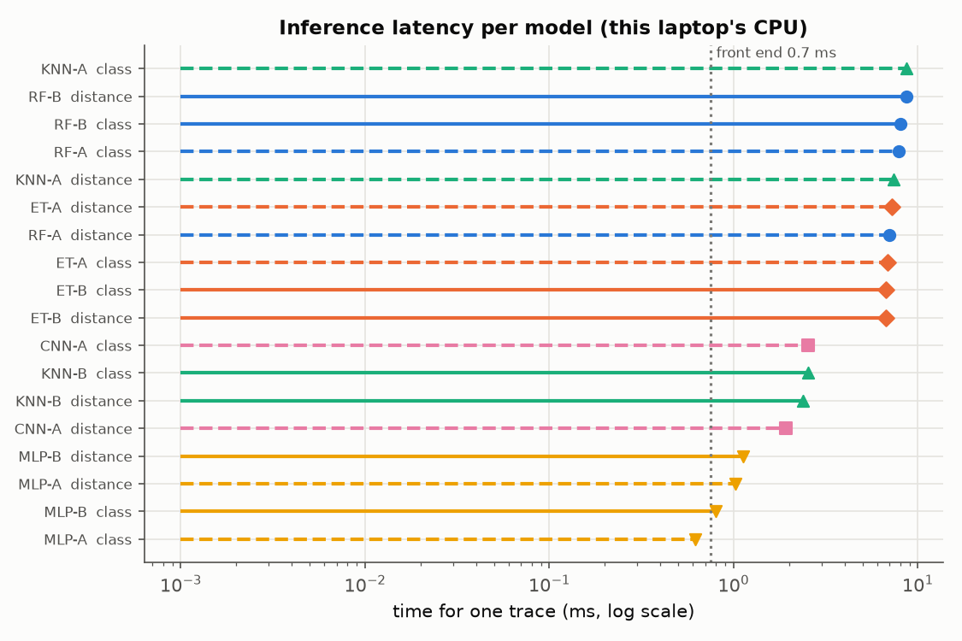
Speed: inference latency per model
0.75 ms
front end per trace (preprocess + baseline + features)
8.67 ms
slowest single-trace model call (KNN-A class)
Training all 18 models: 44 min wall time on 16 cores while sharing the CPU (≈ 20 min of model fitting alone; the CNN is the largest share).
E1–E6 evaluation: 31 min.
Notes:
Measured on the project laptop's CPU. The front end (preprocessing, baseline and 23 features) dominates; every model answers in milliseconds, so the system is interactive.

Slide 79
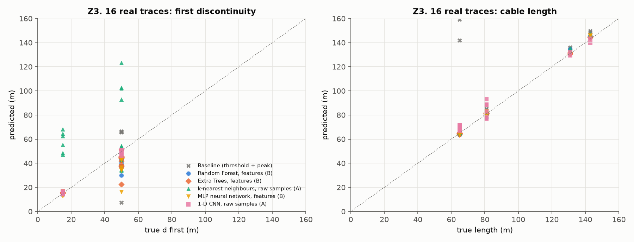
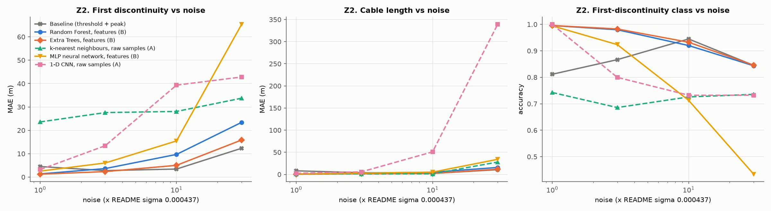
Real measured data: Zenodo 5720438
Model | Z1 sim: first fault MAE (m) | Z1 sim: length MAE (m) | Z3 REAL: first fault MAE (m) | Z3 REAL: length MAE (m) | Z3 REAL: type correct
Matched filter | 4.40 | 8.35 | 8.64 | 13.16 | 9/16
ET-B | 1.23 | 0.50 | 5.62 | 0.61 | 16/16
RF-B | 1.35 | 0.63 | 5.60 | 1.09 | 16/16
CNN-A | 3.22 | 2.63 | 1.23 | 4.22 | 16/16
ET-A * | 2.82 | 0.47 | 1.98 | 0.90 | 16/16
RF-A * | 3.12 | 0.80 | 3.53 | 1.31 | 16/16
MLP-A | 5.32 | 0.55 | 4.53 | 2.34 | 16/16
MLP-B | 2.49 | 1.00 | 7.17 | 1.17 | 16/16
KNN-B | 3.18 | 2.07 | 8.10 | 3.11 | 16/16
KNN-A | 23.84 | 0.92 | 32.73 | 1.58 | 8/16
* raw-input forests evaluated in the first run (Z1 noise shared with training; the seed check shows < 2 % effect).
Notes:
External test on someone else's measurements. Models are trained on that dataset's simulated traces only. Z1: 20 000 held-out simulated traces; Z2: noise x1-30 (left); Z3: the 16 real measured traces (right). On real traces the CNN finds the first fault within 1.2 m on average (baseline 8.6 m) and Extra Trees on features measures the cable length within 0.6 m (baseline 13.2 m). At high noise (x10, x30) the matched filter is the most robust first-fault locator: the models were trained at noise x1 only.

Slide 80
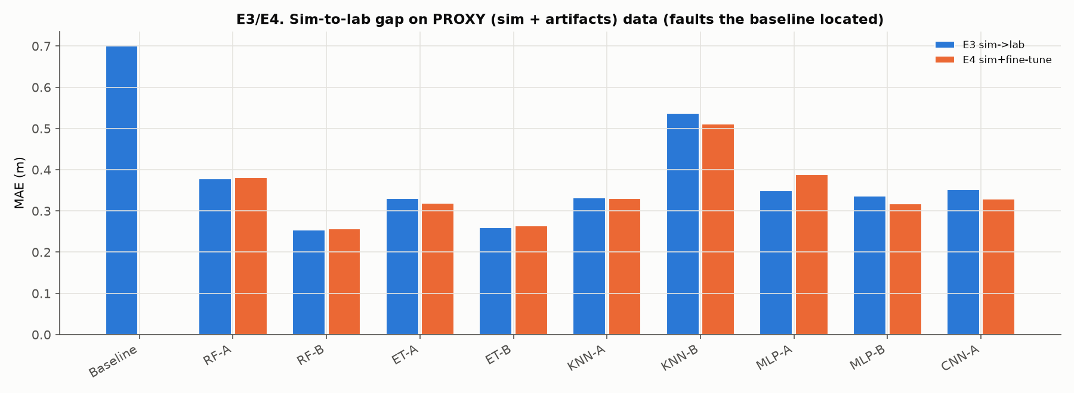
Sim-to-lab gap (E3/E4, proxy until the lab session)
Reading the proxy result
Data: PROXY (sim + artifacts) (1 351 test traces).
E3: trained on clean simulation, tested with lab-like artifacts: every method gets worse (baseline 0.70 m).
On the faults the baseline locates, ML stays at about 0.25-0.35 m.
E4: +149 labelled proxy traces (×5 weight) changes MAE by ≤ 0.05 m: not enough.
Switches to LAB automatically once ≥ 20 logged traces exist.
Notes:
Until our own traces exist, E3/E4 use a proxy set: simulation with lab-like artifacts (adapter reflection, ringing, 1/f noise). On the faults the baseline locates, the ML models keep a clear advantage (about 0.25-0.35 m vs 0.70 m). Fine-tuning with 149 labelled proxy traces (E4) changes the error by at most about 0.05 m, so it does not close the gap: the artifacts need either more targeted data or training with artifacts on (domain randomisation).

Slide 81
Objectives vs measured results
Objective | Measured evidence | Verdict
Realistic labelled simulation | levels within 0.015 of 1 + Γ; delay exact (F09) | met
Baseline to beat | MAE 0.26 m on 85 % coverage | met
ML beats baseline | ET-B: MAE 0.37 m on all faults; fair 0.19 vs 0.26 m | met (simulation)
Fault type | CNN-A macro-F1 0.983 vs baseline 0.860 | met (simulation)
Real data | 16 measured Zenodo traces (Z3) | measured
Own lab data + calibration | procedure and software ready; rehearsed | pending lab
Interactive demo | dashboard, 5 tabs, tested (F14, F15) | met
Notes:
Green = measured and met; amber = measured on simulation/proxy only, or pending lab. No untested feature is claimed as working.

Slide 82
Problems, debugging and solutions
Part 13
What went wrong, why, and how we know it is fixed

Slide 83
Problems found during development
Problem | Root cause | Solution | Verified by
Incident tail detected as an echo | lobe boundary inside the incident edge | echo lobe may not start before the incident lobe ends | baseline unit tests
False alarms at low SNR | noise from the pre-trigger only; fixed smoothing | MAD noise, adaptive Gaussian, longer pre-trigger | E1 false-alarm rates
Γ over-compensated | loss evaluated at the edge knee | loss at 0.1/rise | physics tests
Zenodo download broke (curl 56) | unstable connection | resumable retries, robust range reads | 4.18 GB verified
Pulse tail triggered events | slow tail of the transmitted pulse | high-pass before correlating, blanking | Z1 baseline
Feature windows moved with t0 | windows anchored on shifted axis | windows anchored on the incident edge | test_t_offset_shifts_every_time_feature
E2 lost its training set after cache rename | name changed, loader not | training-set name stored in bundle | selftest F13
Notes:
Each row: symptom, root cause, fix, and the test that now guards it.

Slide 84
Before and after: amplitude-independent normalisation
Before (one stored V_inc)
After (V_inc per trace)
0.5 V generator: open → 'no reflection' / matched.
1.2 V: open and short → 'partial'.
3.0 V: merged-edge path, d = 0.29 m.
Calibration V_inc averaged over all open rows (low-SNR rows pulled it down).
Estimated from each trace; calibration used when they agree.
All 8 amplitude/class cases: correct class, |d − 5| < 0.3 m.
Calibration uses only normal-amplitude rows for V_inc.
Pinned by test_vinc_per_trace_any_amplitude (8 cases).
Notes:
Review finding 1. The before column is the reviewer's run on the old code (5 m RG-58, calibration at 2 V EMF). The after column is the regression test test_vinc_per_trace_any_amplitude: open and short at 5 m with the step at 0.25×, 0.6×, 1× and 1.5× the calibration amplitude, all correct.

Slide 85
Achievements, limitations, future and conclusion
Part 14–16
Separating what is done from what is pending

Slide 86
Status: completed, partial, pending, unverified
Completed
Partial
Pending (needs lab)
Unverified
Simulator, baseline, features
18 models, E1–E6, analysis
Dashboard (5 tabs)
Capture, CSV reader, calibration, fit
Zenodo pipeline + 16 real traces
62 tests + 19-feature self-test
Hardware manual + 13 circuits
E3/E4 on proxy data (switches to LAB automatically)
Report draft: lab sections empty
Instructor approvals (S1)
Real calibration (S8)
≈ 180 + fault traces (S9–S11)
Retrain on calibration, E3/E4 LAB
Setup photo, demo rehearsal
Scope drivers on a real instrument (written per vendor docs)
Fast-edge pulser (optional, not built)
Notes:
Everything that can be done without the lab is done and measured. The lab session is the remaining critical path.

Slide 87
Key results in numbers
0.37 m
85 %
0.983
Extra Trees (features): mean distance error on every faulted test trace (simulation)
share of faults the classical baseline located at all
1-D CNN (raw): macro-F1 over 4 classes
19/19
62
16
features passing the end-to-end self-test
unit and regression tests passing
real measured traces tested (Zenodo Z3)
Notes:
All measured by the project's own scripts; simulation unless marked real.

Slide 88
Limitations
# | Limitation | Consequence / mitigation
L1 | no own lab data yet | E3/E4 are proxy; switch to LAB after the session
L2 | resolution ≈ vp·t_r/2 | faults < 0.4–1.5 m from the tee merge; pulser helps
L3 | learned models do not extrapolate (E2) | train on the full distance range used
L4 | very weak faults (|Γ| < 0.05) | inconsistent detection by every method (E5)
L5 | simulation fidelity (connectors, scope front end) | fit_sim and calibration narrow the gap; Zenodo shows a real gap
L6 | single fault per trace in our own data | multi-fault only in Zenodo labels
L7 | Zenodo k-NN stores 100 k raw traces per target | fine for evaluation, too large to deploy
Notes:
Stated plainly so the results are read correctly.

Slide 89
Future scope
Better models
Better signals
Better system
Domain randomisation: train with lab artifacts on.
Hybrid: ML inside its range, baseline outside.
Fine-tune on our lab traces (E4).
Multi-fault outputs (Zenodo labels).
Time-frequency CNN (Chang & Park).
Matched-load reference subtraction (cancels generator ringing).
74AC14 fast-edge pulser: ≈ 2× resolution.
Averaging + narrow pulses for long cables.
Second cable type (RG-174 / RG-59).
Compact k-NN (shared neighbours) or distillation.
Live capture inside the dashboard.
Confidence-based abstention.
Notes:
Ordered by expected benefit for the effort.

Slide 90
Conclusion
Problem: locate and classify cable faults from one TDR trace, robustly in noise and with real instruments.
Solution: physics simulator → one processing chain → classical baseline vs five ML families on two inputs, calibrated to the setup.
Built with: Python, NumPy/SciPy, scikit-learn, PyTorch, PyVISA, Streamlit/Plotly; tested with 62 unit tests and a 19-feature self-test.
Achieved: Extra Trees (features) locates every fault with MAE 0.37 m (simulation); 1-D CNN (raw) classifies with macro-F1 0.983; tested on 16 real traces.
Remaining: our own lab session: calibration, labelled traces, E3/E4 on real data, final report sections.
Potential: a low-cost, explainable cable diagnostic for student labs and field maintenance.
Notes:
Close with the problem, the solution, the evidence and what remains.

Slide 91
Thank you: questions?
Demo: python index.py dashboard · Evidence: report/results/
Docs: docs/PROJECT_DOCUMENTATION.md
Technical appendix and source references follow.

Slide 92
Technical appendix
Appendix
Formulas, configuration, file formats and source references (docs/TECHNICAL_APPENDIX.md)

Slide 93
Formulas
Quantity | Formula
Wave speed | vp = c/√εr = VF·c
Incident step | V_inc = Vs·Z0/(Rs + Z0)
Reflection coefficient | Γ = (ZL − Z0)/(ZL + Z0)
Series / shunt R | Γ = R/(R + 2Z0) / Γ = −Z0/(Z0 + 2R)
Distance | d = vp·Δt/2
Calibration | Δt = (2/vp)·L + t0
Resolution | Δd_min ≈ vp·t_r/2
Loss | α(f) = α_dc + k_s√f + k_d·f; Γ ≈ amp·e^(2αd)
Robust noise | σ = 1.4826·median|x − median(x)|
MAE / RMSE | mean|d̂ − d| / √mean(d̂ − d)²
Precision / recall / F1 | TP/(TP+FP) · TP/(TP+FN) · 2PR/(P+R)
Notes:
All formulas used in the project, with the symbols defined on the key-terms slide.

Slide 94
Configuration values
Setting | Value | Setting | Value
distance | 0.5–20 m | rise time | 2–10 ns
SNR | 10–40 dB | generator Rs | 0.92–1.08 × Z0
scope input | 1 MΩ ∥ 8–20 pF | sampling | 0.5, 1, 2 ns
partial |Γ| | 0.05–0.70 | ADC | 8 bit
Method A grid | 256 × 1 ns, −16…239 ns | Method B | 23 features
forest | 100 trees | k-NN | k ∈ {5, 15}, distance
MLP | (128,64)/(256,128), α 1e-4 | CNN | 16/32/64/64 ch, k7, ≤ 40 epochs
train / val / test | 20 000 / 4 000 / 6 000 | seeds | 1 / 2 / 3
Notes:
From src/config.py and src/train.py; the full list is in the technical appendix.

Slide 95
Source references: where every claim comes from
Topic | Source file(s)
Physics, simulator | src/sim_tdr.py, docs/theory_sheet.md, tests/test_physics_baseline.py
Baseline, features | src/baseline.py, src/features.py, docs/data_dictionary.md
Models, grids, selection | src/models.py, src/train.py, report/results/validation_grid.csv, analysis_model_config.csv
Simulation results E1–E6 | report/results/summary.md, e*_*.csv, report/figures/fig1–fig10
Localization / detection analysis | report/results/ml_analysis_summary.md, analysis_*.csv, figures a1–a6
Real data | report/results/zenodo_summary.md, zenodo_z*.csv, figures zfig1–3
Testing | report/results/feature_tests.md, tests/, docs/TESTING_REPORT.md
Hardware | hardware/README.md, HARDWARE_GUIDE.md, LAB_PROCEDURE.md, circuits/
Literature | docs/literature.md, docs/model_selection.md
Notes:
Use this slide to find the evidence behind any number in the deck.

