Slide 1
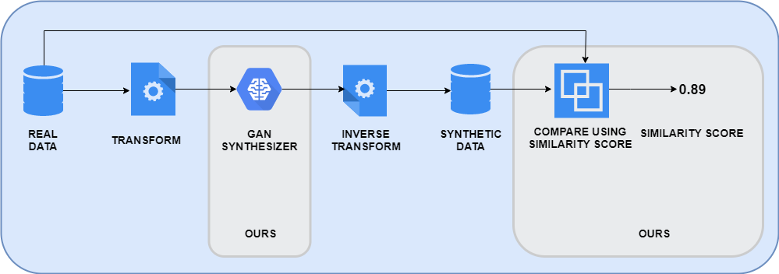
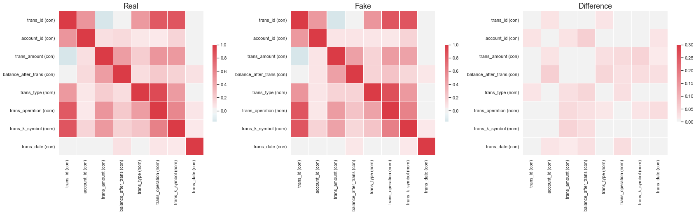
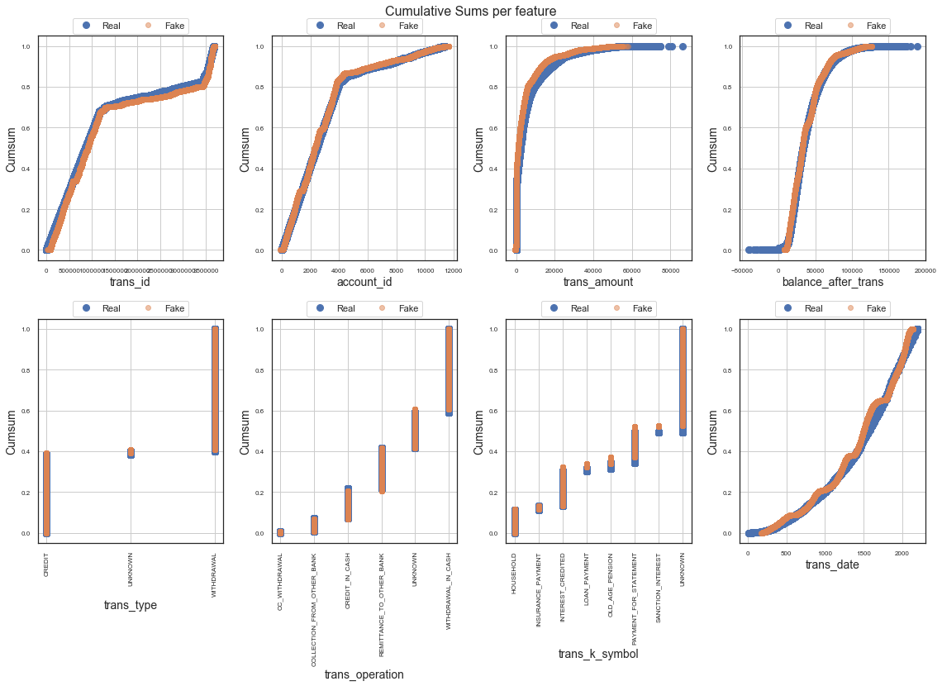
Generate and evaluate synthetic data
Generate data using GANs
Real data is never seen by generator
Captures relevant relations like correlations and distributions
Can handle very large datasets
Requires time to train
Evaluation of synthetic data: how close is synthetic data to real data
Measure basic statistics mean, median, std, variance
Correlations between columns Do age and salary correlate?
Correlations between dataset columns Do salary in the real data and fake data correlate?
Similarity between classifiers trained on real data and classifiers trained on fake data. Test set performance should be similar.
Captured variance of PCA correlates between real and fake data When reduced to a lower dimension, do these datasets behave the same?
Correlations between columns
Distributions of columns

