Slide 1
DoConnect — Capstone Presentation
Ankit Dwivedi • Instructor: Parth Shukla
Angular + ASP.NET Core • SQL Server • xUnit/Jasmine

Slide 2
Agenda
Problem & Objectives
Key Features
Tech Stack
System Architecture
Modules (Frontend & Backend)
REST API Overview
Data Model & ERD
Security & Validation
Testing Strategy
Accessibility & UX
Demo Flow & Screenshots
Results, Challenges, Future Work
Conclusion & Q&A

Slide 3
Problem Statement
Knowledge scattered across chats/forums; difficult to search or moderate.
Need a centralized Q&A with images, moderation, and clear roles.

Slide 4
Objectives
JWT‑secured auth, role‑based access (User/Admin).
Ask/Answer with image uploads and moderation flow.
Searchable question threads and responsive UI.
Robust REST API, validations, and automated tests.

Slide 5
Key Features
Ask Questions with images; Answer with images.
Approve/Reject workflow for Admin; delete images on reject.
Search, tag chips, and pagination.
Profile management; responsive navbar with user dropdown.

Slide 6
Tech Stack
Frontend: Angular (Router, Reactive Forms, HttpClient/Interceptor).
Backend: ASP.NET Core Web API (.NET 9) + EF Core (Code‑First).
DB: SQL Server; Storage: wwwroot/uploads.
Testing: xUnit + Moq; Jasmine/Karma.

Slide 7
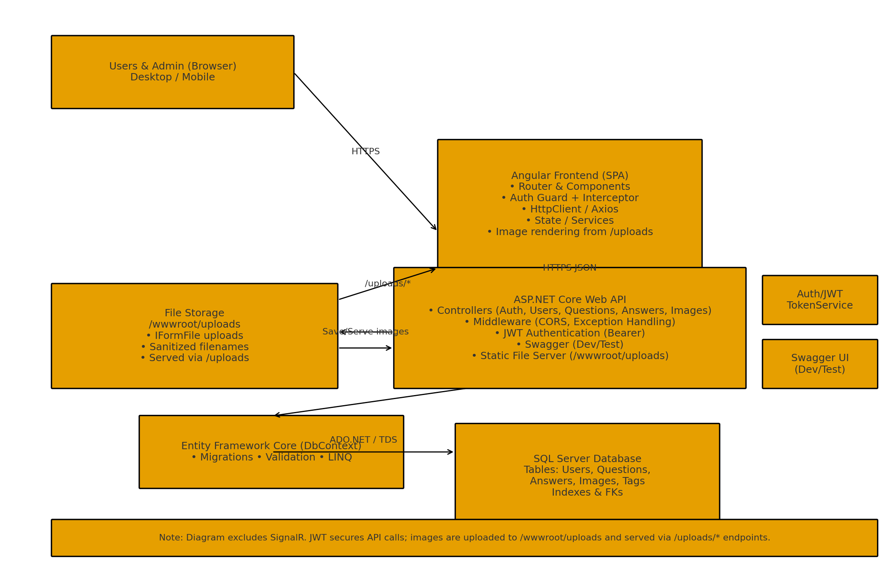
System Architecture

Slide 8
Frontend Modules
Auth: Login, Register, Guards (Auth/Admin).
Questions: Ask, List, Detail (gallery).
Answers: Form + List; status badges.
Shared: Navbar, Snackbar/Toast, FileUpload.

Slide 9
Backend Modules
Controllers: Auth, Users, Questions, Answers, Admin, Images.
Middleware: CORS, Exception Handling, Static Files.
JWT: Token service & policies.
Swagger for dev/test.

Slide 10
REST API (Highlights)
HTTP | Endpoint | Action
POST | /api/auth/register | Register user
POST | /api/auth/login | Login & issue JWT
GET | /api/questions | List/search questions
POST | /api/questions | Create question
GET | /api/questions/{id} | Question details + answers
POST | /api/questions/{id}/answers | Post answer (pending)
PATCH | /api/answers/{id}/status | Approve/Reject (Admin)
POST | /api/files/upload | Upload image (multipart/form-data)

Slide 11
Data Model Overview
Users(UserId, Email, PasswordHash, DisplayName, Role, CreatedAt)
Questions(QuestionId, UserId, Title, Text, Status, CreatedAt)
Answers(AnswerId, QuestionId, UserId, Text, Status, CreatedAt)
Images(ImageId, Path, UploadedAt, QuestionId?, AnswerId?)
Tags & QuestionTags (many‑to‑many) [if used]

Slide 12
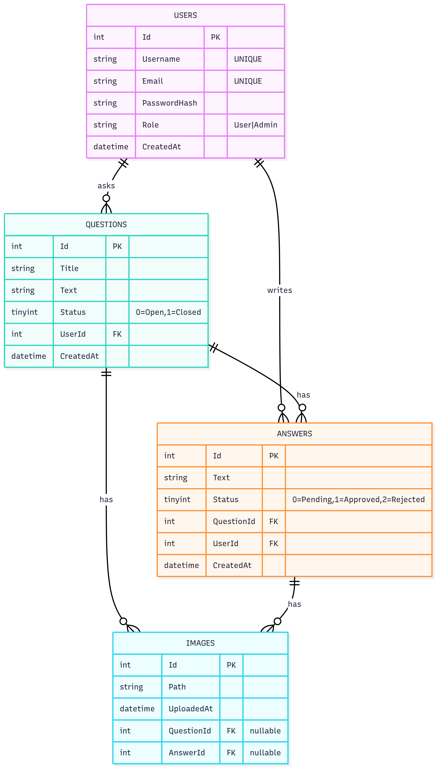
ER Diagram

Slide 13
Security & Validation
JWT bearer tokens; short‑lived access tokens.
Authorization policies for Admin routes.
Input validation + size/type limits on uploads.
Global exception handling & ProblemDetails.

Slide 14
Validation & Error Handling
Model validation: Required/MaxLength/Range.
Consistent 400/401/403/404 responses.
Graceful error toasts on the frontend.

Slide 15
Testing Strategy
xUnit + Moq for services/controllers (Auth, Q/A).
Angular unit tests for forms & components.
Postman collection for E2E sanity checks.

Slide 16
Performance & Optimizations
Indexes on FK columns; composite index (QuestionId, CreatedAt).
Paged endpoints and lightweight DTOs.
Static file caching for /uploads.

Slide 17
Deployment & DevOps
appsettings.* and environment.ts for config.
CI: build → test → publish artifacts.
API on IIS/Azure; Angular on static host/reverse proxy.
Logging (Serilog) and monitoring.

Slide 18
Accessibility & UX
Keyboard navigation, ARIA labels, and focus states.
Color contrast and consistent spacing.
Responsive navbar and forms.

Slide 19
Demo Flow (Live)
Register/Login → Ask Question (with image).
Answer Question → Admin moderation (approve/reject).
Search & tags → Profile update → View uploads.

Slide 20
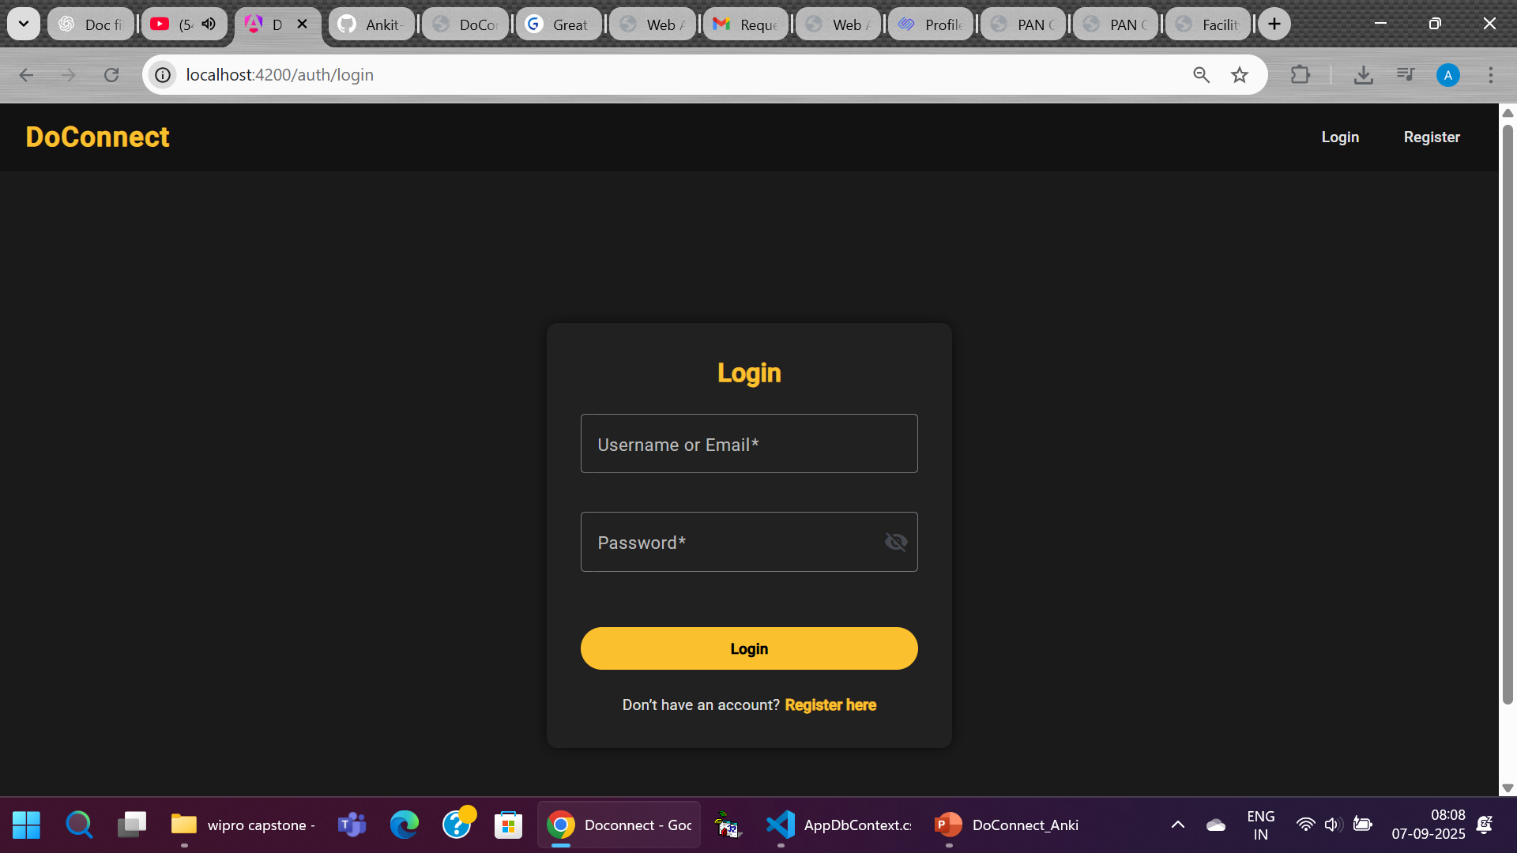
Screenshot — Login
Insert Login screenshot

Slide 21
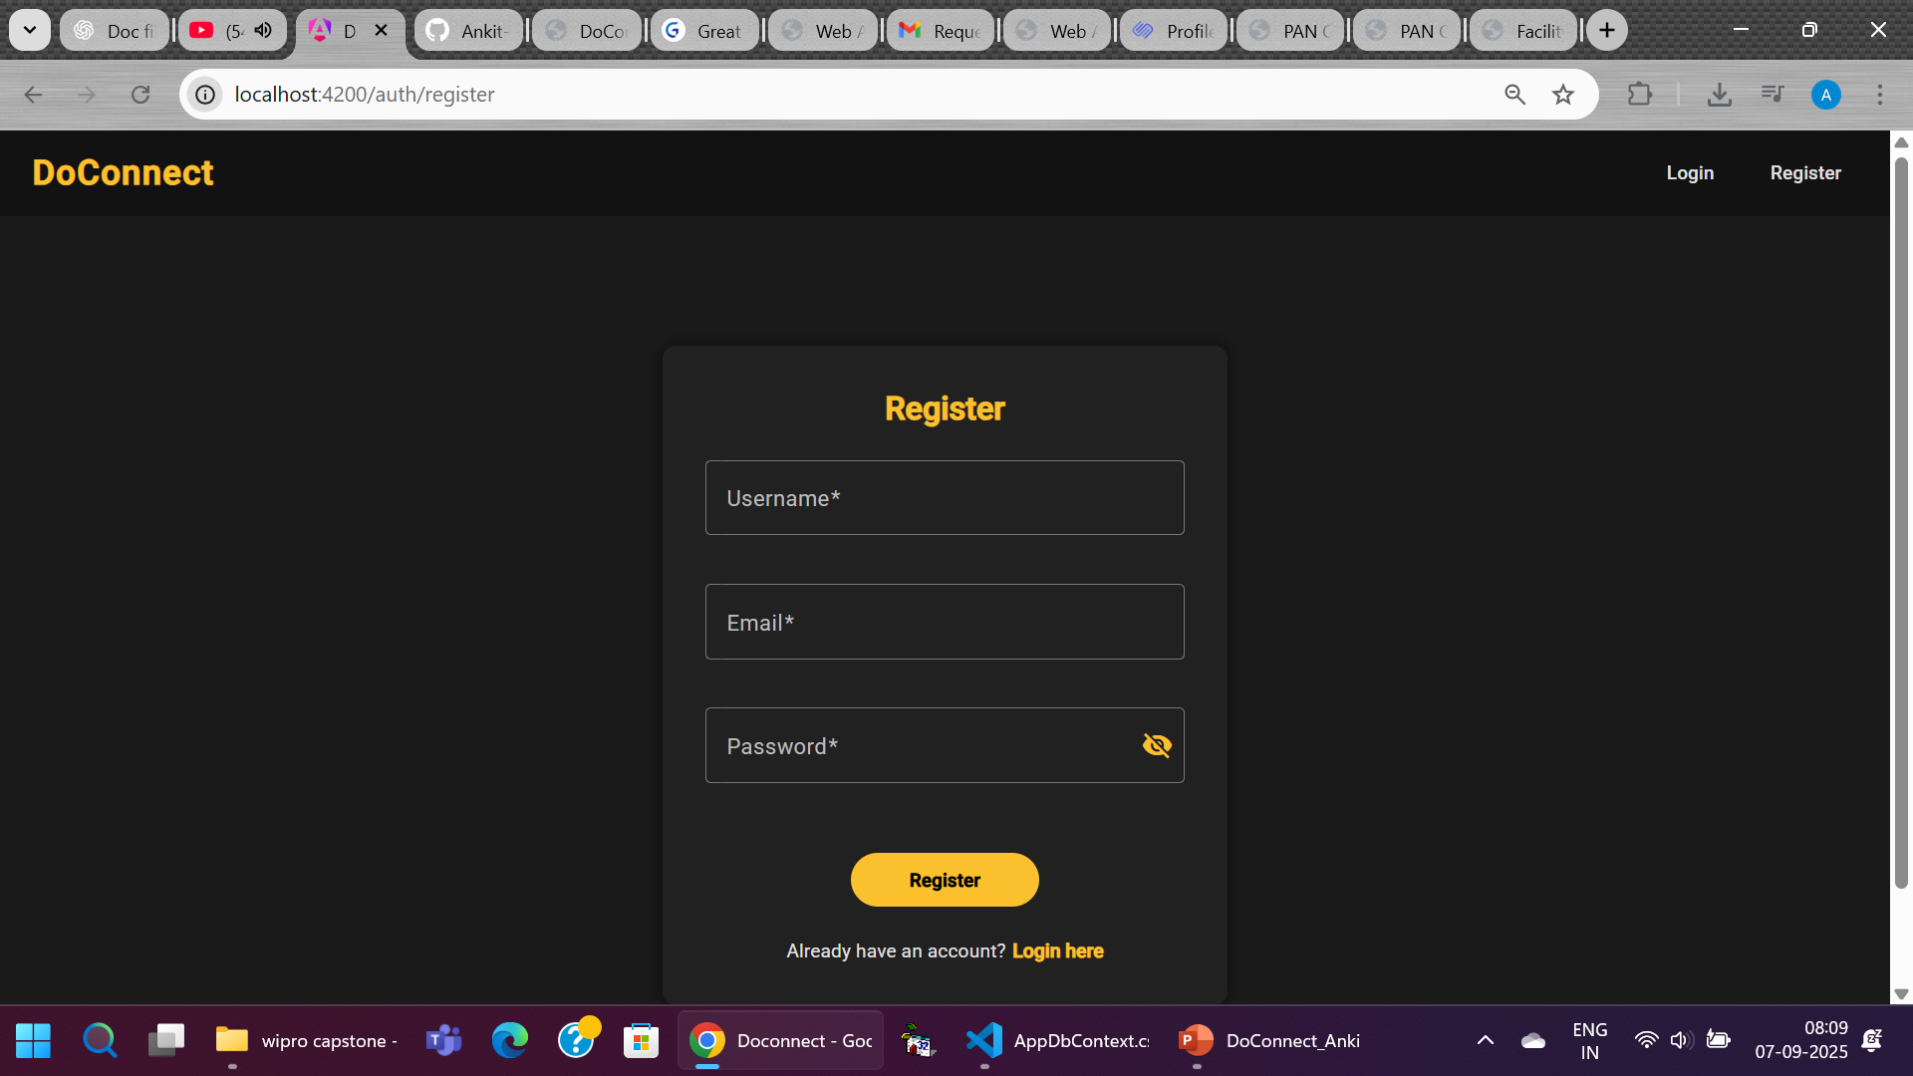
Screenshot — Register
Insert Register screenshot

Slide 22
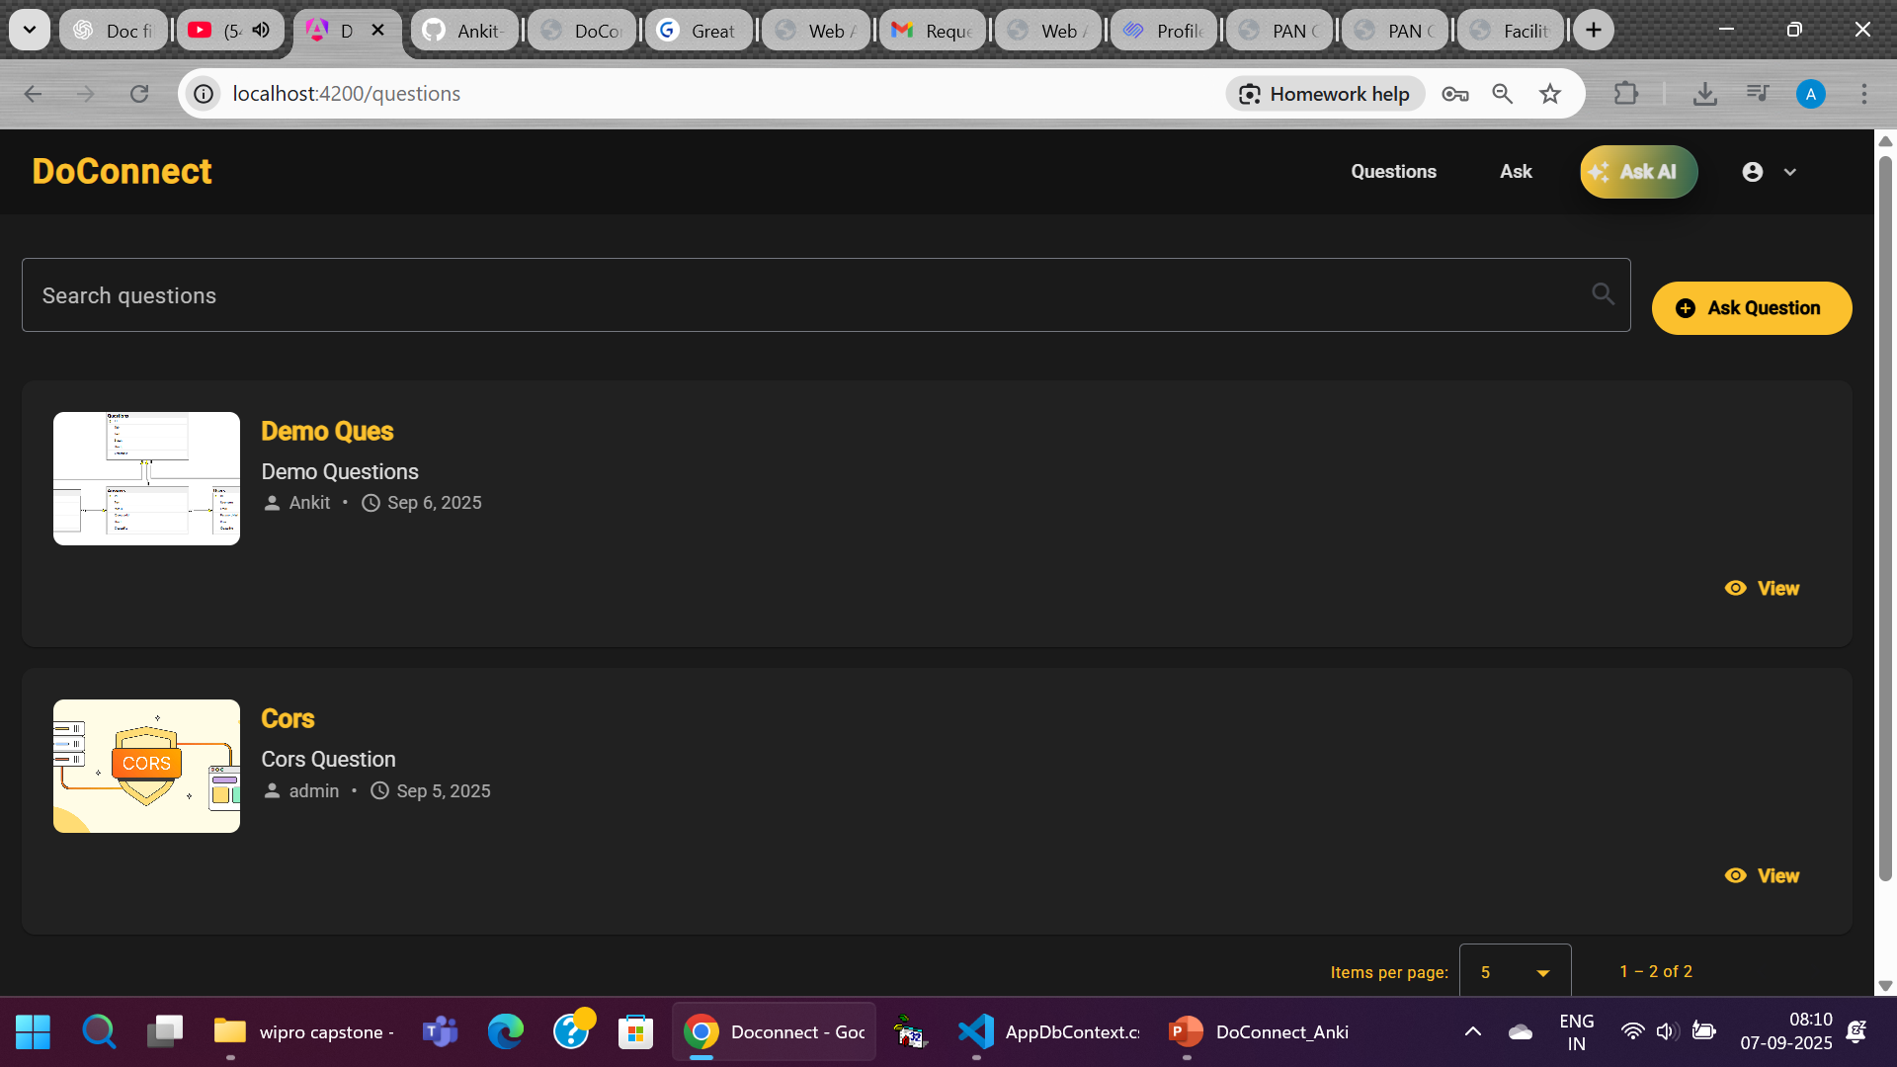
Screenshot — Question List
Insert Question List screenshot

Slide 23
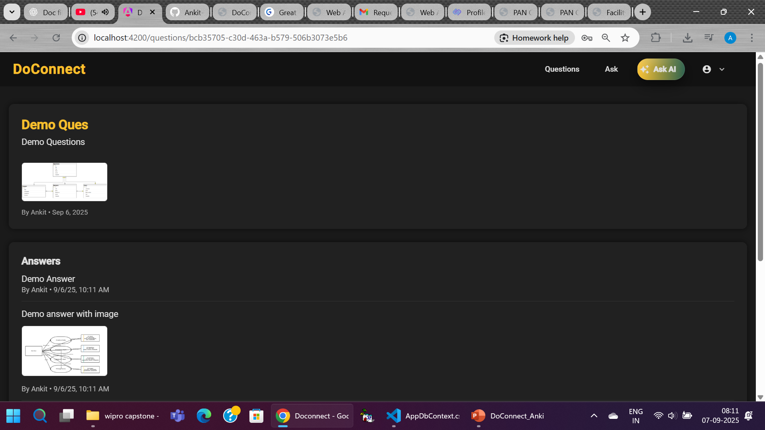
Screenshot — Question Details + Answers
Insert Question Details + Answers screenshot

Slide 24
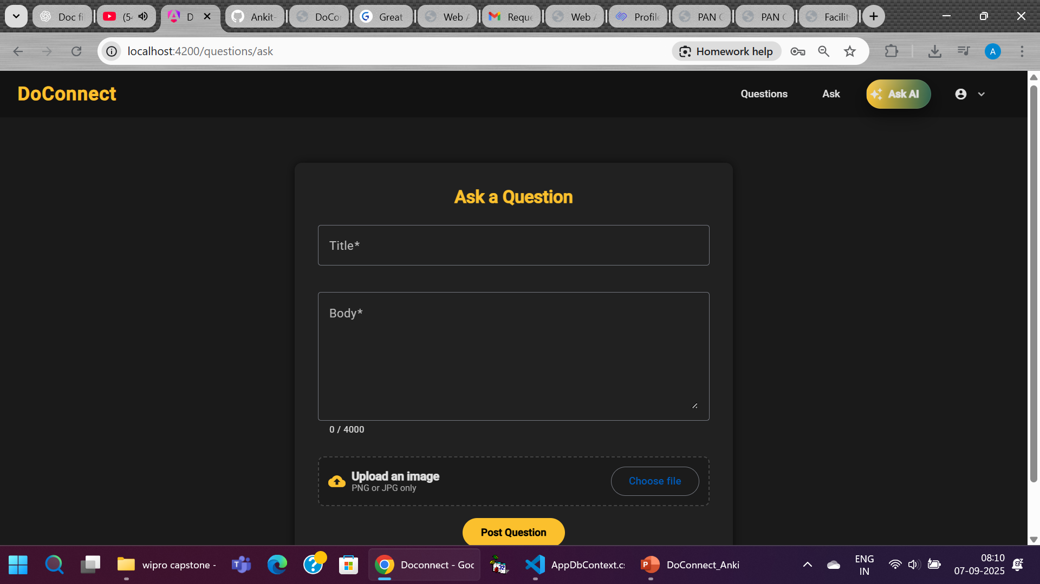
Screenshot — Ask with Image Upload
Insert Ask with Image Upload screenshot

Slide 25
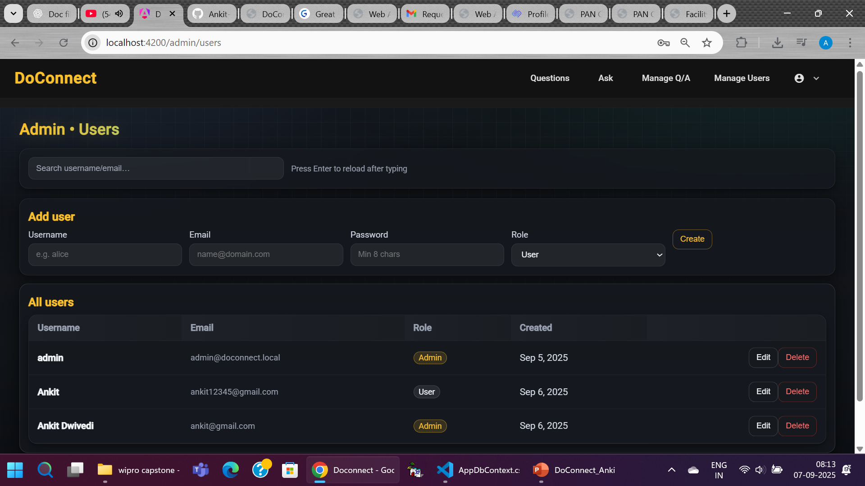
Screenshot — Admin Moderation
Insert Admin Moderation screenshot

Slide 26
Submission Checklist
Final report (DOCX/PDF).
Frontend & Backend source zips.
DB schema SQL; Postman collection.
Screenshots embedded; Git repo archived.

Slide 27
Challenges & Learnings
Handling image uploads safely; MIME/type checks.
Designing moderation workflow cleanly.
Balancing UX responsiveness with validation.

Slide 28
Future Work
Email notifications; richer search/filtering.
Tag suggestions; analytics dashboard.
Role extensions (moderators).

Slide 29
Results & Impact
End‑to‑end Q&A workflow operational and testable.
Modular architecture suitable for extension.
Meets capstone evaluation rubric requirements.

Slide 30
Thanks
Thank you!

