Slide 1

Sprocket Central Pty Ltd
Data analytics approach
[Division Name] - [Engagement Manager], [Senior Consultant], [Junior Consultant]
By: Ankit Gokhroo

Slide 2
Agenda
Introduction
Data Exploration
Model Development
Interpretation

Slide 3
Introduction
New customers analyze:
Look into these factors in new customers:
Age distributions along with gender.
Number of bike purchases.
Job industry category.
Wealth segments.
Number of cars own on each states.
Job Industry category.

Slide 4
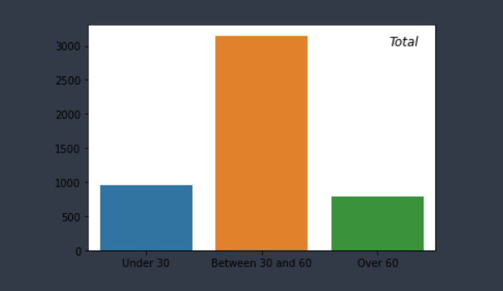
Data Exploration
Customers’ age distribution
As seen here, mostly our new customers are recommended between 30 to 60 years old.
Number of customers above 60 old has big diminution again.
It looks like the percentages of under 30 years old not really change but are more than 60 years old in number.

Slide 5
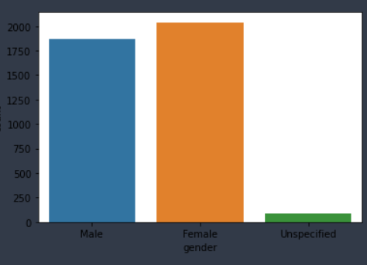
Model Development
Bike purchases by gender
As we can see, our new customers mostly Female with 50.98% purchases
Male contributed to 46.82% purchases
So we should focus on advertises on Female customers than Male customers
Scale number of customers by 10

Slide 6
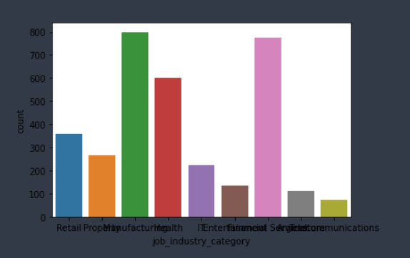
Interpretation
Job industry category.
Mostly our new customers are on Finance industry and our Manufactoring customers are still on top 2.
The rest industries is still same

Slide 7
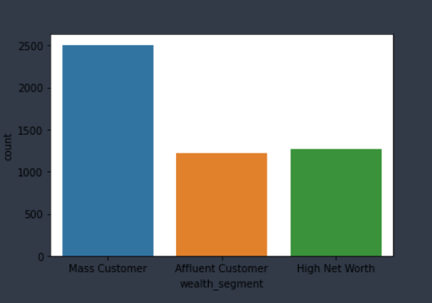
Interpretation
Wealth segments
In all ages, the number of Mass Customers is the highest so we should focus on this social class.
After that, we should focus on High Net Customer.
Then Affluent Customers but mostly second and third quadrant.

Slide 8
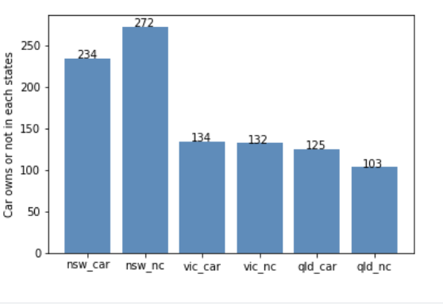
Interpretation
Numbers of cars owned
NSW should be considered the most since numbers of customers don’t own cars is significantly larger than that own.
VIC and QLD has more customers that own car that who don’t but we can try to have something so that those owns car will buy bikes.

Slide 9
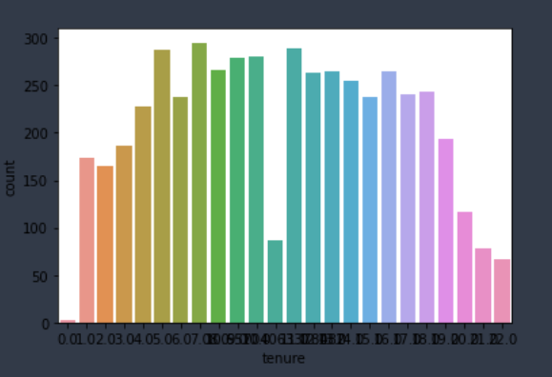
Interpretation
Wealth segments
The mean tenure for the customers was 10.81 years.

Slide 10
Appendix

Slide 11
Appendix
https://github.com/ankitgokhroo68368/KPMG-Virtual-Internship

