Slide 1
Machine Learning
Supervised Learning for Predection Model
~Dr. Palak Mahajan
Ankit Kumar Ojha
Gyan Prakash
Krishna Kumar
Priyanshu Gupta

Slide 2
Problem Statement
To predict student performance (pass/fail and final grade) using machine learning based on academic data
Solution
Develop a machine learning model to predict student perfromance
Implement regression (Random Forest) technique
Analyze how different academic factors affect final results
Create a user-friendly interface for real-time predictions
Improve decision-making using data-driven insights.

Slide 3
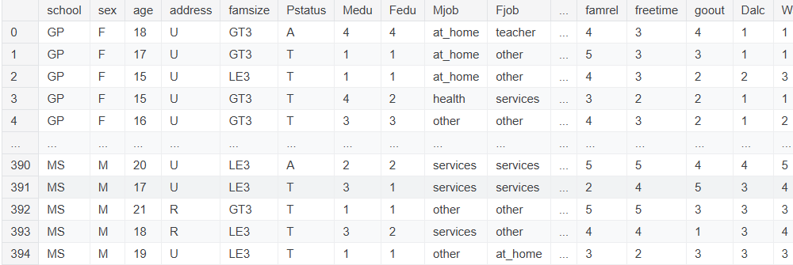
Dataset & Tools
Dataset
Source: Kaggle
200+records
Labeled dataset
Tools & Technologies
Python
Pandas, NumPy
Matplotlib, Seaborn
Scikit-learn
Streamlit

Slide 4
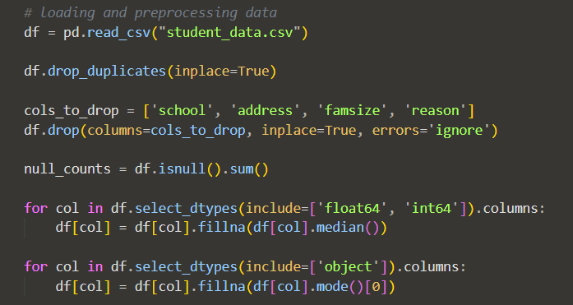
METHODOLOGY
Data Loading & Preprocessing
Data loading from csv format to Dataframe.
In Data-Preprocessing, the duplicated records are dropped and the null values are replaced with central tendencies.

Slide 5
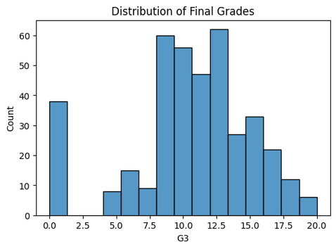
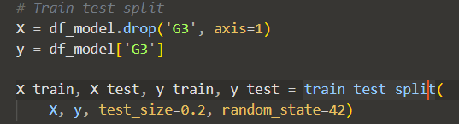
METHODOLOGY
2. Exploratory Data Analysis
Visualized the distribution of final grades to understand overall student performance
Analyzed relationships between features (e.g., G1, G2) and final grade to identify key influencing factors
3. Feature Selection & Encoding
Selected important features like study time, failures, absences, G1, and G2 based on their impact on performance
Converted categorical data (e.g., gender) into numerical form using encoding techniques
4. Train-Test-Split
Divided the dataset into training (80%) and testing (20%) sets
Used training data to build the model and testing data to evaluate its performance

Slide 6

METHODOLOGY
5. Model Building using Random Forest
Selected input features (X) and target variable (G3)
Split data into training and testing sets
Initialized Random Forest Regressor with parameters (n_estimators, random_state)
Trained the model using training data
Used the trained model to make predictions on test data

Slide 7
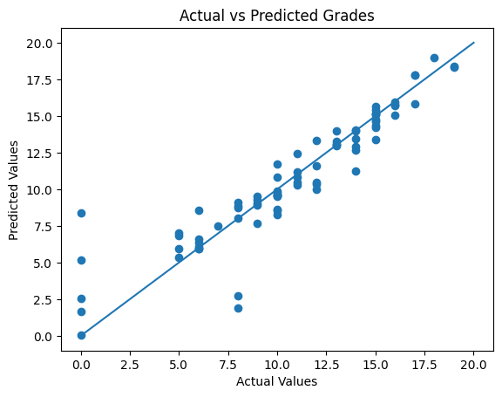
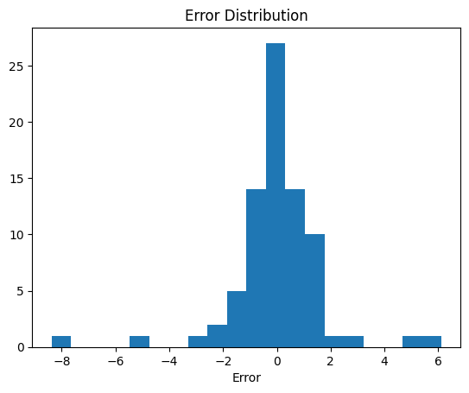
Model & Result
R2 Score: 0.85 | MAE: 1.03

Slide 8
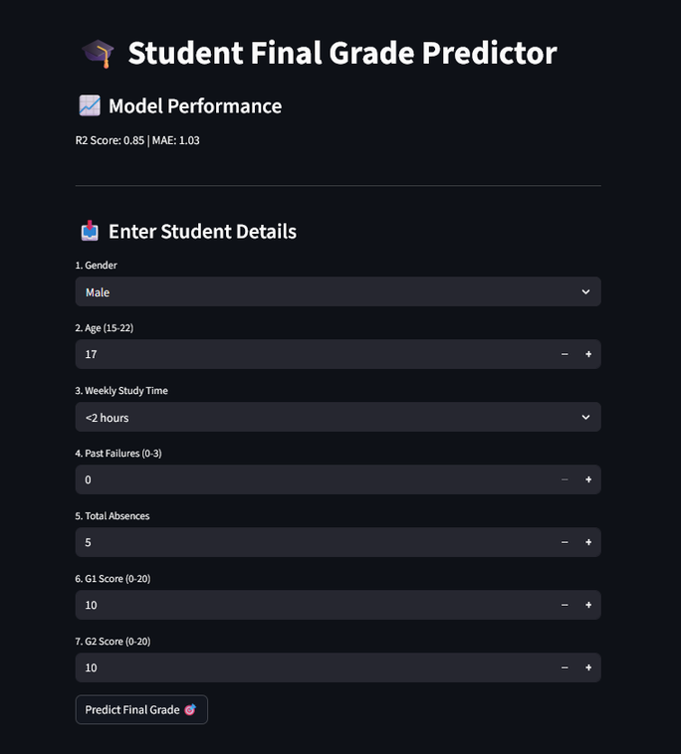
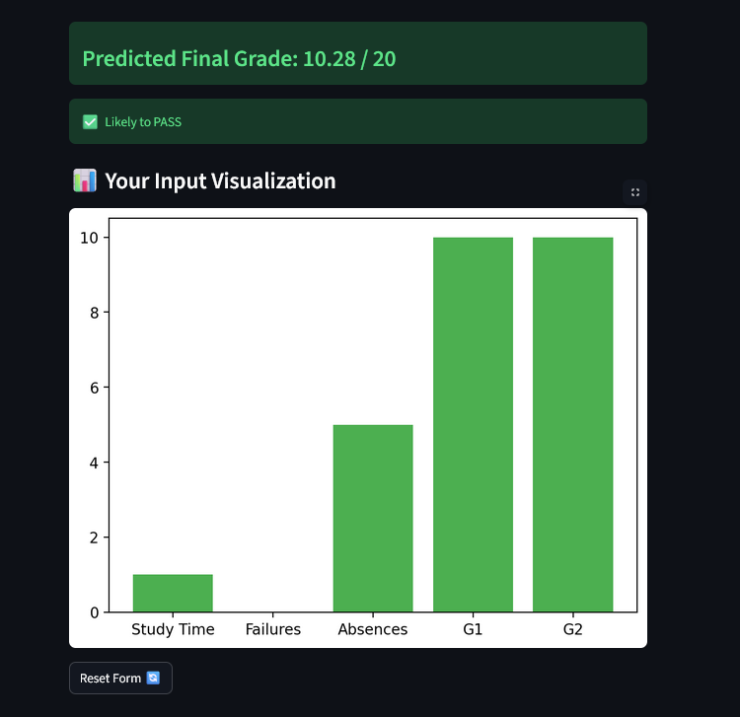
System Demo

Slide 9
CONCLUSION
Random Forest Regression effectively predicts the final student grade (G3)
The model captures complex relationships between input features and output
Important features like G1 and G2 strongly influence the prediction
The model shows good performance based on MAE and R² score
It can be used for real-world grade prediction and academic analysis
Reference link: Model_Link
GitHub: Repo_Link

Slide 10
THANK
YOU

