Slide 1
Numpy

Slide 2
What is NumPy
Stands for "Numeric Python" or "Numerical Python".
Open Source
Module of Python
Provides fast mathematical functions

Slide 3




What is NumPy
scikitlearn
tensorflow
Python
numpy
matplotlib
pandas
The complete Machine Learning eco-system.

Slide 4
Why use NumPy ?
Array-oriented computing
Efficiently implemented multi-dimensional arrays
Designed for scientific computation
Library of high-level mathematical functions

Slide 5
Numpy - Introduction
NumPy’s main object is the homogeneous multidimensional array
It is a table of elements
usually numbers
all of the same type
indexed by a tuple of positive integers
In NumPy dimensions are called axes
The number of axes is rank

Slide 6
Numpy - Introduction
First Dimension / Axis, Len = 4
Second Dimension / Axis, Len = 3
[[ | 0., | 0., | 0., | 0.],
[ | 0., | 0., | 0., | 0.],
[ | 0., | 0., | 0., | 0.]])
The above array has a rank of 2 since it is 2 dimensional.

Slide 7
Creating Numpy arrays
np.array - Creating NumPy array from Python Lists/Tuple
Numpy arrays can be created from Python lists or tuple in the following way.
>>> import numpy as np
>>> a = np.array([1, 2, 3])
>>> type(a)
<type 'numpy.ndarray'>
>>> b = np.array((3, 4, 5))
>>> type(b)
<type 'numpy.ndarray'>

Slide 8
Creating Numpy arrays
np.zeroes - An array with all Zeroes
To create an array with all zeroes the function np.zeroes is used
>>> >>> | x x | = | np.zeros( |  | (3,4) | )
array([[ |  |  | 0., | 0., | 0., | 0.],
[ |  |  | 0., | 0., | 0., | 0.],
[ |  |  | 0., | 0., | 0., | 0.]])

Slide 9
Creating Numpy arrays
np.ones - An array with all Ones
To create an array with all ones the function np.ones is used.
>>> np.ones( (3,4), dtype=np.int16 )
array([[ | 1, | 1, | 1, | 1],
[ | 1, | 1, | 1, | 1],
[ | 1, | 1, | 1, | 1]])

Slide 10
Creating Numpy arrays
np.full - An array with a given value
To create an array with a given shape and a given value np.full is used.
>>> np.full( (3,4), 0.11 )
array([[ 0.11, 0.11, 0.11, 0.11],
[ | 0.11, | 0.11, | 0.11, | 0.11],
[ | 0.11, | 0.11, | 0.11, | 0.11]])

Slide 11
Creating Numpy arrays
np.arange - Creating sequence of Numbers
>>> np.arange( 10, 30, 5 )
array([10, 15, 20, 25])
>>> np.arange( 0, 2, 0.3 ) # it accepts float arguments
array([ 0. , 0.3, 0.6, 0.9,
1.2,
1.5,
1.8])

Slide 12
Creating Numpy arrays
np.linspace - Creating an array with evenly distributed numbers
Returns an array having a specific number of points
Evenly distributed between two values
The maximum value is included, contrary to arange
Ending Number
Total Number of points
Starting Number
>>> np.linspace(0, 5/3, 6)
array([0. , 0.33333333 , 0.66666667 , 1. , 1.33333333
1.66666667])

Slide 13
Creating Numpy arrays
np.random.rand - Creating an array with random numbers
Make a 2x3 matrix having random floats between 0 and 1:
>>> np.random.rand(2,3)
array([[ 0.55365951,
[ 0.5388662 ,
0.60150511,
0.06929014,
0.36113117],
0.07908068]])

Slide 14
Creating Numpy arrays
np.empty - Creating an empty array
To create an uninitialised array with a given shape. Its content is not predictable.
>>> np.empty((2,3))
array([[ 0.21288689, | 0.20662218, | 0.78018623],
[ 0.35294004, | 0.07347101, | 0.54552084]])

Slide 15
Important attributes of a NumPy object
The NumPy’s array class is called ndarray. The important attributes of a ndarray object are -
ndarray.ndim
the number of axes (dimensions) of the array.
[[ 1., 0., 0.],
[ 0., 1., 2.]]
For the above array the value of ndarray.ndim is 2.

Slide 16
Important attributes of a NumPy object
ndarray.shape
the dimensions of the array. This is a tuple of integers indicating the size of the array in each dimension.
[[ 1., 0., 0.],
[ 0., 1., 2.]]
For the above array the value of ndarray.shape is (2,3)

Slide 17
Important attributes of a NumPy object
ndarray.size
the total number of elements of the array. This is equal to the product of the elements of shape.
[[ 1., 0., 0.],
[ 0., 1., 2.]]
For the above array the value of ndarray.size is 6.

Slide 18
Important attributes of a NumPy object
ndarray.dtype
Tells the datatype of the elements in the numpy array. All the elements in a numpy array have the same type.
>>> c = np.arange(1, 5)
>>> c.dtype dtype('int64')
reachus@cloudxlab.com

Slide 19
Important attributes of a NumPy object
ndarray.itemsize
The itemsize attribute returns the size (in bytes) of each item:
>>> c = np.arange(1, 5)
>>> c.itemsize 8
reachus@cloudxlab.com

Slide 20
Reshaping Arrays
The function reshape is used to reshape the numpy array. The following example illustrates this.
>>> a = np.arange(6)
>>> print(a) [0 1 2 3 4 5]
>>> b = a.reshape(2, 3)
>>> print(b) [[0 1 2],
[3 4 5]]
reachus@cloudxlab.com

Slide 21



Indexing and Accessing NumPy arrays
reachus@cloudxlab.com

Slide 22
Indexing one dimensional NumPy Arrays
0 1 2 3 4 5 6
>>> a = np.array([1, 5, 3, 19, 13, 7, 3])
>>> a[3] 19
>>> a[2:5] #range array([ 3, 19, 13])
>>> a[2::2] # How many to jump
Index
array([ 3, 13, 3])
>>> a[::-1]
array([ 3,
#Go reverse
7, 13, 19, 3, 5, 1])

Slide 23
Difference with regular Python arrays
1. If you assign a single value to an ndarray slice, it is copied across the whole slice :
>>> a = np.array([1, 2, 5, 7, 8])
>>> | a[1:3] | = | -1
>>> | a
array([ 1, -1, -1, 7, 8])
>>> b = [1, 2, 5, 7, 8]
>>> b[1:3] = -1
TypeError: can only assign an iterable
reachus@cloudxlab.com

Slide 24
Difference with regular Python arrays
2. ndarray slices are actually views on the same data buffer. If you modify it, it is going to modify the original ndarray as well.
>>> a = np.array([1, 2, 5, 7, 8])
>>> a_slice = a[1:5]
>>> a_slice[1] = 1000
>>> a
array([ 1, 2, 1000, 7, 8])
# Original array was modified

Slide 25
Important attributes of a NumPy object
3. If you want a copy of the data, you need to use the copy method as another_slice = a[2:6].copy() ,
if we modify another_slice, a remains same.

Slide 26
Indexing multi dimensional NumPy arrays
Multi-dimensional arrays can be accessed as
>>> | b[1, | 2] | # | row | 1, col 2
>>> | b[1, | :] | # | row | 1, all columns
>>> | b[:, | 1] | # | all | rows, column 1
The following format is used while indexing multi-dimensional arrays
Array[row_start_index:row_end_index, column_start_index: column_end_index]

Slide 27
Boolean Indexing
We can also index arrays using an ndarray of boolean values on one axis to specify the indices that we want to access.
>>> a = np.arange(12).reshape(3, 4)
>>> rows_on = np.array([ True, False, True])
>>> a[rows_on , : ] # Rows 0 and 3, all columns array([[ 0, 1, 2, 3],
[ 8, 9, 10, 11]])

Slide 28
Linear Algebra with NumPy

Slide 29
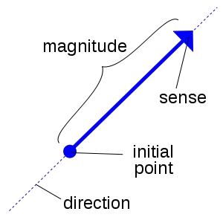
Vectors
A vector is a quantity defined by a magnitude and a direction.
A vector can be represented by an array of numbers called scalars.

Slide 30


Vectors
For example, say the rocket is going up at a slight angle: it has a vertical speed of 5,000 m/s, and also a slight speed towards the East at 10 m/s, and a slight speed towards the North at 50 m/s. The rocket's velocity may be represented by the following vector:
velocity
50 m/s
10 m/s
5,000 m/s

Slide 31

Use of Vectors in Machine Learning
Vectors have many purposes in Machine Learning, most notably to represent observations and predictions.
For example, say we built a Machine Learning system to classify videos into 3 categories (good, spam, clickbait) based on what we know about them.
Good
Spam
Clickbait

Slide 32

Use of Vectors in Machine Learning
For each video, we would have a vector representing what we know about it, such as:
Video
This vector could represent a video that lasts 10.5 minutes, but only 5.2% viewers watch for more than a minute, it gets
3.25 views per day on average, and it was flagged 7 times as spam. As you can see, each axis may have a different meaning.

Slide 33

Use of Vectors in Machine Learning
Based on this vector our Machine Learning system may predict that there is an 80% probability that it is a spam video, 18% that it is clickbait, and 2% that it is a good video. This could be represented as the following vector:
Spam
class_probabilities
Clickbait Good

Slide 34
Representing Vectors in Python
In python, a vector can be represented in many ways, the simplest being a regular python list of numbers.
[1,1,1,1]
Since Machine Learning requires lots of scientific calculations, it is much better to use NumPy's ndarray, which provides a lot of convenient and optimized implementations of essential mathematical operations on vectors.
numpy.array([1,1,1,1])

Slide 35
Vectorized Operations
Vectorized operations are far more efficient
Than loops written in Python to do the same thing
Let’s test it

Slide 36
Vectorized Operations
Matrix multiplication
Using for loop
>>> def multiply_loops(A, B):
C = np.zeros((A.shape[0], B.shape[1])) for i in range(A.shape[1]):
for j in range(B.shape[0]): C[i, j] = A[i, j] * B[j, i]
return C
Using NumPy's matrix-matrix multiplication operator
>>> def multiply_vector(A, B): return A @ B

Slide 37
Vectorized Operations
Matrix multiplication - Sample data
# Two randomly-generated, 100x100 matrices
>>> | X | = | np.random.random((100, | 100))
>>> | Y | = | np.random.random((100, | 100))

Slide 38
Vectorized Operations
Matrix multiplication - Loops - timeit
# First, using the explicit loops:
>>> %timeit multiply_loops(X, Y)
4.23 ms ± 107 µs per loop (mean ± std. dev. of 7 runs, 100 loops each)
Result - It took about 4.23 milliseconds (4.23∗10−3 seconds) to perform one matrix-matrix multiplication
Matrix multiplication - Vector - timeit
# Second, the NumPy multiplication:
>>> %timeit multiply_vector(X, Y)
46.6 µs ± 346 ns per loop (mean ± std. dev. of 7 runs, 10000 loops each)
Result - 46.6 microseconds (46.4
∗10−6 seconds) per multiplication
Conclusion - Two orders of magnitude faster

Slide 39
Basic Operations on NumPy arrays

Slide 40
Addition in NumPy arrays
Addition can be performed on NumPy arrays as shown below. They apply element wise.
>>> | a | = | np.array( | [20, | 30, | 40, | 50] | )
>>> | b | = | np.arange( | 4 )
>>> | b
array([0, | 1, | 2, | 3])
>>> c = a | + | b
>>> c
array([20, 31, 42, 53])

Slide 41
Subtraction in NumPy arrays
Subtraction can be performed on NumPy arrays as shown below. They apply element wise.
>>> | a | = | np.array( | [20, | 30, | 40, | 50] | )
>>> | b | = | np.arange( | 4 )
>>> | b
array([0, 1, 2, 3])
>>> c = a - b
>>> c
array([20, 29, 38, 47])

Slide 42
Element wise product in NumPy arrays
Element wise product can be performed on NumPy arrays as shown below.
>>> A = np.array( [[1,1],
... [0,1]] )
>>> B = np.array( [[2,0],
... [3,4]] )
>>> A*B # element wise product array([[2, 0],
[0, 4]])

Slide 43
Matrix Product in NumPy arrays
Matrix product can be performed on NumPy arrays as shown below.
>>> | A = np.array( [[1,1],
... | [0,1]] )
>>> | B = np.array( [[2,0],
... | [3,4]] )
>>> | np.dot(A, B) | # | matrix | product
array([[5, 4],
[3, 4]])

Slide 44
Division in NumPy arrays
Division can be performed on NumPy arrays as shown below. They apply element wise.
a = np.array( [20, 30, 40, 50] )
b = np.arange(1, 5)
c = a / b c
array([ 20. , 15.
])
, 13.33333333, 12.5

Slide 45
Integer Division in NumPy arrays
Division can be performed on NumPy arrays as shown below. They apply element wise.
a = np.array( [20, 30, 40, 50] )
b = np.arange(1, 5)
c = a // b c
array([20, 15, 13, 12])

Slide 46
Integer Division in NumPy arrays
Division can be performed on NumPy arrays as shown below. They apply element wise.
a = np.array( [20, 30, 40, 50] )
b = np.arange(1, 5)
c = a // b c
array([20, 15, 13, 12])

Slide 47
Modulus in NumPy arrays
Modulus operator can be applied on NumPy arrays as shown below. They apply element wise.
a = np.array( [20, 30, 40, 50] )
b = np.arange(1, 5)
c = a % b c
array([0, 0, 1, 2])

Slide 48
Exponents in NumPy arrays
We can find the exponent of each element in a NumPy array in the following way. It is applied element wise.
a = np.array( [20, 30, 40, 50] )
b = np.arange(1, 5)
c = a ** b c
array([ 20, 900, 64000, 6250000])

Slide 49
Conditional Operators on NumPy arrays
Conditional operators are also applied element-wise
m = np.array([20, -5, 30, 40])
m < [15, 16, 35, 36]
array([False, True, True, False], dtype=bool)
m < 25
array([ True, True, False, False], dtype=bool)
To get the elements below 25
m[m < 25]
array([20, -5])

Slide 50

Broadcasting in NumPy arrays

Slide 51
What is Broadcasting ?
1 | 2
4 | 5
0 | 2
3 | 4
1 | 4
7 | 9
1 | 2
4 | 5
5
???
7

Slide 52
What is Broadcasting ?
In general, when NumPy expects arrays of the same shape but finds that this is not the case, it applies the so-called broadcasting rules.
Basically there are 2 rules of Broadcasting to remember.

Slide 53
First rule of Broadcasting
[[[1, 3 ]]] + [5]
[[[6, 8]]]
(1, 1, 2)
Shape
(1, 1, 2)
(1, )
If the arrays do not have the same rank, then a 1 will be prepended to the smaller ranking arrays until their ranks match.

Slide 54
First rule of Broadcasting
>>> h = np.arange(5).reshape(1, 1, 5) h
>>> array([[[0, 1, 2, 3, 4]]])
Let's try to add a 1D array of shape (5,) to this 3D array of shape (1,1,5), applying the first rule of broadcasting.
h + [10, 20, 30, 40, 50] # same as: h + [[[10, 20, 30, 40, 50]]]
array([[[10, 21, 32, 43, 54]]])

Slide 55

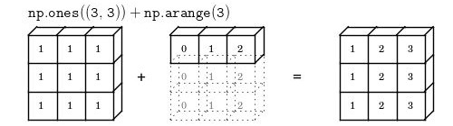
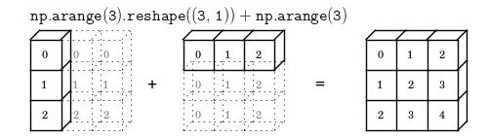
Second rule of Broadcasting

Slide 56
Second rule of Broadcasting
On adding a 2D array of shape (2,1) to a 2D ndarray of shape (2, 3). NumPy will apply the second rule of broadcasting
>>> | k | = | np.arange(6).reshape(2, | 3)
>>> | k
array([[0, |  |  |  | 1, | 2],
[3, |  |  |  | 4, | 5]])
>>> | k | + | [100, |  | 200, | 300]
array([[100, |  |  |  |  | 201, | 302],
[103, |  |  |  |  | 204, | 305]])

Slide 57
Mathematical and statistical functions on NumPy arrays

Slide 58
Finding Mean of NumPy array elements
The ndarray object has a method mean() which finds the mean of all the elements in the array regardless of the shape of the numpy array.
>>> a = np.array([[-2.5, 3.1, 7], [10, 11, 12]])
>>> print("mean =", a.mean()) mean = 6.76666666667

Slide 59
Other useful ndarray methods
Similar to mean there are other ndarray methods which can be used for various computations.
min - returns the minimum element in the ndarray max - returns the maximum element in the ndarray sum - returns the sum of the elements in the ndarray
prod - returns the product of the elements in the ndarray std - returns the standard deviation of the elements in the ndarray.
var - returns the variance of the elements in the ndarray.

Slide 60
Other useful ndarray methods
>>> a = np.array([[-2.5, 3.1, 7], [10, 11, 12]])
>>> for func in (a.min, a.max, a.sum, a.prod, a.std, a.var):
print(func. name , "=", func())
min | = | -2.5
max | = | 12.0
sum | = | 40.6
prod | = | -71610.0
std | = | 5.08483584352
var | = | 25.8555555556

Slide 61
Summing across different axes
We can sum across different axes of a numpy array by specifying the axis parameter of the sum function.
>>> c=np.arange(24).reshape(2,3,4)
>>> c
array([[[ | 0, | 1, | 2, | 3],
[ | 4, | 5, | 6, | 7],
[ | 8, | 9, | 10, | 11]],
[[12, |  | 13, | 14, | 15],
[16, |  | 17, | 18, | 19],
[20, |  | 21, | 22, | 23]]])

Slide 62
Summing across different axes
>>> c.sum(axis=0) # sum across matrices array([[12, 14, 16, 18],
[20, | 22, | 24, | 26],
[28, | 30, | 32, | 34]])

Slide 63
Transposing Matrices
The T attribute is equivalent to calling transpose() when the rank is ≥2
>>> | m1 | = | np.arange(6).reshape(2,3)
>>> | m1
array([[0, | 1, | 2],
[3, | 4, | 5]])
>>> m1.T
array([[0, | 3],
[1, | 4],
[2, | 5]])

Slide 64
Solving a system of linear scalar equations
The solve function solves a system of linear scalar equations, such as:
2x + 6y = 6
5x + 3y = -9

Slide 65
Solving a system of linear scalar equations
>>> | coeffs | = | np.array([[2, | 6], | [5, | 3]])
>>> | depvars | = | np.array([6, | -9])
>>> >>> | solution solution | = | linalg.solve(coeffs, |  |  | depvars)
array([-3.,
2.])

Slide 66
Solving a system of linear scalar equations
Let’s check the solution.
>>> coeffs.dot(solution), depvars (array([ 6., -9.]), array([ 6, -9]))

Slide 67
References
NumPy
https://docs.scipy.org/doc/

Slide 68
Pandas

Slide 69
What is Pandas?
One of the most widely used Python libraries in Data Science after NumPy and Matplotlib
The Pandas library Provides
High-performance
Easy-to-use data structures and
Data analysis tools

Slide 70
Pandas - DataFrame
The main data structure is the DataFrame
In memory 2D table
Like Spreadsheet with column names and row label

Slide 71
Pandas - Data Analysis
Many features available in Excel are available programmatically like
Creating pivot tables
Computing columns based on other columns
Plotting graphs

Slide 72
Pandas - Data Structures
Series objects
1D array, similar to a column in a spreadsheet
DataFrame objects
2D table, similar to a spreadsheet
Panel objects
Dictionary of DataFrames

Slide 73
Pandas - Series Objects
Creating a Series
>>> import pandas as pd
>>> s = pd.Series([2,-1,3,5])
Output -
0 2
1 -1
2 3
3 5
dtype: int64

Slide 74
Pandas - Series Objects
Pass as parameters to NumPy functions
>>> import numpy as np
>>> np.square(s)
Output -
0 4
1 1
2 9
3 25
dtype: int64

Slide 75
Pandas - Series Objects
Arithmetic operation on the series
>>> s + [1000,2000,3000,4000]
Output -
0 1002
1 1999
2 3003
3 4005
dtype: int64

Slide 76
Pandas - Series Objects
Arithmetic operation on the series
>>> s + [1000,2000,3000,4000]
Output -
0 1002
1 1999
2 3003
3 4005
dtype: int64

Slide 77
Pandas - Series Objects
Broadcasting
>>> s + 1000
Output -
0 1002
1 999
2 1003
3 1005
dtype: int64

Slide 78
Pandas - Series Objects
Binary and conditional operations
>>> s < 0
Output -
False
True
False
False dtype: bool

Slide 79
Pandas - Series Objects
Index labels - Integer location
>>> s2 = pd.Series([68, 83, 112, 68])
>>> print(s2)
Output -
0 68
1 83
2 112
3 68
dtype: int64

Slide 80
Pandas - Series Objects
Index labels - Set Manually
>>> s2 = pd.Series([68, 83, 112, 68],
index=["alice", "bob", "charles", "darwin"])
>>> print(s2)
Output -
alice 68
bob 83
charles 112
darwin 68 dtype: int64

Slide 81
Pandas - Series Objects
Access the items in series
By specifying integer location
>>> s2[1]
By specifying label
>>> s2["bob"]

Slide 82
Pandas - Series Objects
Access the items in series - Recommendations
Use the loc attribute when accessing by label
>>> s2.loc["bob"]
Use iloc attribute when accessing by integer location
>>> s2.iloc[1]

Slide 83
Pandas - Series Objects
Init from Python dict
>>> weights = {"alice": 68, "bob": 83, "colin": 86,
"darwin": 68}
>>> s3 = pd.Series(weights)
>>> print(s3)
Output |  | -
alice | 68
bob | 83
colin | 86
darwin | 68
dtype: int64

Slide 84
Pandas - Series Objects
Control the elements to include and specify their order
>>> s4 = pd.Series(weights, index = ["colin", "alice"])
>>> print(s4)
Output -
colin 86
alice 68 dtype: int64

Slide 85
Pandas - Series Objects
Automatic alignment
When an operation involves multiple Series objects
Pandas automatically aligns items by matching index labels

Slide 86
Pandas - Series Objects
Automatic alignment - example
>>> print(s2+s3)
Output -
alice bob charles colin darwin
136.0
166.0
NaN NaN 136.0
dtype: float64
* Note NaN

Slide 87
Pandas - Series Objects
Automatic alignment
Do not forget to set the right index labels, else you may get surprising results
>>> s5 = pd.Series([1000,1000,1000,1000])
>>> print(s2 + s5)
Output-
alice NaN
bob NaN charles NaN darwin NaN
NaN
NaN

Slide 88
Pandas - Series Objects
Init with a scalar
>>> meaning = pd.Series(42, ["life", "universe", "everything"])
>>> print(meaning)
Output-
life
42
universe 42
everything 42 dtype: int64
reachus@cloudxlab.com

Slide 89
Pandas - Series Objects
Series name - A Series can have a name
>>> s6 = pd.Series([83, 68], index=["bob", "alice"], name="weights")
>>> print(s6)
* Here series name is weights
Output-
bob 83
alice 68
Name: weights, dtype: int64
reachus@cloudxlab.com

Slide 90
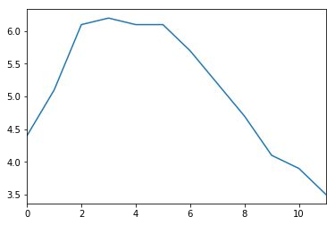
Pandas - Series Objects
Plotting a series
>>> | %matplotlib inline
>>> | import matplotlib.pyplot | as | plt
>>> | temperatures =
[4.4,5.1,6.1,6.2,6.1,6.1,5.7,5.2,4.7,4.1,3.9,3.5]
>>> s7 = pd.Series(temperatures, name="Temperature")
>>> s7.plot()
>>> plt.show()
reachus@cloudxlab.com

Slide 91
Pandas - DataFrame Objects
A DataFrame object represents
A spreadsheet,
With cell values,
Column names
And row index labels
Visualize DataFrame as dictionaries of Series
reachus@cloudxlab.com

Slide 92
Pandas - DataFrame Objects
Creating a DataFrame - Pass a dictionary of Series objects
>>> people_dict = {
"weight": pd.Series([68, 83, 112],index=["alice", "bob", "charles"]),
"birthyear": pd.Series([1984, 1985, 1992], index=["bob", "alice", "charles"], name="year"),
"children": pd.Series([0, 3], index=["charles", "bob"]),
"hobby": pd.Series(["Biking", "Dancing"], index=["alice", "bob"]),
}
reachus@cloudxlab.com

Slide 93
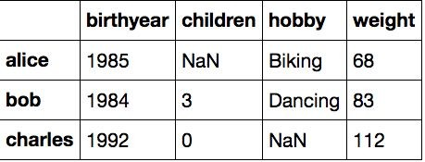
Pandas - DataFrame Objects
Creating a DataFrame
>>> | people | = | pd.DataFrame(people_dict)
>>> | people
reachus@cloudxlab.com

Slide 94
Pandas - DataFrame Objects
Creating a DataFrame - Important Notes
The Series were automatically aligned based on their index
Missing values are represented as NaN
Series names are ignored (the name "year" was dropped)
reachus@cloudxlab.com

Slide 95
Pandas - DataFrame Objects
DataFrame - Access a column
>>> people["birthyear"]
Output -
alice bob charles
1985
1984
1992
Name: birthyear, dtype: int64
reachus@cloudxlab.com

Slide 96
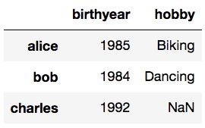
Pandas - DataFrame Objects
DataFrame - Access the multiple columns
>>> people[["birthyear", "hobby"]]
Output -
reachus@cloudxlab.com

Slide 97
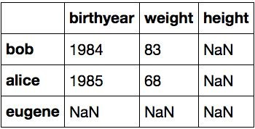
Pandas - DataFrame Objects
Creating DataFrame - Include columns and/or rows and guarantee order
>>> d2 = pd.DataFrame(
people_dict,
columns=["birthyear", "weight", "height"], index=["bob", "alice", "eugene"]
)
>>> print(d2)
reachus@cloudxlab.com

Slide 98
Pandas - DataFrame Objects
DataFrame - Accessing rows
Using loc
people.loc["charles"]
Using iloc
People.iloc[2]
Output -
birthyear | 1992
children | 0
hobby | NaN
weight | 112
Name: charles, dtype: object
reachus@cloudxlab.com

Slide 99
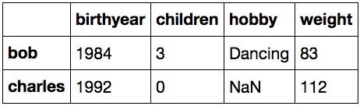
Pandas - DataFrame Objects
DataFrame - Get a slice of rows
>>> people.iloc[1:3]
Output -
reachus@cloudxlab.com

Slide 100
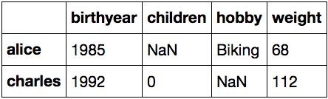
Pandas - DataFrame Objects
DataFrame - Pass a boolean array
>>> people[np.array([True, False, True])]
Output -

Slide 101
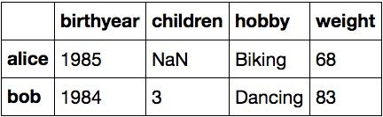
Pandas - DataFrame Objects
DataFrame - Pass boolean expression
>>> people[people["birthyear"] < 1990]
Output -

Slide 102
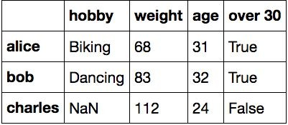
Pandas - DataFrame Objects
DataFrame - Adding and removing columns
>>> # Adds a new column "age"
>>> people["age"] = 2016 - people["birthyear"]
>>> # Adds another column "over 30"
>>> people["over 30"] = people["age"] > 30
>>> # Removes "birthyear" and "children" columns
>>> birthyears = people.pop("birthyear")
>>> del people["children"]
>>> people
reachus@cloudxlab.com

Slide 103
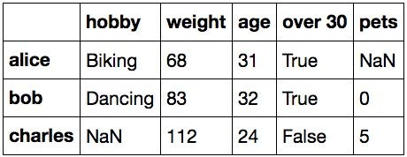
Pandas - DataFrame Objects
DataFrame - A new column must have the same number of rows
>>> # alice is missing, eugene is ignored
>>> people["pets"] = pd.Series({ "bob": 0,
"charles": 5, "eugene":1
})
>>> people
reachus@cloudxlab.com

Slide 104
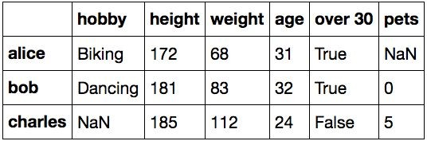
Pandas - DataFrame Objects
DataFrame - Add a new column using insert method after an existing column
>>> | people.insert(1, | "height", | [172, | 181, | 185])
>>> | people
reachus@cloudxlab.com

Slide 105
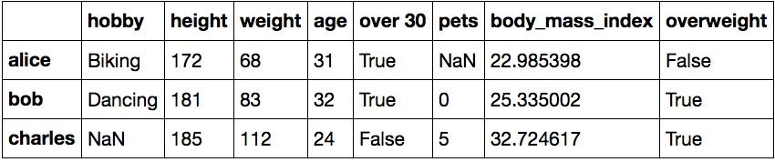
Pandas - DataFrame Objects
DataFrame - Add new columns using assign method
>>> (people
.assign(body_mass_index = lambda df:df["weight"]
/ (df["height"] / 100) ** 2)
.assign(overweight = lambda df: df["body_mass_index"] > 25)
)
reachus@cloudxlab.com

Slide 106
Pandas - DataFrame Objects
DataFrame - Sorting a DataFrame
Use sort_index method
It sorts the rows by their index label
In ascending order
Reverse the order by passing ascending=False
Returns a sorted copy of DataFrame

Slide 107
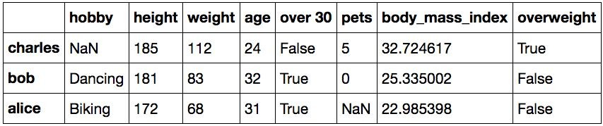
Pandas - DataFrame Objects
DataFrame - Sorting a DataFrame
>>> people.sort_index(ascending=False)

Slide 108
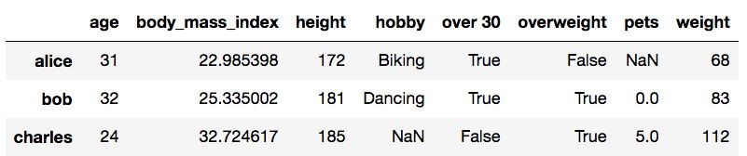
Pandas - DataFrame Objects
DataFrame - Sorting a DataFrame - inplace argument
>>> people.sort_index(inplace=True)
>>> people
reachus@cloudxlab.com

Slide 109
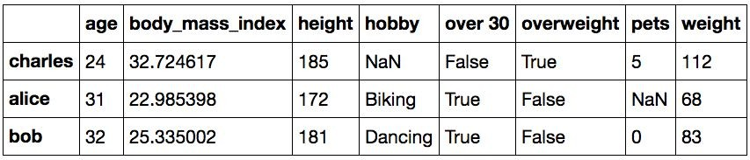
Pandas - DataFrame Objects
DataFrame - Sorting a DataFrame - Sort By Value
>>> people.sort_values(by="age", inplace=True)
>>> people
reachus@cloudxlab.com

Slide 110
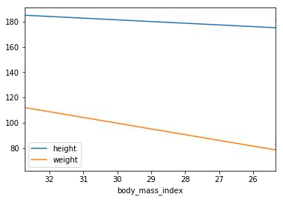
Pandas - DataFrame Objects
Plotting a DataFrame
>>> people.plot(
kind = "line",
x = "body_mass_index", y = ["height", "weight"]
)
>>> plt.show()
reachus@cloudxlab.com

Slide 111
Pandas - DataFrame Objects
DataFrames - Saving and Loading
Pandas can save DataFrames to various backends such as
CSV
Excel (requires openpyxl library)
JSON
HTML
SQL database
reachus@cloudxlab.com

Slide 112
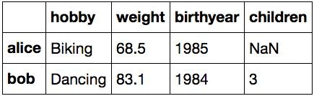
Pandas - DataFrame Objects
DataFrames - Saving
Let’s create a new DataFrame my_df and save it in various formats
>>> my_df = pd.DataFrame( [
],
columns=["hobby","weight","birthyear","children"], index=["alice", "bob"]
)
>>> my_df
["Biking", | 68.5, | 1985, | np.nan],
["Dancing", | 83.1, | 1984, | 3]
reachus@cloudxlab.com

Slide 113
Pandas - DataFrame Objects
DataFrames - Saving
Save to CSV
>>> my_df.to_csv("my_df.csv")
Save to HTML
>>> my_df.to_html("my_df.html")
Save to JSON
>>> my_df.to_json("my_df.json")
reachus@cloudxlab.com

Slide 114
Pandas - DataFrame Objects
DataFrames - What was saved?
>>> for filename in ("my_df.csv", "my_df.html", "my_df.json"):
print("#", filename)
with open(filename, "rt") as f: print(f.read())
print()
reachus@cloudxlab.com

Slide 115
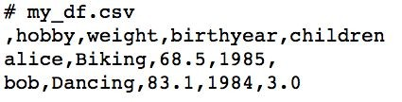
Pandas - DataFrame Objects
DataFrames - What was saved?
Note that the index is saved as the first column (with no name) in a CSV file
reachus@cloudxlab.com

Slide 116
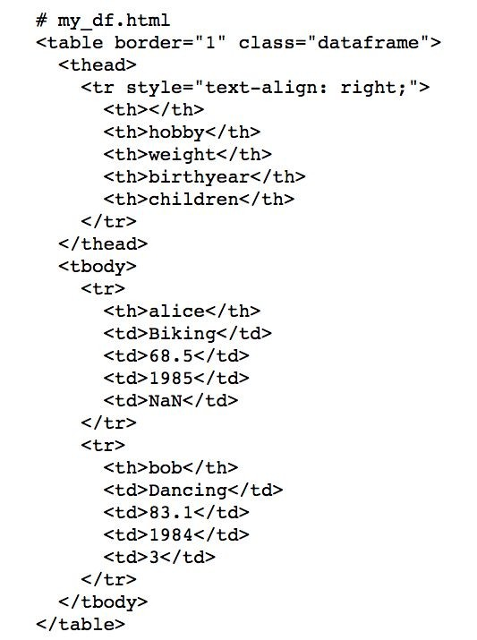
Pandas - DataFrame Objects
DataFrames - What was saved?
Note that the index is saved as <th> tags in HTML
reachus@cloudxlab.com

Slide 117
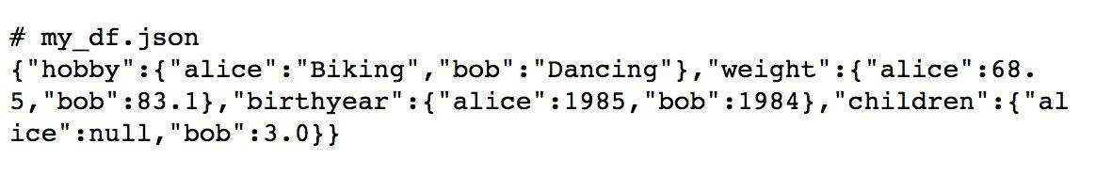
Pandas - DataFrame Objects
DataFrames - What was saved?
Note that the index is saved as keys in JSON
reachus@cloudxlab.com

Slide 118
Pandas - DataFrame Objects
DataFrames - Loading
read_csv # For loading CSV files
read_html # For loading HTML files
read_excel # For loading Excel files
reachus@cloudxlab.com

Slide 119
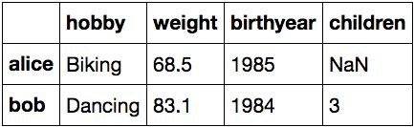
Pandas - DataFrame Objects
DataFrames - Load CSV file
>>> my_df_loaded = pd.read_csv("my_df.csv", index_col=0)
>>> my_df_loaded
reachus@cloudxlab.com

Slide 120
Pandas - DataFrame Objects
DataFrames - Overview
When dealing with large DataFrames, it is useful to get a quick overview of its content
Load housing.csv inside dataset directory to create a DataFrame and get a quick overview
reachus@cloudxlab.com

Slide 121
Pandas - DataFrame Objects
DataFrames - Overview
Let’s understand below methods
head()
tail()
info()
describe()
reachus@cloudxlab.com

Slide 122
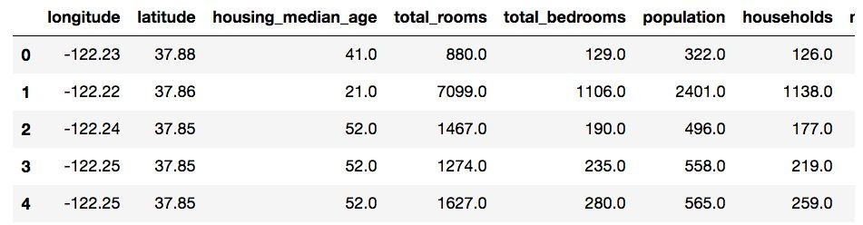
Pandas - DataFrame Objects
DataFrames - Overview - head()
The head method returns the top 5 rows
>>> housing = pd.read_csv("dataset/housing.csv")
>>> housing.head()
reachus@cloudxlab.com

Slide 123
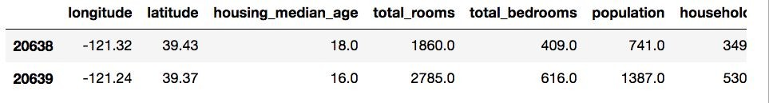
Pandas - DataFrame Objects
DataFrames - Overview - tail()
The tail method returns the bottom 5 rows
We can also pass the number of rows we want
>>> housing.tail(n=2)
reachus@cloudxlab.com

Slide 124
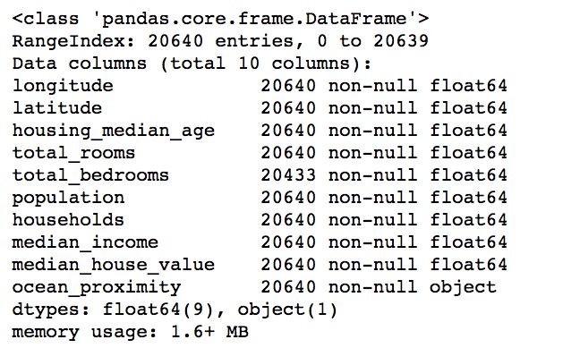
Pandas - DataFrame Objects
DataFrames - Overview - info()
The info method prints out the summary of each column's contents
>>> housing.info()
reachus@cloudxlab.com

Slide 125
Pandas - DataFrame Objects
DataFrames - Overview - describe()
The describe method gives a nice overview of the main aggregated values over each column
count: number of non-null (not NaN) values
mean: mean of non-null values
std: standard deviation of non-null values
min: minimum of non-null values
25%, 50%, 75%: 25th, 50th and 75th percentile of non-null values
max: maximum of non-null values
reachus@cloudxlab.com

Slide 126
References
Pandas
http://pandas.pydata.org/pandas-docs/stable/
reachus@cloudxlab.com

Slide 127
Matplotlib
reachus@cloudxlab.com

Slide 128
Matplotlib - Overview
Matplotlib is a Python 2D plotting library
Produces publication quality figures in a variety of
Hardcopy formats and
Interactive environments
reachus@cloudxlab.com

Slide 129
Matplotlib - Overview
Matplotlib can be used in
Python scripts
Python and IPython shell
Jupyter notebook
Web application servers
GUI toolkits
reachus@cloudxlab.com

Slide 130
Matplotlib - pyplot Module
matplotlib.pyplot
Collection of functions that make matplotlib work like MATLAB
Majority of plotting commands in pyplot have MATLAB analogs with similar arguments
reachus@cloudxlab.com

Slide 131
Matplotlib - pyplot Module
matplotlib.pyplot
Collection of functions that make matplotlib work like MATLAB
Majority of plotting commands in pyplot have MATLAB analogs with similar arguments
reachus@cloudxlab.com

Slide 132

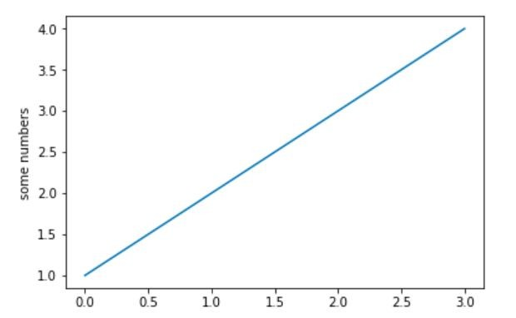
Matplotlib - pyplot Module - plot()
>>> import matplotlib.pyplot as plt
>>> plt.plot([1,2,3,4])
>>> plt.ylabel('some numbers')
>>> plt.show()

Slide 133
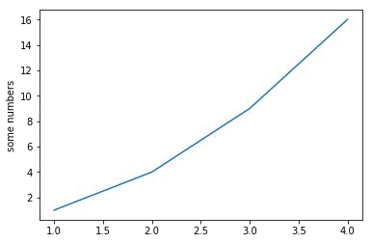
Matplotlib - pyplot Module - plot()
plot x versus y
>>> import matplotlib.pyplot as plt
>>> plt.plot([1, 2, 3, 4], [1, 4, 9, 16])
>>> plt.ylabel('some numbers')
>>> plt.show()
reachus@cloudxlab.com

Slide 134
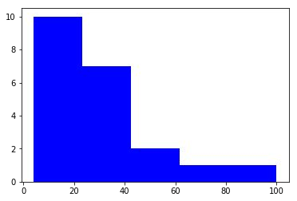
Matplotlib - pyplot Module - Histogram
>>> import matplotlib.pyplot as plt
>>> x = [21,22,23,4,5,6,77,8,9,10,31,32,33,34,35,36,37,18,49,50,
100]
>> num_bins = 5
>> | plt.hist(x, | num_bins, | facecolor='blue')
>> | plt.show()
reachus@cloudxlab.com

Slide 135
References
Matplotlib
https://matplotlib.org/tutorials/index.html
reachus@cloudxlab.com

