Slide 1
🚀 Technology Stack Overview
🎨 Frontend (Client)
Core: React 19 (Latest) + Vite (Lightning fast build tool)
Routing: React Router 7 (Modern SPA navigation)
Styling: Custom CSS3 (Glassmorphism design system)
Icons: Lucide React (Clean, vector-based iconography)
Networking: Axios (Promise-based HTTP client)
⚙️ Backend (Server)
Runtime: Node.js (High-performance JS runtime)
Framework: Express.js (Minimalist API routing)
Database: MongoDB Atlas (Scalable NoSQL cloud database)
Storage: Mongoose (Elegant Object Data Modeling)
🛡️ Security & Scalability
Auth: JSON Web Tokens (JWT) (Stateless secure authentication)
Encryption: Bcrypt.js (Industry-standard password hashing)
Environment: Dotenv (Strict secret/config management)
☁️ Deployment & Infrastructure
Hosting: Render (Automated CI/CD workflows)
Version Control: Git (Collaborative source management)

Slide 2
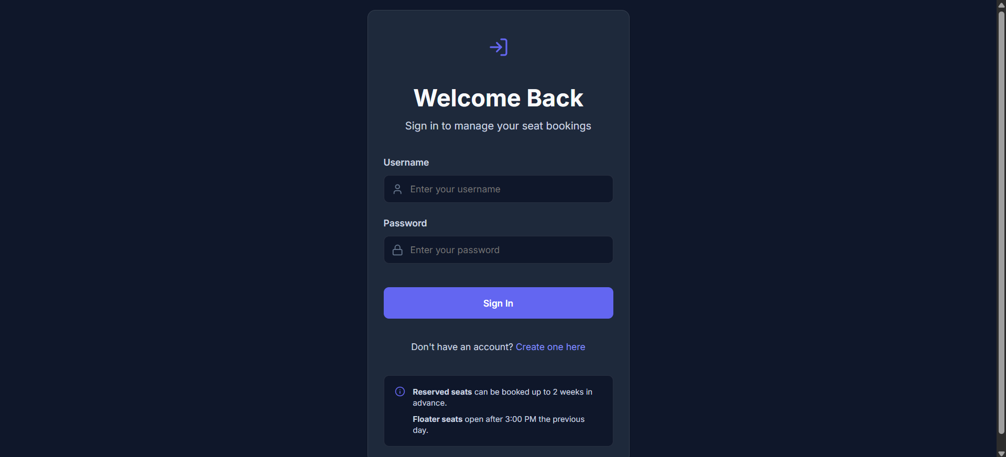

Slide 3
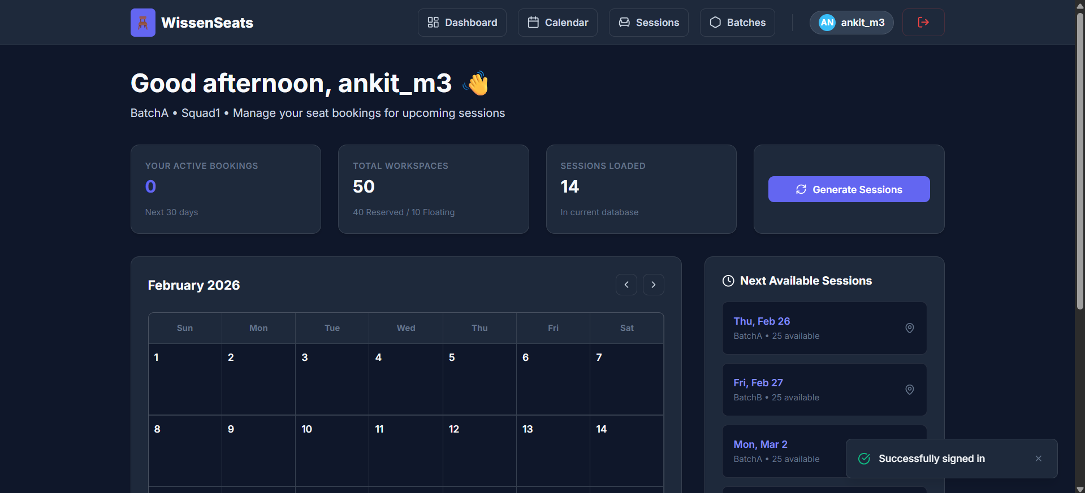

Slide 4
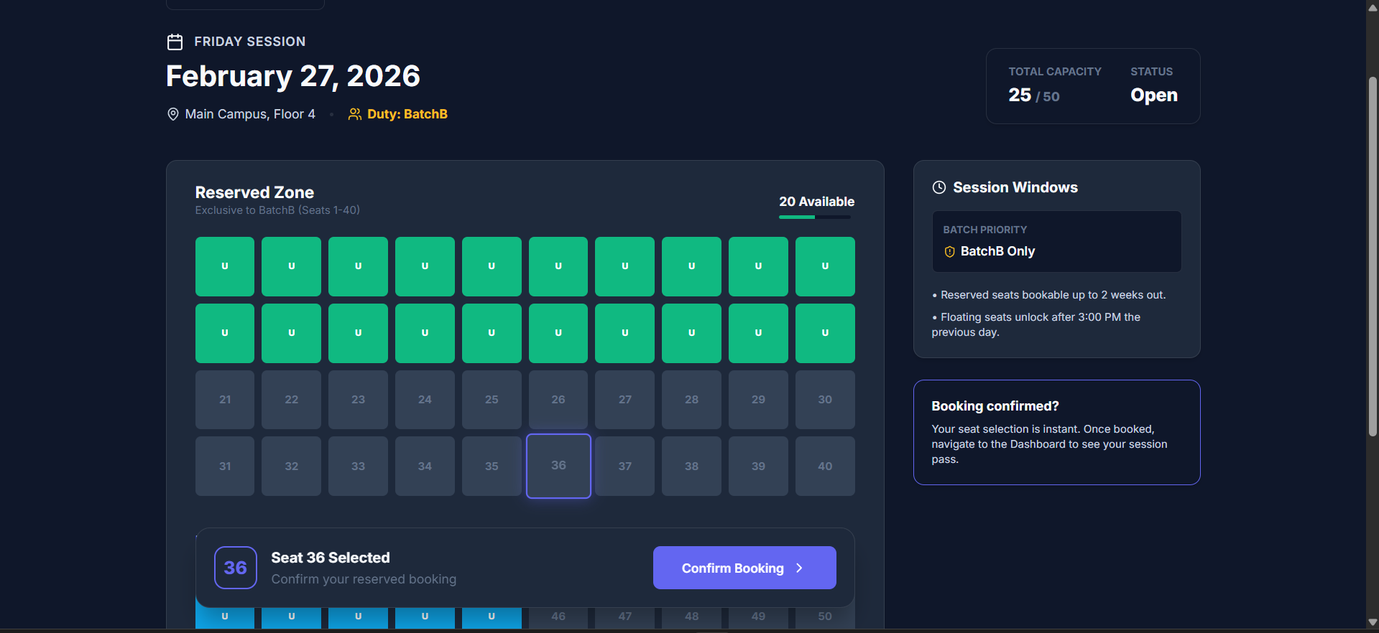

Slide 5
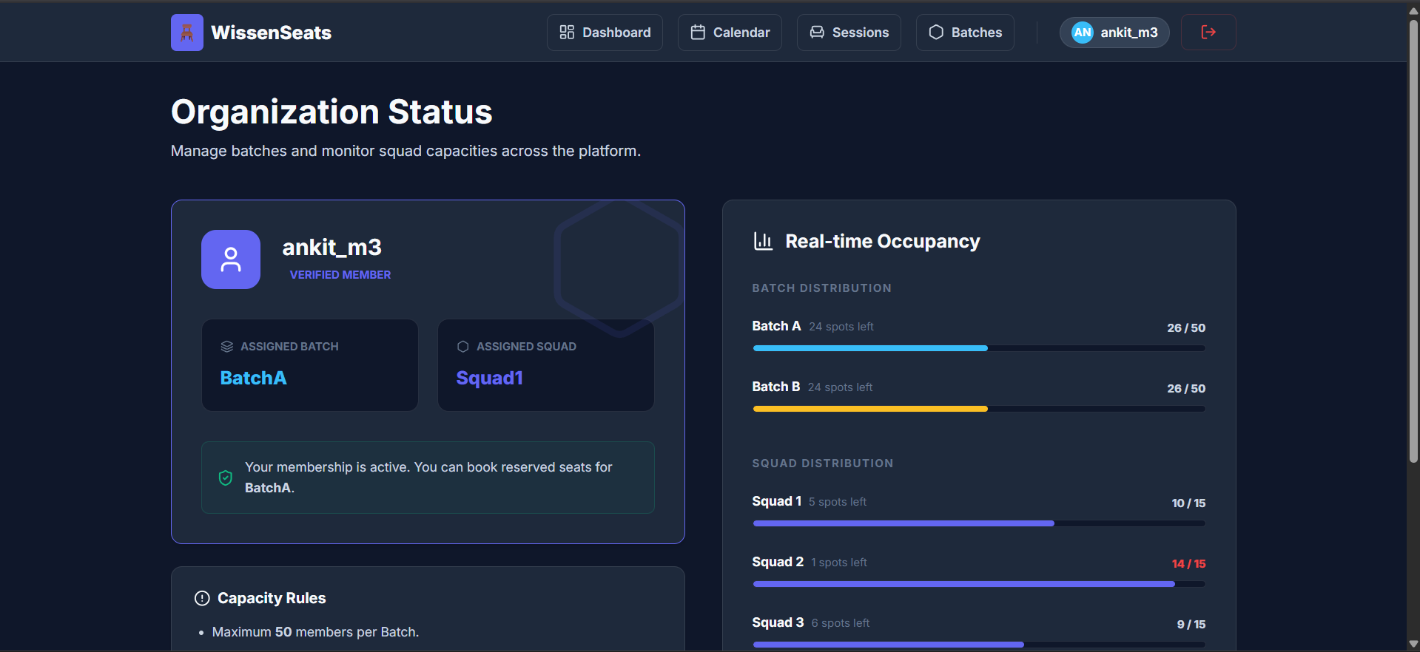

Slide 6
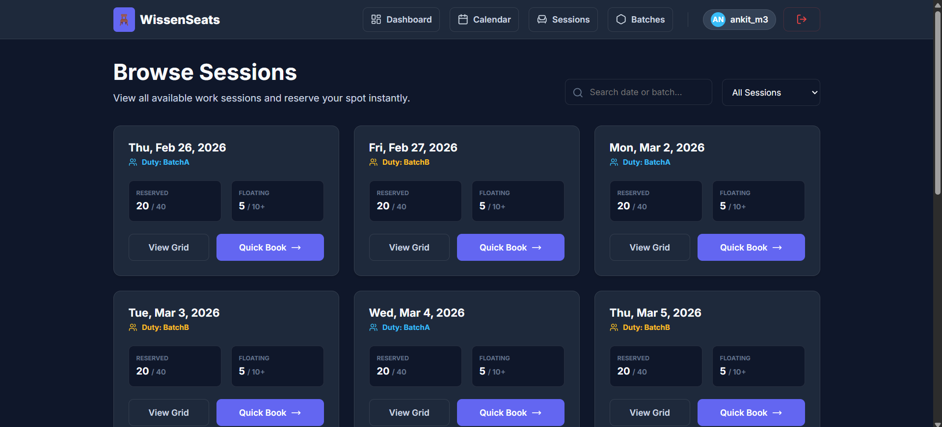

Slide 7
