Slide 1
COEN 275-1 Object Oriented Analysis Design Programming Online Banking System
Ankit Malasi ( W1652459 )
Deep Savla ( W1652329 )
Soham Mehta ( W1650151 )

Slide 2
Problem Statement
The goal of the project is to design a banking system, where users should be able to create an account with an initial balance then should be able to send or receive money using the bank details.
Design and implementation should be in MVC framework.
Backend database to address scalability

Slide 3
Requirement Analysis
General requirements:
Compliance with financial regulations.
Ensuring data integrity through regular backups and similar measures.
Designing a scalable system that performs well under increasing load.
User Registration and Login:
Functional Requirements:
Allowing new users to register by providing required details.
Support for user authentication and secure login
Admins should have access to a dashboard for managing user accounts
Non-Functional Requirements
Storing user data securely.
User-friendly and straightforward registration and login process.
Highly secure admin access.
Intuitive dashboards for ease of use.

Slide 4
Requirement Analysis
Account Management:
Functional Requirements:
Ability for users to open accounts.
Ability for users to view balance and personal information.
Non-Functional Requirements
Reliable and error free account management operations.
System must be able to handle growing number of accounts.
Transactions:
Functional Requirements:
System must enable users to transfer funds between accounts.
Handling of transactions securely and inclusion of verification details for transactions.
Non-Functional Requirements
Transactions must be conducted securely, with safeguards against unauthorized access.
Transactions should be processed promptly without unnecessary delays.

Slide 5
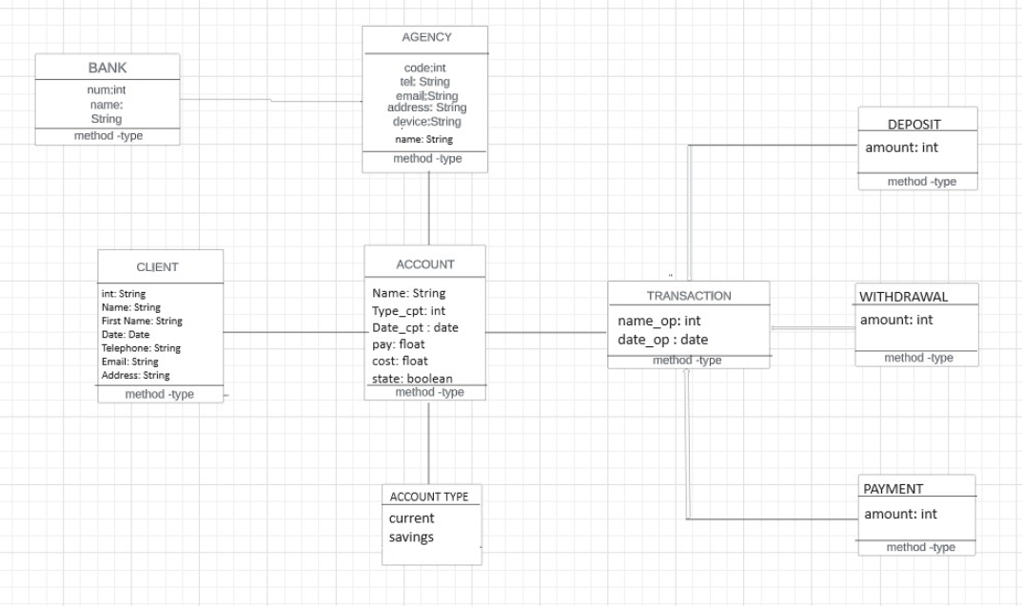
UML diagrams
Class diagram

Slide 6
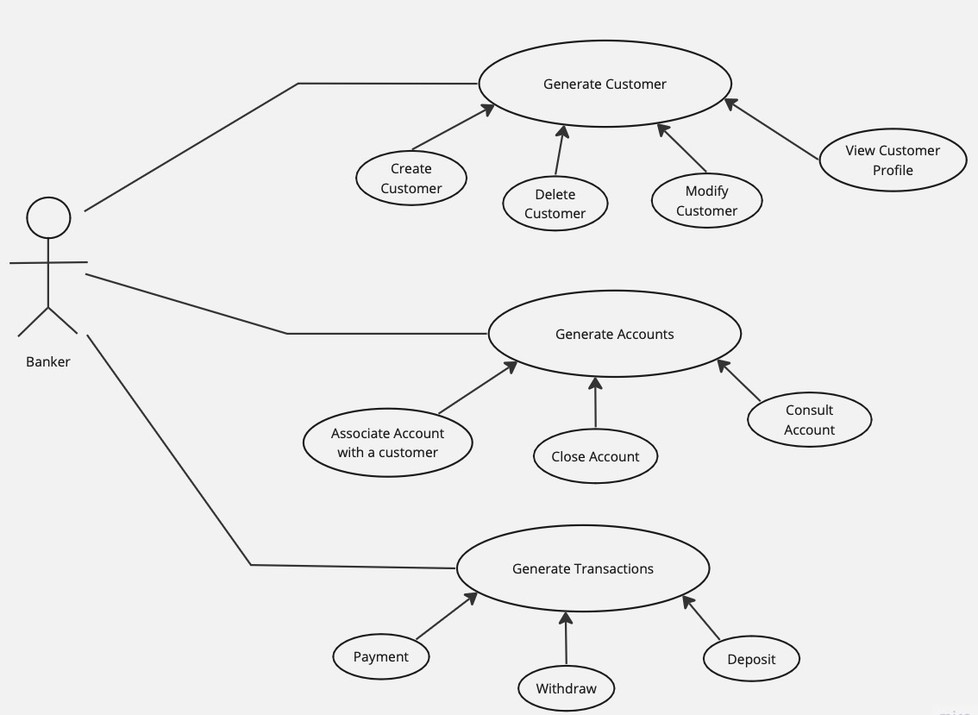
UML diagrams
Use case diagram

Slide 7
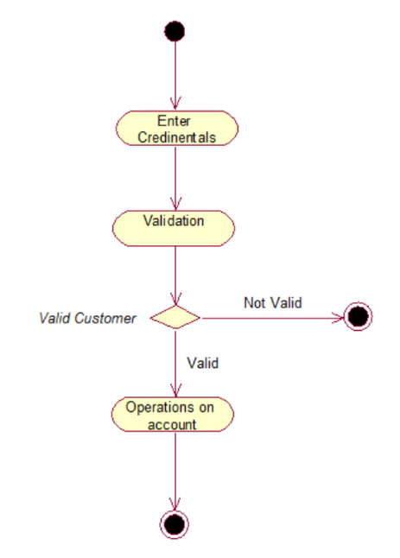
UML diagrams
Activity diagram

Slide 8
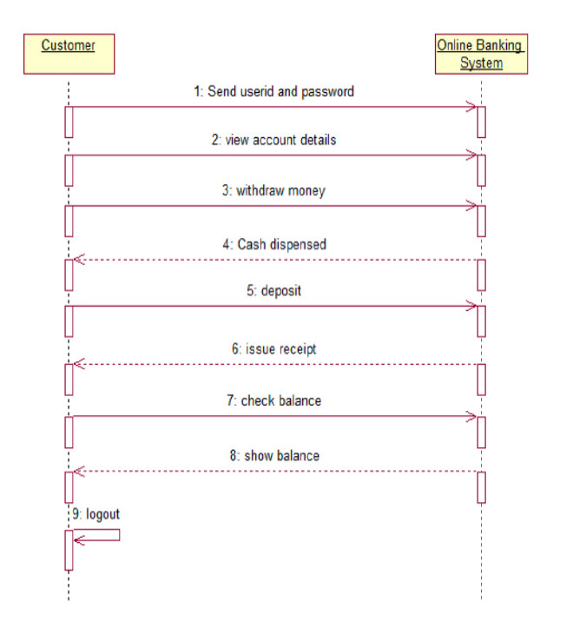
UML diagrams
Sequence diagram

Slide 9
OO Concepts used
Encapsulation:
Bundles data and methods into a single unit, like a class. Used in banking for customer and account data, ensuring security and access control.
Implementation: Achieved through private access modifiers and public methods.
Private variables like code, tel, address, in the ClientModel class, inaccessible directly from outside.
Public Methods include getters like getCode(), getName(), getTel(), getAddress, enabling controlled access to private data.
Abstraction and Security: Encapsulation hides internal object states, forces interaction through an interface of public methods.
Constructor Role: Takes parameters and assigns to private variables, setting data in a controlled manner.

Slide 10
OO Concepts used
Inheritance:
Facilitates a hierarchy of classes.
Allows new classes to inherit properties and methods from existing ones.
Implementation:
Hierarchy of account types (current and fixed) sharing common attributes and behaviors.
Helps to reuse common transaction attributes/methods (e.g., amount, date).
Role in OOP:
Promotes code reusability.
Enhances maintainability.

Slide 11
OO Concepts used
Modularity:
Breaks down systems into smaller, manageable modules/classes.
Implementation:
We have created modules for distinct functionalities like account management, customer service, transaction processing, reporting.
Benefits:
Improves code maintenance.
Helps in fault isolation.

Slide 12
OO Concepts used
Polymorphism:
Polymorphism in programming is the ability of objects of different classes to respond to the same method call in their own unique way.
Implementation:
We have developed distinct controller classes like HomeController.java, SidebarController.java, ClientController.java, TransactionController.java. Each controller has a unique role but shares common functionalities in the init method.
Benefits:
Facilitates easy integration of future additions or modifications..
Enhances flexibility, scalability, and consistency.
Allows efficient expansion and building upon existing controller classes.

Slide 13
Conclusion
Using OO concepts we were successfully able to design and implement an online banking system, where users were able to login and perform operations on their accounts.
Ideal requirement analysis was done in the initial phase of the project .
Implemented the project in MVC architectural pattern.
Model has the data and business logic.
View has the UI components
Controller acts as in interface between the model and view and contains the handlers for click and other operations.
Usage of a MySql database using JDBC, for ease of scalability to support large number of users.
Technologies Used:
Backend – Java
Frontend – Java Fx
Database - MySql

Slide 14
DEMO TIME
Thank You !

