Slide 1

KODERS

Slide 2
IDEA
Our website ‘INDRA’ is named after Indra, the Hindu God of weather. Indians in ancient times believed that a good crop yield was a blessing of Lord Indra. With the help of Machine Learning models and data set of two years, our team has been able to predict, with great accuracy, the weather patterns for the future. This is in turn helps us to predict the yield of crops. With our prediction model, good crop yield is no more a blessing or a curse!

Slide 3
Why we chose the idea?
With production decisions often made before prices are known, forecasts help farmers manage risk. Consumers benefit through the availability of high quality and reasonably priced food. Providing information on expected prices also helps to ensure that markets operate fairly. In addition, forecasts( predictions) are used to identify and form policy responses to emerging issues.
Our aim is to predict yield values based on input parameters provided for the last two years.
To put simply the crops aren’t supervised properly. This forecasting model can help us with finding the right area for our crop, further helping us control damage, which is amongst one of the reasons why we chose this idea.

Slide 4
Architecture
1. Time series model was implemented through python in google colab due to the strong processing power provided by servers.
2. In the Time series model, ARIMA(Autoregressive Integrated Moving Average) algorithm was not implemented since the dataset provided was seasonal and ARIMA algorithm’s prerequisite is the dataset should be stationary.
3. LSTM(long short-term memory network) algorithm was used to predict the already available dataset and was later compared to calculate the error.
4. Three separate programs were provided in the back-end, all dealt with comparing predictions with given datasets.
5. Data was first visualized(as explained in following slides) to provide a more consice and clear approach to the problem statement.

Slide 5
Information regarding datasets used.
The coordinates given were located on the outskirts of Patiala. The conclusions drawn were:-
1. Snowfall will be null throughout the year, thus not contributing to the crop yield.
2. CVI(chlorophyll vegetation index) was used to predict the yield of crops, since the chlorophyll content would drop significantly when wheat crop would approach harvest season, since the colour would change to dusky brown.
3. Due to extremely low sunlight during the winter seasons the CVI is low even though there is winter rainfall as observed from the graph.

Slide 6
Results achieved so far
We have been able to implement machine learning in our python code.
Using temperature as a test parameter, we have been able to accurately predict the temperature and cross check it with the given data table.
The accuracy we have reached to 99.1% in the worst case scenario.
This code provides a basic framework for implementing the other parameters and successfully predicting accurate yield for any crop.
Arima model was not deployed because our data set was seasonal.

Slide 7
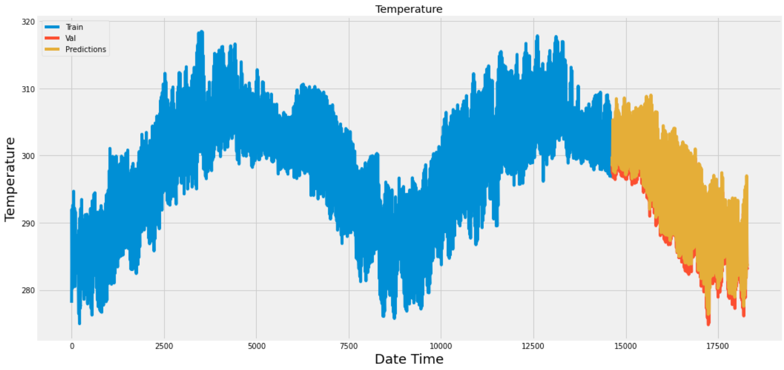

Slide 8
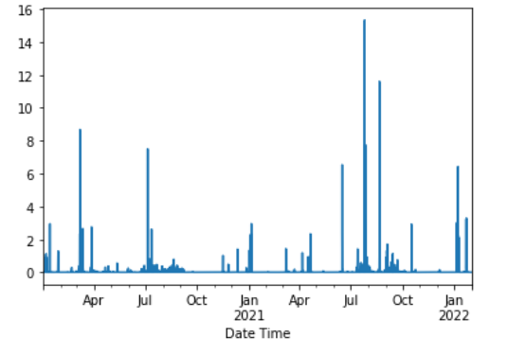
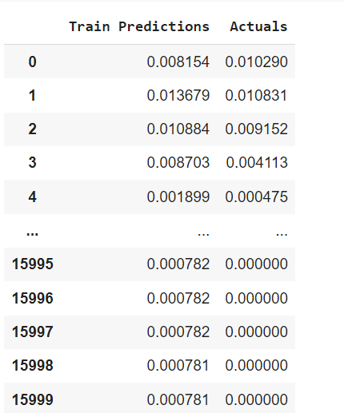

Slide 9
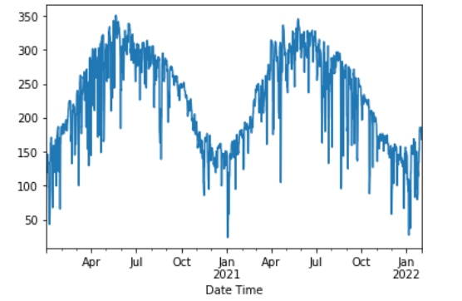
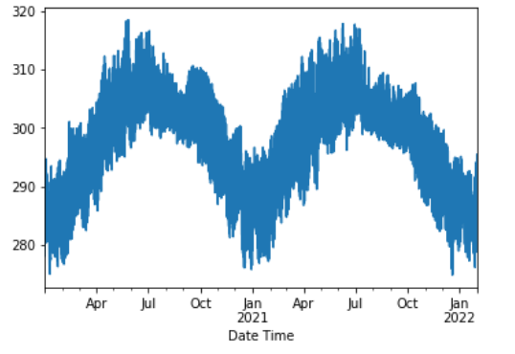
Radiation during day
Radiation at night

