Slide 1
Power System Fault Detection and Classification
CAPSTONE PROJECT
Presented By:
1. ANKIT MEENA-BIKANER TECHNICAL UNIVERSITY - CSE

Slide 2
OUTLINE
Problem Statement (Should not include solution)
Proposed System/Solution
System Development Approach (Technology Used)
Algorithm & Deployment
Result (Output Image)
Conclusion
Future Scope
References

Slide 3
Problem Statement
=>Power distribution systems are prone to various types of faults such as line-to-ground, line-to-line, and three-phase faults. These faults can disrupt power supply and reduce system reliability. The challenge lies in accurately detecting and classifying these faults using electrical measurement data (voltage, current, phasors) to differentiate them from normal operating conditions, thereby ensuring the stability of the power grid.

Slide 4
Proposed Solution
Develop a machine learning model that classifies power system faults using the dataset provided. The model will process electrical measurements to identify the type of fault rapidly and accurately. This classification will help automate fault detection and assist in quicker recovery actions, ensuring system reliability.
Key components:
Data Collection: Use the Kaggle dataset on power system faults.
Preprocessing: Clean and normalize the dataset.
Model Training: Train a classification model (e.g., Decision Tree, Random Forest, or SVM).
Evaluation: Validate the model using accuracy, precision, recall, and F1-score.:

Slide 5
System Approach
The "System Approach" section outlines the overall strategy and methodology for developing and implementing the rental bike prediction system. Here's a suggested structure for this section:
System requirements
=> IBM Cloud(mandatory).
=> IBM Watson AI studio for model development and deployment.
=> IBM cloud object storage for dataset handling.

Slide 6
Algorithm & Deployment
Algorithm Selection:
Random Forest Classifier (or SVM based on performance).
Data Input:
Voltage, current, and phasor measurements from the dataset.
Training Process:
Supervised learning using labeled fault types.
Prediction Process:
Model deployed on IBM Watson Studio with API endpoint for real-time predictions.

Slide 7
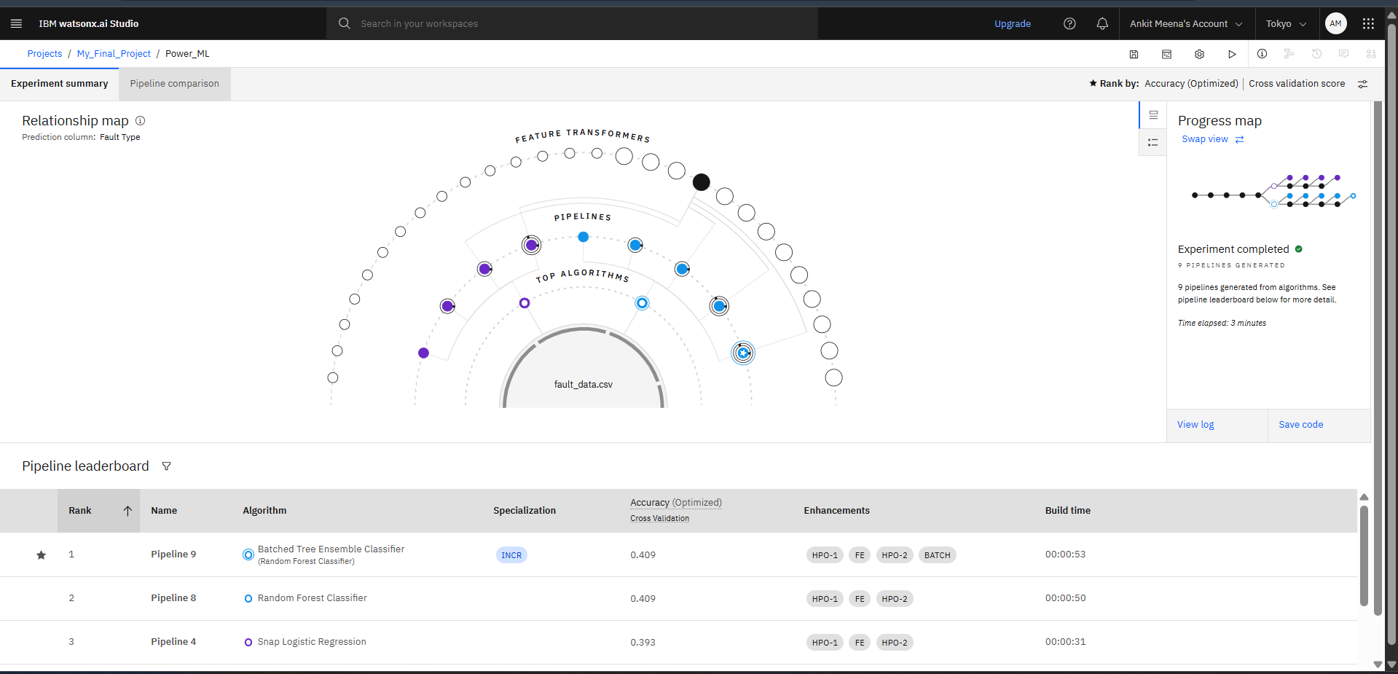
Result

Slide 8
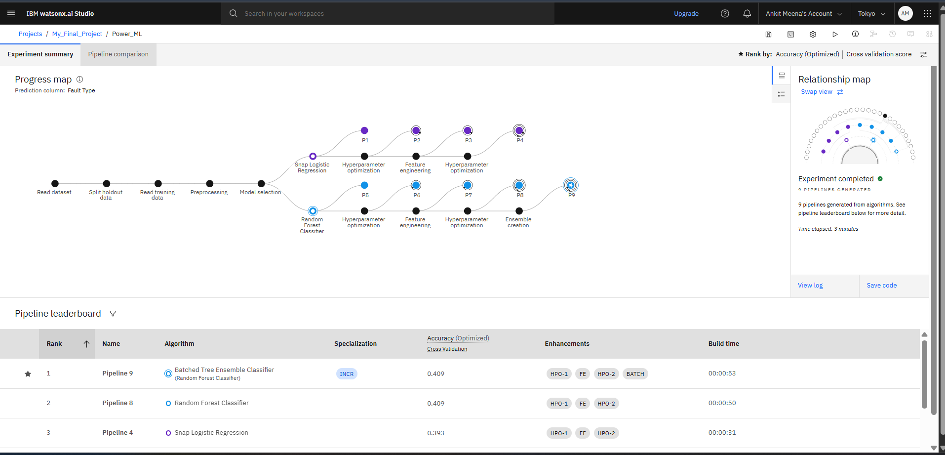
Result

Slide 9
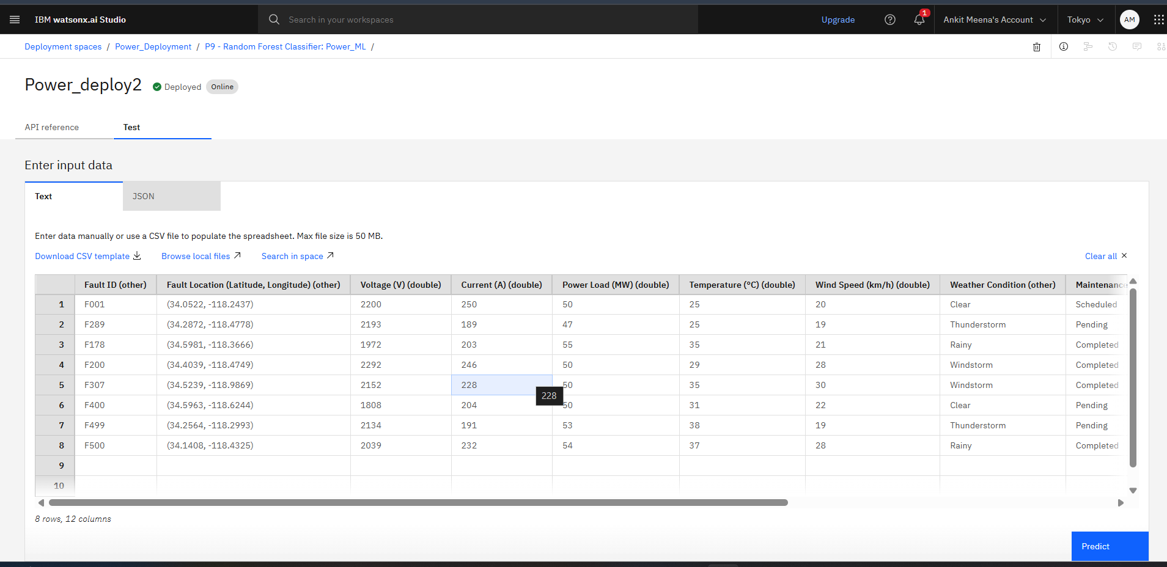
Result

Slide 10
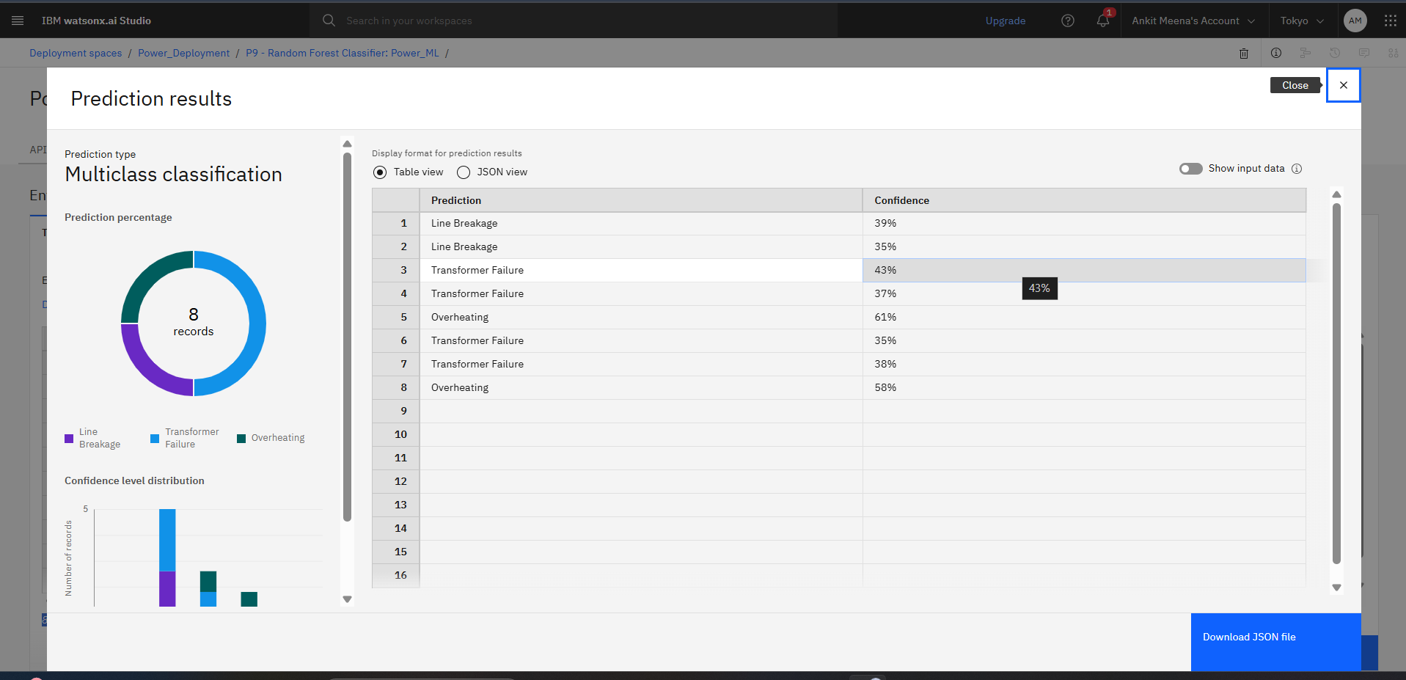
Result

Slide 11
Conclusion
The project demonstrates the use of machine learning — particularly classifiers like Random Forest or SVM — to detect and classify power system faults using electrical parameters such as voltage, current, and phasors.
The ML model was able to distinguish between different types of faults (like line-to-ground, line-to-line, three-phase) with good accuracy, aiding in faster fault identification and system recovery.
IBM Watson Studio was effectively used for model development and deployment, allowing real-time prediction through an API.
The solution shows strong potential to improve grid reliability by automating fault detection processes.

Slide 12
Future scope
The future scopes of this project is below -
Mobile & Cloud-Based Monitoring:
Create cloud APIs or mobile dashboards for engineers to remotely view fault predictions and take actions.
Use platforms like IBM Cloud, AWS, or Azure for large-scale deployment.
🔐 Fault Prediction + Cybersecurity:
Combine fault detection with grid cybersecurity monitoring to detect anomalies caused by cyber attacks or false data injection.
🧠 Hybrid Model Approaches
Combine rule-based logic + ML models to enhance accuracy and interpretability.
Apply ensemble techniques (e.g., combining SVM, RF, and XGBoost) to minimize error.
and many more etc……

Slide 13
References
IBM Watson Studio Documentation 📌 (Used as the platform for model training, evaluation, and deployment.) 🔗 https://www.ibm.com/docs/en/watson-studio
And many mores

Slide 14
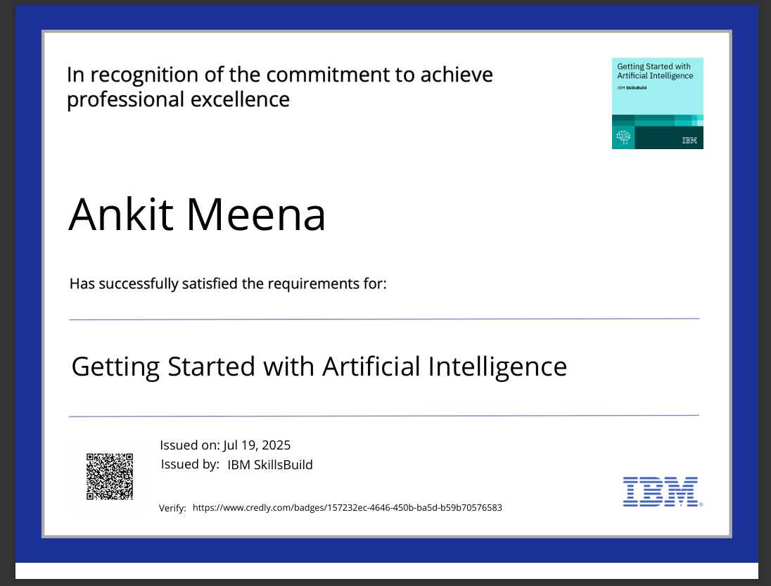
IBM Certifications

Slide 15
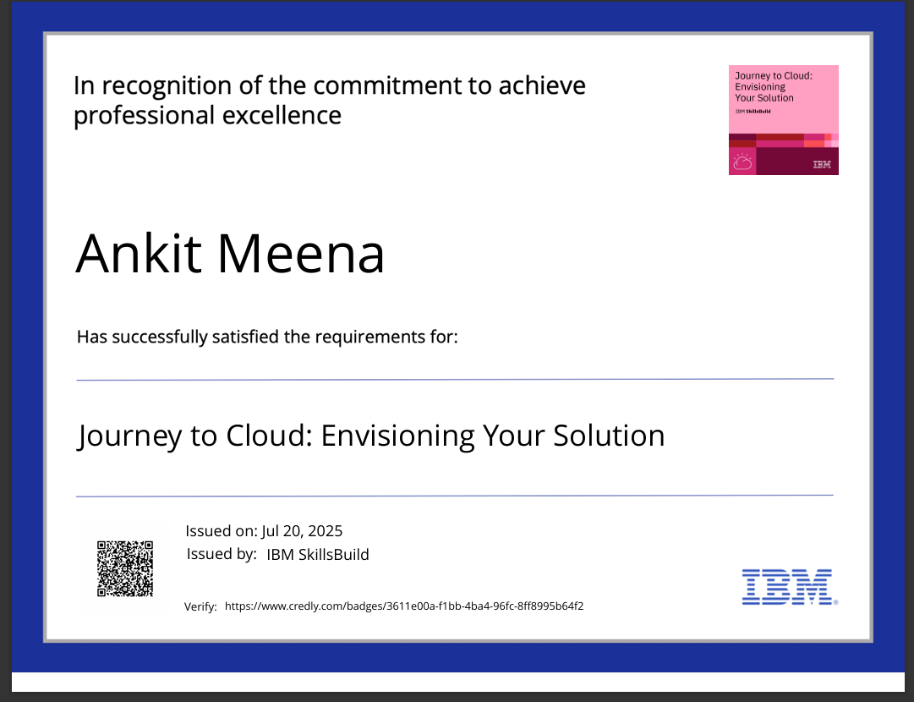
IBM Certifications

Slide 16
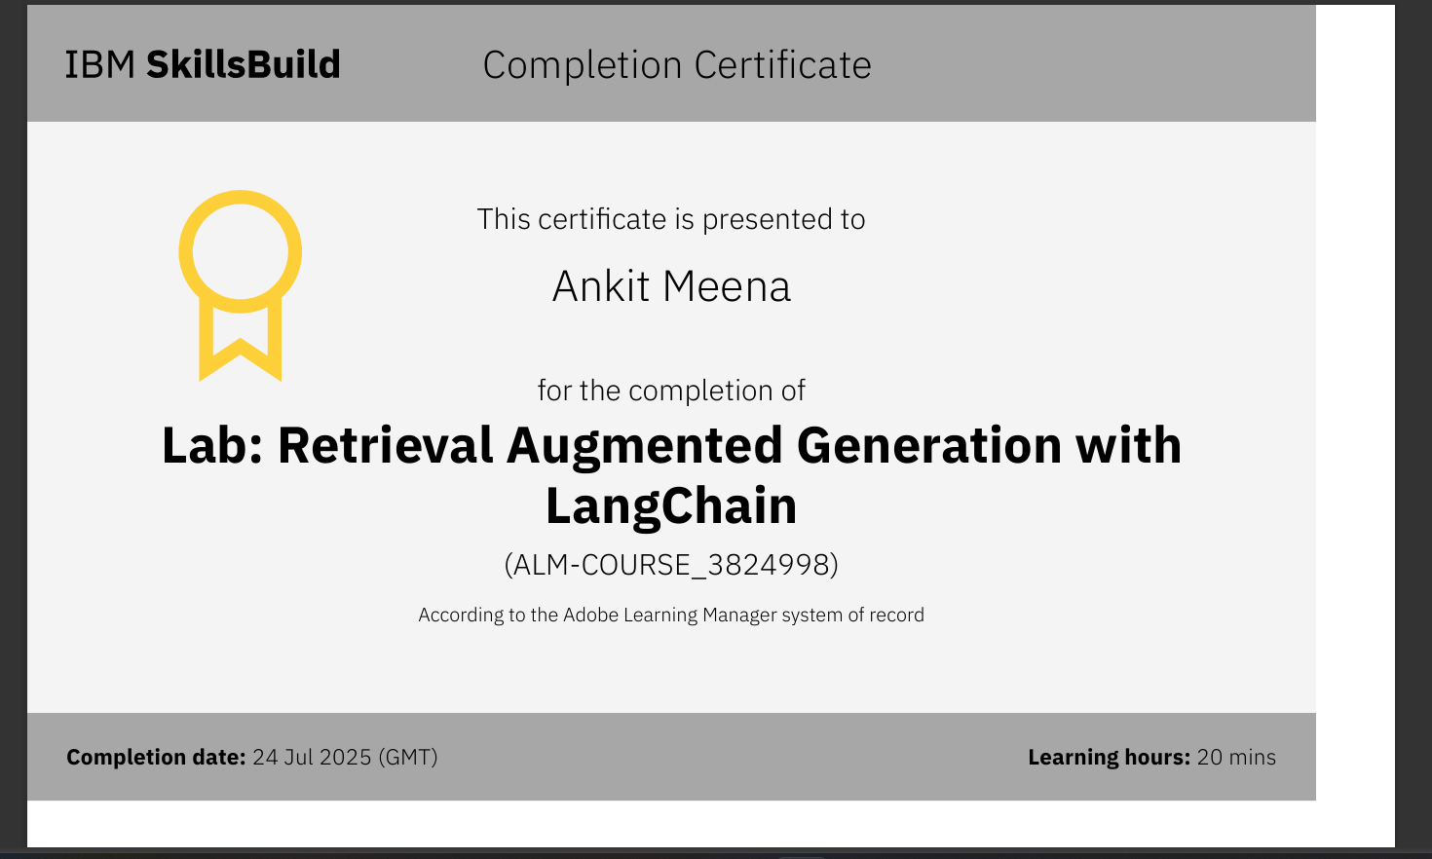
IBM Certifications

Slide 17
THANK YOU

