Slide 1
Better Retrieval for Generation
Ankit Saha - AI21BTECH11004
Pranav Balasubramanian - AI21BTECH11023

Slide 2
Problem Statement
What is Retrieval-Augmented Generation (RAG)?
To address the issue of Large Language Model (LLM) hallucinations and irrelevant outputs, we provide relevant information from a set of retrieved passages (related to the query) to provide the LLM with the necessary context to keep the answer grounded to the query being asked.
This project aims to develop better retrieval strategies that out-perform a set baseline in terms of retrieving.
Notes:
Change

Slide 3
MS MARCO Examples
query: what is rappelling
query_type: description
passages: “Rappelling is the process of coming down from a mountain that is usually done with two pieces of rope. Use a natural anchor or a set of bolts to rappel from with help from an experienced rock climber in this free video on rappelling techniques. Part of the Video Series: Rappelling & Rock Climbing.",
…………….
a descent of a vertical cliff or wall made by using a doubled rope that is fixed to a higher point and wrapped around the body. abseil. mountain climbing, mountaineering-the activity of climbing a mountain. descent-the act of changing your location in a downward direction."
answer: Rappelling is the process of coming down from a mountain that is usually done with two pieces of rope.

Slide 4
Retrieval Methodology
The set of all passages is stored in a FAISS vector database
An embedding model is used to first encode each passage
The encodings are then indexed and stored
We use the IndexFlatIP index, which indexes embeddings based on cosine similarity
Given a query, encode it using the same embedding model
Find its nearest neighbours efficiently in the embedding space using the index
These correspond to the passages with the highest cosine similarity with the query, and thus form our retrieved context (most relevant passages to the query)
Notes:
Same encoder for passages and query since we want vectors from same latent space

Slide 5
Embedding Models Tested
For each query, there are relevant passages with either zero or one passage out of them marked, denoting the passage that was used to generate the answer
We have tested the following embedding models and measured their top-1 and top-3 accuracies in terms of identifying the marked passage out of all the passages
The marked passage can be thought of as the best passage among the relevant passages
The following accuracies have been reported for a part of the training dataset because these marked labels are not present in the test dataset

Slide 6
Embedding Models Tested (contd.)
Model name | Top-1 accuracy | Top-3 accuracy
distilbert-base-uncased | 12.8248 | 36.7980
bert-base-uncased | 9.3880 | 28.1643
all-MiniLM-L6-v2 | 40.4023 | 75.3562
bge-large-en-v1.5 | 44.8449 | 78.2900
ms-marco-MiniLM-L-12-v2 (cross-encoder) | 49.7904 | 83.7385

Slide 7
Baseline
We have chosen the sentence transformer all-MiniLM-L6-v2 as the baseline because
Its embeddings have been optimized for tasks like clustering and semantic similarity unlike BERT and DistilBERT
It is fairly lightweight (22.7M parameters) enabling fast fine-tuning and embedding of all passages in the vector database
For evaluating the baseline, we have indexed all the 1,010,920 test dataset passages in the vector database and retrieved the top-K passages and computed the metrics mentioned in our first presentation for various values of K
The metrics have been computed considering the relevant passages for each query as the true positives

Slide 8
Baseline Metrics
K | Contextual Precision | Contextual Recall | Contextual Relevancy
3 | 0.7077 | 0.1719 | 0.5706
5 | 0.6983 | 0.2546 | 0.5072
10 | 0.6591 | 0.3824 | 0.3812
100 | 0.5074 | 0.6832 | 0.0681

Slide 9
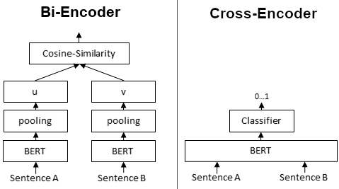
Improving the Baseline: Reranking
Cross-encoders do not give embeddings!

Slide 10
Baseline + Reranker
We first use the encoder baseline to fetch the 100 closest passages (out of 1,010,920) from the FAISS index
Then, we use ms-marco-MiniLM-L-6-v2, a cross-encoder model, which was trained on the MS-MARCO passage ranking dataset (different from our question-answering dataset)
The cross-encoder is used to rerank the top 100 passages based on the similarity score with the query, which is then used for retrieving the best (top-K) set of passages
There is a significant improvement observed in all the metrics

Slide 11
Baseline + Reranker Metrics
K | Contextual Precision | Contextual Recall | Contextual Relevancy
3 | 0.7564 | 0.1868 | 0.6202
5 | 0.7457 | 0.2805 | 0.5584
10 | 0.7045 | 0.4253 | 0.4237
100 | 0.5768 | 0.6832 | 0.0681

Slide 12
Improving the Baseline: Fine-Tuning (Initial Trials)
We have then fine-tuned the baseline retriever all-MiniLM-L6-v2 on our MS-MARCO dataset
We have used the TripletMarginWithDistanceLoss as the loss function with the distance as the cosine distance
Essentially, the loss takes a triplet as input: (anchor, positive, negative)
The model will try to minimize the distance between the anchor (query) and the positive (relevant passage) and maximize the distance between the anchor (query) and the negative (irrelevant passage)

Slide 13
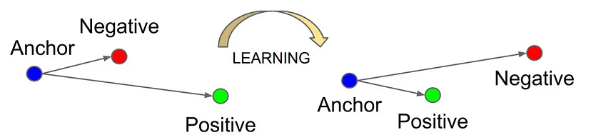

Triplet Margin With Distance Loss

Slide 14
Fine-tuning the Retriever (PyTorch)
We have used all the 10 relevant passages for each query as the positives to form the triplets
For negatives, we have randomly sampled passages corresponding to other queries
The margin has been set as 1.0
Adam optimizer with a learning rate of 1e-3 has been used
128,000 triplets were used for fine-tuning as of now

Slide 15
Fine-tuned + Reranker Metrics (PyTorch)
K | Contextual Precision | Contextual Recall | Contextual Relevancy
3 | 0.0006 | 0.00006 | 0.0002
5 | 0.0006 | 0.00006 | 0.0001
10 | 0.0006 | 0.00006 | 0.00006
100 | 0.0006 | 0.00008 | 0.000008
TripletLoss is highly sensitive to the choice of positive and negative samples.

Slide 16
Mixture of Experts

Slide 17
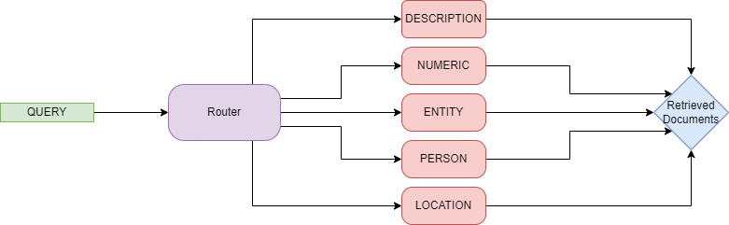
Mixture of experts

Slide 18
Adapter Fine-Tuning
The objective here is to freeze the embedding model, train an adapter (a smaller network) which transforms the current embedding space to another latent space (the domain specific space).
The adapter chosen is a TwoLayerNN, from the llama_index library used with the following parameters :
{
"in_features": 384,
"hidden_features": 512,
"out_features": 384,
"bias": true,
"activation_fn_str": "relu", "add_residual": true
}
Notes:
If out_features != in residual?

Slide 19
all-MiniLM-L6-v2
Sentence Transformer embedding model
384
dim
512
dim
384
dim
N

Slide 20
Adapter Fine-Tuning (contd.)
We then initialize the EmbeddingAdapterFinetuneEngine, an object to perform the fine tuning.
The fine tuning engine uses MyMultipleNegativesRankingLoss, which is similar to the MultipleNegativesRankingLoss in the Sentence Transformers library, but optimized for llama_index embeddings
Each query type’s retriever was fine-tuned for 10 epochs
The number of examples used for each query_type for fine tuning is as shown below:
NUM_EXAMPLES = {
'DESCRIPTION': 100000,
'NUMERIC': 100000,
'ENTITY': 63243,
'LOCATION': 46879,
'PERSON': 42800
}

Slide 21
The Router
The router is a classification network which forwards the incoming query to the best retriever.
Each query is classified into one of the five possible query types.
Was trained on ‘train-00005-of-00007.parquet’ , this was chosen since it had an almost equal portion of all query types which would help the router to distinguish between the query type.
The input to the network is the baseline embedding of the query by the sentence transformer model.
Loss function used: torch.nn.CrossEntropyLoss()

Slide 22
Router performance
input_dim = 384 (dimensionality of embedding)
output_dim = 5 (number of query types)
With 128 hidden dimensions, trained over 70 epochs:
Accuracy of router: 0.8837
With 256 hidden dimensions, trained over 70 epochs:
Accuracy of router: 0.8882
With 256 hidden dimensions, trained over 120 epochs:
Accuracy of router: 0.8928

Slide 23
Comparison of models

Slide 24
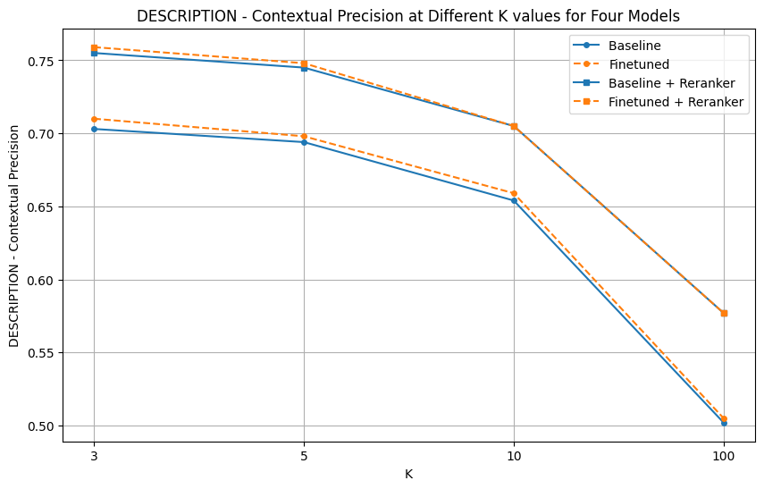
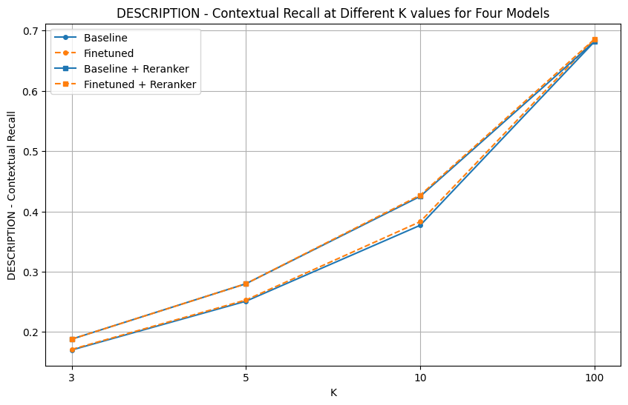
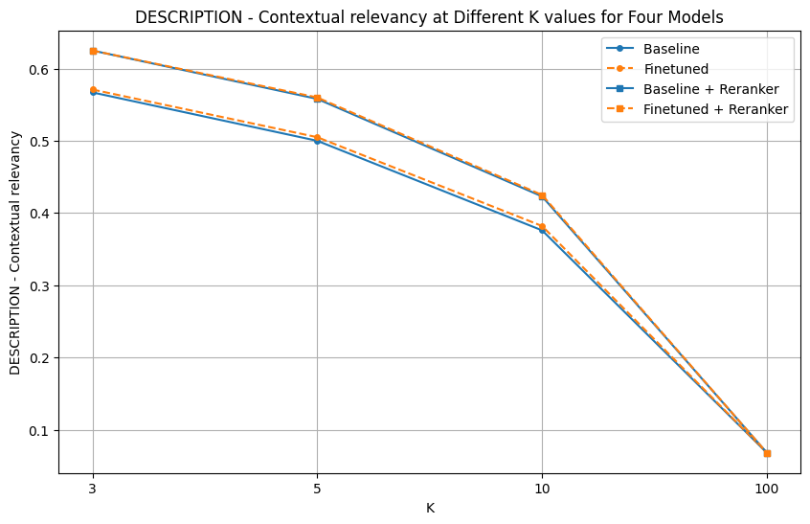
DESCRIPTION Queries

Slide 25
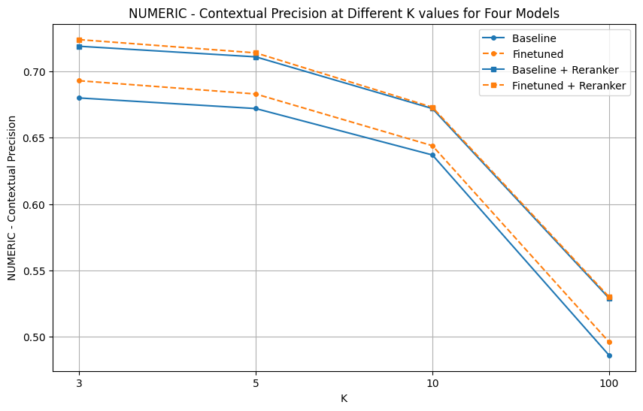
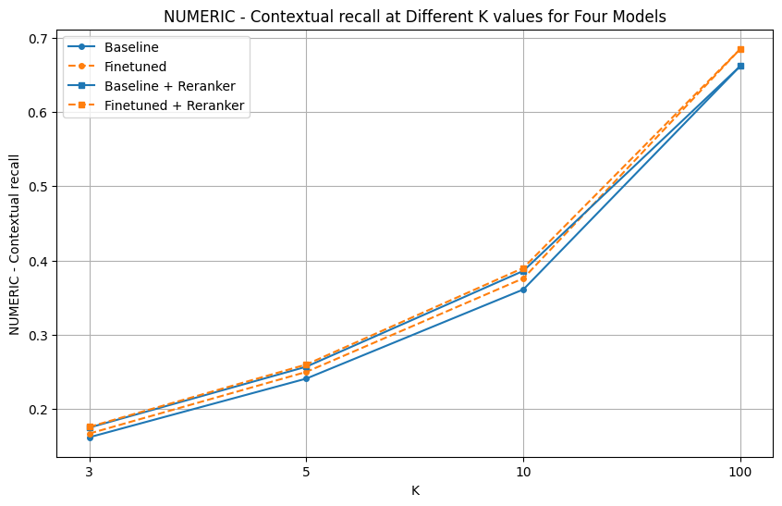
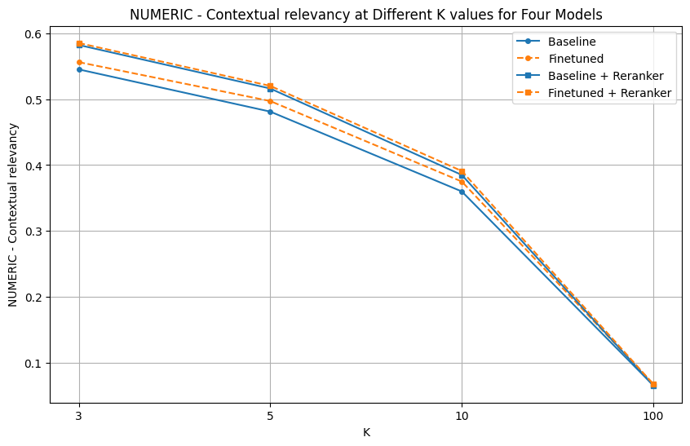
NUMERIC Queries

Slide 26
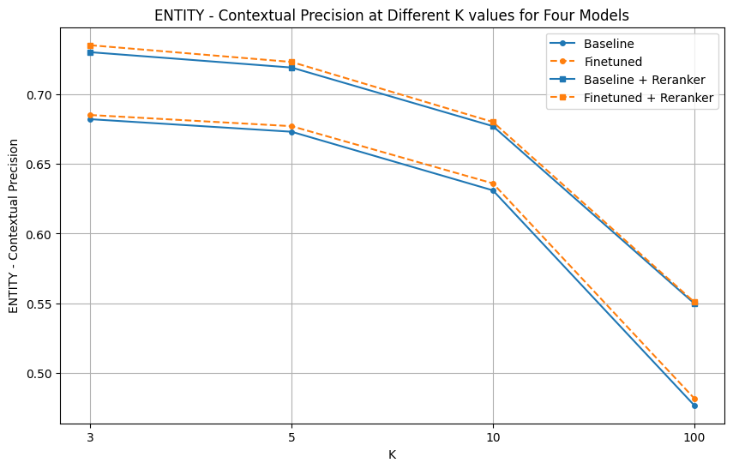
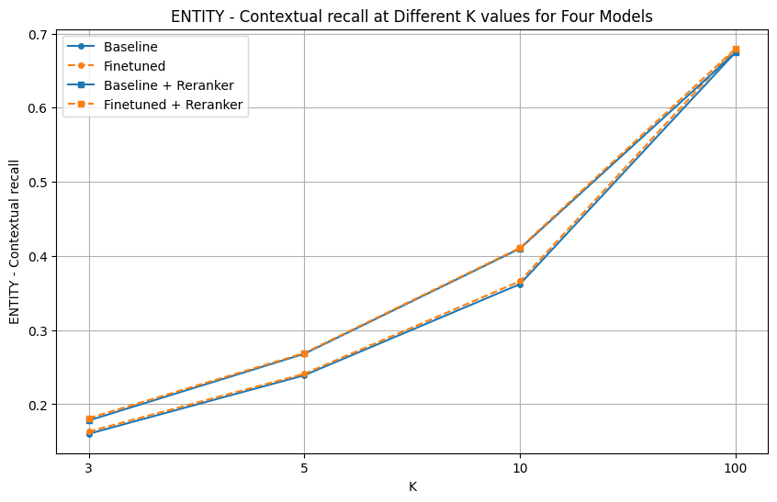
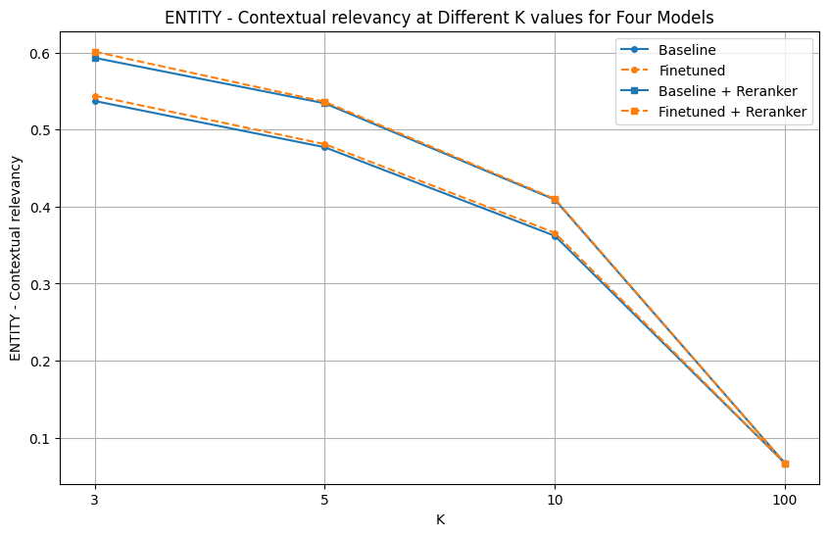
ENTITY Queries

Slide 27
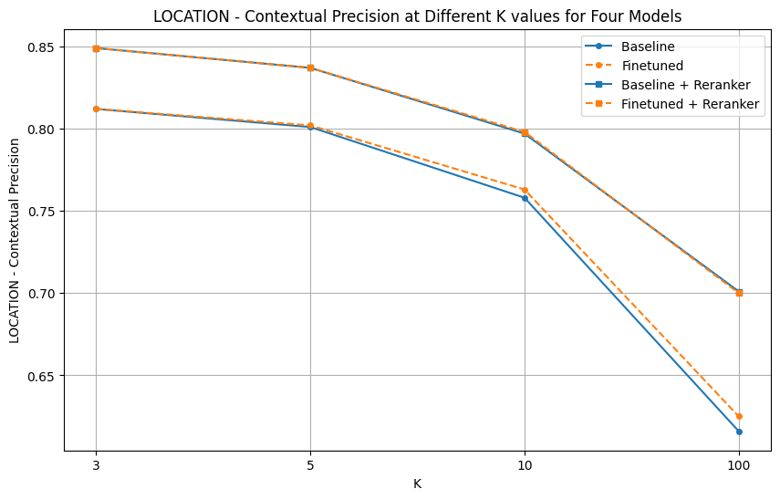
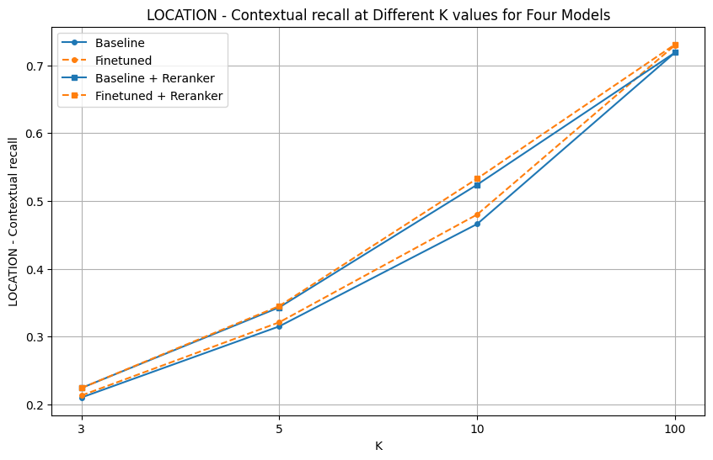
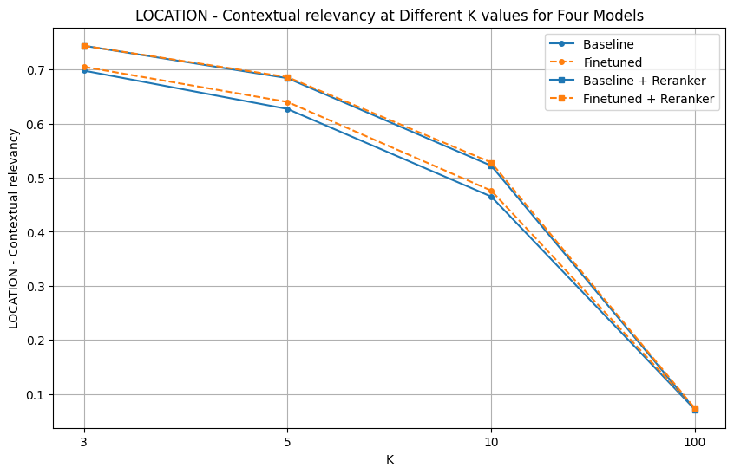
LOCATION Queries

Slide 28
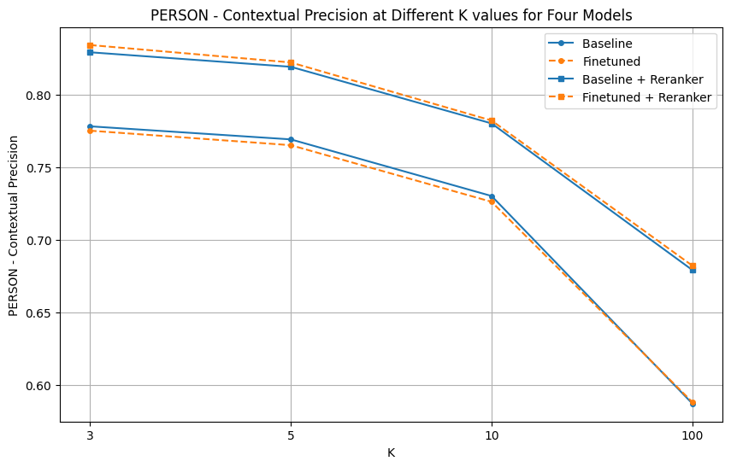
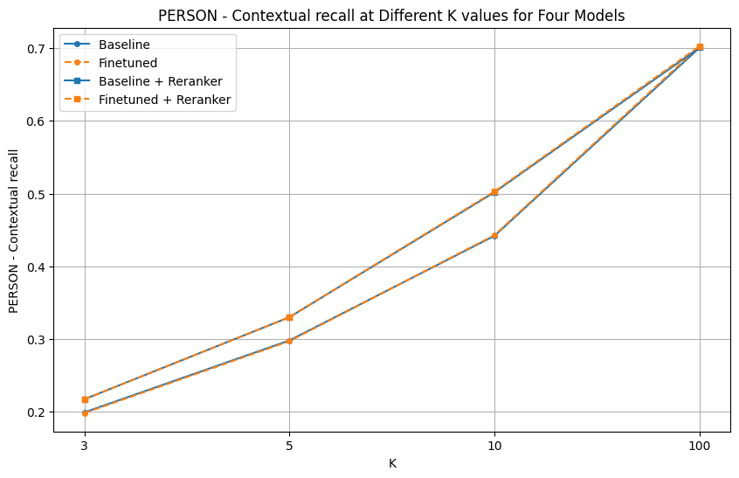
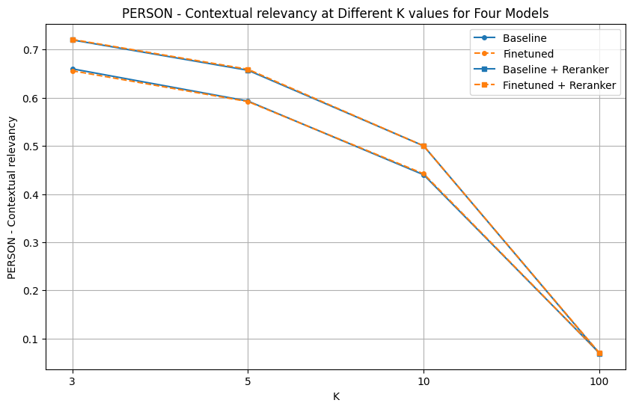
PERSON Queries

Slide 29
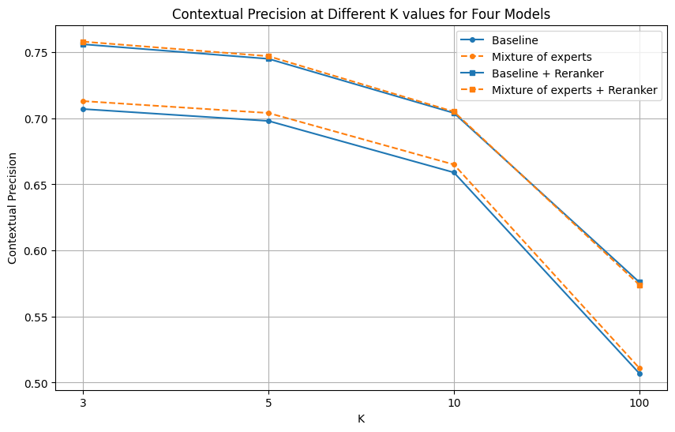
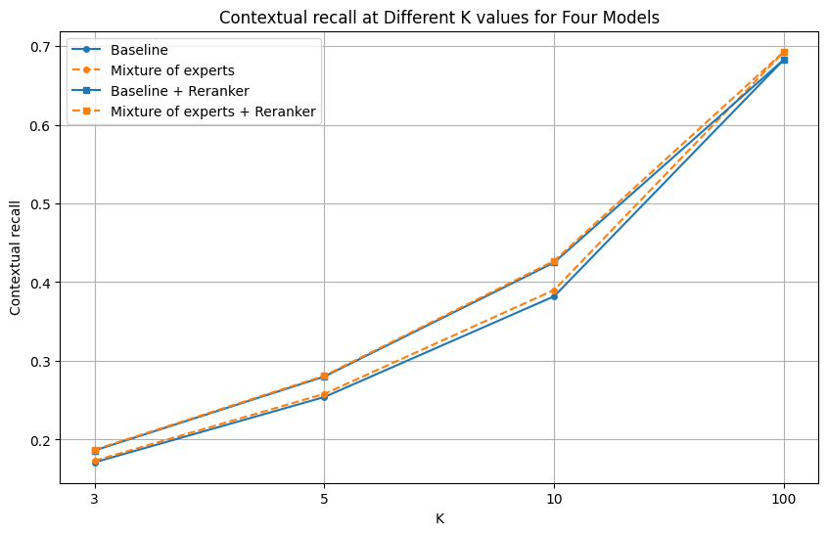
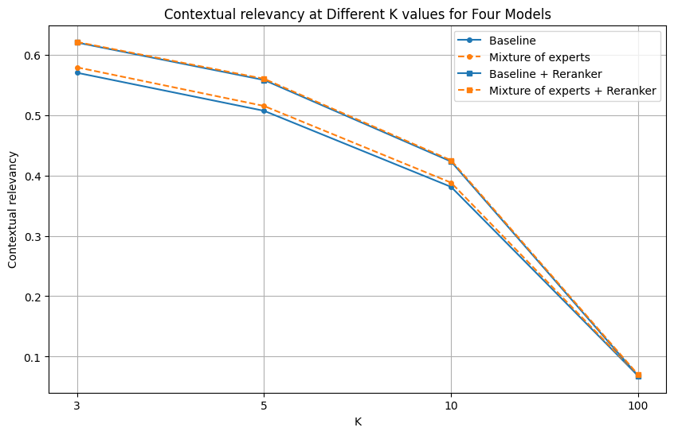
Mixture of Experts’ Performance

Slide 30
Appendix

Slide 31
DESCRIPTION
Fine-Tuned
Baseline
K | Contextual Precision | Contextual Recall | Contextual Relevancy
3 | 0.710 | 0.171 | 0.571
5 | 0.698 | 0.253 | 0.505
10 | 0.659 | 0.383 | 0.382
100 | 0.505 | 0.686 | 0.068
K | Contextual Precision | Contextual Recall | Contextual Relevancy
3 | 0.703 | 0.170 | 0.567
5 | 0.694 | 0.251 | 0.500
10 | 0.654 | 0.377 | 0.376
100 | 0.502 | 0.682 | 0.068

Slide 32
DESCRIPTION
Fine-Tuned with Reranker
Baseline with Reranker
K | Contextual Precision | Contextual Recall | Contextual Relevancy
3 | 0.759 | 0.188 | 0.625
5 | 0.748 | 0.280 | 0.560
10 | 0.705 | 0.427 | 0.425
100 | 0.577 | 0.686 | 0.068
K | Contextual Precision | Contextual Recall | Contextual Relevancy
3 | 0.755 | 0.188 | 0.625
5 | 0.745 | 0.280 | 0.558
10 | 0.705 | 0.425 | 0.423
100 | 0.577 | 0.682 | 0.068

Slide 33
NUMERIC
Fine-Tuned
Baseline
K | Contextual Precision | Contextual Recall | Contextual Relevancy
3 | 0.693 | 0.167 | 0.556
5 | 0.683 | 0.250 | 0.497
10 | 0.644 | 0.376 | 0.375
100 | 0.496 | 0.685 | 0.068
K | Contextual Precision | Contextual Recall | Contextual Relevancy
3 | 0.680 | 0.162 | 0.545
5 | 0.672 | 0.241 | 0.481
10 | 0.637 | 0.361 | 0.360
100 | 0.486 | 0.662 | 0.066

Slide 34
NUMERIC
Fine-Tuned with Reranker
Baseline with Reranker
K | Contextual Precision | Contextual Recall | Contextual Relevancy
3 | 0.724 | 0.176 | 0.585
5 | 0.714 | 0.260 | 0.520
10 | 0.673 | 0.390 | 0.391
100 | 0.530 | 0.685 | 0.068
K | Contextual Precision | Contextual Recall | Contextual Relevancy
3 | 0.719 | 0.175 | 0.582
5 | 0.711 | 0.257 | 0.516
10 | 0.672 | 0.386 | 0.385
100 | 0.529 | 0.662 | 0.066

Slide 35
ENTITY
Fine-Tuned
Baseline
K | Contextual Precision | Contextual Recall | Contextual Relevancy
3 | 0.685 | 0.163 | 0.544
5 | 0.677 | 0.241 | 0.481
10 | 0.636 | 0.366 | 0.366
100 | 0.482 | 0.680 | 0.067
K | Contextual Precision | Contextual Recall | Contextual Relevancy
3 | 0.682 | 0.160 | 0.537
5 | 0.673 | 0.239 | 0.477
10 | 0.631 | 0.362 | 0.362
100 | 0.477 | 0.675 | 0.067

Slide 36
ENTITY
Fine-Tuned with Reranker
Baseline with Reranker
K | Contextual Precision | Contextual Recall | Contextual Relevancy
3 | 0.735 | 0.181 | 0.601
5 | 0.723 | 0.269 | 0.536
10 | 0.680 | 0.411 | 0.410
100 | 0.551 | 0.680 | 0.067
K | Contextual Precision | Contextual Recall | Contextual Relevancy
3 | 0.730 | 0.178 | 0.593
5 | 0.719 | 0.268 | 0.534
10 | 0.677 | 0.410 | 0.409
100 | 0.550 | 0.675 | 0.067

Slide 37
LOCATION
Fine-Tuned
Baseline
K | Contextual Precision | Contextual Recall | Contextual Relevancy
3 | 0.812 | 0.213 | 0.705
5 | 0.802 | 0.321 | 0.640
10 | 0.763 | 0.480 | 0.476
100 | 0.625 | 0.730 | 0.073
K | Contextual Precision | Contextual Recall | Contextual Relevancy
3 | 0.812 | 0.210 | 0.698
5 | 0.801 | 0.315 | 0.627
10 | 0.758 | 0.466 | 0.465
100 | 0.616 | 0.719 | 0.071

Slide 38
LOCATION
Fine-Tuned with Reranker
Baseline with Reranker
K | Contextual Precision | Contextual Recall | Contextual Relevancy
3 | 0.849 | 0.224 | 0.744
5 | 0.837 | 0.345 | 0.686
10 | 0.798 | 0.533 | 0.528
100 | 0.700 | 0.731 | 0.073
K | Contextual Precision | Contextual Recall | Contextual Relevancy
3 | 0.849 | 0.224 | 0.744
5 | 0.837 | 0.343 | 0.684
10 | 0.797 | 0.524 | 0.522
100 | 0.701 | 0.719 | 0.071

Slide 39
PERSON
Fine-Tuned
Baseline
K | Contextual Precision | Contextual Recall | Contextual Relevancy
3 | 0.775 | 0.198 | 0.656
5 | 0.765 | 0.297 | 0.592
10 | 0.726 | 0.443 | 0.442
100 | 0.588 | 0.703 | 0.070
K | Contextual Precision | Contextual Recall | Contextual Relevancy
3 | 0.778 | 0.199 | 0.660
5 | 0.769 | 0.298 | 0.593
10 | 0.730 | 0.442 | 0.440
100 | 0.587 | 0.701 | 0.070

Slide 40
PERSON
Fine-Tuned with Reranker
Baseline with Reranker
K | Contextual Precision | Contextual Recall | Contextual Relevancy
3 | 0.834 | 0.217 | 0.721
5 | 0.822 | 0.330 | 0.659
10 | 0.782 | 0.503 | 0.500
100 | 0.682 | 0.703 | 0.070
K | Contextual Precision | Contextual Recall | Contextual Relevancy
3 | 0.829 | 0.217 | 0.720
5 | 0.819 | 0.330 | 0.657
10 | 0.780 | 0.502 | 0.500
100 | 0.679 | 0.701 | 0.069

Slide 41
Mixture of experts vs Baseline
Mixture of experts
Baseline
K | Contextual Precision | Contextual Recall | Contextual Relevancy
3 | 0.713 | 0.173 | 0.579
5 | 0.704 | 0.258 | 0.515
10 | 0.665 | 0.390 | 0.388
100 | 0.511 | 0.693 | 0.069
K | Contextual Precision | Contextual Recall | Contextual Relevancy
3 | 0.707 | 0.171 | 0.570
5 | 0.698 | 0.254 | 0.507
10 | 0.659 | 0.382 | 0.381
100 | 0.507 | 0.683 | 0.068

Slide 42
Mixture of experts vs Baseline
Mixture of experts with Reranker
Baseline with Reranker
K | Contextual Precision | Contextual Recall | Contextual Relevancy
3 | 0.758 | 0.187 | 0.621
5 | 0.747 | 0.281 | 0.560
10 | 0.705 | 0.427 | 0.425
100 | 0.574 | 0.693 | 0.070
K | Contextual Precision | Contextual Recall | Contextual Relevancy
3 | 0.756 | 0.186 | 0.620
5 | 0.745 | 0.280 | 0.558
10 | 0.704 | 0.425 | 0.423
100 | 0.576 | 0.683 | 0.068

