Slide 1
Global Climate &
Natural Disaster Analysis
(1970–2021)
Presented by:
Ankit Semwal
Course:
Data Visualization
University:
University of Europe for Applied Sciences

Slide 2
Project Overview
Content
Objective
Natural disasters have become more frequent and severe worldwide.
Understanding historical disaster patterns helps improve preparedness.
This project analyzes disaster trends from 1970–2021 using the EM-DAT dataset.
Analyze disaster trends
Study human impact
Evaluate economic losses
Develop an interactive dashboard
The project combines historical disaster records, analytical visualizations, and an interactive dashboard to support trend discovery and decision-making.

Slide 3
Dataset
Dataset Name
EM-DAT International Disaster Database
Coverage
1970–2021
Attributes
Country, Continent, Disaster Type, Disaster Subgroup, Start Year, Total Deaths, Total Affected, Economic Damage, Disaster Magnitude
Before analysis, the dataset required cleaning and preprocessing, including missing-value handling, type conversion, and column standardization.

Slide 4
Methodology
EM-DAT Dataset
Collected the historical disaster records used as the project foundation.
↓
Data Cleaning
Removed inconsistencies, handled missing values, and prepared analysis-ready fields.
↓
Exploratory
Data Analysis
Explored temporal, geographic, and disaster-type patterns in the dataset.
↓
Analytical
Visualizations
Built charts to answer questions on trends, deaths, losses, and affected population.
↓
Interactive Streamlit Dashboard
Integrated the findings into a dashboard with filters, tabs, and KPI summaries.

Slide 5
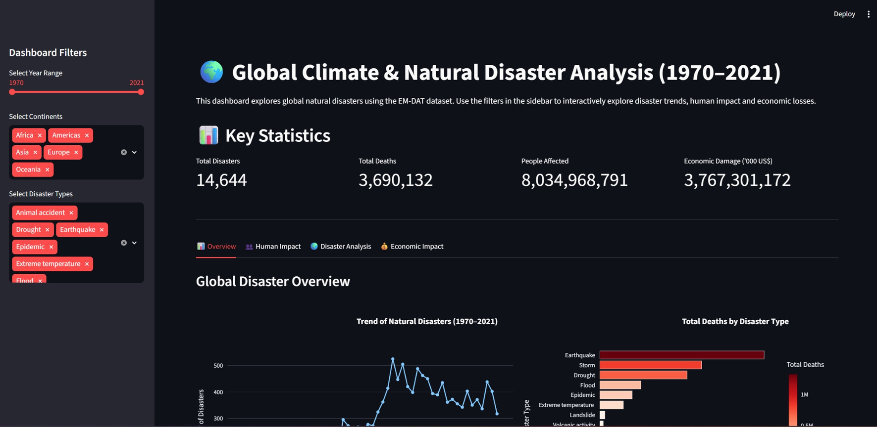
Analytical Visualizations
Disaster trends over time show how recorded events increased across decades.
Deaths by disaster type highlight where mortality is most concentrated.
Economic damage analysis identifies the costliest disaster patterns.
Human impact views compare deaths, affected population, and severity relationships.
These visualizations answer specific analytical questions before the dashboard stage.

Slide 6
Dashboard Overview
Interactive filters for year, continent, and disaster type.
KPI cards summarizing total disasters, deaths, people affected, and economic damage.
Navigation tabs for different analytical views.
Dynamic Plotly charts that respond to selected filters.

Slide 7
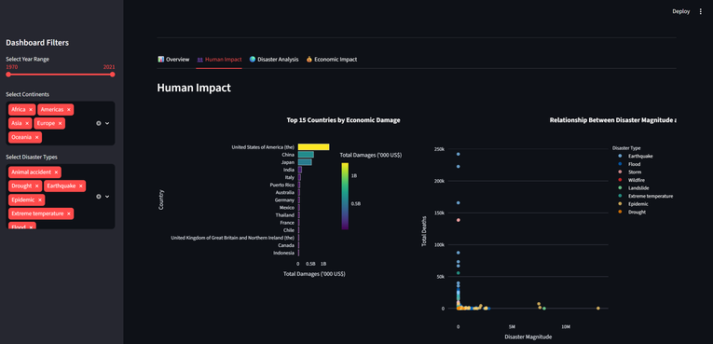
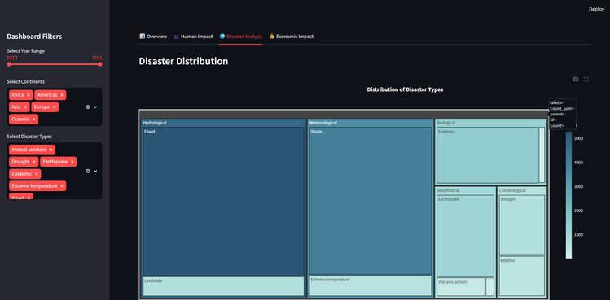
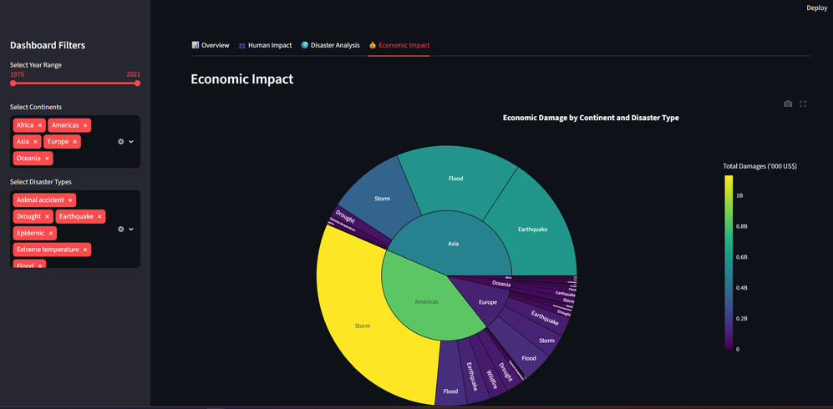
Dashboard Features
📊 Overview
👥 Human Impact
Trends and summary statistics.
Deaths, affected population, and magnitude relationships.
🌍 Disaster Analysis
💰 Economic Impact
Distribution by type and geographic patterns.
Economic losses across continents and disaster types.

Slide 8
Key Findings
Disaster frequency increased over time.
Floods and storms are among the most frequent disasters.
Asia experienced the highest human impact.
Economic losses are concentrated in a few countries.
Disaster magnitude does not always correlate with fatalities.

Slide 9
Challenges
01
Missing values in critical columns such as deaths, affected population, and damage.
02
Extensive preprocessing to standardize data types, categories, and naming conventions.
03
Selecting visualizations that communicate trends clearly without overcrowding the dashboard.
04
Building an interactive dashboard structure with multiple tabs and synchronized components.
05
Ensuring all charts and KPI cards update correctly with user-selected filters.

Slide 10
Conclusion & Future Work
Conclusion
Future Work
Successfully analyzed 50 years of disaster data.
Built an interactive dashboard.
Generated actionable insights.
Integrate real-time disaster feeds.
Add predictive machine learning models.
Deploy the dashboard to the cloud.
Include more recent EM-DAT updates.

Slide 11
Thank You
Global Climate & Natural Disaster Analysis (1970–2021)
Presented by Ankit Semwal
Data Visualization • University of Europe for Applied Sciences

