Slide 1
Atm Banking System

Slide 2
Tasks performed by each Team member
Uday - Validation in the Front End, made pages for withdrawal, pin change, password change and added logout component and added API endpoints for pin change and password change, helped in implementation of JWT..
Anuj - Added API endpoints for withdrawal and deposit using db transactions. Added pin masking. Designed admin home page, and the page to view/edit customer and details. Added styling to the front-end.
Ankit - Validation in the backend, writing unit test, implementation of jwt, structuring the project in proper architecture, implementing mini statement functionality, helper in implementation of disabling user
Josh - Designed database schema, added PIN and password hashing and validation, migrate endpoints to retrieve user data from JWT, added fund transfer and set user enable status endpoint and worked on cheque deposit, withdrawal endpoints, added login page

Slide 3
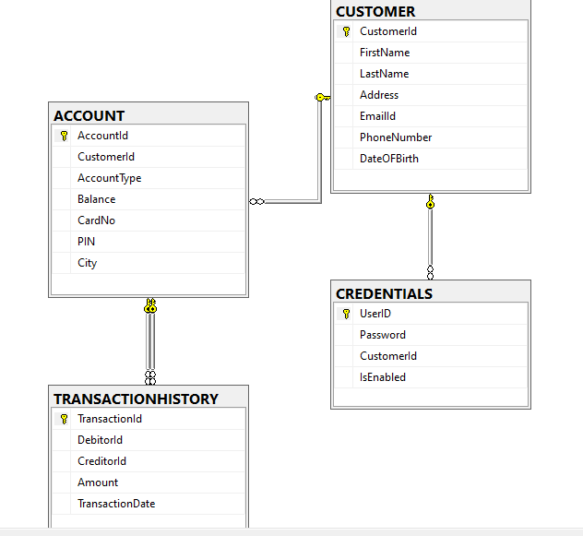
Database Schema

Slide 4
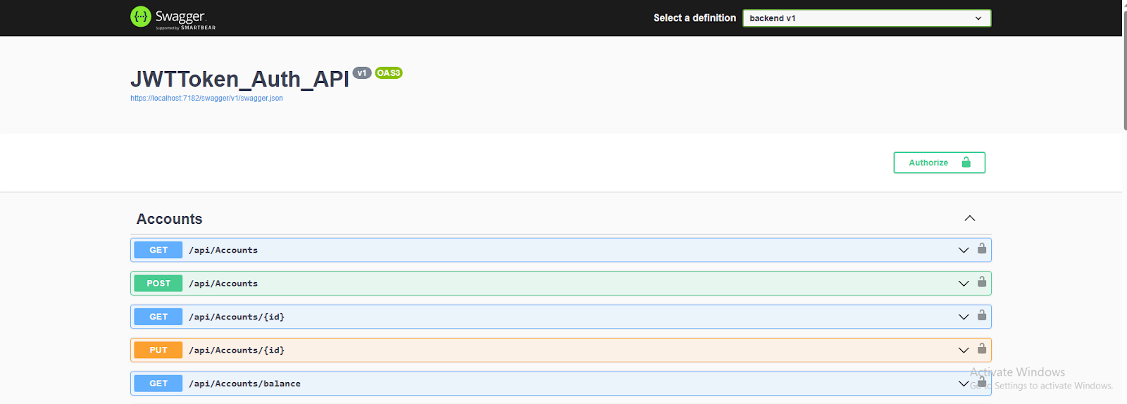
Swagger

Slide 5
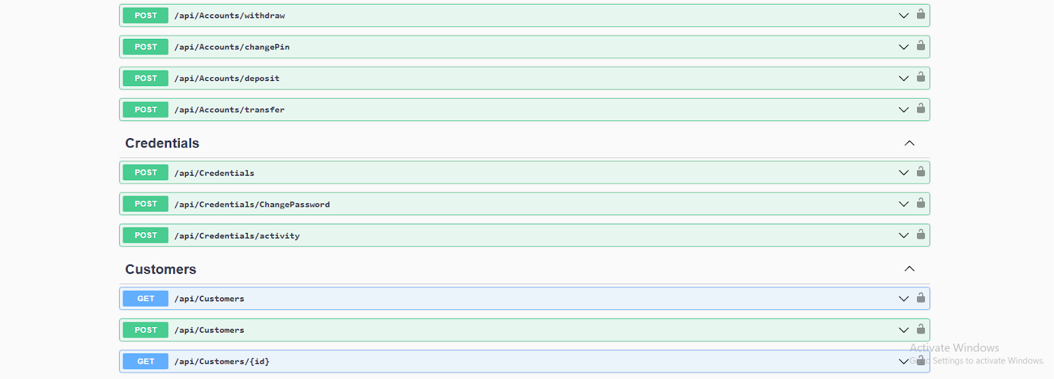

Slide 6
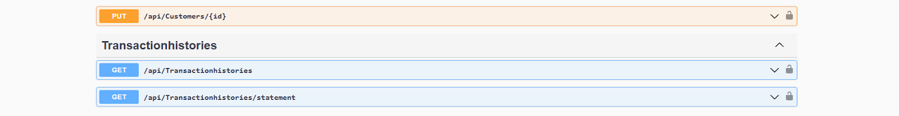

Slide 7
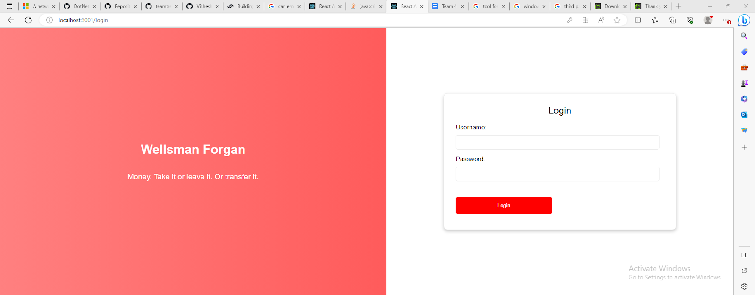
Login Page

Slide 8
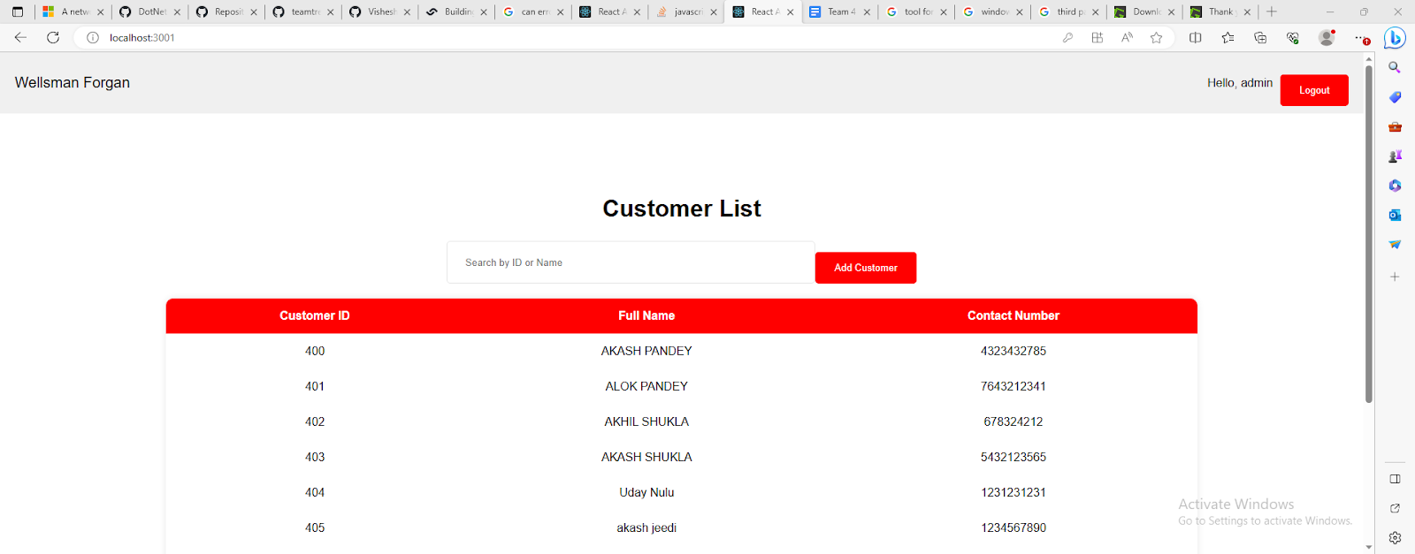
Admin HomePage

Slide 9
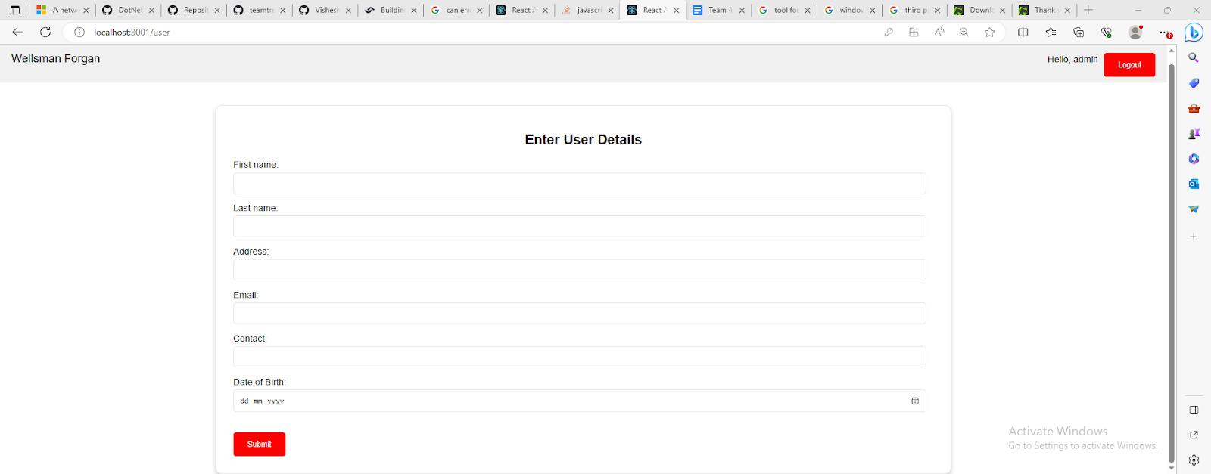
Add User Page

Slide 10
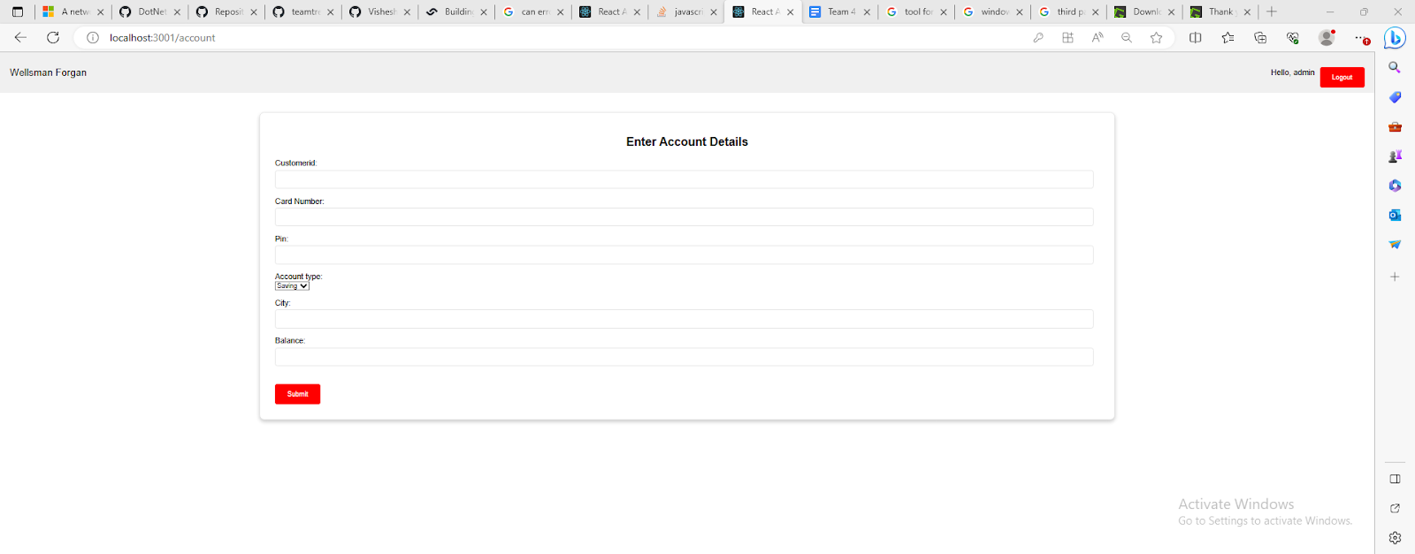
Add Account Page

Slide 11
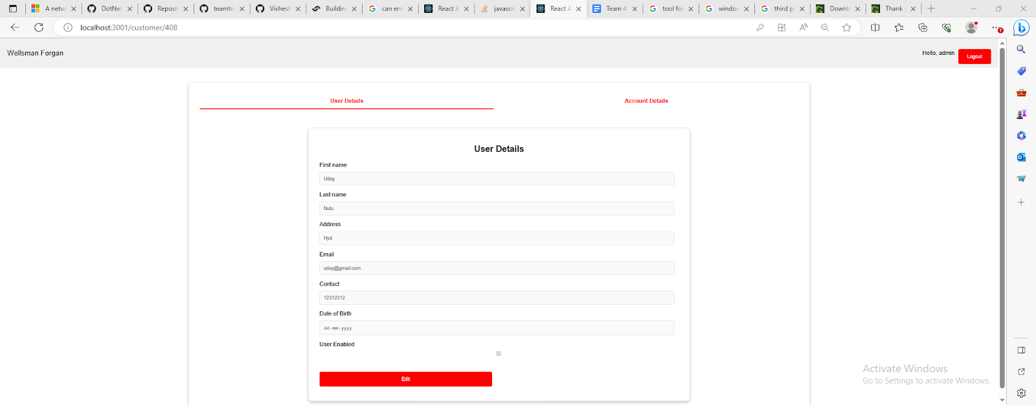
Edit User/Customer Page

Slide 12
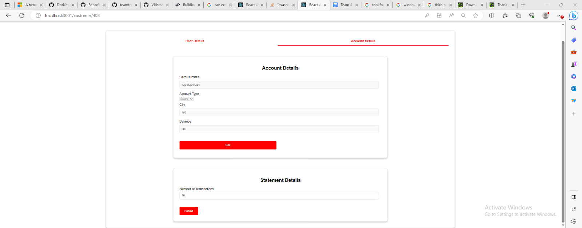
Edit Account Page

Slide 13
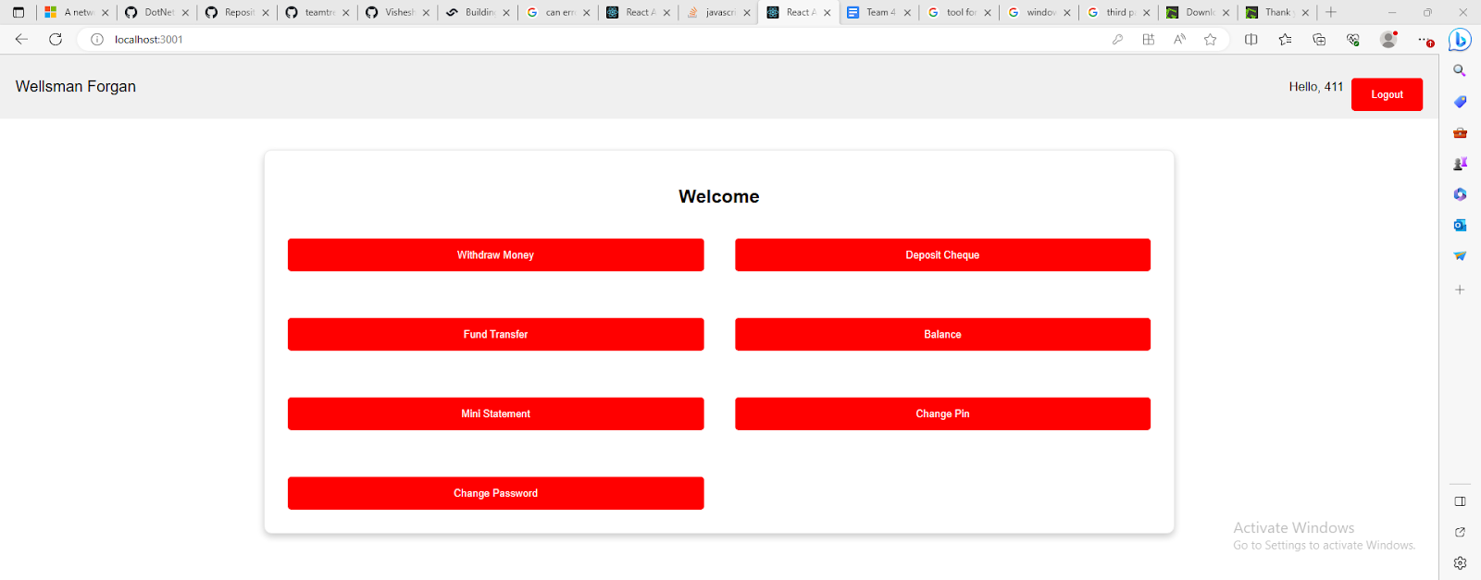
Customer Home Page

Slide 14
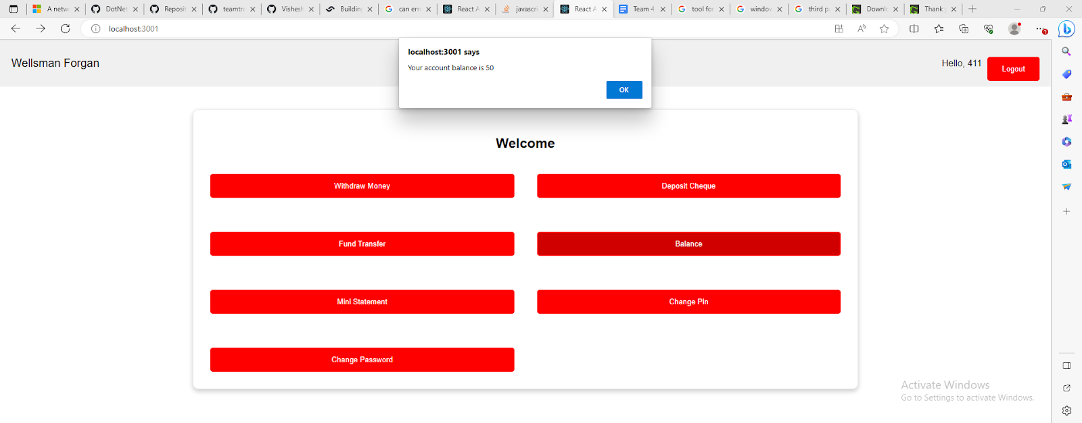
Balance Pop-up

Slide 15
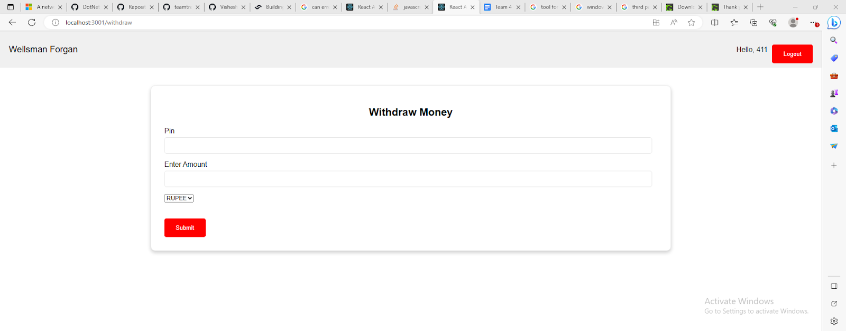
Withdrawal Page

Slide 16
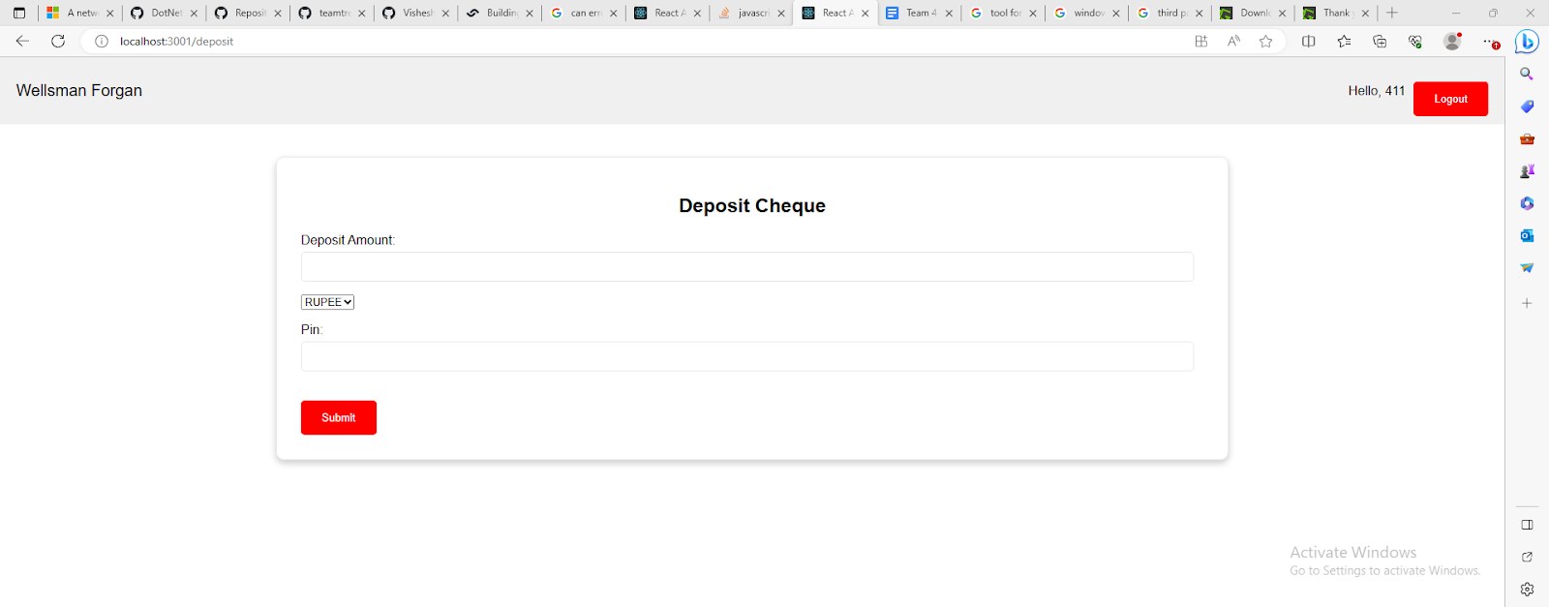
Cheque Deposit

Slide 17
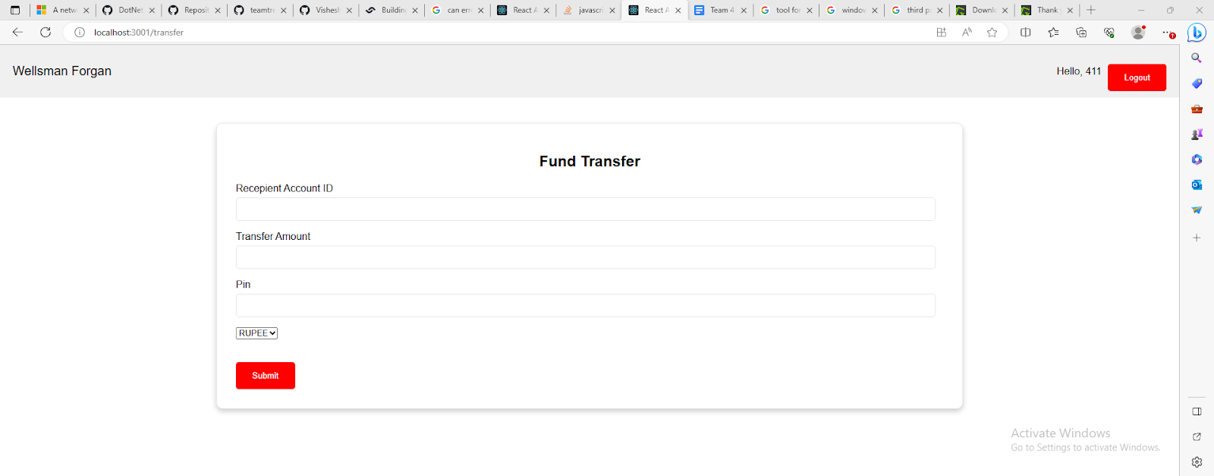
Fund Transfer Page

Slide 18
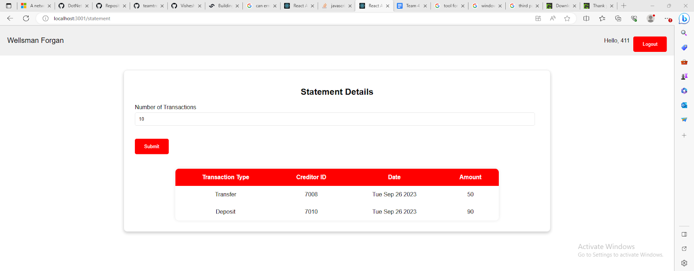
Mini statement Page

Slide 19
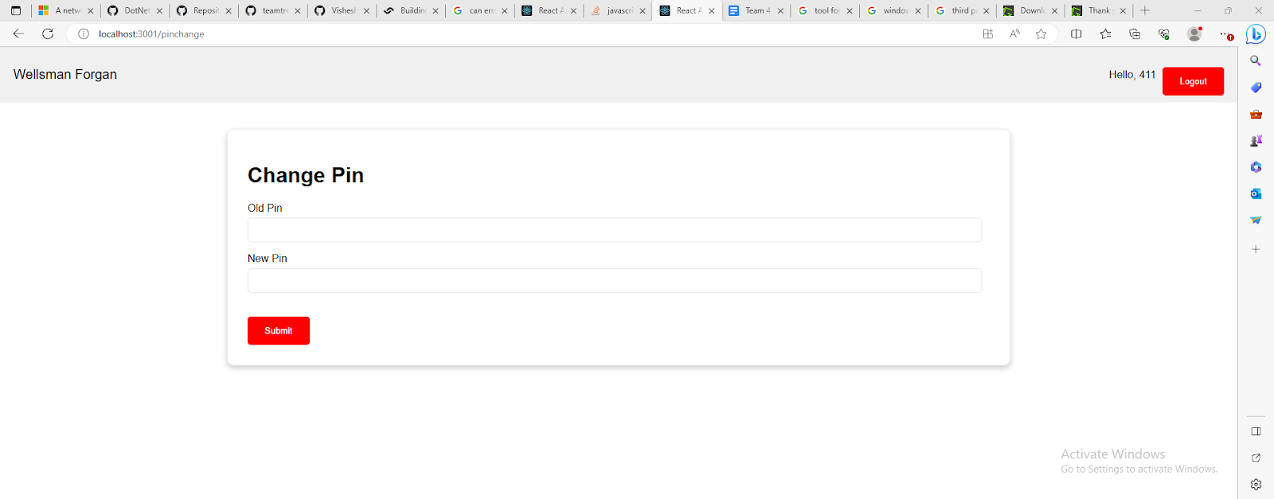
Pin Change Page

Slide 20
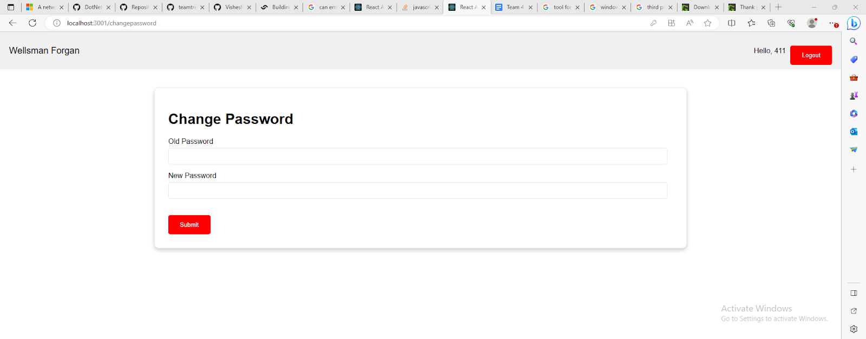
Password Change Page

Slide 21
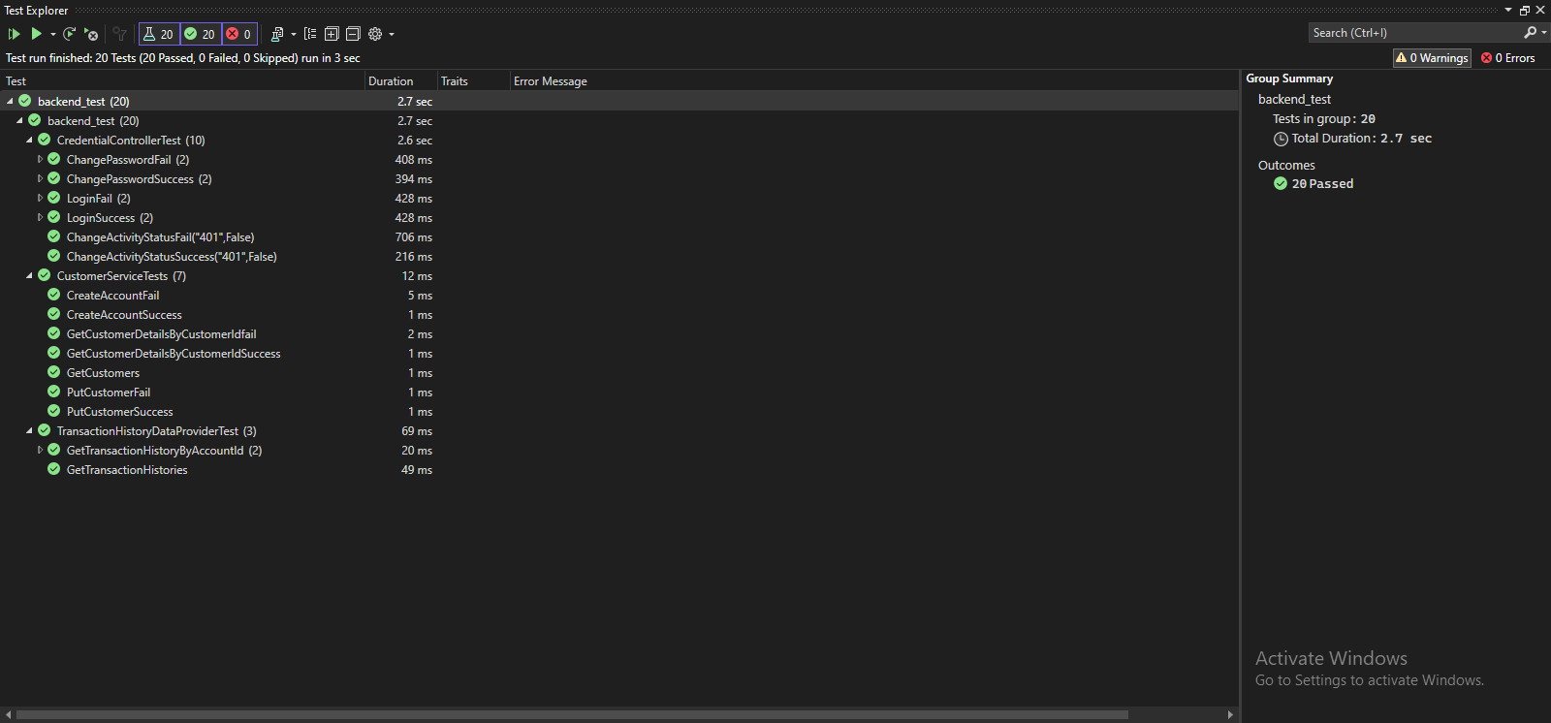
Test Explorer

Slide 22
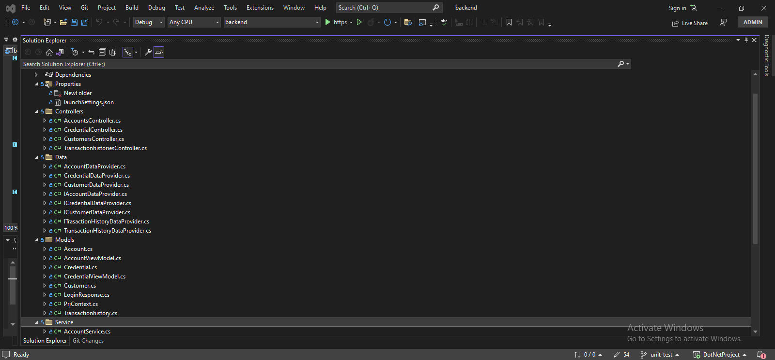
Solution Explorer

Slide 23
