Slide 1

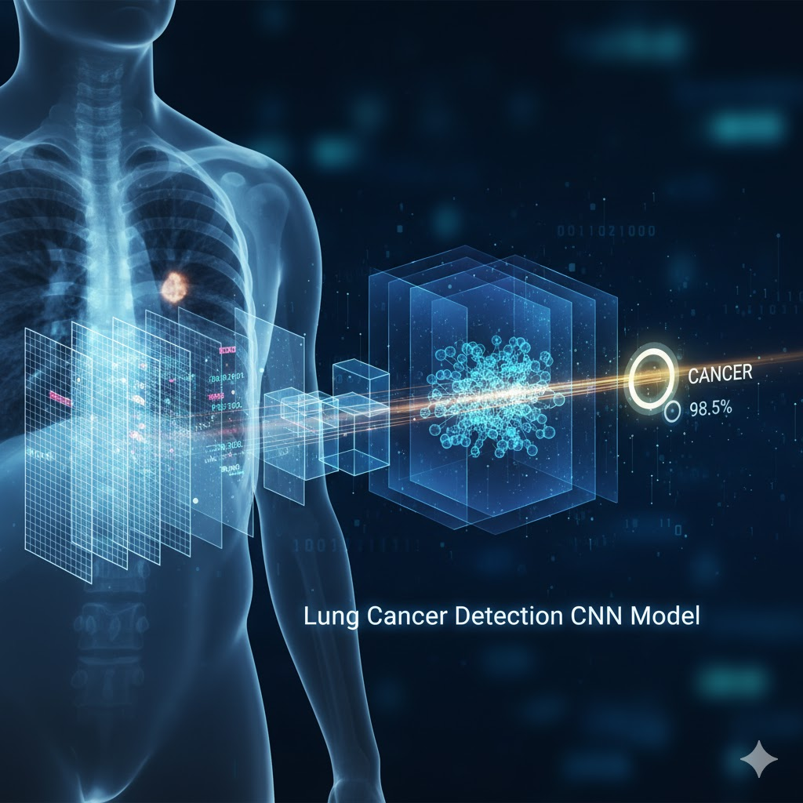
Lung Cancer Detection Using CNN
Developer :
Ankit Kumar
Goal:
Develop and deploy an accurate, automated system for early detection of lung
nodules from CT scans using CNNs
Impact:
Achieving early diagnosis with
99% accuracy
to significantly improve patient prognosis

Slide 2

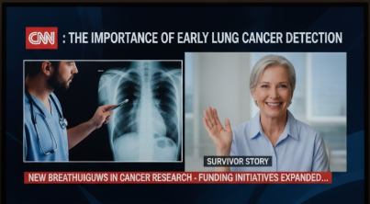
The Critical Need for Automated Diagnosis
Medical Challenge
Dataset Details
Lung cancer is the leading cause of cancer-related deaths globally. Early detection is crucial for improved patient outcomes, yet manual analysis of high-volume CT scans remains a significant bottleneck in clinical workflows.
Source:
Kaggle Database API : https://www.kaggle.com/datasets/hamdallak/the-iqothnccd-lung-cancer-dataset/data
Size:
1,000+ CT scan studies with expert annotations
Radiologists must review thousands of images daily, leading to fatigue-induced errors and inconsistent diagnostic quality.
Format:
128 * 128 pixels patches centered on potential nodules
Why Automation Matters
Labels:
Malignant / Benign/ Normal
Consistency: AI systems provide uniform analysis without fatigue or subjective bias.
Speed: Automated screening reduces diagnostic time from hours to seconds.
Expertise: Serves as a reliable second opinion, augmenting radiologist capabilities.

Slide 3

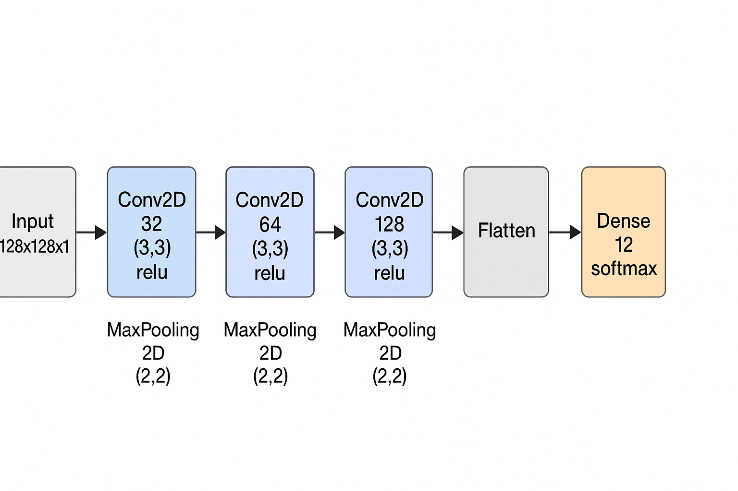
Custom CNN Architecture
Base Architecture
CNN 3 inner layer of relu function and SoftMax for Output .
Layer Breakdown
Input:
128×128×1 (grayscale CT scan patch)
Conv Block 1:
32 filters (3,3)→ ReLU → Max Pooling
Conv Block 2:
64 filters (3,3)→ ReLU → Max Pooling
Conv Block 3:
128 filters (3,3) → ReLU → Max Pooling
Classification Head
Architecture Flow: Input → Convolutional Blocks → Classification → Output
Flatten:
Flatten convolutional output
Dense 1:
512 units with ReLU activation
Output:
2 units with Softmax (Malignant/Benign)

Slide 4

Robust Training Yields High Diagnostic Performance
Optimizer
Loss Function
Adam
Sparse_categorical_crossentropy
Training Epochs
Metrics
30 (with Early Stopping)
Accuracy
Key Performance Metrics (Test Set)
99%
0.0027%
Accuracy
Loss Function
x

Slide 5
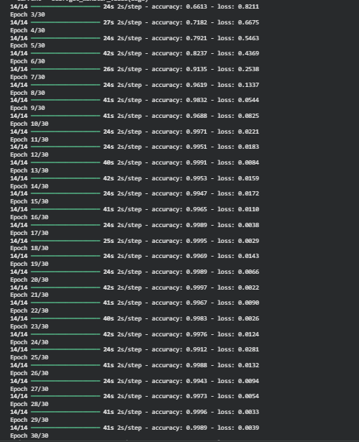
Training Model

Slide 6

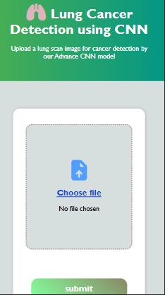

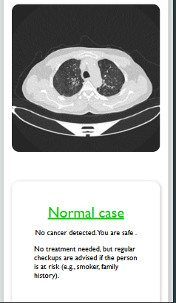
Web Interface for Lung Cancer Detection
Tech Stack
Final Model Performance
Backend:
Python Flask (model serving & API)
99%
Frontend:
HTML5, CSS3, JavaScript
Classification Accuracy
Styling:
Only vanilla CSS
Limitations
Hosting:
Render (Planned)
1.
2D-only analysis: Trained only on 2D imagesas model only train on 2D Model.
Key Features
2.
Dataset-specific: Only train on Kaggle dataset still not use in real scans.
Upload:
Single-slice CT image upload
Home Page
Prediction:
Real-time inference (<2 seconds)
Future Improvements
Interface:
User-friendly, intuitive design
1.
3D CNN integration: Implement volumetric analysis for comprehensive spatial understanding of nodule characteristics.
2.
Multi-source datasets: Expand training with diverse imaging sources to improve robustness and clinical applicability.
Result Page

Slide 7
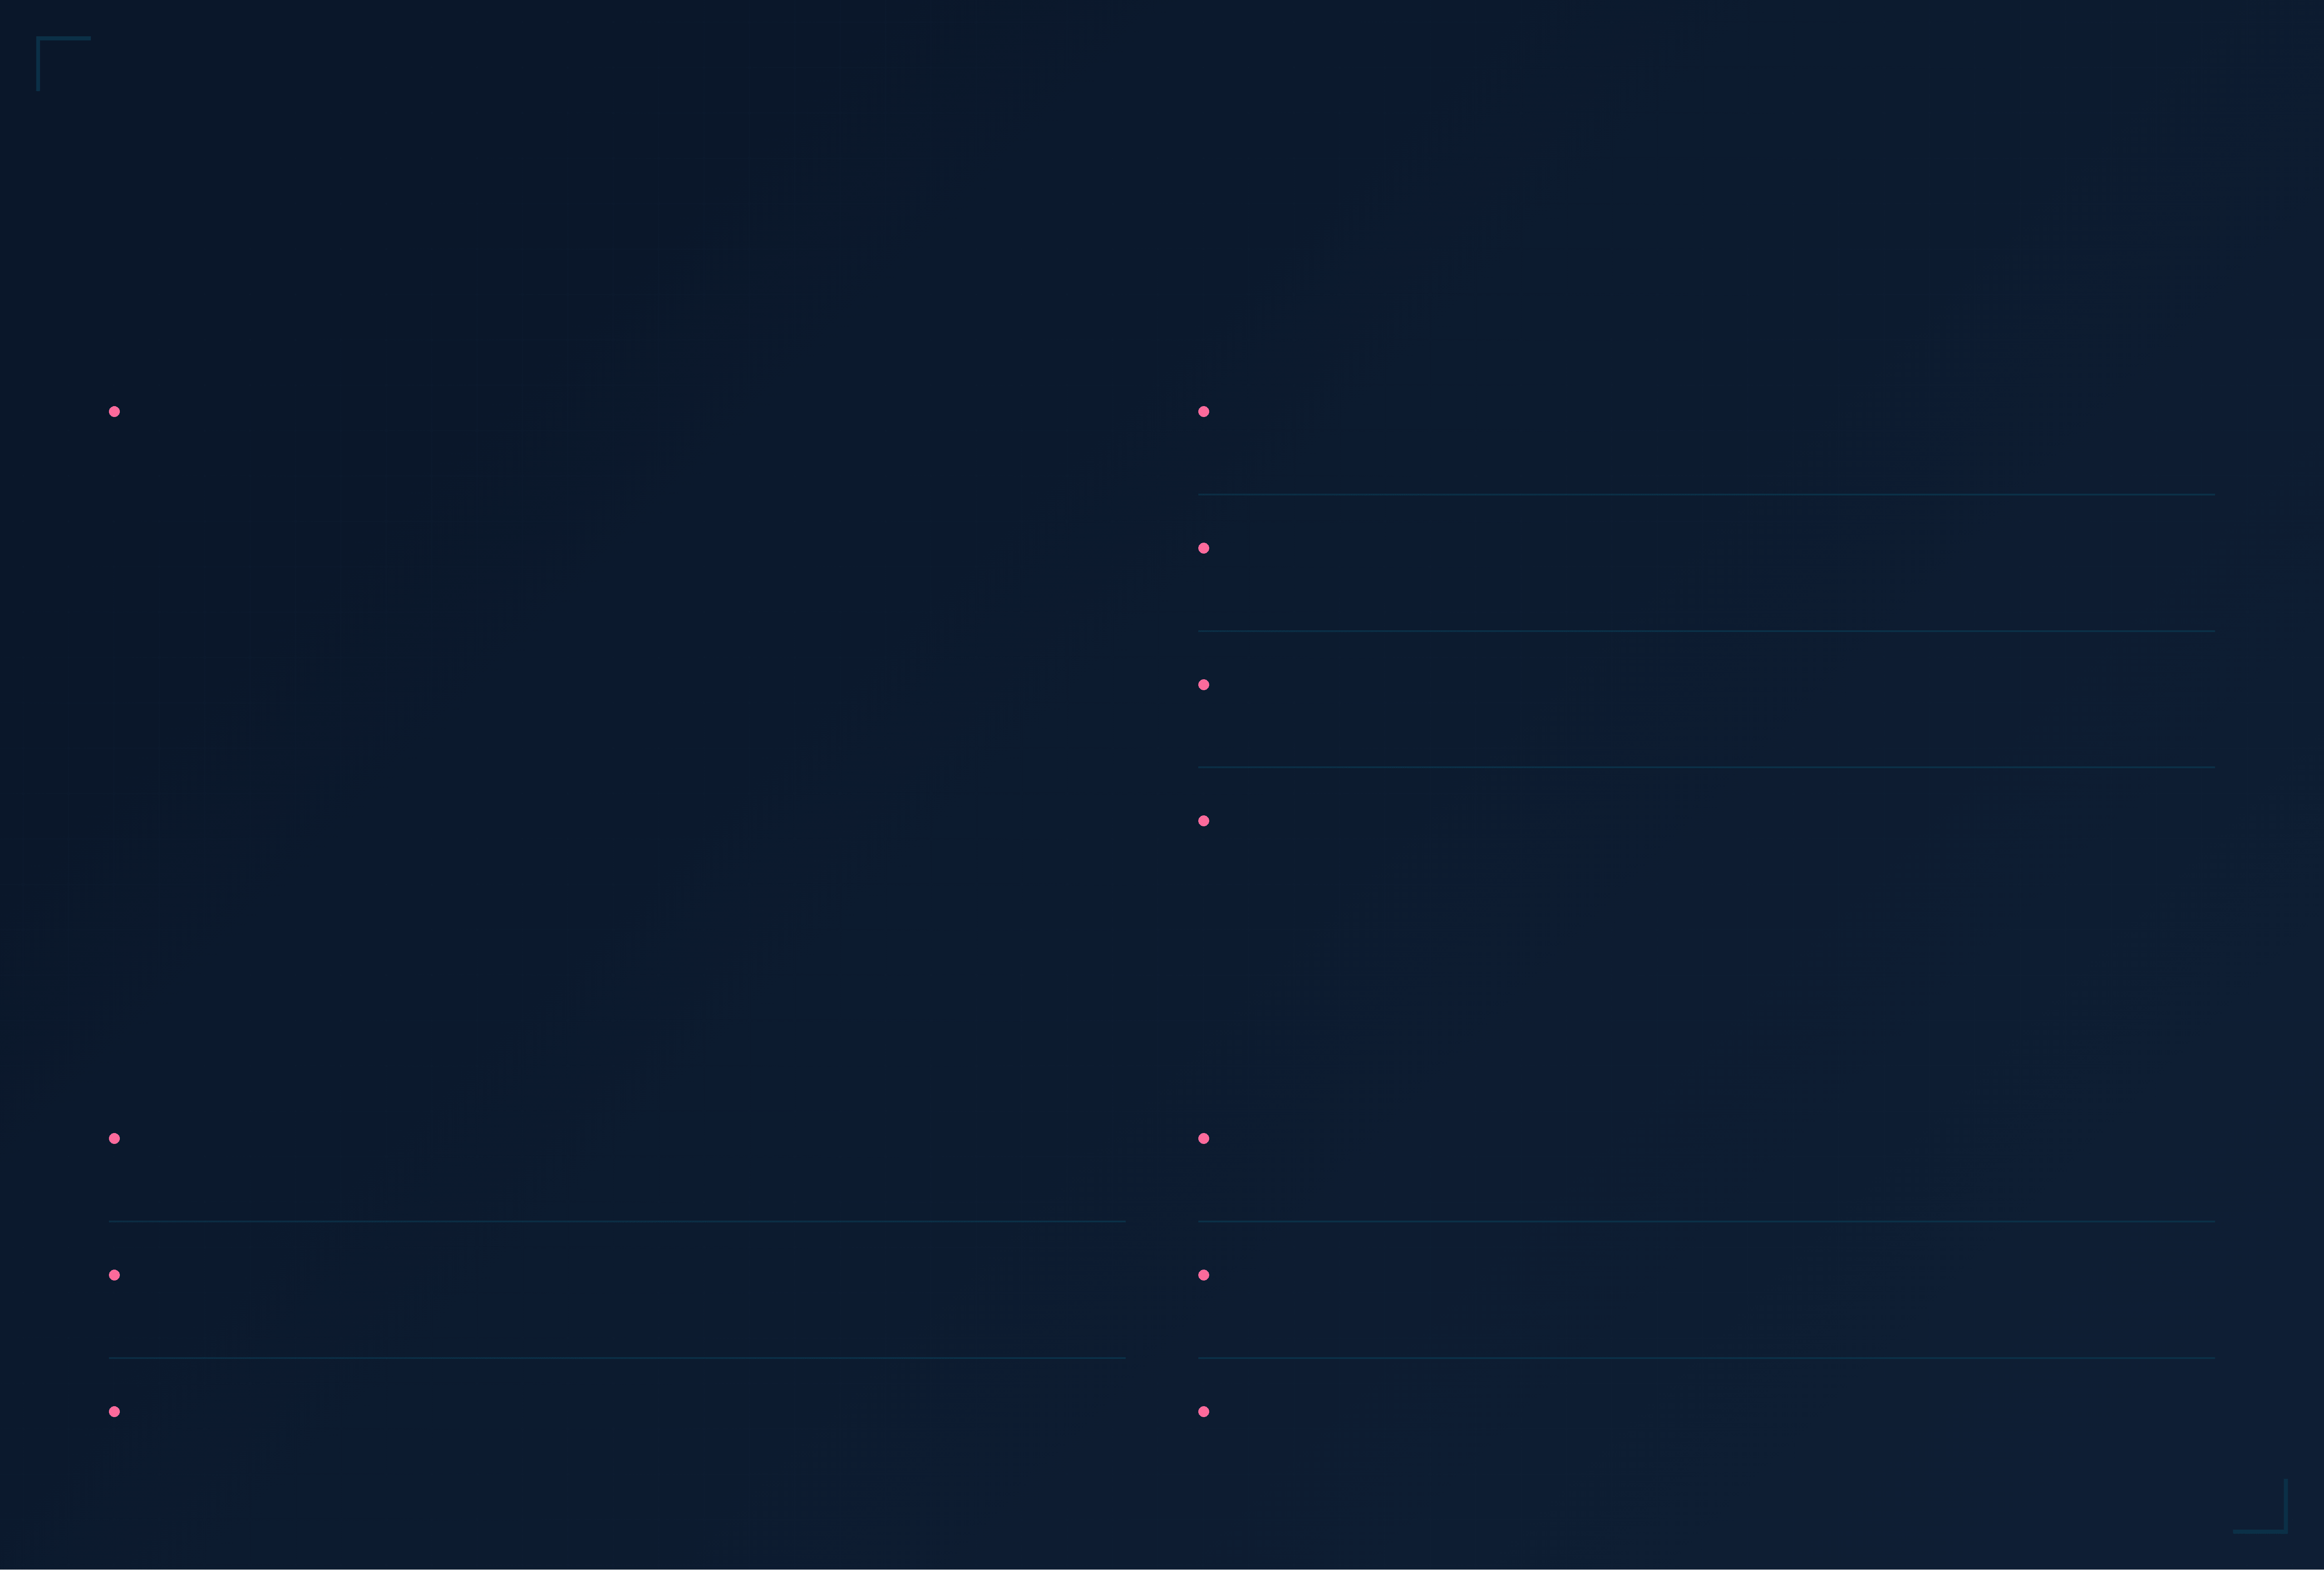
Key Resources and Tools
📊 Dataset Sources
⚙️ Libraries & Frameworks
Kaggle Database
TensorFlow/Keras
https://www.kaggle.com/datasets/hamdallak/the-iqothnccd-lung-cancer-dataset
Deep learning framework for model development and training
Dataset/
├ Benign cases/ images
├ Malignant cases/ images
└── Normal cases/ images
NumPy & Pandas
Data manipulation and numerical computing
Scikit-learn
Evaluation metrics and machine learning utilities
Matplotlib & Seaborn
Data visualization and graph generation
🌐 Website & Deployment
📚 Research References
Python Flask
Deep Convolutional Neural Networks for CAD
Lightweight web framework for backend API development
Foundational research on CNN applications in computer-aided detection
HTML5 / CSS3 / JavaScript
LIDC-IDRI: A Large-Scale Public Lung Nodule Database
Frontend technologies for responsive user interface
Dataset reference paper documenting collection methodology and characteristics
Medical Image Analysis with Deep Learning
Survey of deep learning techniques for medical imaging applications
Presentation created with TensorFlow, Flask, and modern web technologies

