Slide 1
EC 353 Mini Project
Information Theory and Coding
Winter Semester 2021

Slide 2
Project Team
Ankit Kumar - 1801021
Ajit Singh - 1801010
Divyam - 1801057

Slide 3
Problem Statement
Implementing Lossless Data Compression using Arithmetic Coding

Slide 4
Solution
We made an android app to encode and decode a given input by user using arithmetic coding.
Technical Implementation : Java, Android
Input can be a number or a String.
The accuracy achieved for decoding is upto 12 characters and after 12, it may or may not be decode correctly due to probabilities or precision of double in JAVA.
The Probability of each letter is 0.04.

Slide 5
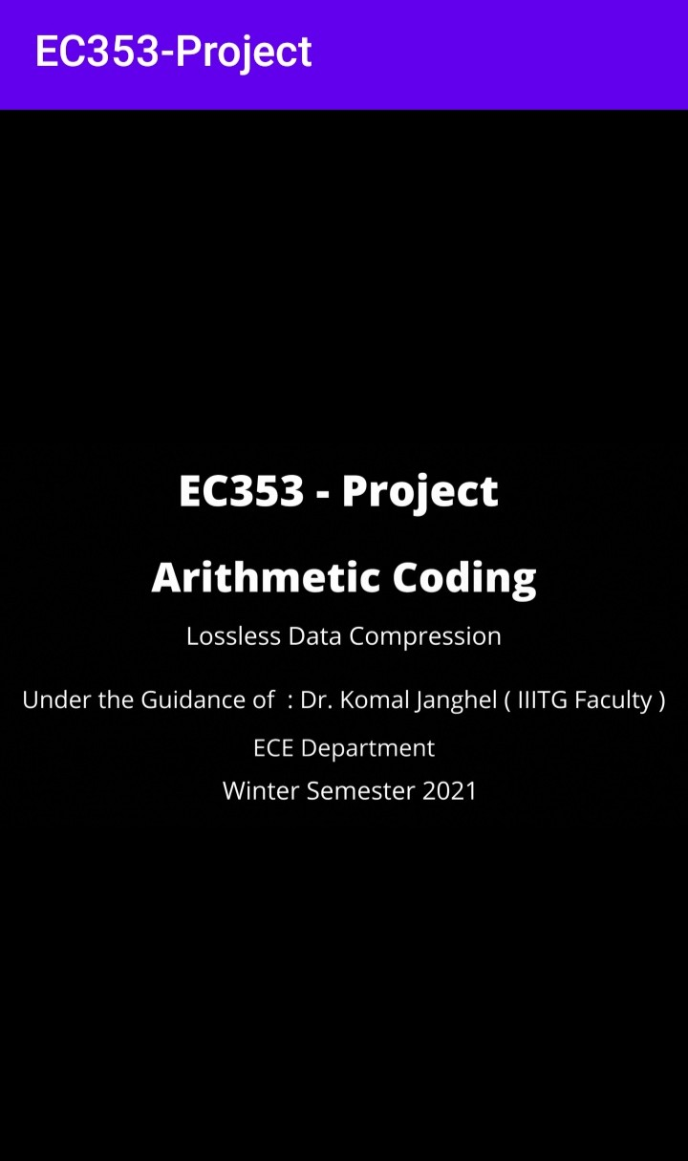
Project Demonstration
Intro -
Place your screenshot here

Slide 6
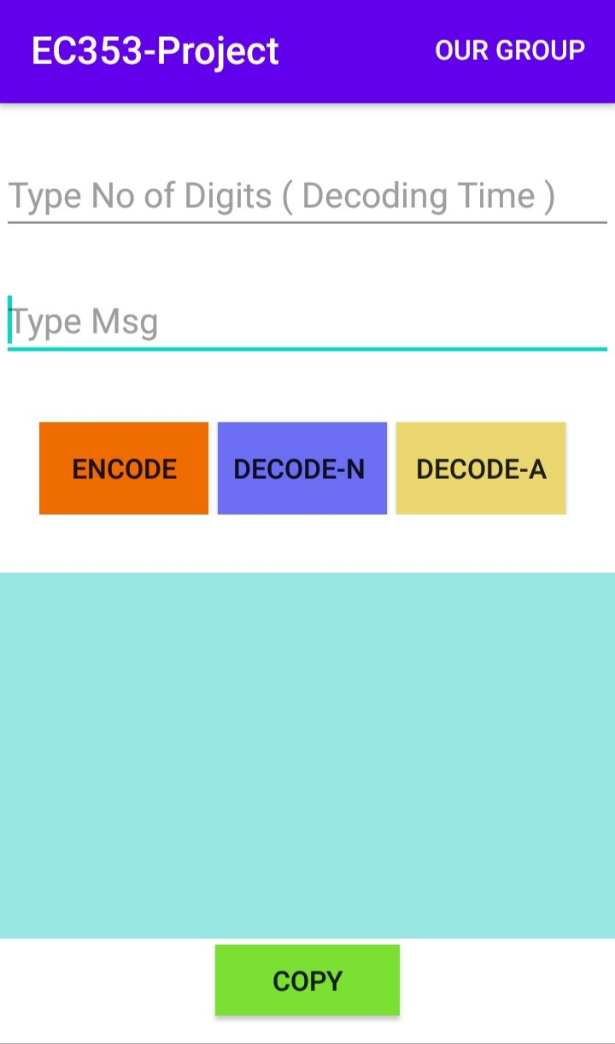
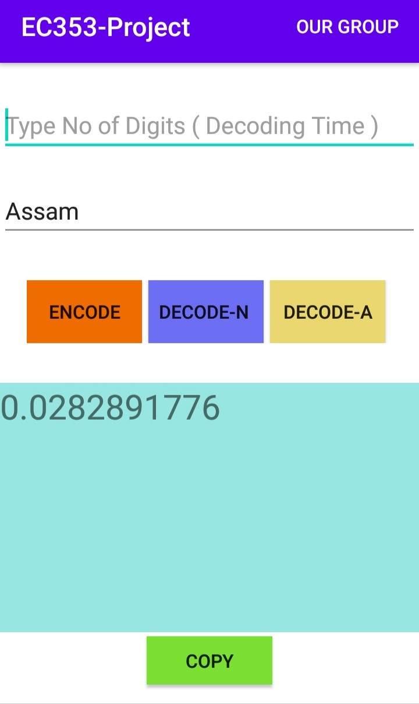
Encoding User Input
Simply enter the message and click on ‘Encode’
For eg, here the user enters
‘Assam’ and receives the
resulting encoded codeword.

Slide 7
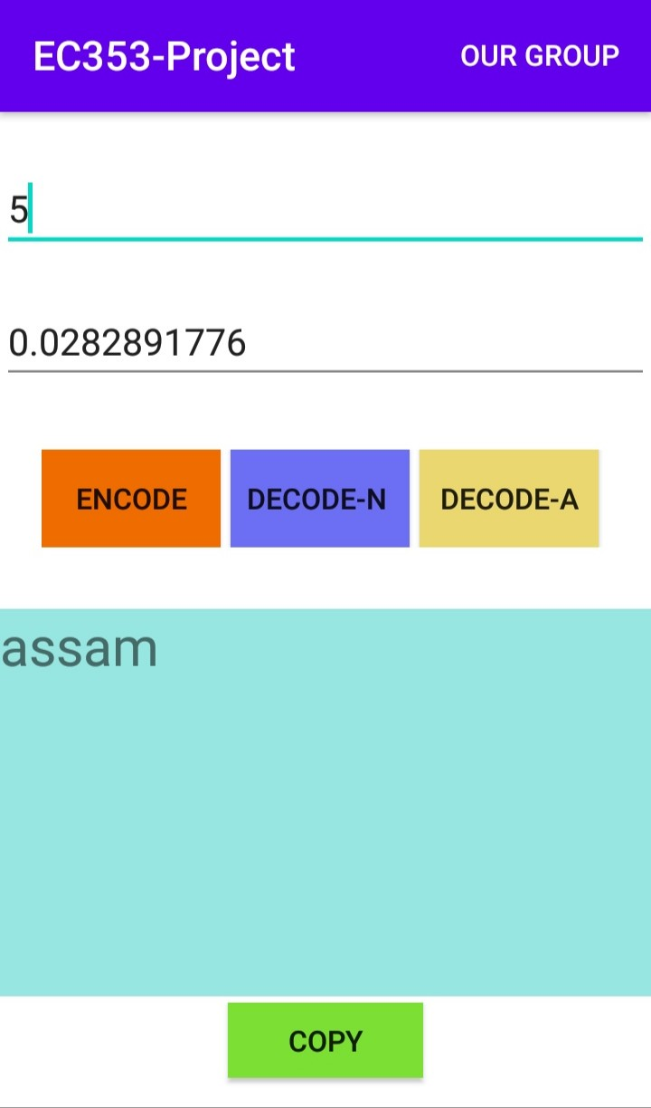
Decoding a codeword
Enter the codeword and enter the expected length of result.
Since here the codeword was for
Assam, enter ‘5’ because Assam
is 5 characters long.
Note: For decoding, Users must write no of Digits. Users can type any numbers and see result upto that digit. If type no is greater than real String, it simply decodes the string and after that print ‘n’.

Slide 8
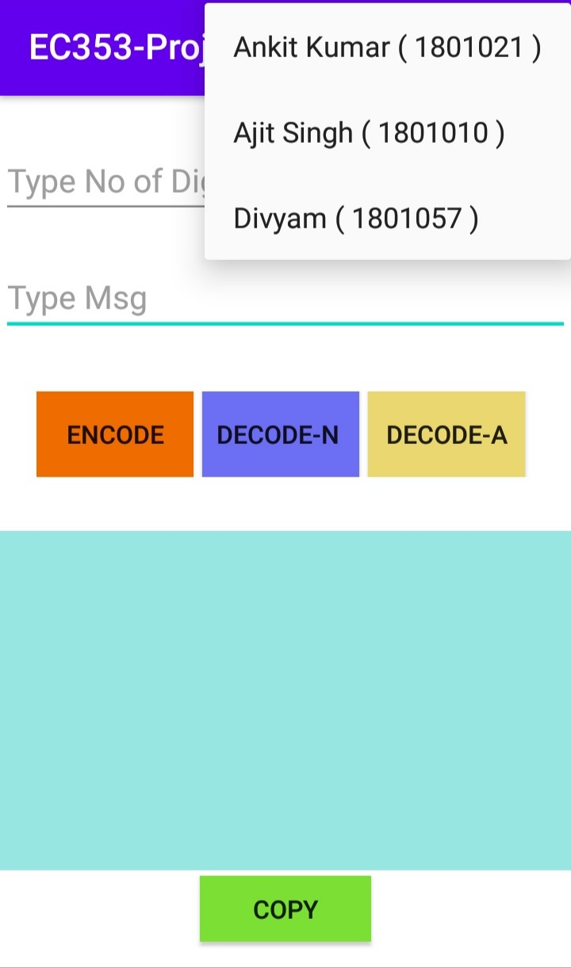

Slide 9
Further Advancements
We took F value for 26 letters :
{ 0, 0.04, 0.08, 0.125, 0.165, 0.2, 0.24, 0.28, 0.32, 0.36, 0.4, 0.44, 0.48, 0.52, 0.56, 0.6, 0.64, 0.68, 0.72, 0.76, 0.8, 0.84, 0.88, 0.92, 0.94, 0.97, 1 }
We are currently working on increasing the accuracy of decoding. It can be increased by altering the probabilities or increasing float precision during programming (Java).

Slide 10
Thanks!

