Slide 1
Problem & Approach
MOTIVATION
The cost of the kernel networking stack
Each DNS query sent over a UDP socket pays a per-packet overhead in terms of syscall, socket-buffer copies, etc
What AF_XDP changes
The userspace exchanges raw frames directly with the NIC driver through shared ring buffers (UMEM + FILL / COMPLETION / RX / TX), bypassing most of that stack.
The question
For a latency-sensitive workload like DNS, how much does the bypass actually save in latency, throughput, and CPU?
APPROACH
Build the same resolver twice.
Swap the I/O path, everything else stays the same
socket_resolver
recvfrom / sendto over a UDP socket
afxdp_resolver
RX / TX rings on an AF_XDP socket
Then benchmark both.

Slide 2
Architecture
DESIGN
One shared dns.c: parsing, validation, local-zone lookup and response building are identical in both binaries. That isolates the comparison to the receive / send path alone.
socket_resolver
NIC
driver
Kernel networking stack
syscall · buffer copies · netfilter / routing
UDP socket
recvfrom / sendto
Resolver
dns.c
afxdp_resolver
NIC
driver
XDP program
redirect UDP/53 → XSKMAP
AF_XDP socket · UMEM rings
FILL / COMPLETION / RX / TX
Resolver
dns.c
AF_XDP replaces only the receive / send path — the kernel stack is bypassed.
same binary logic

Slide 3
Implementation & Methodology
BUILD & BENCHMARK
IMPLEMENTATION
Separate send (TX) and receive (RX) buffers, so replies never clash with incoming queries
Build every reply first, then hand them to the NIC in one batch
Copy-mode AF_XDP with XDP_USE_NEED_WAKEUP
Reply frames crafted by hand: MAC / IP / port swap, checksum recompute
METHODOLOGY
Test environment
veth-pair testbed plus a real NIC run.
Limitation: the e1000e NIC supports only generic-mode XDP + copy-mode AF_XDP, no zero-copy (needs i40e / ice / ixgbe / mlx5).
Procedure
Fixed query rates + one max-rate run, 5 repeats each, same zone and port on both resolvers.
Metrics
Maximum throughput (QPS)
Average latency at a fixed 150k QPS
Resolver CPU per query (pidstat)
CORRECTNESS
Malformed-packet suite (9 cases) passing on both binaries
ASan / UBSan-clean builds

Slide 4
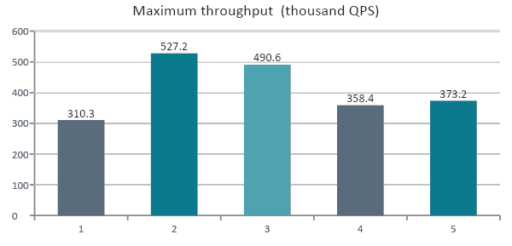
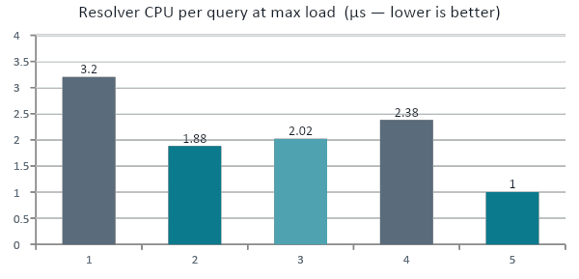
Results
RESULTS
Grey = socket · teal = AF_XDP. At equal load (150k QPS) average latency differs little: 11.0 → 10.3 µs on veth, 119 → 122 µs on the I219.
1.70×
−58%
~373k
Throughput on veth
CPU per query on the I219 NIC
Both tie on the I219
527.2k vs 310.3k QPS, both on a single core
1.00 µs vs 2.38 µs at maximum load
The client's transmit path saturated first, not the resolver

